Slide 1
Tutorial: What thesis template to use for a PhD thesis
PhD candidate year 4: Kwok Chin Yuen
Supervisor: Chng Eng Siong

Slide 2
A. Introduction
All students must strictly follow the thesis template provided by their university or school
Before writing, always check for any specific formatting or writing rules set by your department or graduate office (e.g., font size, referencing style, structure).
In this presentation, I will be using the Nanyang Technological University (NTU) thesis template as an example.

Slide 3
B. Thesis templates
NTU:
https://github.com/wang-chen/thesis_template_ntu
Others:
https://www.overleaf.com/gallery/tagged/thesis

Slide 4
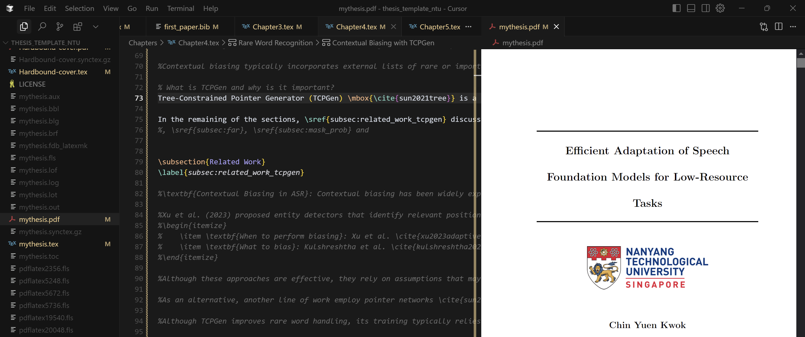
C. What editor to use to edit the template?
I suggest using AI editor like Cursor AI: https://cursor.com/
Install extension for latex
You should be able to open the pdf and code side-by-side

