Slide 1
Tutorial: How to write point form ideas for a PhD thesis
PhD candidate year 4: Kwok Chin Yuen
Supervisor: Chng Eng Siong

Slide 2
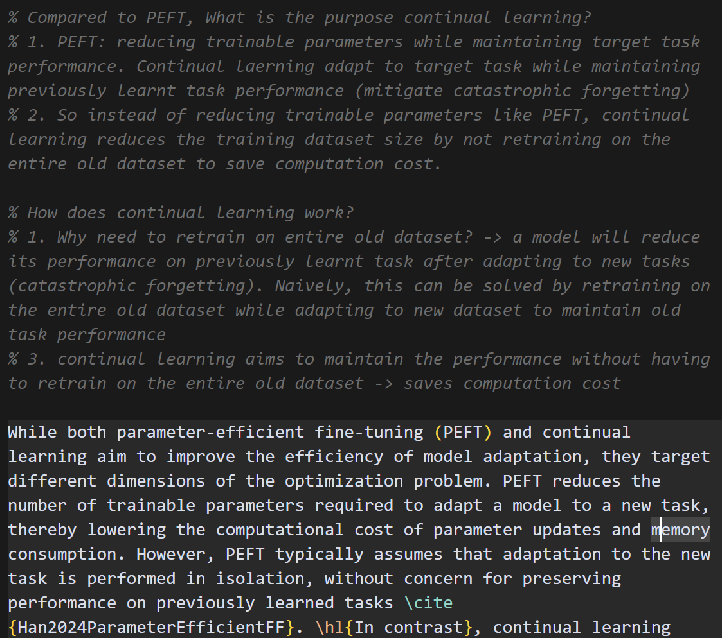
A. Point form
What is point form?
Simple response to the questions in writing plan
Why do you need point form?
To quickly mark down what to write
Think of it like using notion to drop down notes

