Slide 1
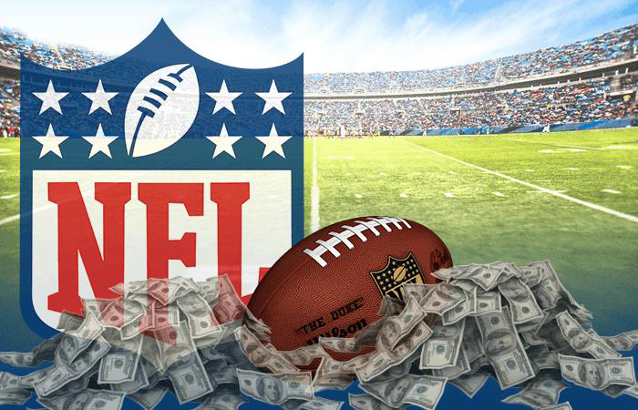
NFL Sports Betting

Slide 2
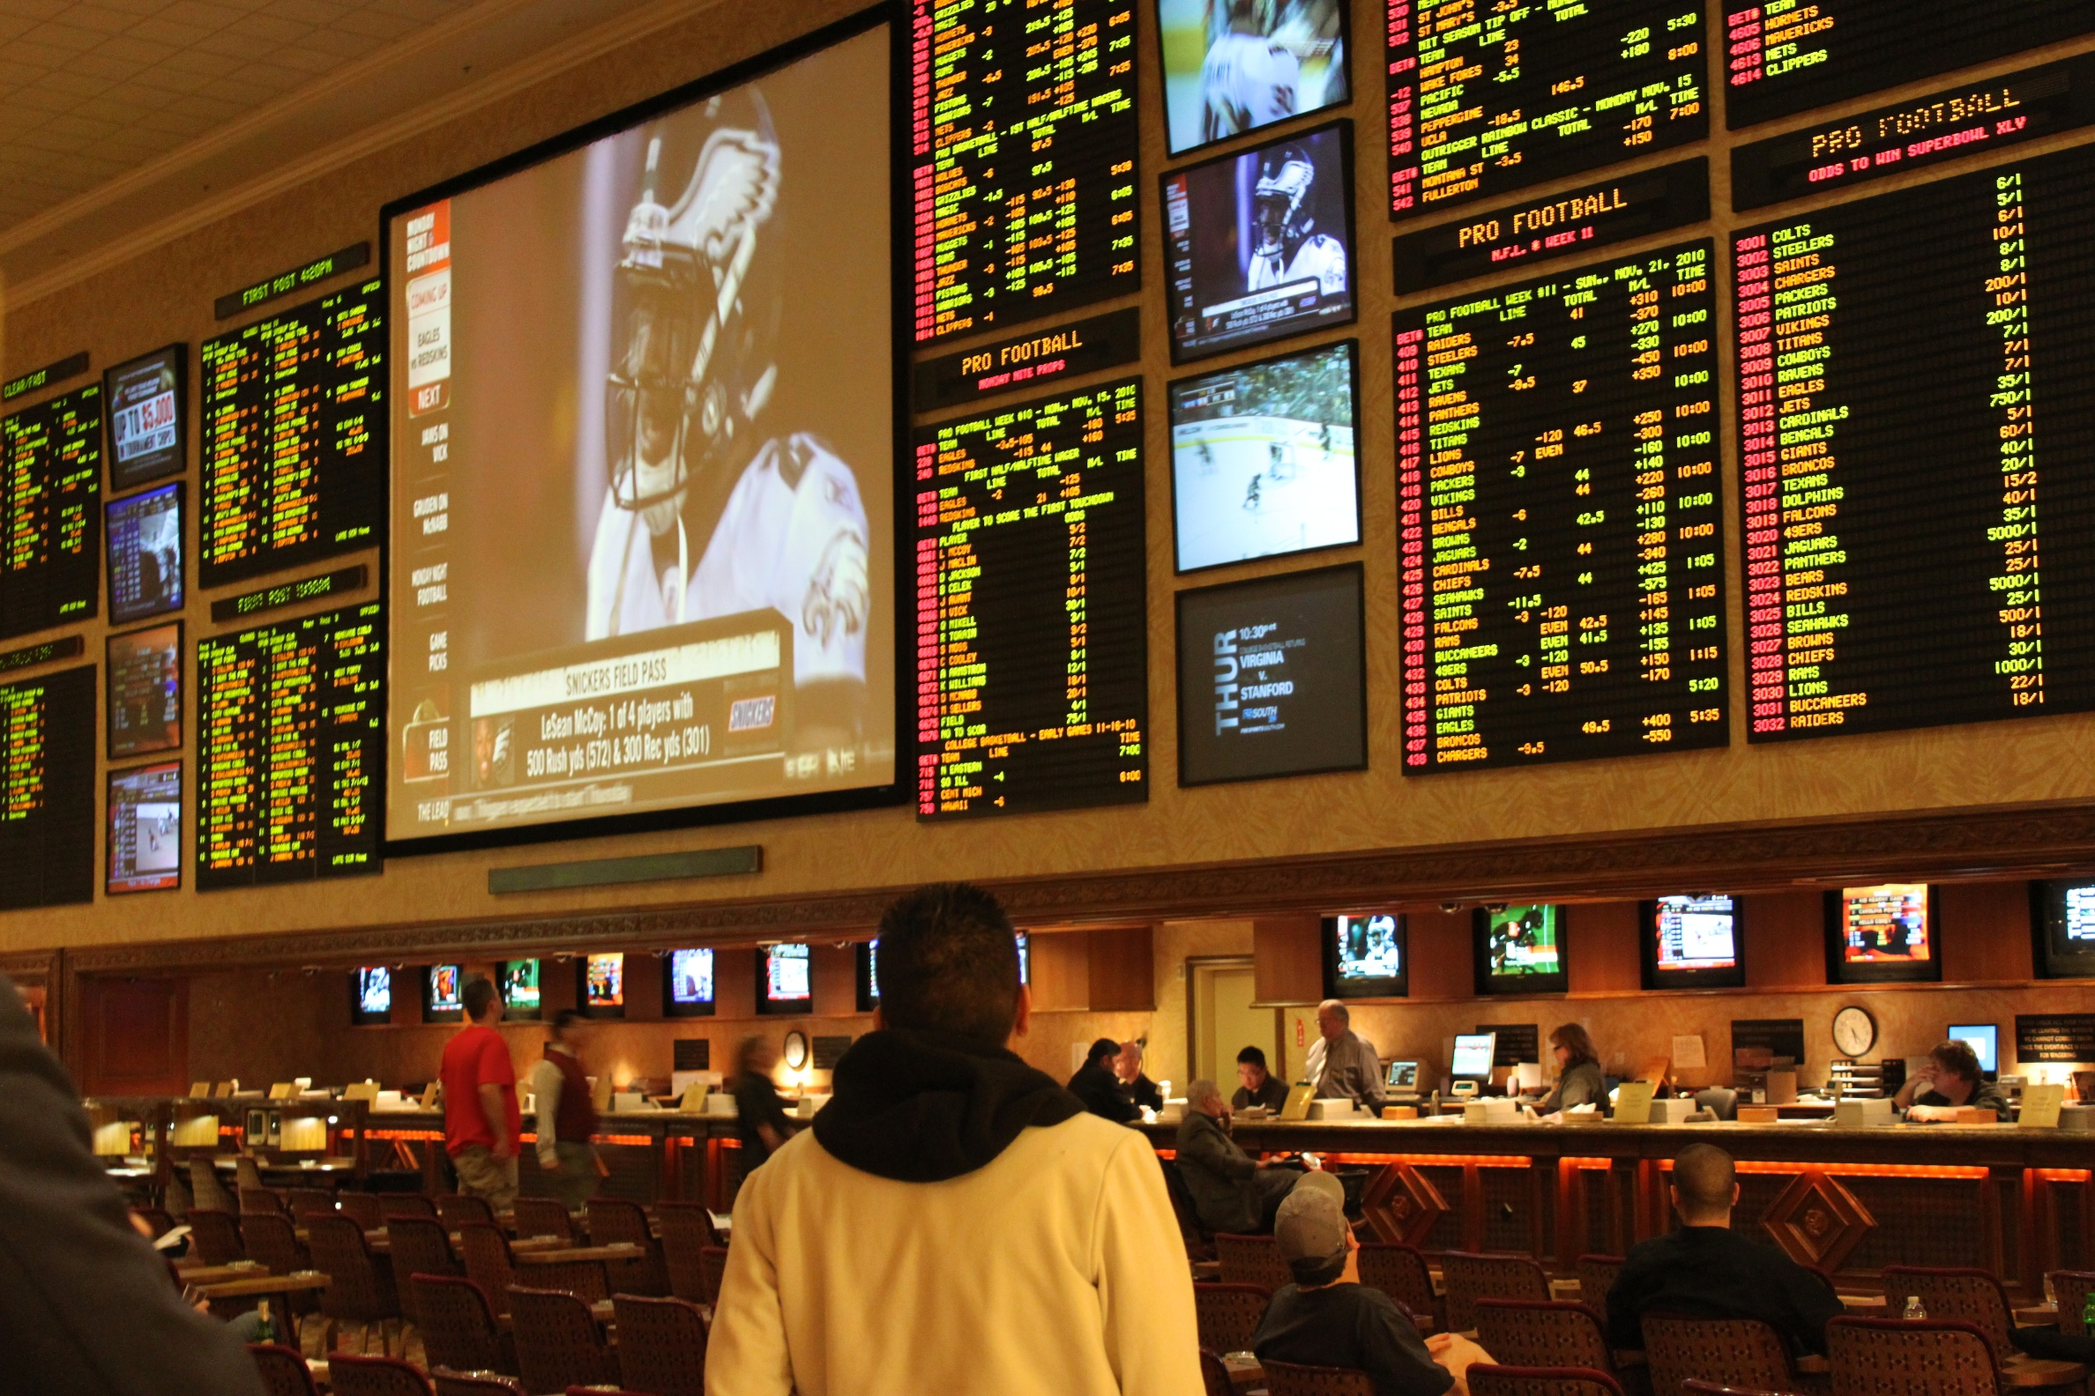
Sports Betting in the United States
1949: Legalized in Nevada
1976: Legalized in New Jersey
Notes:
Illegal until 1949. First casino with a sports book opened in Las Vegas in 1949. Atlantic City, NJ casino in 1976.

Slide 3
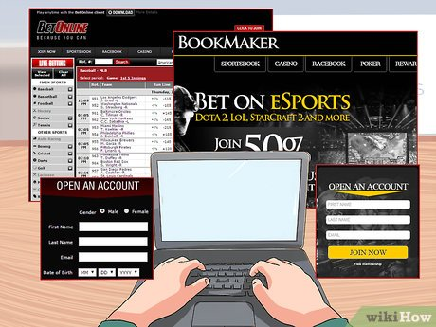
Sports Betting in the United States
2018: The United States Supreme Court granted states the right to determine if sports betting is legal in their state.
Online bookmakers operate outside the Unites States and are available for sports betting to US residents.
Notes:
Since 2018, 22 states have legalized sports betting and more are looking into legalizing it.
This, combined with online sports betting and most sports sites providing odds and analysis has seen sports betting increase dramatically.

Slide 4
How to make money in sports betting
Bookmakers set odds so that bettors have a
50/50 chance of winning.
Goal: Develop machine learning algorithm that predicts winners more than 50% of the time
Notes:
Bookmakers make money by taking a small percentage of every bet.
Bettors make money by winning more than 50% of the time.
The average person won’t be a bookmaker but can be a bettor.

Slide 5

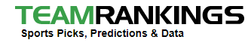
Data
Historical:
Current:
Notes:
Kaggle has historical data to build the model.
TeamRankings has current data to provide info for your next bet.

Slide 6
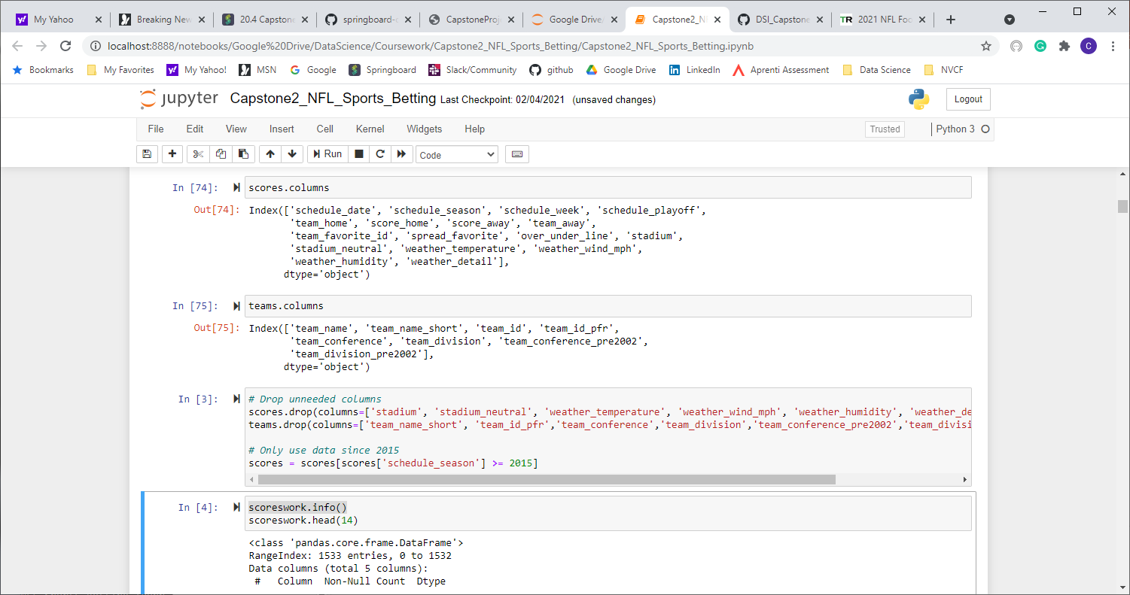
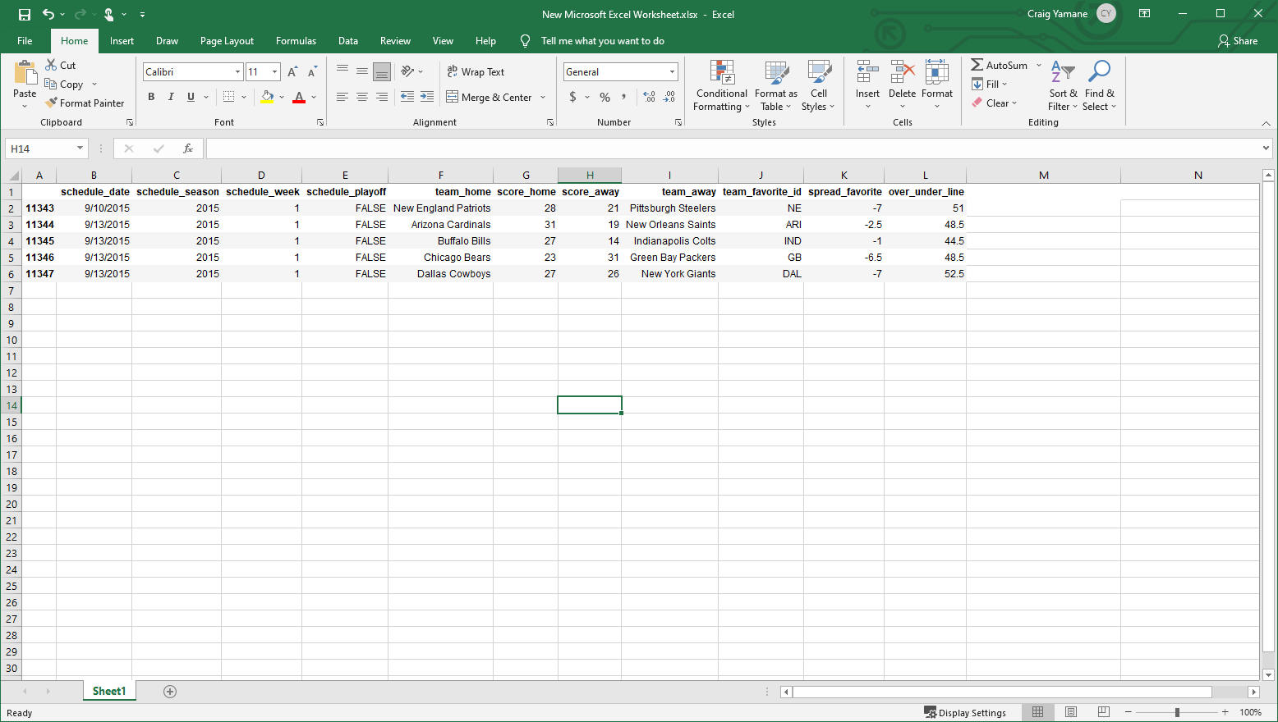
Data Wrangling – Kaggle (historical)
Notes:
Drop unneeded columns and merge

Slide 7
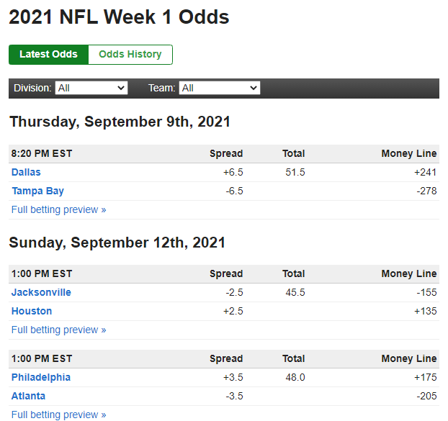
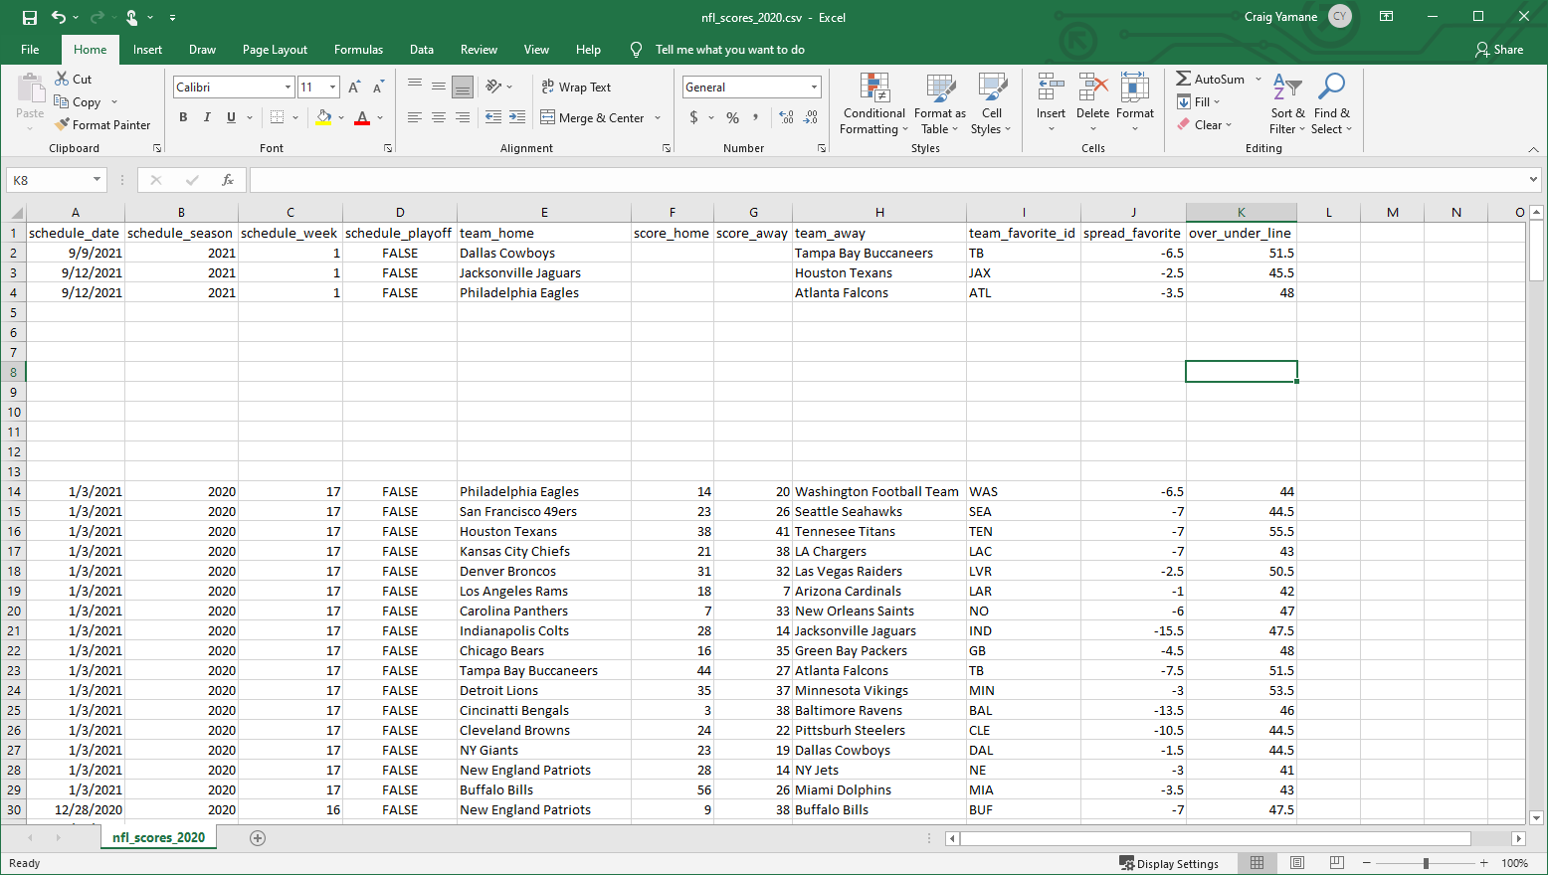
Data Wrangling – TeamRankings (current)
Notes:
Data from TeamRankings is copied into a csv file and reformatted into the same format as the historical Kaggle data.
Combine multiple lines into one line, add team name, add team id for team favorite id.

Slide 8
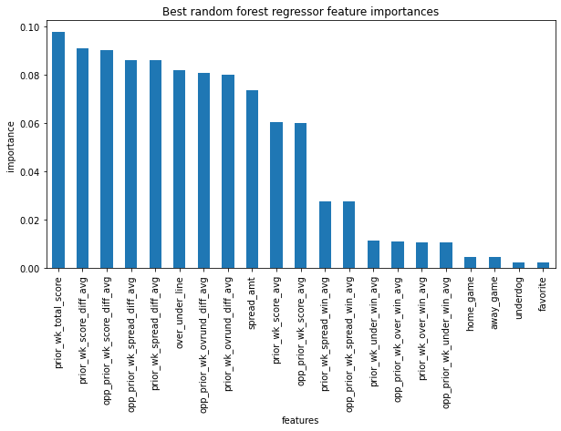
Features

Slide 9
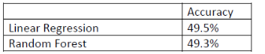
Modelling

Slide 10
Summary
Unfortunately, both models returned results less than 50%. This would not help a person beat the odds and should not be used. Additional features and modelling should be done to provide better results.

