Slide 1
Webscraping and NLP
Lillian

Slide 2

Part 1: Scrape seek.com
Keywords:
Data scientist
Data engineer
Data analyst
Data warehousing
Big data
Business analyst
Data
For all salary ranges (x11)

Slide 3
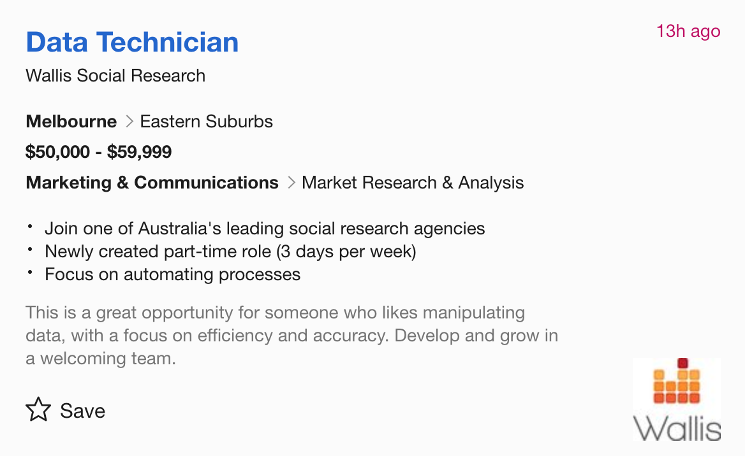
Part 1: Scrape seek.com
Job title
Job link
Company name
Date posted
Location
Area
Job category
Work type
Salary amount (from search page and posting page)
Short description
Long description

Slide 4
Question 1
Which words in job titles best predict job salary?
Which words in job descriptions best predict job salary?
Models used:
Linear regression
Ridge
Lasso
Logistic regression (2&3 classes)
Random forest classifier (2&3 classes)

Slide 5
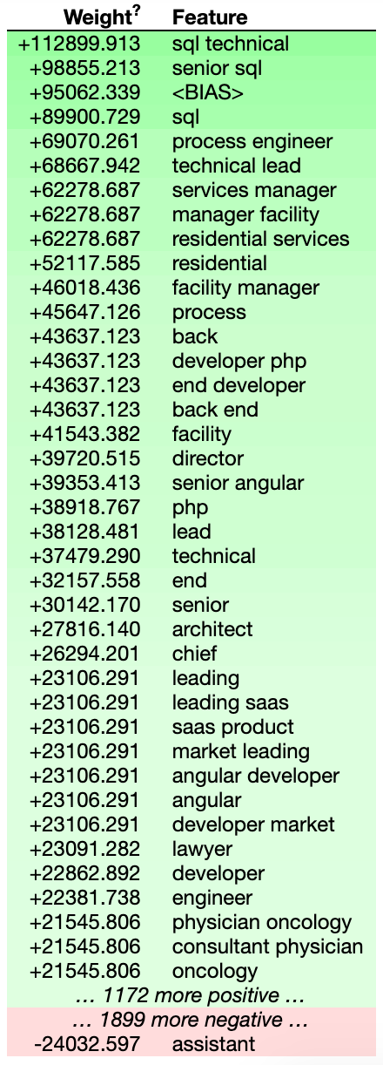
Which words in job titles best predict job salary?

Slide 6
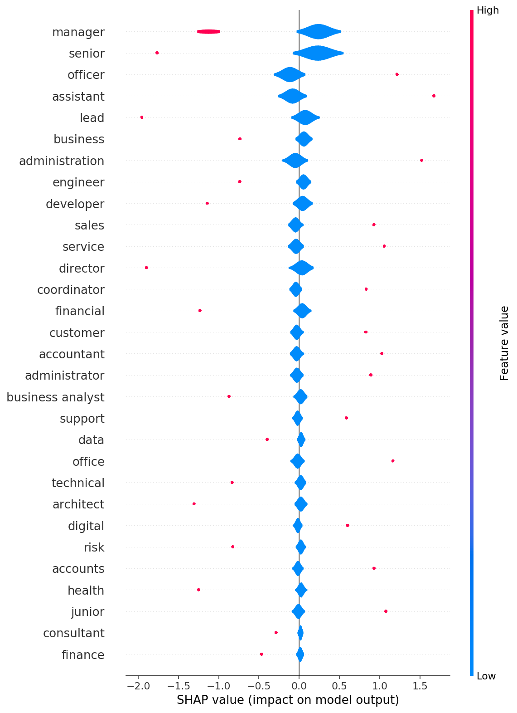
Which words in job titles best predict job salary?
Managerial/leadership roles and skills are highly valued in terms of salary.
Business analysts and people with financial backgrounds are likely to earn more.
People who deal with risk in their work earn more.
Classificaton revealed some different results compared to regression (sql has not shown up here).
But, generally this result makes a lot of sense.
Model cv score: 0.75

Slide 7
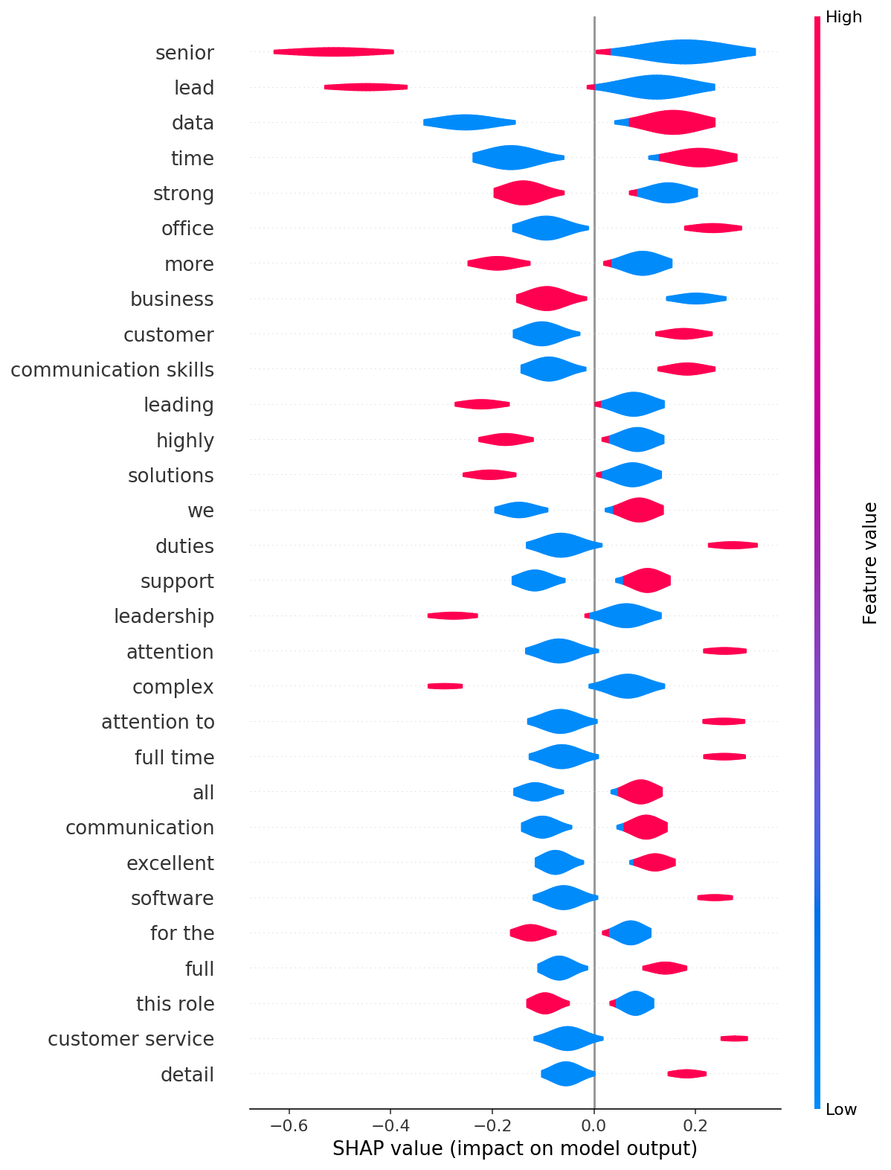
Which words in job descriptions best predict job salary?
This agrees mostly with what was found in job title analysis – seniority modifiers as well as leadership skills/roles are likely to pay more.
Interestingly, it looks like communication skills and customer service are not highly valued in salary.
Model cv score: 0.83

Slide 8
Question 2 Job markets in Syd vs Mel
I investigated the differences in the job market for data jobs in Sydney and Melbourne
Are different skills in demand in Sydney and Melbourne?
Which sectors are currently hiring the most in each city?
Is there a difference in salary in Sydney and Melbourne?
How much?

Slide 9
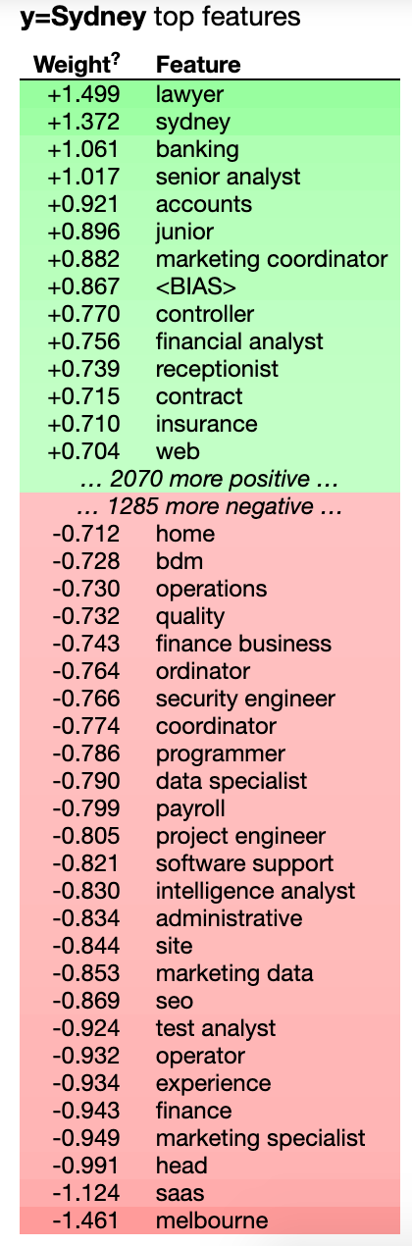
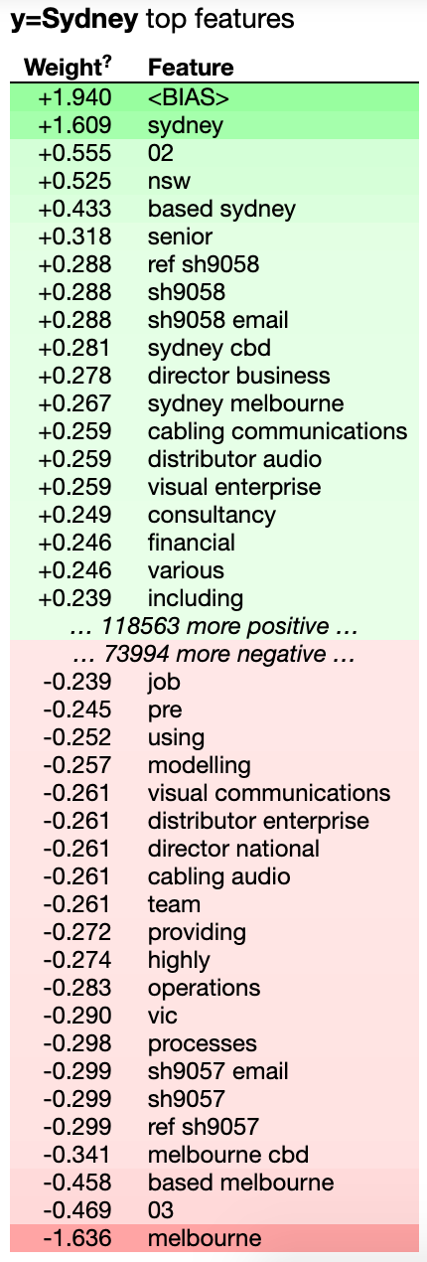
Are different skills in demand in Sydney and Melbourne?
I looked at job titles and job descriptions through classification (high and low salary groupings)
Clearly, features here are very different between Sydney and Melbourne
Job titles
Job descriptions

Slide 10
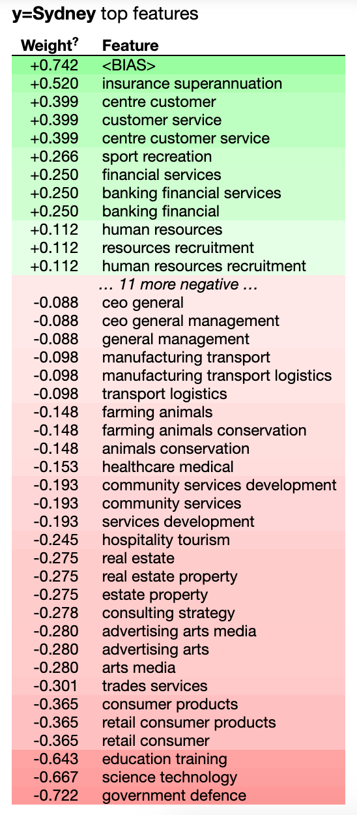
Which sectors are currently hiring the most in each city?

Slide 11
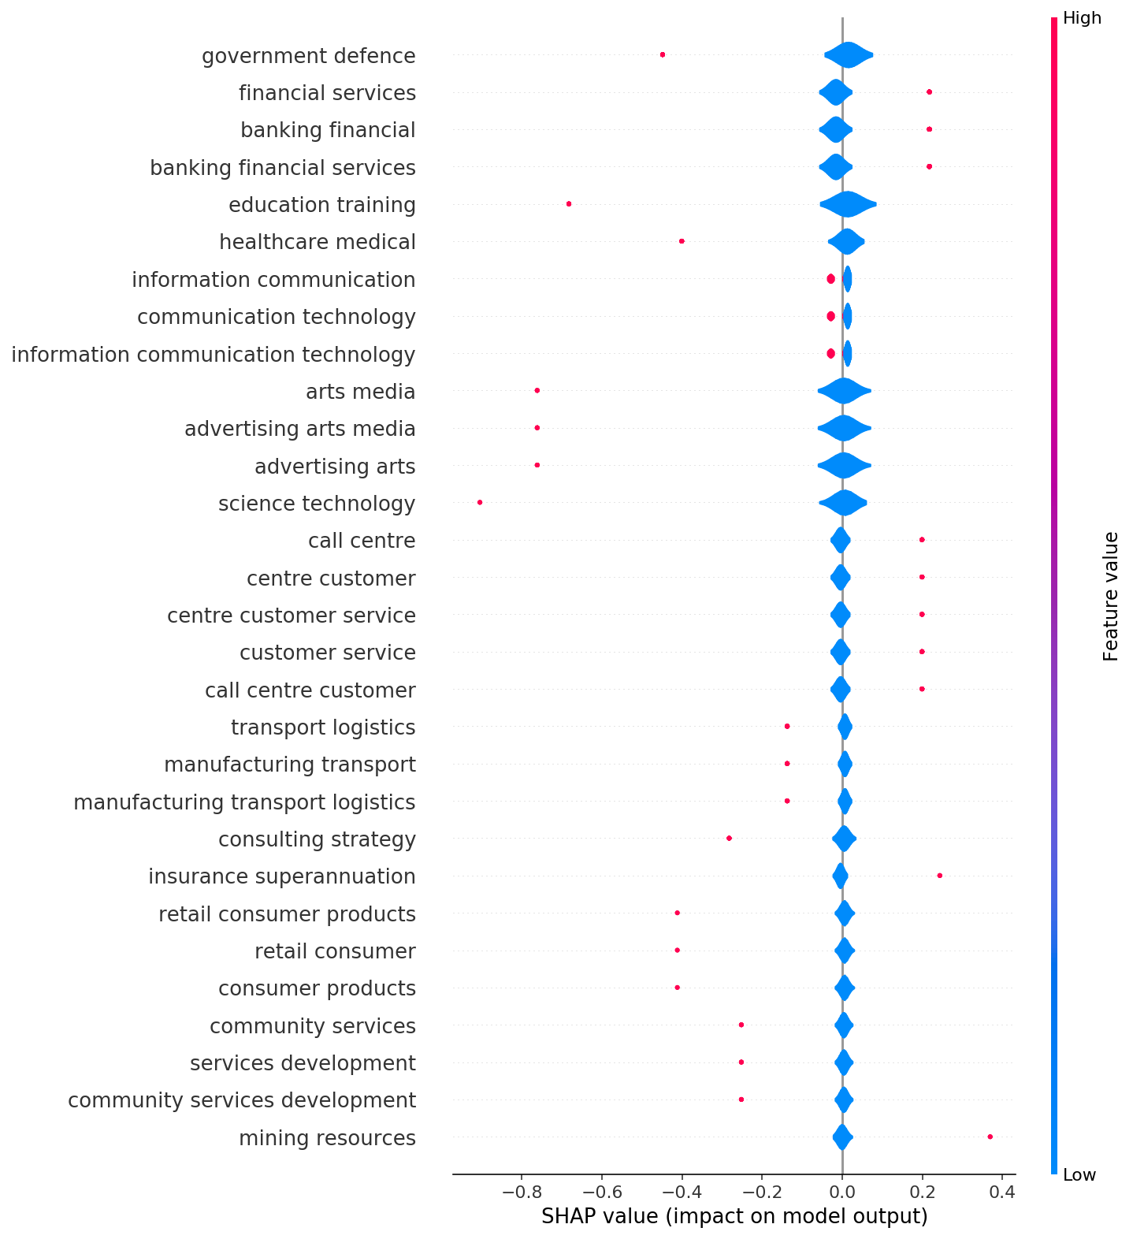
Left = Melbourne Right = Sydney

Slide 12
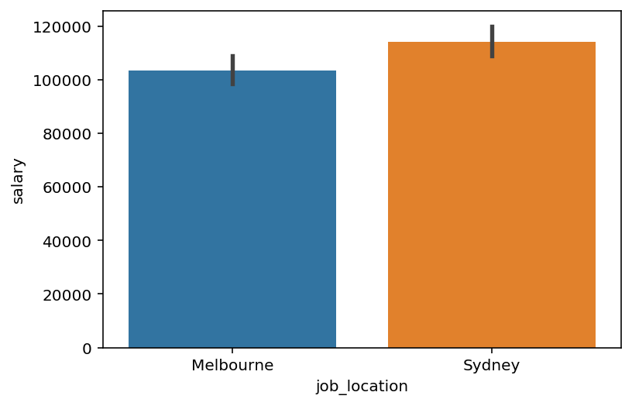
Is there a difference in salary in Sydney and Melbourne?
Yes
$10,615 difference in salary

Slide 13

Thanks for listening

