Slide 1
微服务
什么是微服务？
为什么要用微服务？
传统架构真不行吗？

Slide 2
什么是微服务
单体服务 http
  所有应用模块集中在一起，大家相互拥抱，你中有我，我中有你，也相互影响（你不好过，为什么我也不能好过呢？）
  如果只修改了某个模块功能，要发布这个模块上线时，其它模块也一起发布了，这就是有福同享，有妞大家泡，大同社会
  很容易出现雪崩，也就是蝴蝶效应
  复杂性高，交付效率低，伸缩性差

Slide 3
什么是微服务
  就是：
  是应用的拆分，模块的拆分
  通俗一点来说就是每个模块独立部署，模块之间实现低内聚
  伸缩性强
  每个服务都可以在横向和纵向上扩展；
  每个服务都可按硬件资源的需求进行独立扩容。

Slide 4
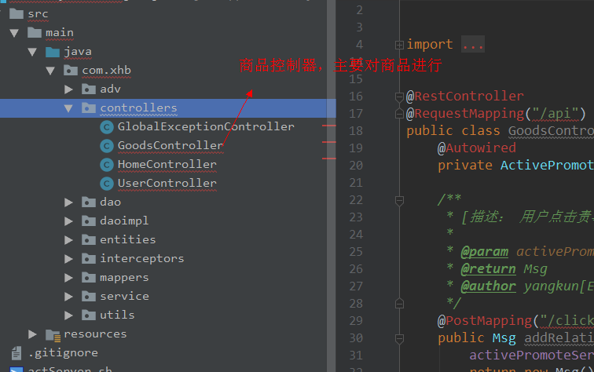
Java传统单体服务

Slide 5
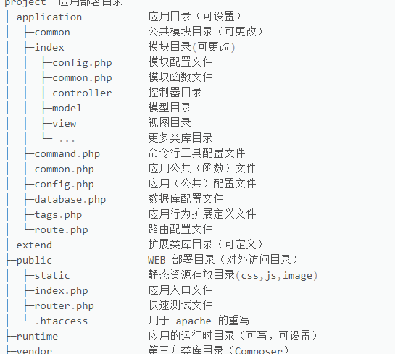
PHP传统单体服务

Slide 6
为什么要用微服务
为了解决单体架构模块相互拥抱的问题
为了解决服务之间雪崩现象
为了更好解决横向与纵向扩展
为了提高开发效率

Slide 7
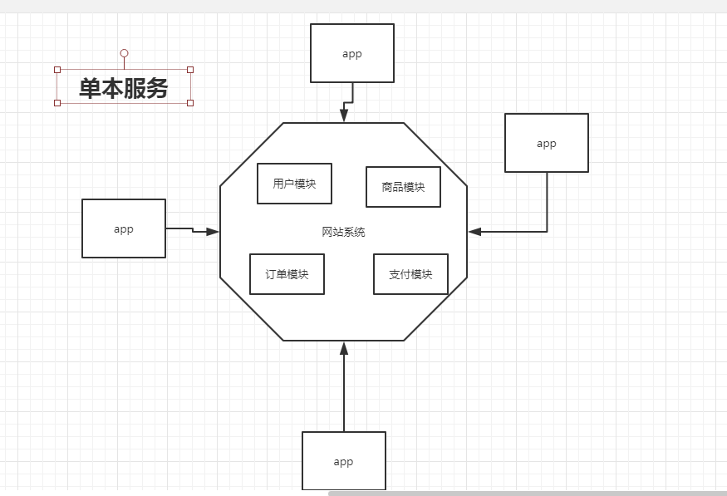
单体服务

Slide 8
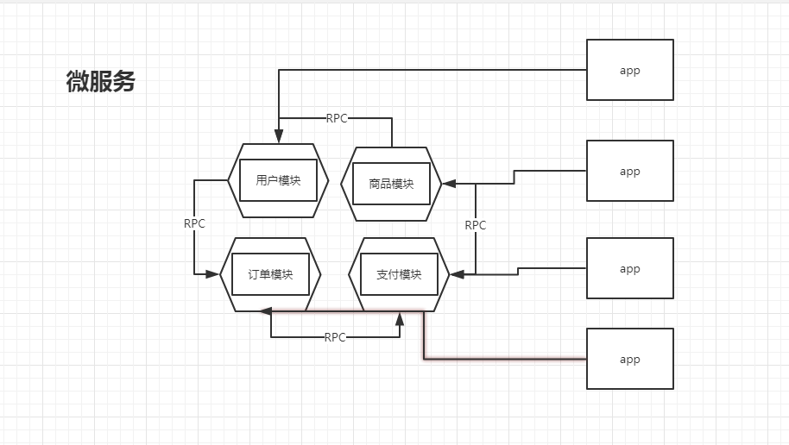
微服务

Slide 9
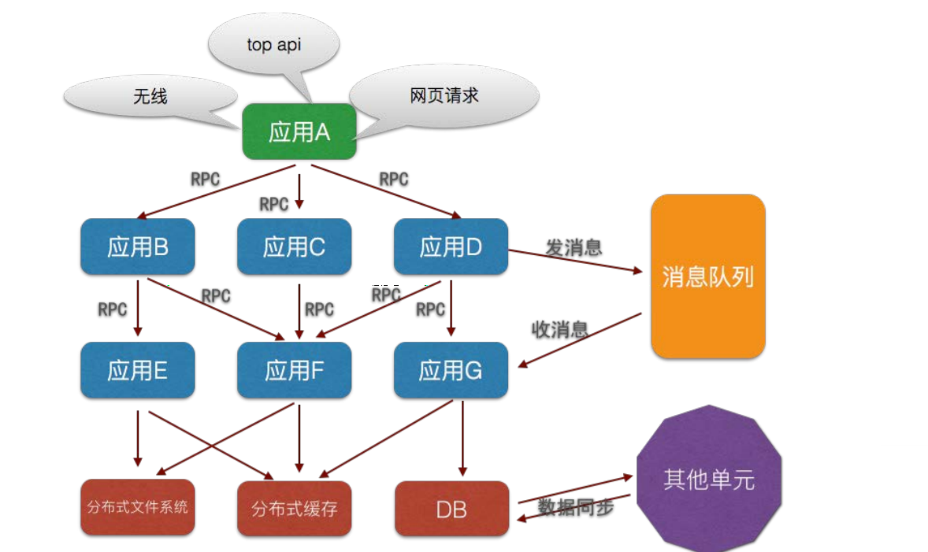
微服务

Slide 10
传统架构真不行吗
当然行！
应用之间用http去访问 http/tcp rpc /tcp
Java robin
nignx负载均衡
DB主从
缓存
队列
…

Slide 11
环境准备
golang 1.12
nginx
Jenkins
  应用 布署，自动化，发布
  Java => jdk
etcd
gitlab
Rabbitmq
Notes:
rpm -Uvh http://nginx.org/packages/centos/7/noarch/RPMS/nginx-release-centos-7-0.el7.ngx.noarch.rpm
systemctl start nginx.service
systemctl enable nginx.service // 加入开机启动
清华镜像
https://mirrors.tuna.tsinghua.edu.cn
gitlab-ce/
https://mirrors.tuna.tsinghua.edu.cn/gitlab-ce/yum/el7/
Step 1
yum install -y curl openssh-server openssh-clients postfix cronie policycoreutils-python
Step 2
rpm -ivh https://mirrors.tuna.tsinghua.edu.cn/gitlab-ce/yum/el7/gitlab-ce-11.1.0-ce.0.el7.x86_64.rpm
Step 3
systemctl start postfix
systemctl enable postfix
vim /etc/gitlab/gitlab.rb
external_url 'http://192.168.60.119' 绑定监听的域名或IP
nginx['listen_port’]=8081
gitlab-ctl reconfigure
gitlab-ctl start
gitlab-rails console production
user = User.where(id: 1).first // id为1的是超级管理员
irb(main):002:0>user.password = 'yourpassword' // 密码必须至少8个字符
irb(main):003:0>user.save! // 如没有问题 返回true
Exit

Slide 12
192.168.5.100
golang 1.12
  export GOPROXY=https://goproxy.io
  go mod tidy
nginx
jenkins
Etcd
Mysql
Redis
Rabbitmq
Notes:
Jenkins
yum install -y lrzsz
安装jdk 1.8
wget http://download.oracle.com/otn-pub/java/jdk/8u131-b11/d54c1d3a095b4ff2b6607d096fa80163/jdk-8u131-linux-x64.tar.gz
设置
JAVA_HOME=
CLASSPATH=$JAVA_HOME\bin;$JAVA_HOME\jre\bin;
CLASSPATH=$JAVA_HOME/lib/
PATH=$PATH:$JAVA_HOME/bin
下载包
wget http://mirrors.jenkins.io/war-stable/latest/jenkins.war
运行
java -jar jenkins.war --httpPort=8080
rz 是把本地的包上传到服务器
sz 是所服务器包下载到本地

Slide 13
Mysql安装
rpm -ivh http://dev.mysql.com/get/mysql57-community-release-el7-8.noarch.rpm
yum install mysql-community-server
查看初始化密码/var/log/mysql.log
mysql_secure_installation
grant all privileges on *.* to ‘root’@‘%’ identified by 'Vector.123'
Notes:
grant all privileges on *.* to ‘Root’@‘%’ identified by 'Vector.123'

Slide 14
Etcd集群搭建
192.168.5.100 master
192.168.5.101 slave
etcd配置文件
/etc/etcd/etcd.conf
Notes:
Master
ETCD_DATA_DIR="/var/lib/etcd/default.etcd" #etcd数据保存目录
ETCD_LISTEN_CLIENT_URLS="http://192.168.5.100:2379,http://localhost:2379" #供外部客户端使用的url ETCD_ADVERTISE_CLIENT_URLS="http://192.168.5.100:2379,http://localhost:2379" #广播给外部客户端使用的url ETCD_NAME="etcd1" #etcd实例名称 ETCD_LISTEN_PEER_URLS="http://192.168.5.100:2380" #集群内部通信使用的URL
ETCD_INITIAL_ADVERTISE_PEER_URLS="http://192.168.5.100:2380" #广播给集群内其他成员访问的URL ETCD_INITIAL_CLUSTER="etcd1=http://192.168.5.100:2380,etcd2=http://192.168.5.100:2380," #初始集群成员列表
ETCD_INITIAL_CLUSTER_TOKEN="etcd-cluster" #集群的名称
ETCD_INITIAL_CLUSTER_STATE="new" #初始集群状态，new为新建集群
Slave
ETCD_DATA_DIR="/var/lib/etcd/default.etcd“
ETCD_LISTEN_CLIENT_URLS="http://192.168.5.101:2379,http://localhost:2379"
ETCD_ADVERTISE_CLIENT_URLS="http://192.168.5.101:2379,http://localhost:2379“
ETCD_NAME="etcd2"
ETCD_LISTEN_PEER_URLS="http://192.168.5.101:2380"
ETCD_INITIAL_ADVERTISE_PEER_URLS="http://192.168.5.101:2380"
ETCD_INITIAL_CLUSTER="etcd1=http://192.168.5.100:2380,etcd2=http://192.168.5.101:2380"
ETCD_INITIAL_CLUSTER_TOKEN="etcd-cluster"

Slide 15
Redis安装
yum install epel-release
yum install redis
Vim /etc/redis.conf
  Bind 0.0.0.0

Slide 16
Rabbitmq 安装
Erlang erlang >= 19.3
socat
logrotate
以上三个是必须的
Notes:
Step 1
yum -y install epel-release
Step 2
yum install erlang
Step 3
yum install rabbitmq-server
集群安装网址
https://www.rabbitmq.com/clustering.html

Slide 17
测试流程
ssh-keygen -t rsa
  一路回车
cat id_dsa.pub >> ~/.ssh/authorized_keys
chmod 600 authorized_keys
Notes:
使用yum命令 // 每台机器都要装
yum install epel-release
yum install -y supervisor
systemctl enable supervisord # 开机自启动#
systemctl start supervisord # 启动supervisord服务#
systemctl status supervisord # 查看supervisord服务状态
vim /etc/supervisord.d/test.ini
[program:main-api]
command=/opt/application/test/test
directory=/opt/application/test
保存退出后
supervisorctl reload

Slide 18
Jenkins发布流程测试
安装插件 publish over ssh
创建视图
构建shell如下备注1
Publish over ssh 见备注 2
Notes:
备注 1
#!/bin/sh
JENKIN_WORKSPACE="/root/.jenkins/workspace/main-api.server"
ScriptFileName="main-api.go"
APPLICATION_APTH="/opt/application/main-api/"
ScriptName="main-api"
echo "进入目录 =>"$JENKIN_WORKSPACE
cd $JENKIN_WORKSPACE
echo "开始编译执行脚本文件 => "$ScriptFileName
go build $ScriptFileName
if [ ! -d $APPLICATION_APTH ];then
mkdir -p $APPLICATION_APTH
fi
PID=`pgrep -f $ScriptName`
if [ "$PID" != "" ]
then
echo "停止已经启动的服务"
supervisorctl stop $ScriptName
fi
scp $ScriptName $APPLICATION_APTH$ScriptName
echo "开始启动服务"
supervisorctl start $ScriptName
sleep 5s
PID=`pgrep -f $ScriptName`
if [ "$PID" = "" ];then
echo "启动服务失败"
exit 1
fi
echo "node1 服务器启动成功“
备注 2
#publish over ssh
Source files 处写 **/test
Remote directory 处写/opt/go/temp
Command 处写如下脚本
#!/bin/sh
ScriptName=“test"
if [ ! -d $APPLICATION_APTH ];then
mkdir -p $APPLICATION_APTH
fi
PID=`pgrep -f $ScriptName`
if [ "$PID" != "" ]
then
echo "停止已经启动的服务"
supervisorctl stop $ScriptName
fi
mv /opt/go/temp/$ScriptName /opt/application/test/
chmod 755 /opt/application/test/$ScriptName
echo "开始启动node2服务"
supervisorctl start $ScriptName
sleep 5s
PID=`pgrep -f $ScriptName`
if [ "$PID" = "" ];then
echo "启动服务失败"
exit 1
fi
echo "启动node2服务成功"

Slide 19
Nginx负载均衡
Nginx 负载均衡配置见备注
如果出现错误可能以下原因
  1. systemctl stop firewalld
  2.修改/etc/selinux/config 文件
  将SELINUX=enforcing改为SELINUX=disabled
  重启机器即可
Notes:
upstream test {
server 192.168.5.100:9098;
server 192.168.5.101:9098;
}
server{
location /api/test {
proxy_pass http://test/test;
}
}

Slide 20
服务列表
user
  Api
  Rpc
integral
  Api
    Cusmer->mq 消费消息
    Edit/add table
  Rpc
    Message quine -> mq 发消息
    Edit/add table
Goods
  Api
  rpc
Order
  Api
  rpc

Slide 21
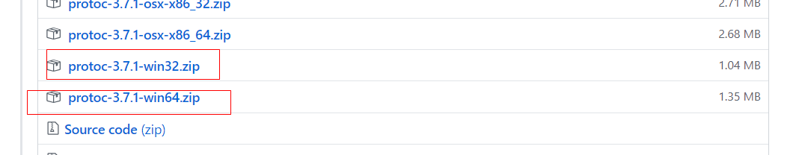
Proto文件
https://github.com/protocolbuffers/protobuf/releases
go get -u github.com/golang/protobuf/protoc-gen-go

Slide 22
Nginx 跨域
Cors ajx 解决
Notes:
if ($request_method = 'OPTIONS') {
add_header Access-Control-Allow-Origin *;
add_header Access-Control-Max-Age 1728000;
add_header Access-Control-Allow-Methods GET,POST,OPTIONS;
add_header Access-Control-Allow-Headers 'DNT,User-Agent,X-Requested-With,If-Modified-Since,Cache-Control,Content-Type,Range';
add_header Content-Type' 'text/plain; charset=utf-8';
add_header Content-Length 0 ;
return 204;
}
add_header 'Access-Control-Allow-Origin' '*';
add_header 'Access-Control-Allow-Credentials' 'true';
add_header 'Access-Control-Allow-Headers' 'Authorization,Content-Type,Accept,Origin,User-Agent,DNT,Cache-Control,X-Mx-ReqToken,X-Requested-With,X-Custom-Header';
add_header 'Access-Control-Allow-Methods' 'GET,POST,OPTIONS';

Slide 23
服务整理
integral-rpc.server => 100：9092，101：9092
user-api.server =>100:9992,101:9992
user-rpc.server =>100:9090,101:9090

