Slide 1
Fudge Company
Data Warehouse
Final Presentation -
IST722 Group＃1
Xuehan Chen, Yue Wang,
Yimin Xiao, Chiau Yin Yang

Slide 2
Business process
Shipment time monitoring management
This process analyzes how many days it takes ship a order after it is placed. Data are drawn from both FudgeMart and FudgeFlix.
Risk analysis
This is a process to assess possible business loss from the orders that customers might fail to pay due to a variety of reasons.

Slide 3
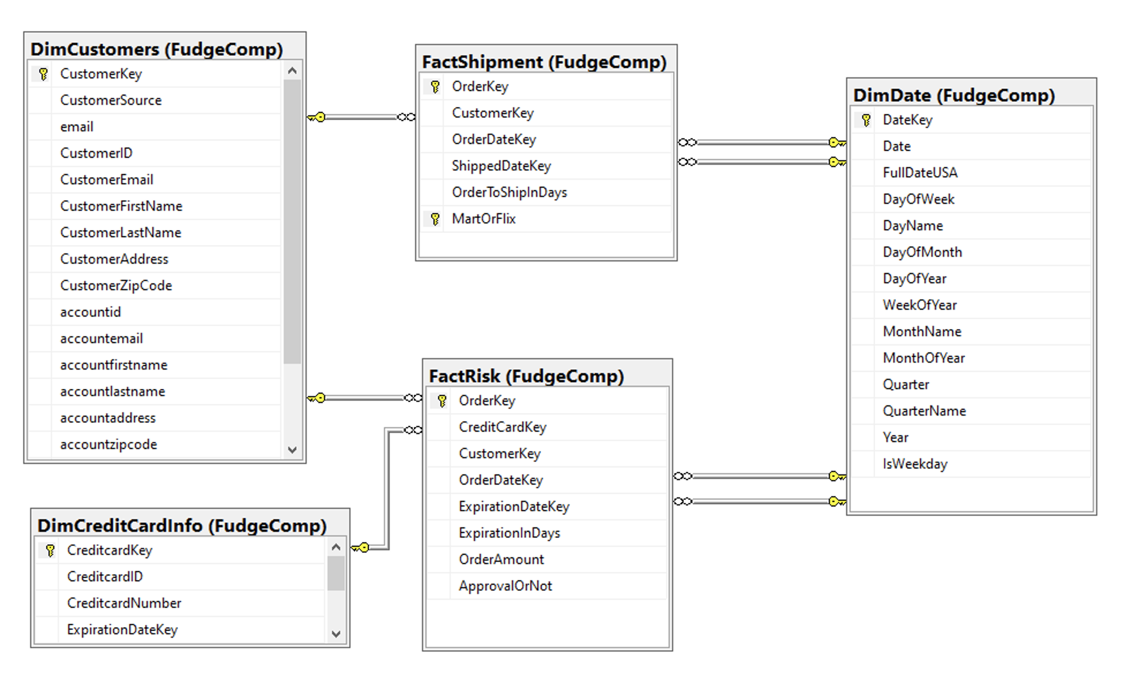
Enterprise Bus - Star Schema
Consolidated Fact Table
Shipment Monitoring
Conformed + integrated Dimension
Customer combined from both data sources
Conformed + Role-playing Dimension
Date dimension
Consolidated Fact Table
Risk Analysis
Notes:
Add schema as well

Slide 4
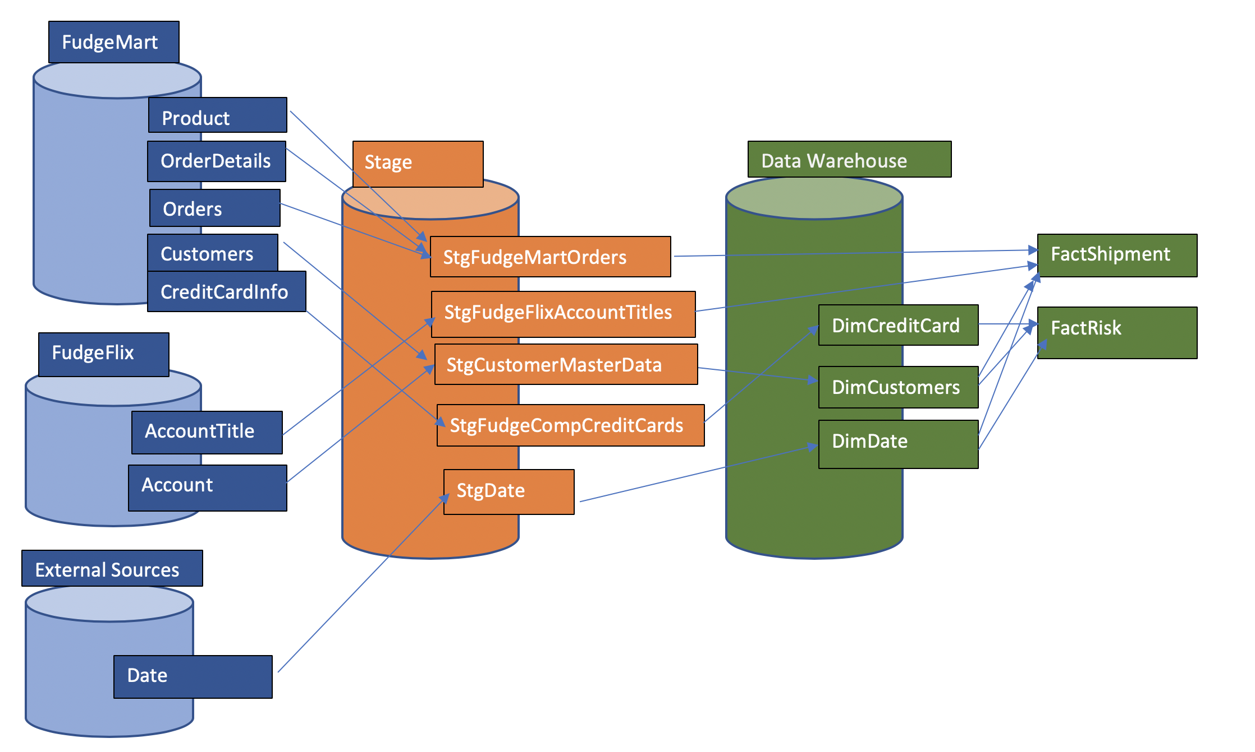
ETL done in SSIS - source to target map
Notes:
Add schema as well

Slide 5
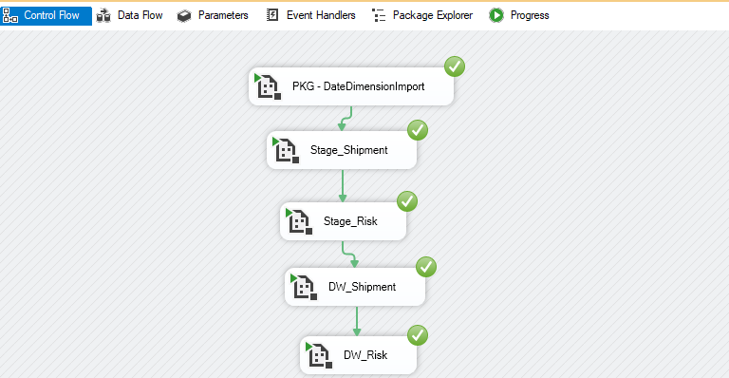
ETL process - all packages

Slide 6
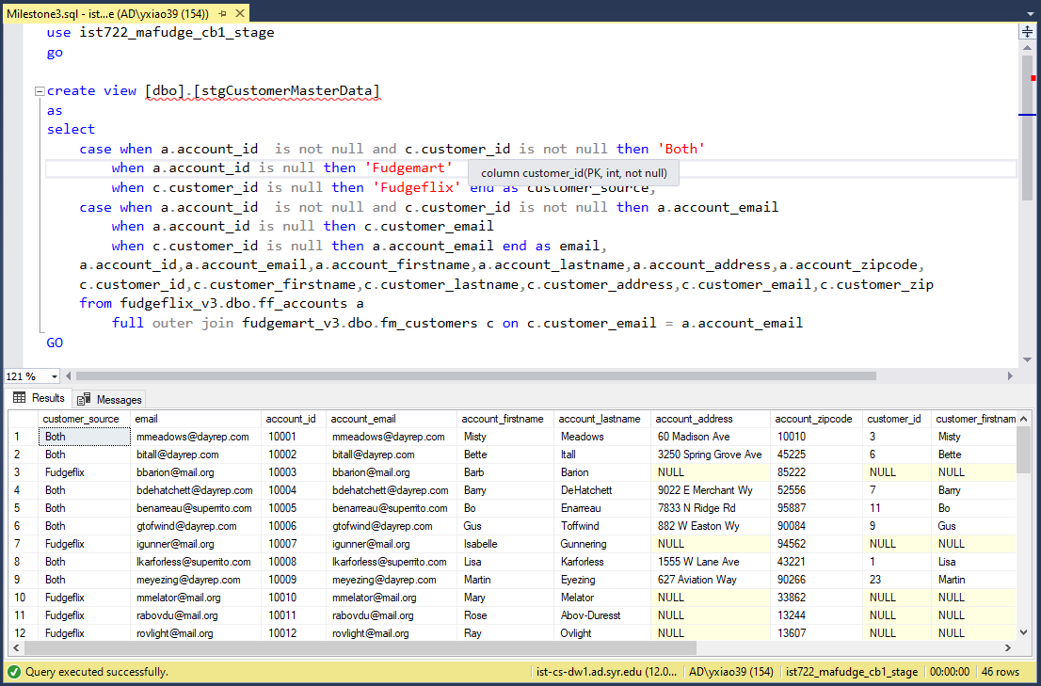
Stage_customers

Slide 7
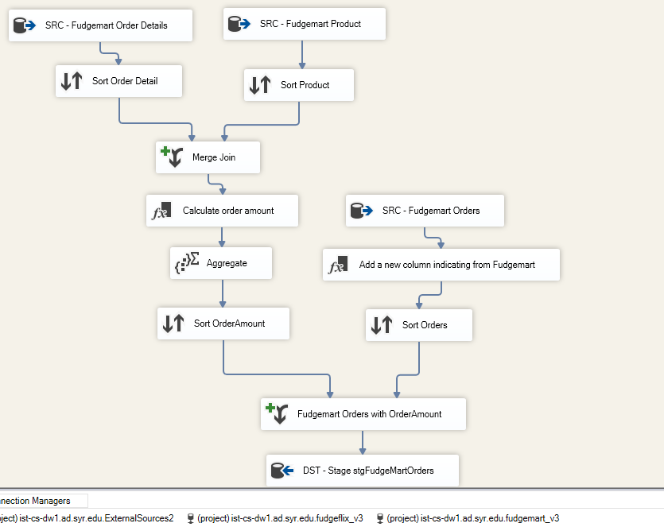
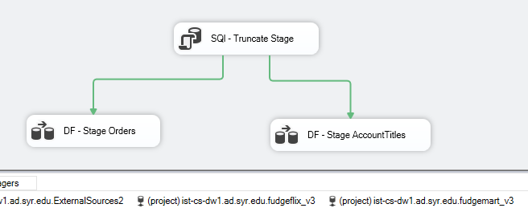
Stage_shipment

Slide 8
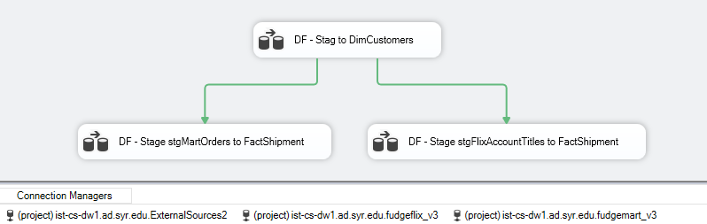
DW_Shipment

Slide 9
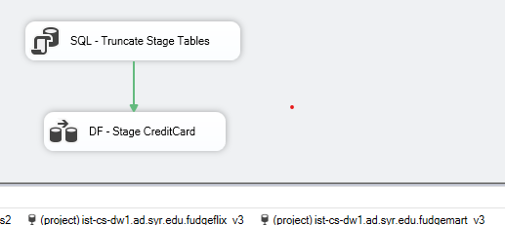
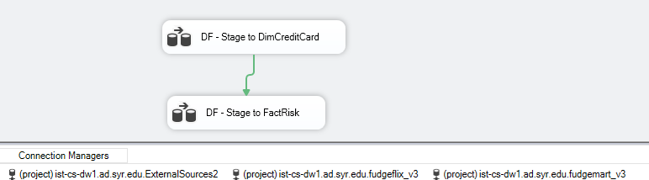
Stage_Risk
DW_Risk

Slide 10
ETL process - all packages details
Source to Stage
Stage risk - Stage credit card information table from Fudgemart
Stage customer
This is done by creating a view in SQL server. The view combines customers from both sources
Stage Shipment - Stage orders from Fudgemart + Calculated order amount and; stage AccountTitles from Fudgeflix
Stage to DW
DW risk - load into Dim credit card; combine credit card info into Fact Risk
DW shipment - load into Dim Customers by including both sources and calculate order to ship in days and other facts

Slide 11
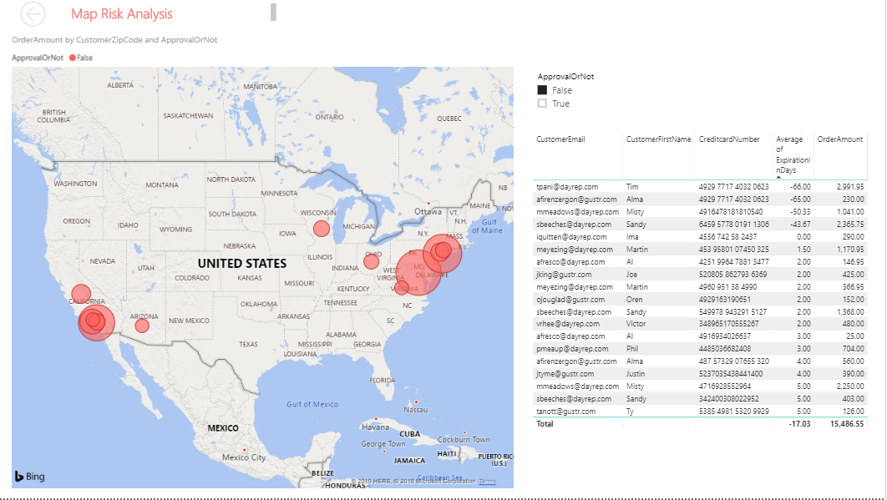
BI dashboard Live Demo - Risk Analysis
Notes:
Live demo

Slide 12
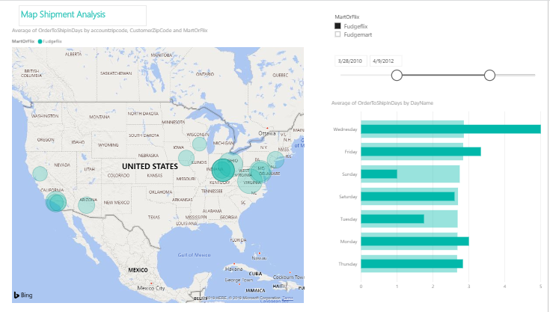
BI dashboard Live Demo - Shipment Analysis

Slide 13
What we’ve done right...
Order table is business process, so it does not need to be a separate dimension
Stage account title and orders separately and integrate into DW with customer dimension so that we can look up back to orders using different customer ID
Also resolve potential issues with using email address as business key as it can be changed.
Did not include too many dimensions - product or order details dimension - but only pull those in to calculate order amount for risk analysis fact table
For shipping date, we replace null with -1, and calculate OrderToShipInDays using the earliest date, which cause relatively low number ⇒ can filter in BI program
Notes:
Issues and good solution

Slide 14
What we could’ve done better...
For better BI analysis, we could’ve included:
Order detail dimension to analyze if certain products delay order to ship → better estimate shipping schedule & customer services
Count of fulfilled orders and count same customer → more facts in BI
Combine shipment monitor and risk analysis to avoid shipping unapproved orders
Data Quality Issues:
Customer address format differs ⇒ zip code only vs. city, state, and zip code
Should include city and state for better BI analysis
Naming may not be consistent throughout the semester
Notes:
Issues with better solution
Not too sure how to count fulfilled orders as the number will change along the time?? Will need shipping date to keep track
Do we still want to combine orders to ship for the same destination?? how

