Slide 1
Fudge Company
Data Warehouse
IST722 Group 1
Xuehan Chen, Yue Wang, Yimin Xiao, Chiau Yin Yang

Slide 2
Business process
Shipment time monitoring management
This process analyzes how many days it takes ship a order after it is placed. Data are drawn from both FudgeMart and FudgeFlix.
Risk analysis
This is a process to assess possible business loss from the orders that customers might fail to pay due to a variety of reasons.

Slide 3
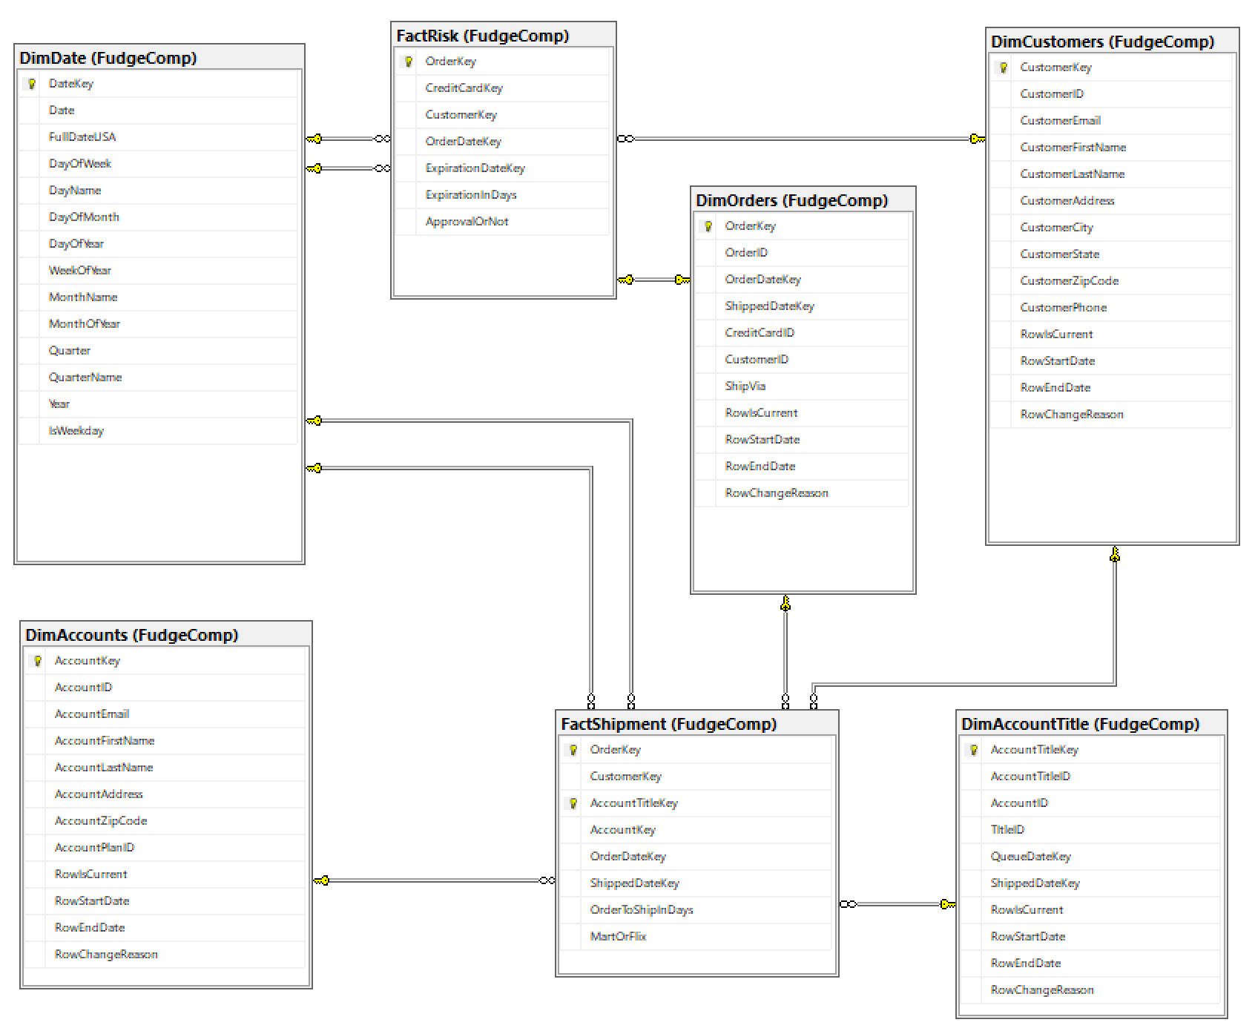
Schema diagram

