Slide 1
Fudge Company
Data Warehouse
Milestone#3 -
IST722 Group 1
Xuehan Chen, Yue Wang, Yimin Xiao, Chiau Yin Yang

Slide 2
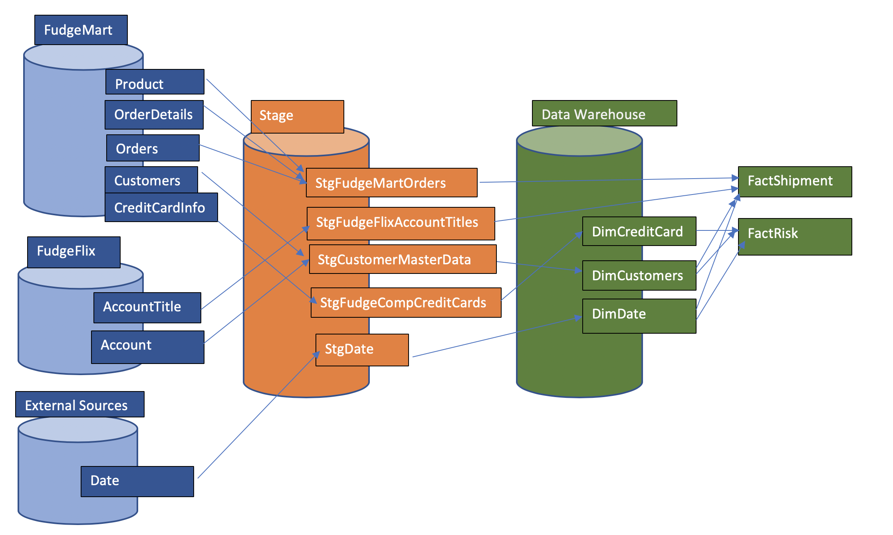
ETL done in SSIS - source to target map

Slide 3
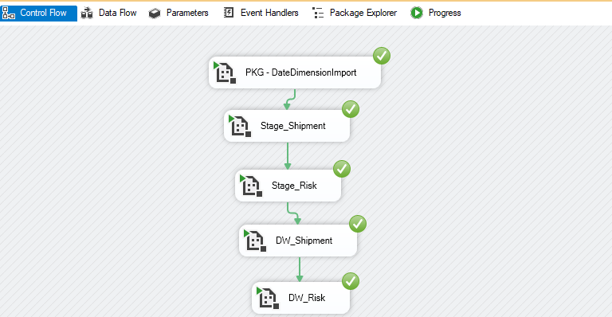
ETL process - all packages

Slide 4
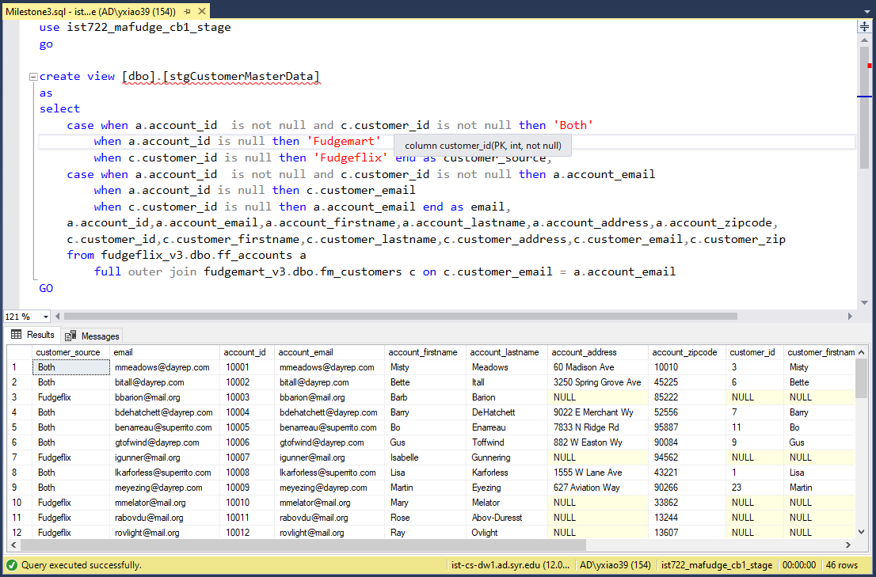
Stage_customers

Slide 5
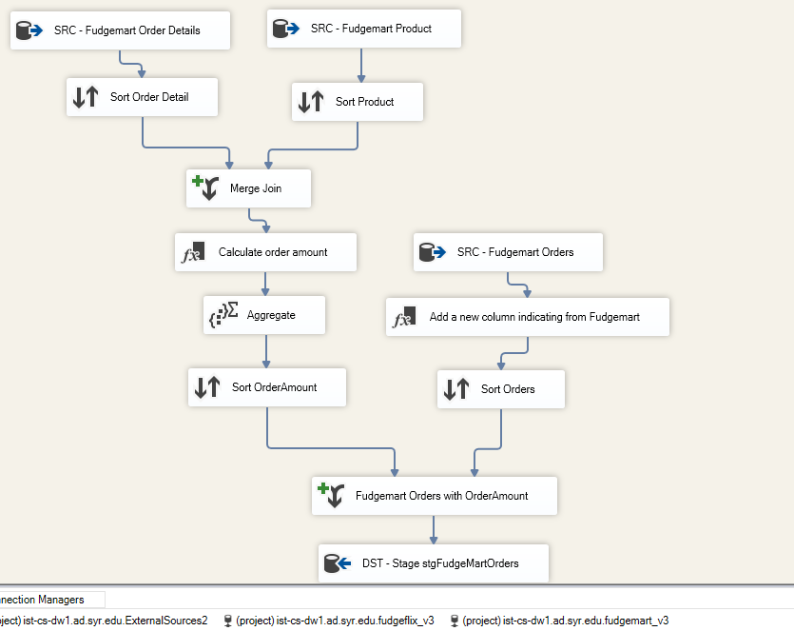
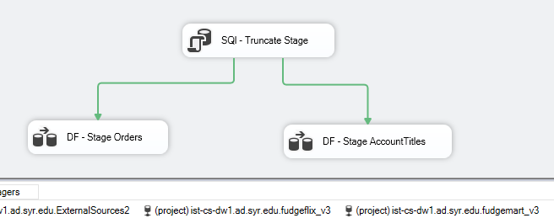
Stage_shipment

Slide 6
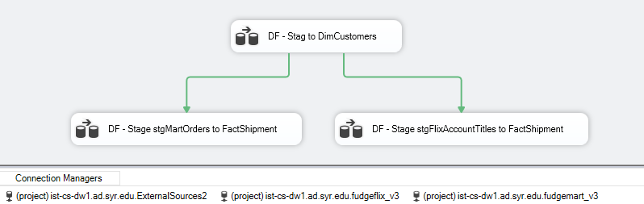
DW_Shipment

Slide 7
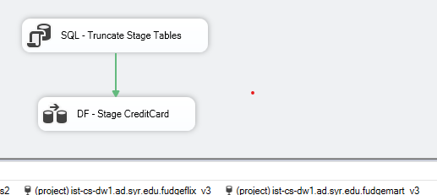
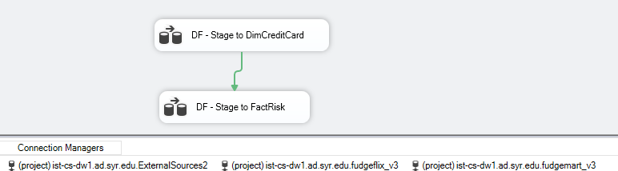
Stage_Risk
DW_Risk

Slide 8
ETL process - all packages details
Source to Stage
Stage risk - Stage credit card information table from Fudgemart
Stage customer
This is done by creating a view in SQL server. The view combines customers from both sources
Stage Shipment - Stage orders from Fudgemart + Calculated order amount and; stage AccountTitles from Fudgeflix
Stage to DW
DW risk - load into Dim credit card; combine credit card info into Fact Risk
DW shipment - load into Dim Customers by including both sources and calculate order to ship in days and other facts

Slide 9
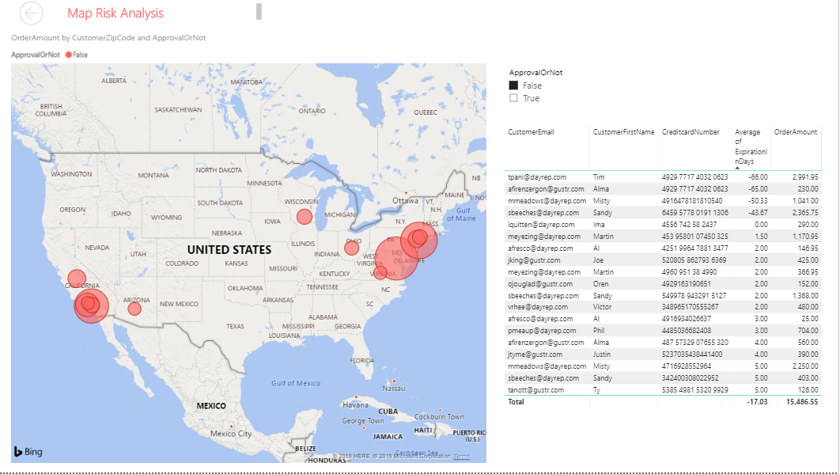
BI dashboard - Risk Analysis

Slide 10
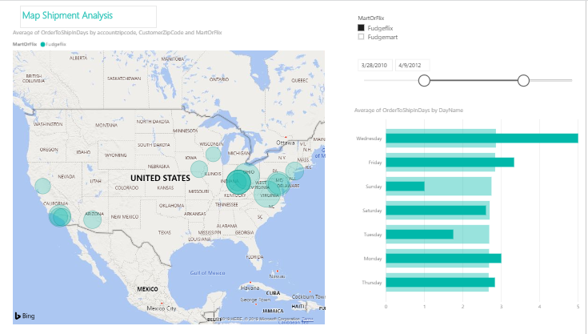
BI dashboard - Shipment Analysis

