Slide 1
Some Improvements on KaniCUDA
A program synthesizer for CUDA

Slide 2
Background – CUDA
CUDA is a parallel programming platform and API created by Nvidia.
CUDA is used for GPGPU(General-Purpose computing on Graphics Processing Units).

Slide 3
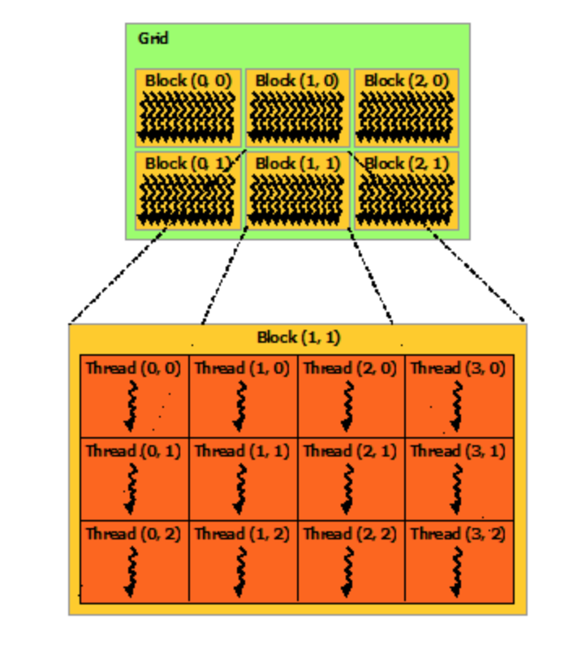
Background – Thread Hierarchy
Functions in CUDA, called kernels, are executed in parallel by threads, or thread blocks.
Threads form a thread block. Each block contains up to 1024 threads. Each block has a blockIdx(up to 3-d)
Each thread has a thread id, and threadIdx(up to 3-d).
FunctionName<<<numBlocks, threadsPerBlock>>>(parameters…);
Both blockIdx and threadIdx are needed to identify a thread.

Slide 4
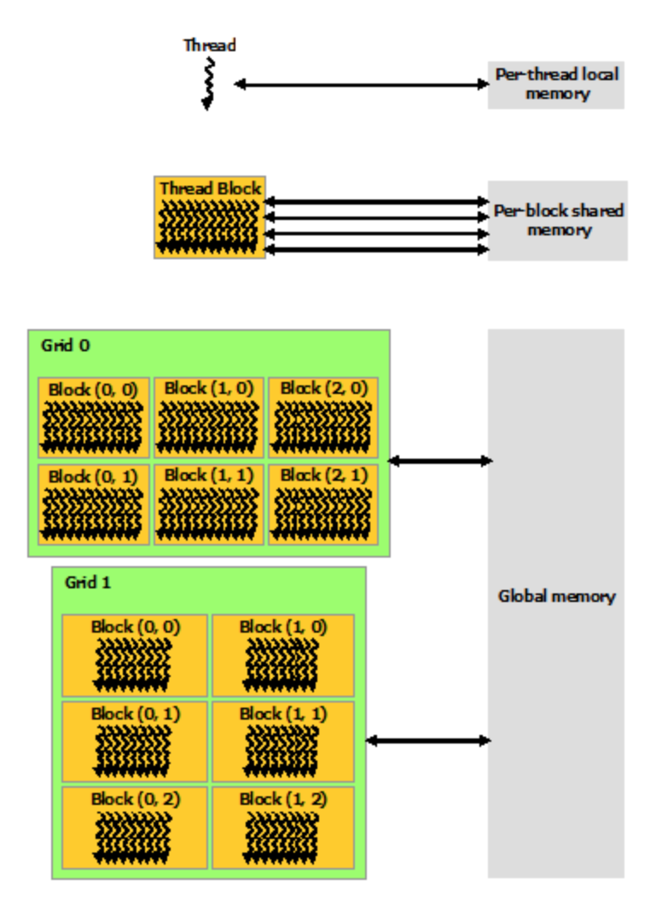
Background – Shared Memory
User can initialize shared memory and copy info from global memory.
Shared memory is available only to its own block.
Shared memory is generally faster than global memory.

Slide 5
Background - KaniCUDA
KaniCUDA generates the expression of shared memory access to replace the expression of global memory access.

Slide 6
Background – KaniCUDA
16x16 Global Memory
Each thread accesses global[thread id]
global[ (blockIdx.x * gridDim.y + blockIdx.y) * BLOCKSIZE + threadIdx.x * blockDim.y + threadIdx.y ]
Each block copies an 8x8 array in global memory to shared memory.
shared[…] = global[…]
Replace global memory access with shared memory access
shared[ threadIdx.x * SHARED_DIMX + threadIdx.y ]
KaniCUDA makes this replacement for the user

Slide 7
Background - KaniCUDA
KaniCUDA generates
Arithmetic Expressions
Logic Expressions
KaniCUDA handles
Shared memory access is not available
(if avail) ? sm[..] : gm[..]
Conditional expression
(some conditions) ? sm[..] : sm[..]

Slide 8
Background - KaniCUDA
KaniCUDA generates the expression of shared memory access to replace the expression of global memory access.
The user declares shared memory and copies info from global memory.
The user declares candidate variables that may appear in shared memory access.
The user declares global memory access to be replaced.

Slide 9
Background – KaniCUDA
Translates CUDA to
Racket language
Replace global memory access
with shared memory access
Emulate the program
Profile the variables
Calculate the expressions
for shared memory access
Expressions
Profiles

Slide 10
Improvement – Quick Search
In many cases, only 2 or 3 out of all candidate variables are used in an arithmetic expression.
Want to examine those related variables only.
Pearson correlation coefficient, denoted by r, is a measure of the strength of a linear association between two variables.

Slide 11
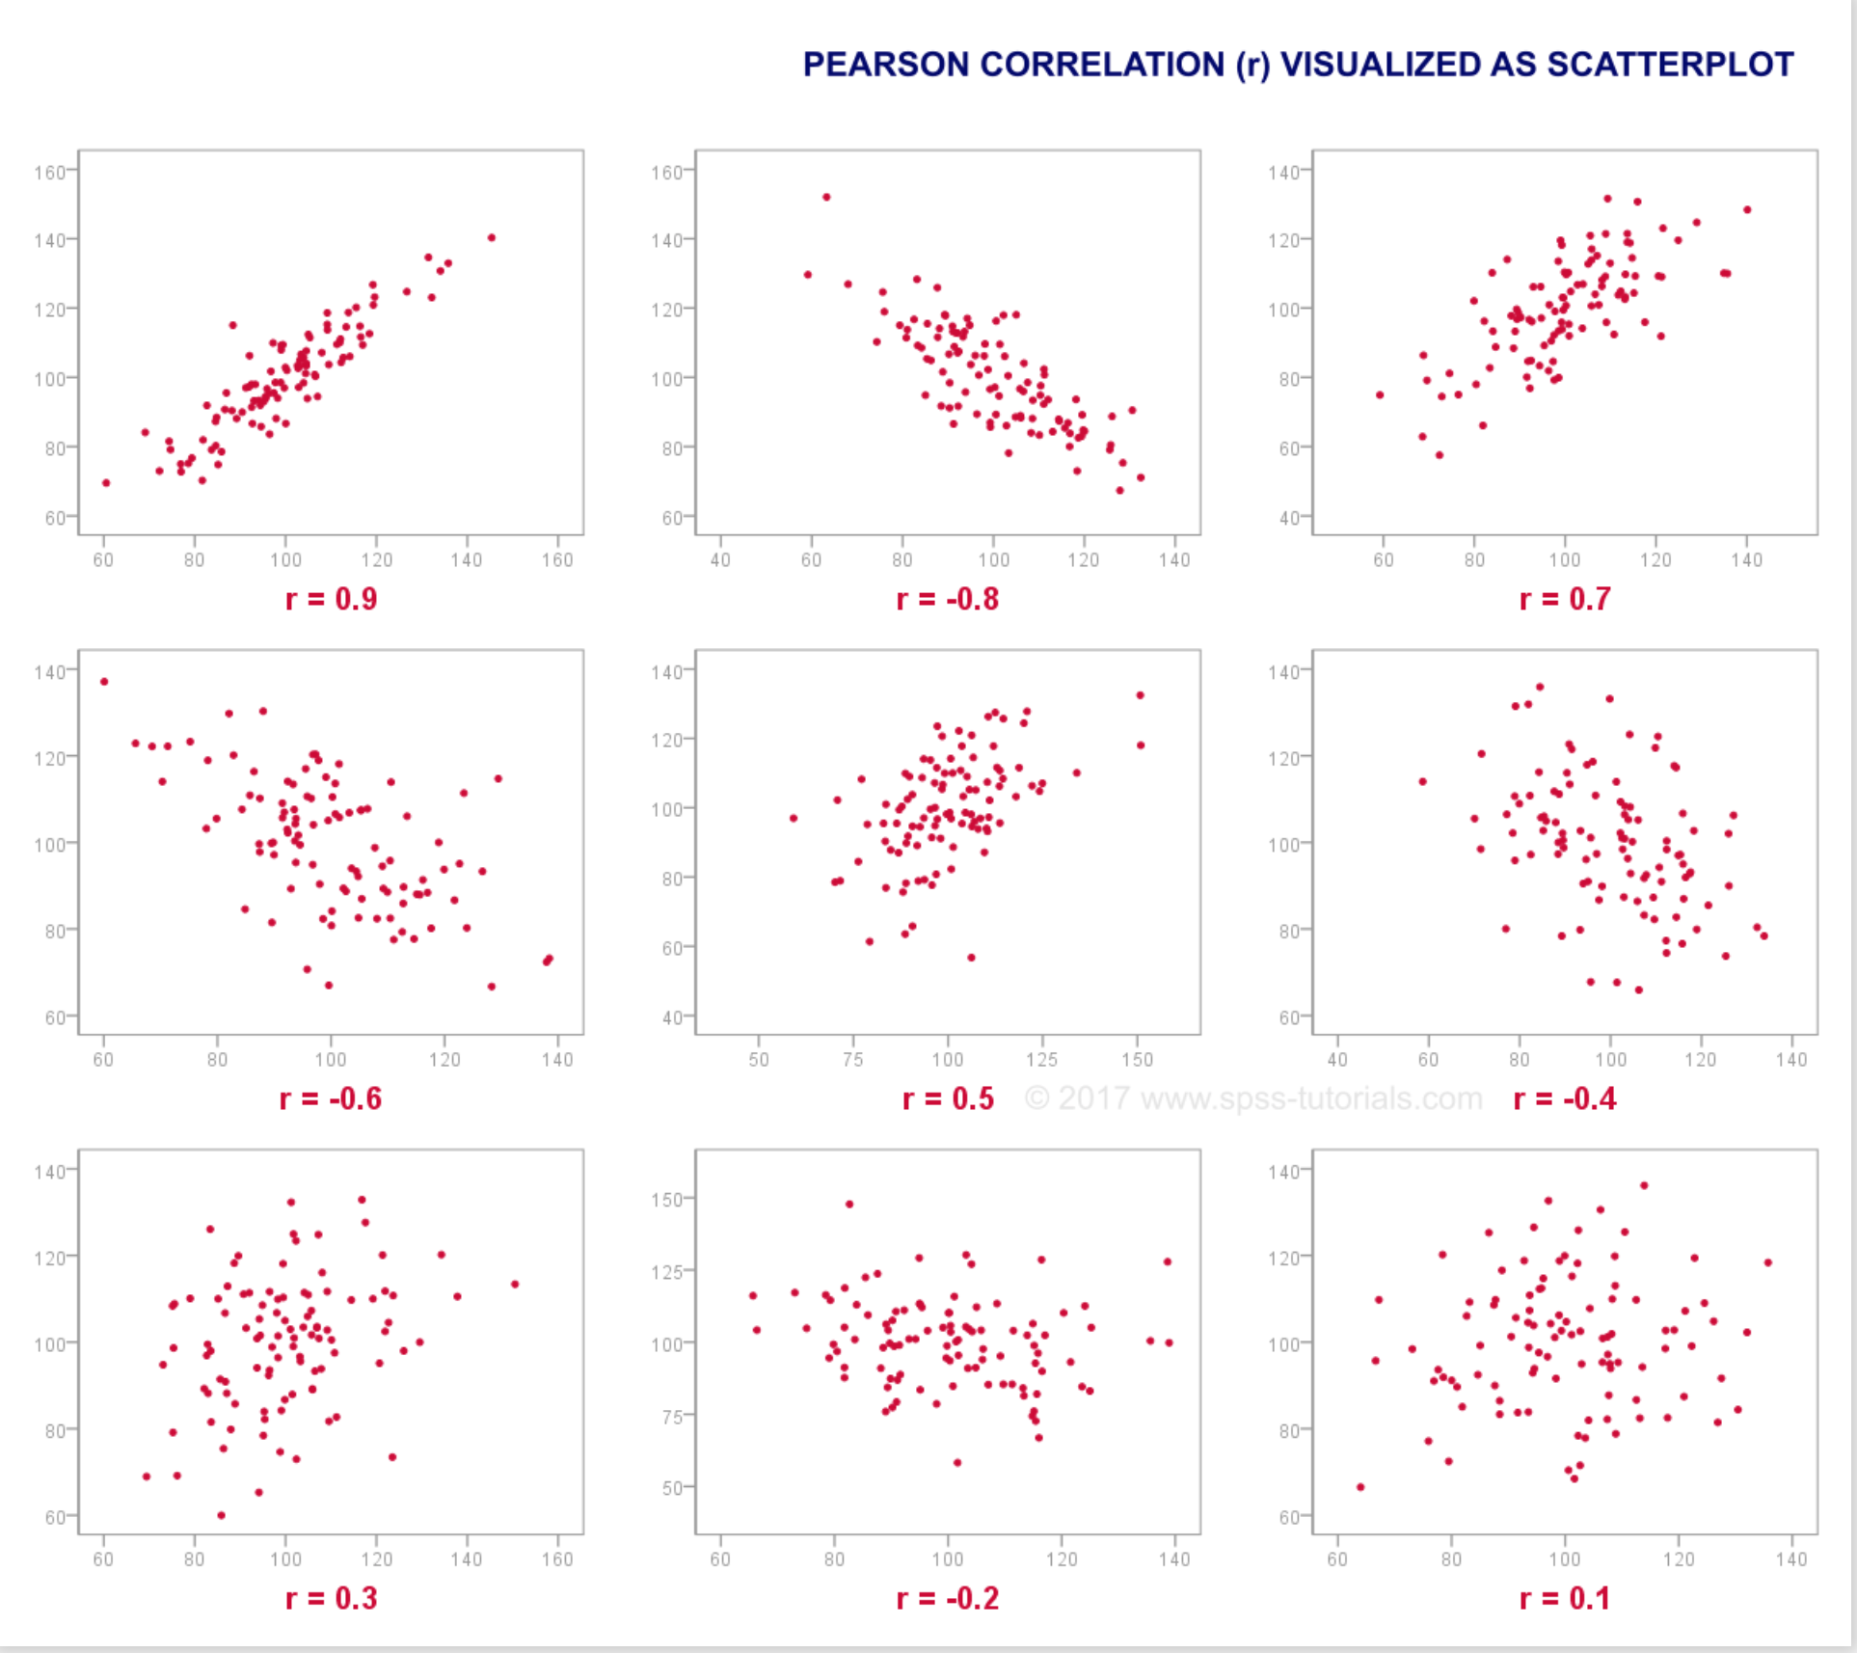

Slide 12
Improvement – Quick Search
Examine the correlation between a candidate variable and sharedMemoryIndex.
Generate expressions only for related variables.
Correlation test fails:
Expressions with high dimensions ex. x*y*z
Expressions with large coefficients ex. 100*x + y
Execute a thorough search if quick search fails

Slide 13
Improvement - Expression
Original KaniCUDA uses java objects to represent expressions.
Arrays are faster than objects
Origianl KaniCUDA generates all expressions, then tests them.
Test each expression immediately after it is generated.
Original KaniCUDA generates repeated expressions
Sort the expressions

Slide 14
Improvement – Arithmetic Expression
Arithmetic expression is represented in a linear style
Unit : constant or variable ex. 2, x, y
Term : unit, or unit * unit ex. y, y*x, y*x*2
Expression: term +- term +- term … ex. y, y + x, y*x + y + 2
Limit the number of operations.

Slide 15
Improvement – Arithmetic Expression
Identifiers
1 : constant 2 : variable
3 : + 4 : - 5 : *
Example
constant list = [1, 2], variable list = [x, y, z]
[1, 0] = 1 [2, 1] = y
[2, 0, 4, 1, 1] = x – 2
[2, 0, 5, 1, 1, 3, 2, 2] = x*2 + z

Slide 16
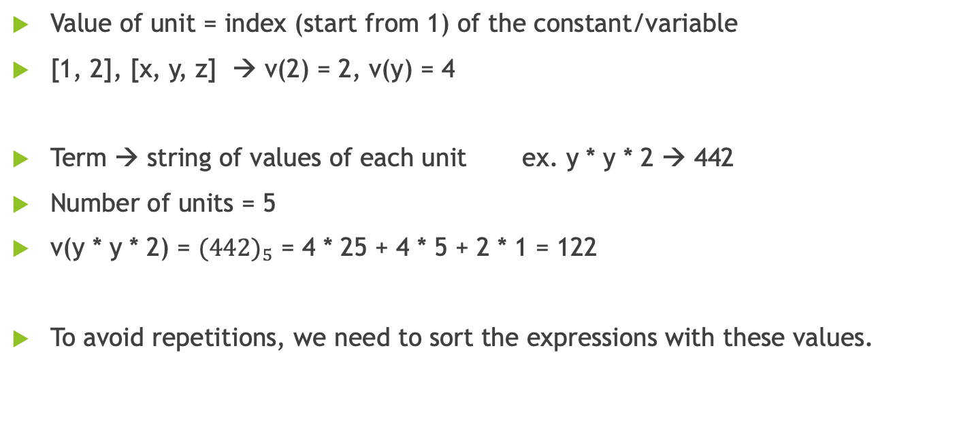
Improvement – Arithmetic Expression
Value of unit = index (start from 1) of the constant/variable
[1, 2], [x, y, z] → v(2) = 2, v(y) = 4
Term → string of values of each unit ex. y * y * 2 → 442
Number of units = 5
v(y * y * 2) = ${(442)}_{5}$ = 4 * 25 + 4 * 5 + 2 * 1 = 122
To avoid repetitions, we need to sort the expressions with these values.

Slide 17
Improvement – Arithmetic Expression
Value of current unit should not exceed value of previous unit
y * x is okay, x * y is not
Value of current term should not exceed value of previous term
x * 2 + y is okay, y + x * 2 is not, y - x - y * 2 is not
Note: this rule applies to +/-, but not to transition from + to -
x * 2 - y is okay, y - x * 2 is also okay
The linear style of arithmetic expression benefits this process.

Slide 18
Improvement – Arithmetic Expression
Continuation-passing style
Functions take an argument: an explicit “continuation”, i.e. a callback function.
It allows different expressions to be generated based on one expression
When the left part of an expression is ready, callback generate function to generate the right part.
ex. y * x → callback gen_plus → y * x + 1, y * x + 2, …
Keep track of one global array, which represents the expression. Once an expression is generated, a callback test function is executed. If the test passes, abort all executions. Otherwise, keep going.

Slide 19
Improvement – Logic Expression
Linear style is beneficial for sorting expressions, but it is difficult to deal with complicated expressions, like logic expression.
Logic expression is represented in a binary tree style (left & right)
Ex. (x != y) || (z > 1)
Difficult to sort the expressions
or
!=
>
x
y
z
1

Slide 20
Improvement – Logic Expression
Identifiers
-1 : && -2 : || -3 : ==
-4 : != -5 : < -6 : >
1 : constant 2 : variable 3 : + 4 : -
Example
constant list = [1, 2], variable list = [x, y, z]
[1, 1] = 2, [2, 0] = x
[-5, 2, 0, 1, 1] = x < 2
[-2, -4, 2, 0, 1, 1, -5, 2, 2, 3, 2, 1, 1, 0] = (x != 2) || (z < y + 1)

Slide 21
Improvement – Logic Expression
First generate simple arithmetic expression and push to an ArrayList
Generate logic expressions for lower triangle
Ex. x + 1 != y is okay, y != x + 1 is not
Arithmetic Expressions →
Arithmetic Expressions →

Slide 22
Benchmark

