Slide 1


OBJECT TRACKER
CLASSICAL COMPUTER VISION • WORKS ON CUSTOM VIDEOS
MOG2/GMG
KALMAN FILTER
HUNGARIAN ALGORITHM
HSV RE-ID
YOLOV8
GRID SEARCH
COURSE: CSE445
PROJECT GROUP: 07
TEAM MEMBERS:
MD NAFIUL ALAM CHOWDHURY — 2231774642
FAHAD HOSSAIN SHOUROV — 2233219642
FARHANA RAHMAN —2233151042
MD SHADMAN SHIHAB — 2231639642
1

Slide 2
PROBLEM STATEMENT:
WHY OBJECT TRACKING MATTERS?
OBJECT TRACKING IDENTIFIES AND FOLLOWS MOVING OBJECTS ACROSS VIDEO FRAMES.
01.
Autonomous vehicles
03.
Surveillance systems
05.
Medical imaging
02.
Sports analytics
04.
Robotics
TRACKING BECOMES DIFFICULT DUE TO:
01.
Camera motion
02.
Varying lighting conditions
03.
Cluttered backgrounds
04.
Fast-moving objects
2
GROUP: 07, MD NAFIUL ALAM CHOWDHURY, FAHAD HOSSAIN SHOUROV, FARHANA RAHMAN, MD SHADMAN SHIHAB

Slide 3
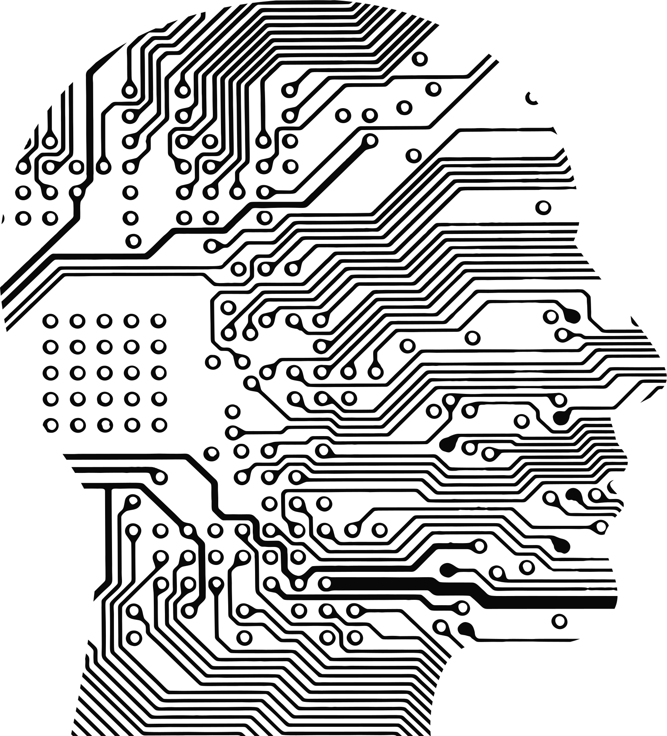

PROJECT GOAL
TO EVALUATE MULTIPLE MOTION TRACKING APPROACHES UNDER DIFFERENT SCENE CONDITIONS AND DETERMINE:
WHICH ALGORITHM PERFORMS BEST IN EACH SCENARIO
HOW SCENE CHARACTERISTICS AFFECT PERFORMANCE
GUIDELINES FOR SELECTING THE RIGHT TRACKING METHOD
05.
3
GROUP: 07, MD NAFIUL ALAM CHOWDHURY, FAHAD HOSSAIN SHOUROV, FARHANA RAHMAN, MD SHADMAN SHIHAB

Slide 4

PROPOSED SOLUTION
OUR TRACKING PIPELINE
WE BUILT A MODULAR MULTI-OBJECT TRACKING SYSTEM USING:
MOG2 (BACKGROUND SUBTRACTION)
GMG (BAYESIAN BACKGROUND MODEL)
YOLOV8 (DEEP-LEARNING DETECTOR)
KALMAN FILTER (STATE PREDICTION)
HUNGARIAN ALGORITHM (OBJECT ASSIGNMENT)
HSV HISTOGRAM RE-ID (IDENTITY RECOVERY)
05.
MACHINE LEARNING
4
GROUP: 07, MD NAFIUL ALAM CHOWDHURY, FAHAD HOSSAIN SHOUROV, FARHANA RAHMAN, MD SHADMAN SHIHAB

Slide 5

SYSTEM WORKFLOW
END-TO-END PIPELINE
VIDEO INPUT
CAMERA STABILIZATION
OBJECT DETECTION
WARMUP GUARD
TRACKING WITH KALMAN + HUNGARIAN
RE-IDENTIFICATION
EVALUATION & OUTPUT
05.
5
GROUP: 07, MD NAFIUL ALAM CHOWDHURY, FAHAD HOSSAIN SHOUROV, FARHANA RAHMAN, MD SHADMAN SHIHAB

Slide 6
DETECTOR COMPARISON
DETECTION METHODS USED:
01.
MOG2
02.
GMG
03.
YOLOv8
Fast and efficient
Best for static cameras
Works well with clean backgrounds
Sharper segmentation
Better for textured backgrounds
Requires warmup time
High accuracy
Handles moving cameras & multiple classes
Computationally expensive
6
GROUP: 07, MD NAFIUL ALAM CHOWDHURY, FAHAD HOSSAIN SHOUROV, FARHANA RAHMAN, MD SHADMAN SHIHAB

Slide 7

TRACKING & RE-IDENTIFICATION
CORE TRACKING TECHNIQUES
01.
Kalman Filter
03.
HSV Re-ID
Predicts object movement across frames
Handles temporary detection loss
Restores identity after occlusion
Uses color histogram similarity
02.
Hungarian Algorithm
Matches detections to predicted tracks
Minimizes assignment cost
7
GROUP: 07, MD NAFIUL ALAM CHOWDHURY, FAHAD HOSSAIN SHOUROV, FARHANA RAHMAN, MD SHADMAN SHIHAB

Slide 8
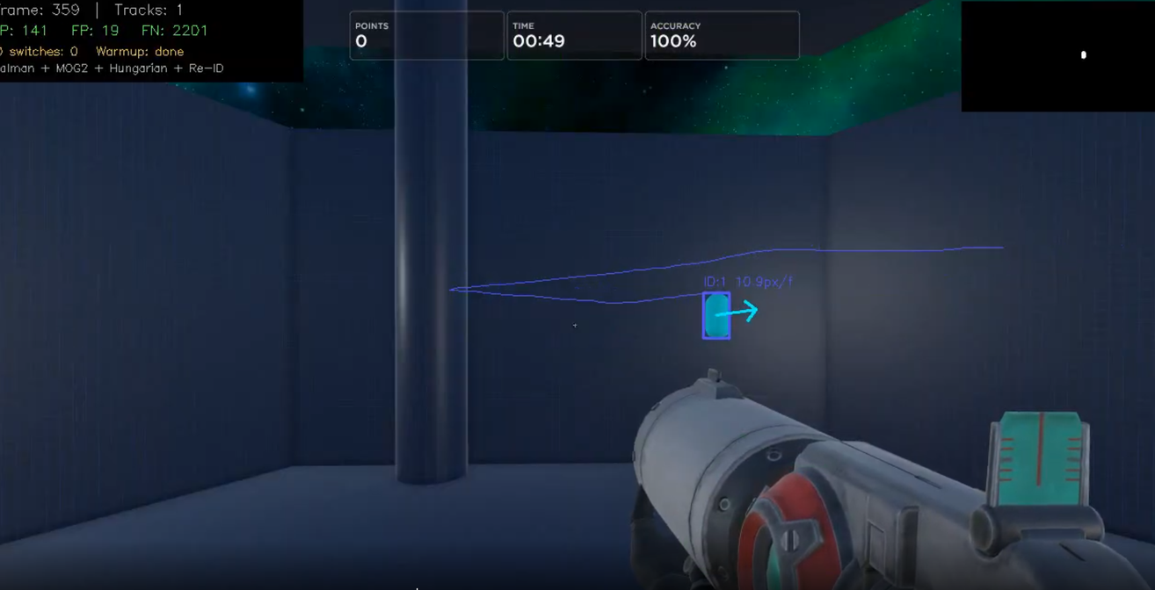

TRADITIONAL BACKGROUND SUBTRACTION (GMG, MOG2)
ADVANTAGES
1.Lightweight and fast (low computational cost)
2.No training required
3.Works well in static scenes
4.Easy to implement (e.g., OpenCV)
Kalman Filter
AIM LAB DYNAMIC TARGET TRACKING
BOUNCING DVD TRACKING TEST
8
GROUP: 07, MD NAFIUL ALAM CHOWDHURY, FAHAD HOSSAIN SHOUROV, FARHANA RAHMAN, MD SHADMAN SHIHAB

Slide 9
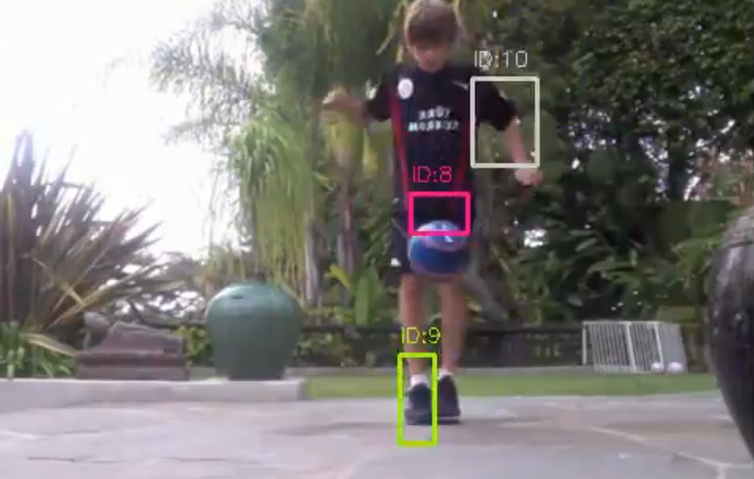
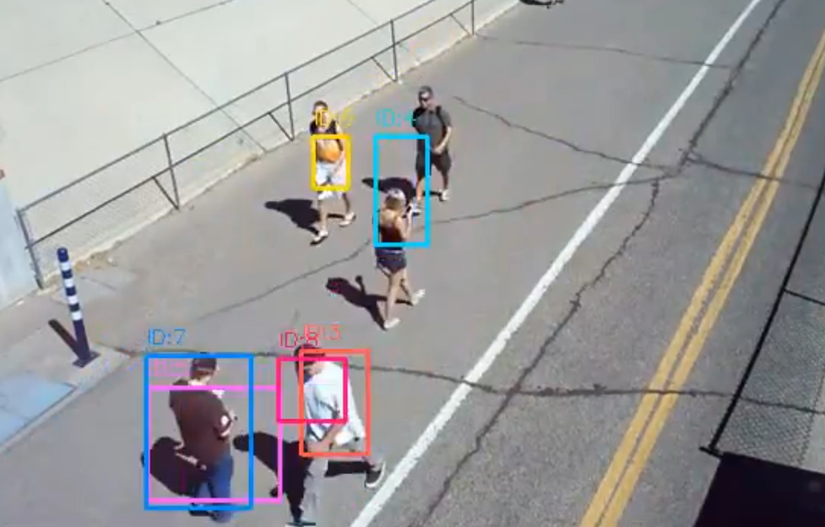
TRADITIONAL BACKGROUND SUBTRACTION (GMG, MOG2)
DRAWBACKS
Struggles with :
Fast-moving objects (motion blur, missed detections)
Multiple objects (merging / fragmentation)
Lighting changes (shadows, reflections)
Detects only motion, not object type
High false positives (noise, background movement)
Poor tracking consistency (IDs unstable or missing)
Kalman Filter
FOOTBALL JUGGLING MOTION TEST
9
PEDESTRIAN MOVEMENT TEST
GROUP: 07, MD NAFIUL ALAM CHOWDHURY, FAHAD HOSSAIN SHOUROV, FARHANA RAHMAN, MD SHADMAN SHIHAB

Slide 10
YOLOV8 (DEEP LEARNING OBJECT DETECTION)
ADVANTAGES
TRADEOFFS
Kalman Filter
Detects multiple objects reliably
Handles fast motion much better
Classifies objects (person, car, etc.)
Robust to lighting changes and noise
Works in dynamic environments
Better tracking when combined with trackers (e.g., DeepSORT)
Requires training (data + time)
Higher computational cost (GPU preferred)
More complex setup
Model size and inference latency
considerations
10
GROUP: 07, MD NAFIUL ALAM CHOWDHURY, FAHAD HOSSAIN SHOUROV, FARHANA RAHMAN, MD SHADMAN SHIHAB

Slide 11
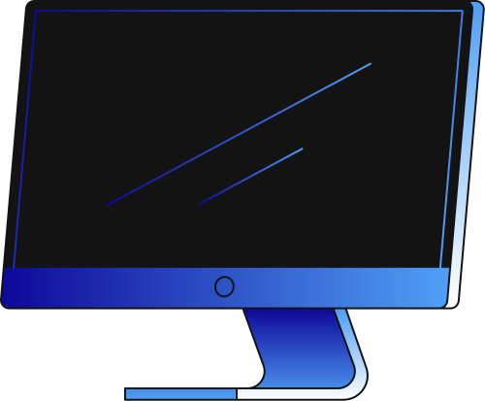
EXPERIMENTAL SETUP
THYNK UNLIMITED
DATASET & EVALUATION
10 video sequences
Diverse conditions:
Static / moving cameras
Single / multiple objects
Clean / cluttered backgrounds
EVALUATION METRICS
Precision
Recall
F1-score
MOTA
ID Switches
Centroid MAE
11
GROUP: 07, MD NAFIUL ALAM CHOWDHURY, FAHAD HOSSAIN SHOUROV, FARHANA RAHMAN, MD SHADMAN SHIHAB

Slide 12
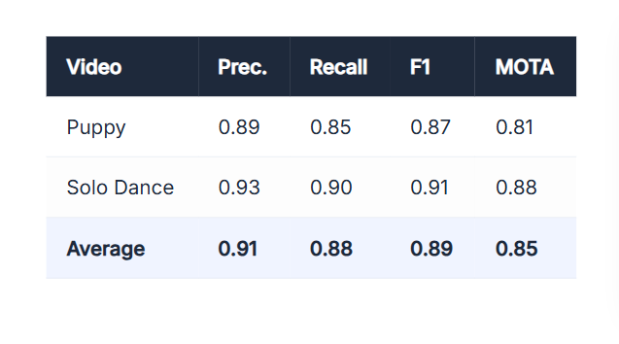
RESULTS
DATASET & EVALUATION
YOLOV8 ACHIEVED BEST OVERALL ACCURACY
F1 ≈ 0.89
MOTA ≈ 0.85
MOG2 PROVIDED FASTEST PERFORMANCE
30–60 FPS ON CPU
GMG SHOWED MODERATE PERFORMANCEBETTER THAN MOG2 IN SOME TEXTURED SCENES
SLOWER DUE TO WARMUP PERIOD
12
GROUP: 07, MD NAFIUL ALAM CHOWDHURY, FAHAD HOSSAIN SHOUROV, FARHANA RAHMAN, MD SHADMAN SHIHAB

Slide 13
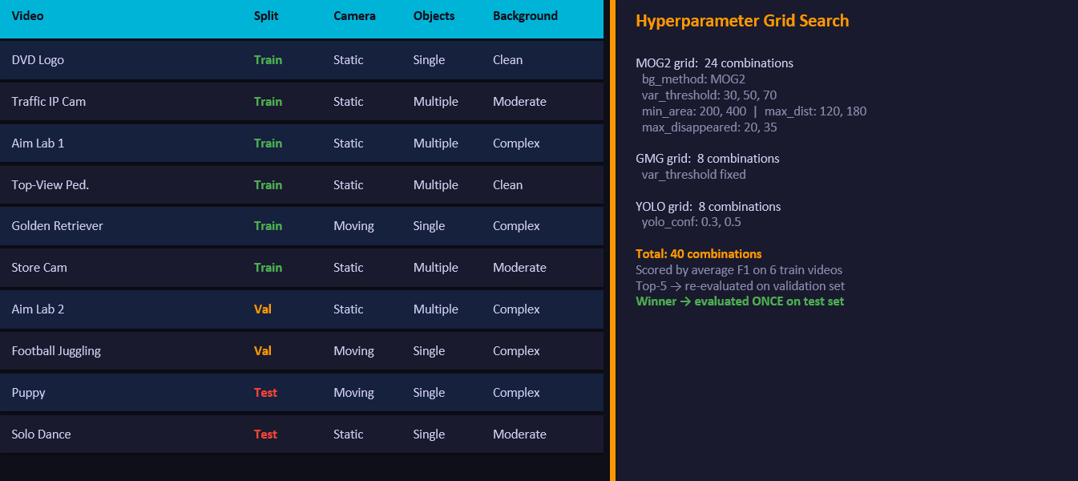
RESULTS
13
GROUP: 07, MD NAFIUL ALAM CHOWDHURY, FAHAD HOSSAIN SHOUROV, FARHANA RAHMAN, MD SHADMAN SHIHAB

Slide 14
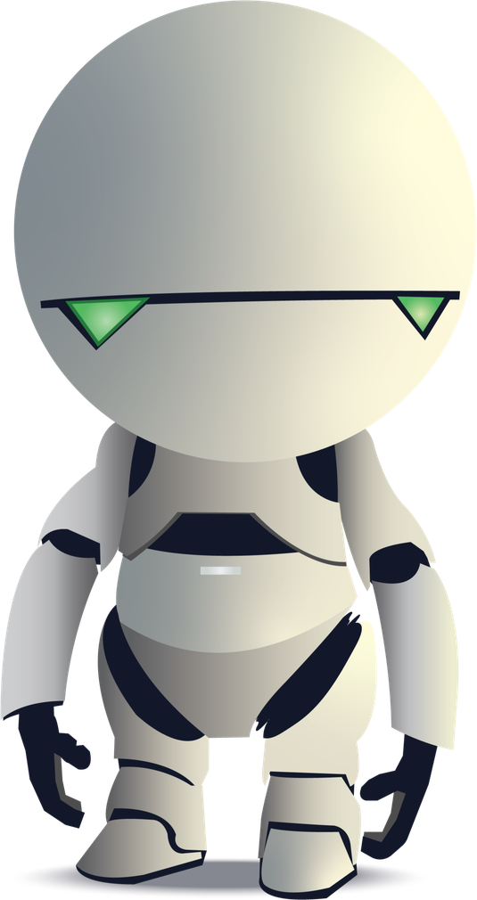
INSIGHTS & ANALYSIS
What We Learned
No single algorithm is best for all scenarios
Detector choice is the most important factor
Scene characteristics should guide algorithm selection
HSV Re-ID reduced identity switches by ~20%
Hyperparameter tuning significantly improves results
GROUP: 07, MD NAFIUL ALAM CHOWDHURY, FAHAD HOSSAIN SHOUROV, FARHANA RAHMAN, MD SHADMAN SHIHAB

Slide 15

CHALLENGES / FAILURE CASES
Observed Limitations
Motion Blur: Causes inaccurate bounding boxes
Occlusion: Can break identity continuity
Illumination Changes: Affects background subtraction methods
Latency: YOLO is slower without GPU acceleration
14
GROUP: 07, MD NAFIUL ALAM CHOWDHURY, FAHAD HOSSAIN SHOUROV, FARHANA RAHMAN, MD SHADMAN SHIHAB

Slide 16
CONCLUSION
Final Takeaways
Built a complete multi-object tracking pipeline
Compared classical and deep-learning methods
Demonstrated that algorithm selection must be scene-aware
Validated importance of modular design + systematic tuning
Core Insight:
There is no universal best tracker — performance depends on context.
15
GROUP: 07, MD NAFIUL ALAM CHOWDHURY, FAHAD HOSSAIN SHOUROV, FARHANA RAHMAN, MD SHADMAN SHIHAB

Slide 17
THANK YOU
16

