Slide 1

“AI-BASED CYBER THREAT DETECTION IN NETWORK TRAFFIC”
B.M.S. College of Engineering
Department of Information Science and Engineering
Review - I
Batch No:- 94
Girish Kumar K S (1BM22IS079)
Movva Rahul Datta (1BM22IS117)
Shruti Mishra (1BM22IS189)
Under the Guidance of:
DivyaShree S
Professor
Department of ISE

Slide 2
Contents
Introduction
Objectives
Problem Statement
System Design
System Architecture
Mathematical models
Implementation
Results
Outcomes

Slide 3
Introduction
As cyber threats grow increasingly sophisticated, traditional rule-based systems struggle to keep up. This project leverages Artificial Intelligence (AI)—including machine learning and deep learning —to analyze network traffic and detect malicious activities in real-time. By integrating adaptive learning, explainable AI, and adversarial resilience, the system aims to minimize false positives and detect both known and zero-day attacks. This project contributes to building smarter, faster, and more robust cybersecurity solutions, ensuring proactive defense in a rapidly evolving digital world.

Slide 4
Objectives
Develop an AI-based system to detect cyber threats in network traffic using machine learning and deep learning techniques.
Integrate feedback-based learning to reduce false positives and improve detection accuracy over time.
Implement Explainable AI (XAI) methods like SHAP/LIME to enhance model transparency and support analyst decision-making.
Strengthen model security using adversarial training to defend against manipulated inputs.
Enable online/incremental learning to allow real-time adaptation to emerging and evolving threats.

Slide 5
Problem Statement
With the exponential growth of digital connectivity, network infrastructures face an unprecedented volume and diversity of cyber threats, including zero-day exploits, botnets, and advanced persistent threats. Traditional network intrusion detection systems (NIDS), which rely on signature-based or rule-based methods, struggle to detect novel and sophisticated attacks, especially in the presence of imbalanced datasets and evolving attack strategies. There is a pressing need for an adaptive, scalable, and intelligent detection system that can learn complex traffic patterns, handle data scarcity, and provide real-time, explainable threat identification to secure modern networks.

Slide 6
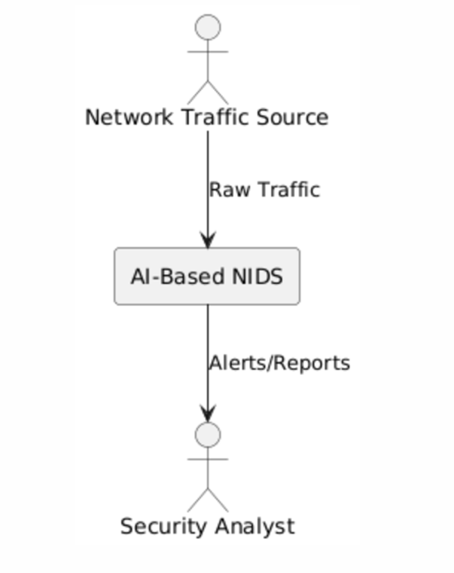
System Design
Level 0 (Context Diagram):
External Entity: Network Traffic Source
System: AI-Based NIDS
Output: Alerts/Reports to Security Analyst

Slide 7
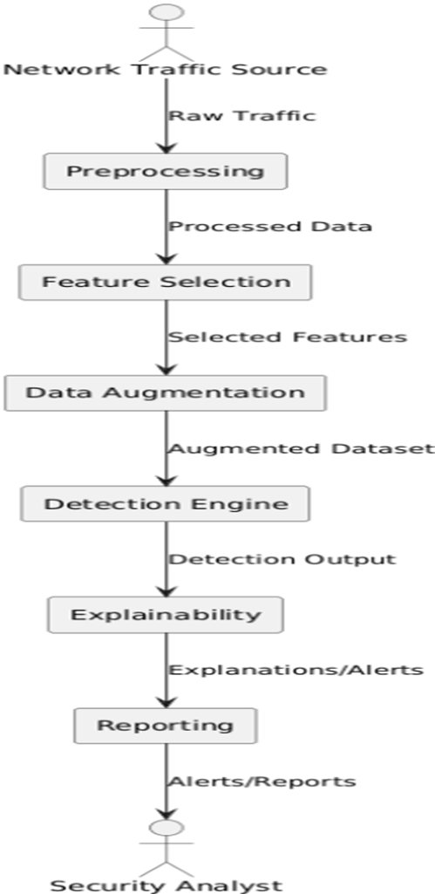
System Design
Level 1 (DFD):
Data flows:
Raw traffic → Preprocessing
Processed data → Feature Selection
Selected features → Data Augmentation
Augmented dataset → Detection Engine
Detection output → Explainability
Explanations/alerts → Reporting

Slide 8
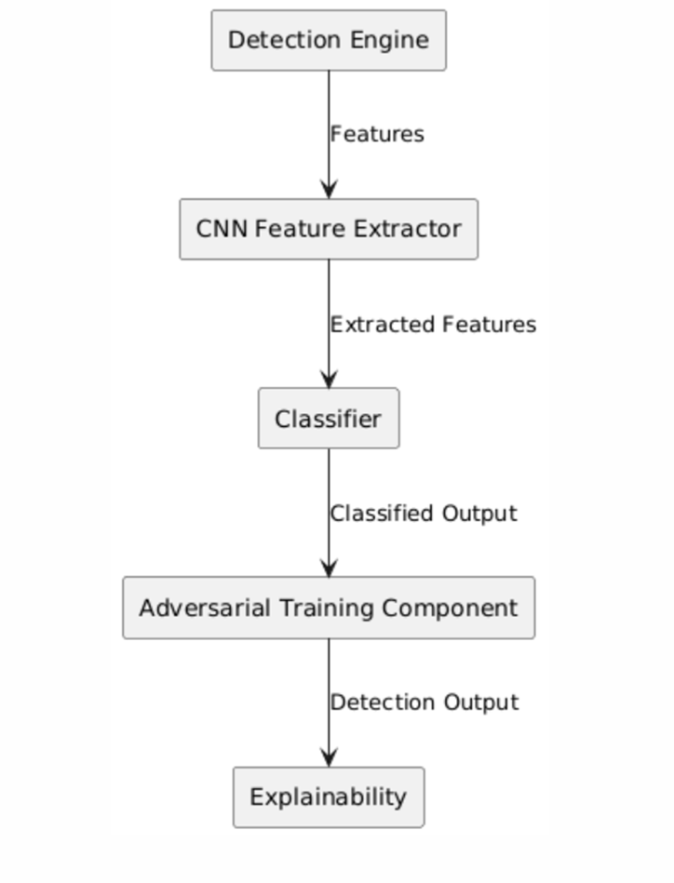
System Design
Level 2 (DFD):
Detection Engine submodules:
CNN Feature Extractor
Classifier
Adversarial Training Component

Slide 9
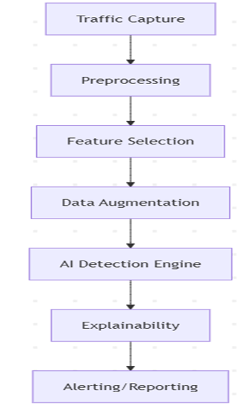
System Architecture
Traffic Capture Module: Collects real-time network traffic data.
Preprocessing Module: Cleans and extracts relevant features from raw packets.
Feature Selection Module: Uses evolutionary algorithms to select optimal features.
GAN-based Data Augmentation Module: Generates synthetic attack samples to balance the dataset.
AI-based Detection Engine: Employs deep CNNs for feature extraction and classification.
Explainability Layer: Provides interpretable outputs for detection decisions.
Alerting & Reporting Module: Notifies analysts and logs incidents.

Slide 10
Implementation
Step 1: Data Preparation & Ingestion –
Load & Clean: Read raw CSV files, normalize column names, and handle missing or infinite values.
Standardize Labels: Map various attack categories and "BENIGN" labels to a consistent, integer-based format.
Scale Features: Apply MinMaxScaler to all numeric features to bring them into a uniform range (0 to 1).
Balance & Cap Dataset: To ensure performance and class representation, the dataset is capped at 250,000 rows using stratified sampling, which preserves the original proportion of each attack type.
Output: A single, clean, and processed CSV file.

Slide 11
Implementation
Step 2: Feature Selection -
Importance Ranking: A Random Forest classifier is trained on the processed data specifically to calculate the impurity-based importance of each feature.
Select Top Features: The top 30 most important features are selected to be processed.
Output: A reduced dataset containing only the most predictive columns, along with a list of their names for future use.

Slide 12
Implementation
Step 3: Model Training & Evaluation -
Random Forest: An ensemble of 400 decision trees. It's robust and provides strong baseline performance. It uses scikit-learn to train the model.
1D CNN: A deep learning model with Conv1D layers, designed to capture sequential patterns within the feature set. GAN Augmentation is a major plus point for the model.
Output: Saved model files (.joblib, .keras), performance metrics (accuracy, F1- score, Recall score, Model size, Number of samples used to train the model), and associated metadata in JSON files.

Slide 13
Implementation
Step 4: Prediction & Deployment -
Load Model: The API loads a persisted model (e.g., the Random Forest) and its feature list.
Process Request: It receives an incoming feature vector (as JSON).
Return Prediction: The data is preprocessed to match the training format, fed into the model, and the resulting prediction (e.g., "Normal" or a specific attack type) is returned.

Slide 14
Mathematical Models
2.1 Random Forest
Ensemble of T decision trees (T=400). Each tree trained on bootstrap sample; feature subset per split (default sqrt(M)).
Split criterion: Gini impurity G(S) = 1 - Σ p_k^2; choose feature/threshold maximizing ΔG.
Prediction: majority vote (mode) across trees; probability = average of per-tree class distributions.

Slide 15
Mathematical Models
2.2 1D CNN Classifier
Layers perform discrete convolution: (x * w)i = Σ{j=0}^{K-1} x_{i+j} w_j.
ReLU activation: f(z)=max(0,z); BatchNorm normalizes activations: y = γ ( (x - μ_B)/√(σ_B^2+ε) ) + β.
Global Average Pooling: v_k = (1/L) Σ_{i=1}^L a_{i,k}.
Dense layer: y = softmax(Wx + b); softmax_k = exp(z_k)/Σ_j exp(z_j).
Loss: Sparse Categorical Cross-Entropy: L = - Σ log p(y_i|x_i).
Class weighting scales per-sample loss by weight w_{y_i}.

Slide 16
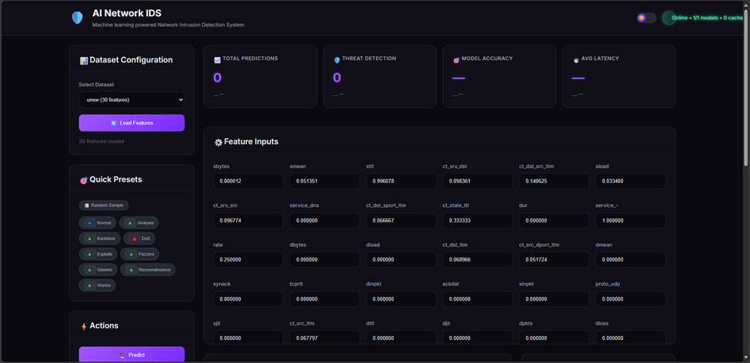
Results

Slide 17
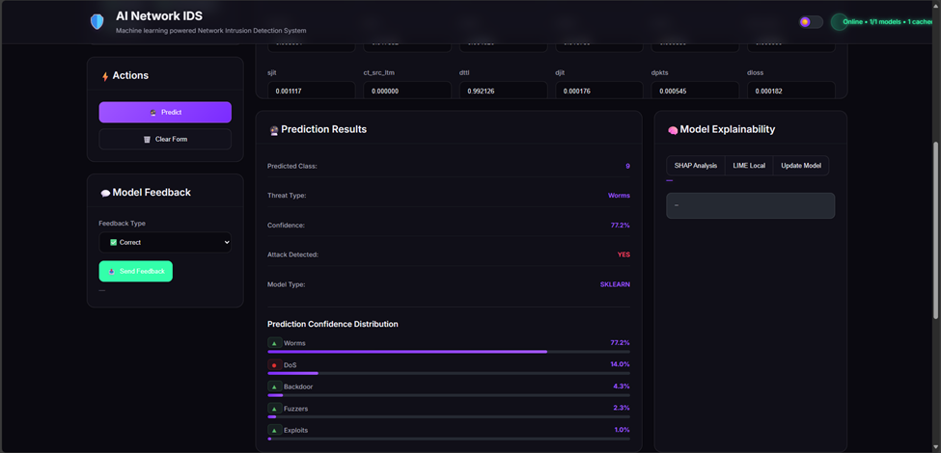

Slide 18
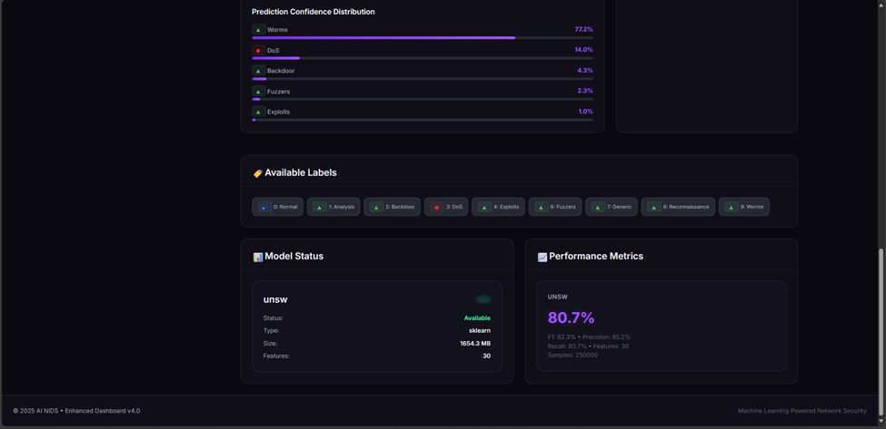

Slide 19
Technology Stack
Language: Python 3.x.
Data Handling: pandas, numpy.
Feature Scaling/Encoding: scikit-learn (MinMaxScaler, LabelEncoder, RandomForestClassifier, SGDClassifier, VotingClassifier, SVC, class_weight utilities, metrics).
Deep Learning: TensorFlow / Keras (Conv1D, Dense, Dropout, BatchNormalization, optimizers, callbacks).
Model Persistence: joblib, Keras .keras format, JSON for metadata.
Explainability (present in repo): LIME (local surrogate explanation) referenced in explainability/ (not detailed here).
Deployment: Flask / FastAPI style (API folder) – script not opened but implied; Dockerfile for containerization.
Environment / Config: OS env vars (MAX_ROWS, TRAIN_GAN, PRIMARY_DATA, SYNTH_DATA, OUTPUT_MODEL).
Version Control & Packaging: Docker, requirements assumed (not explicitly listed here but derivable from imports).

Slide 20
Open Source Tools
Libraries (standard open source):
  pandas (BSD-3-Clause)
  numpy (BSD)
  scikit-learn (BSD)
  TensorFlow / Keras (Apache 2.0)
  joblib (BSD)
  LIME (BSD)
  (Likely) Flask or FastAPI (BSD / MIT depending) for API
No embedded external repository code snippets observed; all logic appears custom composition around library APIs.
Conditional GAN implementation is lightweight, custom (not copied from a template/official example; structure is standard MLP pattern).
Attribution: Using public APIs of the above libraries under their respective permissive licenses; no copyleft obligations detected.

Slide 21
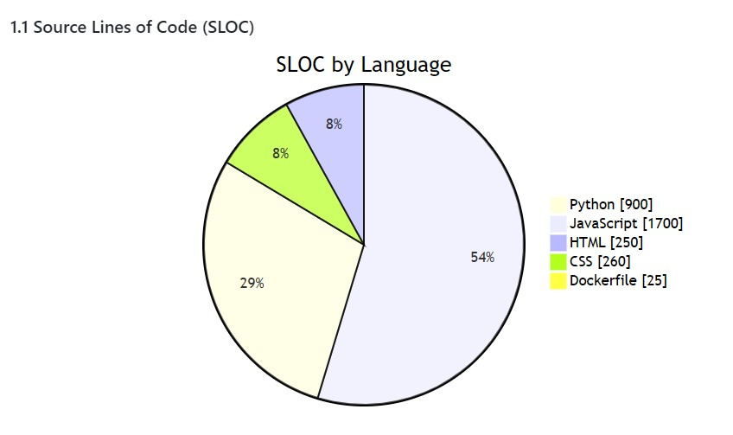

Slide 22
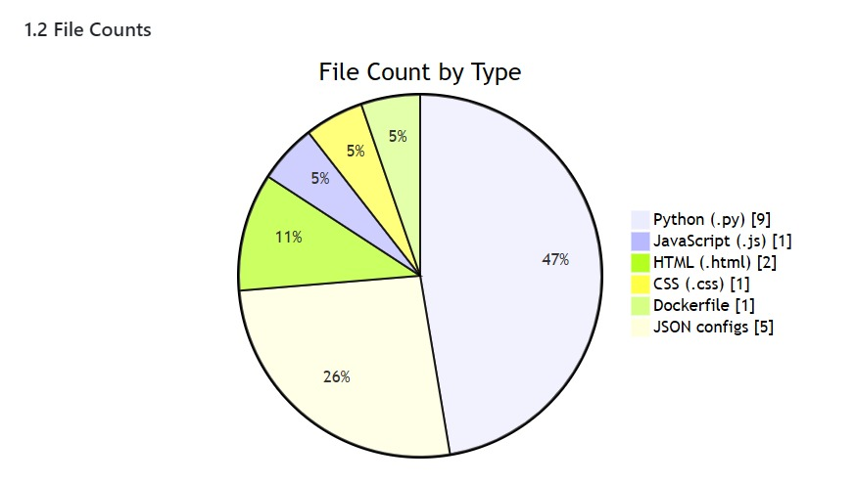

Slide 23
Project Outcomes
AI-powered frontend composition assistant for faster detection
Intelligent notification system for important/priority threats
Vast number of threats
Scalable deployment with Vercel & Neon (serverless Postgres)
Clean and modern UI with CSS + JavaScript
Academic Outcomes:
Poster/Research Paper: Planned for submission in college tech fest / symposium
Prototype Demo: A working web app will be demonstrated live
Patent: Not filed yet, but possible in future for AI-based notification + better models

