Slide 1
Federated Machine Learning: Concept and Applications
QIANG YANG, YANG LIU, TIANJIAN CHEN, YONGXIN TONG,

Slide 2


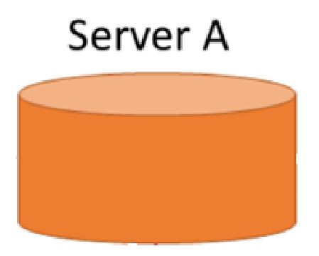





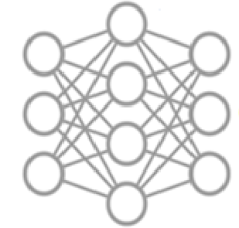






Vertical Federated Learning

