Slide 1
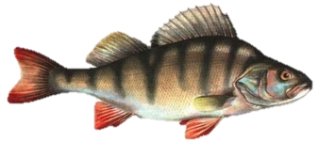
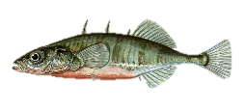
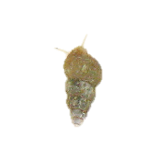
Explore dataset to determine which factors are related
Do predators control stickleback?
Do stickleback control benthic invertebrates?
Do stickleback control algae?

Slide 2
Complete dataset and set up and run analyses
Retrieve water temperature and salinity data from NOAA online database
Add data to current datafiles
Create commands to test variable normality and transform variables if necessary
Do exploratory data analysis in the form of simple regressions and regression trees

Slide 3
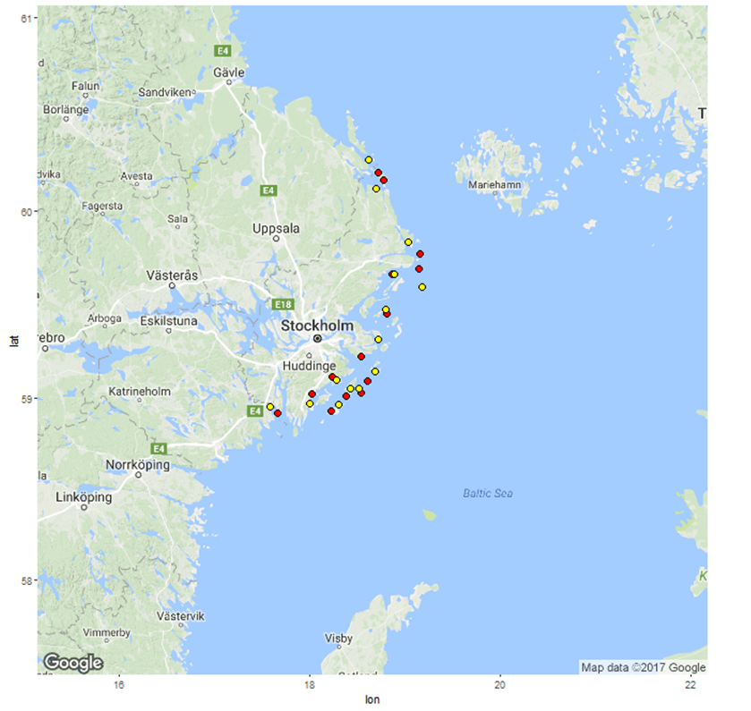
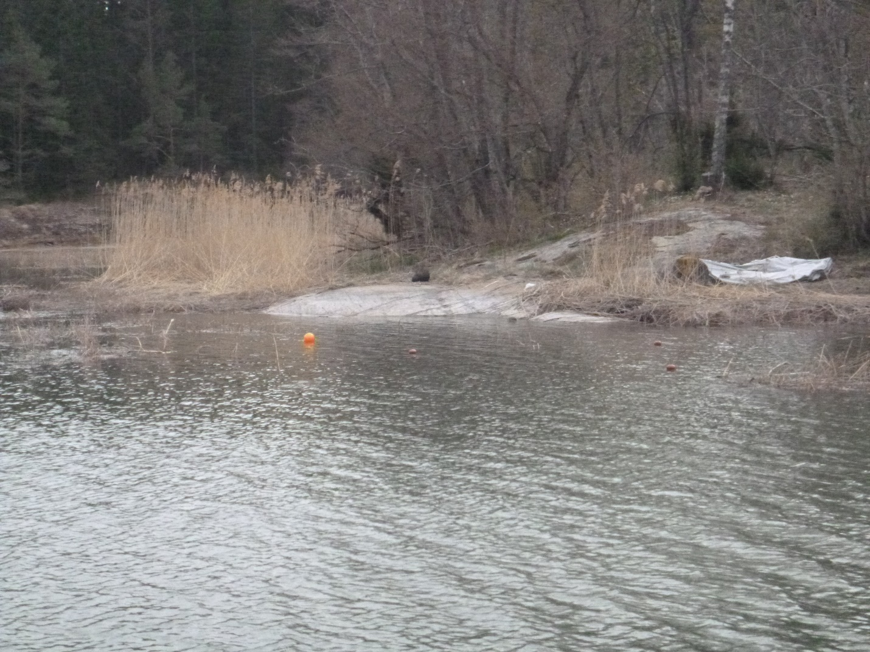
Create maps of each site with all sampling locations, save as image files

