Slide 1
Factors Analyzed for their Contributions to Heart Disease
Capstone 1 Report
V. Moore
6/11/18

Slide 2
Predicting heart disease risk
The problem: heart disease is one of the greatest causes of death, though most influential factors are not necessarily clear.
Understanding these factors could be useful to the patient care community, patients themselves, insurers, policy-makers, and drug researchers.
Data used for analyses presented here come from the University of California, Irvine, Machine Learning Repository and included partially processed data from Cleveland, OH, Long Beach, CA, and Hungary.
The goal of this project is to develop an accurate model for heart disease risk that can be interpreted globally and individually.

Slide 3
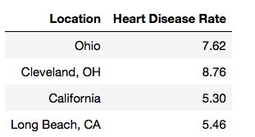
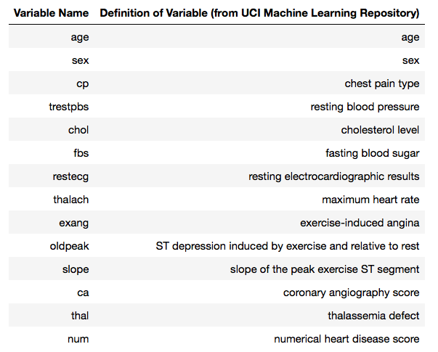
Heart disease rates by location
Variable names and definitions
Heart disease rates (above) in some locations relevant to this study indicate prevalence of heart disease is somewhat higher in Cleveland, OH, than in its surrounding state and also higher than in Long Beach, CA, which shows heart disease at a rate similar to its surrounding state.
Variables examined in this study are shown in the table to the right with their definitions. The target variable is “num”, or “numerical heart disease score”.

Slide 4
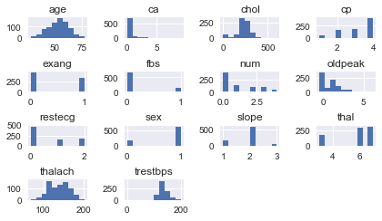
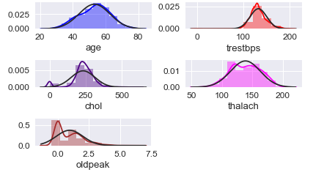
Quick look at the data
To glimpse the distributions (versus normal distributions in black) of continuous variables.
For quick glances at the form of the data for each feature.

Slide 5
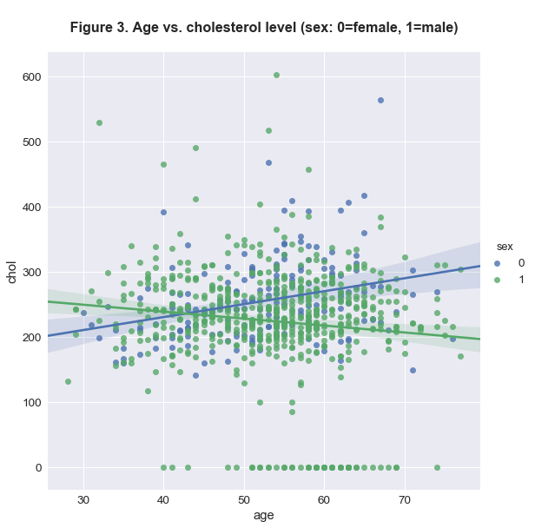
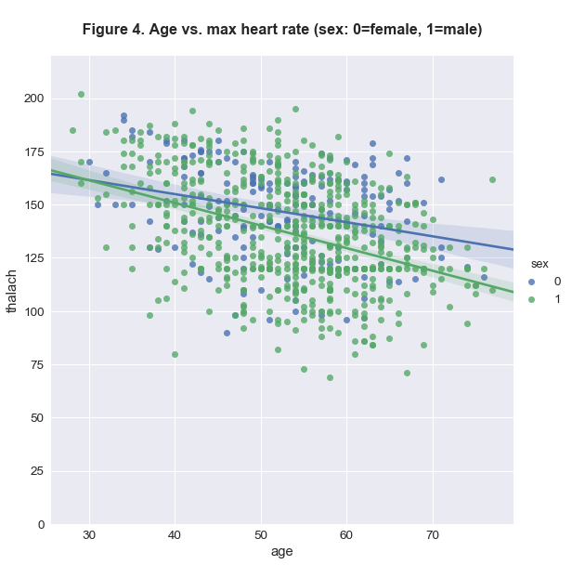
Some relationships between variables
Age versus cholesterol level
Age versus maximum heart rate

Slide 6
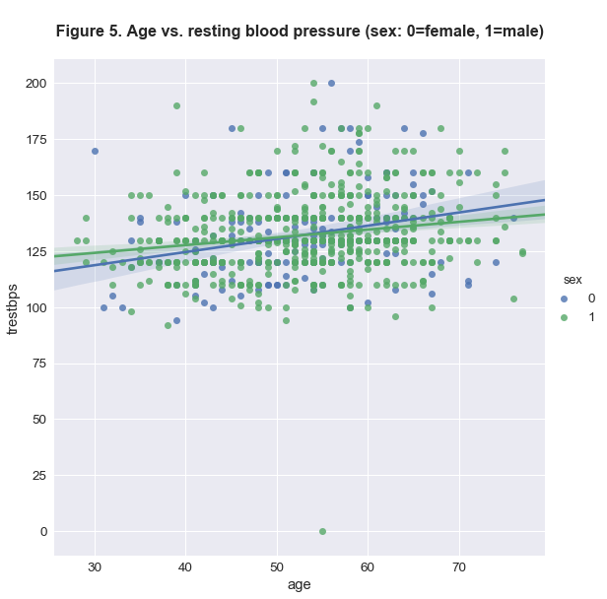
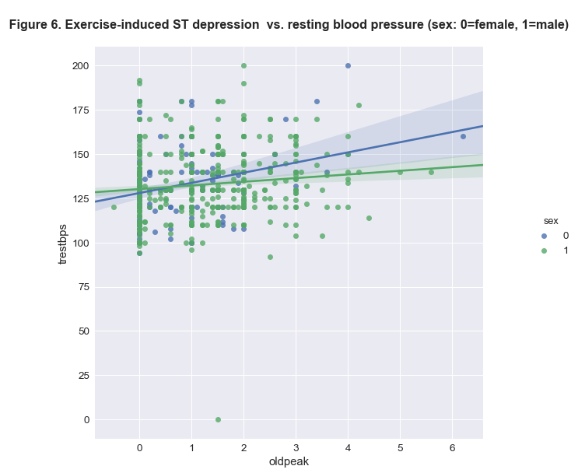
Some relationships between variables
Age versus resting blood pressure
Exercise-induced ST depression versus resting blood pressure

Slide 7
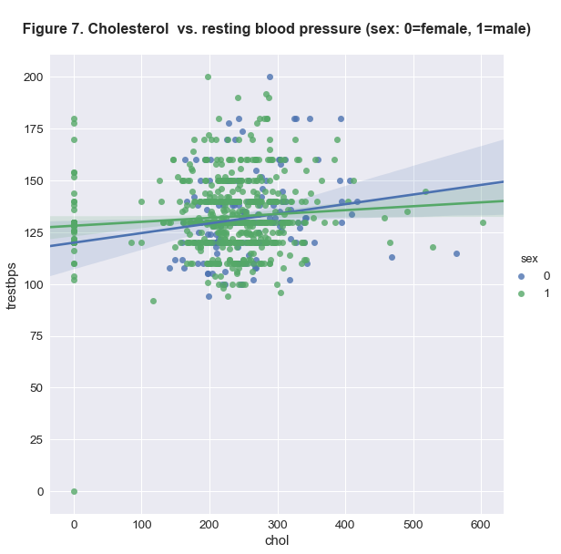
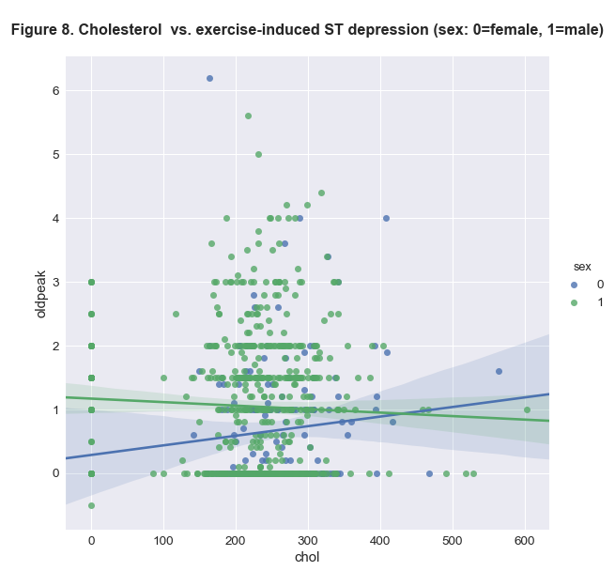
Some relationships between variables
Cholesterol level versus resting blood pressure
Cholesterol level versus exercise-induced ST depression

Slide 8
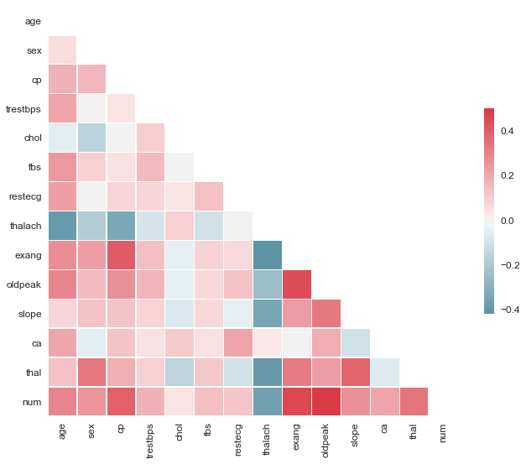
Correlations between features
Derived from Pearson’s correlation coefficients, these may be most accurate for continuous variables or categorical variables that are linearly arranged, but for all variables this heatmap can provided a quick guide to possible correlations.

Slide 9
Machine learning model development
Which supervised classification model works best, and with regard to the following points?
Predictive success with the multiclass target variable (severity of heart disease) versus binary target variable (presence vs. absence of heart disease)
Full dataset with more imputed data points versus the Cleveland subset with relatively fewer imputed data points
Both global and individual feature importance

Slide 10
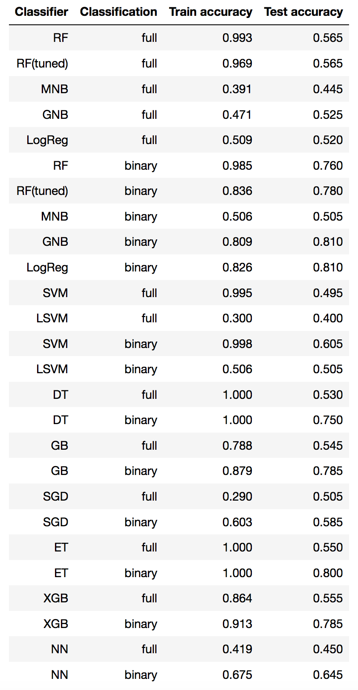
Initial model comparison
Training and test accuracy for multiclass (full) and binary target variable predictions
Tests with the multiclass target used SMOTE-treated data due to imbalanced nature of data in the target classes.
Tests include:
Random forest (RF)
Multinomial naïve bayes (MNB)
Gaussian naïve bayes (GNB)
Logistic regression (LogReg)
Support vector machine (SVM)
Linear SVM (LSVM)
Decision tree (DT)
SGD Classifier (SGD)
Extra trees classifier (ET)
XGBoost (XGB)
Neural network (NN; MLP)
Here, random forest is also compared after tuning with GridSearchCV
Tested on the full dataset

Slide 11
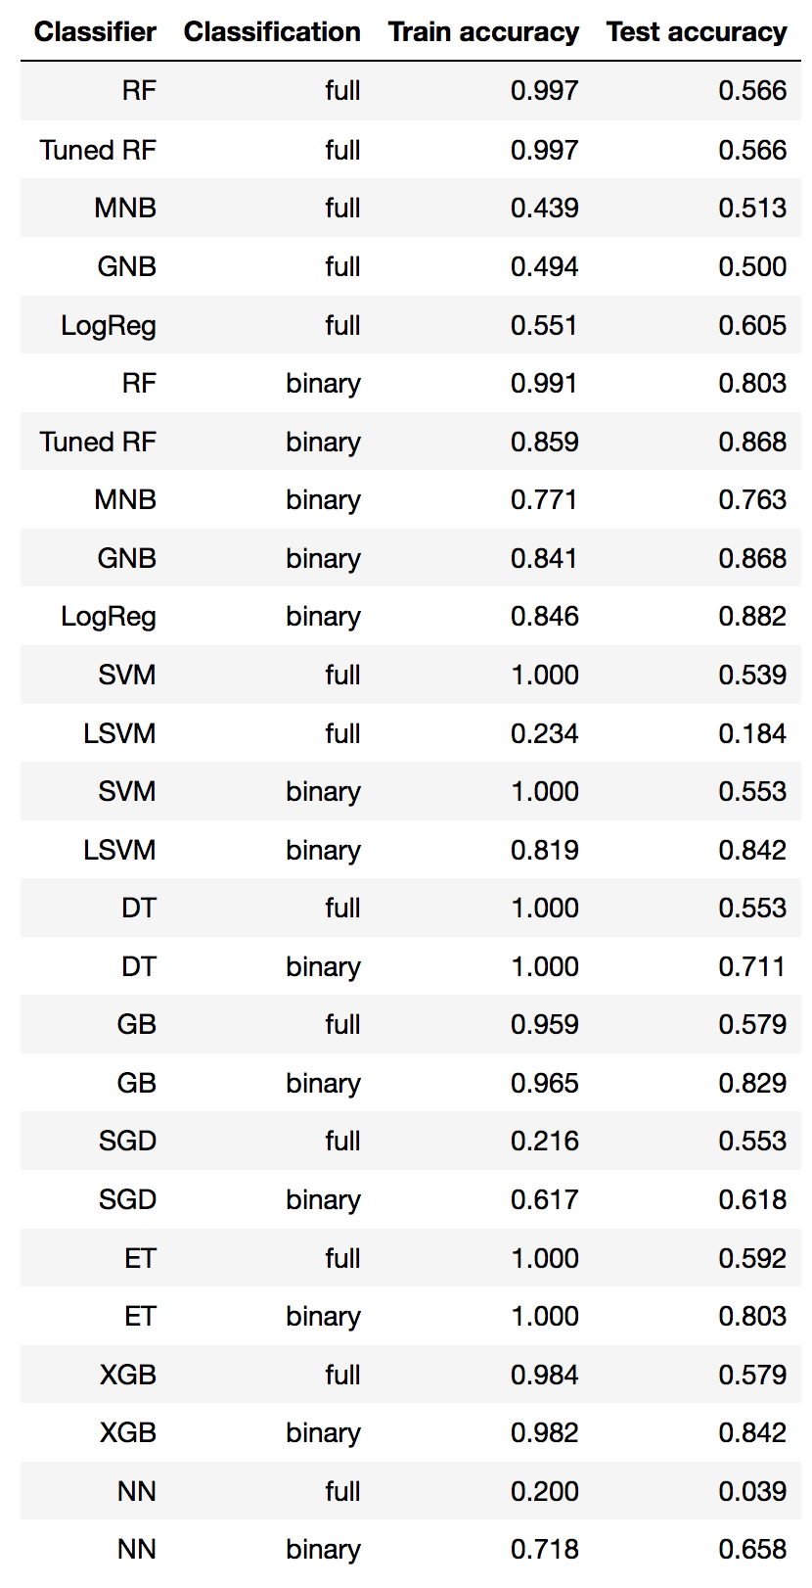
Initial model comparison
Training and test accuracy for multiclass (full) and binary target variable predictions
A binary target variable is much easier for all models to predict with these datasets.
The Cleveland subset imparts a slightly higher test accuracy than does the full dataset, which contains more imputed data, but in the real world this may often occur.
Many models show fairly similar results, while some clearly do not perform well with these datasets.
Tested on the Cleveland subset

Slide 12
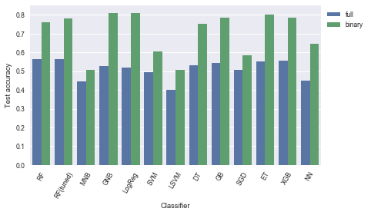
Model comparison for the full dataset
SMOTE-treated multiclass target analyses may have shown greater accuracy than without SMOTE treatment, though for binary target analyses this was not the case, as the binary target arrangement of data was considerably more balanced. Most classifiers still performed better with a binary target, however, though results were similar for some ensemble methods.

Slide 13
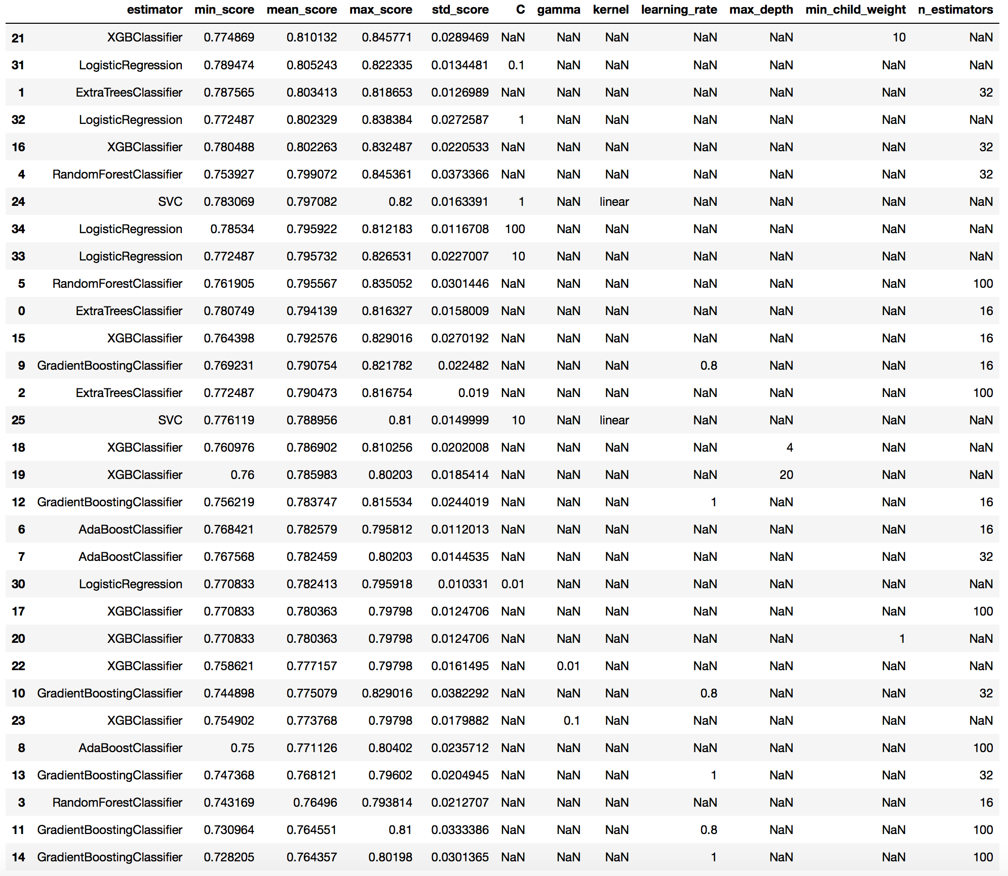
Promising models with tuning of some key hyperparameters, with a binary target
Logistic regression, XGBoost, extra trees, and random forest classifiers usually outperform others in this analysis of the full dataset (training data), in many cases regardless of exact tuning.

Slide 14
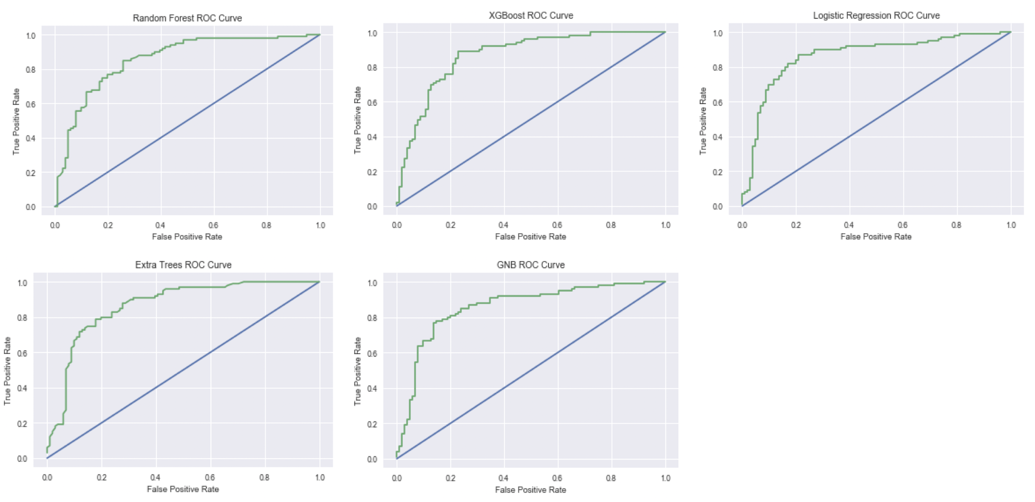
ROC curves
Each of the most successful model types bears a fairly similar ROC curve, with slight differences.

Slide 15
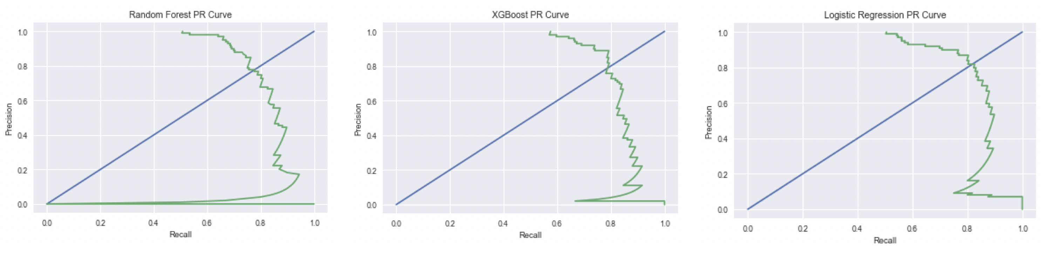
Precision-recall curves
Likewise, successful successful model bear a fairly similar precision-recall curve, with logistic regression perhaps showing the best precision versus recall relationship.

Slide 16
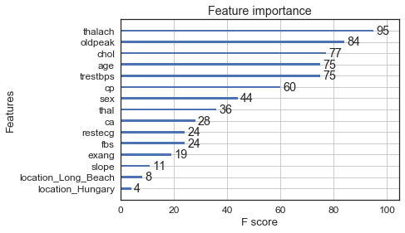
XGBoost feature importance (binary target)
Using XGBoost on the full dataset and with the binary target variable, cholesterol is shown to be the most important feature in this comparison. Maximum heart rate and age follow, with other features showing decreasing importance.
Removal of less important features, however, does not necessarily improve the model’s accuracy and in fact can reduce accuracy, indicating that each of these features contributes some information that may be useful.

Slide 17
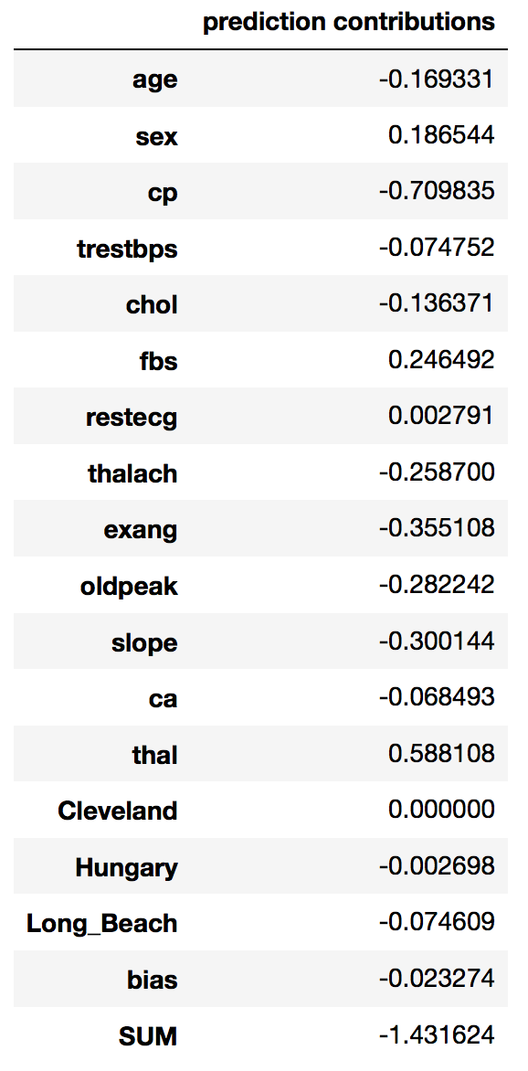
Individual predictive features
It is helpful to know overall trends in impactful features, but it is potentially quite useful for an individual or care provider to know which features contribute what risk to a patient.
XGBoost contains its own SHAP-based method of scoring the contributions of each feature for an individual prediction score.
The SHAP python package also does this and provides visualization tools.
An individual’s feature contributions to the overall predictive score (SUM), here negative for heart disease, derived from this analysis with a binary target using XGBoost’s “pred_contribs” function.

Slide 18
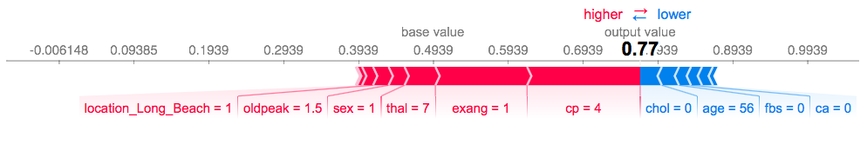
Individual predictive features
Using the SHAP python package, it is possible to examine predictions for each individual and with a quick glance at the features that contribute to the predictive score. In the case shown above, the individual has a low probability of having heart disease, with the features and values highlighted in blue indicating which of the individual’s characteristics are contributing most to reducing risk and features and values highlighted in magenta indicating which are contributing most to the individual’s very modest, possible risk.
According to the model used here, the individual whose data are shown here is at low risk of a positive heart disease diagnosis due, in part, to his low degree of chest pain, lack of exercise-induced angina, and low coronary angiography score. Potentially actionable features this individual may need to pay attention to are his cardiac metric ST depression with exercise relative to rest and high fasting blood sugar.

Slide 19
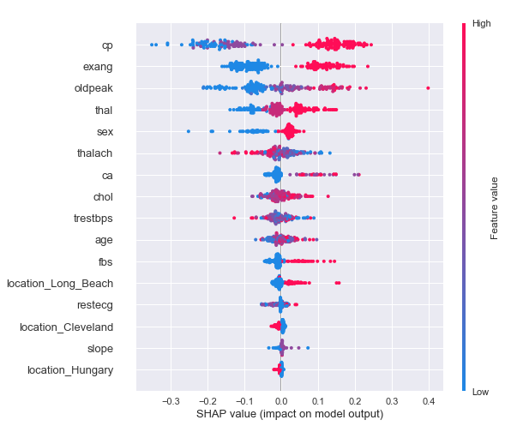
SHAP summary plot
The summary plot to the right is similar to the feature importance plot from before, except that this plot also provides a density component akin to a violin plot, showing where individuals fall along SHAP values for each feature. Also, points in blue represent those lowering the predictive value, with those in magenta imparting greater probability of heart disease for the individual.
Some features appear ranked differently than in the previous feature importance plot. This may relate to different methods of handling extremes in data, but with a SHAP summary plot it is possible to ascertain this information.

Slide 20
Conclusions
A binary target was much more likely to result in accurate predictions from the full dataset used in this report than a multiclass target was, and imputed data imparted slightly less accuracy than a relatively more complete subset of data (i.e., Cleveland data) could. This is unsurprising.
Ensemble-based methods and logistic regression provided the greatest accuracy, and all performed fairly similarly.
SHAP values provide a powerful way to examine both global and individual feature importance, providing a window into how each individual’s prediction score is derived, by which features contribute in what ways, potentially providing actionable information.
Analysis of SHAP values applied to the heart disease dataset allows us to realize certain details, such as that higher chest pain and exercise-induced angina values are associated with a heart disease diagnosis in this particular model. While this is unsurprising, the model allows us to predict more specifically how these values influence patient risk.
SHAP values also allow us to observe where a model may fall short, providing insight into areas of possible model improvement, such as feature selection.

Slide 21
References
Batista, D.S. “Hyperparameter optimization across multiple models in scikit-learn.” Web. Accessed: 6/11/18. http://www.davidsbatista.net/blog/2018/02/23/model_optimization/ .
Centers for Disease Control and Prevention. National Environmental Public HealthTracking Network. Web. Accessed: 3/1/18. www.cdc.gov/ephtracking.
Katsaroumpas, P. “Hyperparameter Grid Search across multiple models in scikit-learn.” Web. Accessed: 6/11/18. http://www.codiply.com/blog/hyperparameter-grid-search-across-multiple-models-in-scikit-learn/ .
Lundberg, S.M., & Lee, S.I. 2017. A unified approach to interpreting model predictions. 31st Conference on Neural Information Processing Systems (NIPS 2017), Long Beach, CA, USA. Pages 1-10.
Lundberg, S.M., Erion, G.G., & Lee, S.I. 2018. Consistent individualized feature attribution for tree ensembles. eprint arXiv:1802.03888. Pages 1-9.
University of California, Irvine Machine Learning Repository. Heart Disease Data Set. Web. Accessed: 3/11/18. archive.ics.uci.edu/ml/datasets/Heart+Disease. Principal investigator information for component datasets used in this study: Hungarian Institute of Cardiology. Budapest: Andras Janosi, M.D.; V.A. Medical Center, Long Beach and Cleveland Clinic Foundation: Robert Detrano, M.D., Ph.D.

