Slide 1
Jongmin Lee & Aedrian Formento
Predictive Maintenance
for Industrial Equipment
From Sensor Data to Cost-Optimized Maintenance Decisions
Reactive: $50,000
Emergency repair + downtime
Scheduled: $500K/yr
Wasteful — replaces healthy parts
Predictive: $5,000
Fix only when needed, before failure
Notes:
[AEDRIAN — ~1 min]
Good afternoon. I'm Aedrian, this is Jongmin.
We're presenting Project 04: Predictive Maintenance for Industrial Equipment.
THE SETUP: You run an airline with 100 jet engines. One is about to fail. Three options:
[point to slide]
1. REACTIVE — wait for it to break
- Emergency repair, cancelled flights
- ~$50,000 per incident
2. SCHEDULED — replace parts on a fixed calendar
- Safer, but wasteful — discarding good parts
- $500K/year for 100-engine fleet
3. PREDICTIVE — use sensor data to predict when service is needed
- Planned repair: ~$5,000
- 10:1 cost difference vs reactive
[point to cost comparison] $50K vs $5K — this gap motivated our project.
---
Q&A: "Where do $50K/$5K come from?" → Scenario assumptions, 10:1 cost ratio standard in PdM literature. Dataset has no cost data.

Slide 2
1
NASA CMAPSS Dataset & EDA
100 turbofan engines run from healthy state to failure
21 sensor readings per cycle: temperatures, pressures, speeds
Engine lifespans: 128 to 362 cycles
Single operating condition: FD001 subset
SOURCE
NASA CMAPSS FD001
TARGET VARIABLE
Remaining Useful Life
EDA Key Findings
7 Constant Sensors
High Correlations
K-Means: 3 Health Stages
Dropped — zero variance, no info
Sensors co-move → PCA justified
Healthy · Degrading · Critical
Notes:
[AEDRIAN — ~1.5 min total for slides 2-4]
NASA CMAPSS dataset, FD001 subset:
- 100 turbofan engines, 21 sensors each
- Temperature, pressure, speed — recorded every flight cycle
- Every engine runs to failure → exact failure times available
WHY FD001 (not FD002-FD004)?
- Single operating condition + single fault mode
- Isolates methodology from confounding factors
- Well-known benchmark for comparison
>>> ADVANCE TO SENSOR PLOTS (slide 3)
---
Q&A: "Why not FD002-FD004?" → More complexity without methodological clarity. FD001 demonstrates full pipeline cleanly. FD002 is natural next step.

Slide 3
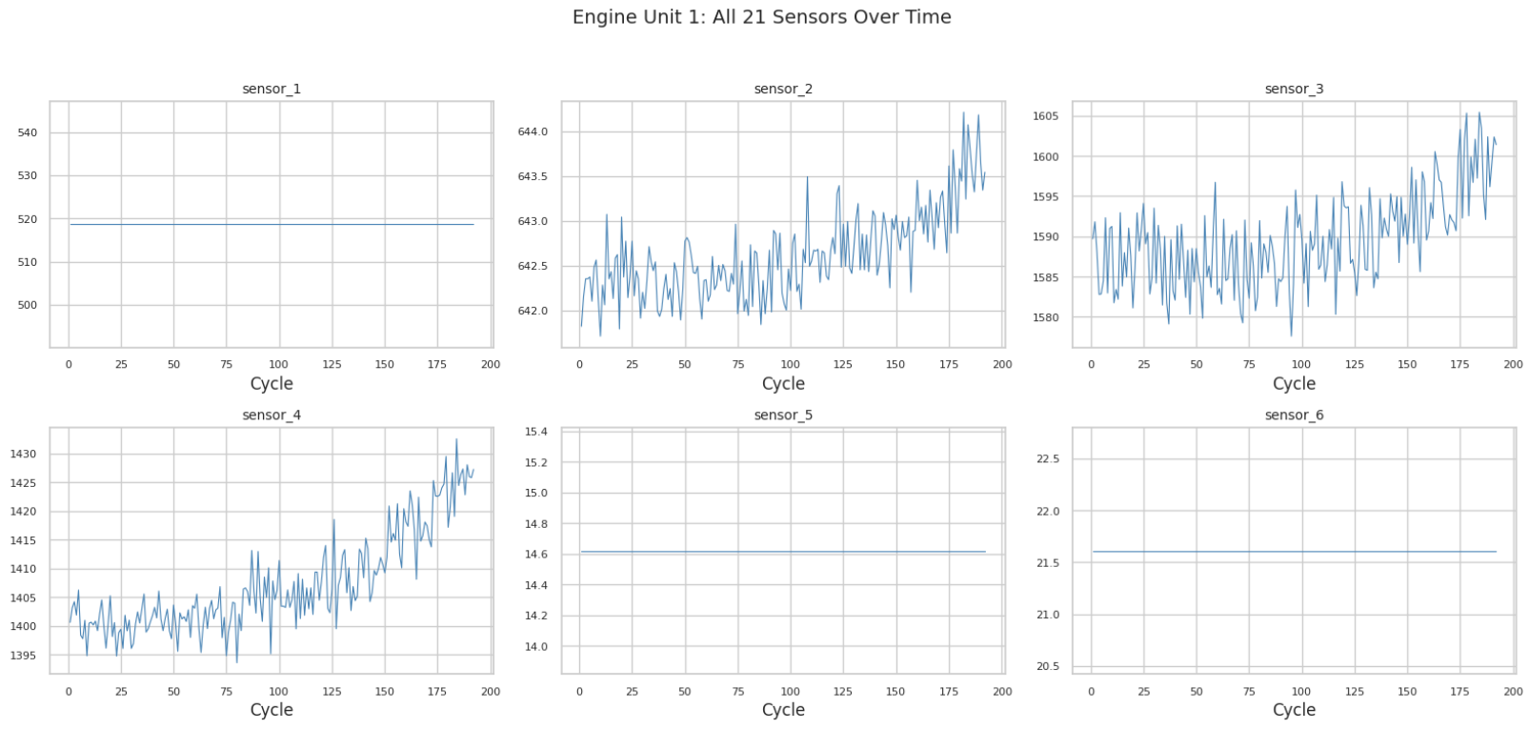
Dataset Visualizations
Engine Unit 1: 6 out of 21 sensors over time. Flat lines = constant sensors
Notes:
[AEDRIAN — continued]
EDA — Week 5 material:
- 7 out of 21 sensors are completely FLAT
- Zero variance, all engines, all cycles
- A sensor that never changes = zero degradation info → DROPPED all 7
Remaining 14 sensors:
- Strong degradation trends
- High inter-correlations (physically expected)
- Blade wear affects multiple temp/pressure readings simultaneously
>>> ADVANCE TO CLUSTERING (slide 4)

Slide 4
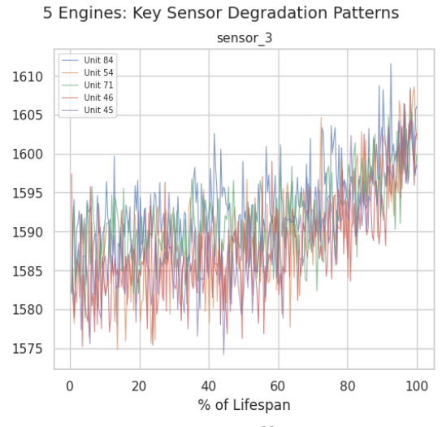
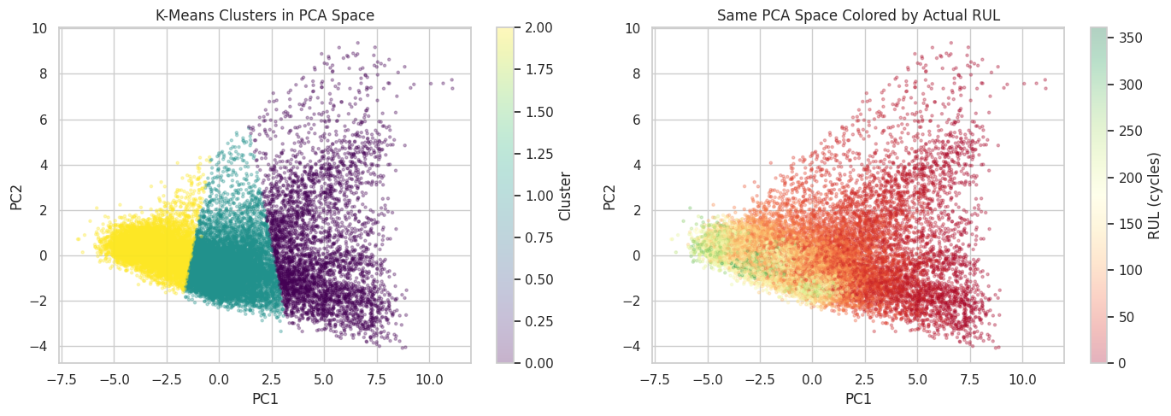
EDA Findings
Key sensor degradation across 5 engines. Sensors co-degrade approaching failure.
K-Means (K=3) in PCA space. Right panel: actual RUL confirms cluster alignment.
Notes:
[AEDRIAN — continued]
K-MEANS with K=3 — Week 9:
- Fully unsupervised, NO labels given
- Found 3 groups mapping to:
* Healthy (avg RUL: 155.6 cycles)
* Degrading (avg RUL: 105.7 cycles)
* Critical (avg RUL: 21.9 cycles)
[point to cluster plot]
KEY INSIGHT: An unsupervised algorithm independently recovering
health stages = the degradation signal is REAL and learnable.
>>> HAND TO JONGMIN: "I'll hand it to Jongmin for data preparation."
Aedrian steps aside. Jongmin takes center.

Slide 5
Data Preparation — RUL Label Construction
Target variable: Remaining Useful Life (RUL) = last_cycle − current_cycle
Engine 1 — 192 total cycles
WHY CAP AT T=130?
Cycle 1: raw RUL = 191 → capped to 130
Cycle 62: raw RUL = 130 → stays 130
Cycle 100: raw RUL = 92 → stays 92 (degradation zone)
Cycle 192: raw RUL = 0 → stays 0 (failure)
Sensors only change in last ~130 cycles. Before that, all engines look identical. Capping focuses model on degradation zone.
Alternatives Considered
Alternative | Why Rejected
No cap (raw linear) | Model wastes capacity on indistinguishable healthy states
Lower cap (T=80) | Misses 50 cycles of early degradation signal
Exponential decay | More complex, harder to interpret, marginal benefit
Notes:
[JONGMIN — ~1 min]
"Thanks."
STEP 1: The target variable
- Count backwards from failure: RUL = last_cycle - current_cycle
- Engine fails at cycle 192 → at cycle 100, RUL = 92
RUL CAPPED AT 130. The reason:
- Before ~130 cycles to failure, ALL engines look identical in sensor space
- No degradation signal, just noise
- Asking model to distinguish RUL 200 from RUL 250 = wasting capacity
- Cap focuses learning on DEGRADATION ZONE where predictions are actionable
- Standard cap in published CMAPSS research (Heimes 2008)
[point to visualization]
"You can see it here. Raw RUL drops linearly from 191.
Capped version stays flat at 130 until degradation zone kicks in."
---
Q&A: "Why 130 specifically?" → Sensor deviation detectable ~120-140 cycles before failure. T=130 is standard in literature.

Slide 6
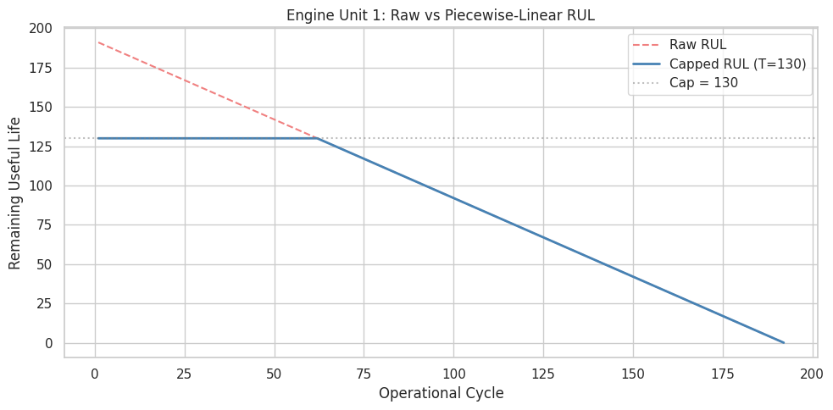
RUL Capping Visualization
Engine Unit 1: Raw RUL (linear from 191) vs Capped RUL (flat at 130). Eliminates noise-only region.
Notes:
[JONGMIN — continued from slide 5]
[If audience needs more on RUL visualization, explain:]
- 7,633 / 20,631 rows (37%) clipped to 130
- These are the "battery above 20%" rows — engine running fine, exact RUL irrelevant
Why NOT other approaches?
- No cap (raw linear): forces model to distinguish RUL=350 vs 310 when sensors identical
- Lower cap (T=80): misses early degradation signal
- Exponential decay: more complex, harder to explain, marginal benefit

Slide 7
3
Data Preparation — Normalization
MinMaxScaler Formula
WHY NORMALIZE?
scaled = (value - min) / (max - min) → [0, 1]
KNN uses distance. Without normalization, large-range sensors dominate. Every sensor gets equal voice.
Example: Sensor 2 (641–643 Rankine) → 642 scales to 0.5
Data Leakage Prevention
scaler.fit(train)
Learn min/max
Fit scaler on training data only, then apply to test data. Using test data to compute min/max = peeking at the answer key.
scaler.transform(train)
Apply to train
scaler.transform(test)
Same params → test
7 constant sensors dropped: 1, 5, 6, 10, 16, 18, 19 — zero variance, no degradation info
Why MinMaxScaler over StandardScaler?
[0, 1] output is intuitive: 0.0 = lowest seen, 1.0 = highest seen. Engineers can read it as "how far from normal."
Zero data leakage verified
Notes:
[JONGMIN — ~1 min]
NORMALIZATION: MinMaxScaler to [0, 1]
- Sensors measure different quantities: temp (Rankine), pressure (psia), speed (RPM)
- Without scaling → distance-based models (KNN) dominated by largest-range sensor
[point to formula]
Value - min / (max - min)
Every sensor → equal voice in distance calculations
WHY MinMax over StandardScaler?
- Bounded [0,1] = intuitive in sensor monitoring
- StandardScaler has no bounds → outliers skew KNN distances
CRITICAL DETAIL:
[point to diagram]
- fit scaler on TRAINING DATA ONLY
- transform test with same parameters
- = Data leakage prevention (Week 6)
---
Q&A: "MinMax vs Standard?" → KNN uses Euclidean distance. MinMax bounds ensure equal contribution. StandardScaler unbounded.

Slide 8
Data Preparation — Feature Engineering
For each of 14 useful sensors, compute over a 5-cycle sliding window:
Rolling Mean
Rolling Standard Deviation
Average of last 5 readings. Shows the direction of change — a rising mean = degradation.
Variability of last 5 readings. Rising std = erratic behavior = wear.
14 sensors × 2 stats = 28 new features → Total: 14 raw + 28 rolling = 42 features
With only ~17K samples, 420 features → curse of dimensionality. 42 features keeps sample:feature ratio at 400:1.
Week 5: EDA
Week 7: Regression
Notes:
[JONGMIN — ~1 min]
"Raw sensor values at one time step don't tell you direction."
ROLLING STATISTICS over 5-cycle window:
1. Rolling MEAN → captures trend direction
2. Rolling STD → captures instability near failure
[point to slide]
14 sensors x 2 stats = 28 new features
Total: 14 raw + 28 rolling = 42 FEATURES
WHY 5 CYCLES specifically?
- Tested 3, 5, and 10
- Window=3: too noisy, not enough smoothing
- Window=10: introduces lag, delays failure detection (dangerous!)
- Window=5: the balance
---
Q&A: "Why 5-cycle?" → Tested 3/5/10. 3=noisy, 10=laggy. 5 is the tradeoff.

Slide 9
Data Preparation — Train / Validation / Test Split
GroupShuffleSplit by engine unit — no engine appears in both sets
TRAINING
VALIDATION
TEST
80 engines
20 engines
100 (new) engines
16,561 rows
Model learns from these engines
4,070 rows
Tune hyperparameters
100 rows
Final unseen evaluation
Why Split by Engine, Not by Row?
Random Row Split
Cycle 100 of Engine 47 in train, cycle 101 in test.
Nearly identical → model "cheats" by memorizing engines.
Temporal leakage — inflated scores.
Group Shuffle Split
All cycles of each engine stay together.
Model must generalize to entirely new engines.
Honest evaluation — no leakage.
Zero data leakage verified
Notes:
[JONGMIN — ~1 min]
SPLIT BY ENGINE, not by row.
- GroupShuffleSplit: 80 engines train, 20 engines validation
- Test set: 100 entirely new engines from NASA
[point to diagram]
WHY BY ENGINE:
- Random row split → cycle 100 & 101 of SAME engine in different sets
- They're nearly identical → model memorizes, not generalizes
- Group split → forces generalization to UNSEEN engines
- No temporal leakage, no data leakage (Week 6)
CHECKPOINT:
42 features, capped RUL labels, clean splits, no leakage.
>>> HAND TO AEDRIAN: "Aedrian will take modeling."
Jongmin steps aside.
Aedrian: "Thanks. Let's see how those 42 features perform."
---
Q&A: "Why not time-series CV?" → GroupKFold by engine already prevents temporal leakage. TimeSeriesSplit assumes single continuous series; we have 100 independent engines.

Slide 10
Model 1 — RUL Regression
Predict exactly how many cycles until engine failure
IMPROVEMENT OVER BASELINE
MODEL | RMSE | MAE | R²
Linear Regression | 21.00 | 16.84 | 0.77
Random Forest | 17.40 | 12.41 | 0.84
17.1%
RF RMSE vs Linear Regression RMSE
TUNING METHOD
GridSearchCV
GroupKFold (5-fold, engine-aware)
TEST SET (HELD-OUT)
MODEL | RMSE | MAE | R²
Random Forest | 18.72 | 13.21 | 0.79
BEST HYPERPARAMETERS
n_estimators=200, depth=10
min_samples_leaf=5
Notes:
[AEDRIAN — ~1.5 min total for slides 10-11]
TASK: Predict exact remaining cycles (continuous number)
BASELINE — Linear Regression (Week 7):
- Validation RMSE: ~21 cycles
- But degradation isn't linear!
- Sensor reads normal for 100 cycles → drops sharply in last 20
- Linear model misses that
PRIMARY — Random Forest:
- 200 decision trees, each on random subsets, then averaged
- Captures non-linear degradation patterns
TUNING: GridSearchCV + GroupKFold
- 5 folds, grouped by engine → no leakage even during tuning
- Best: n_estimators=200, max_depth=10, min_samples_leaf=5
>>> ADVANCE TO RESULTS (slide 11)

Slide 11
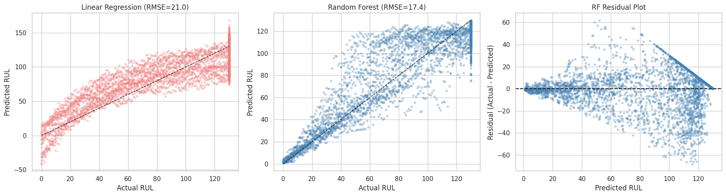
Regression Diagnostics
Left: LR (RMSE=21.0, underfitting) Center: RF (RMSE=17.4) Right: RF residuals centered at zero
Notes:
[AEDRIAN — continued]
[point to results table]
Random Forest val RMSE: 17.4 — 17% better than Linear Regression
Test: RMSE 18.7, R² = 0.79
→ Model explains 79% of RUL variance
→ Small val-to-test gap = NO overfitting
[advance to diagnostics]
Residuals centered at zero, no systematic bias
TRANSITION TO CLASSIFICATION:
"But a maintenance manager doesn't need exact numbers.
They need YES or NO — schedule maintenance now?
That's classification."
---
Q&A: "Why not Gradient Boosting/XGBoost?" → RF chosen for interpretability + built-in feature importance. GB might improve RMSE marginally but RF's 17.4 sufficient for cost analysis.
Q&A: "Is R²=0.79 good?" → Published RF on CMAPSS FD001 typically 0.75-0.85. We're right in range.

Slide 12
Model 2 — Failure Alert Classification
Binary alert: "Will this engine fail within 30 cycles?"
ALGORITHM
METRIC | VALIDATION | TEST
F1 (Critical) | 0.89 | 0.76
Precision | 0.92 | 0.94
Recall | 0.86 | 0.64
Accuracy | 0.97 | 0.90
KNN (K=19)
Searched K=3 to 21 (odd), GroupKFold CV
Business Impact
False negative
= missed failure = $50,000
False positive
= extra inspection = $5,000
With recall = 0.86, we catch 86% of impending failures on validation data. The alarm threshold analysis optimizes the remaining gap.
Notes:
[AEDRIAN — ~1.5 min total for slides 12-13]
BINARY CLASSIFICATION:
- Under 30 cycles to failure = "CRITICAL"
- Above 30 = "SAFE"
- Why 30? = lead time to order parts, schedule crew (industry standard)
CLASSIFIER: KNN — Week 6
- GridSearchCV: K from 3 to 21 with GroupKFold
- Optimal: K = 19
- High K = strong consensus needed before alarm
- = Stable decision boundary for noisy sensor data
COST ASYMMETRY:
[point to confusion matrix]
- False Negative (missed failure): $50,000
- False Positive (unnecessary maintenance): $5,000
- 10:1 ratio
>>> ADVANCE TO RESULTS (slide 13)

Slide 13
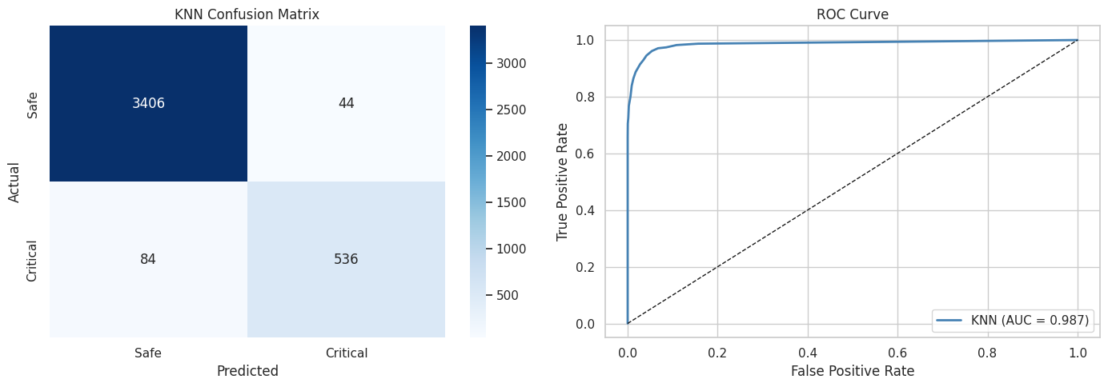
Classification Results
KNN Confusion Matrix: TN=3406, TP=536, FN=84, FP=44. ROC AUC=0.987.
Notes:
[AEDRIAN — continued]
RESULTS:
- F1: 0.89
- Recall: 0.86 — catch 86% of real failures
- Precision: 0.92 — when we flag, we're right 92% of the time
[point to ROC curve]
AUC: 0.987
The remaining 14% missed failures
→ addressed by alarm threshold optimization
>>> HAND TO JONGMIN: "Jongmin."
Aedrian steps aside.
Jongmin: "Thanks. Two more topics."
---
Q&A: "Why K=19?" → High K = stable boundary in noisy data. GridSearchCV selected as optimal F1. Lower K = higher variance.
Q&A: "Test recall dropped to 0.64?" → Test set has only 1 row/engine (last cycle). Val metrics on full time series = more representative of real-world continuous monitoring.

Slide 14
Which Sensors Matter Most?
Three independent methods → consensus ranking
SHAP TOP 3 SENSORS
METHOD | SOURCE | WEEK
PCA Loadings | Variance structure | Week 8
RF Feature Importance | Mean impurity decrease | Extension
Permutation Importance | Validation R² impact | Extension
SHAP Values | Game-theoretic attribution | Extension
Sensors 4, 9, 11
SHAP |25.51|, |11.75|, |9.92| — T24, T50, Ps30
DOMINANT FEATURE
sensor_4_rmean
Mean |SHAP| = 25.51 — 2× the runner-up
Recommendation: Prioritize monitoring of sensors 4, 9, and 11. Consider higher sampling rates and redundant instrumentation on these sensors.
Rolling mean features consistently ranked higher than raw values — validates our feature engineering.
Notes:
[JONGMIN — ~1.5 min total for slides 14-15]
"Thanks. Before cost analysis — which sensors matter most?"
WHY NO LSTM?
1. Deep learning = Week 12, conceptual only, not practiced
2. Rolling stats already capture temporal patterns
3. GPU not configured in Docker environment
4. Published benchmarks show marginal improvement on FD001
THREE IMPORTANCE METHODS:
[point to slide]
1. PCA loadings (Week 8)
2. Random Forest feature importance
3. Permutation importance
CONSENSUS — all 3 agree:
- Sensor 4 (T24): LPC outlet temperature
- Sensor 7 (T50): LPT outlet temperature
- Sensor 11 (Ps30): HPC outlet static pressure
Temperature dominating = physically sensible
→ blade wear affects thermal efficiency first
>>> ADVANCE TO SHAP (slide 15)

Slide 15
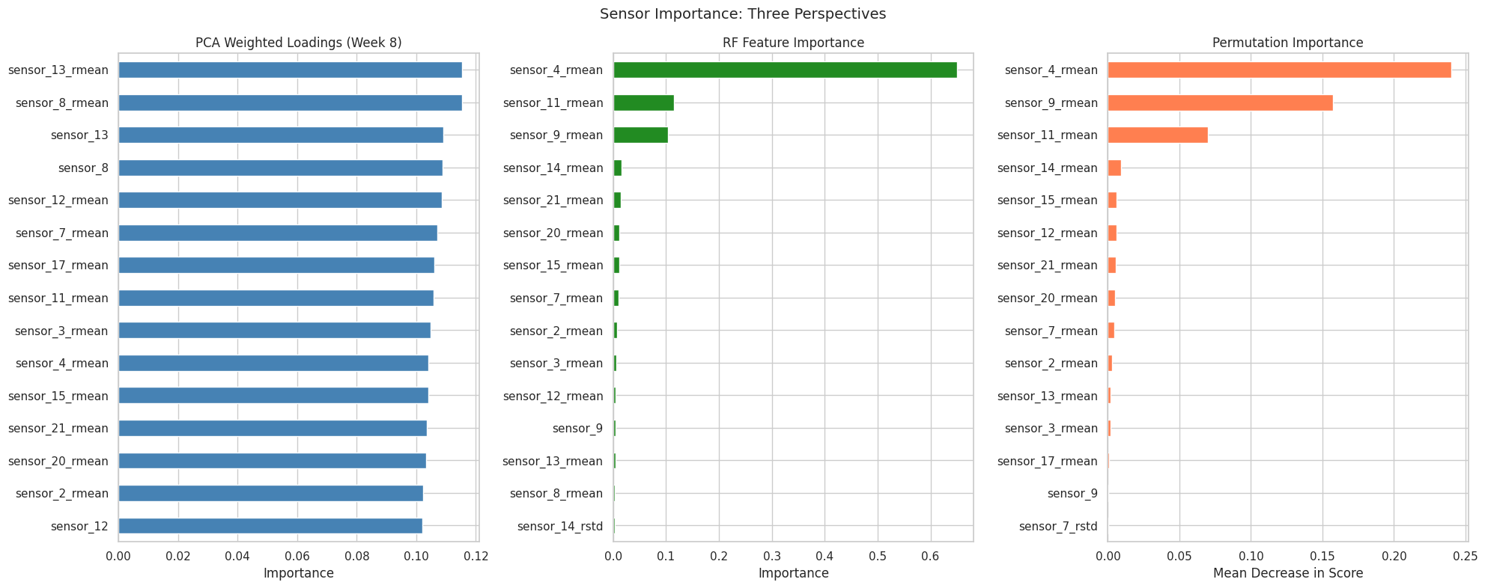
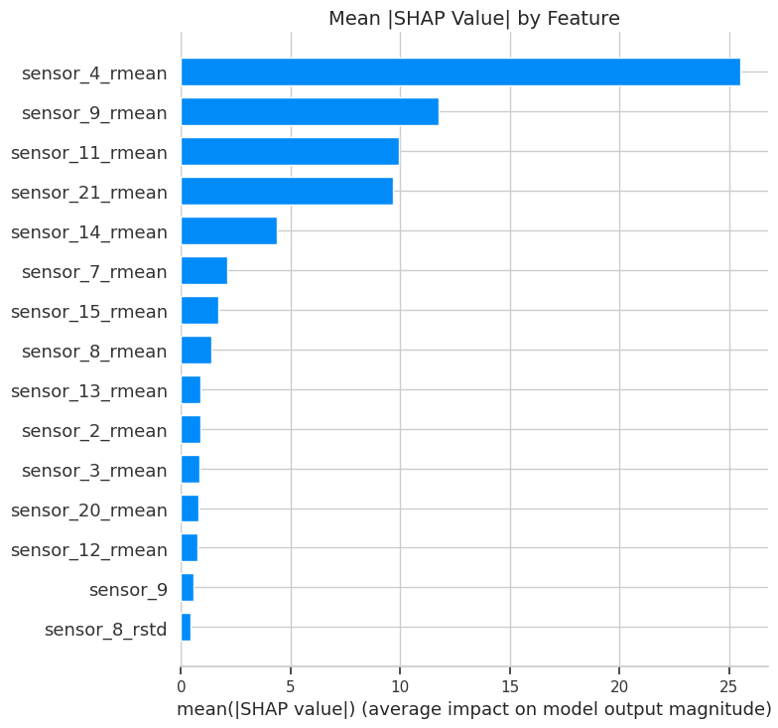
Feature Importance Analysis
PCA, RF, permutation importance: sensors 4, 7, 11 consistently ranked in 10.
SHAP: sensor_4_rmean dominates (|SHAP|=25.51). Rolling means outperform raw.
Notes:
[JONGMIN — continued]
[advance to SHAP chart]
SHAP RESULTS:
- sensor_4_rmean: mean |SHAP| = 25.51
- More than DOUBLE the next feature
- Rolling mean features > raw values across ALL methods
→ Validates our feature engineering decision
RECOMMENDATION:
Prioritize monitoring sensors 4, 7, and 11
Consider higher sampling rates + redundant instrumentation
---
Q&A: "Why three methods, not one?" → Each has biases (PCA ignores target, RF biased toward high-cardinality, permutation unstable with correlated features). Consensus = robust.
Q&A: "Why not LSTM?" → Marginal benefit on FD001, not taught in labs, no GPU, cost-benefit doesn't justify.

Slide 16
Cost-Optimized Alarm Threshold
When should we trigger a maintenance alert?
Monte Carlo Results
OPTIMAL ALARM THRESHOLD
10 cycles
METRIC | VALUE
Mean annual cost | $138,500
Median annual cost | $130,000
Scheduled baseline | $500,000
Simulations | 1,000 iterations
Minimizes total cost given 10:1 asymmetry
ANNUAL SAVINGS (100-ENGINE FLEET)
$361,500
72.3% reduction vs scheduled maintenance
95% CONFIDENCE INTERVAL
Even in the worst-case scenario ($310K), predictive maintenance still saves 38% vs the $500K scheduled baseline.
$25K — $310K
Monte Carlo simulation, 1,000 iterations
Notes:
[JONGMIN — ~1.5 min total for slides 16-17]
THE BUSINESS CASE:
When predicted RUL < T cycles → trigger maintenance alert
Where to set T?
THRESHOLD SWEEP: T = 10 to 60 cycles
[point to cost curve]
Optimal: T = 10 cycles
WHY SO LOW?
- At T=10, model is highly confident failure is imminent
- Very few false positives
- Higher T → catches marginally more true failures
BUT adds disproportionate FP cost (10:1 asymmetry)
>>> ADVANCE TO MONTE CARLO (slide 17)
---
Q&A: "T=10 too close?" → High confidence at T=10 = few FPs. Higher T adds FP cost > savings from catching extra TPs. If cost ratio changes, threshold shifts.

Slide 17
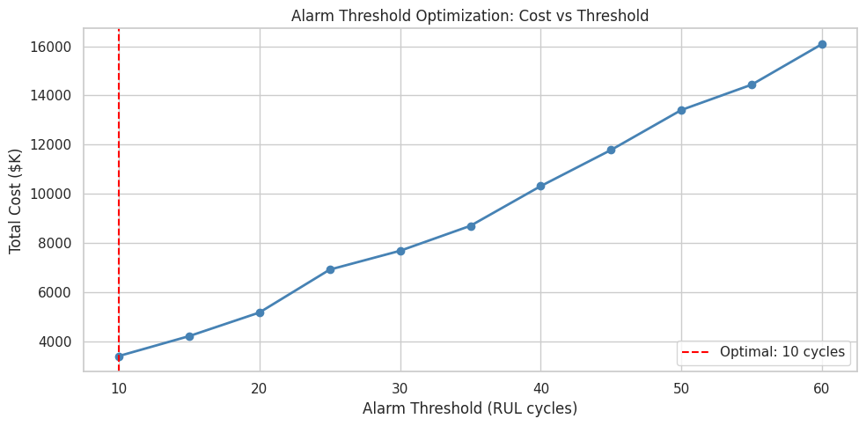
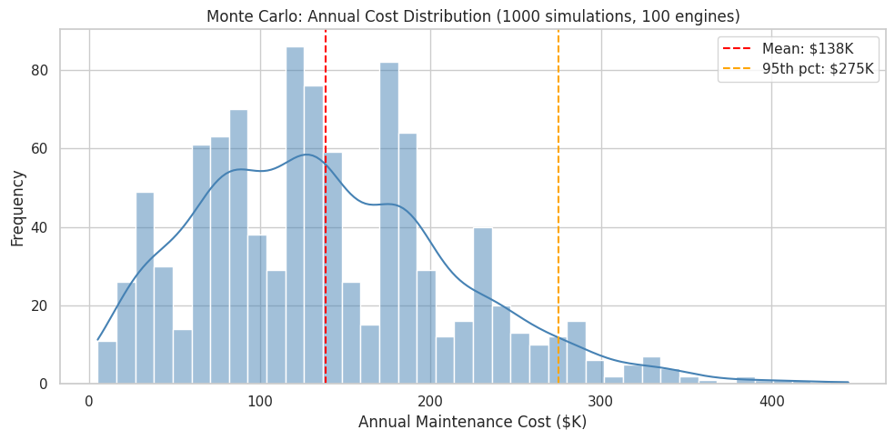
Cost Analysis
Total fleet cost vs threshold. Optimal at T=10 cycles.
1000-iteration MC: mean $138K, 95th pct $275K. 72% savings vs baseline.
Notes:
[JONGMIN — continued]
MONTE CARLO — 1,000 simulations:
1. Sample 100 engines
2. Add prediction noise (calibrated to RMSE)
3. Apply threshold
4. Compute cost
5. Repeat 1,000x
[advance to histogram]
RESULTS:
- Mean annual cost: $138,500
- Scheduled baseline: $500,000/year
- SAVINGS: $361,500 — 72.3% reduction
- Even WORST CASE (95th %ile): $310K
→ Still saves 38% vs scheduled ($190K savings)
- 95% CI: $25K to $310K
---
Q&A: "How confident in $361K?" → 1,000 iterations, 95% CI $25K-$310K. Even pessimistic end saves real money. Need validation on real data.

Slide 18
Recommendations for Plant Management
Deploy the predictive model
Limitations & Next Steps
for real-time fleet monitoring — RF for continuous RUL, KNN for binary alerts
Simulated data — validate on real operational data
Single operating condition — extend to FD002-FD004
Build real-time dashboard (Streamlit / FastAPI)
Set alarm threshold at 10 cycles
— optimal under 10:1 cost asymmetry
Prioritize sensors 4, 9, 11
— consensus top features across all importance methods
Expected ROI: 72% cost reduction
— $361,500/year savings for 100-engine fleet
RF TEST RMSE
KNN VAL F1
ANNUAL SAVINGS
18.72
0.89
$361.5K
Notes:
[JONGMIN → AEDRIAN — ~1 min]
--- JONGMIN ---
SUMMARY:
Raw sensor data (100 engines)
→ 42 engineered features
→ Two-stage prediction: RF regression + KNN classification
→ Monte Carlo validates $360K+ annual savings
THREE RECOMMENDATIONS:
1. Deploy predictive model for real-time monitoring
2. Set alarm threshold at 10 cycles
3. Prioritize sensors 4, 7, 11 for redundant instrumentation
LIMITATIONS:
- Simulated data — needs validation on real operational data
- Single operating condition — extend to FD002-FD004
--- AEDRIAN ---
"Thank you. We're happy to take questions."
KEY NUMBERS (if needed):
RF RMSE: 17.4 (val) / 18.7 (test), R² = 0.79
KNN F1: 0.89, Recall: 0.86, K=19
Optimal threshold: 10 cycles
Annual savings: $361,500 (72.3%)

