Slide 1
Using mini-microscope to investigate contextual fear memory
in a mouse model of Alzheimer’s Disease
Chen Yan
Josselyn Lab
Hospital for Sick Children
Toronto, Ontario, Canada
May 28, 2017
Notes:
Thank Ed

Slide 2
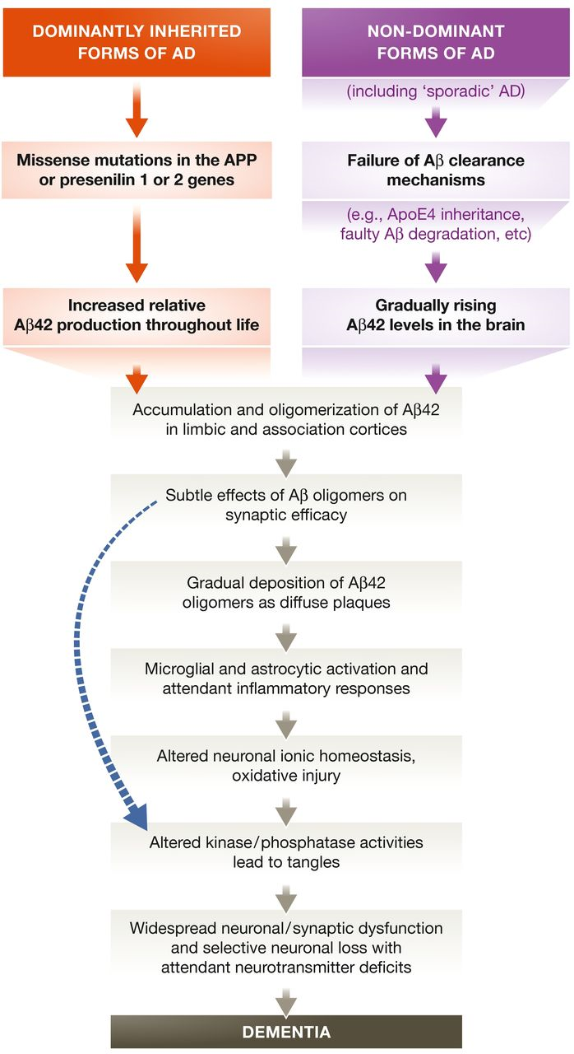
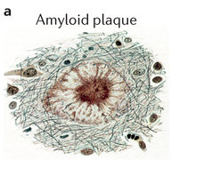
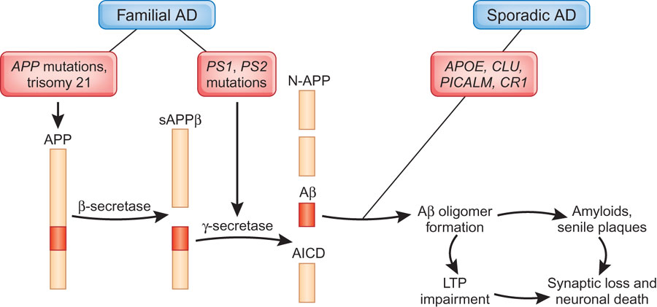
Amyloid hypothesis
Figures from Selkoe & Hardy, EMBO Molecular Medicine, 2015
Notes:
The amyloid beta hypothesis of AD posits that AD results from abnormal accumulation of Aβ (derived from the proteolytic processing of amyloid precursor protein, APP) Although challenged, this hypothesis remains influential.
In particular because autosomal dominant mutations in APP cause familial AD (fAD). Most recent iteration of hypothesis suggest that in the early stages of AD, high Ab disrupts synaptic mechanisms necessary for memory. We wanted to examine this.

Slide 3
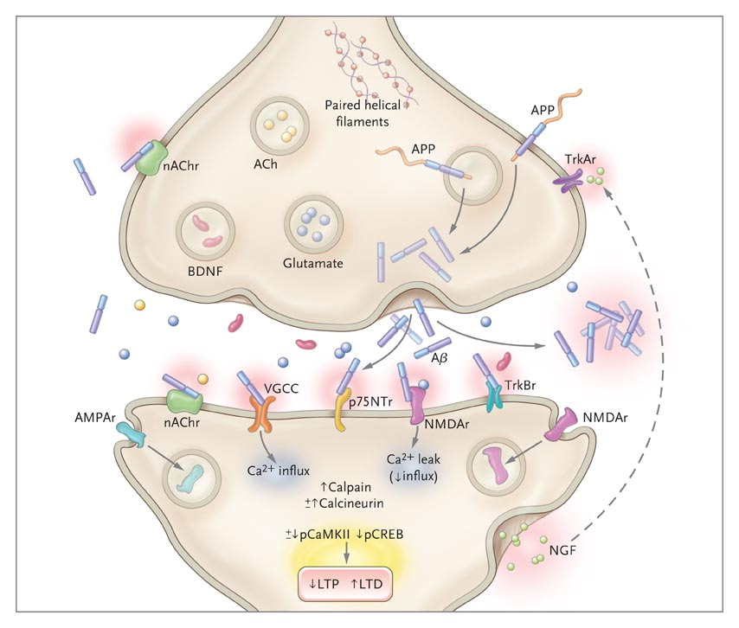
Alzheimer’s Disease as synaptic failure
Figure from Querfurth et al., NEJM, 2010
Notes:
Abeta causes endocytosis of AMPAR and NMDAR
As a result, -LTP and -LTD

Slide 4
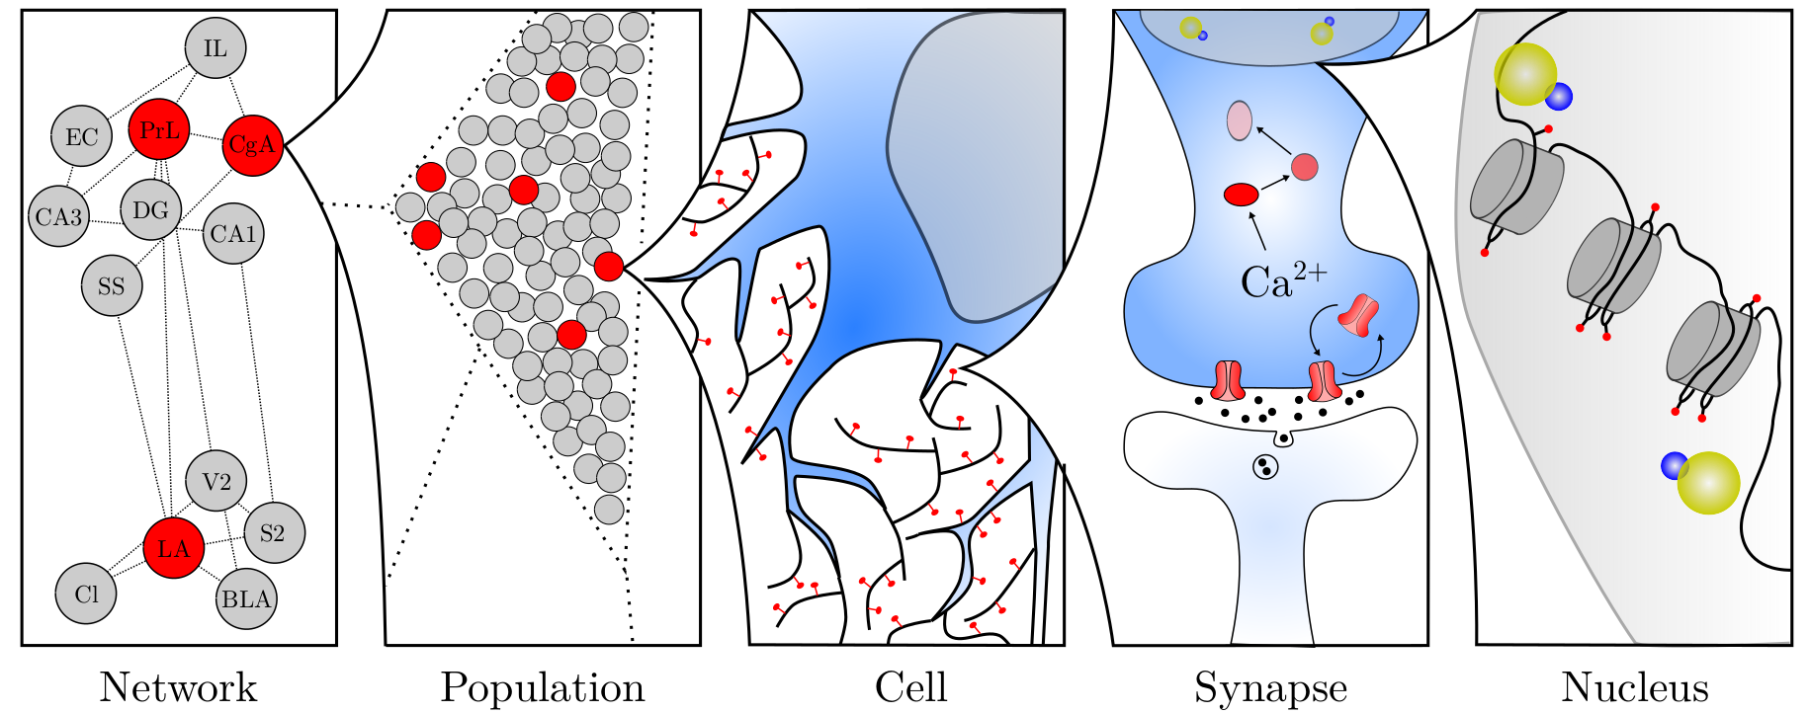
Alzheimer’s Disease
Network
Population
Cell
Synapse
Gene
Figure from Santoro (2015)
Notes:
AD affect brain at different levels
It is still unknown that what’s the deficit of AD on a population level is less well studied

Slide 5
Objectives
Investigate AD deficit at neural population level
Examine whether restoring synaptic function helps learning and memory in AD

Slide 6
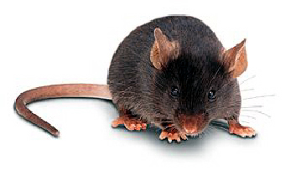
TgCRND8 mice
Control (RFP/GFP alone)
APP^{Sw+Ind}
APP^{MV} (inactive control)
Chishti et al., JBC, 2001

Slide 7
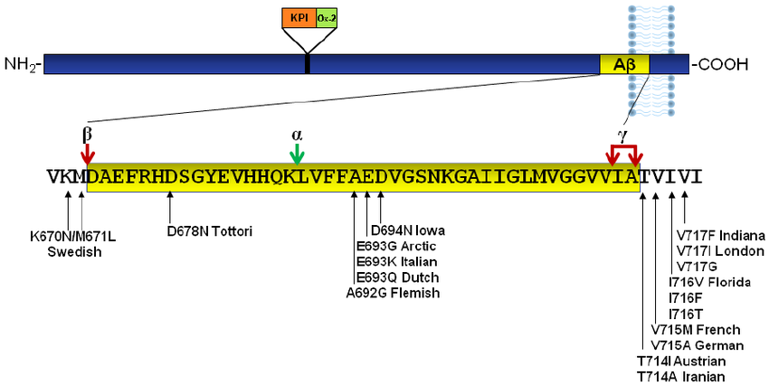
TgCRND8 mice
Control (RFP/GFP alone)
APP^{Sw+Ind}
APP^{MV} (inactive control)
expresses hAPP^{Swe + Ind} (familial AD)
High Aβ and plaques in age-dependent manner
Memory deficits beginning ~10 weeks of age
Chishti et al., JBC, 2001

Slide 8
Blocking AMPAR endocytosis
TAT-GluA2_{3Y}
Figure from Querfurth et al., NEJM, 2010
Notes:
To restore synaptic funciton, we used the well characterized TAT-GluA23Y by Yutian Wang group, blocks AMPAR endocytosis, LTD enhances synaptic function in slices and WT mice

Slide 9
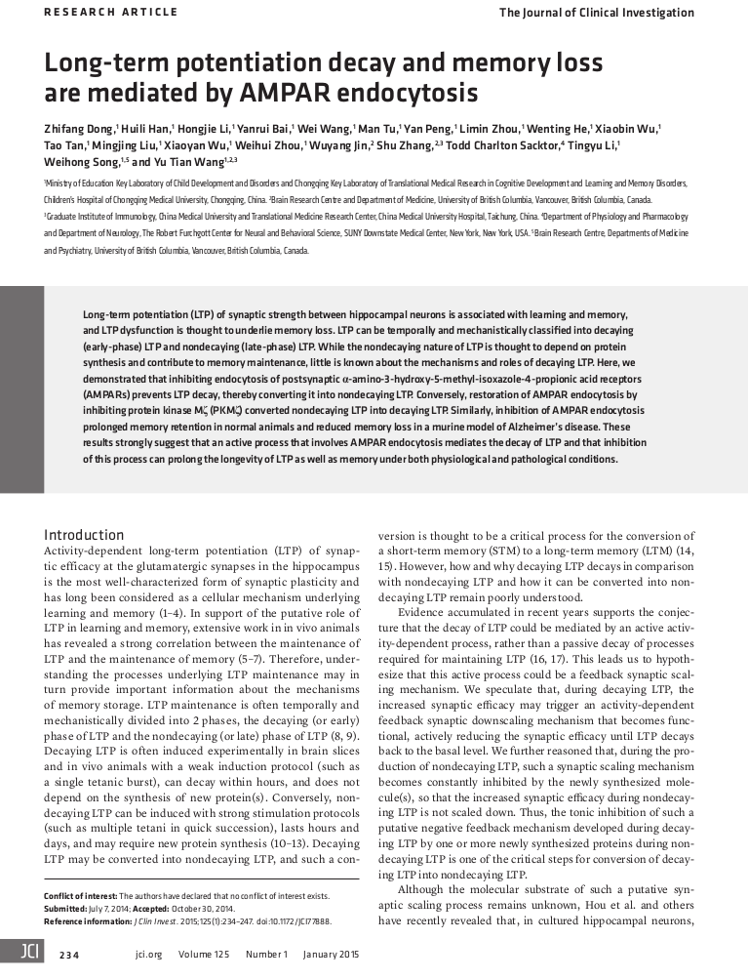
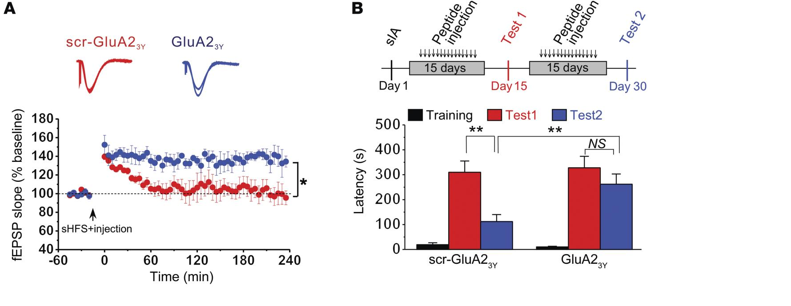
Blocking AMPAR endocytosis
Dong et al., JCI, 2015
Notes:
In another mouse model of AD, chronic TAT peptide enhances LTP and inhibitory avoidance memory

Slide 10
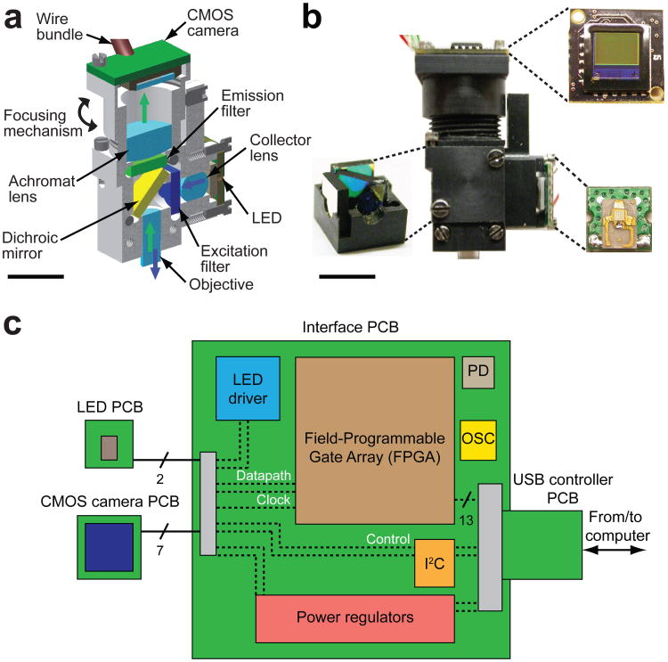
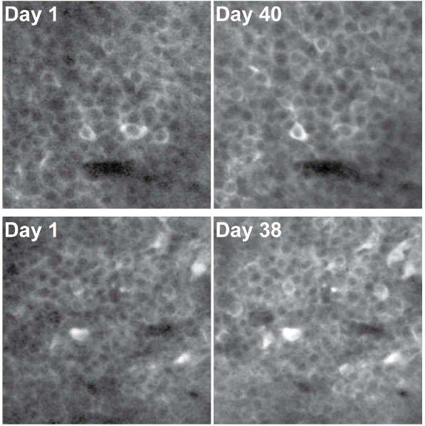
Miniature microscope
Ghosh et al., Nat Meth, 2011, Ziv et al., Nat Neurosci, 2013
Notes:
First developed in Mark Schnitzer’s lab
Able to monitor gCaMP signal from hundreds of neurons in CA1
Clock <6min

Slide 11
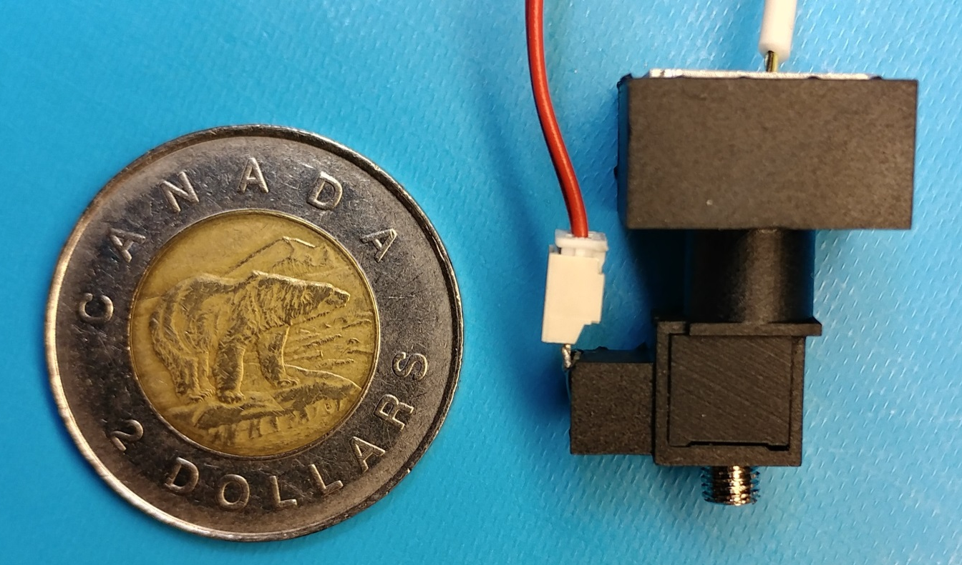
Mini-microscope
Notes:
Size: coin
Weight: 3g
Cost: $300-$1000 depends on camera (Canadian dollars)

Slide 12
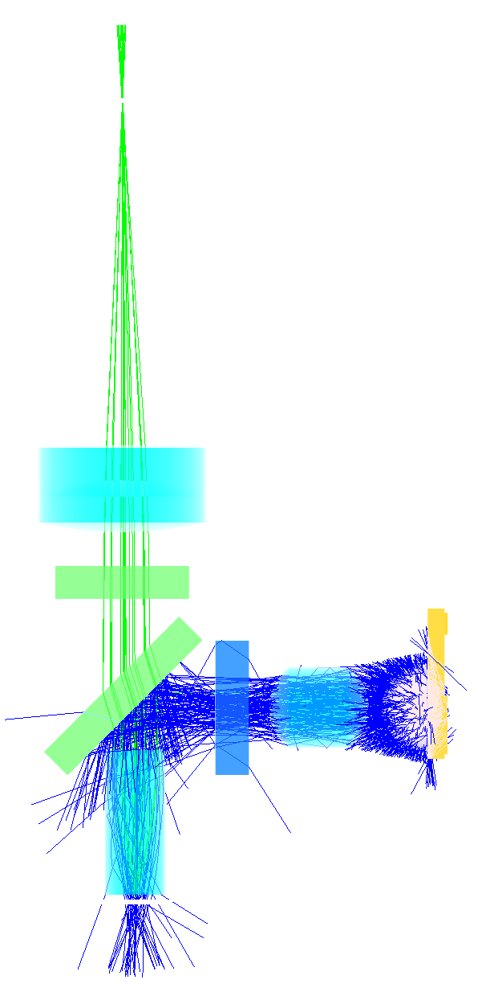
Mini-microscope
Notes:
Simple mechanism:
blue excitation from LED
Used a GRIN lens as objective
Fluorescence collected onto CMOS camera
Design and schematic will be available
Took a student and a couple hours to assemble (2 student-hour)

Slide 13
Calcium imaging in TgCRND8 mice
Notes:
Sample gCaMP dF video
Mini-microscope does not affect mice’s behaviour
This kind of data is hard to acquire using e-phys or two-photon

Slide 14
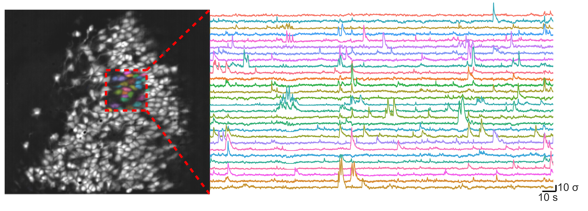
Calcium imaging in TgCRND8 mice
Notes:
More than 300 neurons recorded

Slide 15
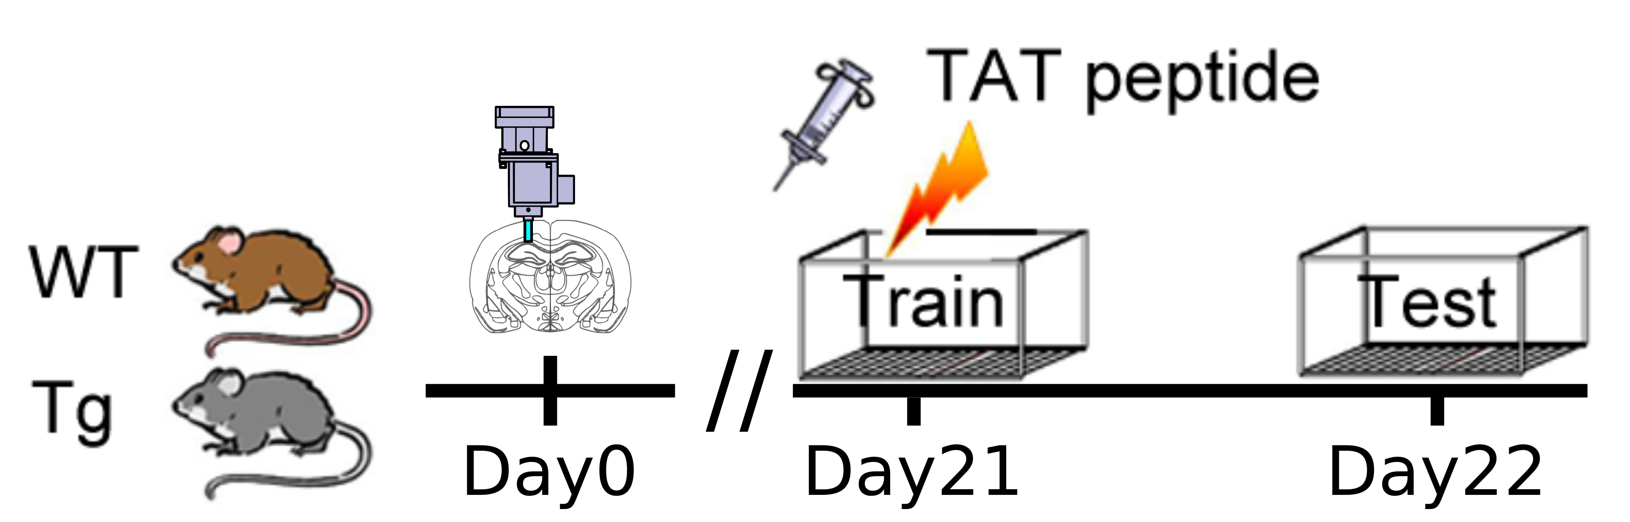
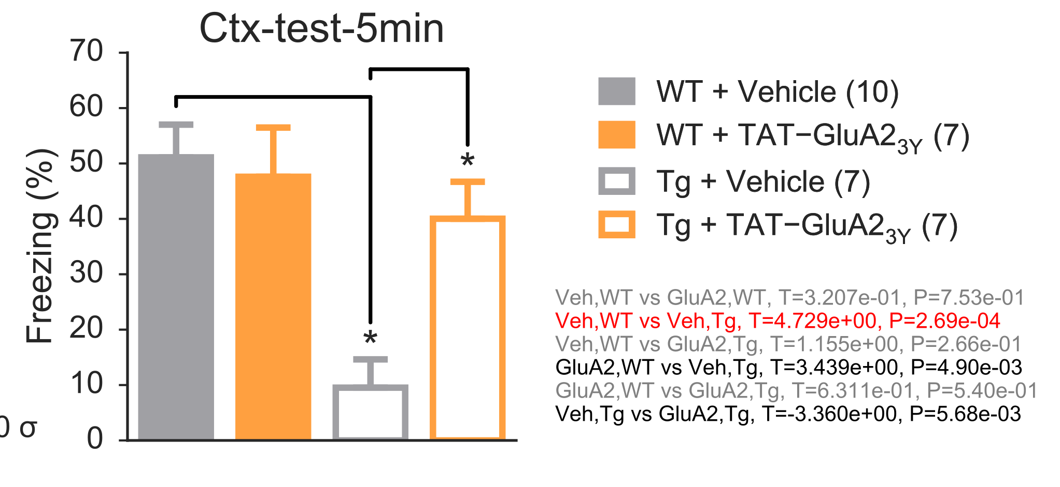
Behaviour
Tg mice have deficit in contextual fear conditioning
Rescued by TAT-GluA2_{3Y}
Notes:
1. Express gCaMP in both WT and TG mice, implant mini-microscope above CA1
2. Use contextual fear conditioning to examine memory, single shock
3. Infuse TAT-GluA23Y or saline before training
4. Record calcium transients during training and testing
Memory deficit in Tg mice, rescued by TAT-GluA23Y

Slide 16
Alzheimer’s Disease
Network
Population
Cell
Synapse
Gene
Figure from Santoro (2015)
Notes:
Calcium imaging data. First, single cell level

Slide 17
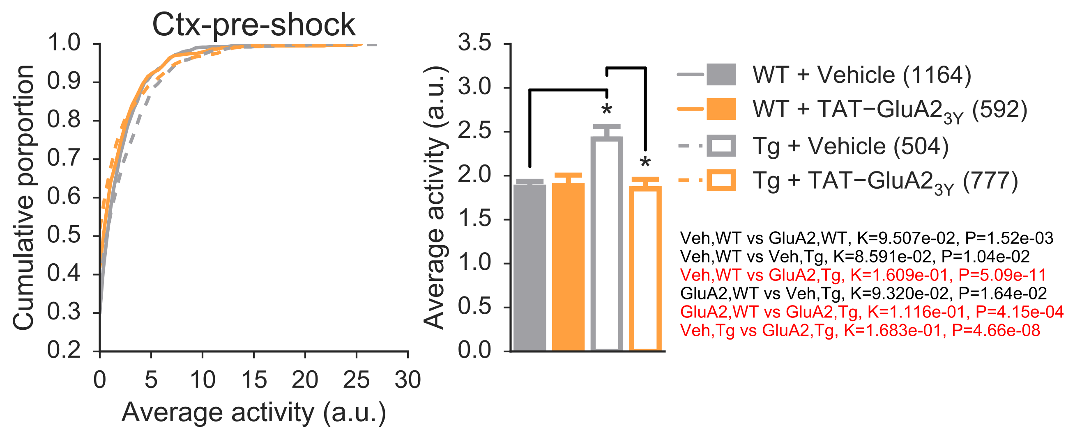
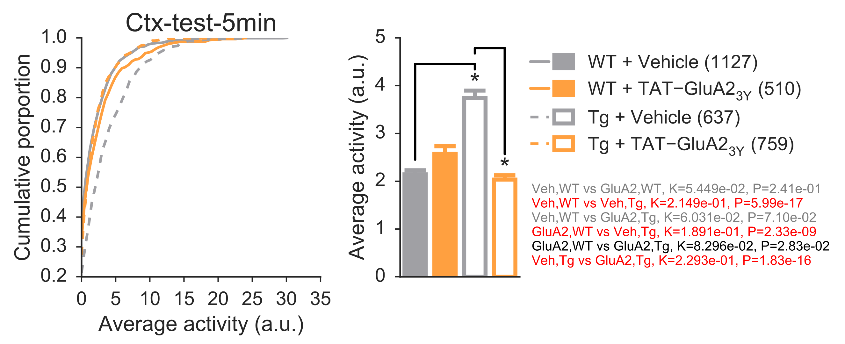
Activity
Training
(before shock)
Memory Test
CA1 Cells in Tg mice are hyperactive
Consistent with in vivo electrophysiology and IEG studies
Notes:
Overall cell activity
Transition to mutual information: how well the cell encode behaviour?

Slide 18
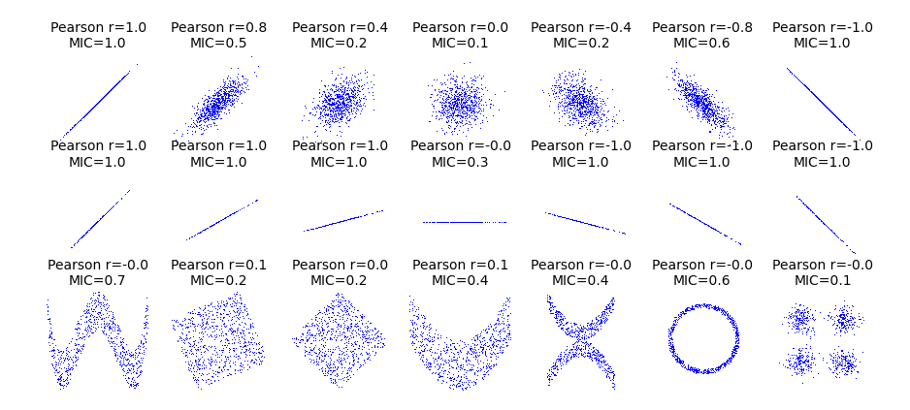
Mutual Information
Captures both linear and non-linear relationships
Notes:
correlation on steroids, but also captures non-linear relationship
For example the bottom row, x, y has a non-linear relatioship, but correlation is zero. Mutual information content better captures this.
Half way!! Make sure clock at <12min

Slide 19
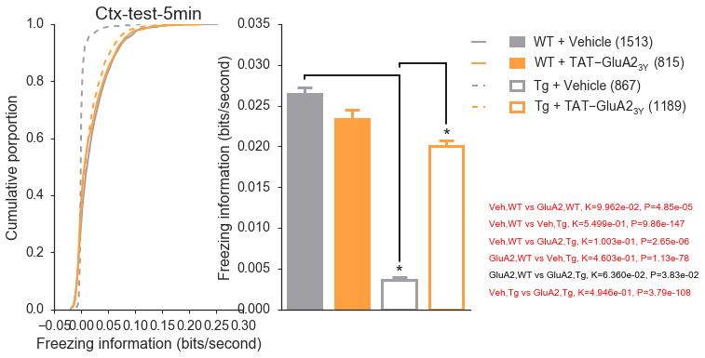
Mutual information (activity vs freezing)
MI(cell’s activity, behavioural state)
CA1 cells in Tg mice contain less information of freezing
Notes:
Calculated mutual information between cell activity and freezing
Tg mice has significant less information content about freezing

Slide 20
Alzheimer’s Disease
Network
Population
Cell
Synapse
Gene
Figure from Santoro (2015)
Notes:
Is the same encoding deficit also present on a population level?

Slide 21
Predicting behaviour from cell activity
Cell1: 0.05, Cell2: 0.1, Cell3: 1.0 ......
Freezing: True
Cell1: 0.1, Cell2: 2.1, Cell3: 1.1 ......
Freezing: ?
Notes:
Train classifier to detect neural signature of freezing
Train classifier to predict freezing states from cell activity at each time point
Use a 5-fold cross-validation

Slide 22
Predicting behaviour from cell activity
Cell1: 2.2, Cell2: 1.5, Cell3: 0.2, Cell4: 2.3 ......
Freezing: ?
Naive Bayes
gSVM
Cell1: 2.2, P(freezing|Cell1) = 0.55
Cell2: 1.5, P(freezing|Cell2) = 0.70
Cell3: 0.2, P(freezing|Cell3) = 0.50
Cell4: 2.2, P(freezing|Cell4) = 0.48
.
.
.
P(freezing) =f(P(freezing|Cell)) = 0.9
Cell1: 2.2
Cell2: 1.5
Cell3: 0.2
Cell4: 2.2
.
.
.
Freezing? =f(Cell) = True
Notes:
We used two classifiers, NB and gSVM.
NB regards each cell independent from others.
NB makes prediction based on each cell, then combine those predictions to make overall decision.
In this way, NB detects a “cellular signal of freezing”
GSVM is what the mathematician called a universal classifier. It looks at the activity of all the cells at the same time, and make a prediction.
GSVM captures information in individual cells as well as synergy between them. Detects a network signal of freezing.

Slide 23
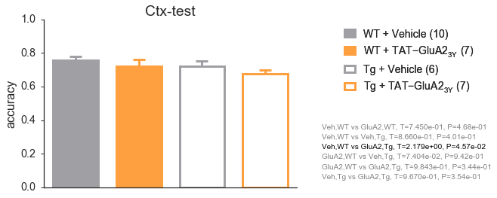
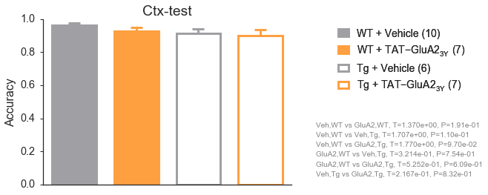
Encoding in network
Naive Bayes
Regard each cell as independent
SVM
(Gaussian Kernel)
Universal classifier
Network encodes more information about freezing than individual cells
Population compensates for information content deficit in Tg mice
Notes:
1. SVM performance better than NB, suggesting some information about freezing is stored at the network level instead of individual cell level
2. Performance is similar across groups, suggesting compensation of the lack of information content in cells

Slide 24
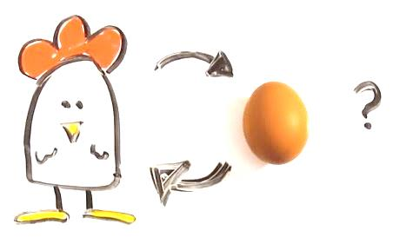
Predicting behaviour from cell activity
Notes:
Is the neural signature detected by the classifier a result of behaviour?

Slide 25
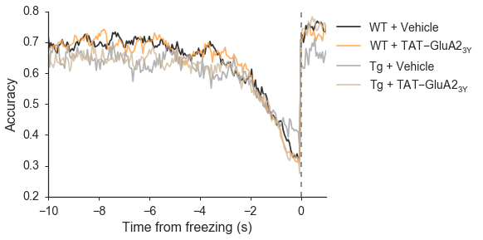
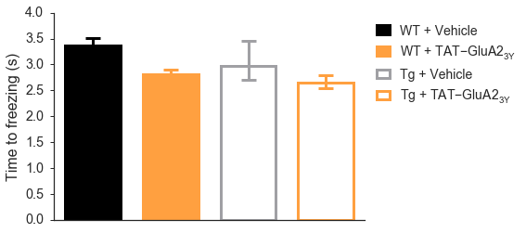
Prediction at state transition
Naive Bayes
Notes:
Align the classifier prediction when the mouse start to freeze
Found a gradual decrease of accuracy: classifiers detects freezing pattern before the mouse froze
Bar graph shows how early the pattern appears
NB result shows that the cellular pattern appears at a similar time between all groups
Similar to pattern completion process

Slide 26
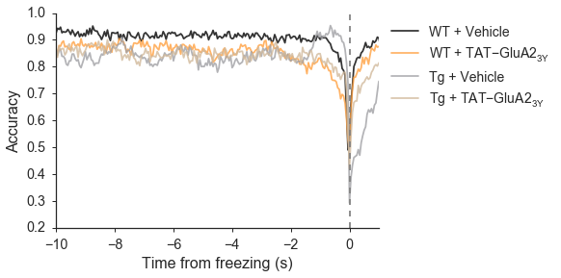
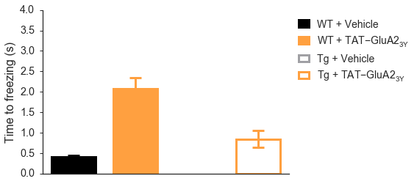
Prediction at state transition
Naive Bayes
gSVM
Classifiers predict freezing before behavioural onset
The prediction signal does not occur in Tg-Veh by SVM
Notes:
GSVM data:
Able to detect network pattern in WT groups, but missing in vehicle-treated Tg mice
Rescued by TAT-GluA23Y treatment
Interestingly, TAT-GluA23Y treatment in WT creates an earlier network signal

Slide 27
Population conclusion
Neural signature for freezing (memory recall) occurs first at the level of individual cells and then at the network level (similar to pattern completion)
That freezing in Tg mice could be predicted at the level of single cell but not at the level of the network suggests that Tg mice have deficit in pattern completion
TAT-GluA2_{3Y} administration during training largely reversed this deficit
Notes:
Clock < 18min

Slide 28
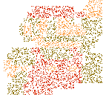

Pattern completion
Mechanism for memory recall
Notes:
Pattern completion: ability to “fill in” and complete an incomplete pattern
Freezing = Mario, each cell is responsible for changing the colour of a single pixel

Slide 29
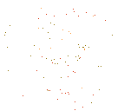
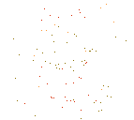
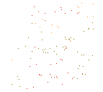
Pattern completion
No “network” signal
Increasing “network” signal
Full “network” signal
AD mice
WT mice
AD mice + GluA2_{3Y}
WT mice + GluA2_{3Y}
Notes:
This is what we think happens just before the mice freeze
Cellular signal = pixel show colour for the mario
Network signal = a mario image
All three groups have similar increasing cellular signal.
AD has a missing network signal
Rescued by TAT-Glua2
WT-Glu has an increased network signal

Slide 30
Pattern completion
No “network” signal
Increasing “network” signal
Full “network” signal
AD mice
WT mice
AD mice + GluA2_{3Y}
WT mice + GluA2_{3Y}
Suggest that strengthening the memory network (engram) enhances pattern completion (memory retrieval)
Notes:
This result then raises the question: why does the vehicle-treated tg mice froze less?
To answer this question, it is useful to look at the pattern completion process from another perspective.

Slide 31
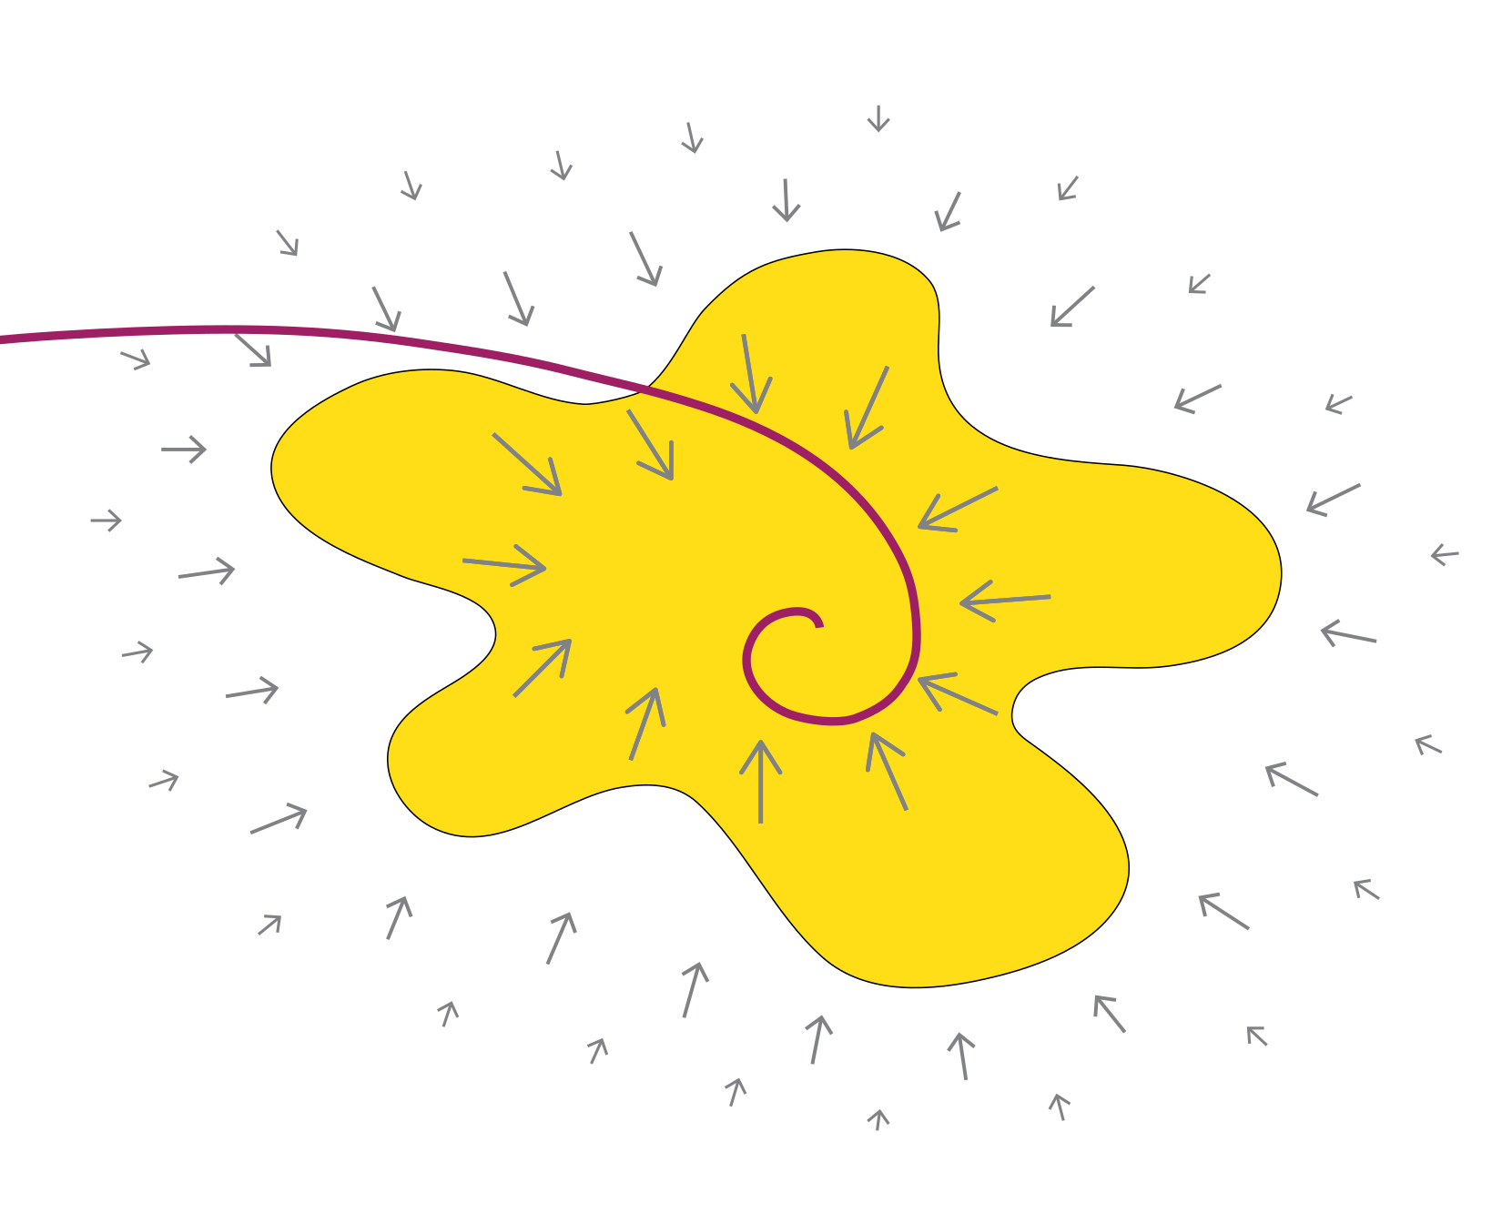
Pattern completion v2
Notes:
Another way of understanding pattern completion is regard it as an attractor dynamics
Figure shows network state
Yellow area = freezing, outside = non-freezing
Pattern completion = a force to pull the network state towards the memory
Red line = trajectory of network
Robust

Slide 32
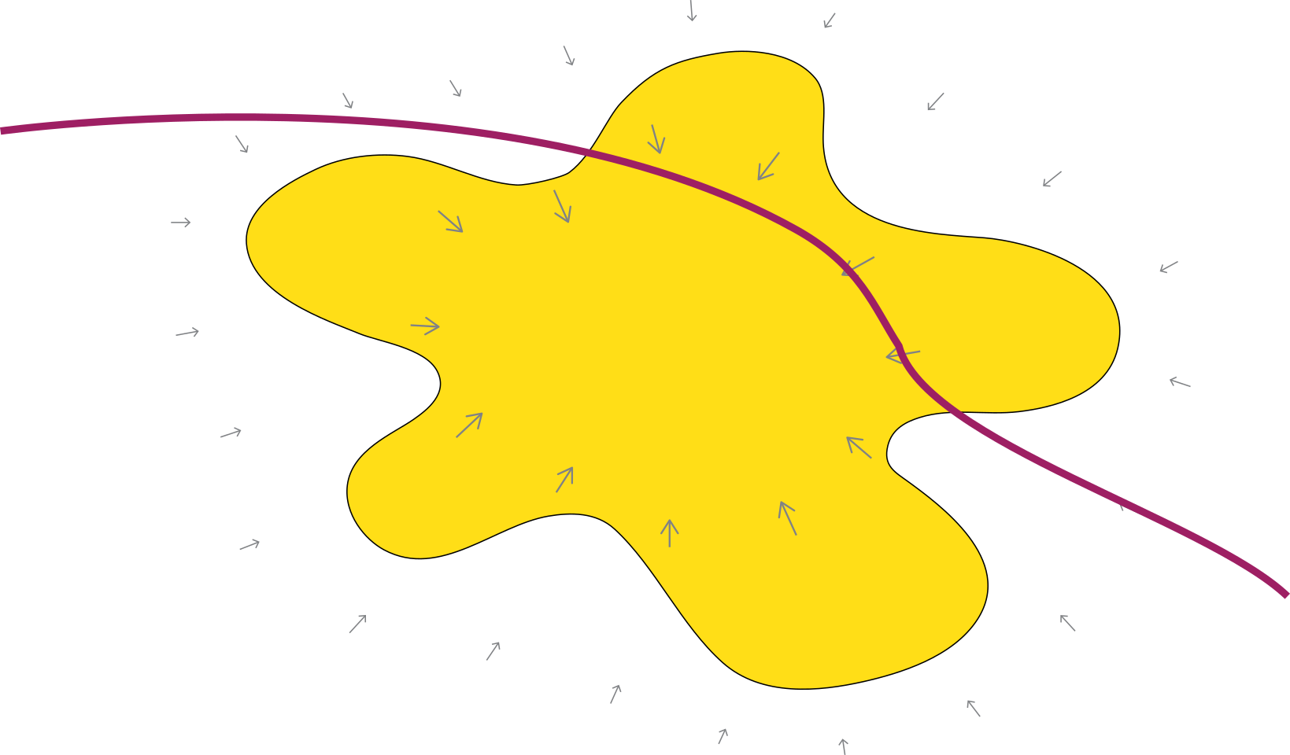
Pattern completion v2
Notes:
Deficit of pattern completion = unstable memory
Easily kicked out of memory state
GSVM allows us to calculate the distance from network state to the boundary

Slide 33
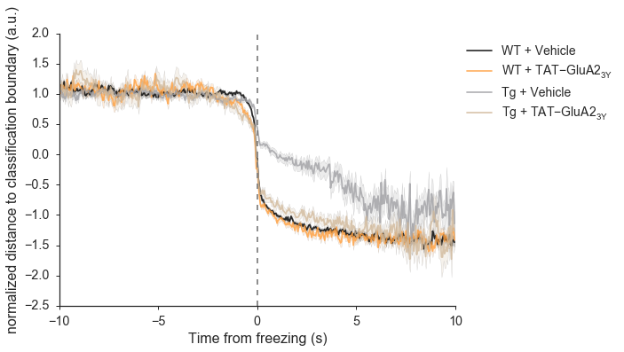
Unstable memory expression
Distance to classification boundary
Notes:
It is possible that a deficit in the pattern completion process makes the freezing pattern less stable.
Here we plotted the normalized vector distance to the classification boundary in gSVM. We can see when Tg-mice froze, the network state lingers at the boundary between freezing and non-freezing.
May make it more susceptible to disruption

Slide 34
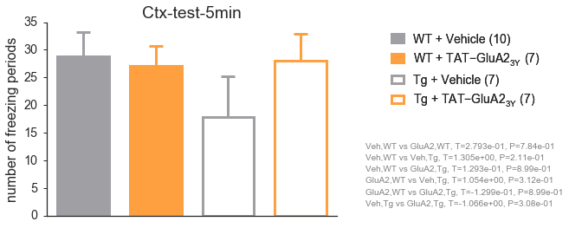
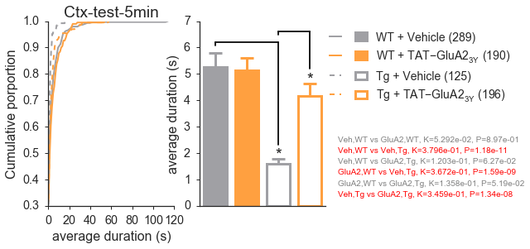
Unstable freezing bouts
Tg mice have shorter freezing bouts
Rescued by GluA2_{3Y}
number of bouts
length of bouts
Notes:
We examined the number of bouts and length of freezing bouts.
The decrease of freezing in Vehicle-treated Tg mice is due to siginficant shortened freezing bouts. Suggesting deficit in maintaining the memory recall …

Slide 35
Conclusion
CA1 cells in Tg mice are hyperactive and encode less information
Tg mice have deficit in pattern completion, leading to unstable memory expression
TAT-GluA2_{3Y} rescues these deficits, potentially by strengthening the memory network

Slide 36
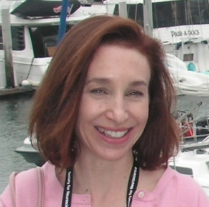
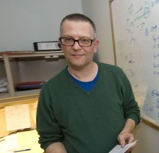
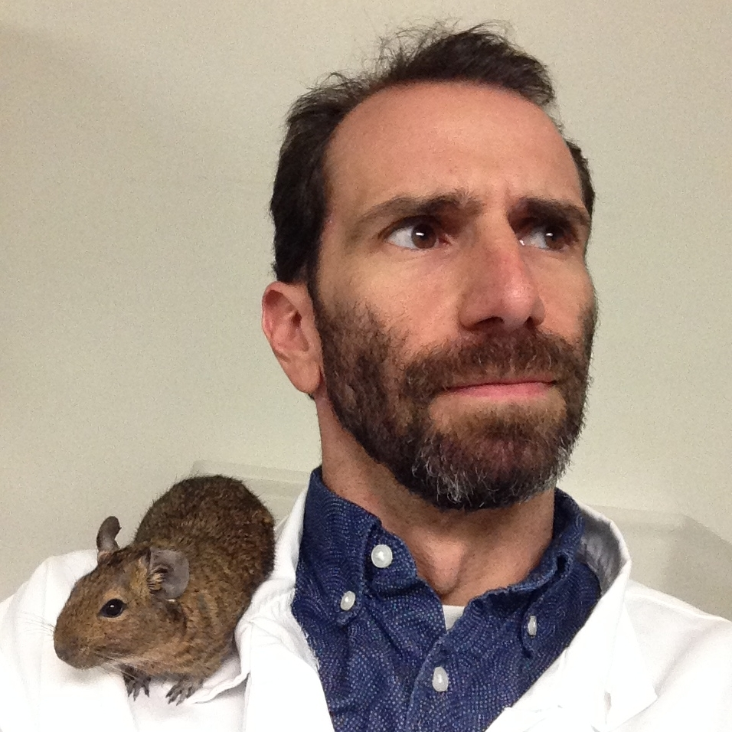
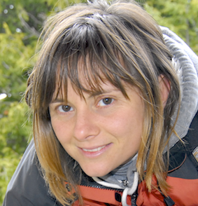
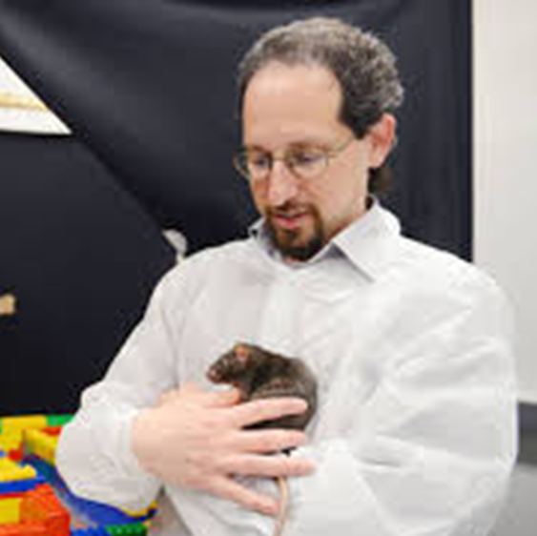

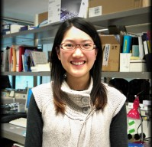


Acknowledgments
Supervisor
Sheena Josselyn
Josselyn lab
Valentina Mercaldo
Alex Jacob
Adelaide Yiu
Special thanks
Paul Frankland
Nathan Insel
(U Montana)
David Redish
(U Minnesota)
Funding
Notes:
Thank supervisor Sheena
Valentina and Adelaide for behavioural experiment
Alex for help with the design of mini-microscope
Paul, Nathan and David Redish for interpretation of the calicum imaging data and input for analysis
Thank funding agency

Slide 37
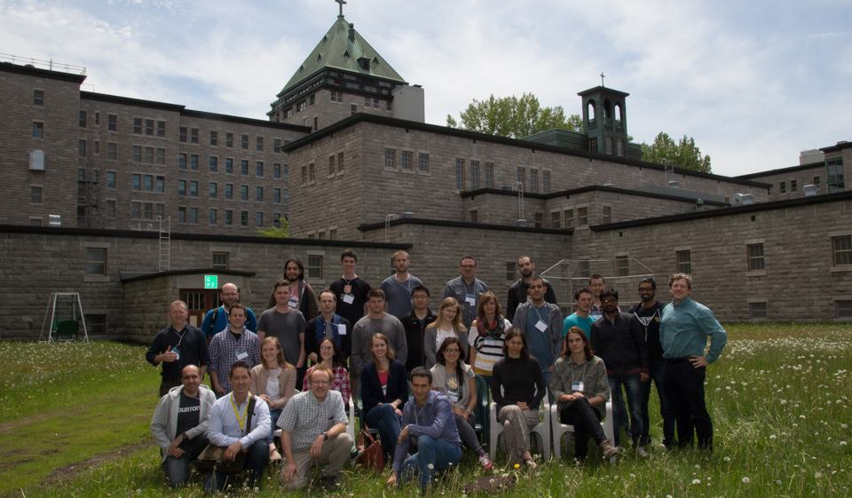
Neurophotonics Summer School 2015
Notes:
I would also like to take this chance to thank the wonderful people in Laval behind the neurophotonics summer school
It was a great learning experience, without the stuff I learn in the summer school we would not be able to build the mini-microscope and collect any of the data
Go there, or send students over

Slide 39
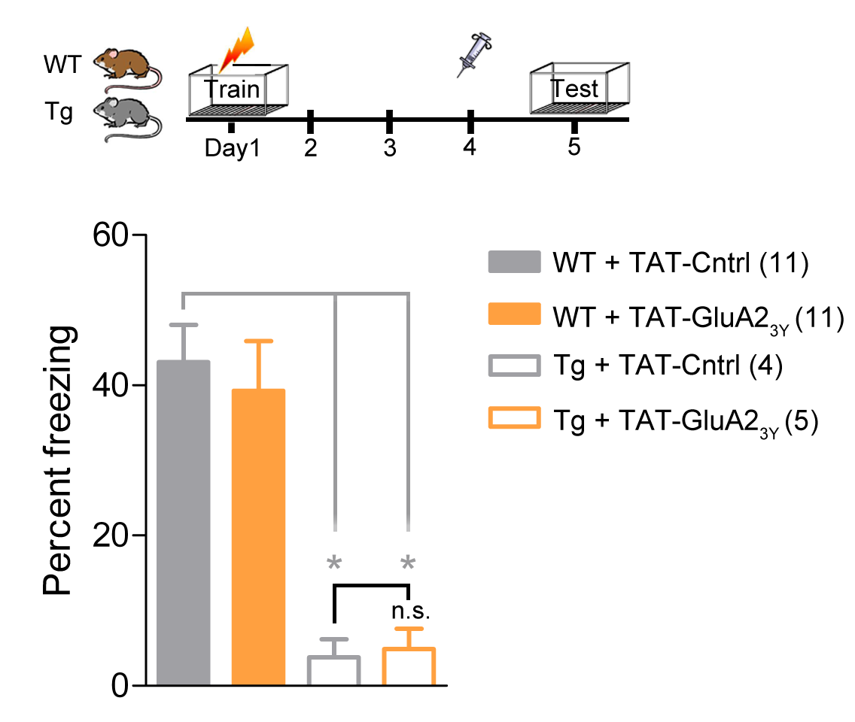
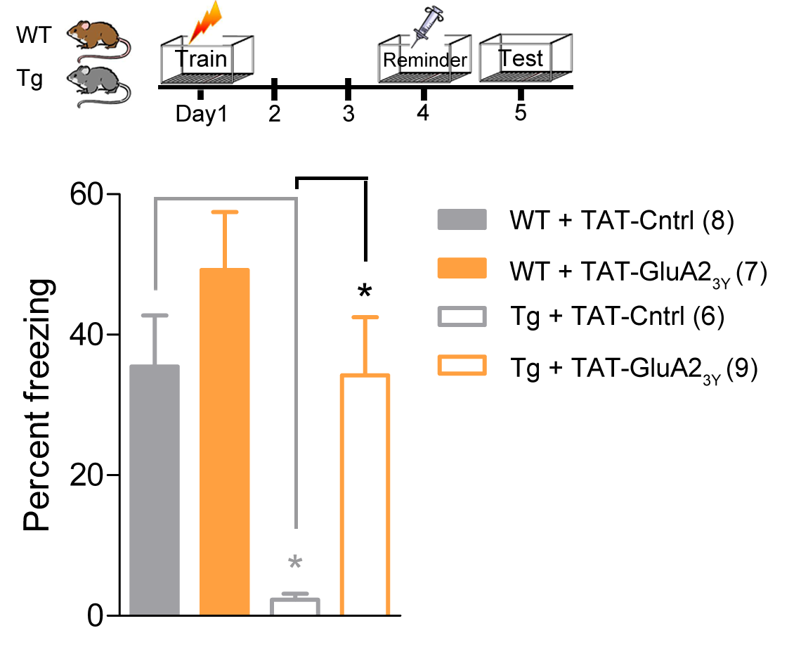
Reactivate memory
Memory deficits of Tg-Veh mice can be rescued with GluA2_{3Y} with
a reminder
Notes:
Reminder experiment

