Slide 1
Link Analysis of DBLP Dataset
Casey Yardley
CSCI 485
Spring 2012
Vancouver Island University

Slide 2
Goals
Analyze a dataset of academic paper citation relationships from the DBLP Computer Science Bibliography.
Use PageRank Link Analysis on the references between papers to find the most influential.
Use the ranking as an order for which papers to search first in a keyword search.

Slide 3
Dataset
Citation network containing 1,632,422 papers and 2,327,450 citation relationships.
Format: 845.4 MB text file.
Data Fields:
  Paper Title, Authors, Year, Publiation Venue
  Paper Index ID
  ID of all papers that reference this paper
  Paper Abstract

Slide 4
Issues
Very large dataset
References between papers are very disjoint.
  Many papers that are referenced frequently by others do not reference many papers themselves
  Many papers that references others frequently are not referenced by many other papers
  Many papers are not referenced by any other papers

Slide 5
Data Preparation
Parsed text file and inserted into a SQLite database, allowing for significantly faster access to specific papers based on their IDs.
Group papers by their publisher, so link analysis will be preformed on publishers.
  Create a table that counts the number of publishers that have a paper which reference a given publisher (naive authority value).
  Create a table that counts how many publishers are referenced by all the papers published by a given publisher (naive hub value).

Slide 6
Data Preparation
Create a list of publishers that have naive authority value which is greater than some min_authority value and have naive hub value value which is greater than some min_hub value.
  If values are too low, the dataset is too large to process
  If values are too high, the references are too disjoint.

Slide 7
Reference Matrix
Create a square matrix with one column for each publisher in the reduced publisher list.
In each row, mark the corresponding column.
Example:
 | pub1 | pub2 | pub3 | pub4 | pub5
pub1 | 0 | 1 | 0 | 1 | 0
pub2 | 0 | 0 | 0 | 1 | 0
pub3 | 1 | 1 | 0 | 0 | 1
pub4 | 0 | 0 | 0 | 0 | 1
pub5 | 1 | 1 | 1 | 1 | 0
- Pub1 references Pub2 and Pub4
- Pub2 references Pub4
- Pub3 references Pub1, Pub2, and Pub5
- Pub4 references Pub5
- Pub5 references Pub1, Pub2, Pub3,
and Pub4

Slide 8
Page Rank
The Page Rank algorithm is a link analysis method that is similar to how search engines like Google rank the internet.
Works by creating a web of links between pages, ignoring pages without outgoing links.
Depends on the idea of Hubs and Authorities
A page's hub value is influenced by the values of the authorities that it links to.
A page's authority value is influenced by the values of the hubs that link to it

Slide 9
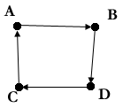
Page Rank
Since the values of Hubs and Authorities depend on eachother, the algorithm must be run many times to generate accurate ranking.
Once done, the pages with the higher ranks are the pages that are most influential.
Examples:
After 100 Iterations:
- A = 0.25
- B = 0.25
- C = 0.25
- D = 0.25

Slide 10
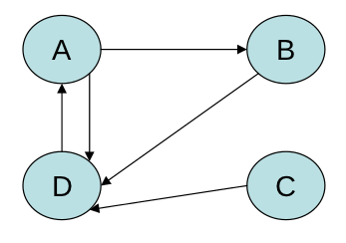
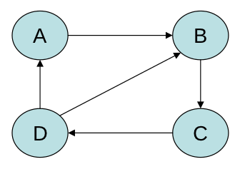
Page Rank
After 100 Iterations:
- A = 0.3725
- B = 0.1958
- C = 0.0375
- D = 0.3941
After 100 Iterations:
- A = 0.1550
- B = 0.2868
- C = 0.2813
- D = 0.2766

Slide 11
Results
The following table compares a naive ranking of how often publishers reference and are referenced by others, to the results of the Page Rank algorithm. In the table:
Naive Hubs refers to the publishers who reference the most other publishers
Naive Authorities refers to the publishers who are referenced by the most other publishers
The Most Influential Publishers refers to the most influential publishers, generated by the PageRank algorithm.

Slide 12
 | Naive Hubs | Naive Authorities | The Most Influential Publishers:
1 | Commun. ACM | CoRR | Commun. ACM
2 | Theor. Comput. Sci. | ICRA | IEEE Computer
3 | IEEE Trans. Computers | Discrete Mathematics | J. ACM
4 | DAC | Commun. ACM | ACM Comput. Surv.
5 | Winter Simulation Conference | Theor. Comput. Sci. | SIGMOD Conference
6 | IEEE Trans. Pattern Anal. Mach. Intell. | IEICE Transactions | STOC
7 | Inf. Process. Lett. | Microwave Theory and Techniques, IEEE Transactions on | IEEE Trans. Software Eng.
8 | IEEE Trans. Software Eng. | IEEE Transactions on Information Theory | ACM Trans. Program. Lang. Syst.
9 | Pattern Recognition Letters | Electronics Letters | POPL
10 | VLDB | HICSS | VLBD

Slide 13
Search
The search engine works by taking the list of most influential publishers (determined by the Page Rank algorithm) and searching the abstracts of the papers that they published for a keyword(s).
Search term can be a regular expression.

Slide 14
Future Work
Optimize and minimize database queries.
Better/more data caching.
Group papers together in a better way than by publisher. Perhaps using abstract keywords to group together similar papers?

Slide 15
Demonstration

