Slide 1

Customer Success Growth Insights
Retention • Churn Risk • Expansion Opportunities
Case: Data Analyst & Coordinator
Marta Caballero Puig
January 2026

Slide 2
Executive summary: where to focus
What we learned
Healthy retention in 2024-2025: churn impact mainly from high-volume segments, not niche tiers.
Account access losses are time-clustered: it seems like some periods drive most of real churn.
Expansion in behavior: high usage on lower tiers (especially close to renewal) signals to customers outgrowing their plans.
What we should do next
Protect renewals: run a sprint to outreach at-risk accounts renewing soon with a specified playbook.
Prioritize upsell timing: start with subset renewing within 60 days and target “high usage” + “low tier” subscriptions.
Activate before expanding: usage of invites, logins and creators are leading indicators. Fix activation gaps before pushing for upgrades.
Method
Data prep: standarized ~ 100 plan name variants into 8 plan tiers to ensure consistent segmentation.
Definitions used: 90-day renewal window + effective churn (“lost access”) + based segmentation. Focus on 2024-2025 for current dynamics.
Tier grouping used for segmentation (higher/lower tiers): Pro+ = Pro/Premium/Max; Standard & below = Standard/Standard Plus/Low/Other

Slide 3
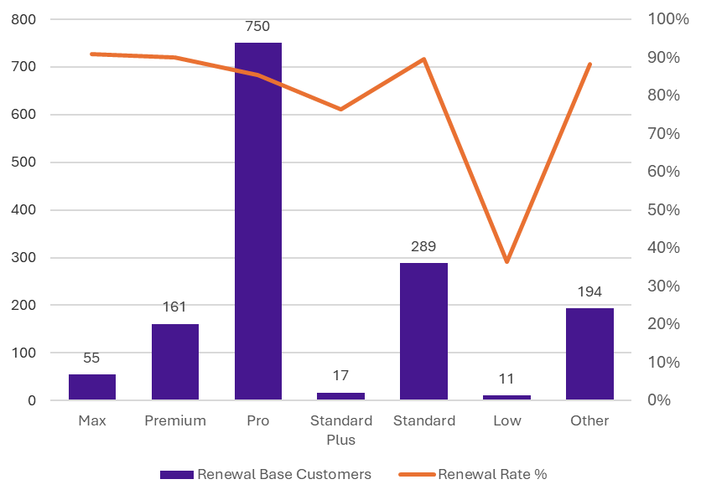
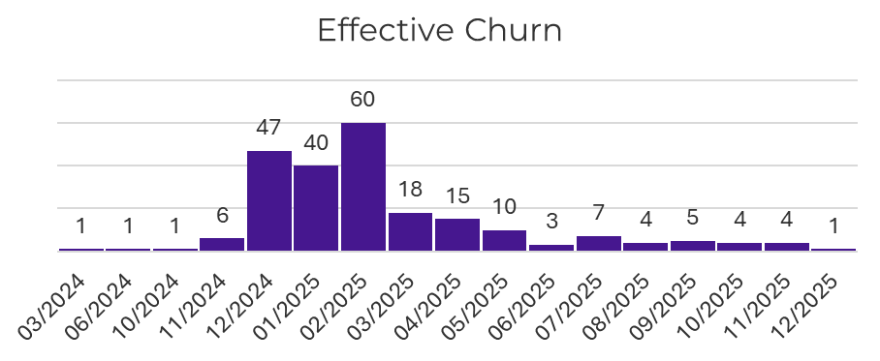
Retention & Churn: segmentation
Customer renewal rate by plan tier
Churn concentrates in Pro: 108/756 churned customers (~14%)
Overall retention is strong (2024-2025): most tiers have ~86-93% renewal (90-day definition)
Note on winbacks: older churn can look inflated due to long gaps + later reactivation (counted as churn at original end of month)

Slide 4

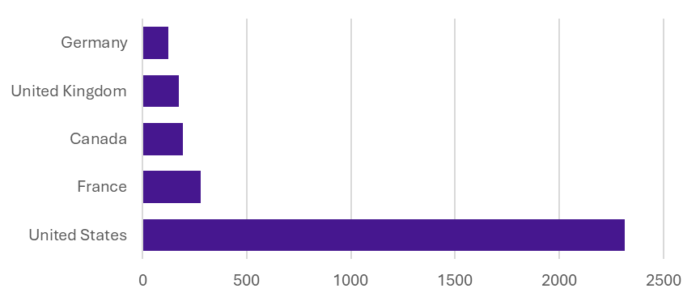
Expansion opportunities
Who is outgrowing their plan?
Upsell targets: 143 customers are heavy users but on lower tiers. 23 renew within 60 days → ideal timing to offer an upgrade.
Usage / tier | Pro & + | Standard & below
High usage | 264 | 143
Low usage | 2156 | 1394
Expansion opportunity: large accounts with many seats but low activation. Focus on onboarding + activation and convert to seat/tier upgrade.
Top countries with upsell-ready customers
Next actions (playbook)
Upgrade: standard and below + high usage (143)
Renewal outreach: prioritize 23 renewing ≤60d
Seat activation: many seats + low invites → training + champions

Slide 5
Coordination & delivery plan
This week
Contact top at-risk renewals & top expansion targets
This month
Activation playbook for churn/expansion segment
Invites → Logins → Creators
Measure success
Renewal rate (90d)
Effective churn (lost access)
Expansion wins (tiers/seats)
Conversion rate
Plan (how we set it up)
Follow-up (how we run it)
Inform others (how we communicate)
Owners
Data & QA / Insights & Segmentation / Storytelling & Slides
Scope & definitions
One source of truth / Metric definitions
Rythm
Daily 10-min sync / Midpoint QA check / Final review
Tracking
Jira/Kanban board + sprint checklist / Blockers escalated within 24h
Weekly status
Shipped / Next / Risks & asks
Shared hub
Jira board / Folder / Changelog / Backlog
Stakeholder touchpoints
Midpoint preview / Presentation

