Slide 1

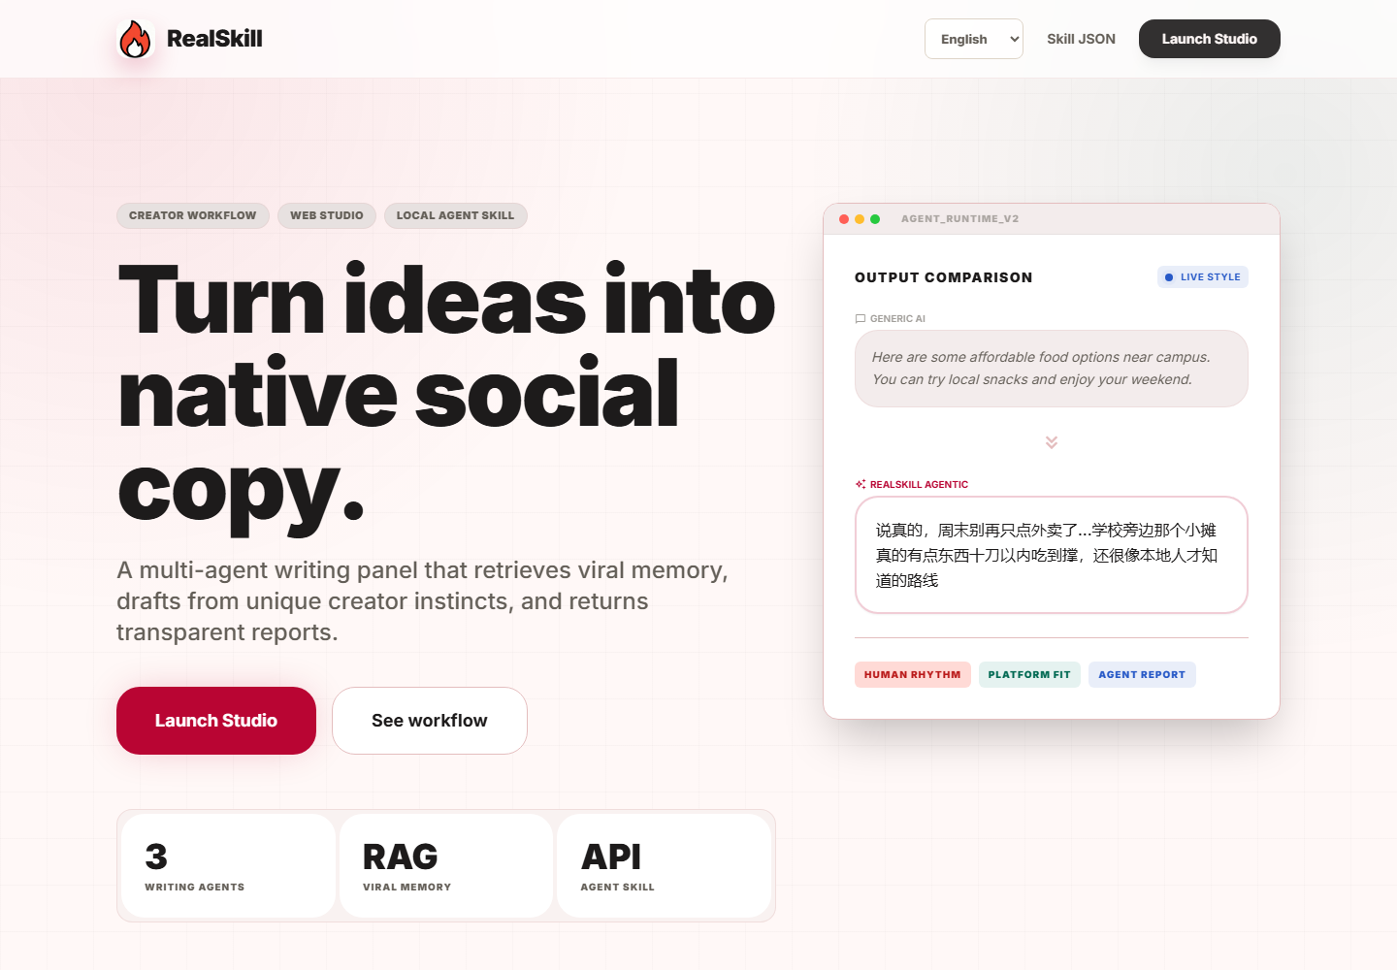
RealSkill
MULTI-AGENT SOCIAL COPY STUDIO
RealSkill
Platform-native social copy, generated by a multi-agent writing panel.
Web studio
Local agent skill
Report assets
01/12

Slide 2
RealSkill
PROBLEM
Generic AI copy still sounds generic.
The core gap
Creators need content that feels native to the platform, not just grammatically correct.
Social platforms reward rhythm, context, and lived-in detail. A polished paragraph is not enough.
Same voice across platforms
Weak creator-style transfer
No transparent quality control
Outputs are hard to reuse as assets
02/12

Slide 3
RealSkill
USERS
Built for creator-facing teams.
Creators
Campus communities
Save time while keeping a personal, natural voice.
Create local guides, events, and community updates.
RealSkill focuses on people who repeatedly turn rough ideas into social posts across different channels.
Indie brands
Agencies
Adapt offers and product moments to social rhythm.
Compare drafts and explain creative direction to clients.
03/12

Slide 4
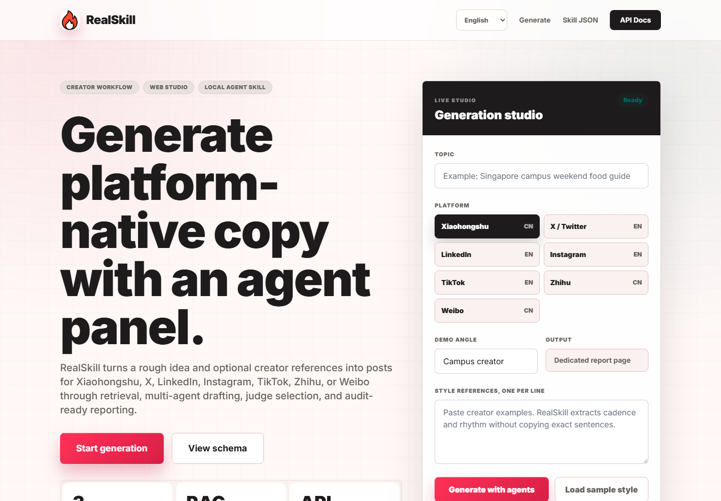
RealSkill
SOLUTION
A writing panel with retrieval, agents, and reports.
The user enters a topic, selects a platform, and optionally adds style references. RealSkill handles the writing workflow.
Trend memory before drafting
Three specialized agent drafts
Judge selection with scores
Publish-ready report output
04/12

Slide 5
RealSkill
DEMO FLOW
Input. Run. Report.
The flow is intentionally simple: the product explains the generation process while it works.
1. Enter brief
2. Agent Run
3. Report
Topic, platform, and optional style references.
Retrieval, Agent A/B/C, judge selection, and humanization.
Final copy, scores, drafts, charts, and notes.
05/12

Slide 6
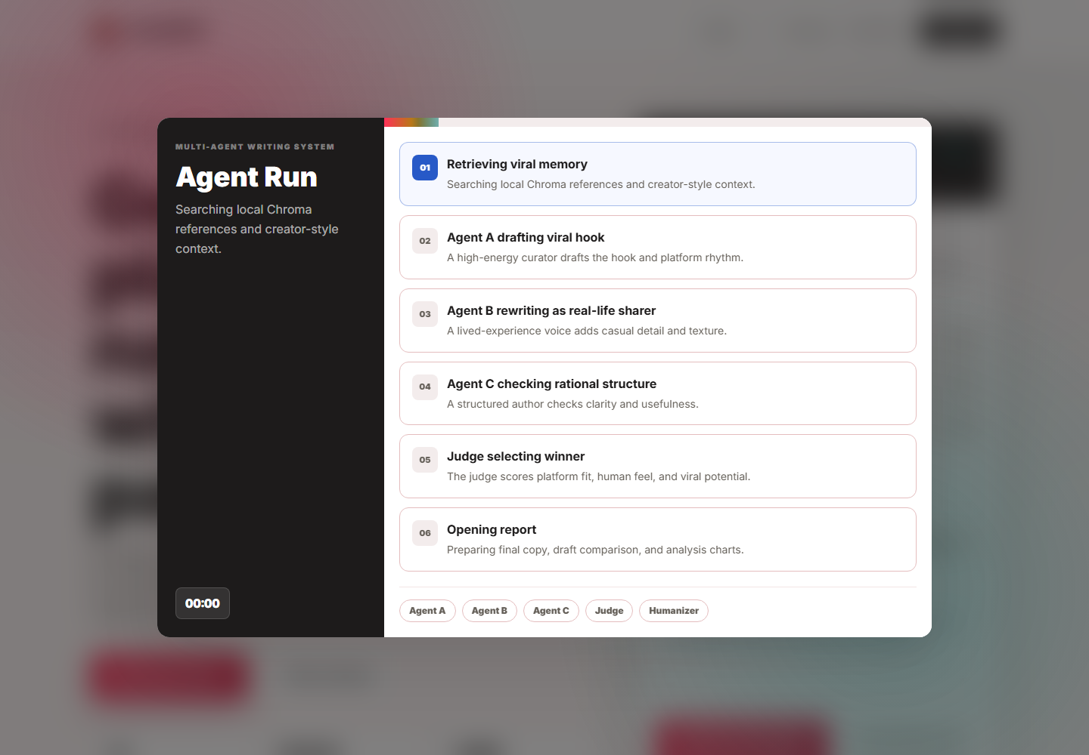
RealSkill
AGENT WORKFLOW
Different agents, different instincts.
RealSkill avoids one fixed answer by separating creative roles and judging their outputs.
Agent A: viral hook and rhythm
Agent B: lived-in creator voice
Agent C: structure and usefulness
Judge: winner and reasoning
Humanizer: final cleanup
06/12

Slide 7
RealSkill
PLATFORMS
Designed for domestic and global channels.
The same workflow adapts default language and platform rhythm based on where the post will be published.
Xiaohongshu
Weibo
Zhihu
X / Twitter
LinkedIn
Instagram
TikTok
07/12

Slide 8
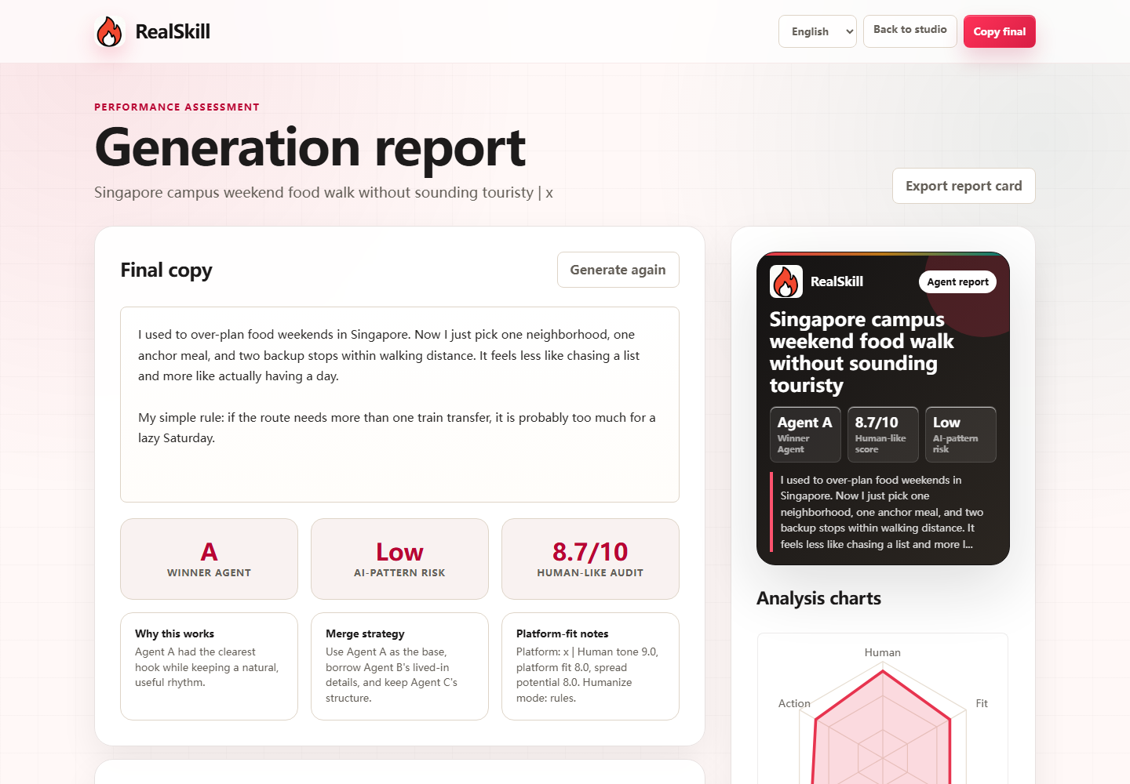
RealSkill
PRODUCT
A complete web experience, not a slide-only concept.
08/12

Slide 9
RealSkill
WHY DIFFERENT
From prompt output to reusable content asset.
Retrieval
Agent panel
Local trend memory informs the draft.
Three strategies compete instead of one answer.
RealSkill makes the reasoning and alternatives visible, so creators can trust and reuse the result.
Judge
Report
Selection is scored and explained.
The final output includes drafts, risk, and charts.
09/12

Slide 10
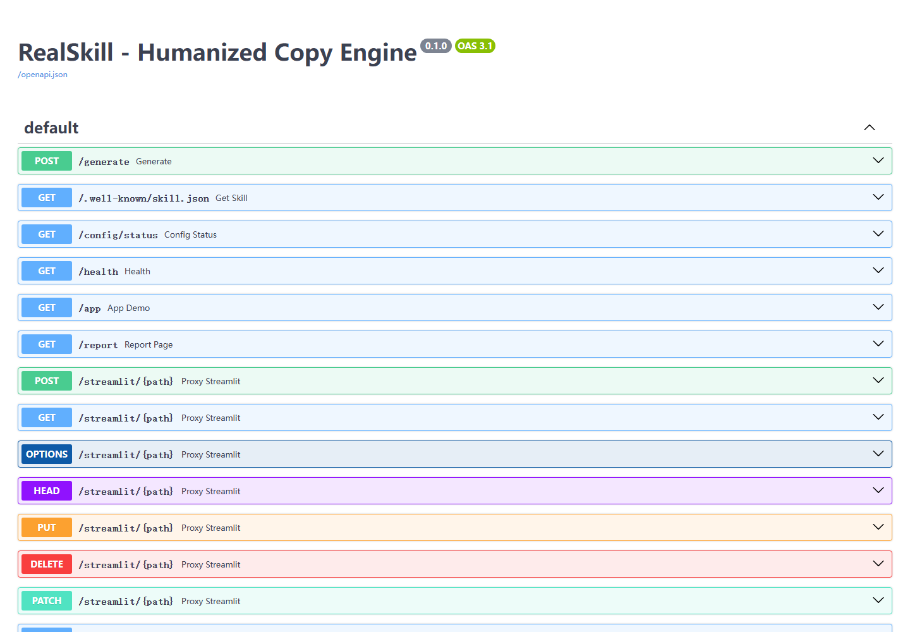
RealSkill
ARCHITECTURE
FastAPI web studio with an agent-callable core.
FastAPI serves the UI and /generate endpoint
ChromaDB stores local viral memory
OpenAI-compatible API powers drafting and judging
Static HTML/CSS/JS keeps deployment simple
Skill manifest exposes the same capability to agents
10/12

Slide 11
RealSkill
AGENT SKILL LAYER
The web app is one interface. Agents can call it too.
RealSkill exposes a discovery schema and can be packaged as a local skill, so the same capability works outside the web UI.
Discovery
Local package
Shared core
GET /.well-known/skill.json exposes the callable schema.
build_skill_zip.py creates RealSkill_agent.zip.
The same generator powers web and local agent calls.
11/12

Slide 12
RealSkill
ROADMAP
Toward a creator workflow layer.
Persistent generation history and saved reports
Demo link
Team workspace and shared brand memory
TBD
More direct trend connectors for global platforms
Image cards and PDF report exports
Deeper analytics for platform fit and audience intent
12/12

