Slide 1
CEF 440
INTERNET AND MOBILE
PROGRAMMING

Slide 2
TABLE OF CONTENT
INTRODUCTION
TYPE OF MOBILE APPLICATIONS
PROGRAMMING LANGUAGES USED TO BUILD MOBILE APPLICATIONS
MOBILE APPLICATION DEVELOPMENT FRAMEWORKS
HOW TO COLLECT AND ANALYSE THE REQUIREMENT FOR A MOBILE APPLICATION DEVELOPMENT
HOW TO ESTIMATE A MOBILE APPLICATION DEVELOPMENT COST

Slide 3
INTRODUCTION
A mobile app (or mobile application) is a software application developed specifically for use on small, wireless computing devices, such as smartphones and tablets, rather than desktop or laptop computers.
It can be classified in 3 categories :
Native applications
Web applications
Hybrid applications

Slide 4
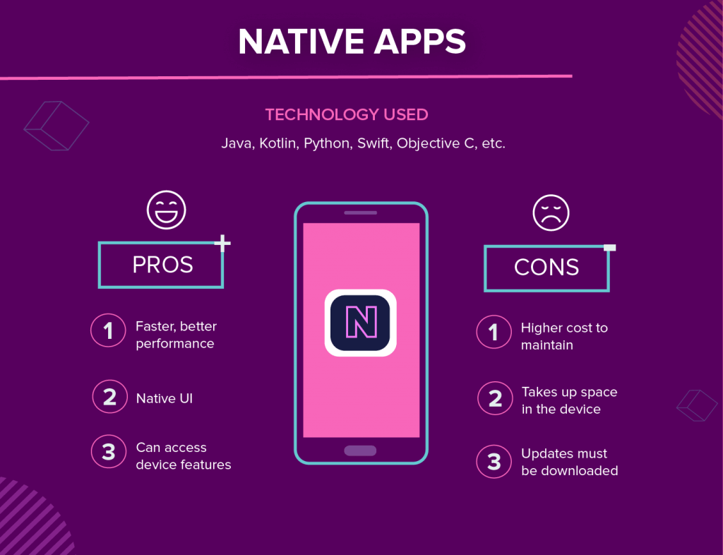
NATIVE APPLICATIONS
These apps are created for one specific platform or operating system.

Slide 5
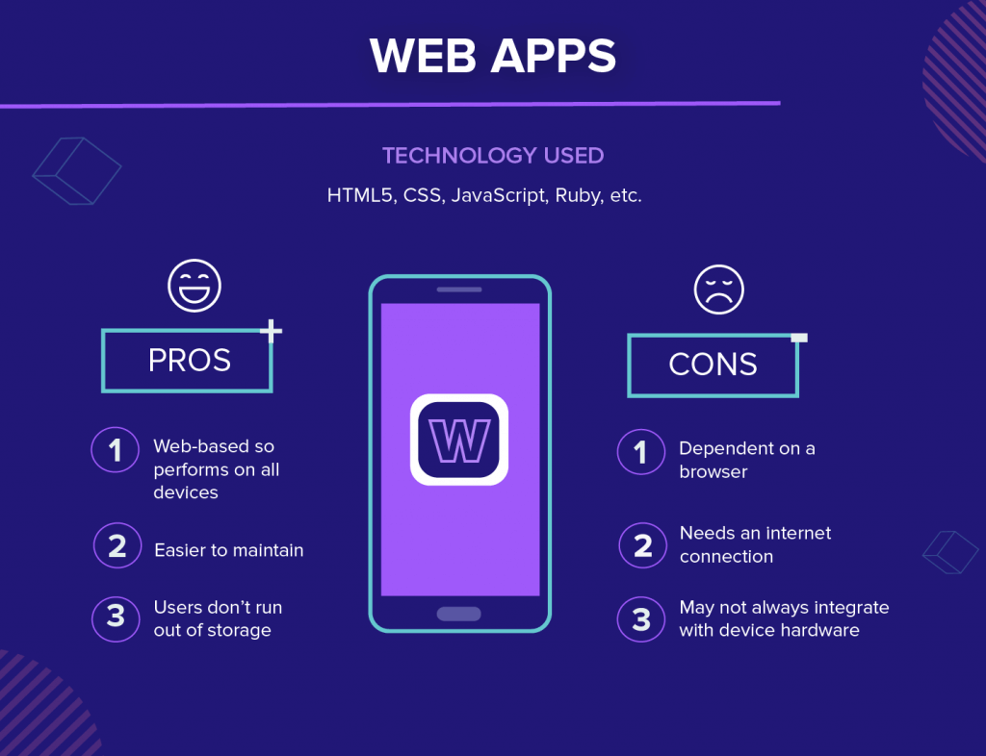
WEB APPLICATIONS
These are responsive versions of websites that can work on any mobile device or OS because they are delivered using a mobile browser.

Slide 6
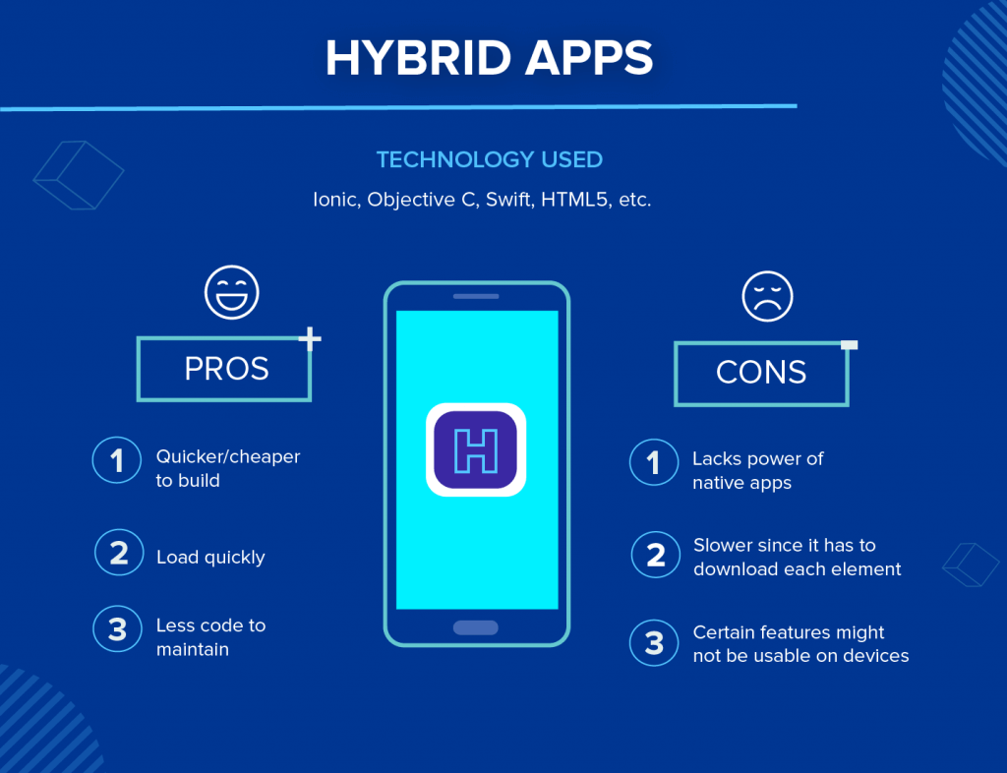
HYBRID APPLICATIONS
These apps are a combination of both native and web apps, but wrapped within a native app, giving it the ability to have its own icon or be downloaded from an app store.

Slide 7
PROGRAMMING LANGUAGES USED FOR MOBILE APPLICATIONS DEVELOPMENT
The programming languages commonly used for mobile application development are:
Java: it is one of the most widely used languages for developing Android apps.
Swift: it is a modern language developed by Apple for building iOS, iPadOS, macOS, tvOS, and watchOS apps.
Kotlin: Considered as an advance version of java, it’s language is clear, concise and statistically typed programming language.
Dart: It’s a client-optimized language for developing fast applications on any platform( android ou iOS).

Slide 8
C#: is a language developed by Microsoft that is used for developing Windows, Xbox, and Windows Phone apps. It's also a popular choice for game development using the Unity engine.
Python: used to develop cross-platform applications in web, mobile and desktop from scratch.
Javascript: It’s a high-level, interpreted and cross-platform programming language that can be used to build both Android, iOS and desktop app.
In the table below is a summary of how programming languages are used for mobile application development.

Slide 9
Programming language | platform | Operating system | Level of difficulty | Framework | Programmer experience
javascript | Hybrid app Web apps | Android and IOS | Easy to learn | React native | beginner
kotlin | Native app | Android | Easy to learn | Native android SDK | beginner
Java | Native app | Android | Easy to learn |  | intermediate
Swift | Native app | IOS | Easy to learn | Native IOs | beginner
Objective-C | Native app | IOS | Easy to learn | - | beginner
C# | Hybrid apps | Android and IOS | intermediate | Xamarin | intermediate
Dart | Hybrid apps | Android and IOS | Easy to learn | Flutter | beginner
Python | Hybrid apps | Android and ios | One of the easiest PL | kivy | beginner
C++ | Hybrid apps | Android and IOS | Hard to learn | Microsoft tool in VS | professional

Slide 10
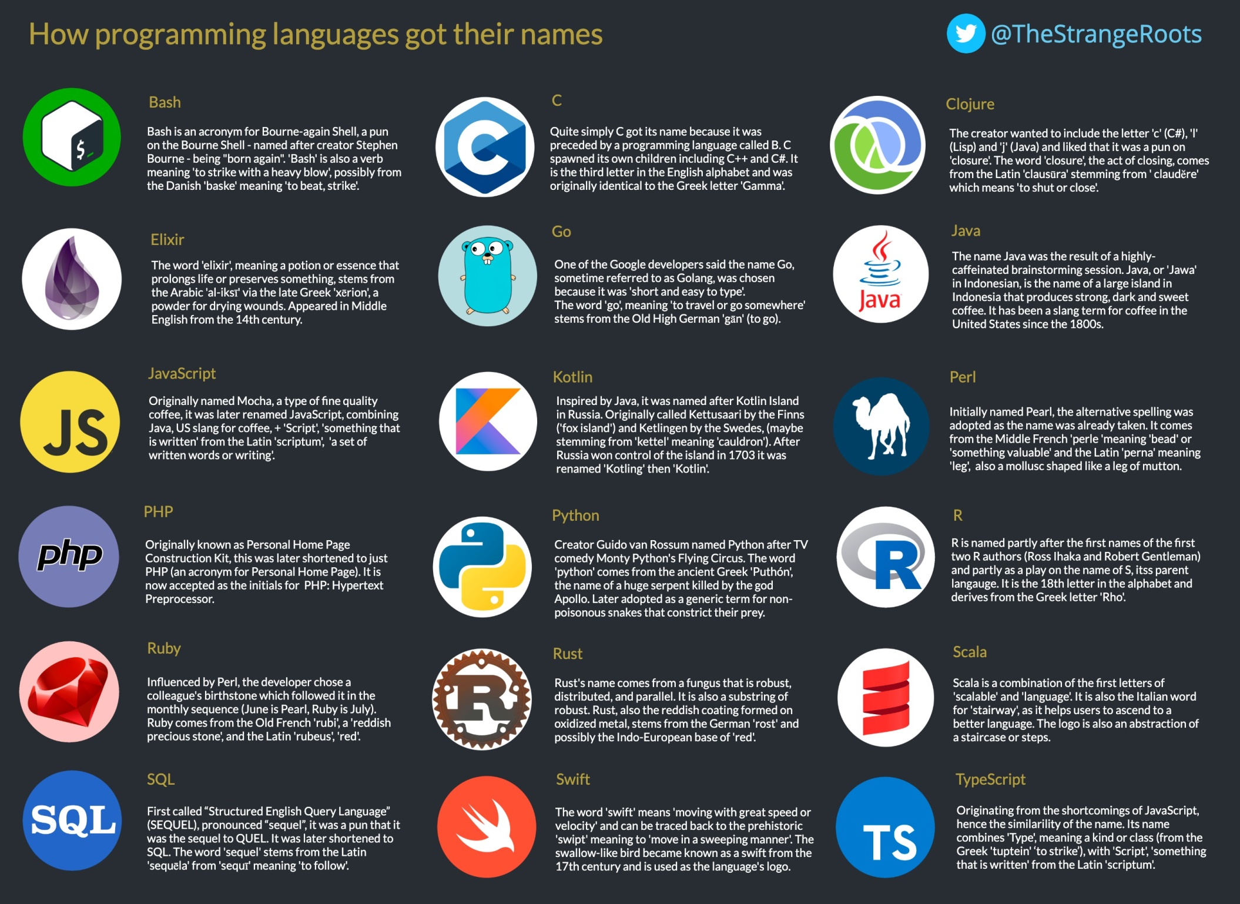

Slide 11
MOBILE APPLICATION DEVELOPMENT FRAMEWOKS
A mobile App development framework supports and accelerates the process of application development.
Although Native applications offers an unmatched experience in terms of aesthetics and functionality, native apps are costly to build and maintain. The solution lies in creating a web, hybrid, or cross-platform mobile app for business with budget constraints by leveraging mobile app development frameworks.

Slide 12
MOBILE APPLICATIONS DEVELOPMENT FRAMEWORKS
FLUTTER
This is a Google’s open-source framework for developing native Android and iOS apps using a single codebase.
Examples of applications built using Flutter development include Google, Alibaba, and Abbey Road Studios
ii. REACT NATIVE
Developed and maintained by Facebook, react native is an open-source, cross-platform app development framework .
It helps to develop Android and iOS mobile apps.
Examples of popular apps build using React Native development include Tesla, Airbnb, Skype, and Amazon Prime are the best examples of React Native apps

Slide 13
IONIC
This is an open-source framework built with Apache Cordova (Phone Gap) and Angular, allowing developers to build Android and iOS apps.
This is a complete framework that enables developers to build Progressive Web Apps (PWAs)
and hybrid and cross-platform mobile applications.
XAMARIN
It is a Microsoft-owned open-source framework for developing native and high performance Android, iOS, macOS, tvOS and watchOS apps leveraging.
APACHE CORDOVA
Also known as PhoneGap, It is a cross-platform app development framework that leverages CSS3, HTML5 and JavaScript to build mobile applications.
NATIVE ANDROID (KOTLIN)
It was first introduced by google in 2009 and was updated in 2017 and became the main language for building native Android apps. Android SDK allow developers to write lower-level-code, which make it easier to control the environment, build complex features and debug apps.

Slide 14
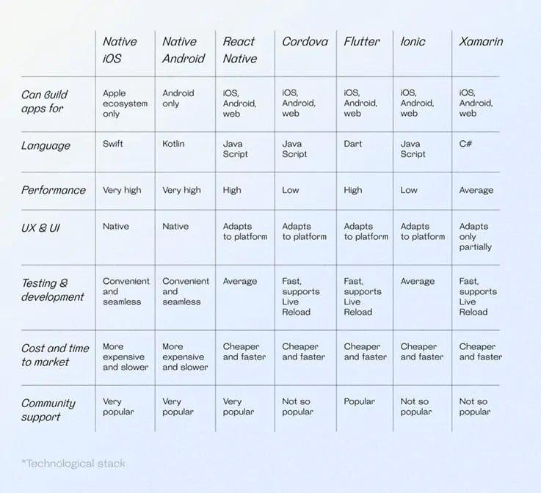

Slide 15
HOW TO COLLECT AND ANALYZE THE REQUIREMENTS NEEDED FOR A MOBILE APPLICATION DEVELOPMENT
The Software requirements analysis is the process of identifying, defining and documenting the requirements of a software system.
Categories of Requirements:
Functional Requirements: : function the software solution is required to perform.
Technical Requirements: technical issues to take in consideration for the software solution to be well implements.
Transitional Requirements: implement in case an extra product is needed
Operational Requirements: operations to be carried out in the backend for proper functioning of the system.

Slide 16
HOW TO ESTIMATE A MOBILE APPLICATIONS DEVELOPMENT COST
The price of building an app highly depends on its functionality and the wages of those who are going to build it. Every feature takes a number of hours to program, and the more complex the app, the higher will be the price of building and maintaining it after release.

Slide 17
Below are some factors that influence the cost
of a mobile application:
Features
Platforms
Design
App Maintenance
Team development size
Team location

Slide 18
CONCLUSION
In summary, there are basically three categories of mobile apps which are Native apps, web-based apps and hybrid apps. Also there are several mobile programing language and mobile app development frameworks such as Flutter, React native, Ionic, JavaScript, swift, xamarin, etc… In order to develop a good mobile application, we have to know and analyze its requirements

