Slide 1
INTERNET AND MOBILE PROGRAMMING
CEF 440

Slide 2
DESIGN AND MODELING OF A FOOD MANAGEMENT SYSTEM APPLICATION

Slide 3

TABLE OF CONTENT
INTRODUCTION
Class Diagram
Use Case Diagram
Sequence Diagram
Activity Diagram
Data Flow DIAGRAM
CONCLUSION

Slide 4

1. INTRODUCTION
Let’s get started with the analysis

Slide 5

After the collection and the analysis of Requirements, the Design phase consist of bringing out the differents aspects of the application.

Slide 6
2. CLASS DIAGRAM
Describes the static structure of the system.

Slide 7
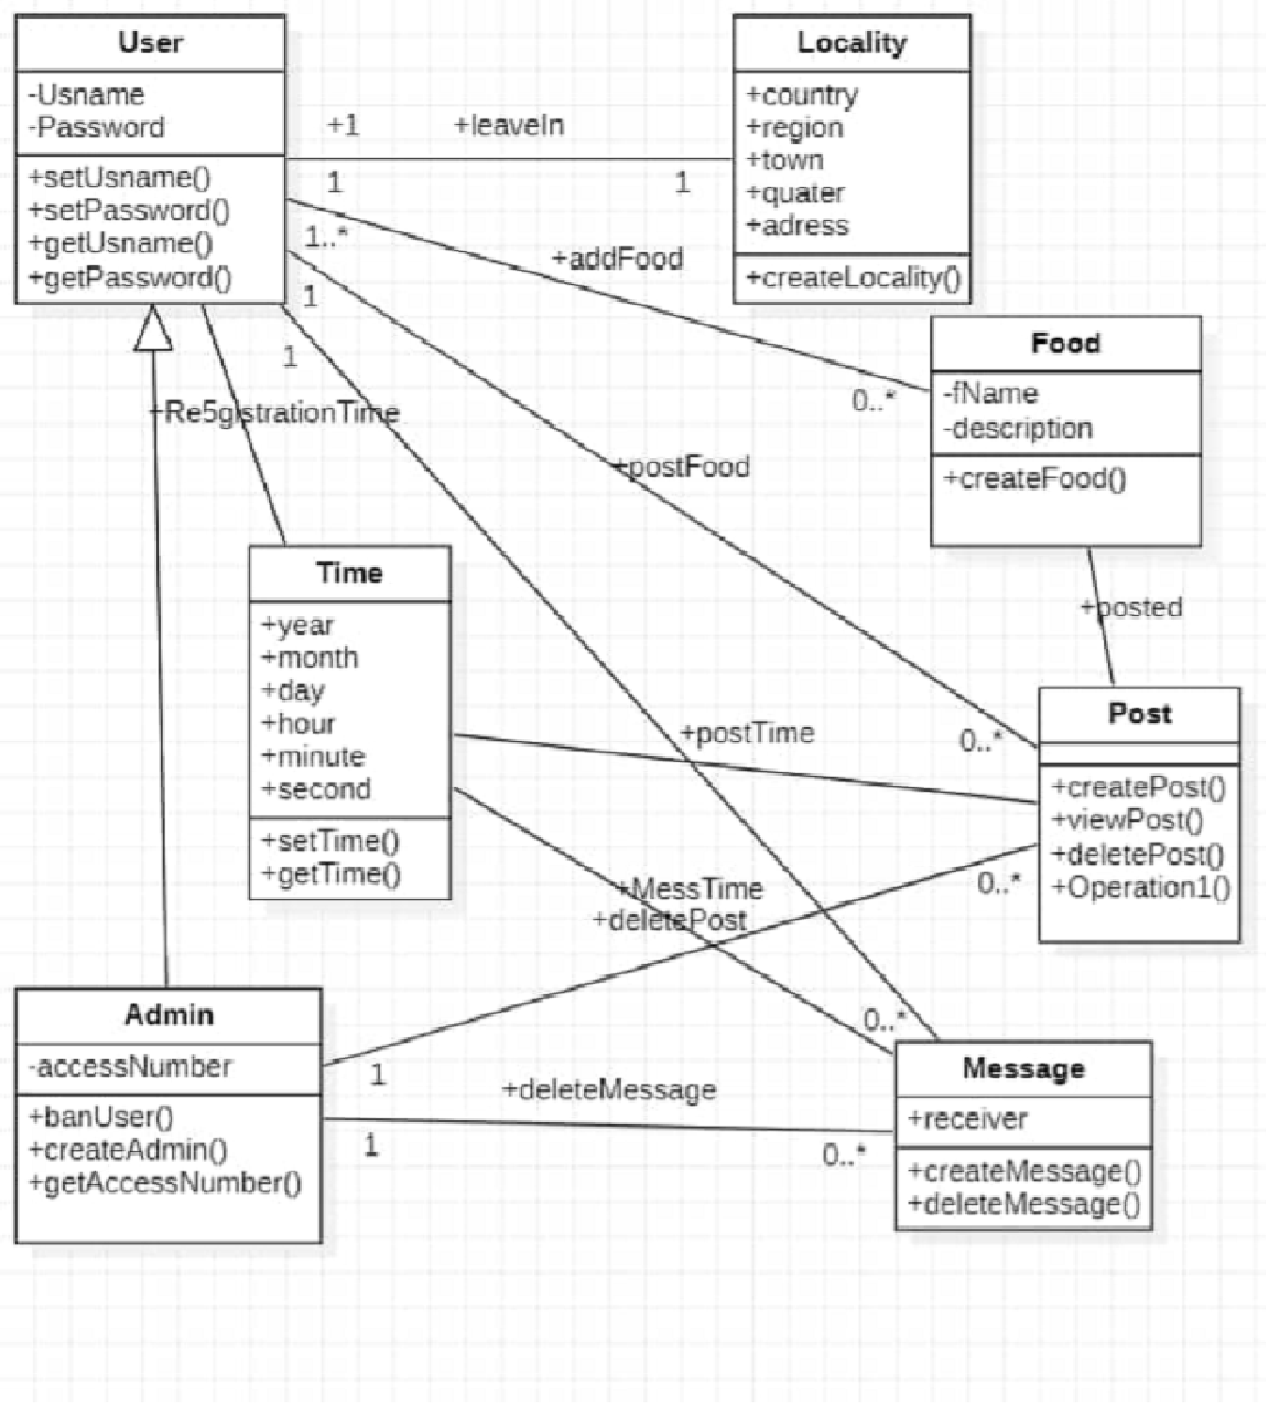

Slide 8
3. USE CASE DIAGRAM
Interaction of the system with the its different actors.

Slide 9
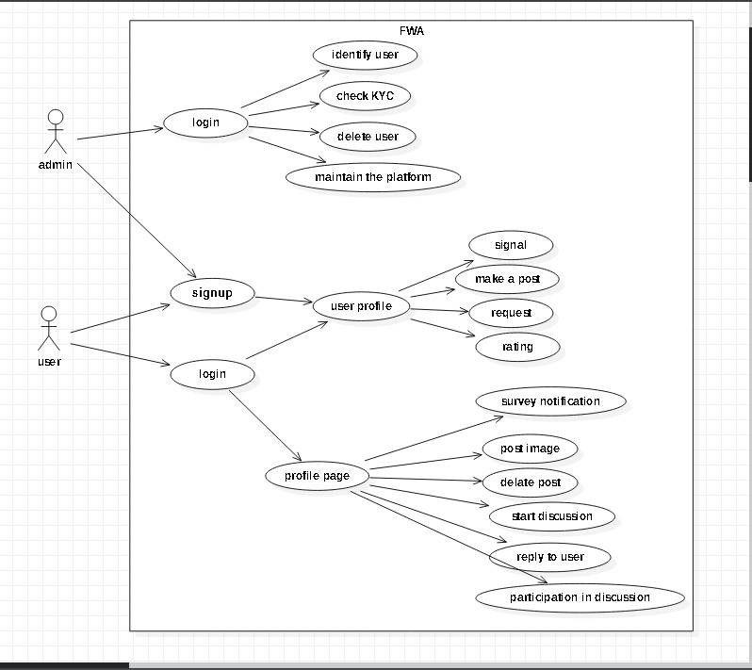

Slide 10
4. SEQUENCE DIAGRAM
Shows the flow of functionality through a Use case.

Slide 11
SEQUENCE DIAGRAM
Registration
Login
Food posting
Discussion, rating and comment
Search
Notification

Slide 12
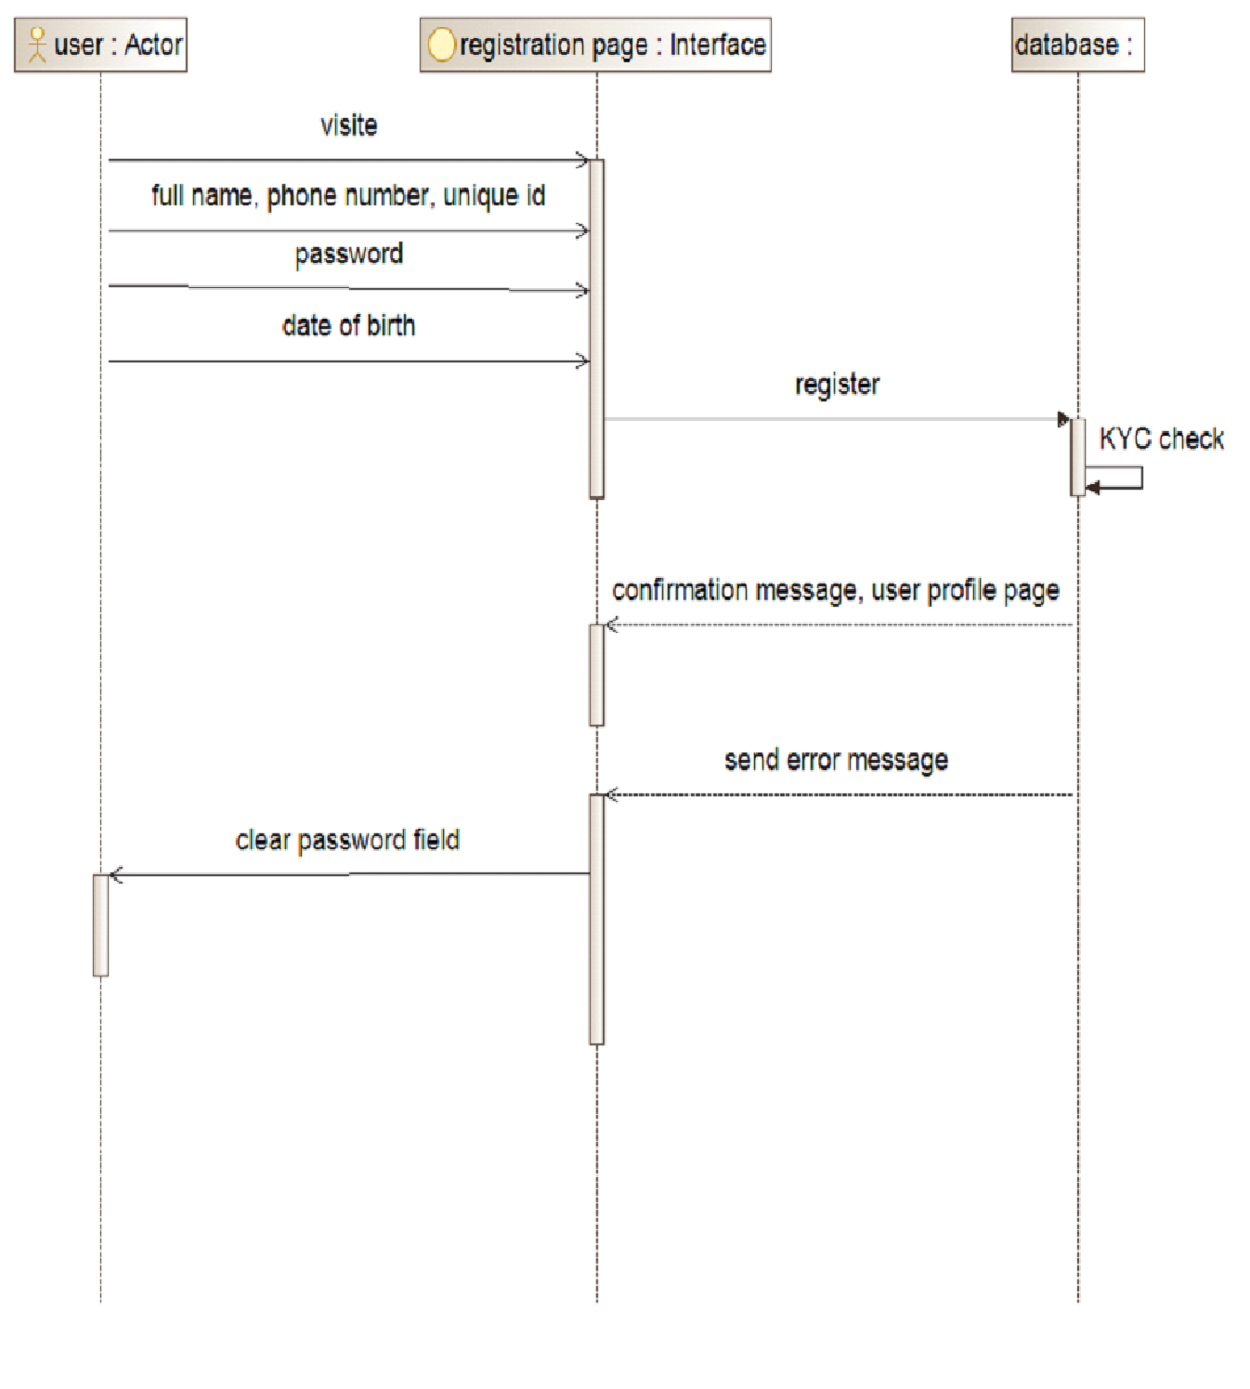
REGISTRATION

Slide 13
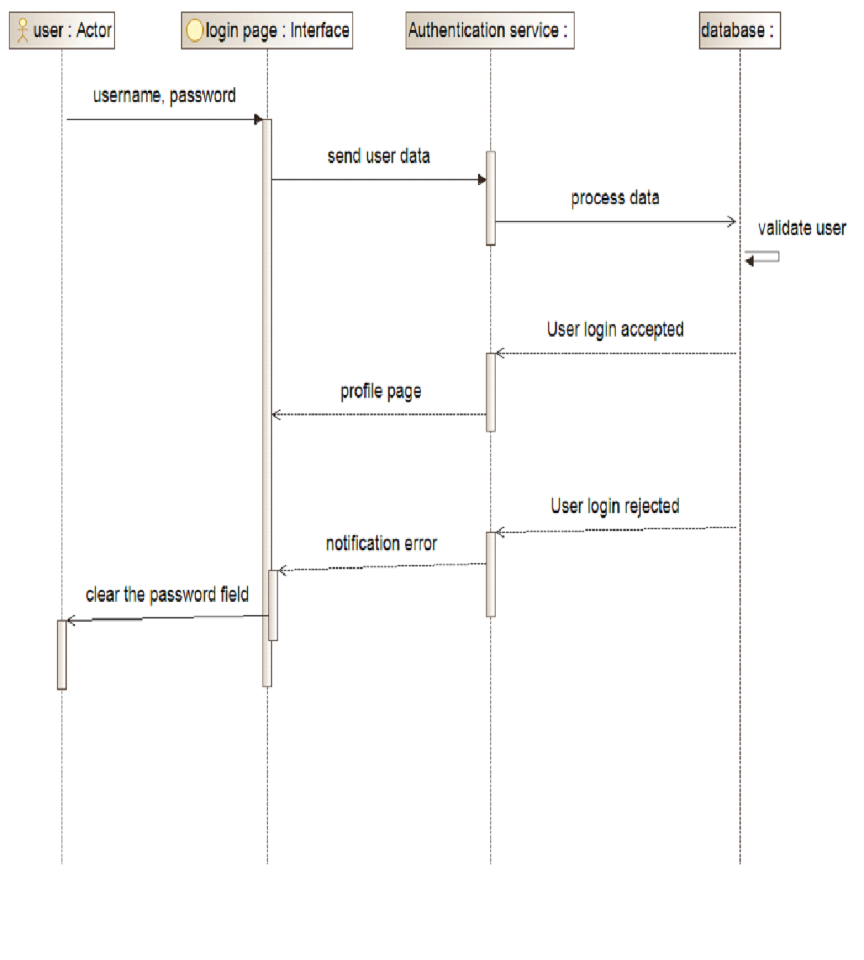
LOGIN

Slide 14
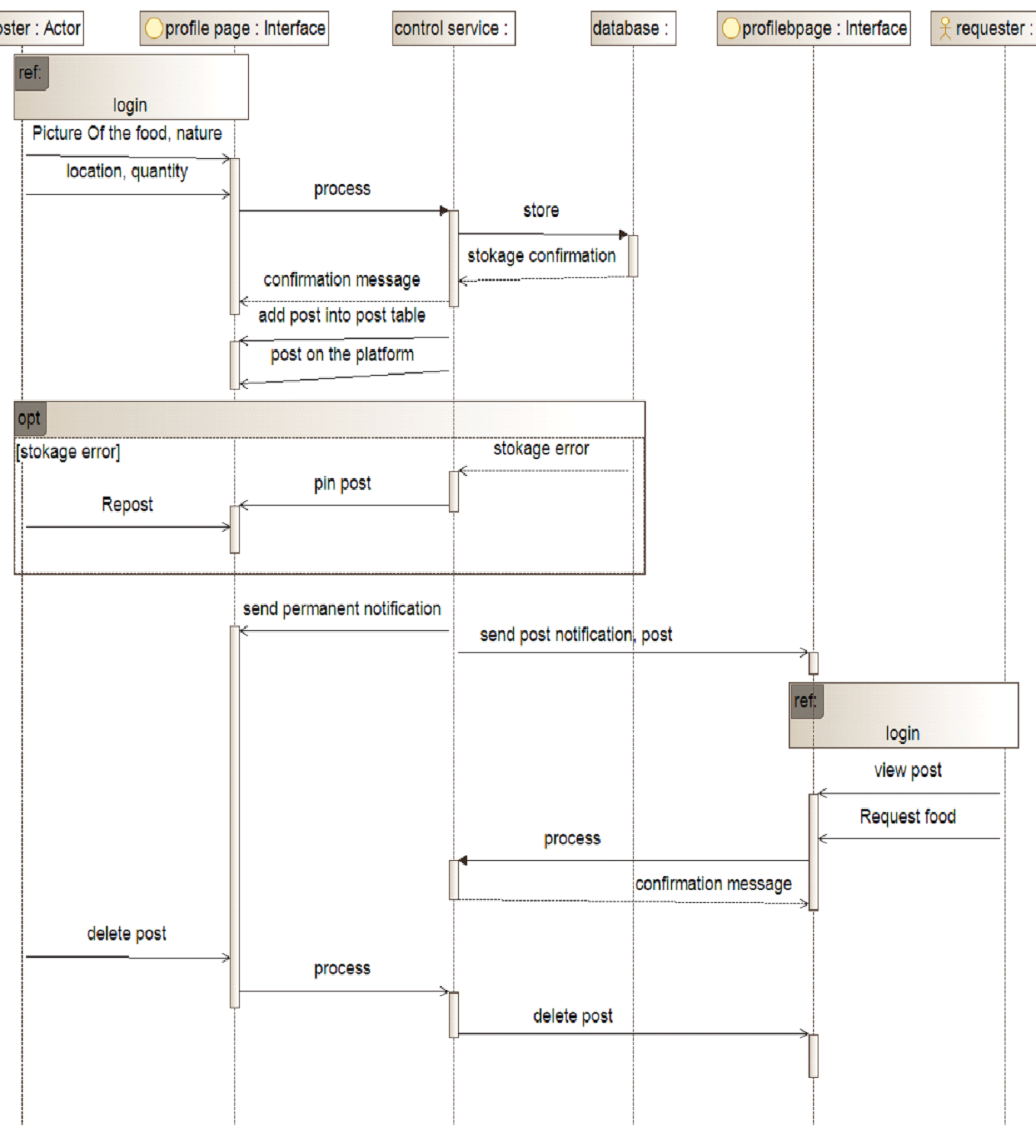
FOOD POSTING

Slide 15
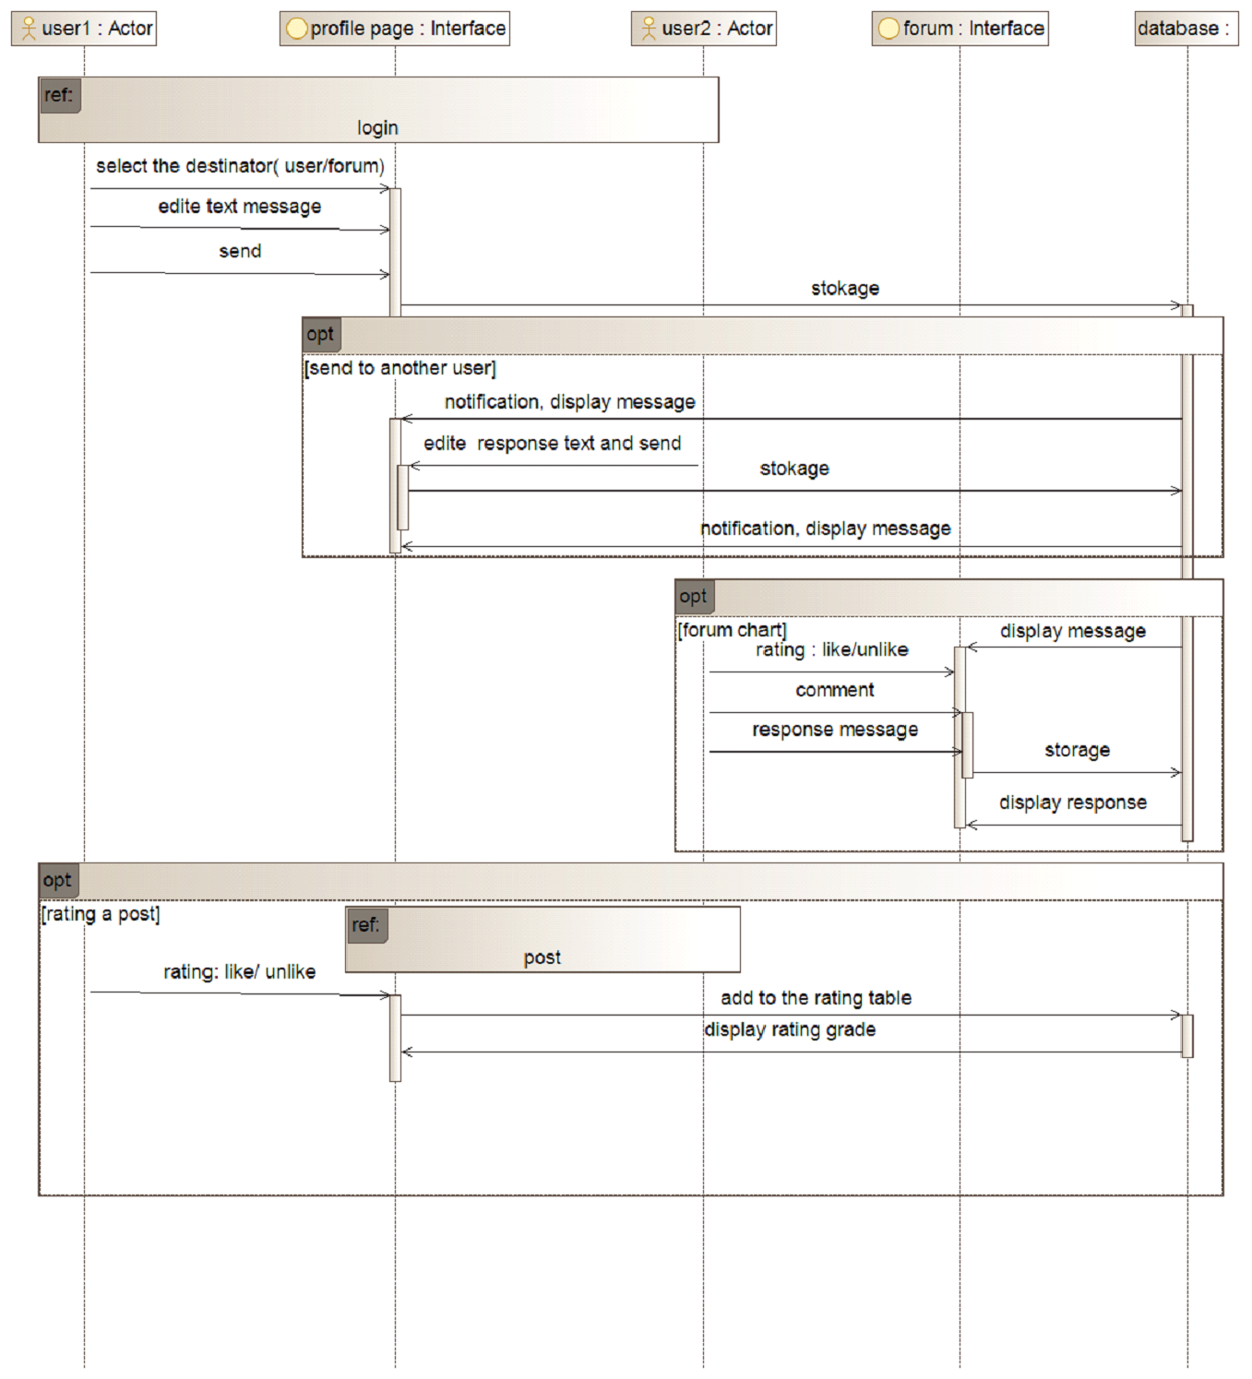
DISCUSS
COMMENT
RATING

Slide 16
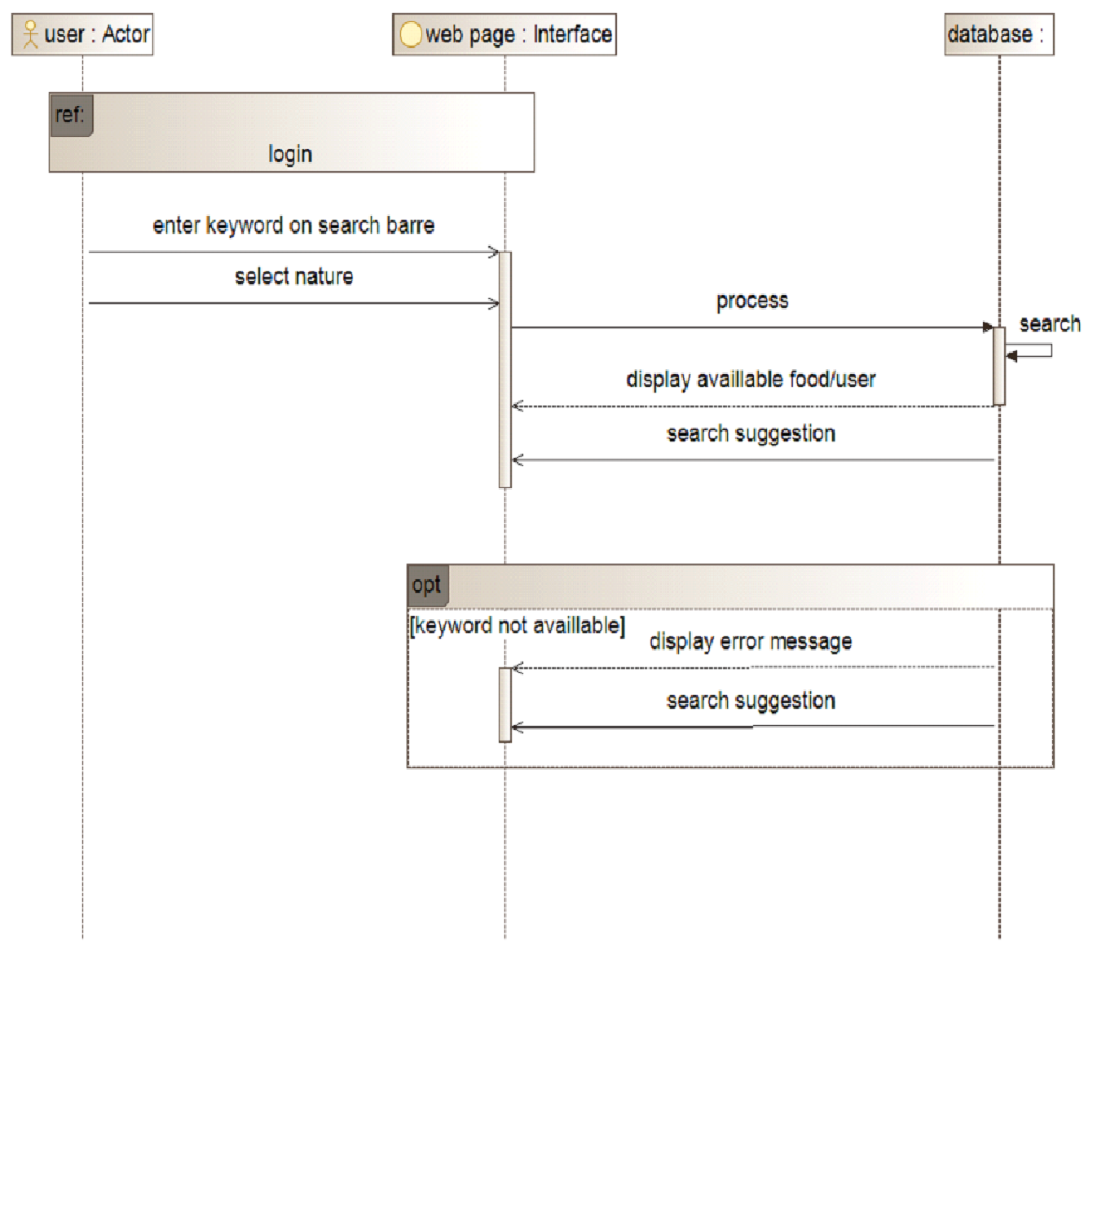
FOOD SEARCH

Slide 17
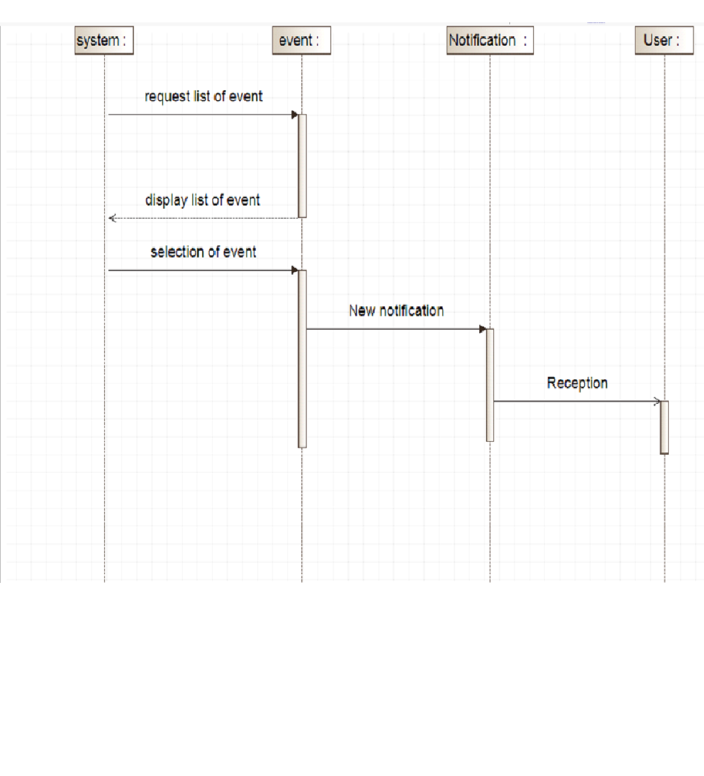
NOTIFICATION

Slide 18
5. ACTIVITY DIAGRAM
Describe the activities of each class.

Slide 19
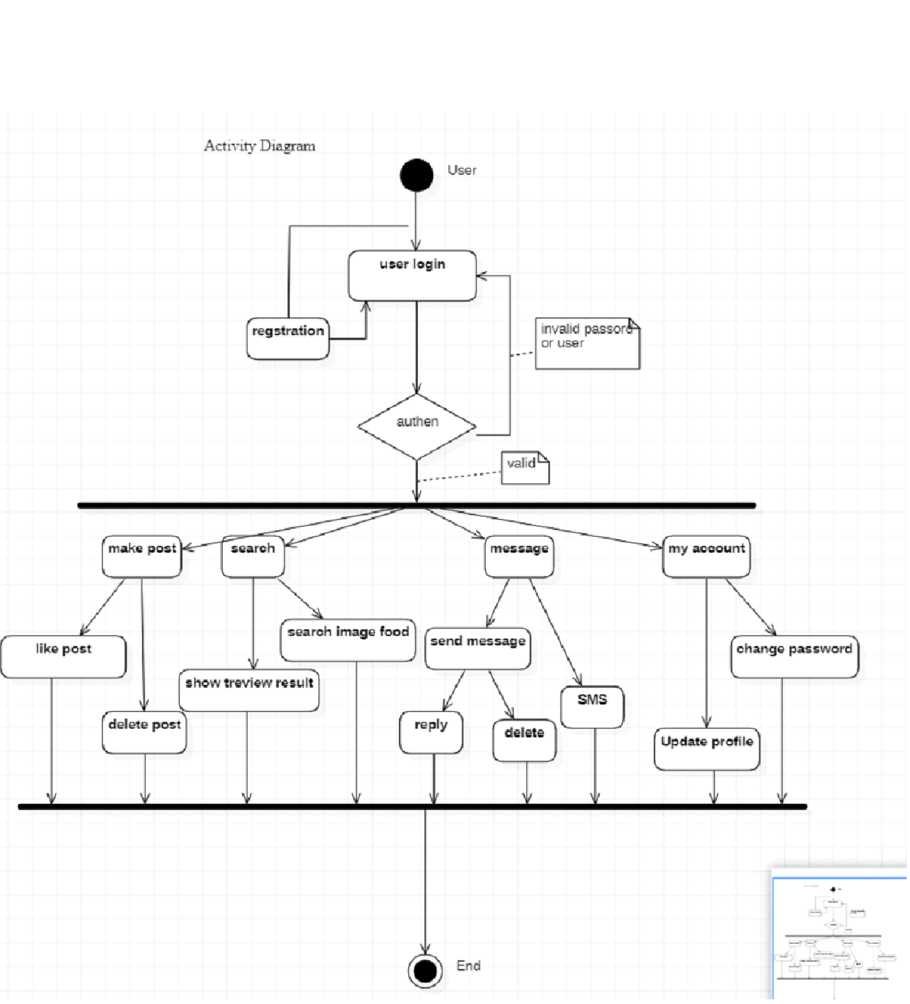

Slide 20
6. DATA FLOW DIAGRAM
Shows information flow in the processes of the system.

Slide 21
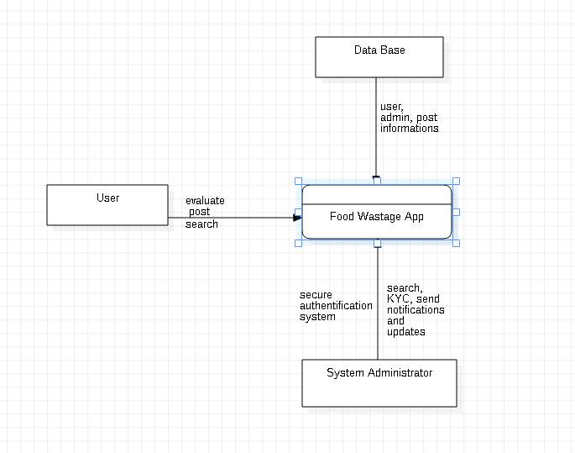
LEVEL 0

Slide 22
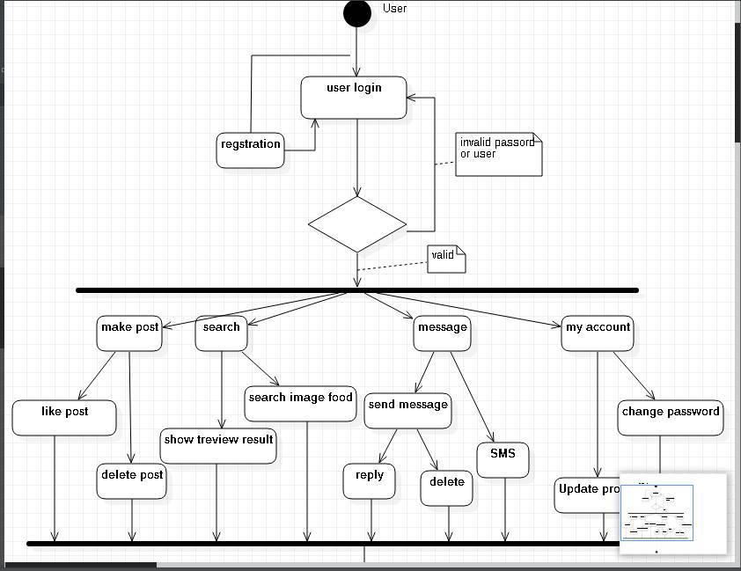
LEVEL 1

Slide 23
6. CONCLUSION

Slide 24
Overall, the design and modeling of a food management application requires careful consideration of user needs, technical requirements, and data management strategies to create a functional and effective tool for managing food-related tasks.

Slide 25

THANKS!
Any questions?
You can find us at:
https://github.com/cybelle715

Slide 26

GROUP I

