Slide 1
CYBER 327 / LECTURE 22
Digital Modulation Families and Constellation Basics
How do bits become a transmitted waveform?
FRIDAY, OCTOBER 23, 2026
LECTURE 22 | DIGITAL MODULATION FAMILIES
01

Slide 2
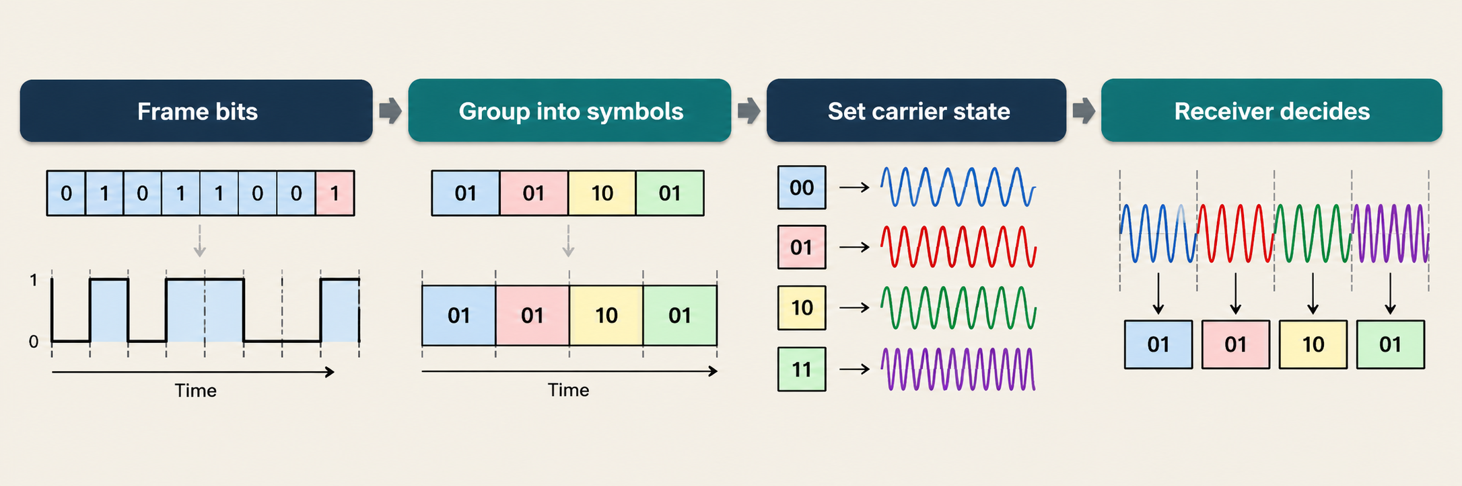
START WITH THE NEXT PROBLEM
A radio cannot transmit an abstract 0 or 1
DIGITAL MODULATION ASSIGNS BIT GROUPS TO DISTINGUISHABLE SIGNAL STATES
LECTURE 22 | DIGITAL MODULATION FAMILIES
02
Notes:
The frame may include data, CRC/FEC, and authentication fields.

Slide 3
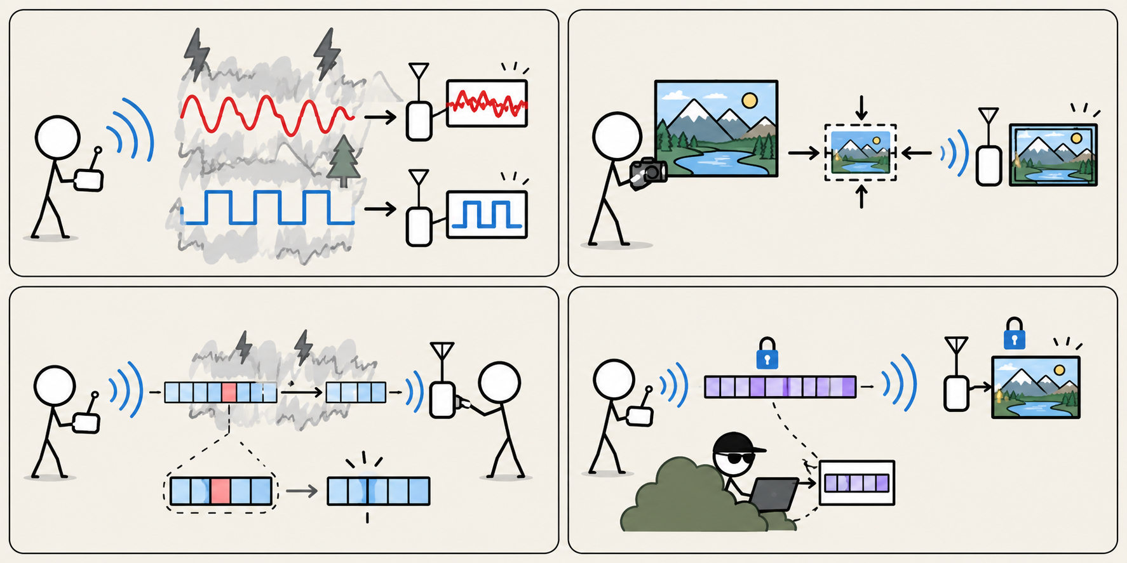
START WITH THE NEXT PROBLEM
Why Digital Modulation?
GREATER NOISE IMMUNITY
CAN BE COMPRESSED
ERROR DETECTION & CORRECTION
CAN BE ENCRYPTED
02
LECTURE 22 | DIGITAL MODULATION FAMILIES
Notes:
Disadvantages
More complex circuitry
Inherently requires more BW (less efficient in b/s/Hz)

Slide 4
WORK THE EXAMPLE
AM, FM, and PM but digital
Family | What carries the symbol? | Binary example | Flavors
ASK / OOK Amplitude Shift Keying On-off Keying | Carrier amplitude | Off = 0; on = 1 (OOK) | OOK, QAM, 16QAM, 64QAM, 256QAM, etc.
FSK Frequency Shift Keying | Carrier frequency | One tone = 0; another = 1 | BFSK, QFSK, 8FSK, 16FSK, etc.
PSK Phase Shift Keying | Carrier phase | 0 degrees = 1; 180 degrees = 0 | BPSK, QPSK, 8PSK, 16PSK, etc.
LECTURE 22 | DIGITAL MODULATION FAMILIES
03
Notes:
Keying means choosing discrete states.
OOK is a special form of ASK.

Slide 5
MAKE IT VISIBLE
Compare the same 1 0 1 1 message
1
0
1
1
OOK
BFSK
BPSK
Same bits, same symbol slots, different carrier property. Idealized: no pulse shaping.
LECTURE 22 | DIGITAL MODULATION FAMILIES
04
Notes:
Read the four bit slots left to right. OOK changes amplitude; BFSK changes cycles per slot; BPSK reverses carrier phase. The drawing is idealized and editable. It omits pulse shaping and acquisition details; real transmitters must control spectral spreading.

Slide 6

BUILD THE IDEA
A symbol can represent more than one bit
Modulation | Available choices | Bits per symbol
Binary FSK | 2 frequencies | 1
BPSK | 2 phases | 1
QPSK | 4 phases | 2
16-QAM | 16 amplitude-and-phase combinations | 4
Symbol
One selected signaling state during a symbol interval.
Two states:
0/1 ⟶ one bit per symbol
Four states:
00, 01, 11, and 10 ⟶ two bits per symbol
$$\frac{bits}{symbol}=\log_{2}M$$
Example
A modulation scheme has 16 possible signal states. How many bits can each symbol represent?
for M possible states
How many symbols for each modulation if you will transmit 101100?
LECTURE 22 | DIGITAL MODULATION FAMILIES
05
Notes:
For fixed-length binary labels and M a power of two, bits/symbol = log2(M). Baud is symbols per second, not necessarily transitions per second: repeated identical symbols need not create a change.

Slide 7
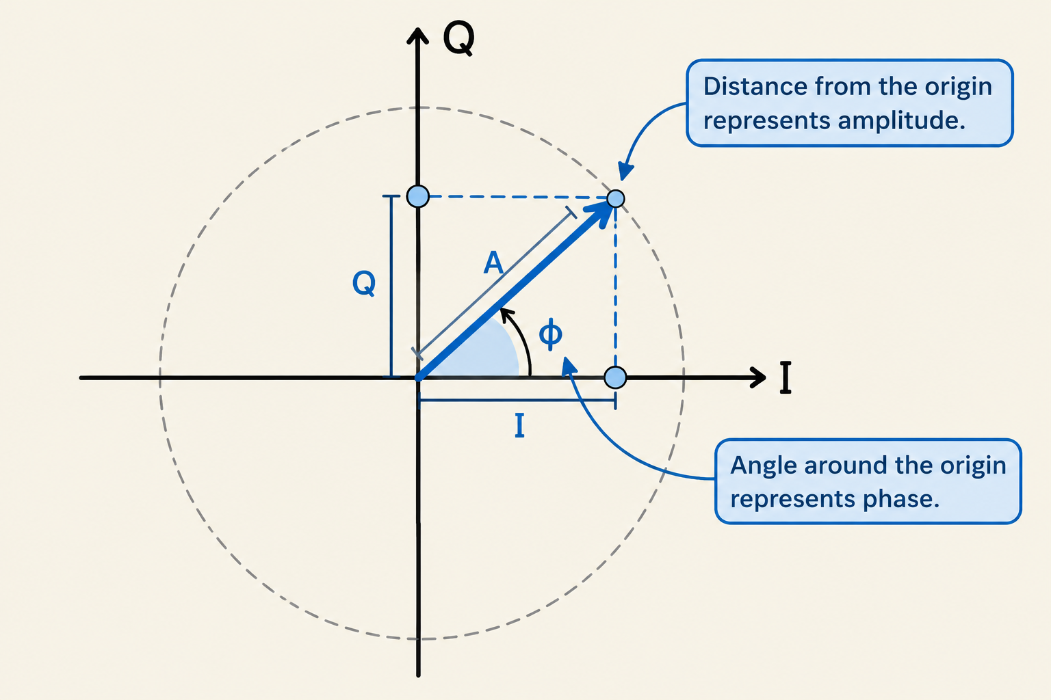

BUILD THE IDEA
I and Q describe a carrier state with two numbers
$$s\left(t\right)=I\cos\left(2πf_{c}t\right)−Q\sin\left(2πf_{c}t\right)$$
In-Phase
The amount of the reference carrier
Quadrature
The amount of the carrier shifted by 90º
QPSK symbol | I | Q
00 | +1 | +1
01 | −1 | +1
11 | −1 | −1
10 | +1 | −1
Plot I horizontally and Q vertically: the result is a constellation.
LECTURE 22 | DIGITAL MODULATION FAMILIES
06
Notes:
Use s(t) = I cos(2 pi fc t) - Q sin(2 pi fc t) for this sign convention. Radius gives amplitude; angle gives phase relative to the receiver reference. Receiver mixing and timing recovery estimate I/Q at symbol decision times.

Slide 8
MAKE IT VISIBLE
Constellation is not a spectrum
BPSK: 2 states
QPSK: 4 states
Q
Q
01
00
I
I
0
1
11
10
Bit pair | Phase | I/Q signs
00 | +45 degrees | +I, +Q
01 | +135 degrees | -I, +Q
11 | -135 degrees | -I, -Q
10 | -45 degrees | +I, -Q
TRANSMISSION: 10110001
LECTURE 22 | DIGITAL MODULATION FAMILIES
07
Notes:
BPSK 1 bit/symbol
QPSK 2 bits/symbol
Constellation: which amplitude-and-phase choices represent the bits. The filled dot marks the current choice.
Spectrum: how the transmitted signal’s power is distributed across frequencies over time. This example shows a theoretical spectrum with pulse shaping.

Slide 9

WORK THE EXAMPLE
Baud and bit rate answer different questions
bits/symbol
Modulation | Bits per symbol | At 1,000 symbols/s
BPSK: M = 2 | log2(2) = 1 | 1,000 bit/s
QPSK: M = 4 | log2(4) = 2 | 2,000 bit/s
16-QAM: M = 16 | log2(16) = 4 | 4,000 bit/s
$$\text{Bit rate}=\text{Baud rate}×\log_{2}M$$
bits/s
symbols/s
Two transmitters operate at 3,000 symbols/s. One uses QPSK; the other uses 16-QAM. Find their bit rates.
A QPSK transmitter must carry a mapped bit rate of 18 kbit/s. What symbol rate is required?
LECTURE 22 | DIGITAL MODULATION FAMILIES
09
Notes:
QPSK: 3,000×2=6,000 bit/s.
- 16-QAM: 3,000×4=12,000 bit/s.
2
$$R_{s}=\frac{R_{b}}{\log_{2}\left(M\right)}=\frac{18,000}{2}=9,000$$
Followup: “Would 16-QAM require the same symbol rate? No, half

Slide 10
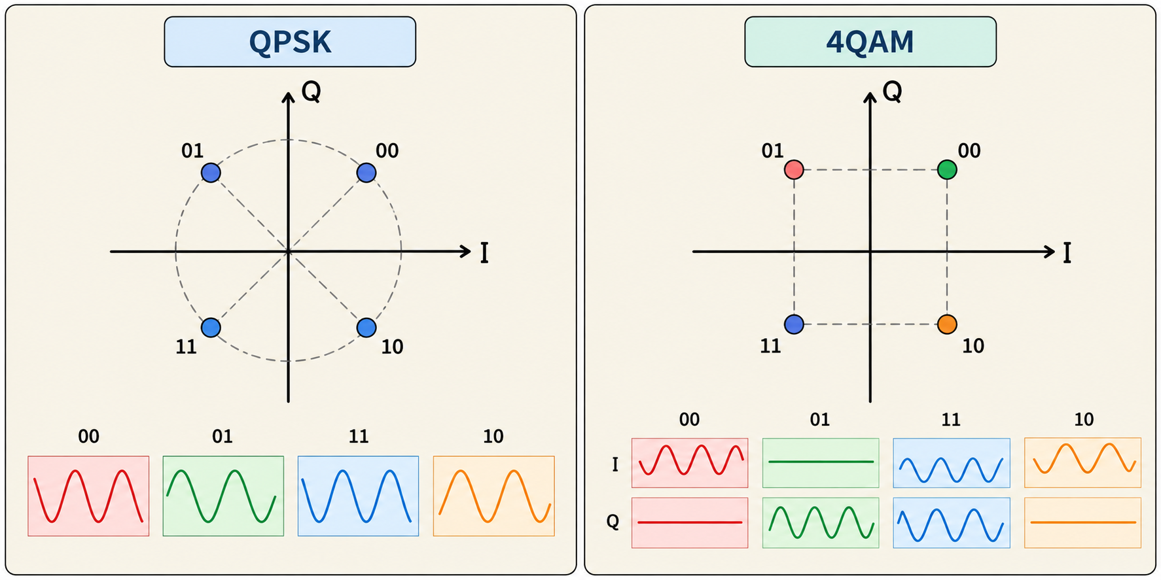
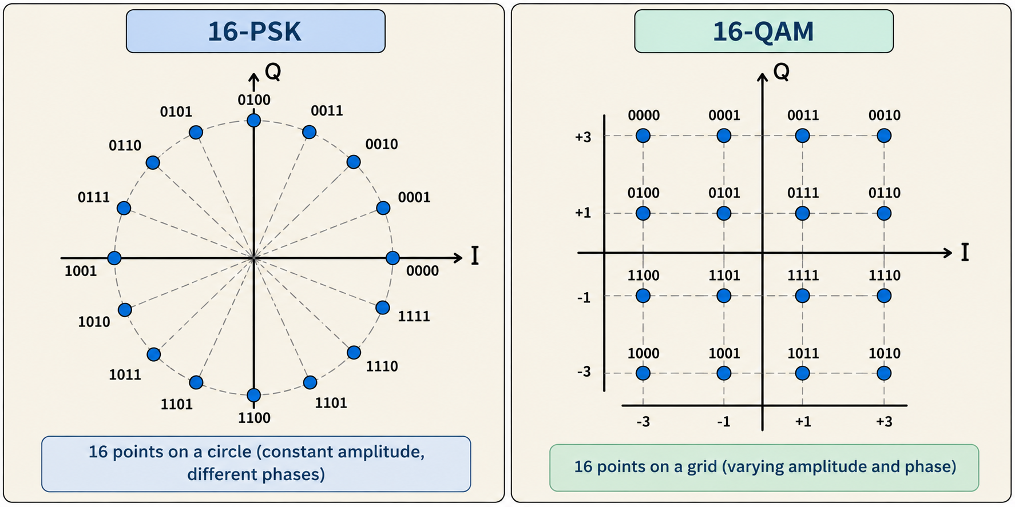
BUILD THE IDEA
QAM adds amplitude choices as well as phase
At equal symbol rate, more states carry more mapped bits per second BUT leave less room for errors.
LECTURE 22 | DIGITAL MODULATION FAMILIES
10

Slide 11
MAKE IT VISIBLE
Noise turns ideal points into clouds
Clean QPSK
Disturbed QPSK
Q
Q
I
I
One ideal point per state
Samples spread around intended states
The receiver measures (-0.7,+0.9). Which bit pair should it choose using the nearest allowed point?
LECTURE 22 | DIGITAL MODULATION FAMILIES
11
Notes:
Additive noise is one cause; timing error, phase error, distortion, and interference can also spread or move points.
01, because the measurement is closest to (-1,+1).

Slide 12

BUILD THE IDEA
Spectral efficiency
Takeaways
More bits per symbol can increase bit/s per Hz without raising symbol rate.
Higher-order modulation is useful only if the receiver can distinguish its states.
$$η=\frac{R_{b}}{BW}$$
Bit rate (bits/s)
Bandwidth (Hz)
Spectral Efficiency (bits/s/Hz)
Spectral efficiency measures how much information we can transmit using a given amount of bandwidth.
A link has:
Bit rate: 24 kbit/s
Code rate: 3/4
BW: 12 kHz
Find:
the information bit rate
gross spectral efficiency
useful spectral efficiency.
LECTURE 22 | DIGITAL MODULATION FAMILIES
12
Notes:
3R_{info}=24,000×3/4=18,000 bit/s
η_{gross}=24,000/12000=2 bit/s/Hz
η_{useful}=18000/12000=1.5 bit/s/Hz

Slide 13
CHECK UNDERSTANDING
Exit check
A designer changes a link from QPSK to 16-QAM while keeping the same symbol rate and average symbol energy.
What happens to the mapped bit rate?
Why might the receiver make more errors under the same noise conditions?
NEXT: QAM AND BIT ERROR RATE
LECTURE 22 | DIGITAL MODULATION FAMILIES
15
Notes:
It doubles: four bits per symbol instead of two.
The constellation has smaller minimum point spacing, leaving less decision margin.

