Slide 1
CYBER 327 / LECTURE 16
Filters, Clock Recovery, PLLs, and Synchronization
A receiver must select a channel and recover timing before it can trust symbols.
MONDAY, OCTOBER 12, 2026
LECTURE 16 | FILTERS CLOCK RECOVERY PLLS
01
Notes:
Open with the distinction or case in Slide 2. Preserve the communications model before adding the cybersecurity application. The step may remain outside lock or tracking range even if initial acquisition was possible.

Slide 2
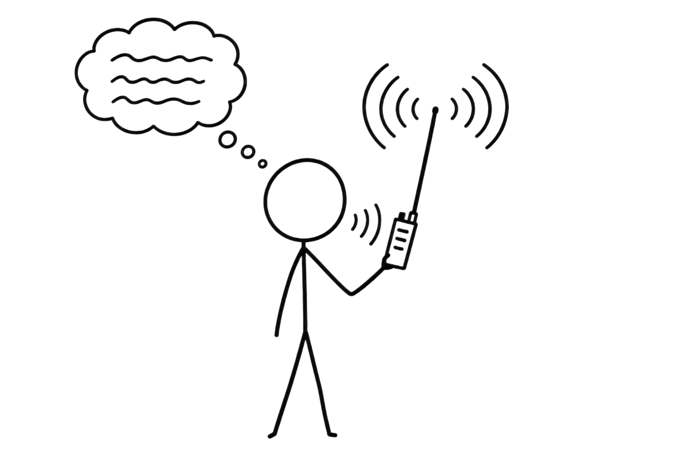
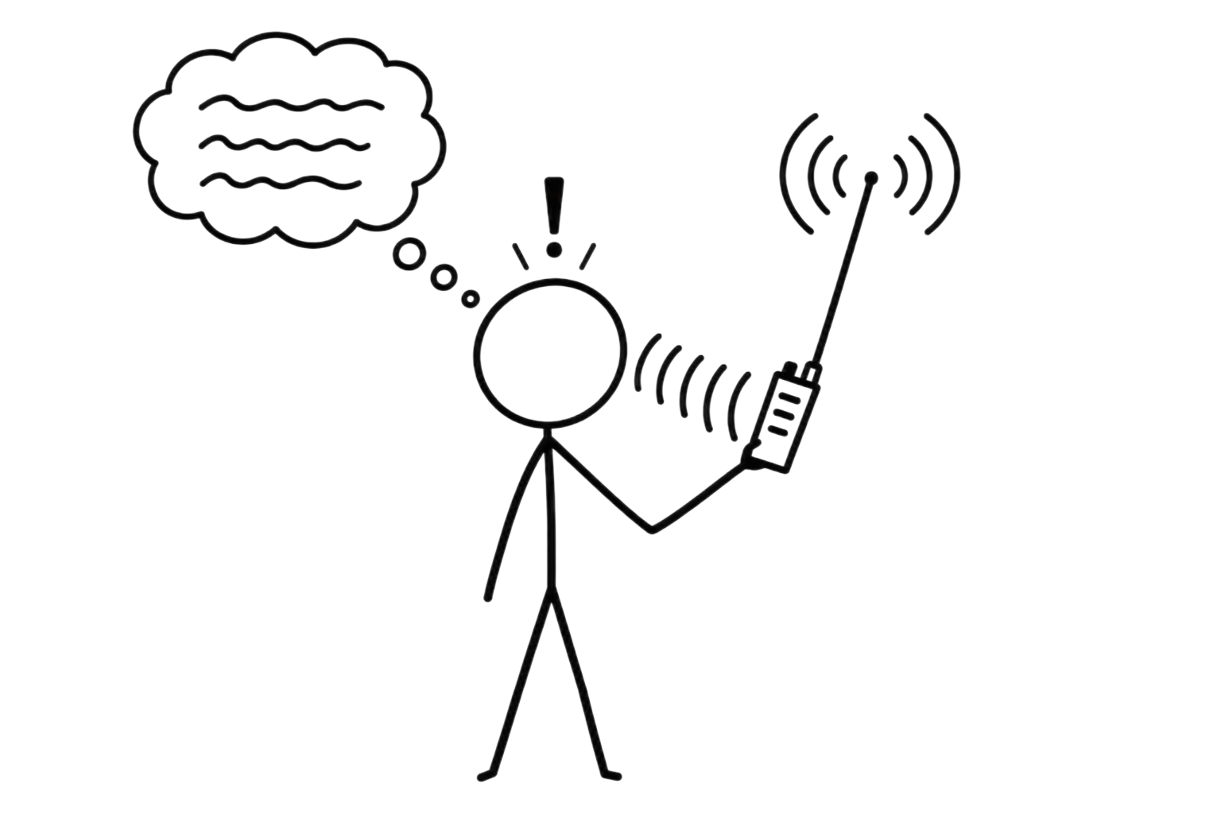
RECALL
The Communication System
Must produce high dv/dt
Must deal with noise
Distance α cost, power, size
Must amplify weak signal
Message
Transmitter
Receiver
Recovered message
Medium
02

Slide 3
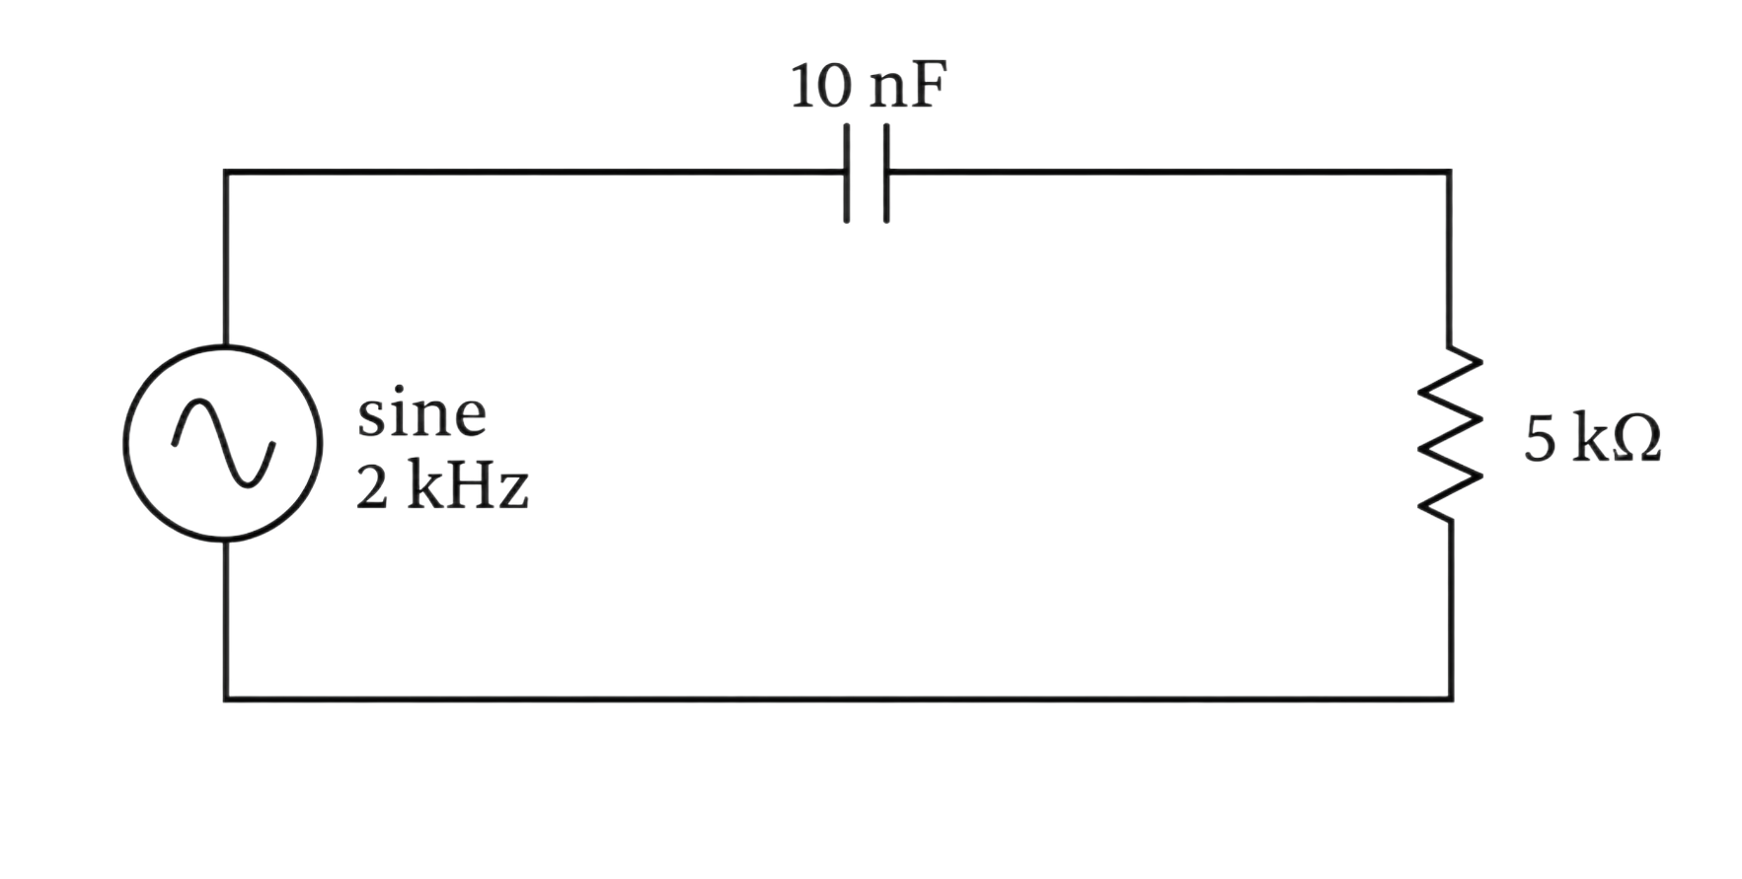
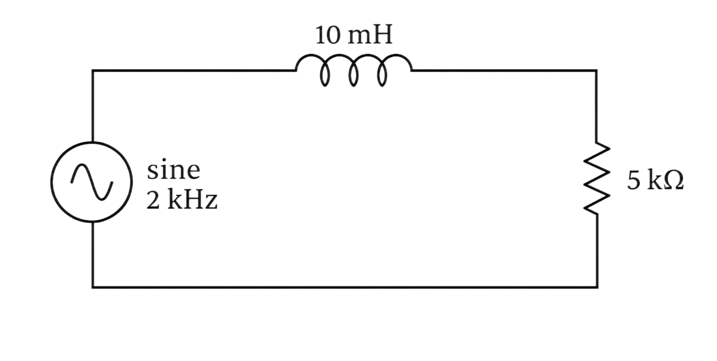
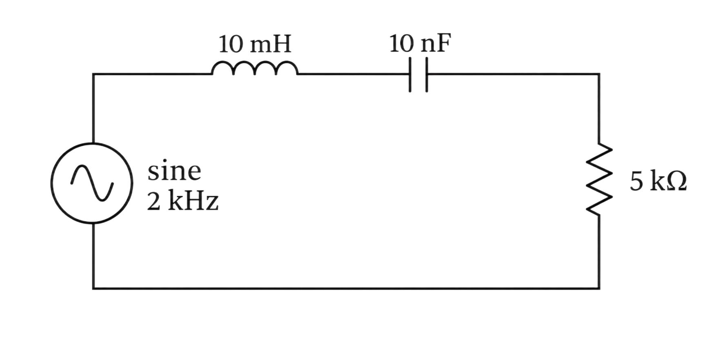
COMMUNICATIONS FOUNDATION
Filters keep the signal you want
Filter | V across
Low pass
High-pass
Band-pass
Band-stop
LECTURE 16 | FILTERS CLOCK RECOVERY PLLS
03

Slide 4
COMMUNICATIONS FOUNDATION
Filters keep the signal you want
Filter | V across
Low pass | C in RC R in RL C in RLC
High-pass | R in RC L in RL L in RLC
Band-pass | R in RLC
Band-stop | LC in RLC
LECTURE 16 | FILTERS CLOCK RECOVERY PLLS
03

Slide 5
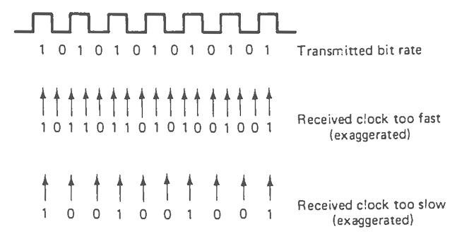
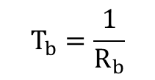

WORKING VOCABULARY
Determine when to read each bit
Clock Recovery
Extraction of symbol timing from a received signal.
Symbol
The physical signal state that represents one or more bits of information.
Bit Interval
$$T_{b}=\frac{1}{R_{b}}$$
$R_{b}$= bit rate
LECTURE 16 | FILTERS CLOCK RECOVERY PLLS
04
Notes:
Imagine a digital signal carrying 1,000 bits per second. Each bit lasts 1 ms, but the receiver still needs to locate those bit intervals.

Slide 6
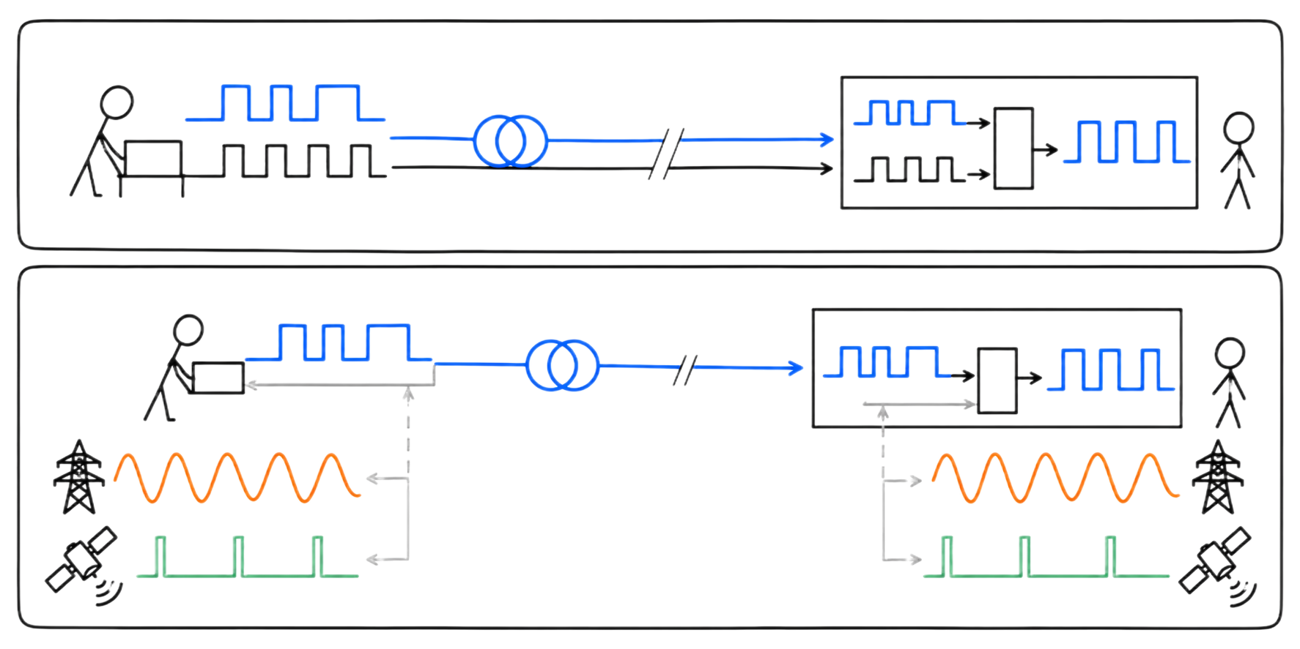
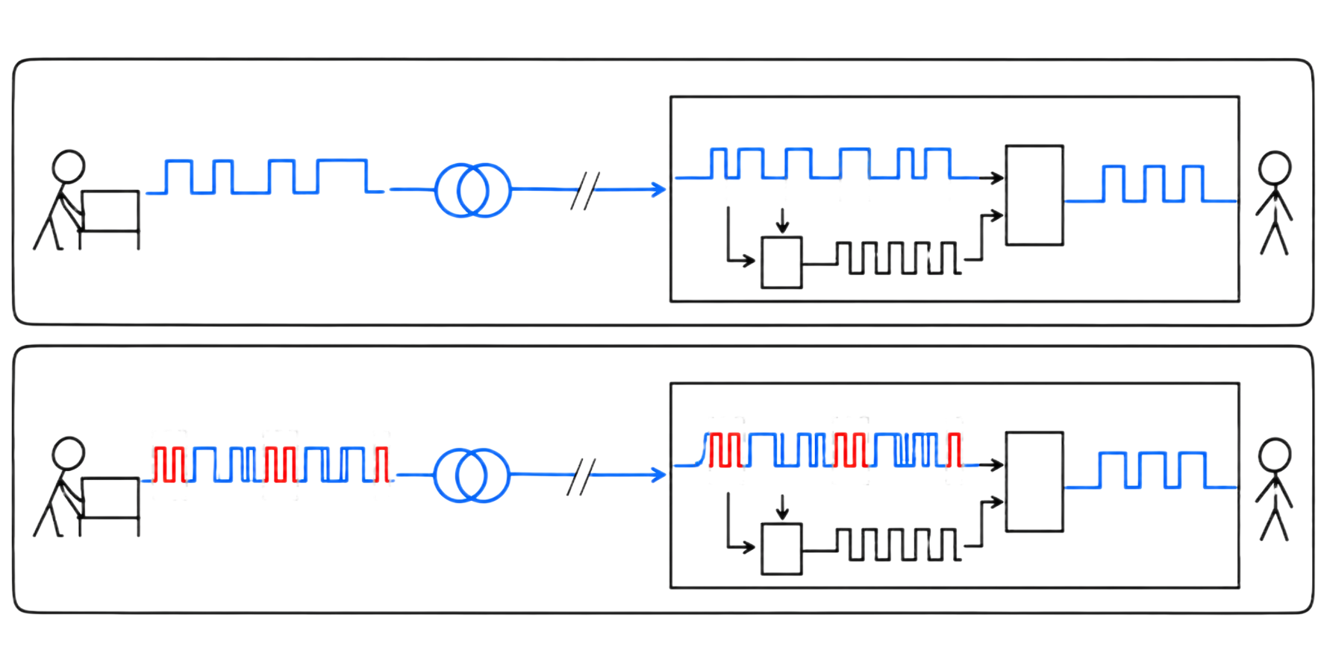
WORKING VOCABULARY
Determine when to read each bit
Synchronizing options
Send the clock as a separate signal
  Requires separate channel, more BW
  Common for short-distance communication, where each channel is nearly free
Reference a common signal
  50 Hz, 60 Hz
  GPS clock
  WWV, WWVH – Short wave signal of atomic clock (Coordinated Universal Time)
Derive clock timing from the received data
Use special bits as part of the data stream
#3, 4 together by far the most common for distances over about 15 feet.
LECTURE 16 | FILTERS CLOCK RECOVERY PLLS
04
Notes:
Imagine a digital signal carrying 1,000 bits per second. Each bit lasts 1 ms, but the receiver still needs to locate those bit intervals.

Slide 7
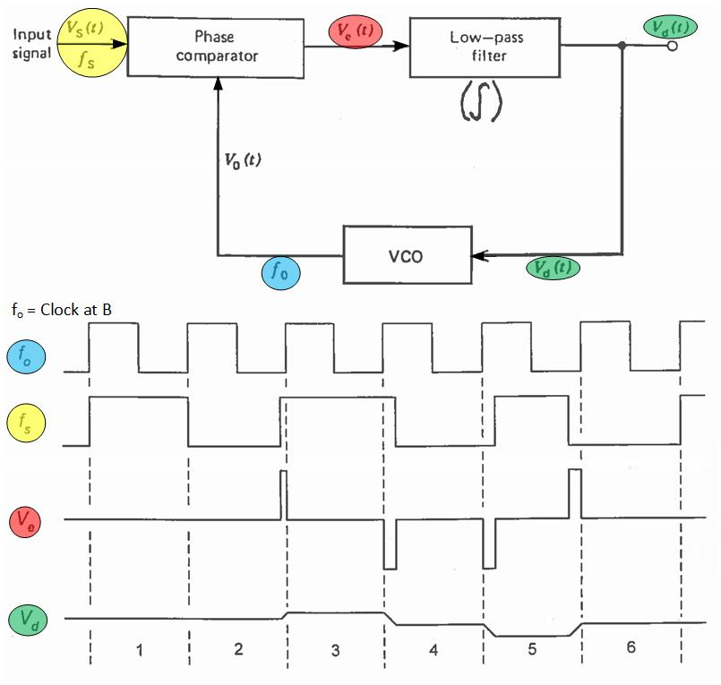
WORKING VOCABULARY
Continually Correct the Timing
Phase Locked Loop (PLL)
  A circuit that is used to recover the clock.
  A feedback system.
  It compares an incoming timing reference with a local oscillator and adjusts the oscillator to stay aligned.
LECTURE 16 | FILTERS CLOCK RECOVERY PLLS
04
Notes:
Imagine a digital signal carrying 1,000 bits per second. Each bit lasts 1 ms, but the receiver still needs to locate those bit intervals.

Slide 8
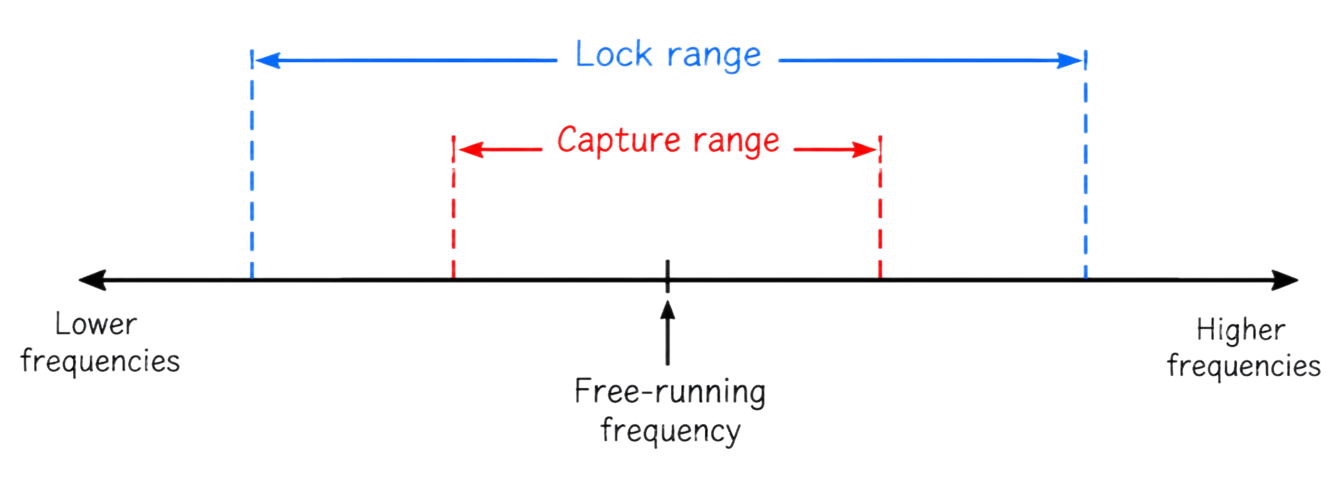
WORKING VOCABULARY
Continually Correct the Timing
Capture range
  The frequencies at which a PLL can initially synchronize with an incoming signal.
  The frequencies over which a PLL can remain synchronized after it has already locked.
Lock range
LECTURE 16 | FILTERS CLOCK RECOVERY PLLS
04

Slide 9
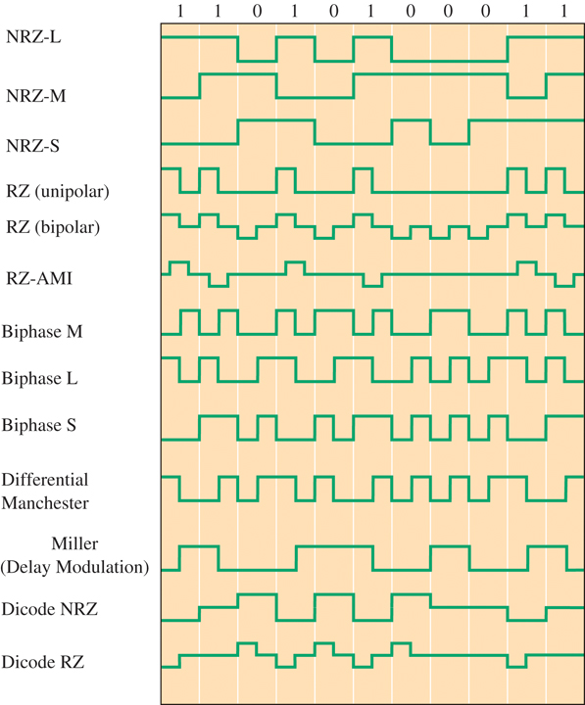
WORKING VOCABULARY
Types of Encoding
  Can you recover the timing if you transmit a lot of zeroes/ones?
LECTURE 16 | FILTERS CLOCK RECOVERY PLLS
04

Slide 10
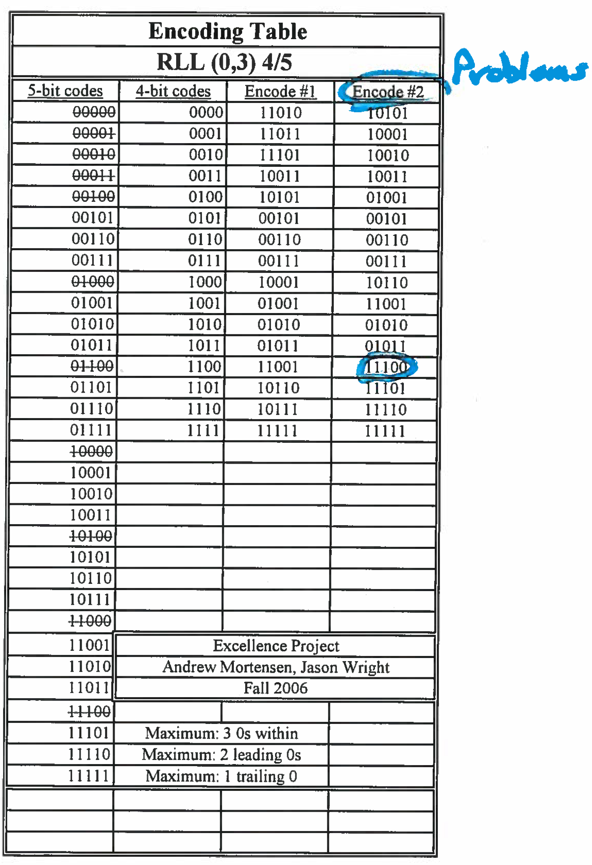
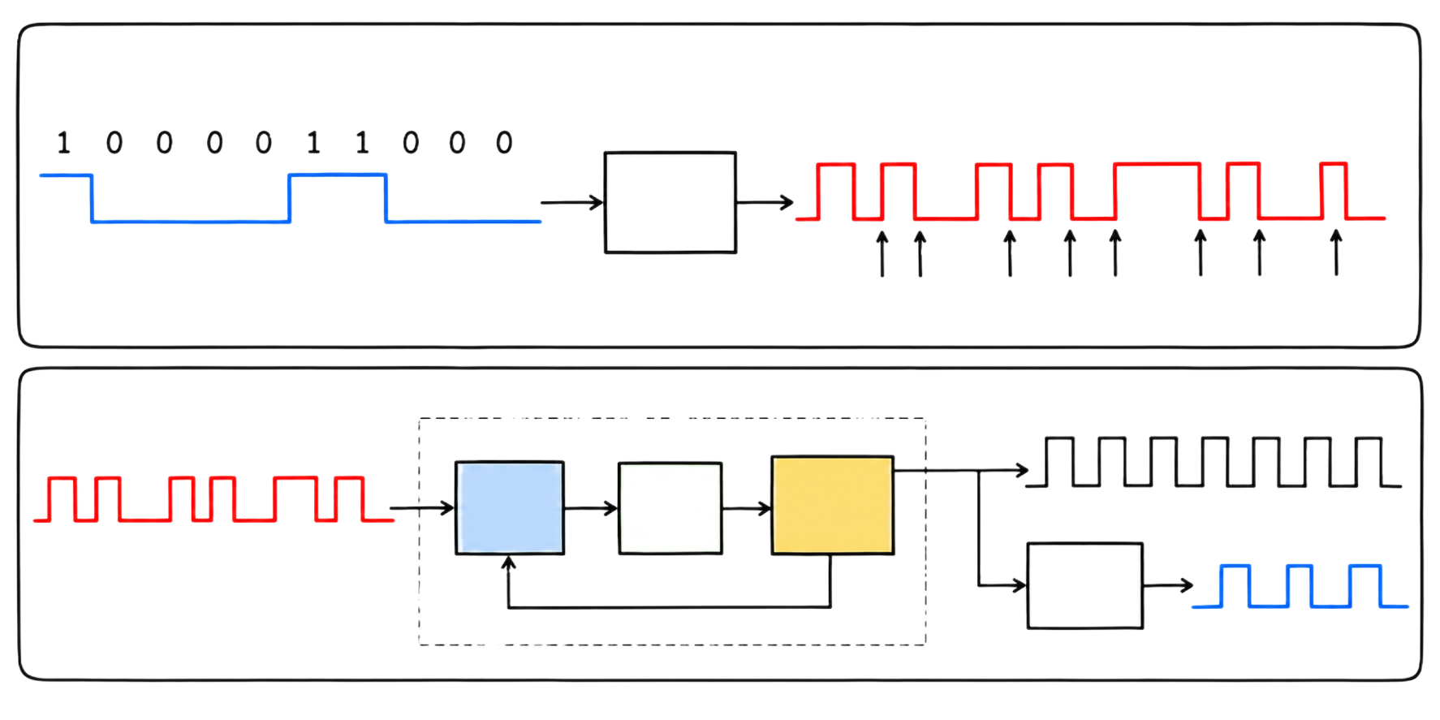
WORKING VOCABULARY
Continually Correct the Timing
Run-Length Limiting (RLL)
  Encode the data so that long sequences without transitions are avoided.
LECTURE 16 | FILTERS CLOCK RECOVERY PLLS
04

Slide 11
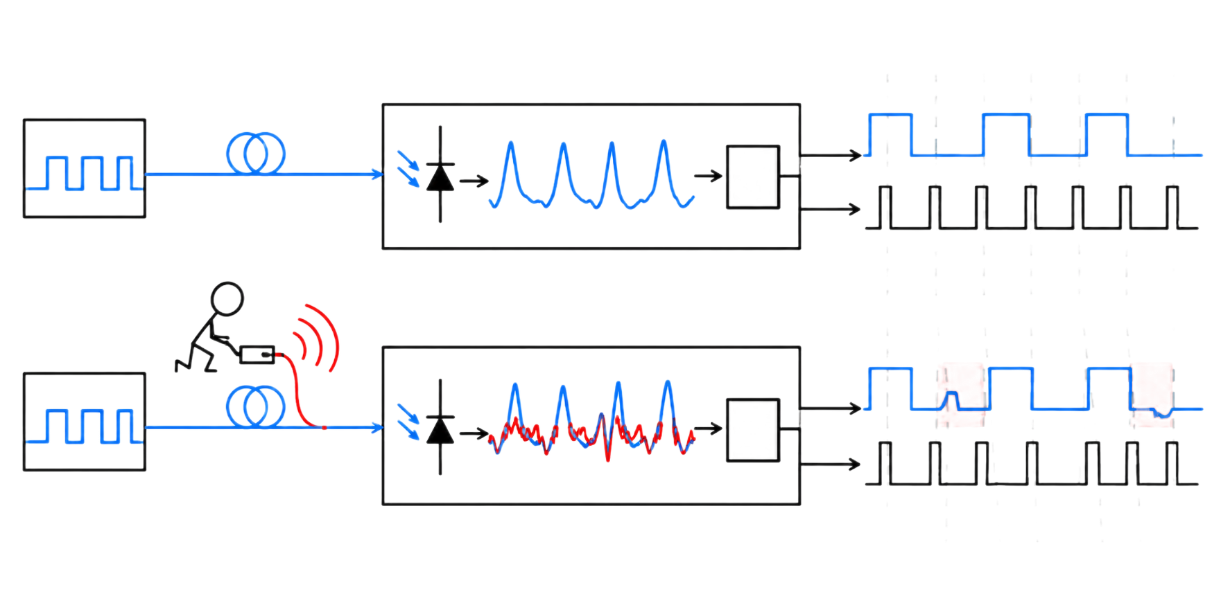
APPLICATION
Cybersecurity follows the physical behavior
Network receivers
An attacker does not need to access the message. They can disturb the timing to misread bits, reject message or lose sync.
LECTURE 16 | FILTERS CLOCK RECOVERY PLLS
08

Slide 12
BRIDGE FORWARD
Exit check
How can a valid-looking signal still fail if timing is wrong?
NEXT: RECEIVER ARCHITECTURE, SENSITIVITY, AND SE
LECTURE 16 | FILTERS CLOCK RECOVERY PLLS
10

