Slide 1
CYBER 327 / LECTURE 17
Receiver Architecture, Sensitivity, and Selectivity
Sensitivity, selectivity, and dynamic range fail in different ways.
MONDAY, OCTOBER 12, 2026
LECTURE 17 | RECEIVER ARCHITECTURE SENSIT
01

Slide 2
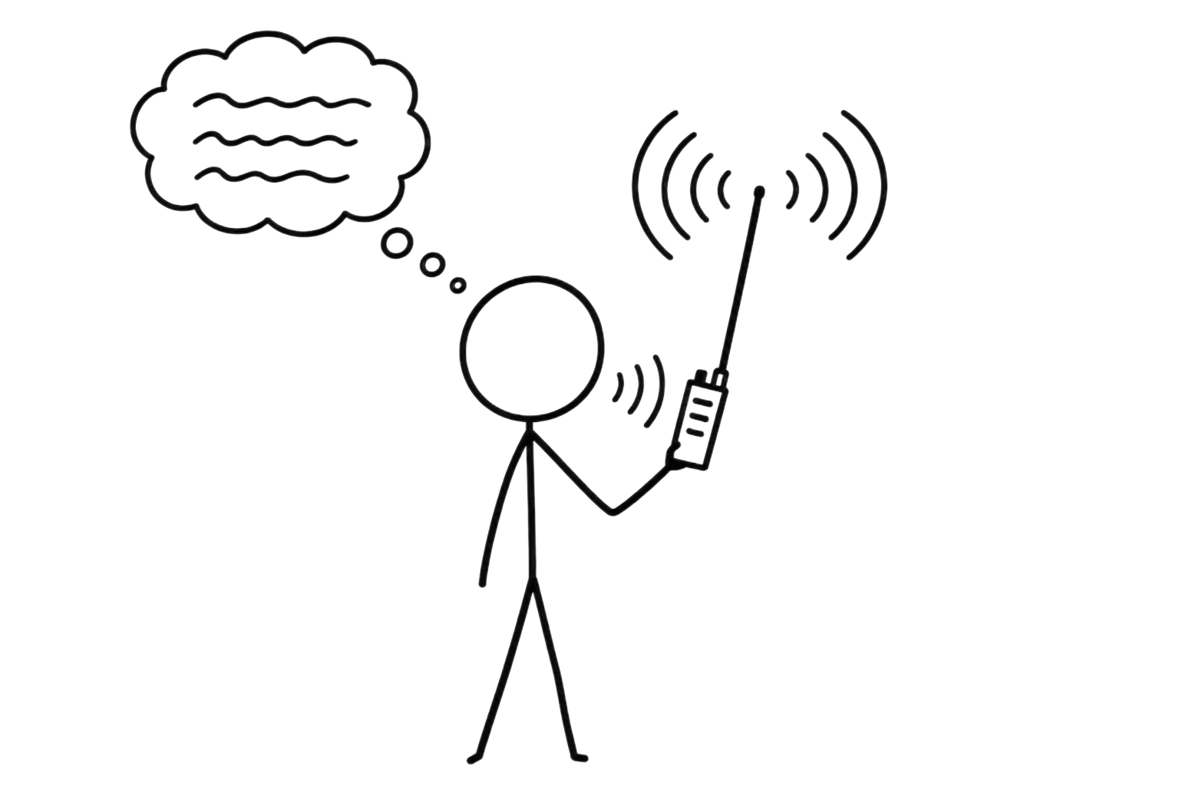
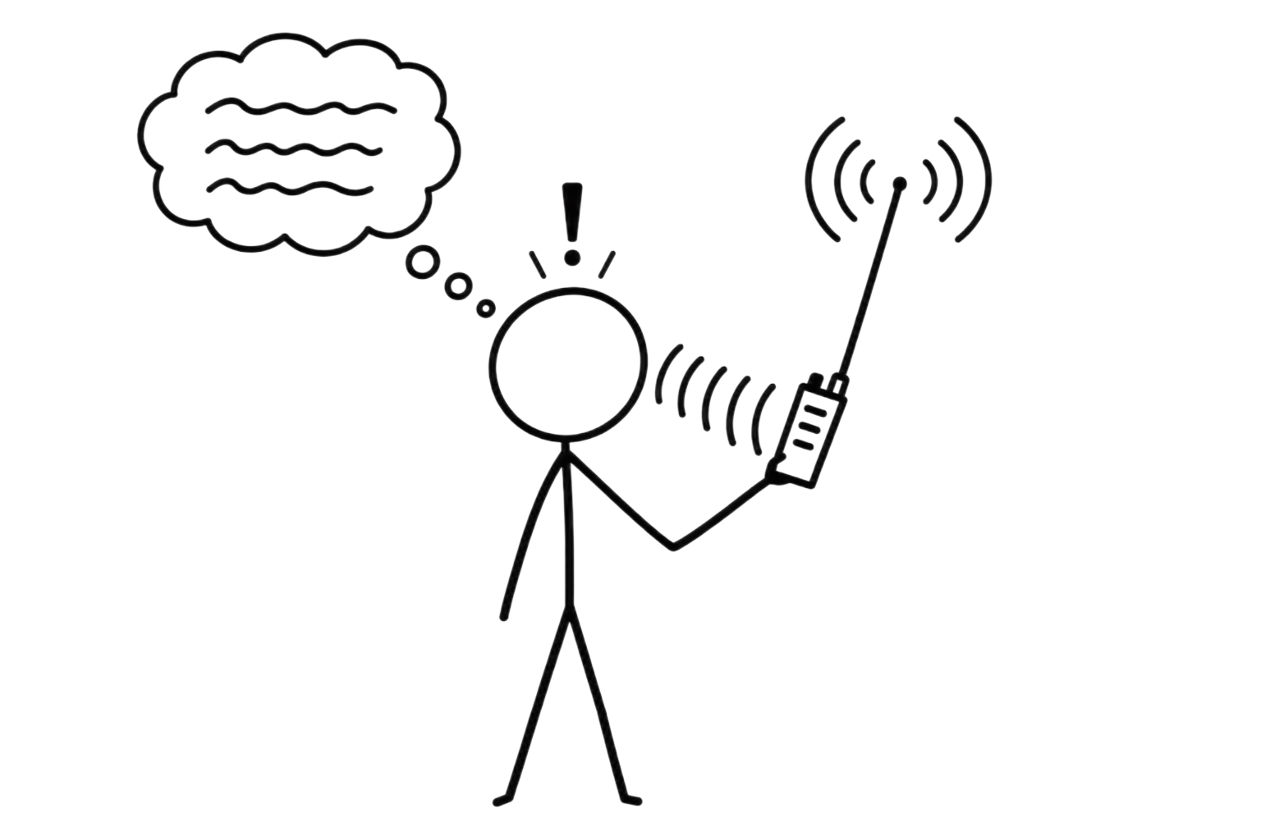
RECALL
The Communication System
Message
Transmitter
Receiver
Recovered message
Medium
02

Slide 3
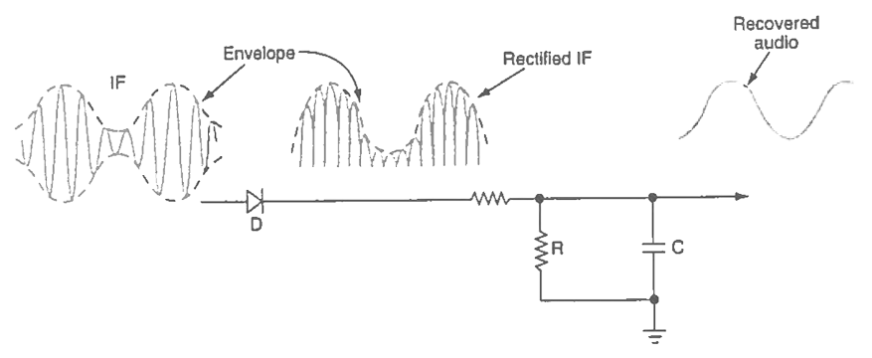
COMMUNICATIONS FOUNDATION
The AM Receiver
LECTURE 17 | RECEIVER ARCHITECTURE SENSIT
03

Slide 4
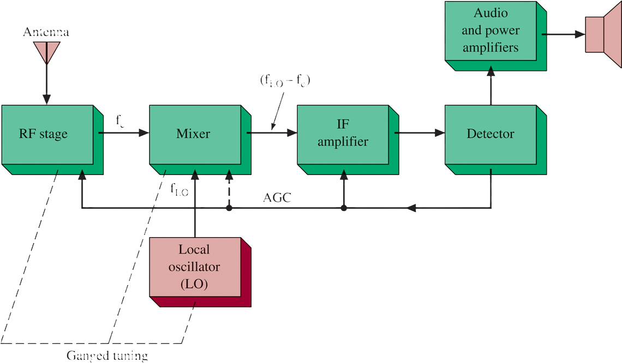



COMMUNICATIONS FOUNDATION
The Superheterodyne receiver
Antenna
Antenna
$$f_{LO}-f_{C}$$
$$f_{C}$$
$$f_{LO}$$
GOAL
Bring the signal to an intermediate frequency (IF) because your detector is super good at that IF
LECTURE 17 | RECEIVER ARCHITECTURE SENSIT
03

Slide 5







COMMUNICATIONS FOUNDATION
The Superheterodyne receiver
Antenna
$$540-1610 kHz$$
Antenna
$$f_{LO}−f_{C}$$
$$1160 kHz$$
$$Audio (20-20kHz)$$
$$f_{C}$$
$$455 kHz$$
$$455 kHz$$
$$f_{LO}$$
$$1615 kHz$$
EXAMPLE: KSL 1160AM
Bring the signal to an intermediate frequency (IF) because your detector is super good at that IF
LECTURE 17 | RECEIVER ARCHITECTURE SENSIT
03

Slide 6






COMMUNICATIONS FOUNDATION
The Superheterodyne receiver
Antenna
$$87.9-108.1 MHz$$
Antenna
$$f_{LO}−f_{C}$$
$$89.1 MHz$$
$$Audio (20−20kHz)$$
$$f_{C}$$
$$10.7 MHz$$
$$10.7 MHz$$
$$f_{LO}$$
$$99.8 MHz$$
EXAMPLE: KBYU 89.1 FM
Bring the signal to an intermediate frequency (IF) because your detector is super good at that IF
LECTURE 17 | RECEIVER ARCHITECTURE SENSIT
03

Slide 7
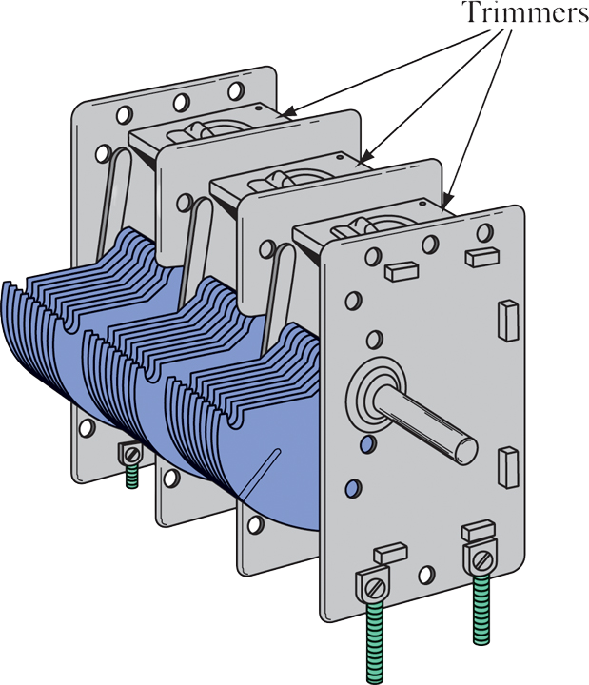
COMMUNICATIONS FOUNDATION
Variable Ganged Capacitor
How does the two set of plates affect tuning?
LECTURE 17 | RECEIVER ARCHITECTURE SENSIT
03
Notes:
More overlap, More C, F0 decreases

Slide 8
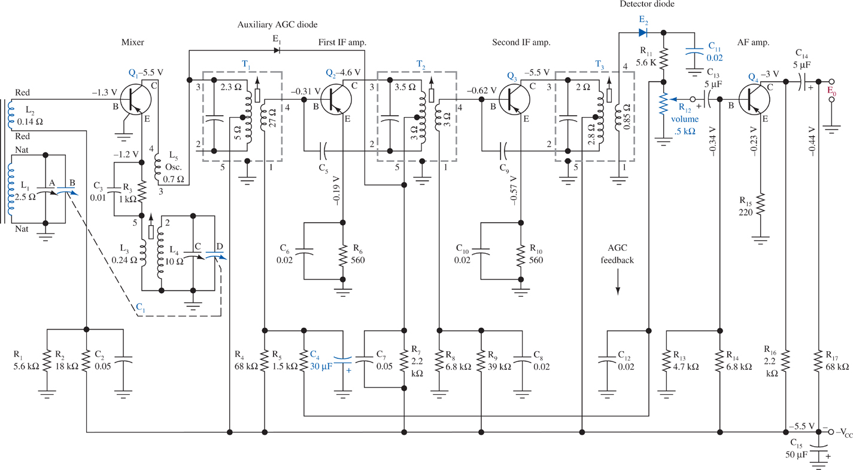
COMMUNICATIONS FOUNDATION
AM Superheterodyne Receiver Schematic
LECTURE 17 | RECEIVER ARCHITECTURE SENSIT
03
Notes:
More overlap, More C, F0 decreases

Slide 9
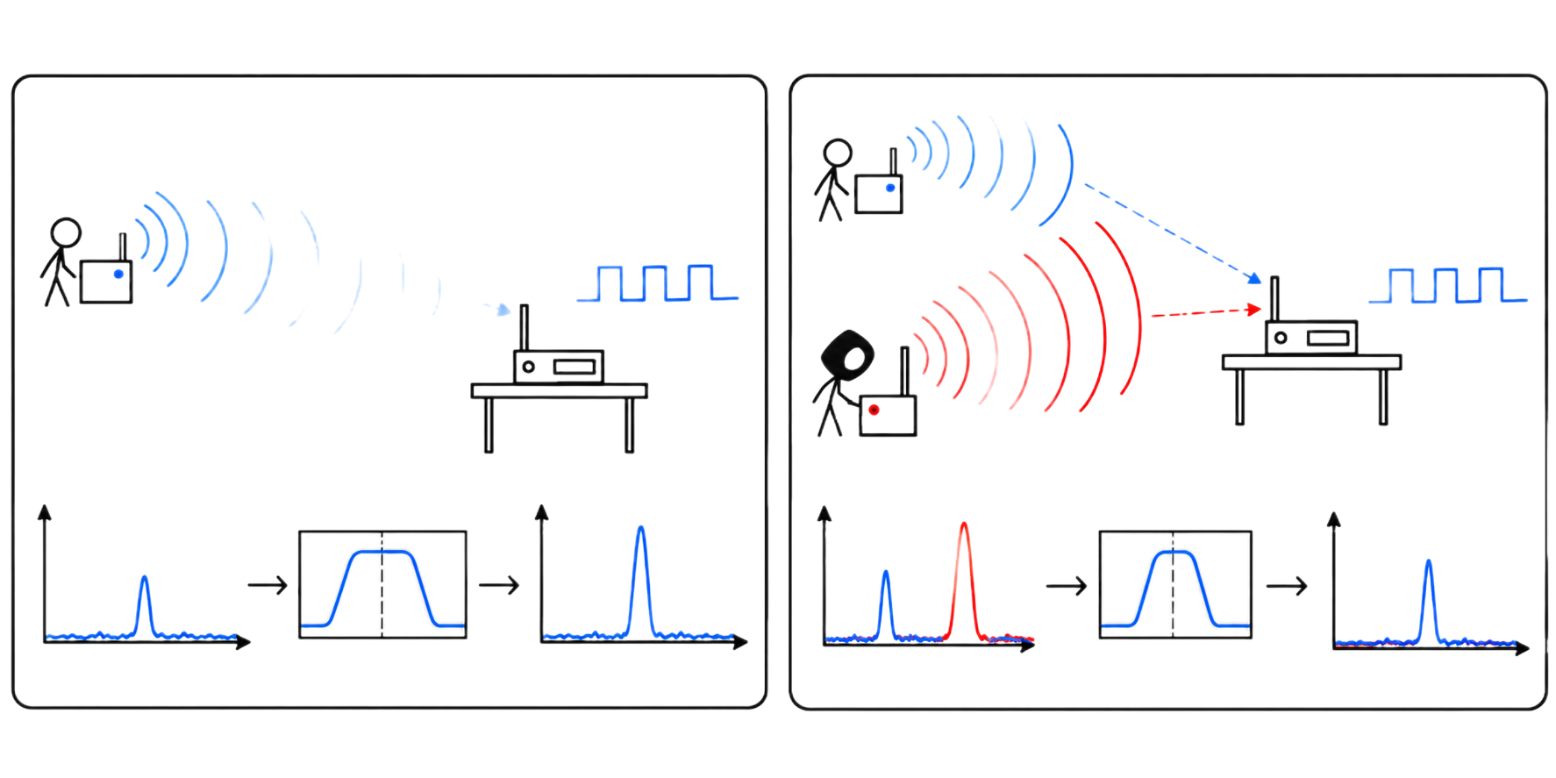


WORKING VOCABULARY
Terms must be tied to observations
Term | Operational meaning
sensitivity | Minimum input level for stated receiver performance. A distant transmitter might become unreadable because its signal is too weak.
selectivity | Ability to accept a desired channel while attenuating nearby energy. A desired signal might be strong enough, but another signal nearby in frequency can interfere.
$$SINR=\frac{S}{I+N}$$
$$margin_{dB}=P_{r}−sensitivity$$
Sensitivity margin
Signal to Interference plus Noise Ratio
LECTURE 17 | RECEIVER ARCHITECTURE SENSIT
04
Notes:
if sensitivity is −100 dBm and the received signal is −80 dBm, Margin is 20 dB
SINR is linear, convert to dB if SINR dB
$${\text{SINR}}_{\text{dB}}=10\log_{10}\left(\frac{S}{I+N}\right)$$

Slide 10
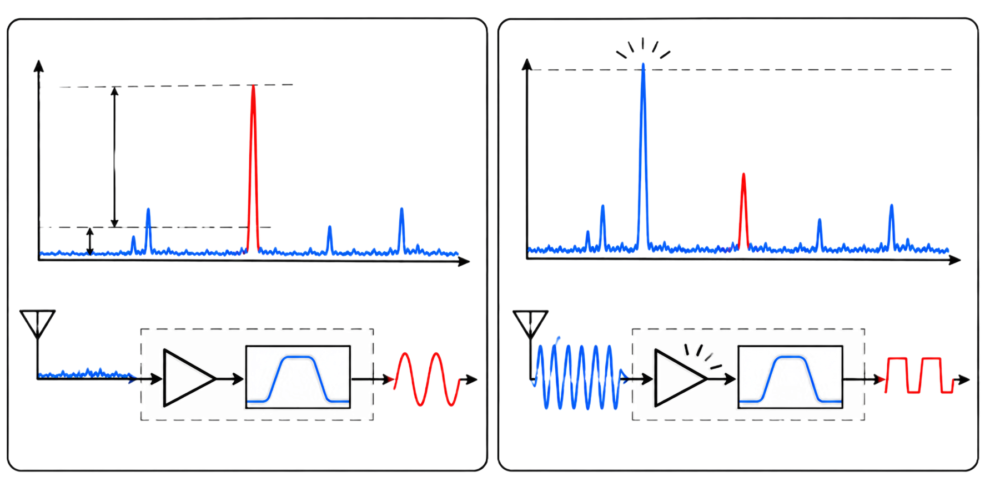
WORKING VOCABULARY
Terms and relationships
Term | Operational meaning
dynamic range | Span between the smallest usable and largest tolerable inputs. A sufficiently strong unwanted signal can push a receiver stage into distortion or reduce its ability to recover a weaker signal
front-end overload | Nonlinear behavior caused by excessive input before successful selection. Filtering after a stage has overloaded cannot necessarily undo that distortion.
$$dynamic range=\frac{largest usable input power}{smallest usable input power}$$
Receiver span
LECTURE 17 | RECEIVER ARCHITECTURE SENSIT
04
Notes:
$$\text{If the smallest usable input is }\text{−100 dBm}\text{ and the largest is }\text{−20 dBm}\text{, the dynamic range is} \text{80dB}$$
Unwanted signal is inside the receiver bandwidth (selectivity/interference problem)
Suppose the receiver accepts 99–101 MHz, and an unwanted signal appears at 100.2 MHz.
Both signals pass through the filter. Their energies overlap, potentially making the desired message difficult to recover.
Unwanted signal is outside the receiver bandwidth (front-end overload problem)
Suppose an extremely strong signal appears at 110 MHz.
Even though the receiver is tuned to 100 MHz, that unwanted signal may still reach the receiver's front-end amplifier before being sufficiently filtered.
If it's strong enough, it can cause amplifier compression, saturation, or other nonlinear effects.
The receiver may then struggle to recover the 100 MHz signal—even though the unwanted signal is outside the desired bandwidth.

Slide 11
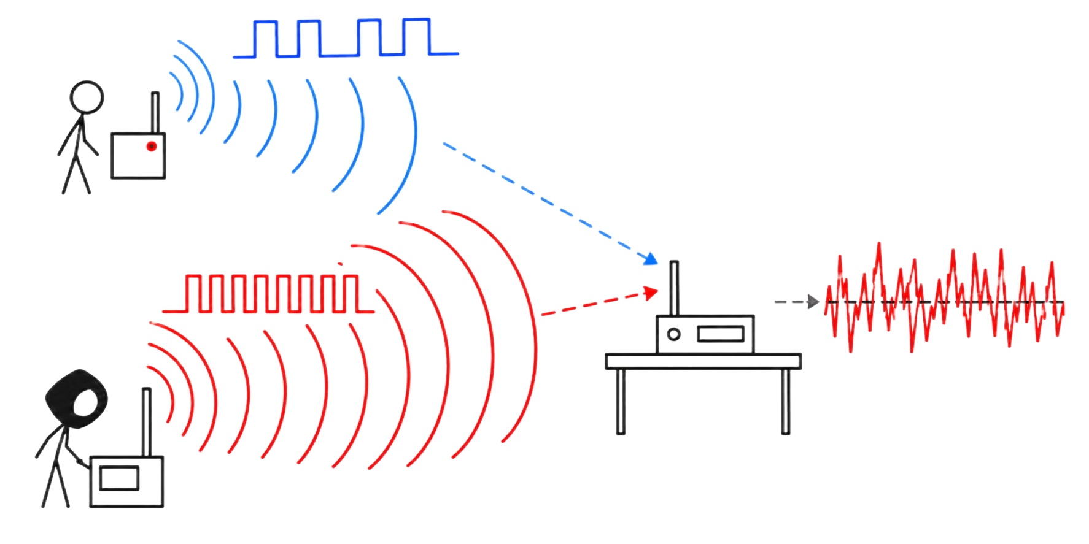
APPLICATION
Cybersecurity follows the physical behavior
A receiver can fail because:
the desired signal is too weak
competing signals are insufficiently rejected
its input stages are overloaded
Receiver blocking/ desensitization
LECTURE 17 | RECEIVER ARCHITECTURE SENSIT
08
Notes:
Weak desired signal buried in noise - Sensitivity
Unwanted signal inside the passband - Interference / selectivity
Strong unwanted signal outside the passband overloads an amplifier - Front-end overload / blocking

Slide 12
BRIDGE FORWARD
Exit check
What happens between the physical measurement and the encoded data?
NEXT: PULSE MODULATION, PCM, ADCS, AND DACS
LECTURE 17 | RECEIVER ARCHITECTURE SENSIT
10

