Slide 1
CYBER 327 / LECTURE 14
Amplitude Modulation
How messages reshape the carrier
MONDAY, OCTOBER 5, 2026
LECTURE 14 | AMPLITUDE MODULATION AND SID
01
Notes:
Open with the distinction or case in Slide 2. Preserve the communications model before adding the cybersecurity application. At the carrier and sidebands near 96 and 104 kHz; ideal AM bandwidth is 8 kHz.

Slide 2
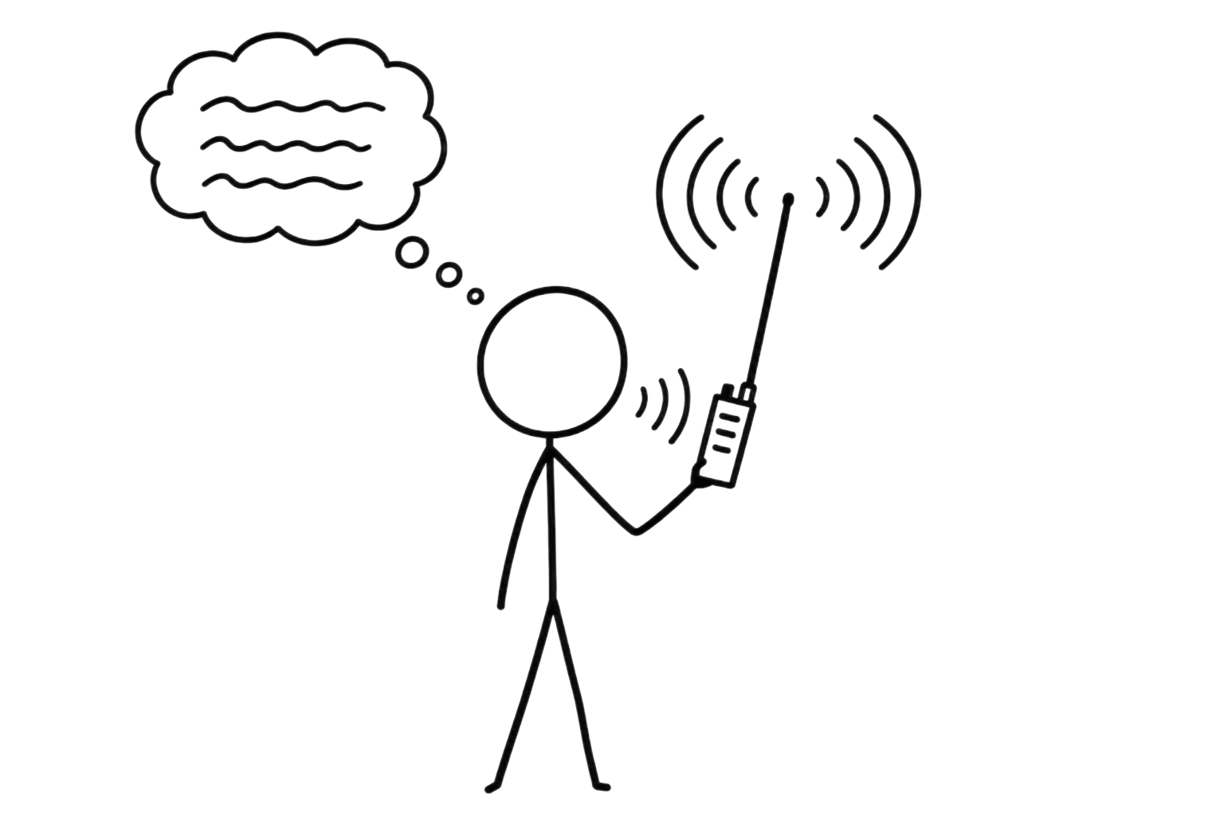
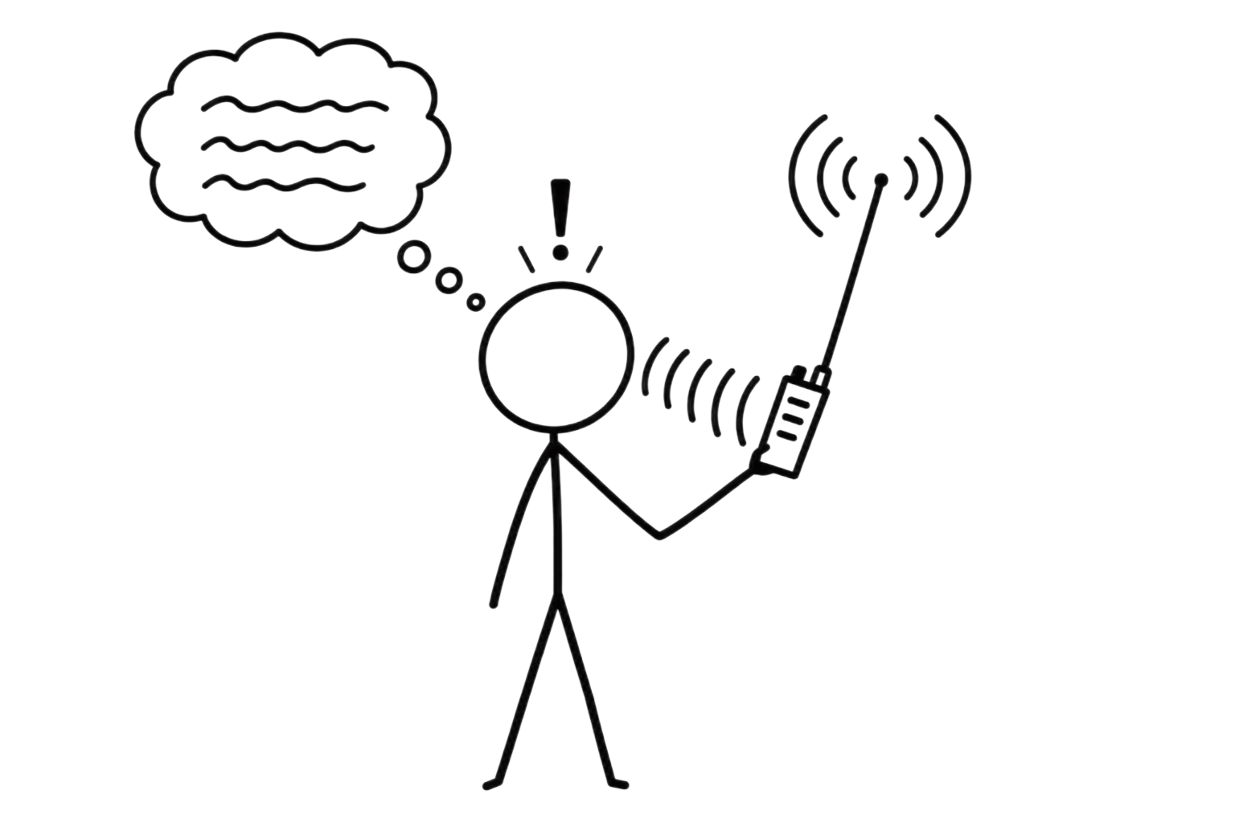
CONCEPT
Recap
Message
Transmitter
Receiver
Recovered message
Medium
LECTURE 14 | AMPLITUDE MODULATION AND SID
02

Slide 3

CONCEPT
The problem
LECTURE 14 | AMPLITUDE MODULATION AND SID
02

Slide 4
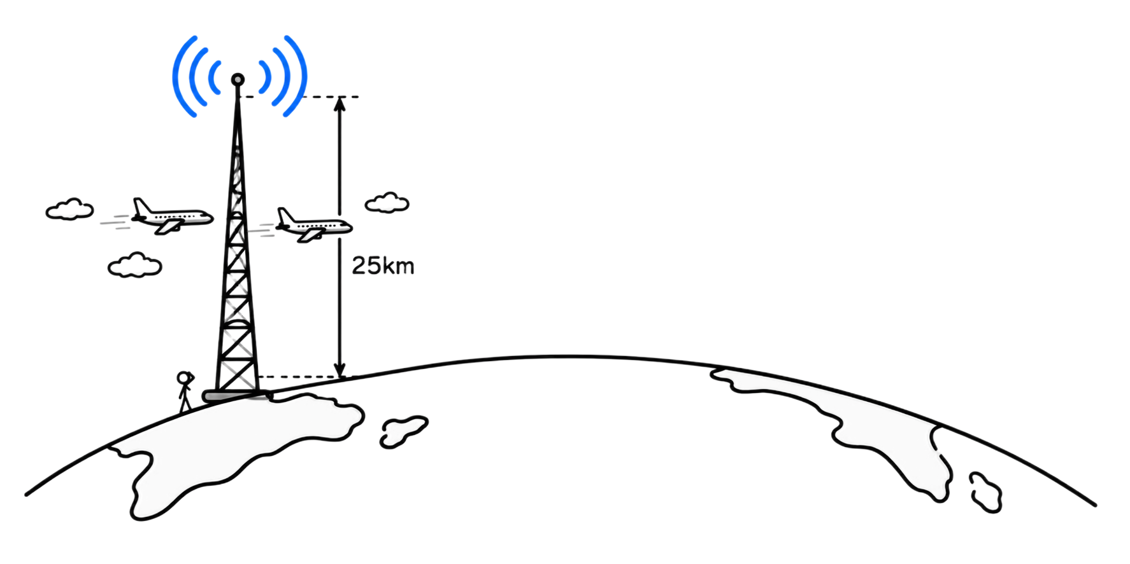

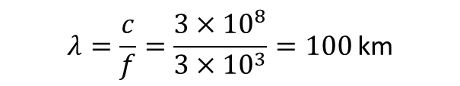
CONCEPT
The problem
$$0<f_{m}<3 \text{kHz}.$$
I want to transmit speech, so
$$λ=\frac{c}{f}=\frac{3×{10}^{8}}{3×{10}^{3}}=100 \text{km}$$
$$\frac{λ}{4}=25 \text{km}.$$
But I need an antenna of:
LECTURE 14 | AMPLITUDE MODULATION AND SID
02

Slide 5
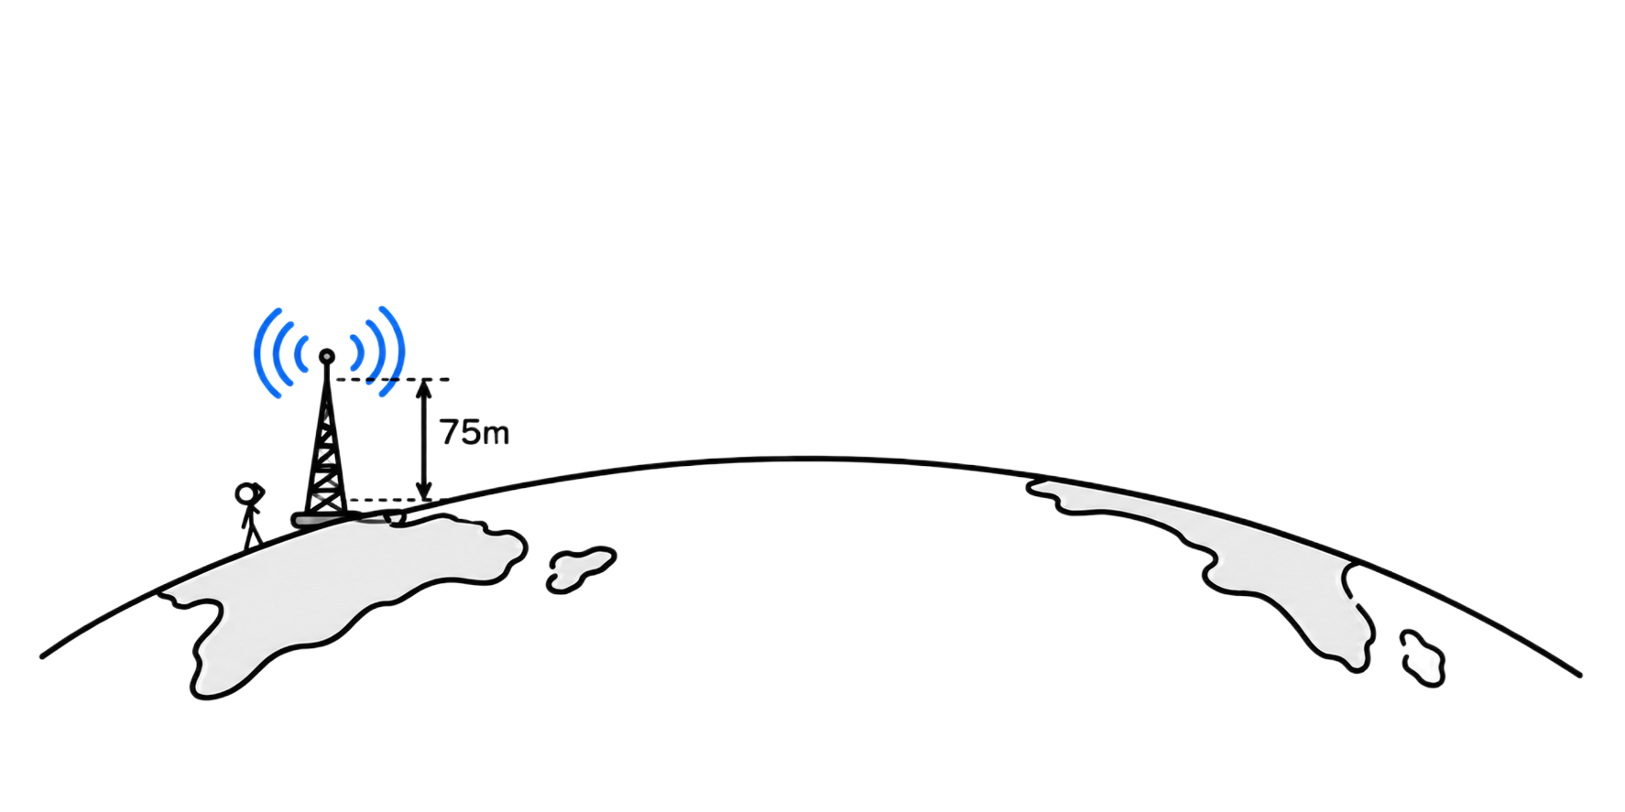

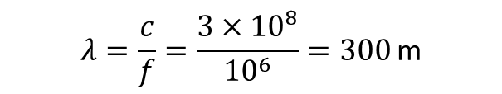
CONCEPT
The solution
$$f_{c}=1 \text{MHz}.$$
What if I transmit a carrier instead:
$$λ=\frac{c}{f}=\frac{3×{10}^{8}}{{10}^{6}}=300 \text{m}$$
$$\frac{λ}{4}=75 \text{m}.$$
So I need an antenna of:
LECTURE 14 | AMPLITUDE MODULATION AND SID
02

Slide 6
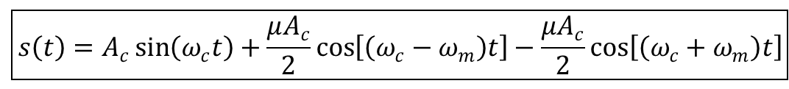
CONCEPT
A bit of useless math
$$m\left(t\right)=\sin\left(ω_{m}t\right)$$
My message:
$$c\left(t\right)=A_{c}\sin\left(ω_{c}t\right)$$
My carrier:
$$\boxed{s\left(t\right)=A_{c}\left[1+μm\left(t\right)\right]\sin\left(ω_{c}t\right)}$$
$$s\left(t\right)=A_{c}\left[1+μ\sin\left(ω_{m}t\right)\right]\sin\left(ω_{c}t\right)$$
$$s\left(t\right)=A_{c}\sin\left(ω_{c}t\right)+μA_{c}\sin\left(ω_{m}t\right)\sin\left(ω_{c}t\right)$$
$$\sin{A}\sin{B}=\frac{1}{2}\left[\cos\left(A−B\right)−\cos\left(A+B\right)\right]$$
Since:
$$\boxed{s\left(t\right)=A_{c}\sin\left(ω_{c}t\right)+\frac{μA_{c}}{2}\cos\left[\left(ω_{c}−ω_{m}\right)t\right]−\frac{μA_{c}}{2}\cos\left[\left(ω_{c}+ω_{m}\right)t\right]}$$
LECTURE 14 | AMPLITUDE MODULATION AND SID
02
Notes:
We have a carrier and two sidebands

Slide 7
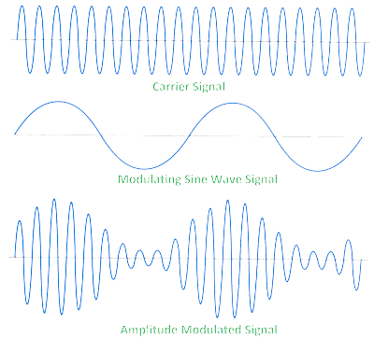
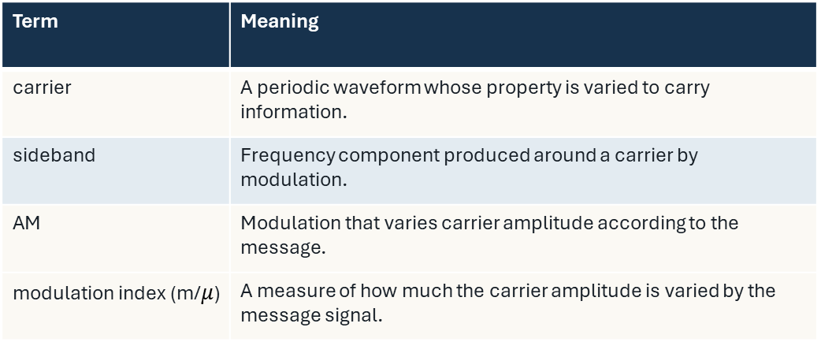
WORKING VOCABULARY
Important Terms
Term | Meaning
carrier | A periodic waveform whose property is varied to carry information.
sideband | Frequency component produced around a carrier by modulation.
AM | Modulation that varies carrier amplitude according to the message.
modulation index (m/$μ$) | A measure of how much the carrier amplitude is varied by the message signal.
$$\boxed{s\left(t\right)=A_{c}\left[1+μm\left(t\right)\right]\sin\left(ω_{c}t\right)}$$
LECTURE 14 | AMPLITUDE MODULATION AND SID
04
Notes:
Require students to use each term in a sentence that names a signal, channel, instrument, or decision.

Slide 8
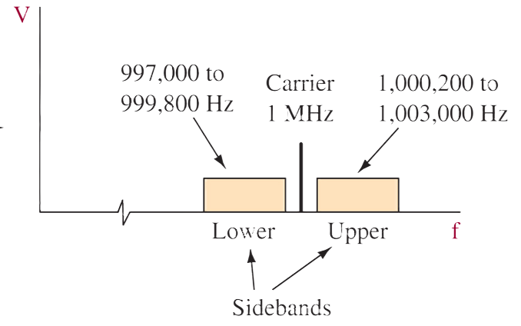
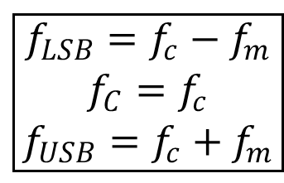
QUANTITATIVE MODEL
Important Relationships
$$\boxed{\begin{aligned}f_{LSB}=f_{c}−f_{m} \\ f_{C}=f_{c} \\ f_{USB}=f_{c}+f_{m}\end{aligned}}$$
Lower sideband
Upper sideband
$$\text{Sidebands} \text{=} \text{carrier} ± \text{message} \text{frequency}$$
$$\boxed{BW_{AM}=2f_{m,max}}$$
LECTURE 14 | AMPLITUDE MODULATION AND SID
05
Notes:
1 MHz Carrier
200Hz to 3kHz intelligence
What’s the bandwidth?

Slide 9
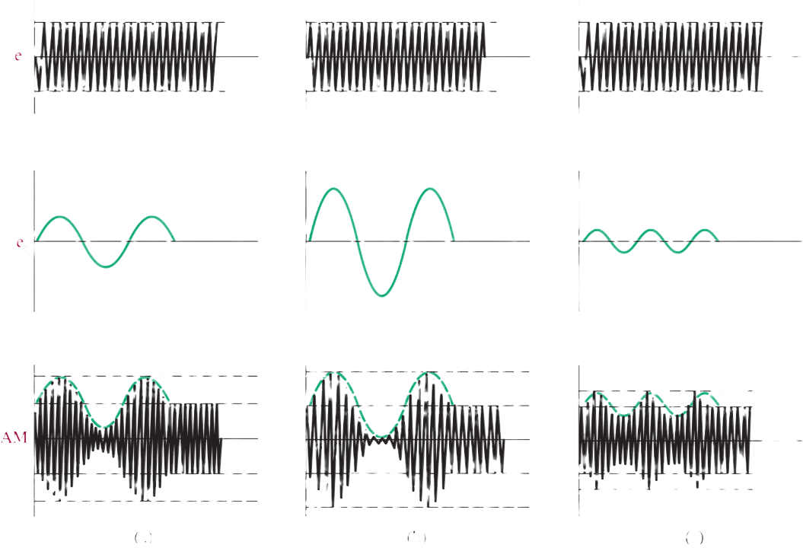
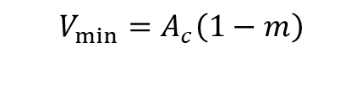

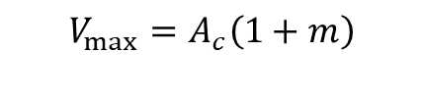


QUANTITATIVE MODEL
Important Relationships
$$m=\frac{V_{max}−V_{min}}{V_{max}+V_{min}}$$
$$V_{max}=A_{c}\left(1+m\right)$$
$$V_{min}=A_{c}\left(1−m\right)$$
$$m=\frac{A_{m}}{A_{c}}$$
m≈0.5
m≈0.98
m≈0.25
What are the minimum and maximum values of m for AM?
Typically:
$$0≤m≤1$$
LECTURE 14 | AMPLITUDE MODULATION AND SID
05
Notes:
m=1
The efficiency equation is
\eta=\frac{\mu^2}{2+\mu^2}
so at mu=1
eta_{\max}=\frac{1}{2+1} =1/3
eta_{\max}=33.3\%}
So:
mu_{\max}=1 \eta_{\max}=33.3
If you increase M, you increase the power of the sidebands, carrier stays the same

Slide 10
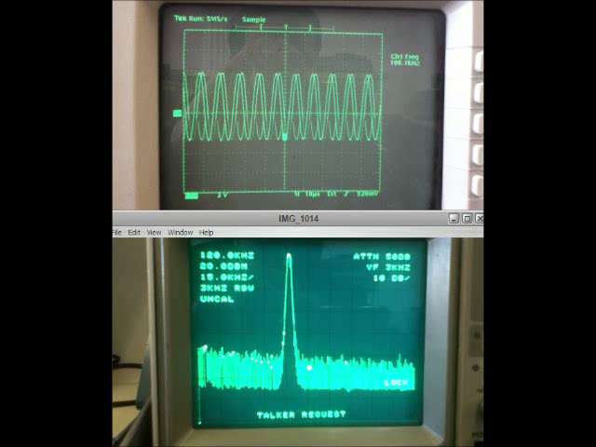
APPLY THE MODEL
What if m>1?
LECTURE 14 | AMPLITUDE MODULATION AND SID
09
Notes:
A 100 kHz carrier is amplitude-modulated by a 4 kHz tone. Where should spectral energy appear?
At the carrier and sidebands near 96 and 104 kHz; ideal AM bandwidth is 8 kHz.

Slide 11
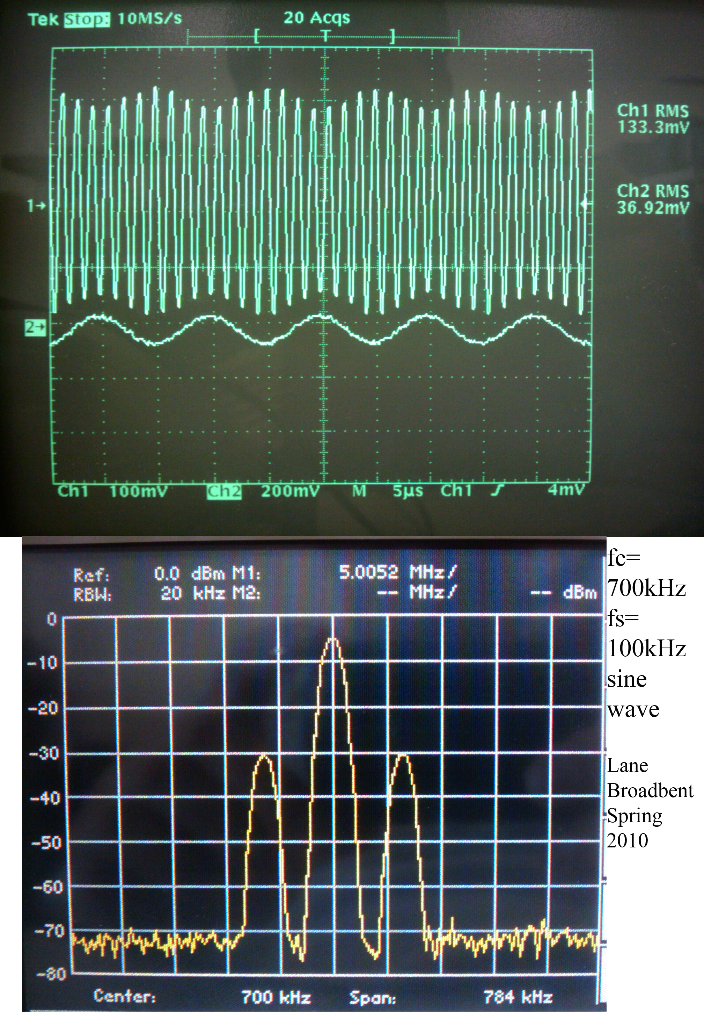
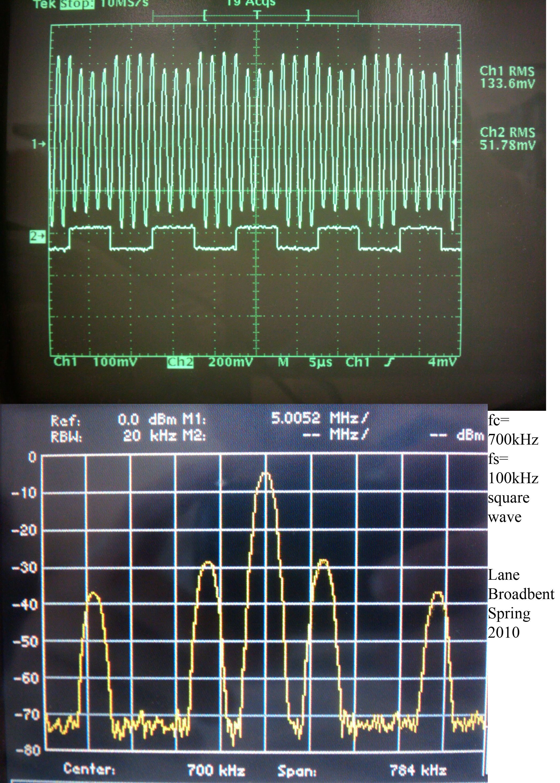
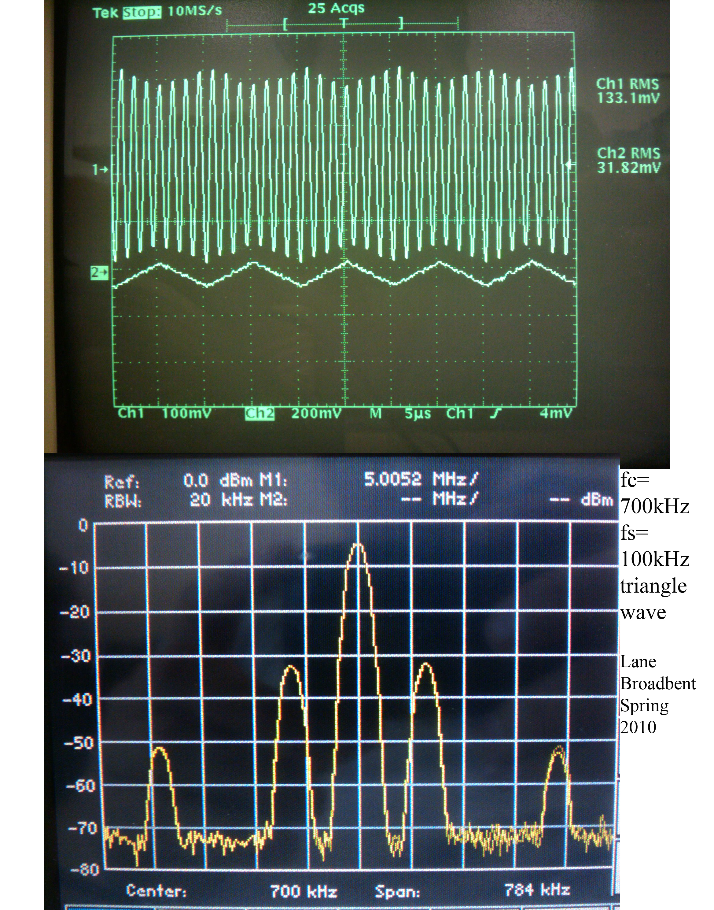
APPLY THE MODEL
In the oscilloscope
LECTURE 14 | AMPLITUDE MODULATION AND SID
09
Notes:
A 100 kHz carrier is amplitude-modulated by a 4 kHz tone. Where should spectral energy appear?
At the carrier and sidebands near 96 and 104 kHz; ideal AM bandwidth is 8 kHz.

Slide 12
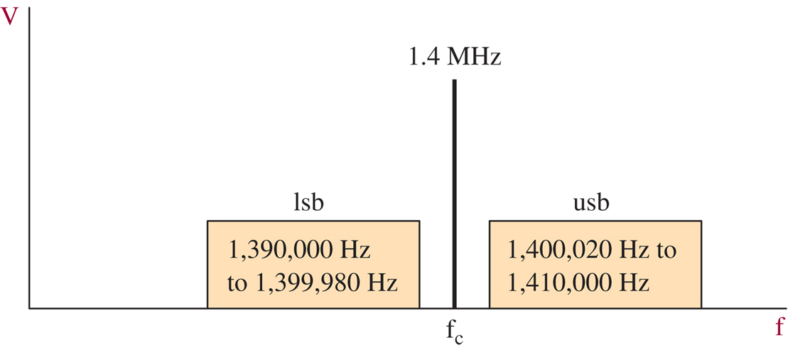
APPLY THE MODEL
Practice
What is the BW of the modulating signal?
What is the BW of the carrier?
What is the BW of the composite signal?
LECTURE 14 | AMPLITUDE MODULATION AND SID
09
Notes:
A 100 kHz carrier is amplitude-modulated by a 4 kHz tone. Where should spectral energy appear?
At the carrier and sidebands near 96 and 104 kHz; ideal AM bandwidth is 8 kHz.

Slide 13



APPLY THE MODEL
Practice
An AM transmitter has:
Find the USB and LSB frequencies.
On an oscilloscope, an AM envelope has:
Find m and the percent modulation.
$$f_{c}=800\text{ kHz}, f_{m}=5\text{ kHz}$$
Which of these signals are overmodulated?
$$V_{max}=9V, V_{min}=3V$$
$$m=0.3, m=1, m=1.2$$
An AM signal has:
Find Vmax and Vmin.
An AM signal has sidebands at:
What are fc and fm?
An AM station uses a carrier of 1.2 MHz. Its message contains frequencies from 100 Hz to 6 kHz. What is the bandwidth of the complete AM signal?
$$A_{c}=10V, m=0.6$$
$$995\text{ kHz} \text{and} 1005\text{ kHz}.$$
LECTURE 14 | AMPLITUDE MODULATION AND SID
09
Notes:
1
Fusb = 800 + 5 = 805kHz
Flsb = 800 – 5 = 795 kHz
2
$$BW=2\left(6\right)=\boxed{12\text{ kHz}}$$
3
$m=\frac{9−3}{9+3}$=0.5
4
6
$f_{c}=\frac{1005+995}{2}$=1000
$$fm=1005−1000=5k$$

Slide 14
BRIDGE FORWARD
Exit check
What’s the problem with AM?
Are there other ways to modulate?
NEXT: FM, PM, DEVIATION, AND MODULATION TRADEOFF
LECTURE 14 | AMPLITUDE MODULATION AND SID
10
Notes:
Yes

