Slide 1
CYBER 327 / LECTURE 19
Aliasing, False Telemetry, and Sensor Spoofing
A valid-looking digital value can misrepresent the physical input.
FRIDAY, OCTOBER 16, 2026
LECTURE 19 | ALIASING FALSE TELEMETRY AND
01

Slide 2
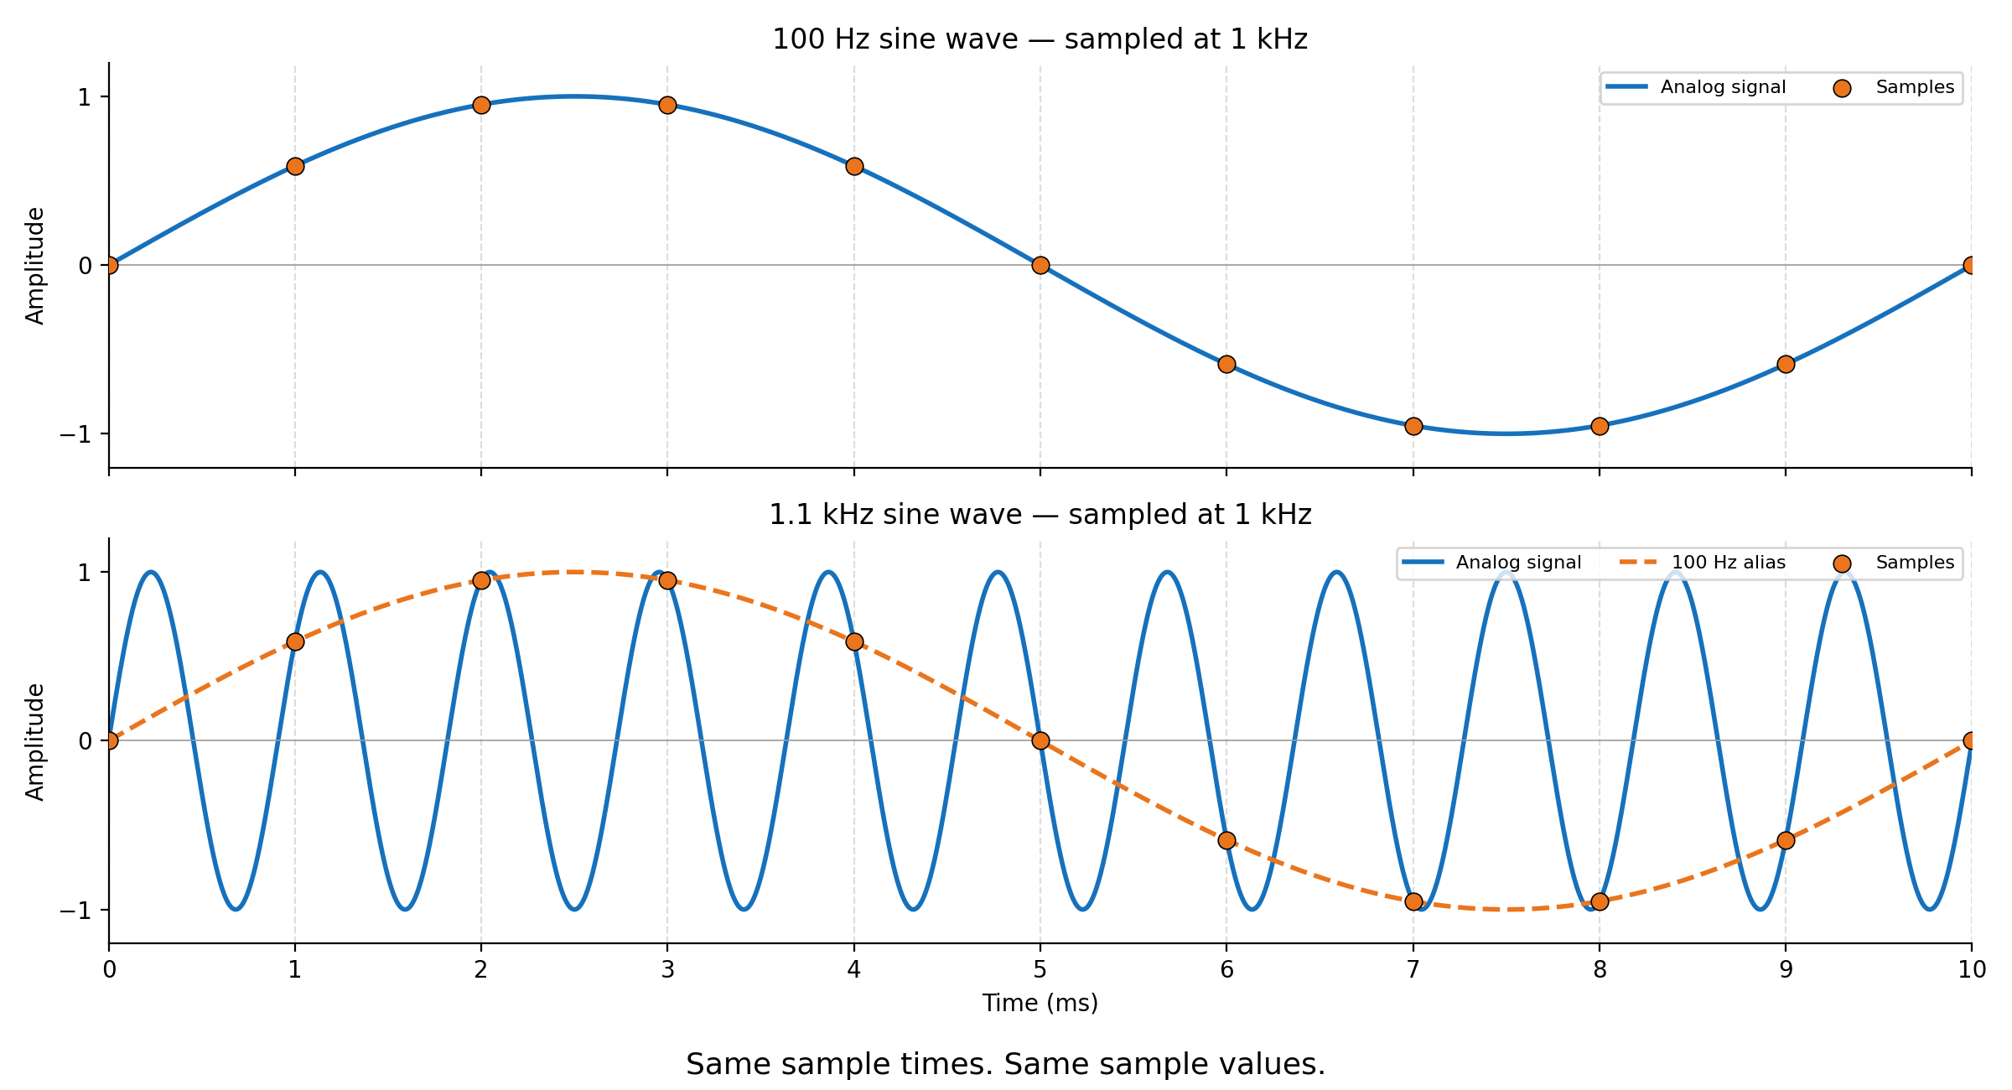
FROM CONCEPT TO EVIDENCE
Sampling can create a false picture
Aliasing
a sampled signal becomes distorted because the sampling rate is too low to accurately capture the original data.
https://so-okada.github.io/math_teaching_materials/sampling_theorem_aliasing.html
LECTURE 19 | ALIASING FALSE TELEMETRY AND
02
Notes:
Use the three cards as an advance organizer. Ask students what prior-week idea each card depends on.

Slide 3

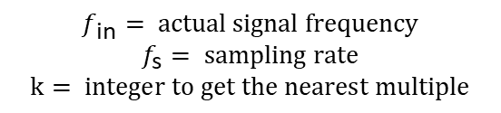


QUANTITATIVE MODEL
Nyquist-Shannon Sampling Theorem
An analog signal can be perfectly reconstructed without loss of information if it is sampled greater than twice the highest frequency component.
Alias location
$$f_{s}>2f_{max}$$
$$f_{alias}=\left|f_{in}−kf_{s}\right|$$
Actual Input | Sampling Rate | Apparent frequency
200 Hz | 2000 samples/s | 200 hz
1800 Hz | 2000 samples/s | 200 hz
1800 Hz | 5000 samples/s | 1800 Hz
$$f_{\text{in}}= actual signal frequency$$
$$f_{\text{s}}= sampling rate$$
$$k= integer to get the nearest multiple$$
If not, aliasing will occur!
24 Hz Camera, 24 Hz Water
24 Hz Camera, 25 Hz Water
24 Hz Camera, 23 Hz Water
LECTURE 19 | ALIASING FALSE TELEMETRY AND
05
Notes:
It should be greater than!
If equal, its 0

Slide 4
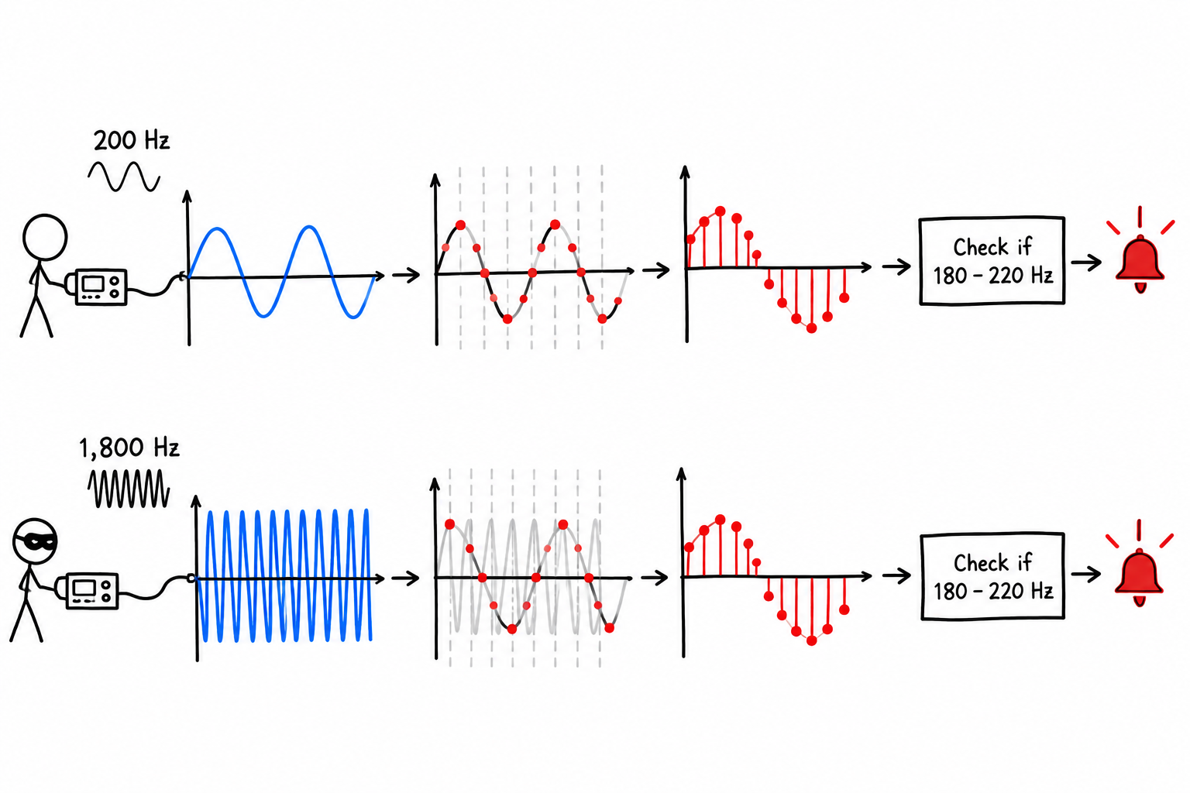
APPLICATION,
Cybersecurity follows the physical behavior
A genuine 200 Hz input activates it correctly.
But a 1,800 Hz input sampled at 2,000 samples/s can also appear to be 200 Hz and activate it incorrectly.
How can you protect against this?
LECTURE 19 | ALIASING FALSE TELEMETRY AND
08
Notes:
Increase the sampling rate so the 1,800 Hz signal is represented correctly.
- Filter unwanted frequencies before the ADC so less interference reaches it.

Slide 5
BRIDGE FORWARD
Exit check
Are there other ways to correct misrepresentations?
NEXT: ERROR DETECTION AND CORRECTION FUNDAMENTAL
LECTURE 19 | ALIASING FALSE TELEMETRY AND
10
Notes:
Use the response to open the next meeting. Practice-case resolution: The input is above Nyquist and aliases to an indistinguishable sampled sequence.

