Slide 1
CYBER 327 / LECTURE 29
Wireless Access: Keys, Readers, and Relay Attacks
MONDAY, NOVEMBER 9, 2026
LECTURE 29 | WIRELESS ACCESS KEYS READERS
01
Notes:
Last lecture: Wireless Signal Strength
This lecture: What will the signal look like?

Slide 2
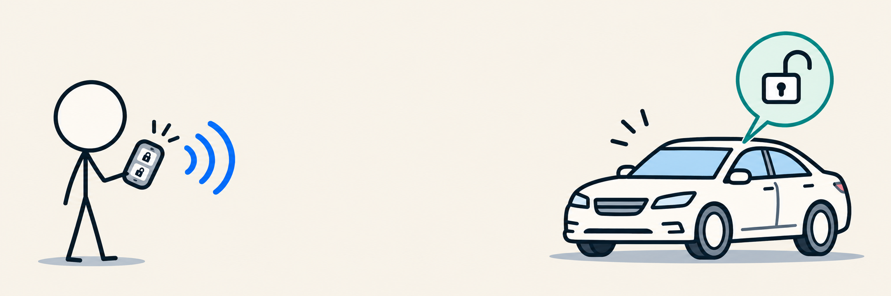
EVERYDAY TECHNOLOGY
A key fob story (Rolling Code)
Reader
asks
→
Key
responds
→
Reader
checks
→
Door
opens
LECTURE 29 | WIRELESS ACCESS KEYS READERS
02
Notes:
You are an antenna!

Slide 3
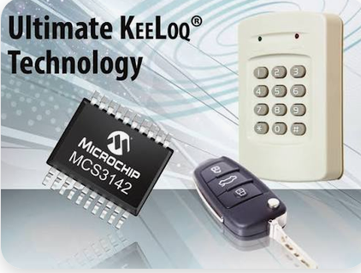
PUT IT TOGETHER
Follow the message through the radio link
Frame
bits
Line
coding
RF
modulation
Antenna /
channel
→
→
→
Manchester
OOK carrier
@433.92 MHz
Serial Number
Encrypted Info
MAC
32
128
32
192-bit frame
LECTURE 29 | WIRELESS ACCESS KEYS READERS
03
Notes:
For the frame I use:
Encryption
MAC
Counters
The fob has 2 keys: the encryption key and the MAC key
How about CRC?

Slide 4
REVIEW
Manchester+OOK
Convention: 1 = midpoint rise; 0 = midpoint fall
1
0
1
0
Coded
levels
LECTURE 29 | WIRELESS ACCESS KEYS READERS
04

Slide 5
MODULATION CHANGES THE CARRIER
Manchester+OOK
Convention: 1 = midpoint rise; 0 = midpoint fall
1
0
1
0
Coded
levels
OOK
carrier
HIGH → carrier ON LOW → carrier OFF
LECTURE 29 | WIRELESS ACCESS KEYS READERS
05

Slide 6
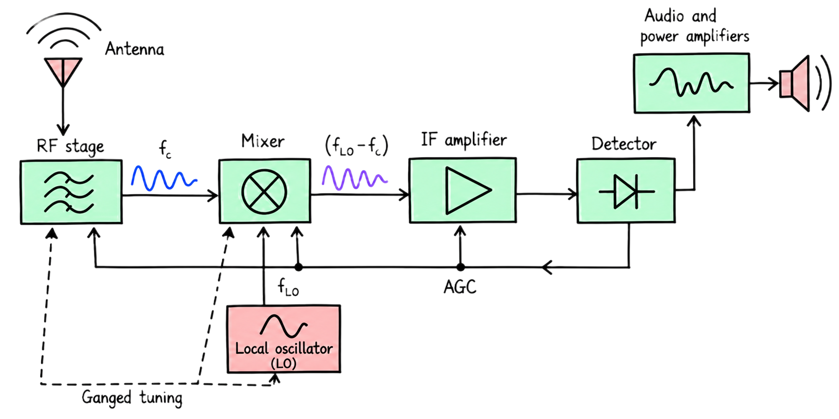
A USABLE SIGNAL AND AN AUTHORIZED ACTION ARE SEPARATE QUESTIONS
Receiver recovers the bits
Filter
→
Demodulate
→
Recover
timing
→
Decode /
parse
LECTURE 29 | WIRELESS ACCESS KEYS READERS
06
Notes:
Reverse the transmitter chain
Check the

Slide 7
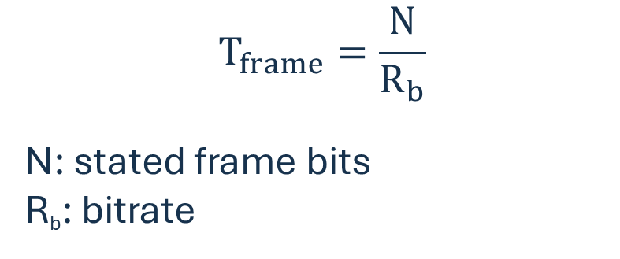
COUNT MATCHING QUANTITIES: FRAME BITS AND FRAME-BIT RATE
How long does the frame occupy the link?
Example
Frame duration
If bitrate is 3kbit/s, what is the frame duration of our current fob (192 bits)?
$$T_{frame}=\frac{N}{R_{b}}$$
N: stated frame bits
R_{b}: bitrate
LECTURE 29 | WIRELESS ACCESS KEYS READERS
07
Notes:
64ms

Slide 8
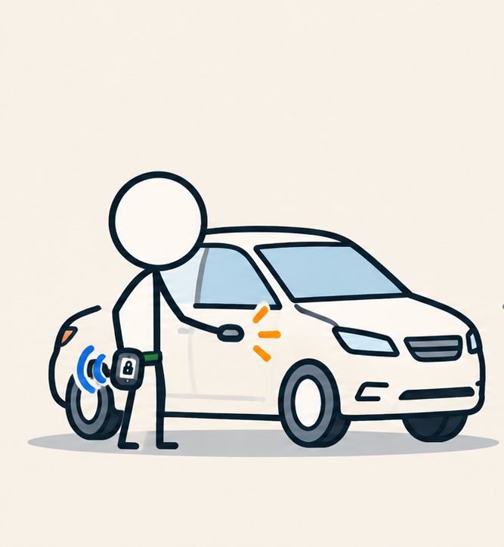
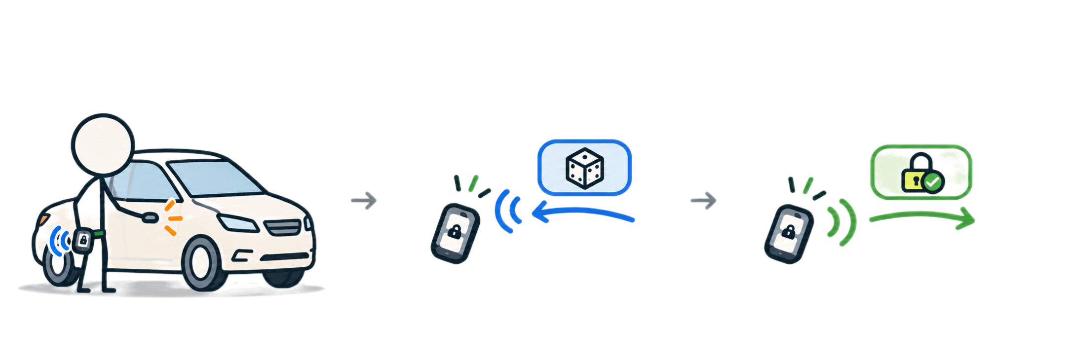
NO CRYPTOGRAPHIC ARITHMETIC
Challenge-Response Model
Verifier (car) sends a challenge
Claimant (fob) calculates a response
Claimant (fob) sends the response to prove identity
“Your challenge is 739152"
Manchester + OOK
LF ~ 125 kHz
“My response is A8F2"
Manchester + OOK
UHF ~ 433.92 MHz
Both endpoints hold a secret.
LECTURE 29 | WIRELESS ACCESS KEYS READERS
09
Notes:
How is freshness accounted for? The challenge is a nonce
Nonce = a value used once in context.

Slide 9
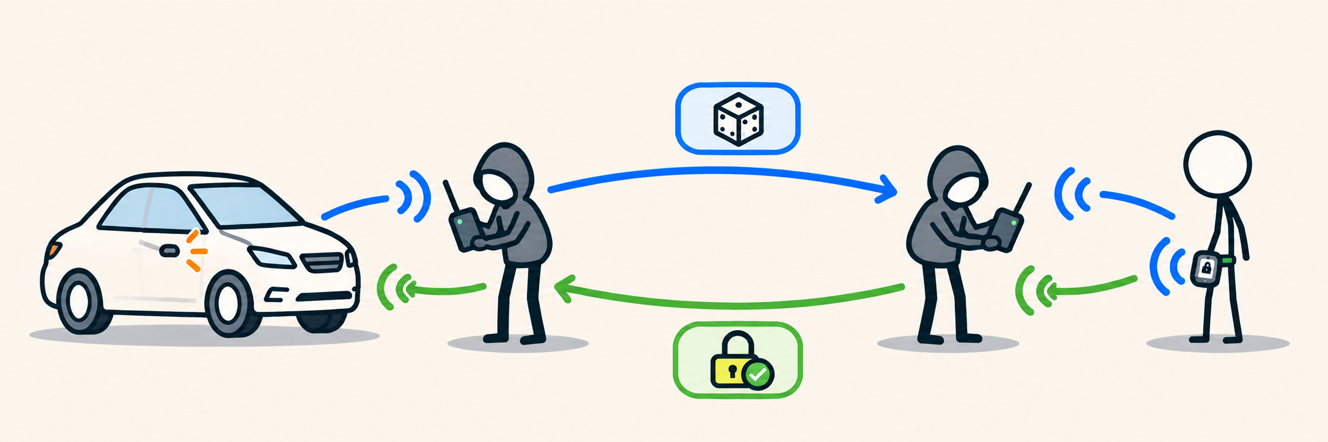
FORWARD THE CURRENT CHALLENGE
Relay Attack
The forwarding devices need not know the secret.
LECTURE 29 | WIRELESS ACCESS KEYS READERS
11
Notes:
How to mitigate this?

Slide 10
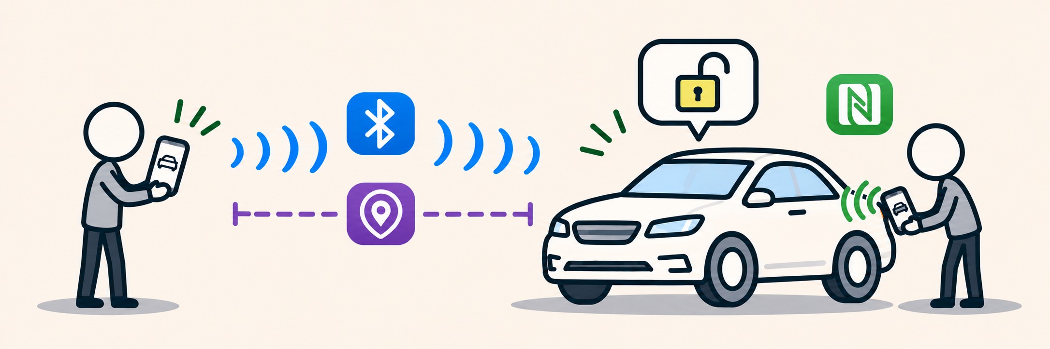
MODERN COMPARISON
A phone as a fob
Bluetooth LE
UWB
NFC
Low Energy
Connection + authentication
LE 1M/2M:
Gaussian FSK (GFSK)
+ connected hopping
Ultra-wideband
Secure ranging:
check physical distance
Near-field communication
Tap-based access option
CCC Digital Key Release 3.0. Each radio has a different role.
LECTURE 29 | WIRELESS ACCESS KEYS READERS
15

Slide 11
TRY BEFORE THE INSTRUCTOR REVEALS THE NOTES SOLUTION
Practice: turn bits into a signal and calculate airtime
A · Draw the waveform
B · Calculate airtime
Bits: 1010
Use our Manchester convention, then sketch the OOK carrier.
Frame: 256 bits
Rate: 2 kbit/s
Find the frame duration.
Rate is before Manchester mapping. Exclude added preamble, gaps and retries.
LECTURE 29 | WIRELESS ACCESS KEYS READERS
17
Notes:
For 1010: LH | HL | LH | HL
128 ms

Slide 12
EXIT CHECK AND THE NEXT INVESTIGATIONS
From readable messages to trusted actions
Scenario A
Scenario B
An attacker resends an accepted answer recorded yesterday.
An attacker forwards today’s request to the genuine key and returns its answer.
NEXT: ASCII, UART AND RS-232
LECTURE 29 | WIRELESS ACCESS KEYS READERS
20
Notes:
A: replay
B: Relay

