Slide 1
CYBER 327 / LECTURE 24
OFDM, Spread Spectrum, and Shannon Revisited
How should we organize a waveform when the channel causes problems?
WEDNESDAY, OCTOBER 28, 2026
LECTURE 24 | OFDM SPREAD SPECTRUM AND SHA
01

Slide 2
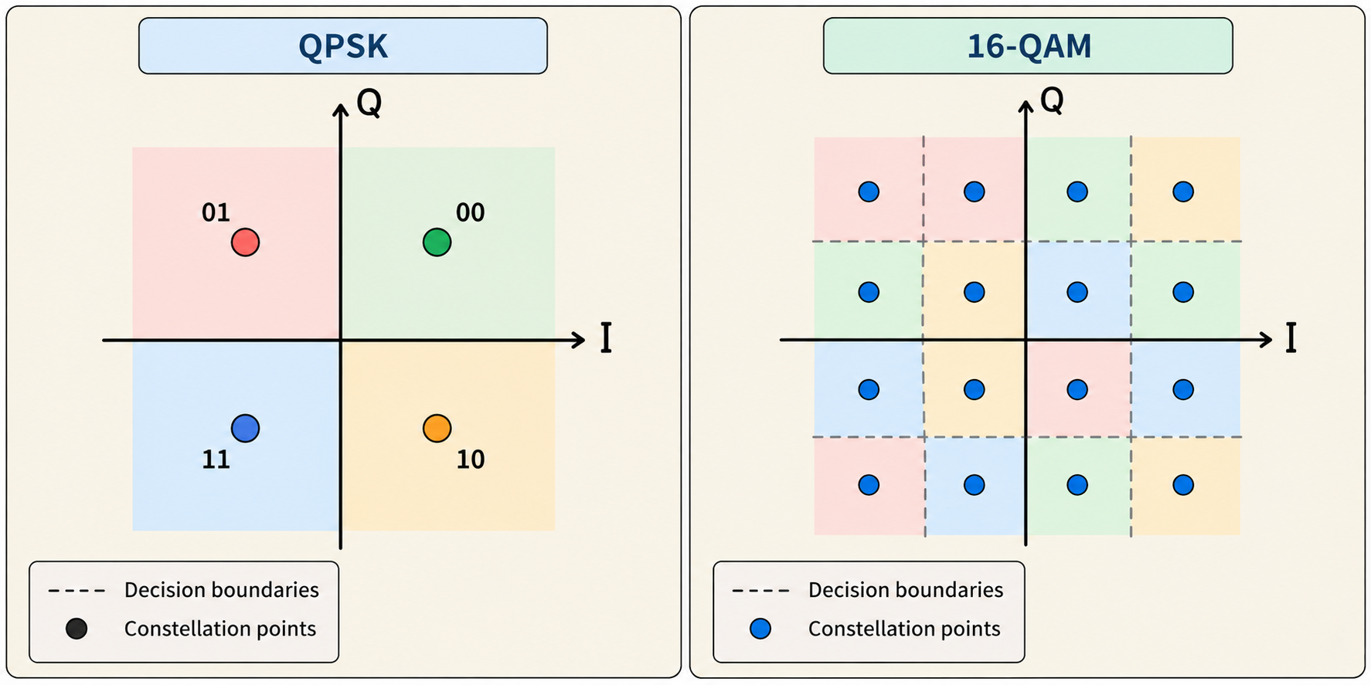
FROM MEASURED BER TO WAVEFORM DESIGN
Review on QPSK/QAM
LECTURE 24 | OFDM SPREAD SPECTRUM AND SHA
02

Slide 3
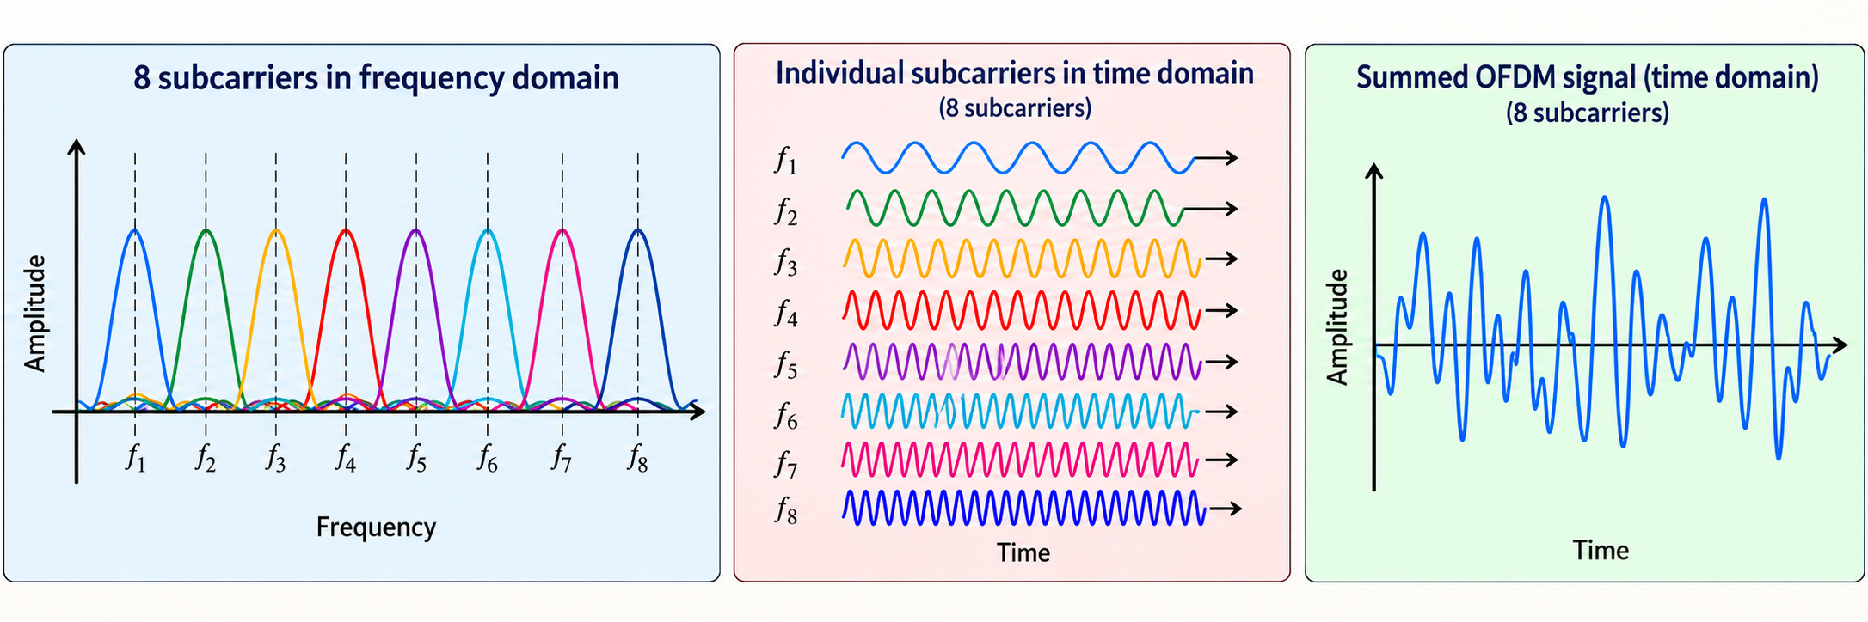
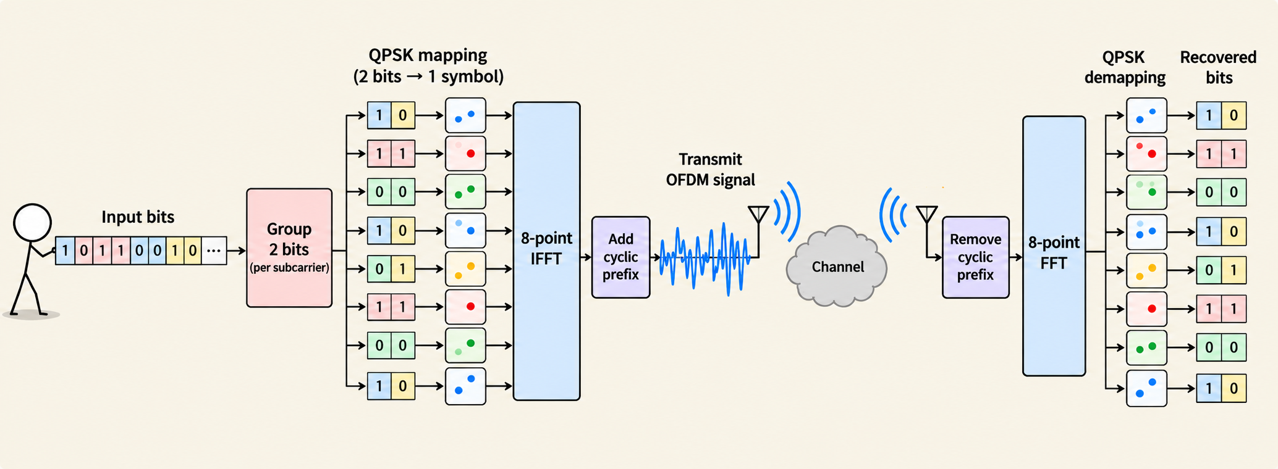
OFDM = ORTHOGONAL FREQUENCY-DIVISION MULTIPLEXING
OFDM sends symbol groups in parallel
Goal
Spread the transmission across multiple subcarriers simultaneously
$$total bits per symbol=bits per symbol × \# of subcarriers$$
All eight subcarriers are simultaneous during one useful OFDM interval.
The receiver separates them, then makes the constellation decisions.
LECTURE 24 | OFDM SPREAD SPECTRUM AND SHA
03

Slide 4
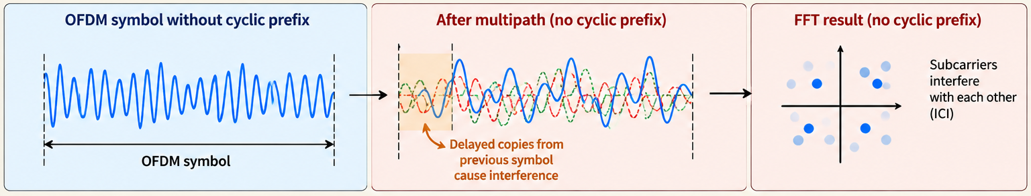
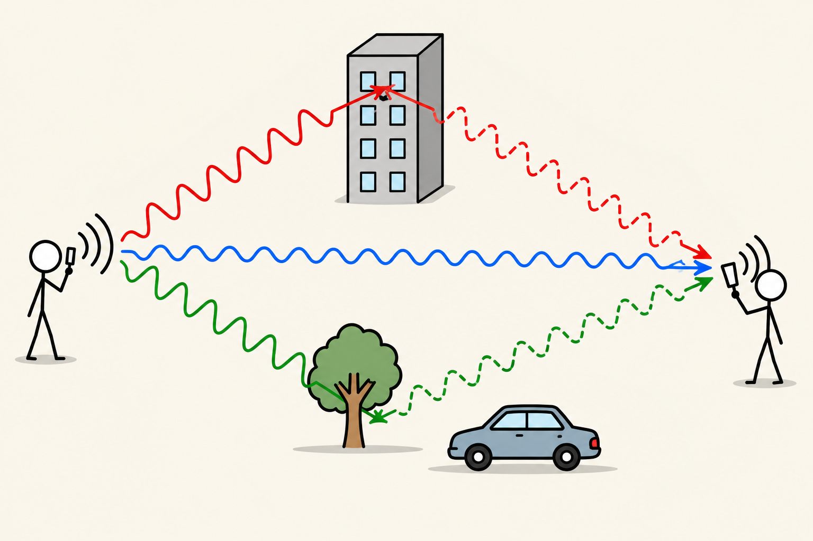
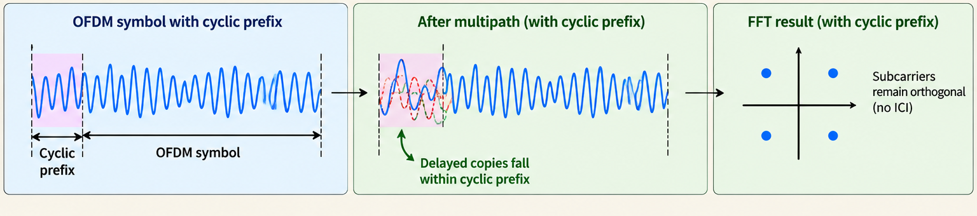
MULTIPATH = DIFFERENT PATHS AND ARRIVAL TIMES; CP = CYCLIC PREFIX
A cyclic prefix gives delayed copies room
Multipath
A signal reaches a receiver through more than one path
LECTURE 24 | OFDM SPREAD SPECTRUM AND SHA
06

Slide 5

MULTIPATH = DIFFERENT PATHS AND ARRIVAL TIMES; CP = CYCLIC PREFIX
A cyclic prefix gives delayed copies room
The cyclic prefix must cover the echo/delays
Copy the same samples
CP: 25 us
Useful block: 100 us
Tail: 25 us
$$Total transmitted interval= T_{u}+T_{CP}=125us$$
$$T_{CP}>T_{echo}$$
Useful interval (the symbol)
LECTURE 24 | OFDM SPREAD SPECTRUM AND SHA
06

Slide 6
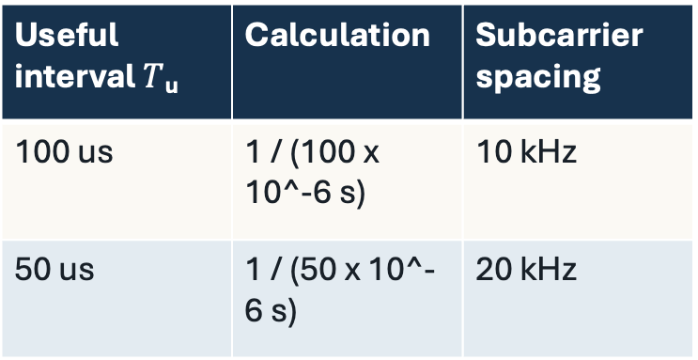
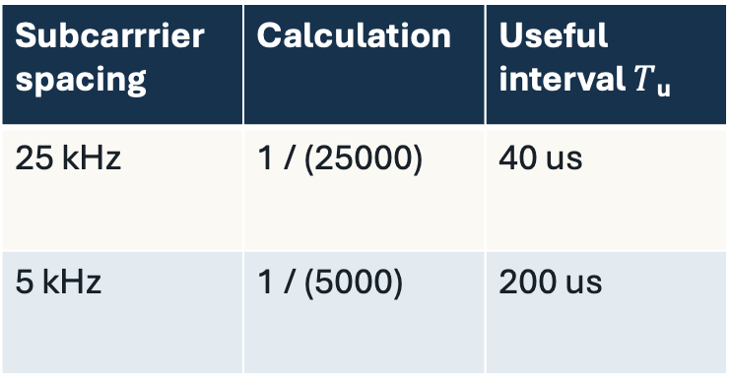
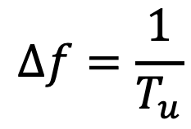
DEFINE T_U BEFORE TAKING ITS RECIPROCAL
Longer useful intervals mean closer spacing
Useful interval $T$_{u} | Calculation | Subcarrier spacing
100 us | 1 / (100 x 10^-6 s) | 10 kHz
50 us | 1 / (50 x 10^-6 s) | 20 kHz
$$Δf=\frac{1}{T_{u}}$$
Spacing
Useful Interval
Subcarrrier spacing | Calculation | Useful interval $T$_{u}
25 kHz | 1 / (25000) | 40 us
5 kHz | 1 / (5000) | 200 us
LECTURE 24 | OFDM SPREAD SPECTRUM AND SHA
05

Slide 7
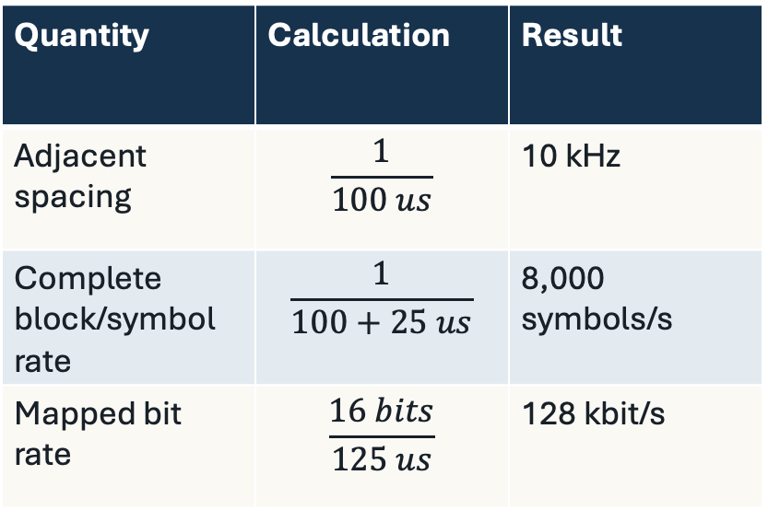
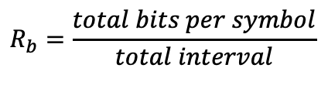
SIMPLIFIED EXAMPLE: ALL EIGHT SUBCARRIERS CARRY DATA; NO OTHER OVERHEAD
The cost of using cyclic prefix
I designed an OFDM link with 8 QPSK data subcarriers. I measured delays in my medium to be 15us, so I want my prefix to be 25 us. If I want Tu to be 100us, what is my bitrate?
Quantity | Calculation | Result
Adjacent spacing | $$\frac{1}{100 us}$$ | 10 kHz
Complete block/symbol rate | $$\frac{1}{100+25 us}$$ | 8,000 symbols/s
Mapped bit rate | $$\frac{16 bits}{125 us}$$ | 128 kbit/s
$$R_{b}=\frac{total bits per symbol}{total interval}$$
LECTURE 24 | OFDM SPREAD SPECTRUM AND SHA
07

Slide 8
SIMPLIFIED EXAMPLE: ALL EIGHT SUBCARRIERS CARRY DATA; NO OTHER OVERHEAD
Comparing with QPSK
Quantity | QPSK + OFDM | Single-carrier QPSK | Single-carrier QPSK
Useful time to send 16 bits | 100 µs | 800 µs | 100 µs
(Useful) Baud Rate | 10 k baud | 10 k baud | 80,000 baud
Data carriers | 8 simultaneously | 1 | 1
Useful duration of each QPSK symbol | 100 µs per subcarrier | 100 µs | 100µs/8symbols =12.5 µs
How 16 bits are sent | 8 QPSK symbols simultaneously | 8 QPSK symbols sequentially | 8 QPSK symbols sequentially
Prefix included in this comparison | 25 µs per block | None | None
Total time for 16 bits | 125 µs | 800 µs | 100 µs
Bit rate | 128 kbit/s | 20 kbit/s | 160 kbit/s
LECTURE 24 | OFDM SPREAD SPECTRUM AND SHA
07

Slide 9
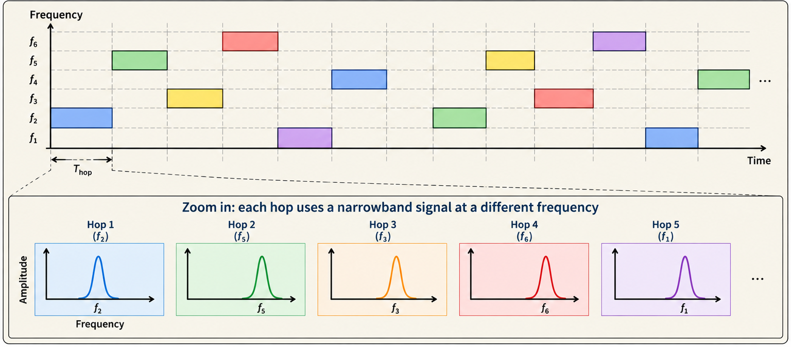
Goal
FHSS = FREQUENCY-HOPPING SPREAD SPECTRUM; CONCEPTUAL SEQUENCE
Spread the transmission by hopping across multiple frequencies over time
Frequency Hopping Spread Spectrum (FHSS)
LECTURE 24 | OFDM SPREAD SPECTRUM AND SHA
09

Slide 10
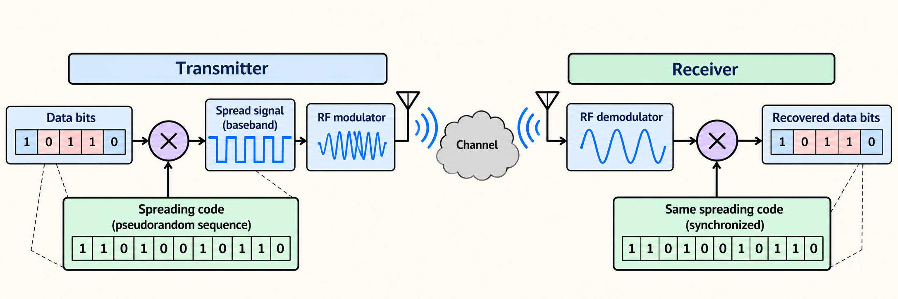
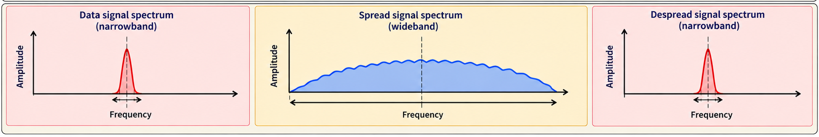
DSSS = DIRECT-SEQUENCE SPREAD SPECTRUM; A SHORT TEACHING CODE
Goal
Direct Sequence Spread Spectrum (DSSS)
Spread the transmission to a wider band continuously
LECTURE 24 | OFDM SPREAD SPECTRUM AND SHA
10

Slide 11
ILLUSTRATIVE IDEAL CHIPS; REAL RECEPTION NEEDS SYNCHRONIZATION AND NOISY-SAMPLE DECISIONS
Matched despreading recovers the data
Transmit: 101 Chip: 1011001
Data bit | Repeated bit | XOR sequence | Transmitted chips
1 | 1111111 | 1011001 | 0100110
0 | 0000000 | 1011001 | 1011001
1 | 1111111 | 1011001 | 0100110
Received chips | XOR sequence | Despread result | Majority decision
0110110 | 1011001 | 1101111 | Six ones → 1
1111101 | 1011001 | 0100100 | Five zeros → 0
0100100 | 1011001 | 1111101 | Six ones → 1
LECTURE 24 | OFDM SPREAD SPECTRUM AND SHA
11

Slide 12
THESE MECHANISMS CAN BE COMBINED; NONE IS AN AUTHENTICATION CHECK
Choose the mechanism for the problem
Method | Good when you have | What to watch out for
OFDM + CP | Multipath/delayed reflected copies | Prefix time, synchronization
FHSS | Narrow band interference | Hop timing and channel sequence
DSSS | Narrow band interference Weak signal | Wider band, code alignment
LECTURE 24 | OFDM SPREAD SPECTRUM AND SHA
12

Slide 13

IDEAL BAND-LIMITED CHANNEL WITH ADDITIVE WHITE GAUSSIAN NOISE
Shannon still bounds the information rate
$$C=B\log_{2}\left(1+{SNR}_{linear}\right)$$
For a Shannon Capacity of 400 kbit/s,
“Reliable communication is impossible”
Information rate | What Shannon says
300 kbit/s | Arbitrarily low error probability is theoretically achievable with suitable coding
500 kbit/s | Arbitrarily low error probability is impossible under the same channel conditions
you cannot sustain that information rate and eliminate errors. To improve reliability, you must reduce the information rate or improve the channel’s bandwidth or SNR.
LECTURE 24 | OFDM SPREAD SPECTRUM AND SHA
13

Slide 14
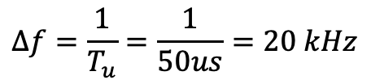
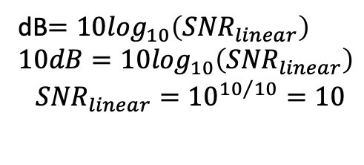
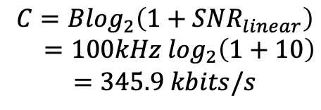
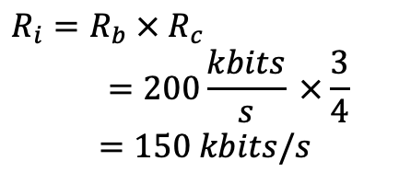
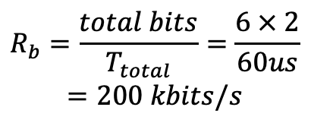
ASSUME CORRECT TIMING, A STABLE CHANNEL AND NO ADDITIONAL OVERHEAD
Practice
$$Δf=\frac{1}{T_{u}}=\frac{1}{50us}=20 kHz$$
$$R_{b}=\frac{total bits}{T_{total}}=\frac{6 × 2}{60us}$$
$$=200 kbits/s$$
We have QPSK link with:
6 subcarriers
T_{u} = 50us
T_{CP} = 10 us
R_{C} =3/4
Find:
the subcarrier spacing,
the bit rate,
the information-bit rate, and
whether an 8 us delay fits within the prefix.
A channel has 100 kHz bandwidth and 10dB SNR.
A design claims 400 kbits/s of information.
A second design targets 250 kbits/s of information.
Can the channel support both designs?
$$R_{i}={R_{b} × R}_{c}$$
$$=200\frac{kbits}{s} ×\frac{3}{4}$$
$$=150 kbits/s$$
dB$=10\log_{10}\left({SNR}_{linear}\right)$
$10dB=10\log_{10}\left({SNR}_{linear}\right)$
$${SNR}_{linear}={10}^{{10}/{10}}=10$$
$$C=B\log_{2}\left(1+{SNR}_{linear}\right)$$
$$=100kHz \log_{2}\left(1+10\right)$$
$$=345.9 kbits/s$$
LECTURE 24 | OFDM SPREAD SPECTRUM AND SHA
16
Notes:
Yes it fits the prefix
Design 1 is impossible
Design 2 is possible

Slide 15
CHECK UNDERSTANDING
Exit check
What if we still fail?
NEXT: PULSES, TIMING AND EYE PATTERNS
LECTURE 24 | OFDM SPREAD SPECTRUM AND SHA
18

