Slide 1
CYBER 327 / LECTURE 01
WELCOME TO
DIGITAL COMMUNICATIONS
COURSE INTRODUCTION AND ELECTRICAL FOUNDATIONS
SEP 02, 2026
LECTURE 01 | FOUNDATIONS I
01
Notes:
Welcome students and state that the course begins with electrical foundations before introducing advanced communication and cybersecurity applications.

Slide 2

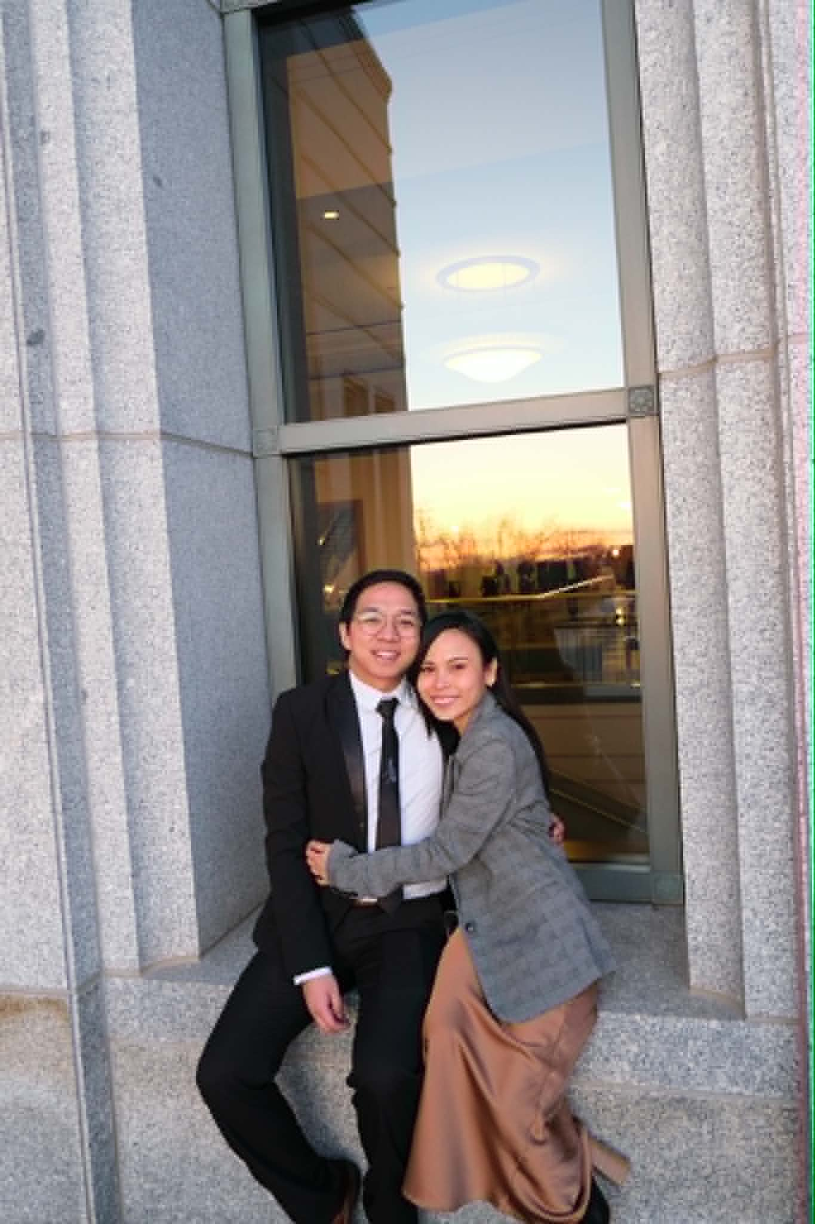



PRELIMINARIES
JERSON FRANCIA
LECTURE 01 | FOUNDATIONS I
02

Slide 3
PRELIMINARIES
INTRODUCTIONS
WHAT IS YOUR NAME?
WHERE IS HOME?
WHAT YEAR ARE YOU?
WHAT DO YOU DO TO DESTRESS?
LECTURE 01 | FOUNDATIONS I
02

Slide 4
COURSE INFORMATION
SYLLABUS
https://cyber-327.github.io/syllabus/
QUESTIONS WITH THE SYLLABUS?
LECTURE 01 | FOUNDATIONS I
02

Slide 5
COURSE INFORMATION
GRADES & POLICIES
Category | Weight
Labs | 30%
Homework | 15%
Quizzes | 10%
Midterms | 20%
Finals | 15%
Excellence Project | 5%
Professionalism | 5%
Labs
Venue: 424 EB
Work in groups of 1-3
Submit individually
Reports due on the Thursday before the next lab
Please be there for lab hour
Homework
Due every other Tuesday
LECTURE 01 | FOUNDATIONS I
02

Slide 6
COURSE INFORMATION
GRADES & POLICIES
Category | Weight
Labs | 30%
Homework | 15%
Quizzes | 10%
Midterms | 20%
Finals | 15%
Excellence Project | 5%
Professionalism | 5%
Extension
Everyone has 4 extension credits
1 credit = 1 calendar day extension
Max 2 credits on 1 assignment
Late = 50% cap
Revision
Everyone has 2 revision credits
Allows you to revise an assignment to recover any lost points
Must be used on a submitted work
*Exceptional circumstances are handled separately
LECTURE 01 | FOUNDATIONS I
02

Slide 7
COURSE INFORMATION
GRADES & POLICIES
Category | Weight
Labs | 30%
Homework | 15%
Quizzes | 10%
Midterms | 20%
Finals | 15%
Excellence Project | 5%
Professionalism | 5%
Quiz
Occurs at the start of Wednesday lecture
5-8 minutes
Open book, closed neighbor
12 quizzes throughout semester, but 2 lowest scores will be dropped
Missed quizzes are zero
*Exceptional circumstances are handled separately
LECTURE 01 | FOUNDATIONS I
02

Slide 8
COURSE INFORMATION
GRADES & POLICIES
Category | Weight
Labs | 30%
Homework | 15%
Quizzes | 10%
Midterms | 20%
Finals | 15%
Excellence Project | 5%
Professionalism | 5%
Midterm
2 midterm exams
Open-book, closed neighbor
Midterm 1: October 9-11
Midterm 2: November 13-15
Final Exam
In person
Closed book
Date & Time TBA
LECTURE 01 | FOUNDATIONS I
02

Slide 9
COURSE INFORMATION
GRADES & POLICIES
Category | Weight
Labs | 30%
Homework | 15%
Quizzes | 10%
Midterms | 20%
Finals | 15%
Excellence Project | 5%
Professionalism | 5%
Excellence Project
Can be submitted anytime this semester
Professionalism
Attendance
Attitude
Participation
LECTURE 01 | FOUNDATIONS I
02

Slide 10
THE FOCUS OF THIS CLASS
DIGICOMM, IN A NUTSHELL
A
B
HOW CAN WE SEND DATA FROM A TO B:
TO UNDERSTAND THESE ISSUES,
WE MUST FIRST UNDERSTAND:
FASTER
MORE RELIABLY
EFFICIENTLY
SECURELY
at a higher data rate
less errors and data loss
at a lower cost
fulfilling CIA
WHAT?
HOW?
electricity
waves
light
wire
optical fiber
wireless
is being propagated
is it being propagated
LECTURE 01 | FOUNDATIONS I
02

Slide 11
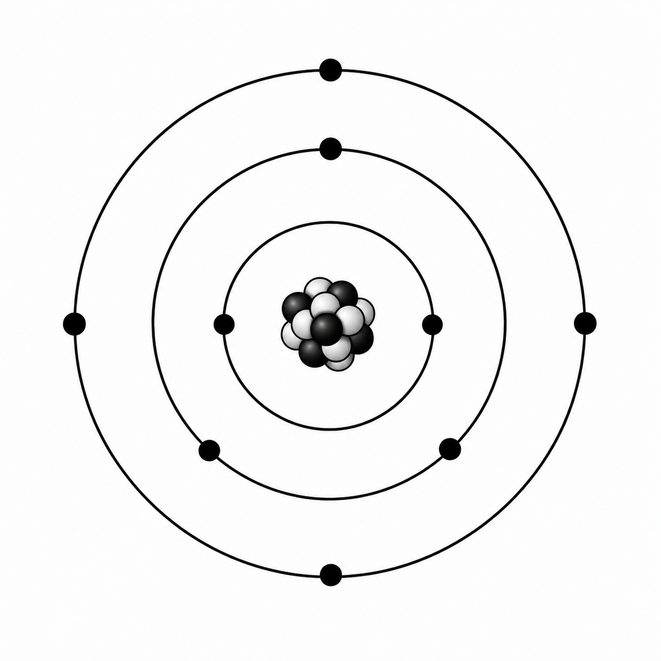

FIRST QUESTION
What Is Electricity?
Push and Pull
The behavior of electric charges interacting or moving, allowing energy transfer
LECTURE 01 | FOUNDATIONS I
02
Notes:
Keep the course overview under five minutes. The 70/30 balance is a semester target, not a quota for each meeting.

Slide 12
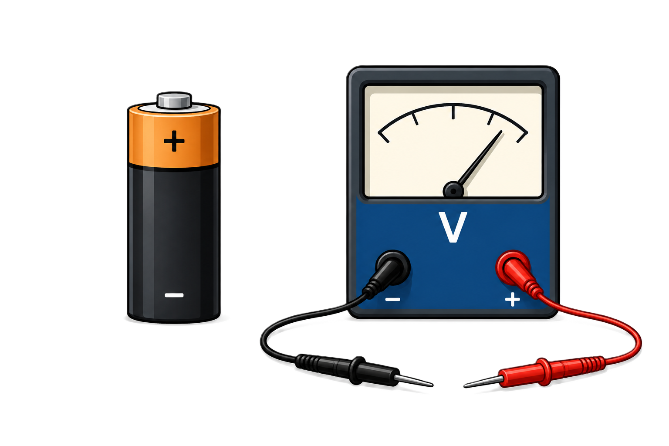
ELECTRICAL QUANTITY 1
Voltage is a difference between two points
Potential difference
Describes how much electrical potential differs between a selected first point and second point.
Unit: Volt Symbol: E/V
Measurement
A voltmeter connects across two points. Includes the reference and polarity.
NEVER SAY 'VOLTAGE AT A POINT' WITHOUT A REFERENCE
LECTURE 01 | FOUNDATIONS I
06

Slide 13
ELECTRICAL QUANTITY 2
Current flows through a complete path
Charge flow
Describes the rate at which electric charge moves through a path.
Unit: Ampere/Amp Symbol: I
Path rule
No complete path means no sustained current.
LECTURE 01 | FOUNDATIONS I
07

Slide 14
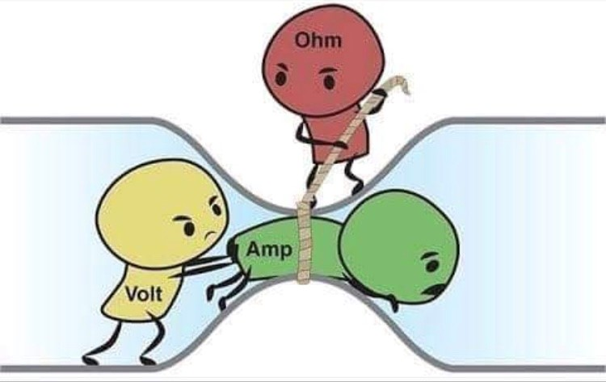
ELECTRICAL QUANTITY 3
Resistance limits current
Opposition
How strongly something opposes the flow of electric current.
Unit: Ohm Symbol: R
Relationship to I & V
How much voltage is needed to produce a certain amount of current?
LECTURE 01 | FOUNDATIONS I
08

Slide 15
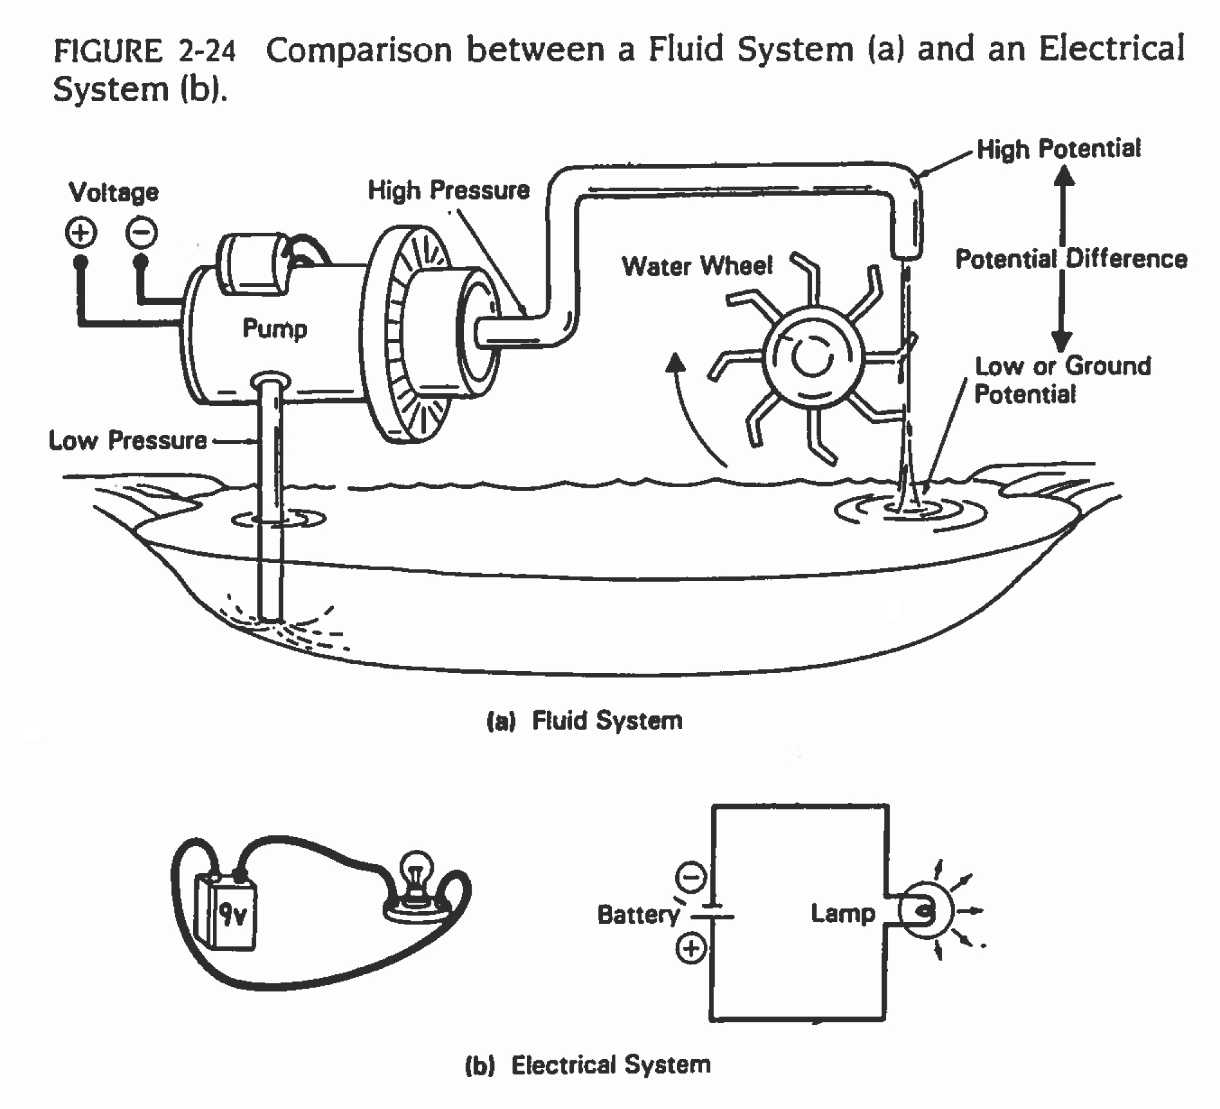
ELECTRICAL QUANTITY 4
Power sets practical limits
Energy transfer
Power is the rate at which electrical energy is supplied, converted, or dissipated.
Unit: Watt (W) Symbol: P
WHAT HAPPENS WITH TOO MUCH POWER?
LECTURE 01 | FOUNDATIONS I
09

Slide 16
BRIDGE TO COMMUNICATION
ELECTRONIC TERMS
Term | Units | Unit Abbrev | Symbol | Meaning
Voltage | Volts | V | E/V | ElectroMotive Force (EMF)
Current | Amperes | A | I | Flow of electrons 1 A = 1 Coulomb/sec
Resistance | Ohms | Ω | R | Opposition to electron flow
Power | Watts | W | P | Energy/unit time – Joules/sec 1 W = 1 Joule/sec
Frequency | Hertz | Hz | f | Cycles/sec 1 Hz = 1 cycle/sec
LECTURE 01 | FOUNDATIONS I
10

Slide 17
BRIDGE TO COMMUNICATION
ENGINEERING PREFIXES
Prefix | Symbol | Multiplier | Prefix | Symbol | Multiplier
milli | m | 10⁻³ | kilo | k | 10³
micro | µ | 10⁻⁶ | Mega | M(illion) | 10⁶
nano | n(ine) | 10⁻⁹ | Giga | G | 10⁹
pico | p | 10⁻¹² | Tera | T(welve) | 10¹²
femto | f(ifteen) | 10⁻¹⁵ | Peta | P | 10¹⁵
atto | a | 10⁻¹⁸ | Exa | E(ighteen) | 10¹⁸
zepto | z | 10⁻²¹ | Zetta | Z | 10²¹
yocto | y | 10⁻²⁴ | Yotta | Y | 10²⁴
LECTURE 01 | FOUNDATIONS I
09

Slide 18
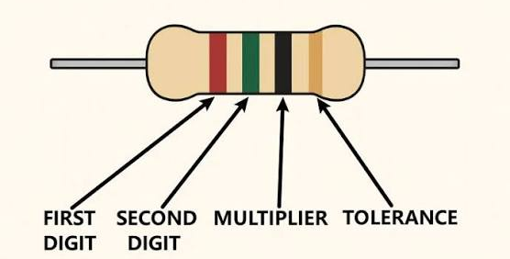
BRIDGE TO COMMUNICATION
RESISTOR COLOR CODE
Color | Value | Multiplier | Tolerance | Tolerance (%)
Black | 0 | 10⁰ | Gold | ±5
Brown | 1 | 10¹ | Silver | ±10
Red | 2 | 10² | Blank | ±20
Orange | 3 | 10³
Yellow | 4 | 10⁴
Green | 5 | 10⁵
Blue | 6 | 10⁶
Violet | 7 | 10⁷
Gray | 8 | 10⁸
White | 9 | 10⁹
Better Boys Realize Our Young Girls Become Very Great Women
LECTURE 01 | FOUNDATIONS I
09
Notes:
Connect power to the current-limited bench supply. No calculation is required yet.

Slide 19
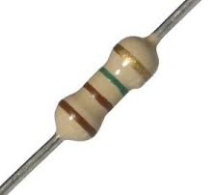
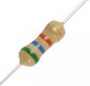
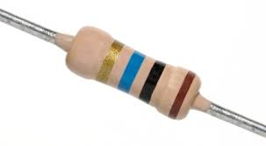
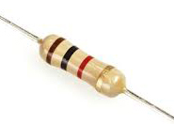
BRIDGE TO COMMUNICATION
RESISTOR COLOR CODE
Better Boys Realize Our Young Girls Become Very Great Women
LECTURE 01 | FOUNDATIONS I
09

Slide 20
BRIDGE TO COMMUNICATION
RESISTOR COLOR CODE
10MΩ ±5%
1.1MΩ ±5%
5.6kΩ ±5%
1.0kΩ ±5%
Better Boys Realize Our Young Girls Become Very Great Women
LECTURE 01 | FOUNDATIONS I
09

Slide 21
BRIDGE TO COMMUNICATION
RESISTOR COLOR CODE
360kΩ ±10%
10Ω ±20%
Better Boys Realize Our Young Girls Become Very Great Women
LECTURE 01 | FOUNDATIONS I
09

Slide 22
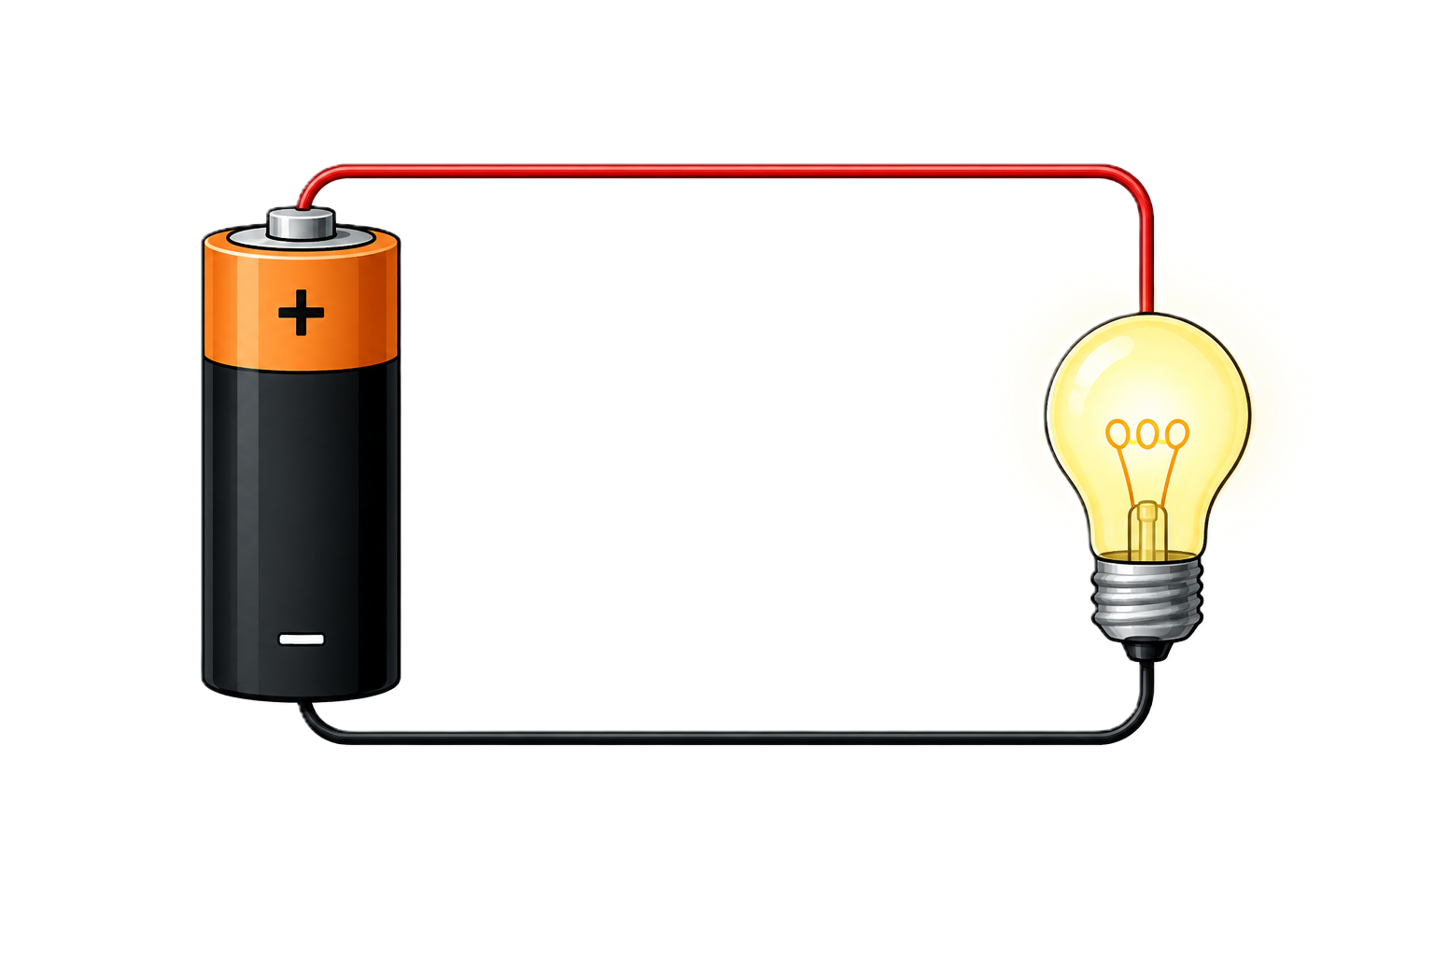
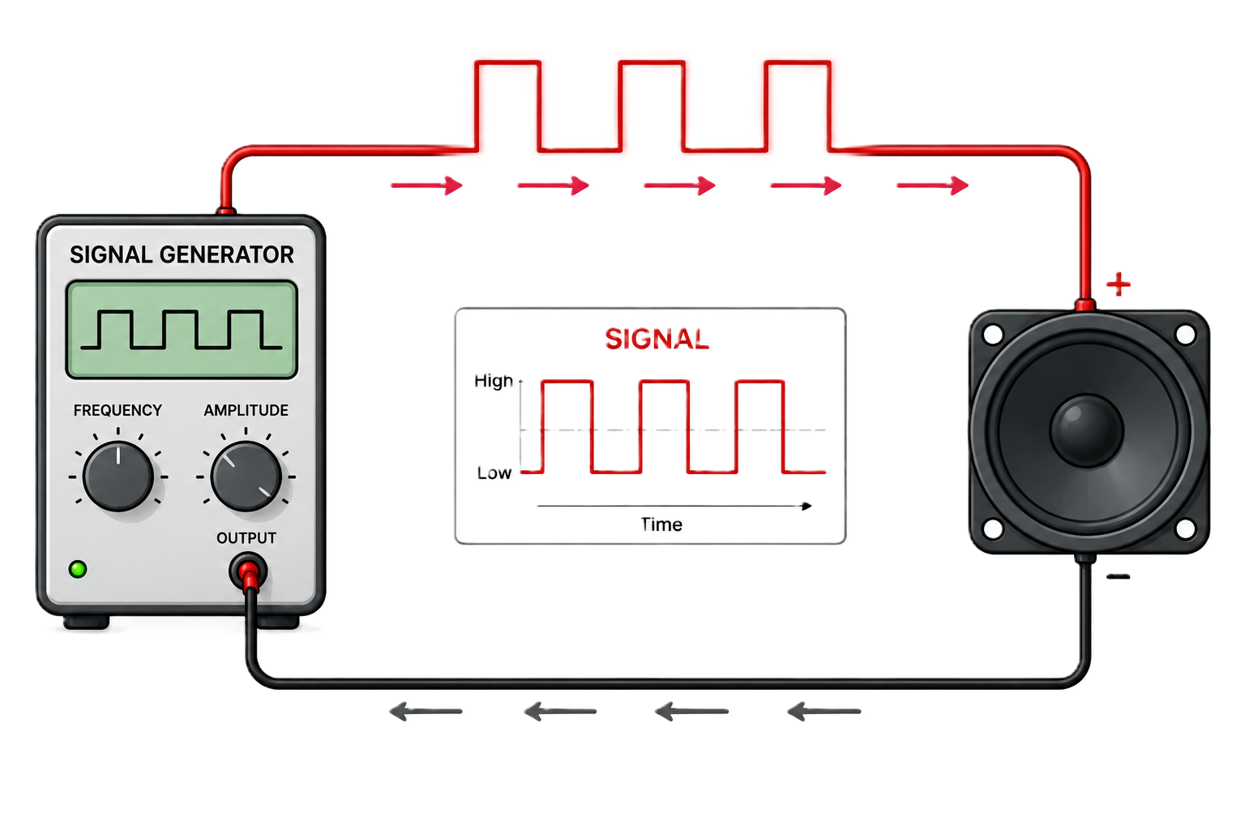
BRIDGE TO COMMUNICATION
A signal is a controlled physical change
Steady DC
A node remains near one voltage. The value can power a circuit or represent one stable condition.
Changing voltage
A node moves between distinguishable levels. A receiver can interpret the measured pattern as information.
LECTURE 01 | FOUNDATIONS I
10

Slide 23
START WITH TOPOLOGY
A circuit needs a complete path
SOURCE +
SWITCH
RESISTOR
LOAD
RETURN -
The source provides an electrical potential difference.
The load receives electrical energy.
The return conductor completes the path back to the source.
LECTURE 01 | FOUNDATIONS I
05
Notes:
Use the physical demonstration. Trace the loop before enabling power, then compare open-switch and closed-switch behavior.

Slide 24
BEFORE YOU LEAVE
Exit ticket
Why does a circuit need a complete loop?
Can’t it be just one line?
NEXT: OHM'S LAW + SERIES CIRCUITS
LECTURE 01 | FOUNDATIONS I
14
Notes:
An open path prevents sustained current

