Slide 1
CYBER 327 / LECTURE 20
Error Detection and Correction Fundamentals
The sensor sent one message. How can we notice or repair changed bits?
MONDAY, OCTOBER 19, 2026
LECTURE 20 | ERROR DETECTION AND CORRECTI
01

Slide 2
PRACTICE RECAP
Practice Problems
PLL recovery
Sensitivity
ADC code
A PLL is centered at 10.0 kHz. Its capture range is ±200 Hz, and its lock range is ±600 Hz.
The PLL starts unlocked. The input is 10.4 kHz. Is that input within its capture range?
The PLL is already locked at 10.2 kHz, and the input slowly drifts to 10.7 kHz. Is that input still within its stated lock range?
A receiver needs at least −95 dBm at its input to meet its stated performance target. The received signal is −78 dBm.
Calculate the sensitivity margin.
An attenuator reduces the received signal by 20 dB. Is the signal still above the sensitivity threshold?
An ideal 8-bit ADC measures voltages from 0 to 10.00 V.
How many possible codes does it have?
Calculate its ideal voltage step.
Approximately what code corresponds to 2.62 V?
LECTURE 20 | ERROR DETECTION AND CORRECTI
02
Notes:
PLL
No
No
Sensitivity
17 dB
-98, no
ADC
256
39mV
67

Slide 3
PRACTICE RECAP
Practice Problems
Alarm
PCM
Sampling Interval
A detector for an alarm samples at 2,000 samples/s. It has activated on a sinewave of 4600 Hz.
Predict the apparent frequency. Should the alarm activate?
Leave the input unchanged and increase sampling to 10,000 samples/s. Predict the apparent frequency and alarm state.
A single-channel PCM system takes 8,000 samples each second and represents each sample with 8 bits.
Calculate the bit rate.
A sampler takes 4,000 samples per second. Calculate the time between samples.
LECTURE 20 | ERROR DETECTION AND CORRECTI
02
Notes:
600 Hz, No
4600 Hz
64kbits/s
1/4000

Slide 4
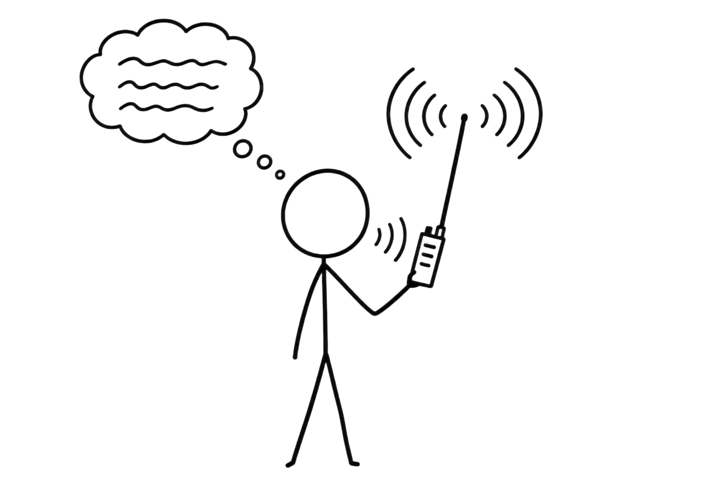
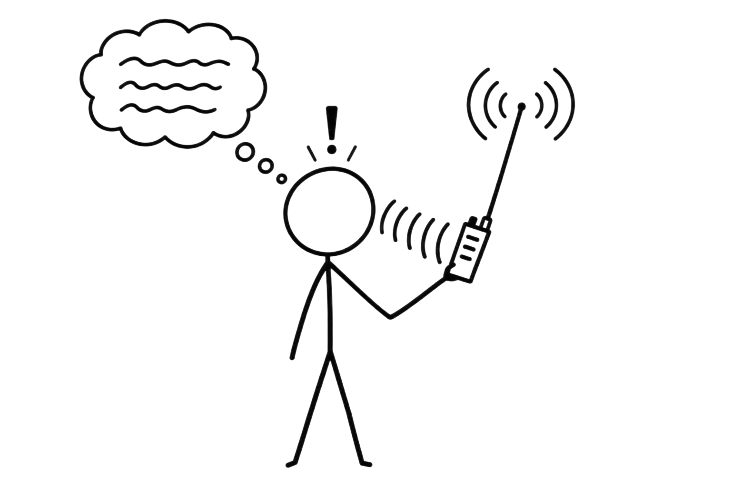
SYSTEM GOAL
Components of all Communication Systems
Message
Transmitter
Receiver
Recovered message
Medium
EVERY BLOCK TRANSFORMS, TRANSPORTS, OR INTERPRETS A PHYSICAL SIGNAL
02
Notes:
a waveform has both a time-domain appearance and a frequency-domain structure
signals compete with noise so we consider bandwidth and SNR (Shannon)
AM changes carrier amplitude; FM changes instantaneous frequency.
Receiver: Clock recovery, PLLs. Sensitivity
Sampling, Aliasing

Slide 5
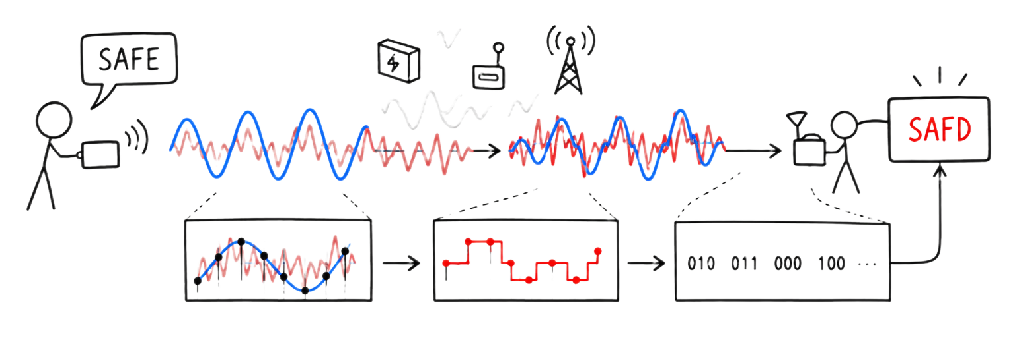
START WITH A PROBLEM
How do I know that the bits changed?
Error control
  Error detection
    parity, checksum, CRC
  Error correction
    ARQ, FEC, Interleaving
Redundancy
Extra information beyond the original data
LECTURE 20 | ERROR DETECTION AND CORRECTI
02

Slide 6
MAKE IT VISIBLE
Parity Bits
Data | Parity
Sent
1
0
1
1
1
4 ones: even
One bit changed
1
0
0
1
1
3 ones: FAIL
Two bits changed
1
1
0
1
1
4 ones: PASS
Set Even or Odd Parity
Even parity: Data plus parity must contain an even number of 1s
Odd parity: Data plus parity must contain an odd number of 1s
LECTURE 20 | ERROR DETECTION AND CORRECTI
04
Notes:
Can parity locate where the error occurred? No
What are the problems with this?

Slide 7
MAKE IT VISIBLE
Parity Bits
Character | ASCII bits | Number of ones | Added parity bit
S | 01010011 | 4 | 0
A | 01000001 | 2 | 0
F | 01000110 | 3 | 1
E | 01000101 | 3 | 1
Transmission: 010100110010000010010001101010001011
Received: 010100110010000010010001101010001001
FAIL
Received: 010100110010000010010001101010001101
PASS
LECTURE 20 | ERROR DETECTION AND CORRECTI
04
Notes:
Can parity locate where the error occurred? No
What are the problems with this?

Slide 8

MAKE IT VISIBLE
Checksum
Character | S | A | F | E | Total
Numerical code | 83 | 65 | 70 | 69 | 287
For an 8-bit checksum, mod by 256:
$287 mod 256=31$ = 00011111
Transmission: 01010011 01000001 01000110 01000101 00011111
Received: 01010011 01000001 01000110 01000100 00011111
FAIL
Received: 01010011 01000001 01000111 01000100 00011111
PASS
LECTURE 20 | ERROR DETECTION AND CORRECTI
04

Slide 9
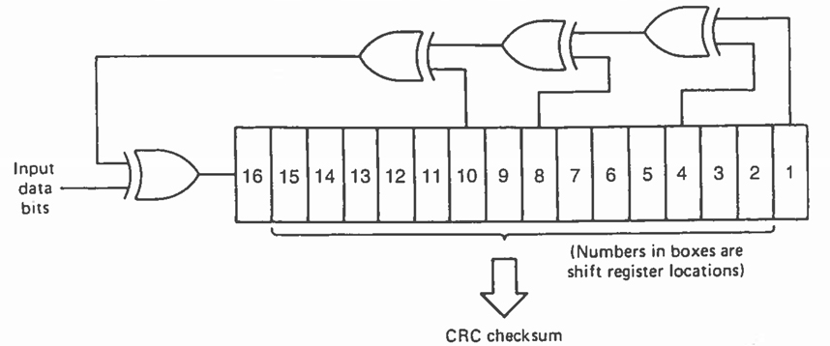
MAKE IT VISIBLE
Cyclic Redundancy Check (CRC)
Runs the message’s bits through an agreed calculation to produce a short check value.
Transmission: 01010011 01000001 01000110 01000101 11010010
S A F E
0x53 0x41 0x46 0x45 0xD2
8-bit CRC
      Received:
      Calculated:
S A F E
0x53 0x41 0x46 0x44 0xD2
FAIL
0x53 0x41 0x46 0x44 0xD5
LECTURE 20 | ERROR DETECTION AND CORRECTI
04

Slide 10
ERROR CHECKS
Send extra information so errors leave a clue
Check | Chance of missing a corrupted message
One parity bit | About 1 in 2
8-bit additive checksum | About 1 in 256
8-bit CRC | About 1 in 256
16-bit additive checksum | About 1 in 65,536
16-bit CRC | About 1 in 65,536
32-bit additive checksum | About 1 in 4.3 billion
32-bit CRC | About 1 in 4.3 billion
Equal numbers ≠ Equal Protection
Right table assumes uniformly random errors
Error pattern | Simple 8-bit additive checksum | 8-bit CRC
One data bit flips | Always detects | Always detects
One byte increases by 1; another decreases by 1 | Always misses | Detects many such changes; depends on positions and CRC
Two different data bytes swap positions | Always misses | Detects many swaps; depends on data and CRC
Burst spanning up to 8 bits | Can miss some | Always detects*
LECTURE 20 | ERROR DETECTION AND CORRECTI
03

Slide 11
BUILD THE IDEA
A failed check gives us two recovery choices
Request another copy: automatic repeat request (ARQ). This costs time and requires a return path.
Simplest implementation of FEC: majority correction:
1
Add enough structured redundancy to repair some errors: forward error correction (FEC).
1 transmits as 111
2
CRC Transmission: 01010011 01000001 01000110 01000101 11010010
FEC Transmission: 000 111 000 111 000 000 111 111 000 111 000 000 000 000 000 111 000 111 000 000 000 111 111 000 000 111 000 000 000 111 000 111 000 000 000 111 111 111 111 111
What are the disadvantages for this specific FEC?
LECTURE 20 | ERROR DETECTION AND CORRECTI
09
Notes:
the checksum/CRC is calculated before the FEC bits are added.
Add FEC to [SAFE | CRC]
3x the transmitted bits
If non-random errors (burst) can still give errors

Slide 12
BUILD THE IDEA
Error Correcting Code (ECC): Block Parity
1 error
2 errors
Parity in 2 dimensions
Data |  |  |  | Parity
1 | 1 | 0 | 1 | 0
1 | 0 | 0 | 0 | 1
1 | 1 | 0 | 1 | 1
0 | 0 | 0 | 0
Data |  |  |  | Parity
1 | 1 | 0 | 1 | 0
1 | 0 | 0 | 0 | 1
1 | 1 | 0 | 1 | 0
0 | 0 | 1 | 0
Arrange the data in a grid, then add parity bits for each row and each column
What could go wrong with this?
Assume even parity. Which bit(s) could be erroneous?
LECTURE 20 | ERROR DETECTION AND CORRECTI
09
Notes:
2 errors: detected but location ambiguous

Slide 13
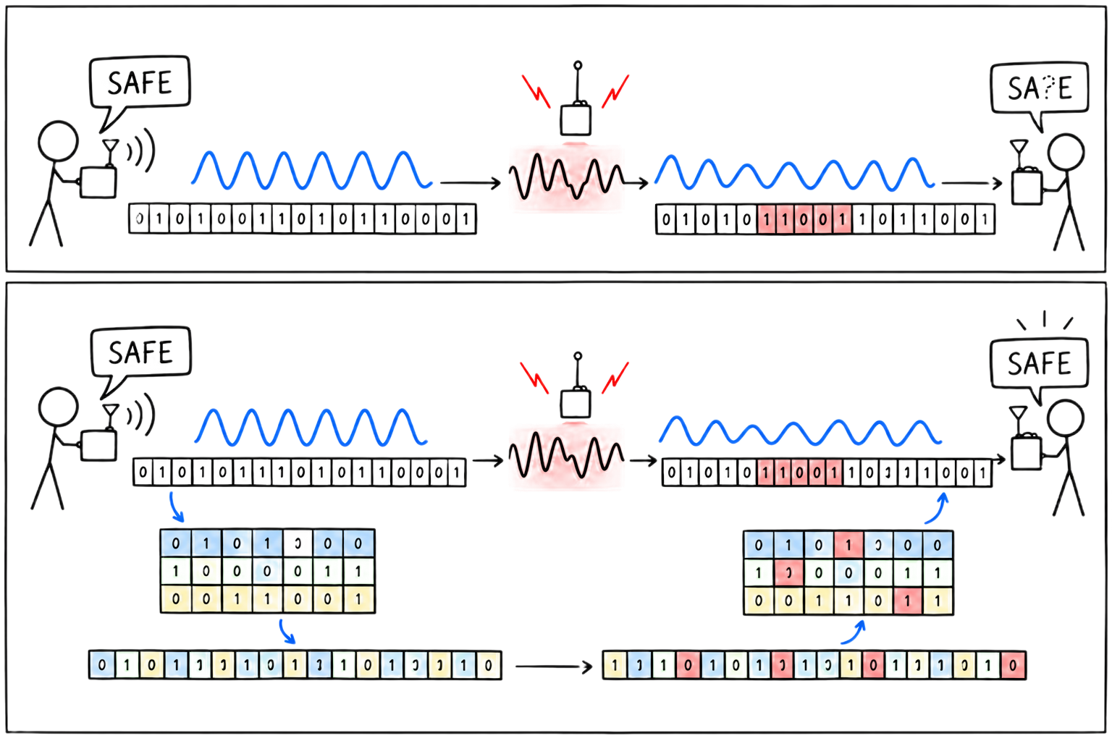
BUILD THE IDEA
Bursts & Interleaving
Burst Error
Random errors are scattered, but a burst damages a nearby run of transmitted bits.
Interleaving
sends pieces of different codewords in alternating order.
Spreads burst damage so ECC can work well
LECTURE 20 | ERROR DETECTION AND CORRECTI
12
Notes:
After deinterleaving, a code capable of one correction per word can handle this example.

Slide 14
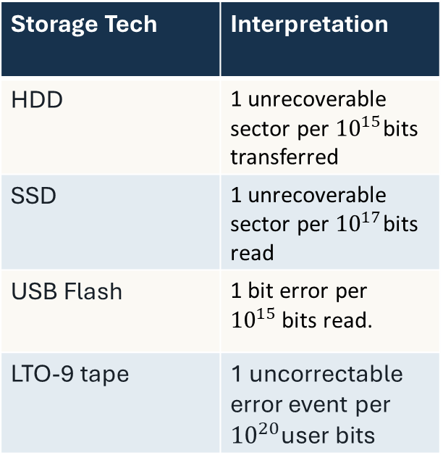
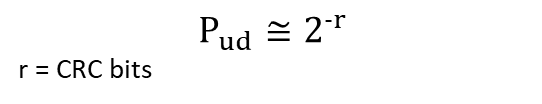

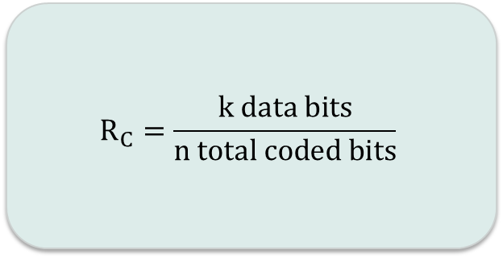
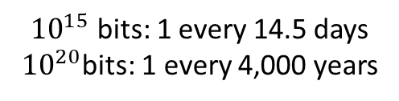
WORK THE EXAMPLE
Storage Tech | Interpretation
HDD | 1 unrecoverable sector per ${10}^{15}$bits transferred
SSD | 1 unrecoverable sector per ${10}^{17}$bits read
USB Flash | 1 bit error per ${10}^{15 }$bits read.
LTO-9 tape | 1 uncorrectable error event per ${10}^{20}$user bits
Reliability has a rate and delay cost
$$R_{C}=\frac{k data bits}{n total coded bits}$$
Code Rate
Information Bit Rate
$$R_{info}=R_{coded}R_{c}$$
How much of the packet is data?
What rate remains?
CRC Error Probability
$$P_{ud}≅2^{-r}$$
r = CRC bits
If reading at 100MB/s:
the probability that a corrupted frame passes its CRC check
${10}^{15}$ bits: 1 every 14.5 days
${10}^{20}$bits: 1 every 4,000 years
LECTURE 20 | ERROR DETECTION AND CORRECTI
13
Notes:
If 8 data over 12 coded bits:
30 kbit/s
Rc = 2/3
Rinfo =20 kbit/s

Slide 15
CHECK UNDERSTANDING
Explain the next step
The CRC passes. What do we still not know?
Name one error the chosen code can detect, one cost of redundancy, and one unsupported trust claim.
NEXT: WHO AUTHORIZED THE MESSAGE?
LECTURE 20 | ERROR DETECTION AND CORRECTI
15

