Slide 1
CYBER 327 / LECTURE 21
Integrity, Authentication, and Encryption
WEDNESDAY, OCTOBER 21, 2026
LECTURE 21 | INTEGRITY AUTHENTICATION AND
01
Notes:
Reserve minutes 0–10 for the scheduled Quiz 7; coverage is unchanged. Say: Last lecture asked whether the bits arrived correctly. Today asks whether the receiver should obey them. Our running example is a classroom toy door receiving OPEN or LOCK, not an actual access-control product. After the quiz, spend seven minutes reviewing Lecture 20 using parity, code rate, information rate and the random-remainder CRC estimate. Do not add minimum-distance formulas. By the end, students should select a protection for corruption, forgery, replay, or eavesdropping. They do not need to calculate a cryptographic MAC or write encryption code.

Slide 2
LECTURE 20 PRACTICE
Review
Data 1011010 uses even parity. Which parity bit should be added?
The complete received word is 10100100. Does its even-parity check pass?
Rate
k = 12 information bits
n = 16 transmitted bits
Coded rate = 8.00 Mbit/s. Ignore other overhead and retries.
Calculate the code rate and the added bits per codeword.
Find the information bit rate.
A valid word 10110100 changes to 10000101. Does parity detect the error?
What is the probability of a random corruption for a 16-bit CRC?
LECTURE 21 | INTEGRITY AUTHENTICATION AND
02
Notes:
Code rate: k/n
Added bits: n − k
Information bitrate R_coded × R_c

Slide 3
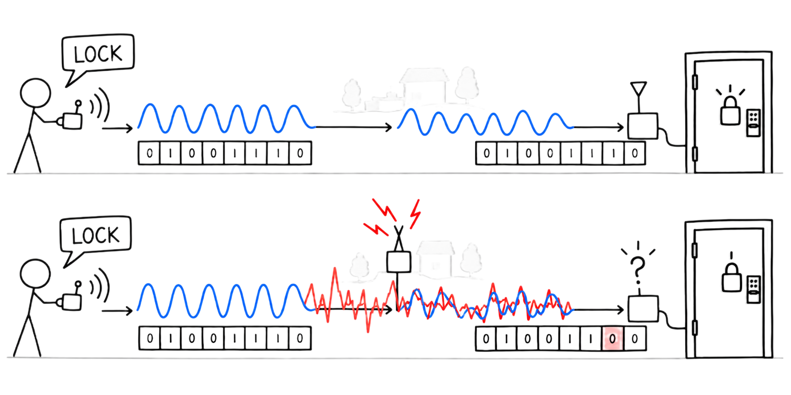
PURPOSE IN THE COMMUNICATION CHAIN
Our current situation
LECTURE 21 | INTEGRITY AUTHENTICATION AND
04
Notes:
The owner sends LOCK, but interference damages some bits. How would the receiver notice?
Solution: Add a CRC and reject messages that fail the check

Slide 4
PURPOSE IN THE COMMUNICATION CHAIN
Our current situation
Technique | Detect errors? | Correct errors? | Typical overhead | Common applications
Parity bits | Yes | No | 1 bit per protected group | UART, legacy memory, RAID parity (different construction)
Checksums | Yes | No | Often 16 or 32 bits | TCP, UDP, IPv4, files, software packages
CRC | Yes | No | Typically 8, 16, or 32 bits | Ethernet, Wi-Fi, USB, CAN, storage
Cryptographic hashes | Yes | No | 256 bits for SHA-256 | Software downloads, Git, digital signatures, file integrity
ECC | Yes | Yes | Varies by code | ECC RAM, SSDs, QR codes, satellite communications, cellular networks
LECTURE 21 | INTEGRITY AUTHENTICATION AND
04
Notes:
The owner sends LOCK, but interference damages some bits. How would the receiver notice?
Solution: Add a CRC and reject messages that fail the check

Slide 5
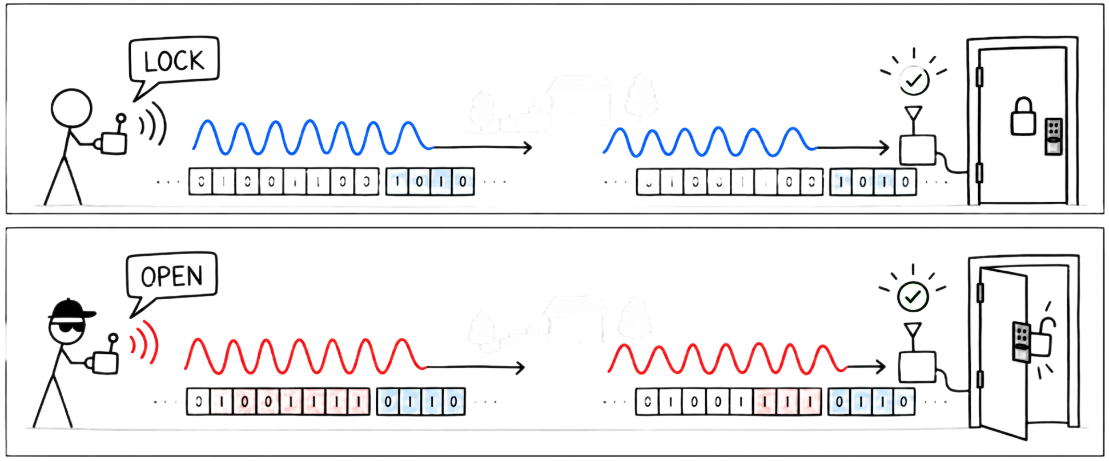
PURPOSE IN THE COMMUNICATION CHAIN
The bits arrived. Should the door obey?
Integrity | Was protected content changed or forged?
Message authentication | Was this formed by someone with the trusted key?
Authorization | Is that sender allowed to request this action?
So far
Today
represent the information and recover the bits reliably
check whether a received command should be trusted and allowed.
LECTURE 21 | INTEGRITY AUTHENTICATION AND
04
Notes:
Say: Imagine the receiver has recovered every bit perfectly. That still does not tell us who sent OPEN. Ask: Could an attacker also send a perfectly readable signal? Expected: yes
The attacker in this example can replace the command and the attached check. No secret is needed to calculate a CRC

Slide 6
PURPOSE IN THE COMMUNICATION CHAIN
The bits arrived. Should the door obey?
What is sent? | CRC check
Authorized controller sends LOCK | Matching CRC: pass
Attacker changes LOCK to OPEN; keeps old CRC | Fails
Attacker sends OPEN with a newly calculated CRC | Pass
LECTURE 21 | INTEGRITY AUTHENTICATION AND
04
Notes:
Say: Imagine the receiver has recovered every bit perfectly. That still does not tell us who sent OPEN. Ask: Could an attacker also send a perfectly readable signal? Expected: yes
The attacker in this example can replace the command and the attached check. No secret is needed to calculate a CRC

Slide 7
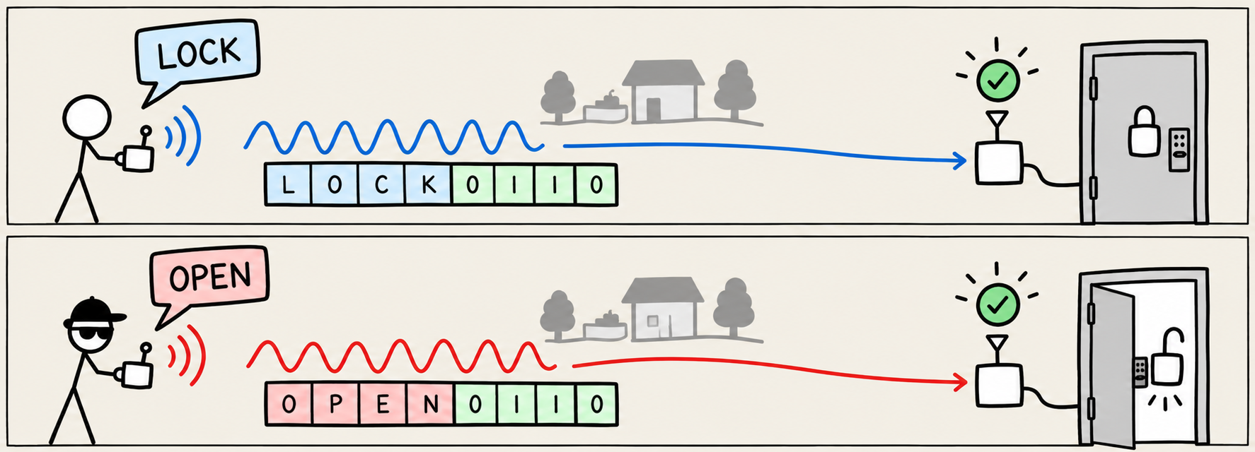
PURPOSE IN THE COMMUNICATION CHAIN
A matching CRC does not give permission
Collision
Different messages | Calculated CRC | Decision
LOCK + extra byte A | X | Accept
OPEN + extra byte B | X | Accept
Two different inputs produce the same output
LECTURE 21 | INTEGRITY AUTHENTICATION AND
04
Notes:
Upgrade, we now only approve from a whitelist of CRCs
Assume the attacker has found a second well-formed message with the approved CRC.
We need a check that depends on a secret, not just a different CRC rule

Slide 8
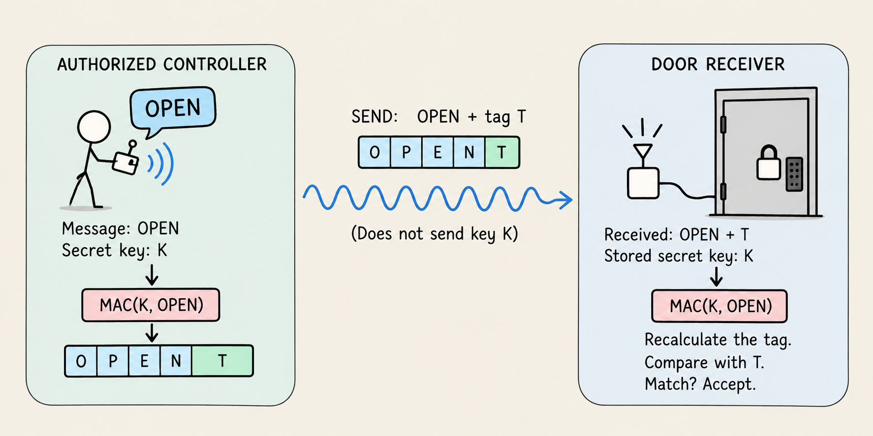
MAKE IT VISIBLE
Make check depend on a secret
Message authentication code (MAC)
a check calculated from the message and a secret key.
LECTURE 21 | INTEGRITY AUTHENTICATION AND
08
Notes:
Trace left to right. Both endpoints already store key K. The controller calculates tag T from OPEN and K; it sends OPEN and T, not K. The door independently calculates the expected tag from the received message and its stored K. Ask: If an outsider changes OPEN to LOCK but keeps T, what should happen? Expected: verification should fail. T is a placeholder, not a computed example or recommended tag length. Correct verification rejects a mismatch. A match supports the key-holder claim but is not permission to act immediately. It could still be an old message. Use an established cryptographic library in a real implementation; students are not designing a MAC algorithm.

Slide 9
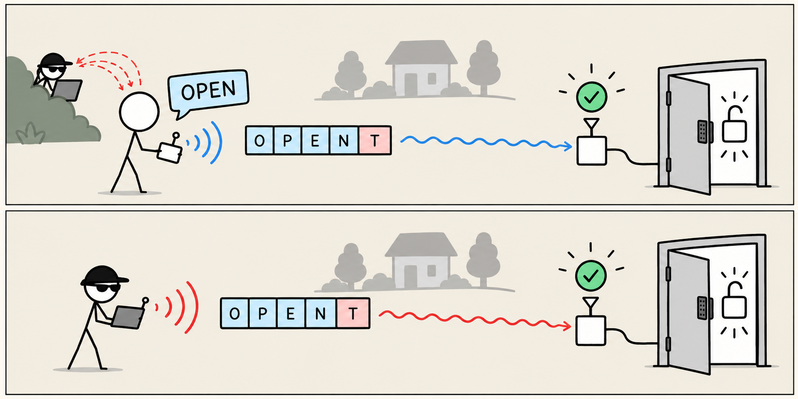
A VALID MESSAGE CAN STILL BE THE WRONG MESSAGE NOW
Replay: send an old valid message again
Time | What happens? | What does the door see?
09:00 | Owner sends OPEN; observer records message + tag | Valid tag; door opens
09:10 | Owner sends LOCK | Valid tag; door locks
09:15 | Observer resends the recorded OPEN + original tag | Tag is still valid; opening is unsafe
LECTURE 21 | INTEGRITY AUTHENTICATION AND
10
Notes:
Define replay first: recording a valid message and sending that same message again later. Ask: Does the observer need to learn the key or calculate a new tag? Expected: no. The bits and tag are unchanged, so MAC verification alone cannot distinguish the replay. This is not a CRC collision; it is reuse of a genuine message. Transition: We must give the receiver a way to recognize previously accepted commands.

Slide 10
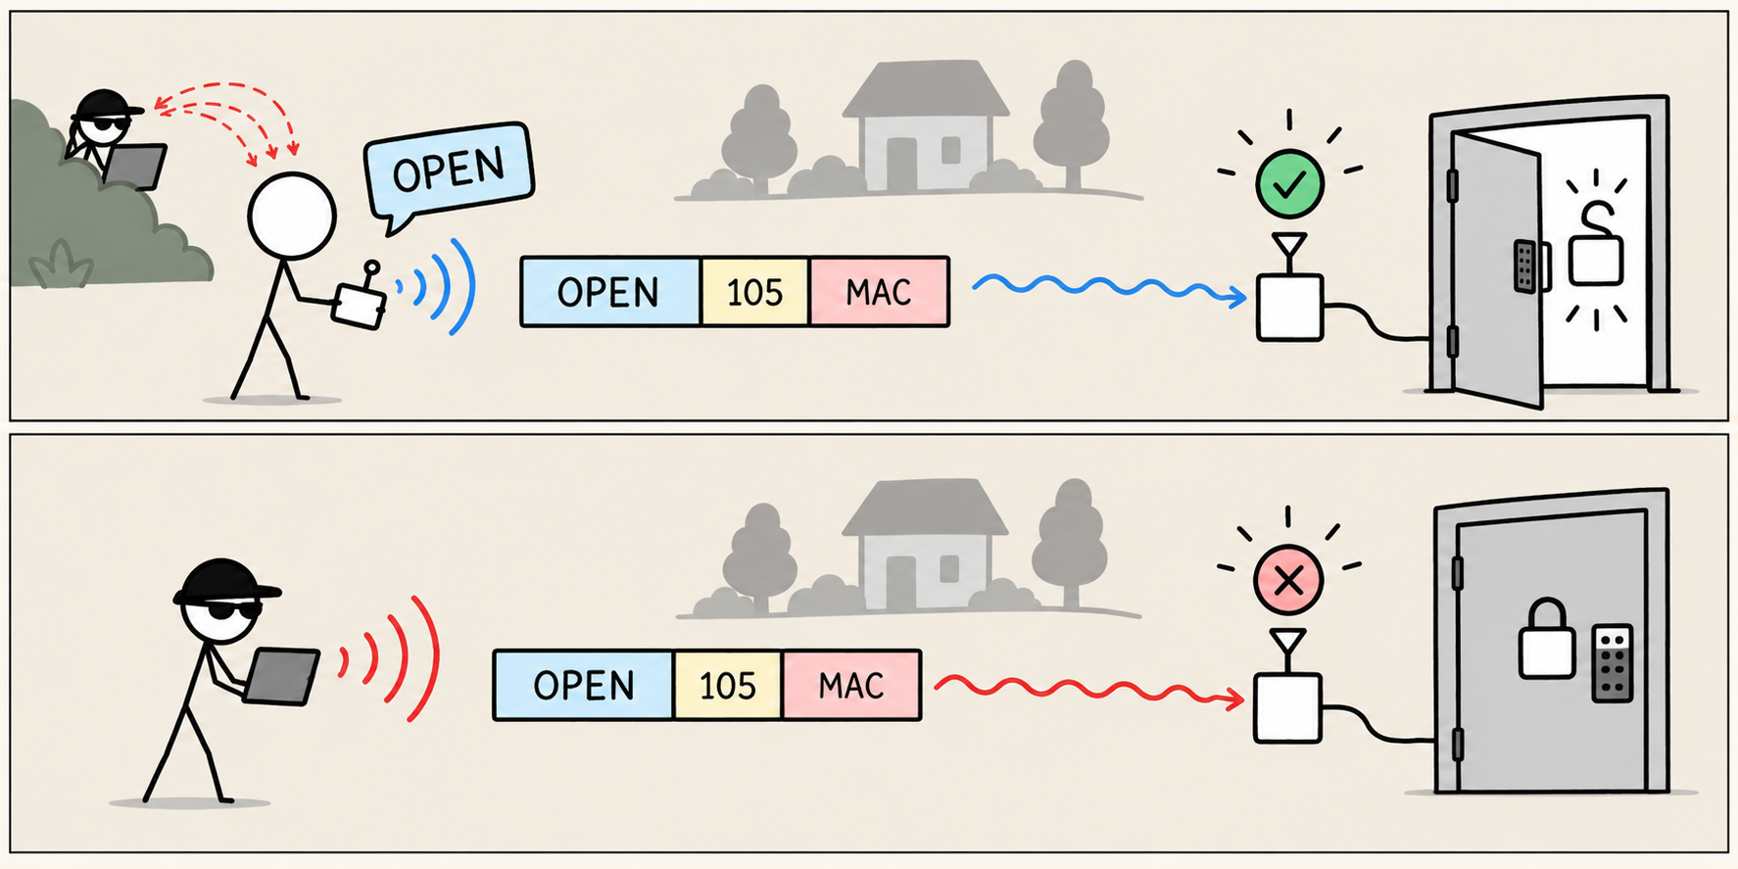
ADD A COUNTER AND A RECEIVER RULE
Freshness: is this a new command?
Received command | Valid tag? | Receiver starts with last = 41
Door A | 42 | OPEN | Yes | Accept; remember 42
Door A | 42 | OPEN, repeated | Yes | Reject: already accepted 42
Door A | 43 | LOCK | Yes | Accept; remember 43
Counter/Nonce
An increasing message number
LECTURE 21 | INTEGRITY AUTHENTICATION AND
11
Notes:
Define freshness: evidence that a message belongs to the current exchange, rather than being an old accepted message reused.
A counter is a message number that increases.
Ne wproblem: these checks do not hide OPEN from an observer. Encryption is not a replacement for the counter rule.

Slide 11
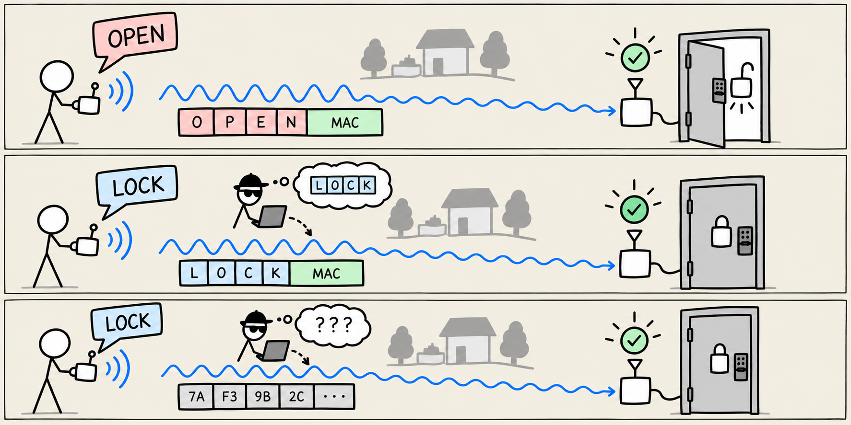
A DIFFERENT PROBLEM NEEDS A DIFFERENT PROTECTION
Encryption: keep the message private
Plaintext
Ciphertext
What if we only use encryption?
The readable message
The encrypted text
LECTURE 21 | INTEGRITY AUTHENTICATION AND
12
Notes:
An attacker can copy an encrypted OPEN message and resend it without understanding its contents.

Slide 12
PAUSE AND ASK BEFORE GIVING EACH ANSWER
Choose the tool for the problem
Problem | Useful protection
Noise changes bits | CRC with retry, or error-correcting coding
Outsider replaces OPEN and recalculates CRC | MAC / authenticated encryption
Observer resends a previously accepted OPEN | Protected counter + remembered state
Observer reads the command | Encryption / authenticated encryption
LECTURE 21 | INTEGRITY AUTHENTICATION AND
14

Slide 13
CHECK UNDERSTANDING
Exit
What can still go wrong with our final design?
NEXT: BITS INTO WAVEFORMS
LECTURE 21 | INTEGRITY AUTHENTICATION AND
19
Notes:
Stolen secret key: someone who obtains the controller’s key can create valid commands.
Counter reset: if restarting the door makes it forget accepted counters, previously rejected replays might become acceptable again.
Delayed commands: our counter rule rejects previously accepted commands. A valid command that was never received earlier might still pass later if its counter is higher.
- Blocked communication: an attacker could prevent reception. Encryption does not make the radio signal immune to interference.
- Device or software compromise: an attacker controlling the receiver’s software could bypass the checks entirely.

