Slide 1
CYBER 327 / LECTURE 31
Network Topologies, Ethernet Frames, and Interface Leakage
FRIDAY, NOVEMBER 13, 2026
LECTURE 31 | NETWORK TOPOLOGIES ETHERNET
01
Notes:
More wired connections

Slide 2
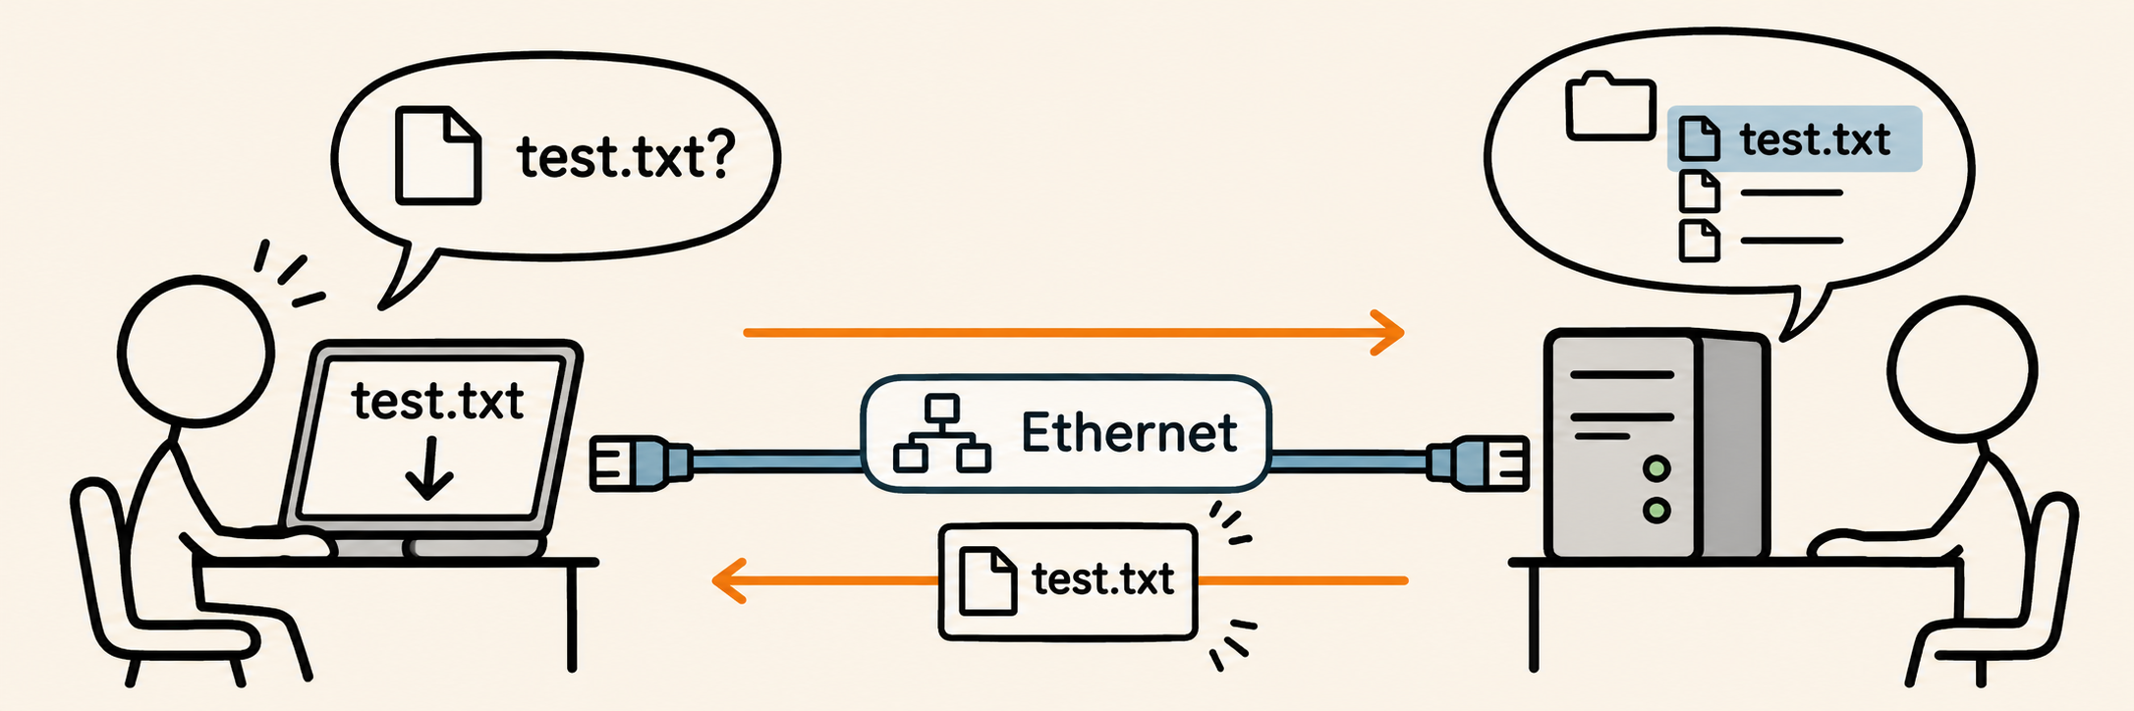
ETHERNET DELIVERY
Two computers exchange a file over a wired link
1
File bytes
2
Ethernet frames
3
Physical signals
4
Received file
Client: the computer requesting the file
Server: the computer providing the file
Ethernet is a set of rules for sending frames over a wired communication link.
LECTURE 31 | NETWORK TOPOLOGIES ETHERNET
02
Notes:
Ethernet is not limited to an Internet connection.
The application and network settings are already configured in this example.

Slide 3
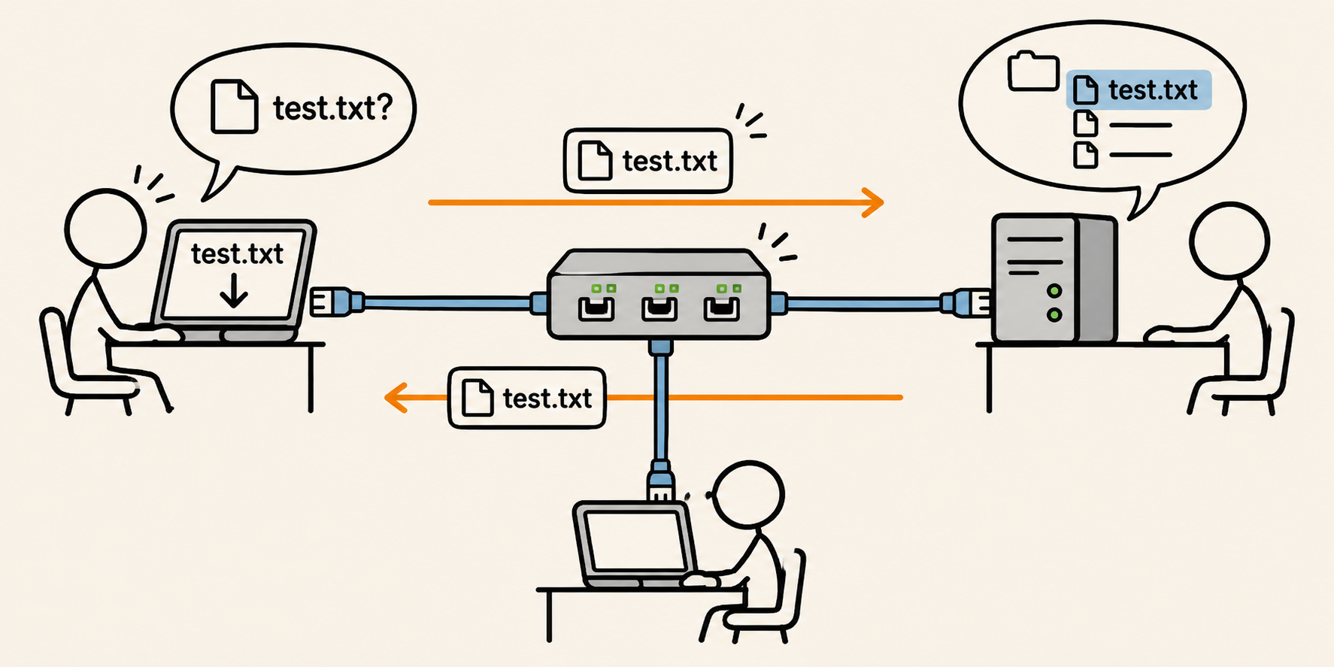
ETHERNET DELIVERY
A switch connects devices in a local network
Each cable is a separate link
Topology - the arrangement of devices and links.
LAN - local area network: devices communicating within a local network.
The file transfer stays within this LAN (Internet access not required)
LECTURE 31 | NETWORK TOPOLOGIES ETHERNET
04
Notes:
A switch port is a connection socket for one link.
The physical arrangement is a star (several links meet at the switch). This creates a reason to identify which interface should receive a frame.
Source: https://www.cisco.com/site/us/en/learn/topics/small-business/network-switch-vs-router.html

Slide 4
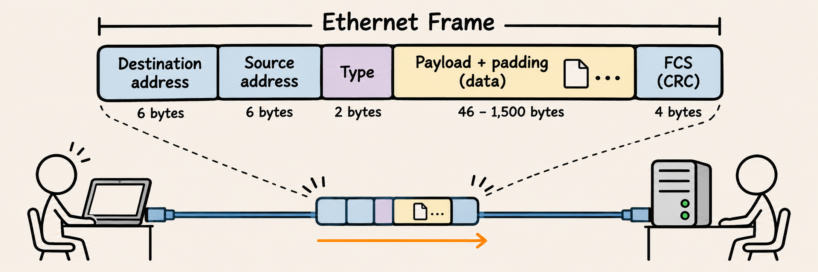
ETHERNET DELIVERY
A frame carries delivery fields, data and an error check
MAC Address
IPv4/IPv6/ARP
Payload: the data carried inside this frame, including other protocol information.
FCS = frame check sequence
6 + 6 + 2 + 4 = 18 bytes of frame overhead.
LECTURE 31 | NETWORK TOPOLOGIES ETHERNET
05
Notes:
The type field tells the receiver how to interpret the carried protocol.
FCS uses CRC, retrieving Lecture 20; a valid check is not cryptographic authentication.

Slide 5
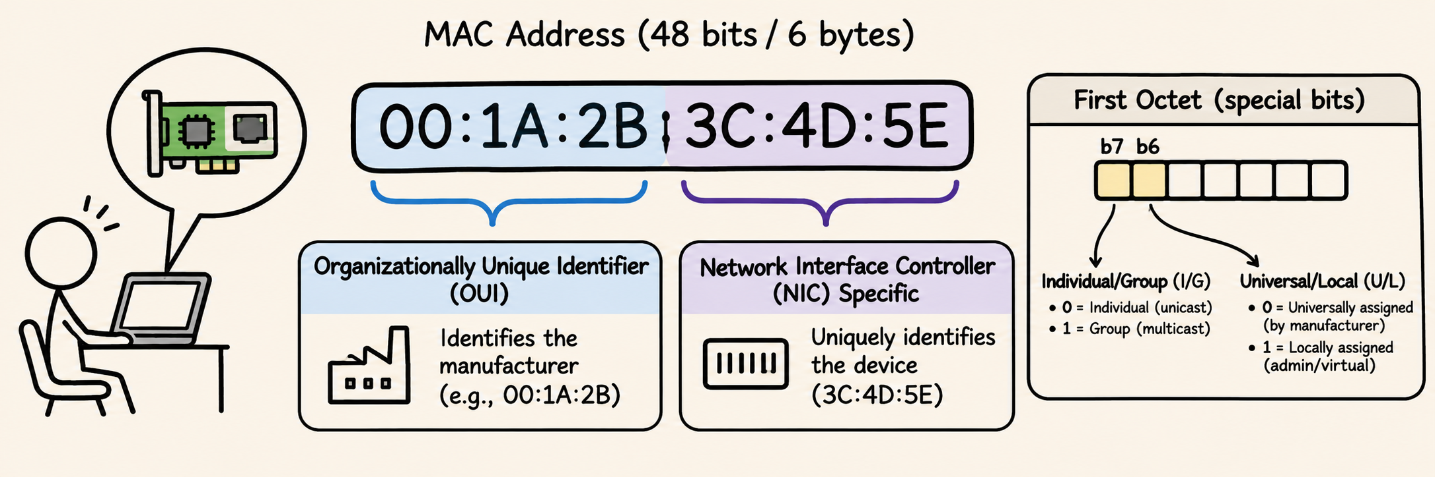
ETHERNET DELIVERY
A MAC address names an Ethernet interface
In our example | MAC address
Client interface | 00:00:0C:00:00:10
File-server interface | 00:00:0C:00:00:20
Server’s reply frame | Destination = client · Source = file server
MAC = Media Access Control
not Message Authentication Code
LECTURE 31 | NETWORK TOPOLOGIES ETHERNET
06

Slide 6
ETHERNET DELIVERY
The switch forwards a known destination toward its port
Reply destination: CLIENT → port 1
Port 1
Port 3
Port 2
Read the destination address in the frame.
Forward toward the port associated with that destination.
LECTURE 31 | NETWORK TOPOLOGIES ETHERNET
07

Slide 7
ETHERNET DELIVERY
Frame overhead consumes transmission time
Example
Calculate
100 Mbit/s link
1,500-byte Ethernet payload
18 bytes: addresses + type + FCS
How big is the frame in bits?
What is the transmission time of one frame?
What fraction of the frame is the payload?
Frame-only time: exclude preamble, start delimiter, interframe gap and processing.
LECTURE 31 | NETWORK TOPOLOGIES ETHERNET
08
Notes:
22–26 minutes
Use 6+6+2+1500+4=1518 bytes and 1518×8=12144 bits.
T=N/R=12144/100000000 seconds=121.44 microseconds.
The payload fraction is 1500/1518×100≈98.81%.

Slide 8
ETHERNET DELIVERY
Compared to UART
Feature | UART | Ethernet
How data is organized | Small frames, often carrying one byte each | Frames carrying addresses, control information, and a data payload
How timing is set | Both ends agree on a baud rate | Uses timing and signaling defined by the Ethernet standard
Addressing? | No built-in addresses | Uses MAC addresses
Error detection | Optional parity | Includes a CRC frame check
Electrical signaling | Often simple HIGH/LOW voltage levels | Depends on the Ethernet version and medium
Typical use | Communication between chips, modules, or a debug console | Networking computers, routers, cameras, and other devices
LECTURE 31 | NETWORK TOPOLOGIES ETHERNET
15

Slide 9
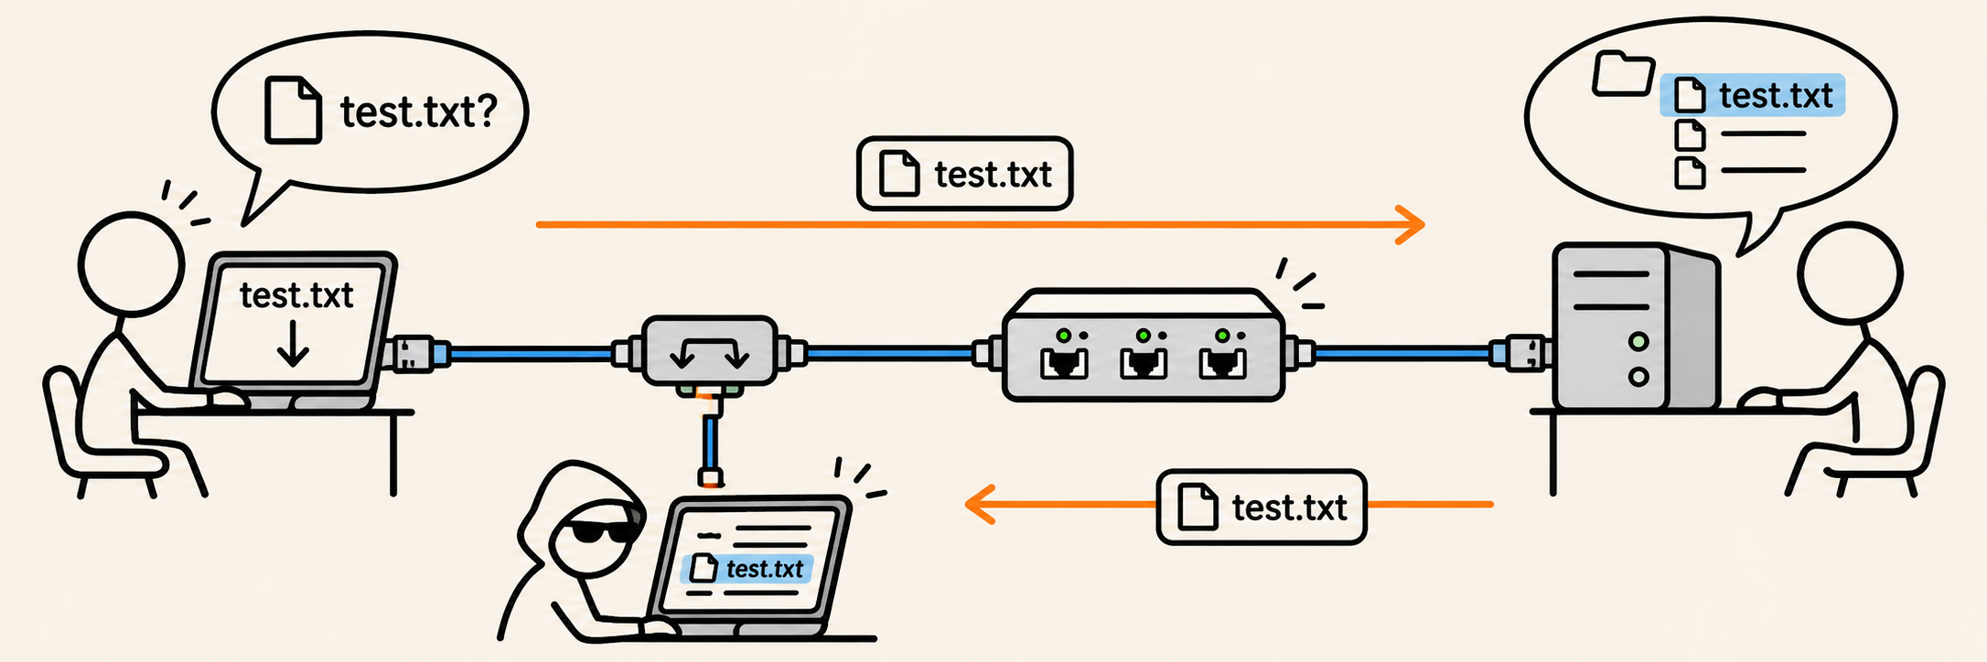
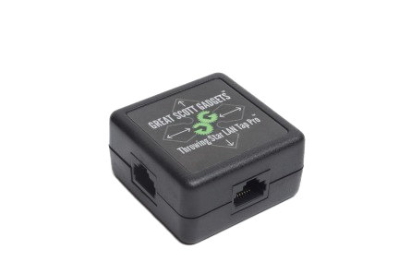
ETHERNET DELIVERY
An attacker taps the cable carrying the file transfer
The tap copies traffic crossing the selected client–switch link.
The attacker examines those copied frames.
Physical access to this link creates an observation point on this file transfer.
LECTURE 31 | NETWORK TOPOLOGIES ETHERNET
09
Notes:
A tap is capture hardware,

Slide 10
ETHERNET DELIVERY
What can be protected?
HTTPS
Encrypts at the payload level*
LECTURE 31 | NETWORK TOPOLOGIES ETHERNET
10
Notes:
IP header20 bytesSource/destination IP addresses and other IP information
TCP header20 bytesPort numbers, sequence numbers, and other TCP information
↳ Application dataUp to 1,460 bytesPart of the file transfer
Only the application data part is encrypted. It does not say anywhere that it is HTTPs encrypted.

Slide 11
ETHERNET DELIVERY
Exit: what did the attacker actually learn?
A complete Ethernet frame is 1,000 bytes, including its FCS.
At 100 Mbit/s, what is its frame-only transmission time?
A tap copies the frame, but the file data is encrypted.
Name two things still observable
NEXT: NETWORK MEDIA
LECTURE 31 | NETWORK TOPOLOGIES ETHERNET
16
Notes:
Private resolution: N=1000×8=8000 bits, T=8000/100000000=0.000080 seconds=80 microseconds.
Ethernet addresses, frame length, timing and direction are possible observations.

