Slide 1
CYBER 327 / LECTURE 05
More AC, Phasors, Inductance, and Reactance
Changing signals make component behavior depend on frequency and phase.
SEP 14, 2026
LECTURE 05 | INDUCTANCE + REACTANCE
01

Slide 2
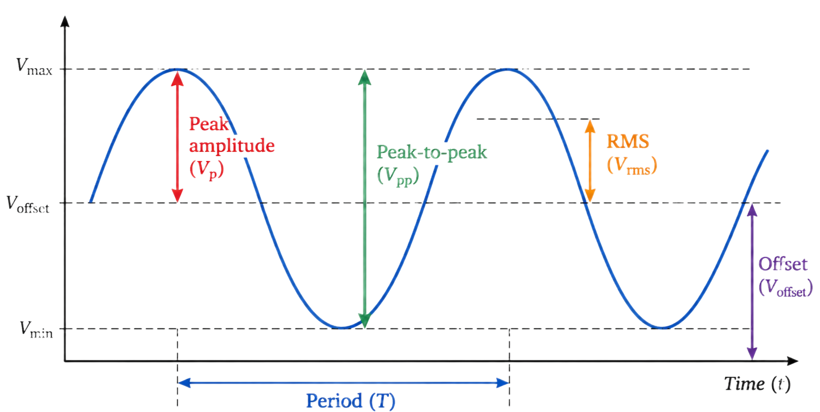
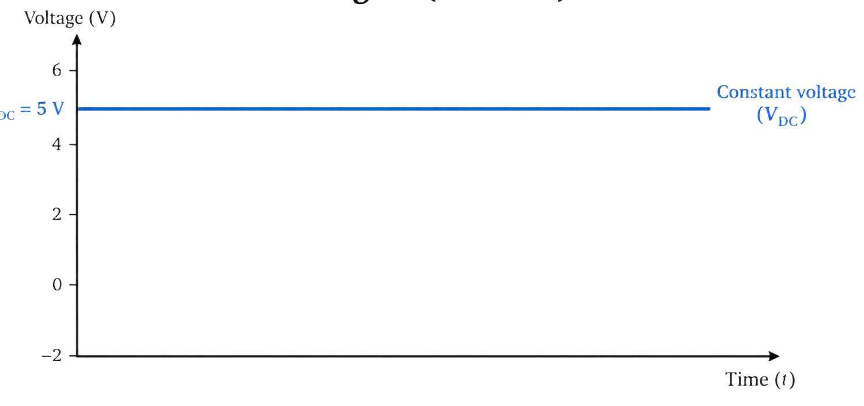
FROM WAVEFORM TO MODEL
AC describes change over time
Magnitude
Timing
Response
Peak, peak-to-peak, RMS, and offset describe vertical behavior.
Period, frequency, and phase describe repetition and relative position.
Components can pass, oppose, delay, store, or couple changing signals.
LECTURE 05 | INDUCTANCE + REACTANCE
02

Slide 3
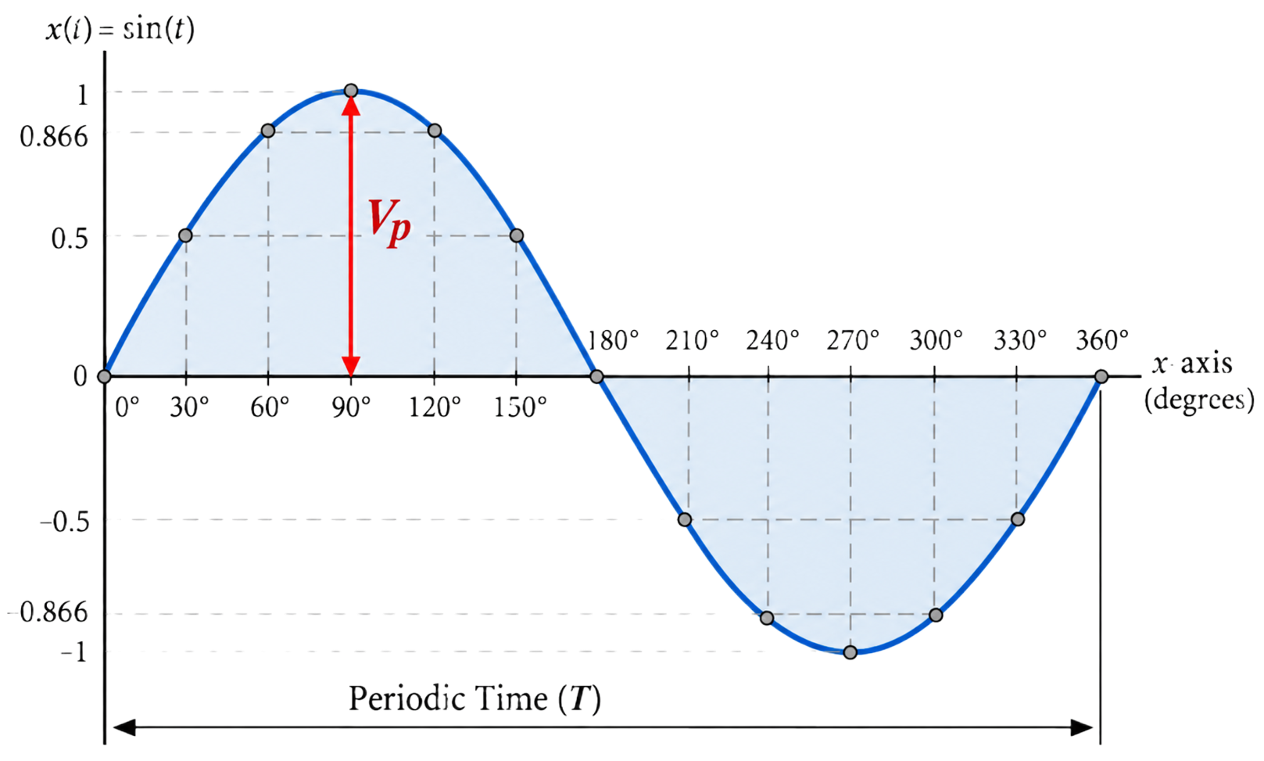

SIGNAL REPRESENTATION
The sine wave model
Amplitude?
Frequency?
Phase?
RMS?
$$V\left(t\right)= V_{p}sin⁡(2πft+∅)$$
Angular velocity $ω=2πf$
LECTURE 05 | INDUCTANCE + REACTANCE
03

Slide 4
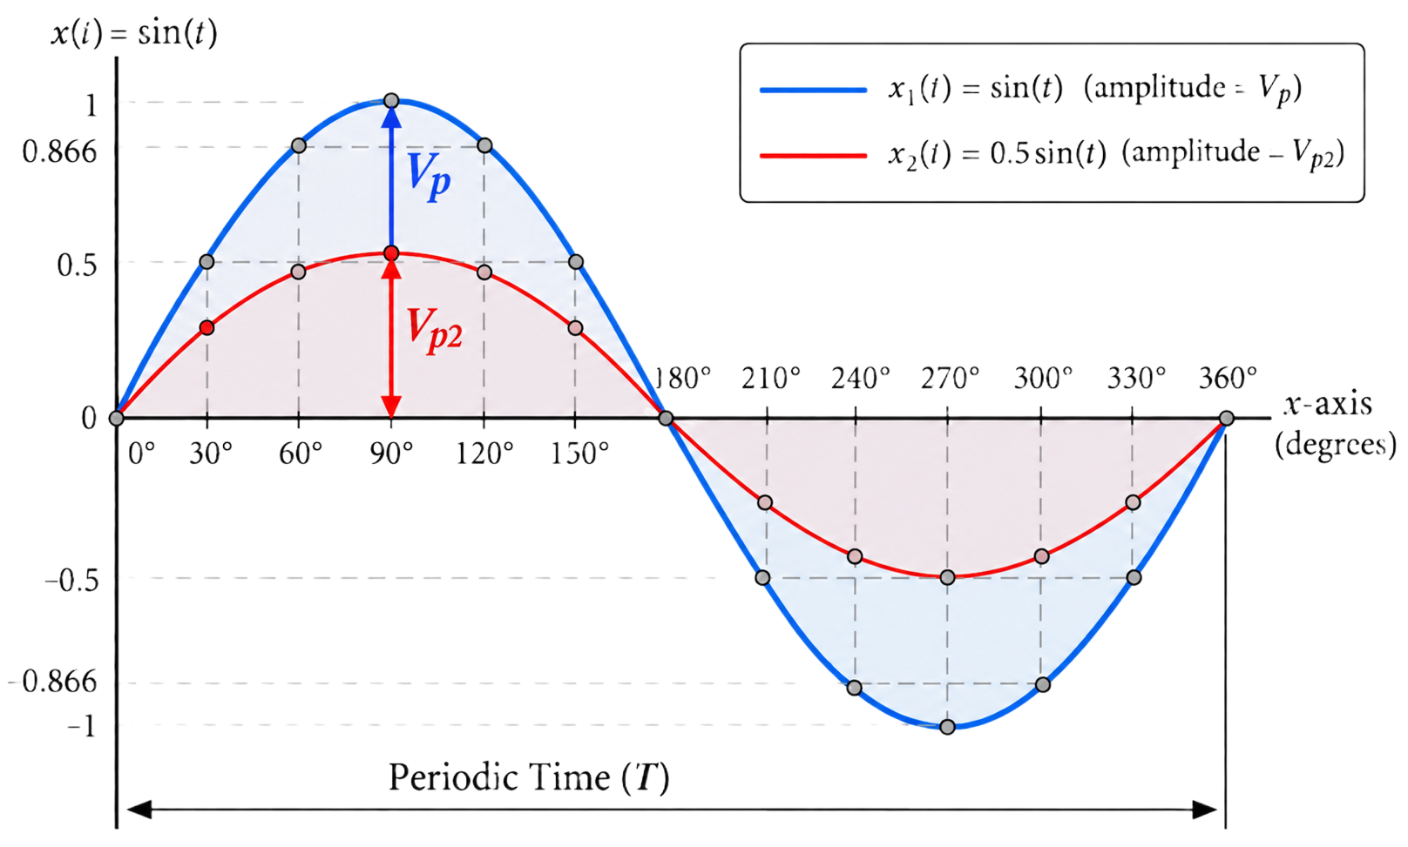
SIGNAL REPRESENTATION
The sine wave model
$$V\left(t\right)= V_{p}sin⁡(2πft+∅)$$
The sinusoids are in-phase
LECTURE 05 | INDUCTANCE + REACTANCE
03

Slide 5
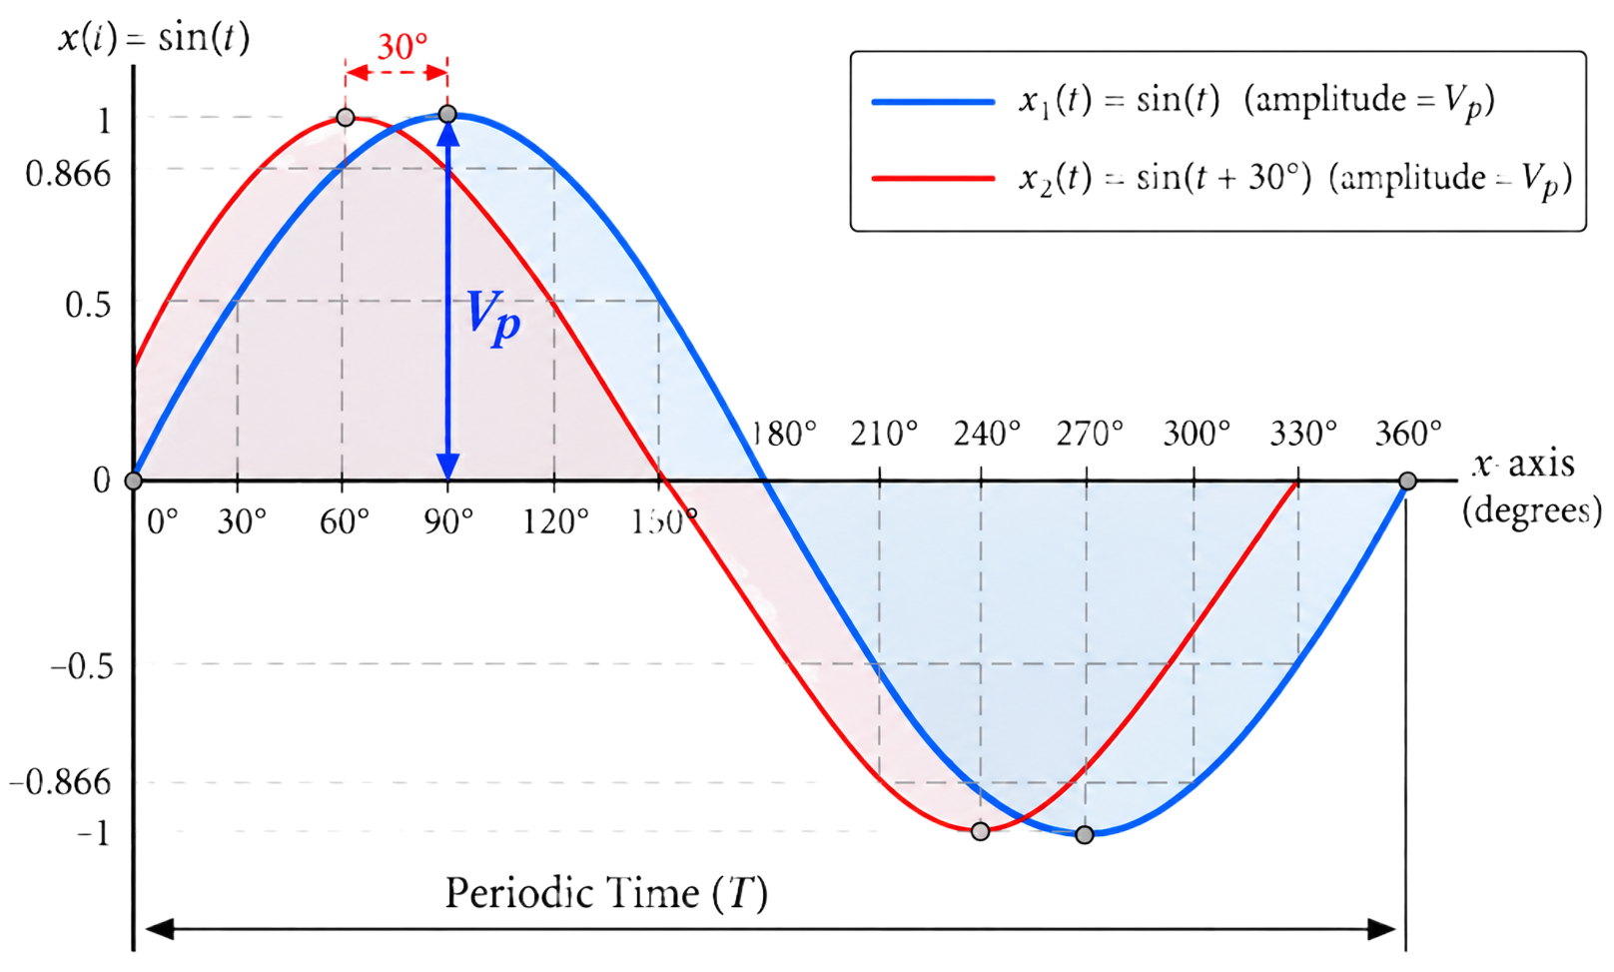
SIGNAL REPRESENTATION
The sine wave model
$$V\left(t\right)= V_{p}sin⁡(2πft+∅)$$
The sinusoids are out of phase
LECTURE 05 | INDUCTANCE + REACTANCE
03

Slide 6
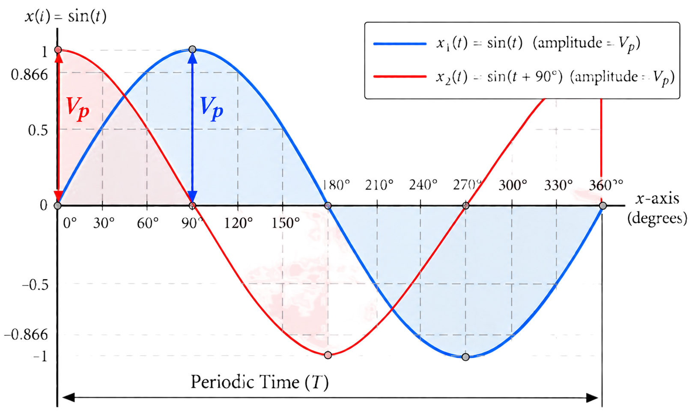
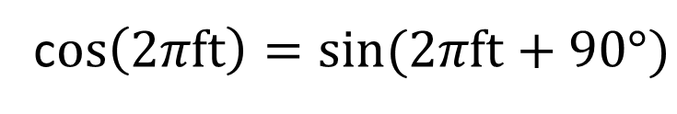
SIGNAL REPRESENTATION
The cosine wave
c$os\left(2πft\right)=sin⁡(2πft+90°)$
A cosine wave is a sine wave that lags 90$°$
A sine wave is a cosine wave that leads 90$°$
LECTURE 05 | INDUCTANCE + REACTANCE
03

Slide 7
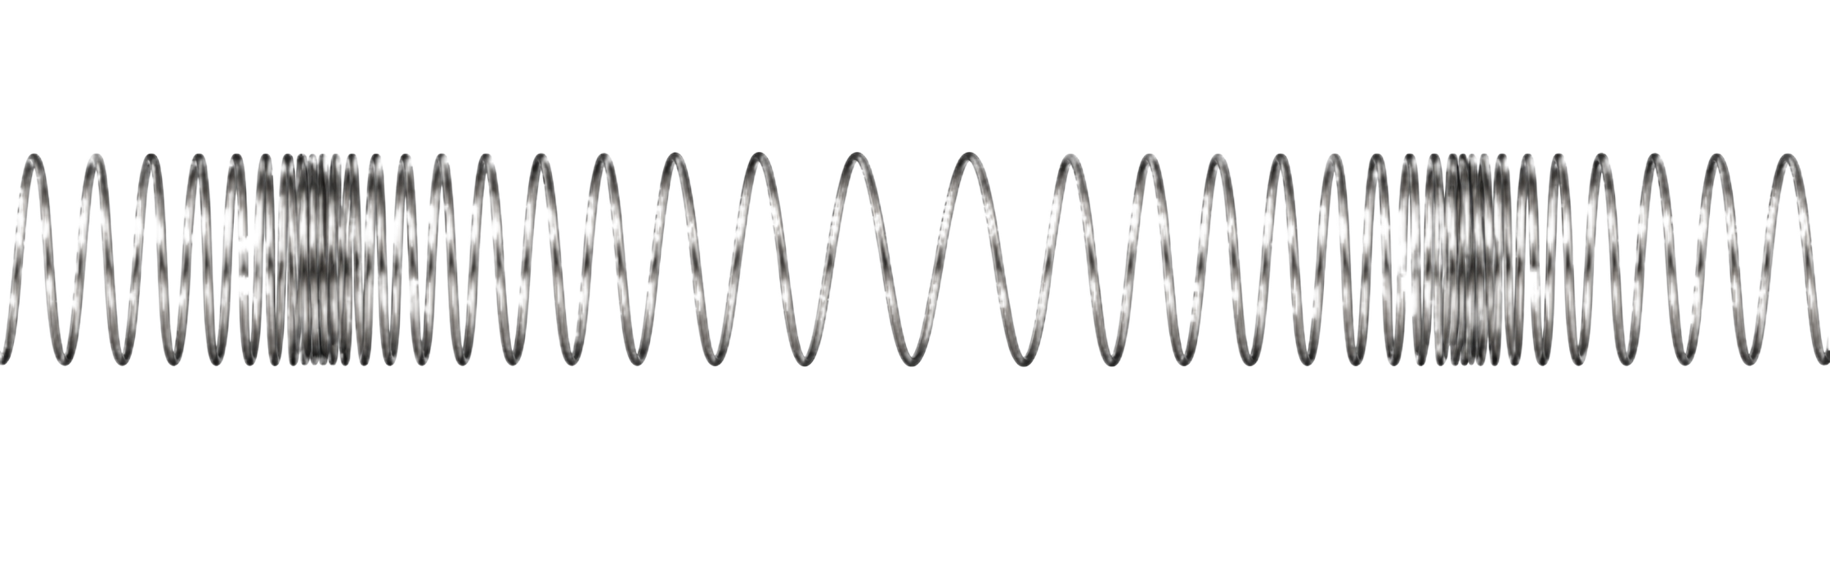
INTUITION
The phasor
LECTURE 05 | INDUCTANCE + REACTANCE
05

Slide 8
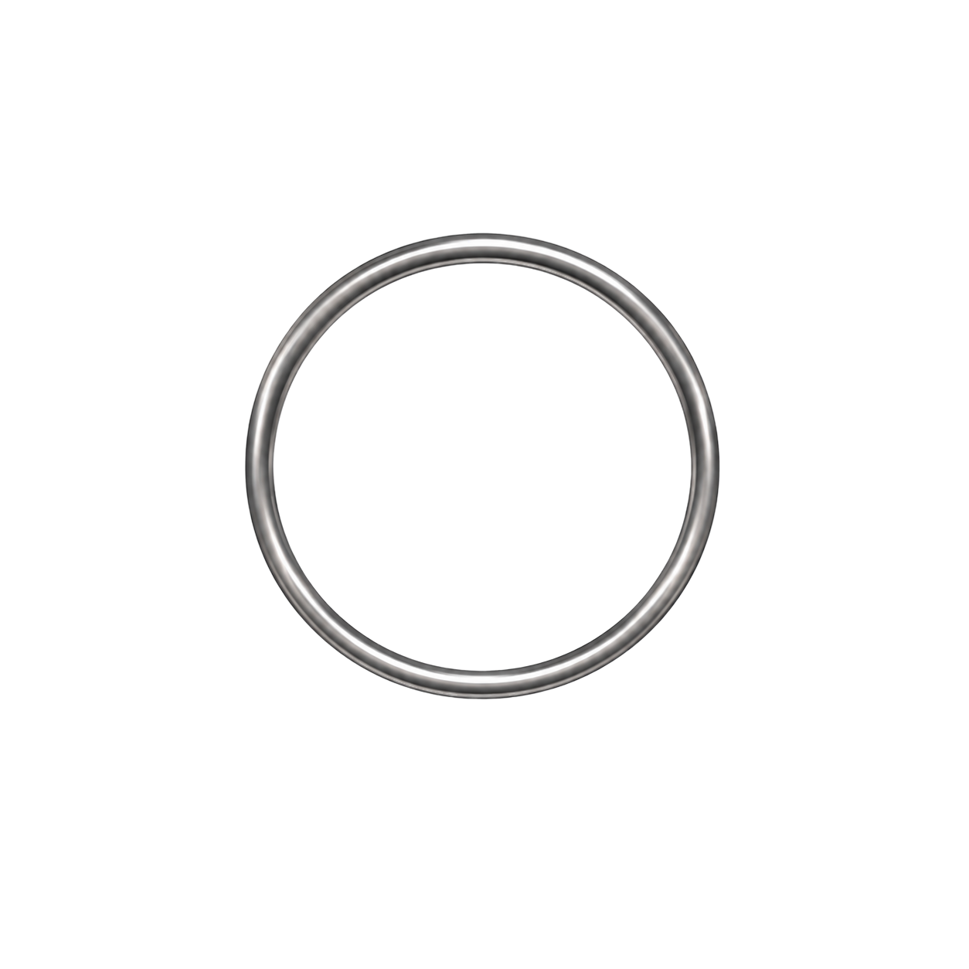
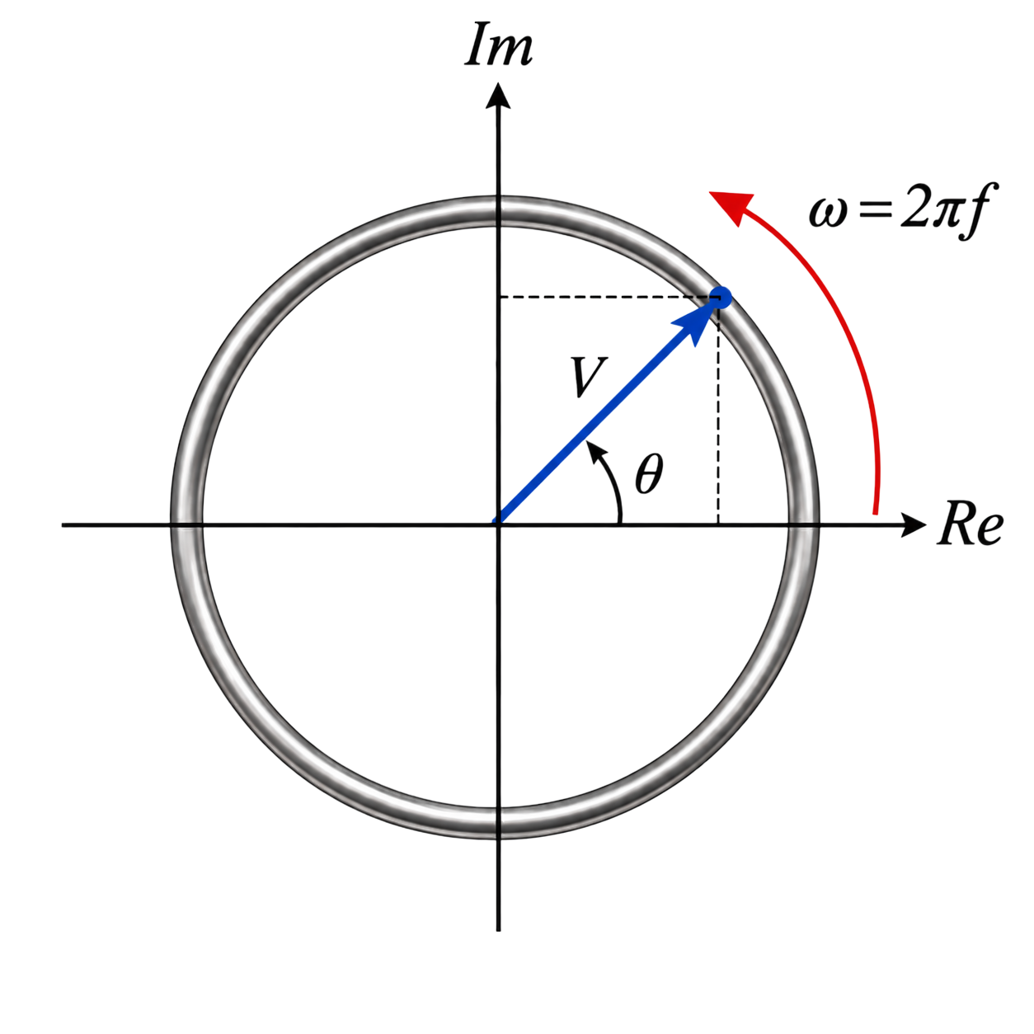


INTUITION
The phasor
AKA Polar representation
$$Amplitude ∠ Angle$$
$$5 ∠ 45°$$
LECTURE 05 | INDUCTANCE + REACTANCE
05

Slide 9
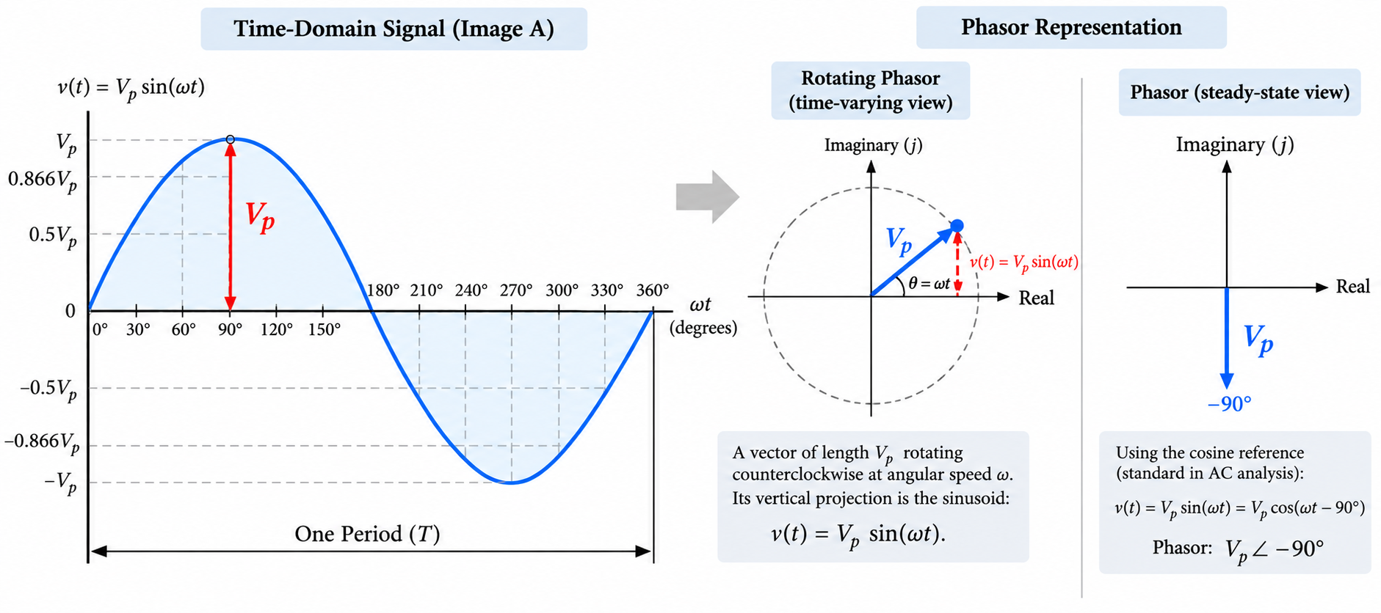
INTUITION
The phasor
LECTURE 05 | INDUCTANCE + REACTANCE
05

Slide 10






INTUITION
The phasor
AKA Polar representation
Note that
$$j = ∠ +90°$$
$$Amplitude ∠ Angle$$
$$5 ∠ 45°$$
Convention for this course:
$$V\left(t\right)= V_{p}sin⁡(2πft+45°)$$
$$V_{RMS}∠ ∅°$$
$$V_{p} ∠ 45°$$
$$\frac{V_{p}}{\sqrt{2}}∠ ∅°$$
$$I_{RMS}∠ ∅°$$
LECTURE 05 | INDUCTANCE + REACTANCE
05

Slide 11
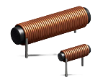
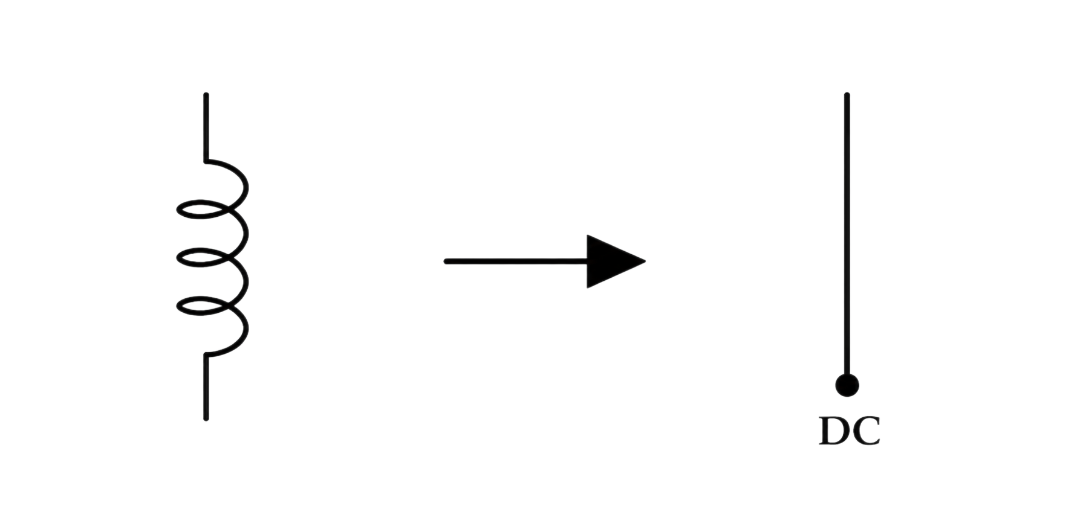

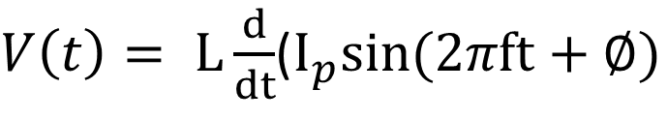




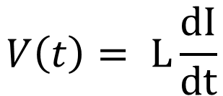
COMPONENT BEHAVIOR
The inductor
Stores energy in a magnetic field
$$V\left(t\right)= L\frac{dI}{dt}$$
$$I\left(t\right)= I_{p}sin⁡(2πft+∅)$$
$V\left(t\right)= L\frac{d}{dt}$($I_{p}sin⁡(2πft+∅)$
L = inductance (Henry)
$$V\left(t\right)= LI_{p}2πfcos⁡(2πft+∅)$$
For DC, $\frac{dI}{dt}=0$. For AC, it’s a different story.
$$V\left(t\right)=ωLI_{p}sin⁡(ωt+∅+90°)$$
Changing current creates changing magnetic flux.
The induced voltage opposes the change that produced it.
Inductors resist rapid current change, not steady ideal DC after transients settle.
$$I=I_{p}∠∅$$
$$V=ωLI_{p}∠(∅+90°)$$
$$V=jωLI_{p}$$
LECTURE 05 | INDUCTANCE + REACTANCE
06

Slide 12


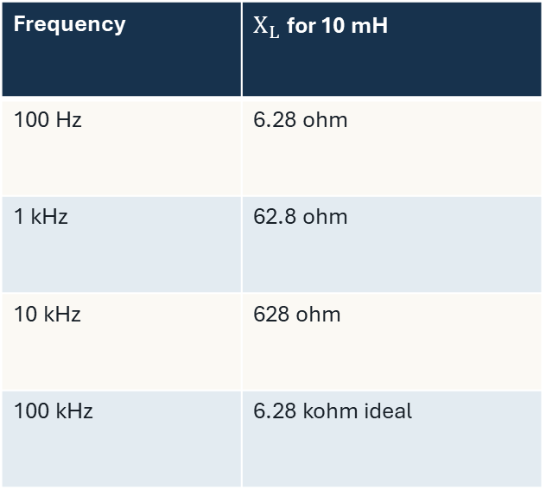
FREQUENCY DEPENDENCE
Inductive reactance
Like resistance but not quite
Frequency | $X_{L}$ for 10 mH
100 Hz | 6.28 ohm
1 kHz | 62.8 ohm
10 kHz | 628 ohm
100 kHz | 6.28 kohm ideal
Intended
$$X_{L}=2πfL$$
Transformers, inductive sensors, RFID, and wireless power use controlled coupling.
Unintended
$$V=IX_{L}$$
Nearby loops and conductors can receive energy from changing current.
Magnitude relationship for an ideal inductor.
AN INDUCTOR CAN LOOK SMALL AT LOW f AND LARGE AT HIGH f
LECTURE 05 | INDUCTANCE + REACTANCE
07

Slide 13
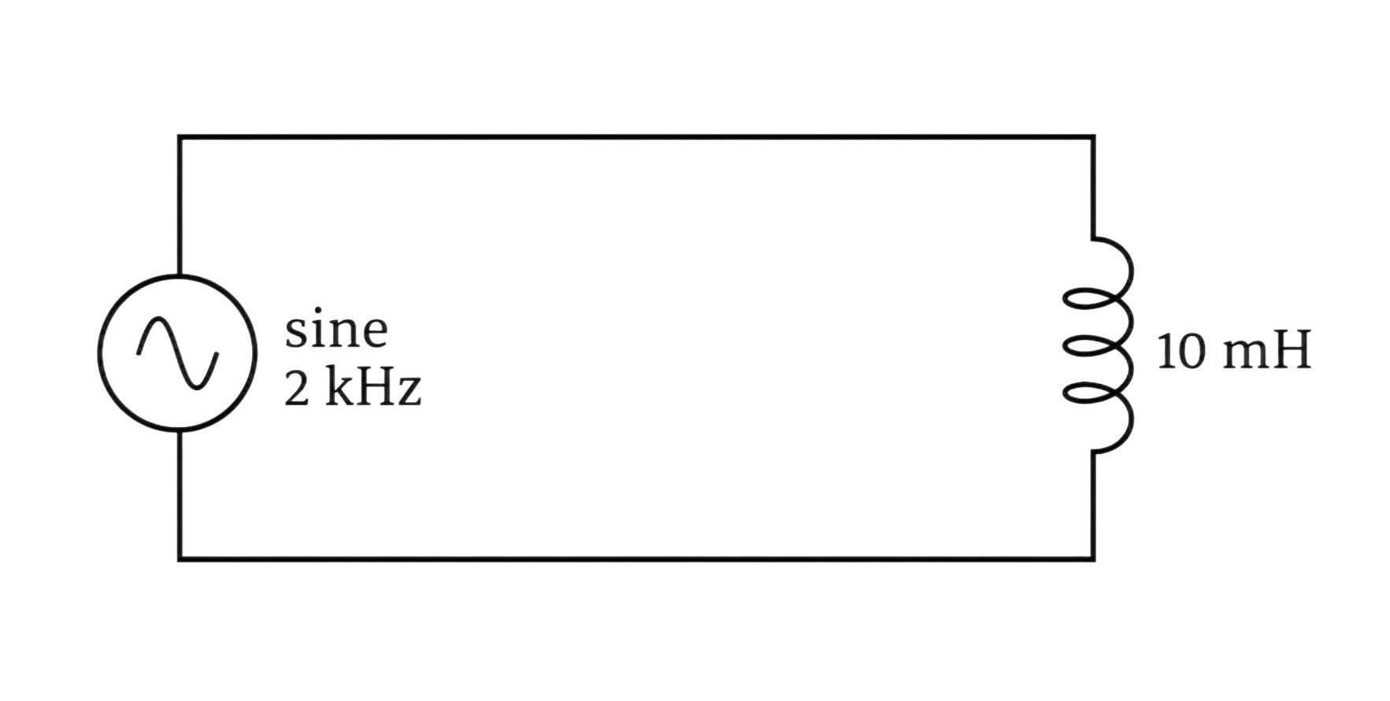





REACTANCE AND CURRENT
Example
$$L= 10 mH$$
$$f= 2 kHz$$
$$V_{RMS}= 1V$$
$$X_{L}= ?$$
$$I_{L}= ?$$
LECTURE 05 | INDUCTANCE + REACTANCE
11
Notes:
XL = 125.7 Ω and IL = 7.96 mArms

Slide 14
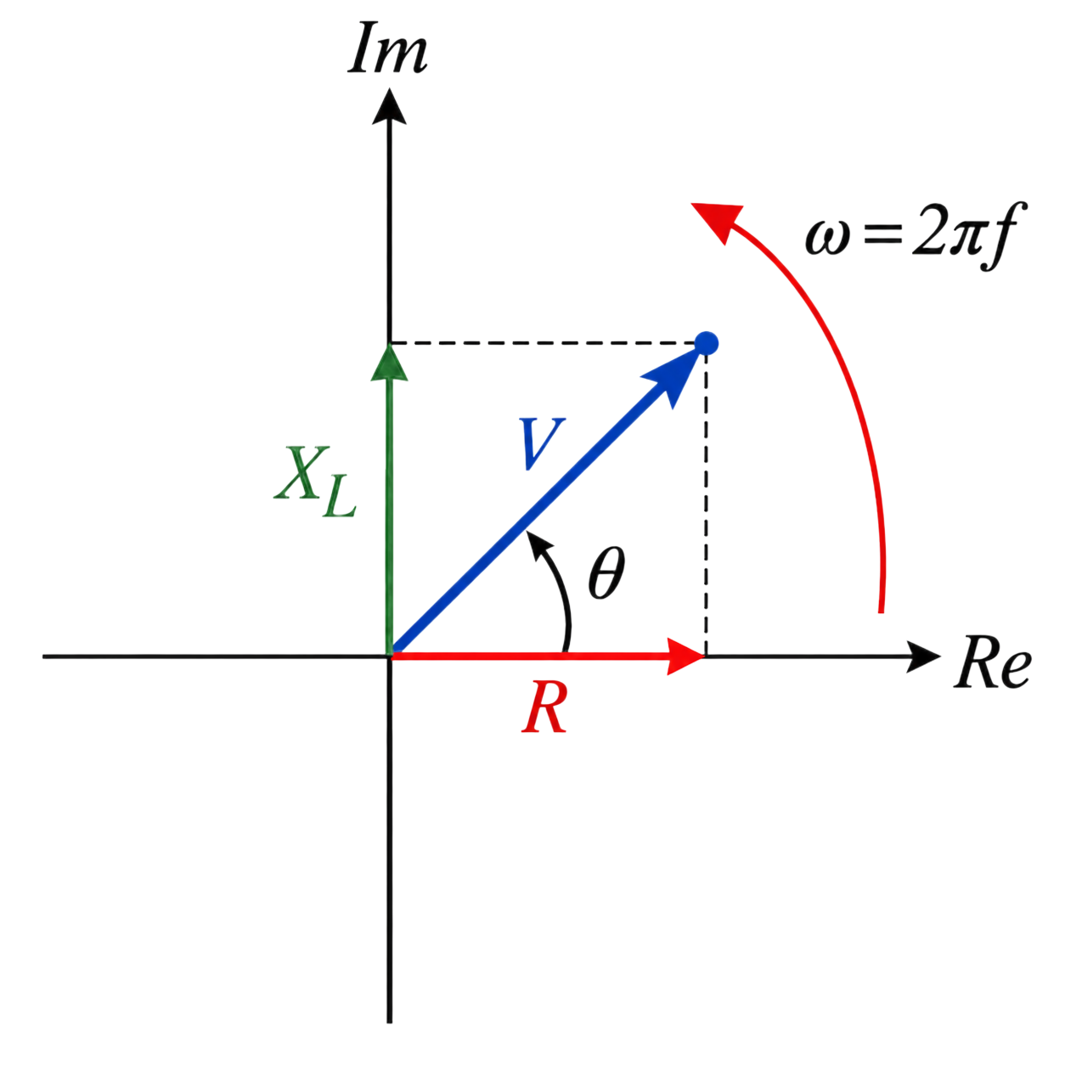
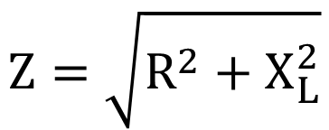
REACTANCE AND CURRENT
Putting it all together
Impedance
$$Z=\sqrt{R^{2}+X_{L}^{2}}$$
LECTURE 05 | INDUCTANCE + REACTANCE
11

Slide 15
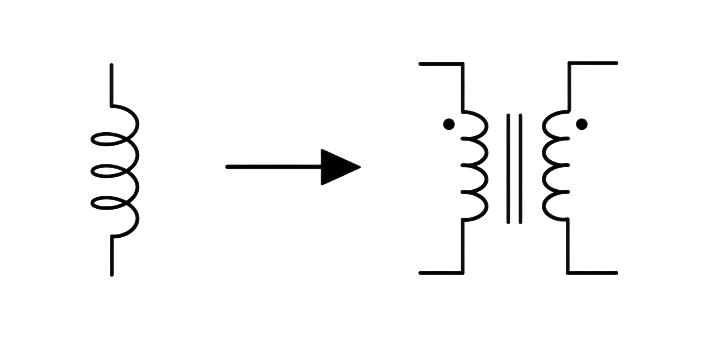
BEFORE WEDNESDAY
Exit check
Can two coils share a magnetic field?
NEXT: TRANSFORMERS + ISOLATION
LECTURE 05 | INDUCTANCE + REACTANCE
12

