Slide 1
CYBER 327 / LECTURE 06
Transformers, Isolation, and Coupling
Controlled magnetic transfer creates useful links and imperfect boundaries.
SEP 16, 2026
LECTURE 06 | TRANSFORMERS + ISOLATION
01

Slide 2
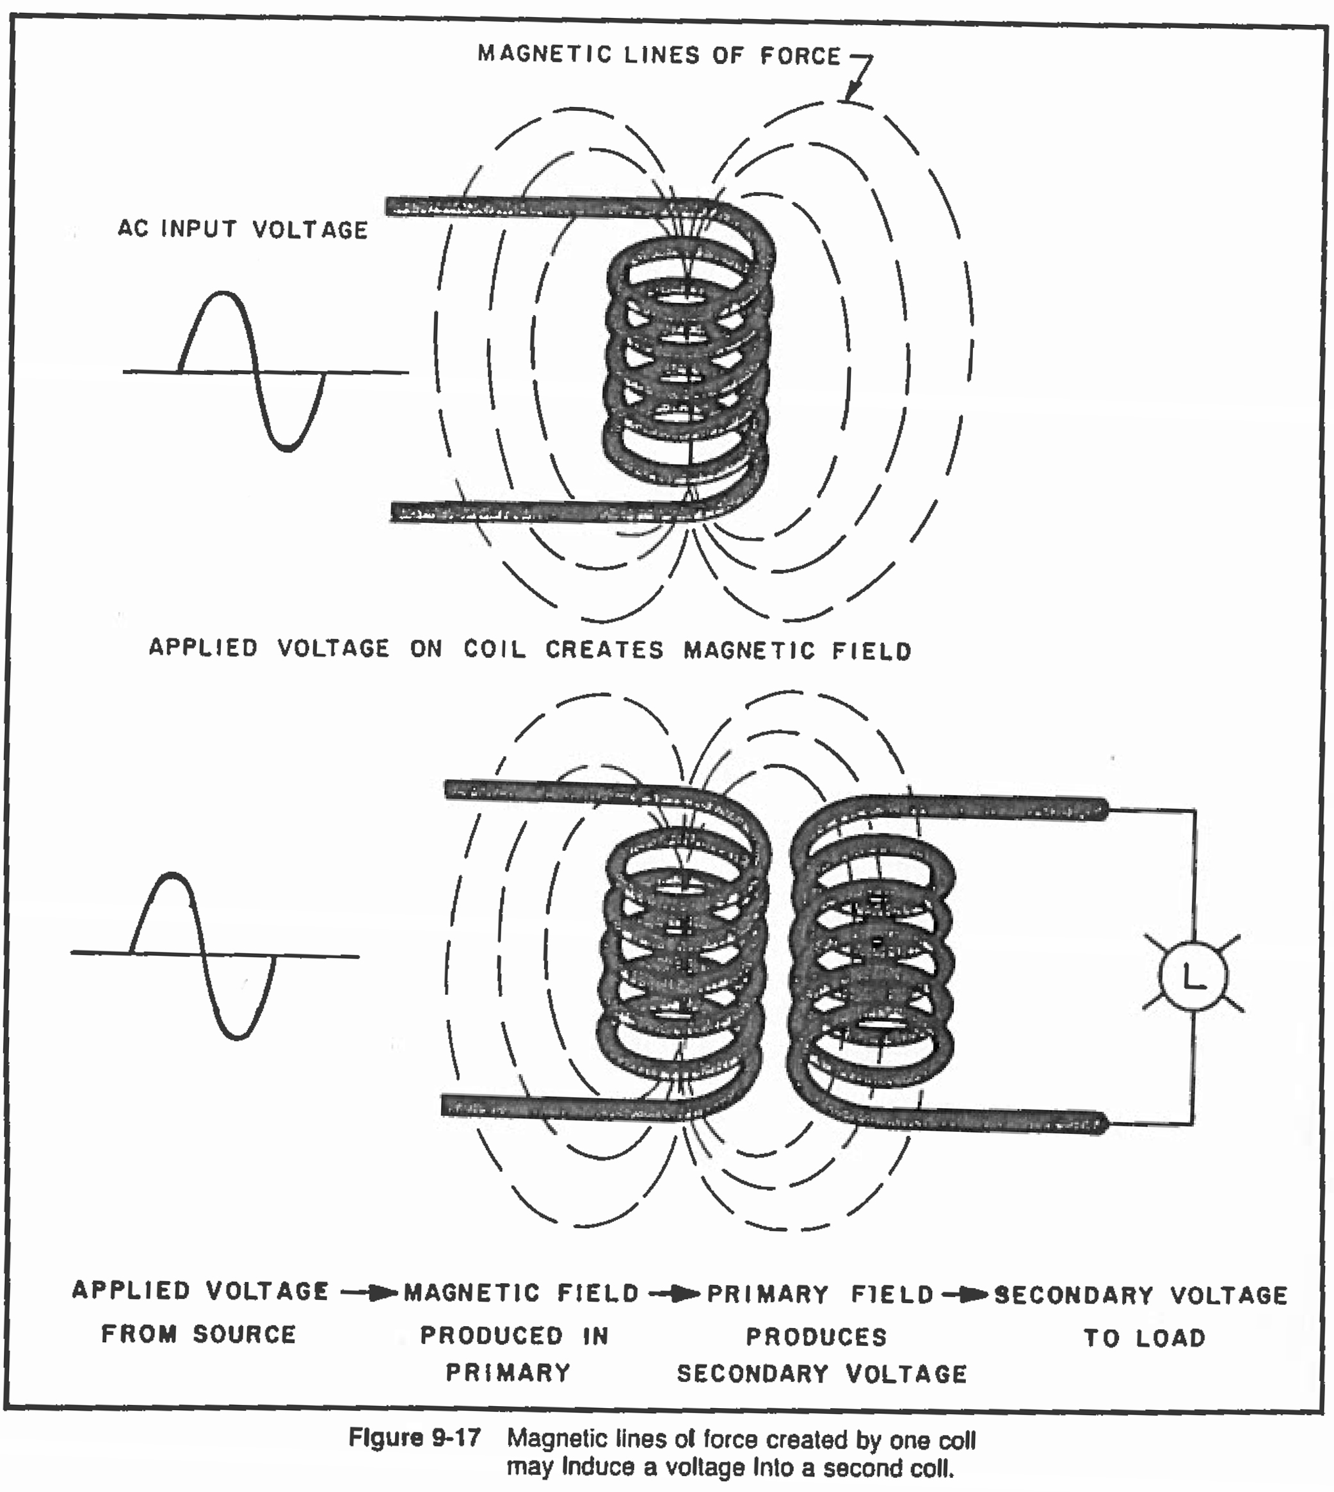
MENTAL MODEL
A transformer is controlled magnetic coupling
Energy transfers through a changing magnetic field.
NO CHANGING FLUX -> NO IDEAL TRANSFORMER ACTION
LECTURE 06 | TRANSFORMERS + ISOLATION
02

Slide 3
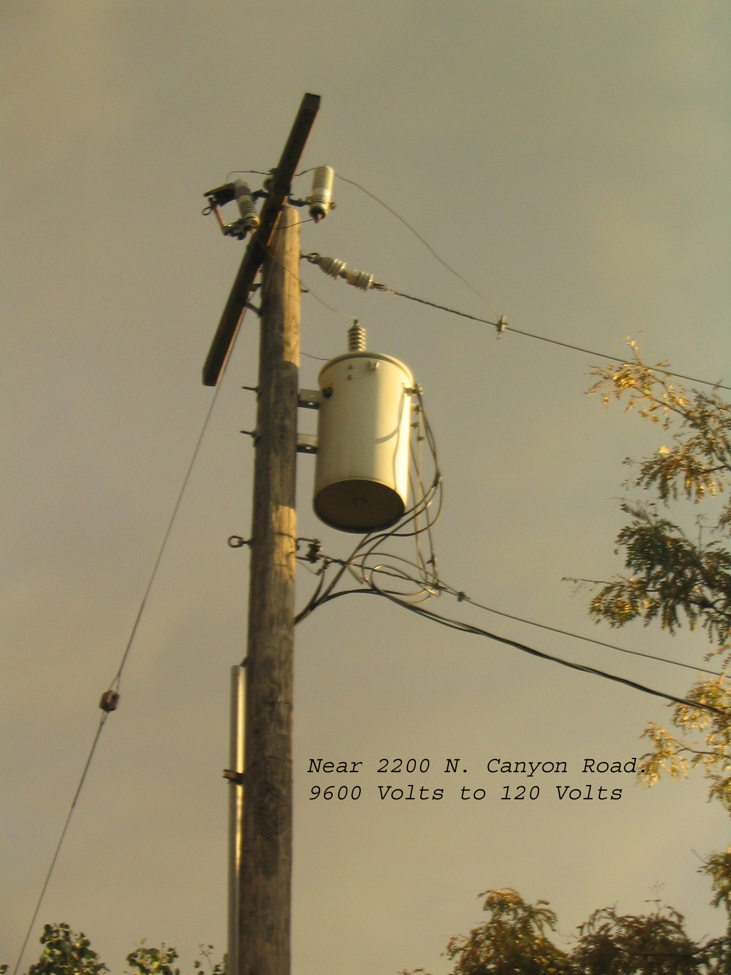
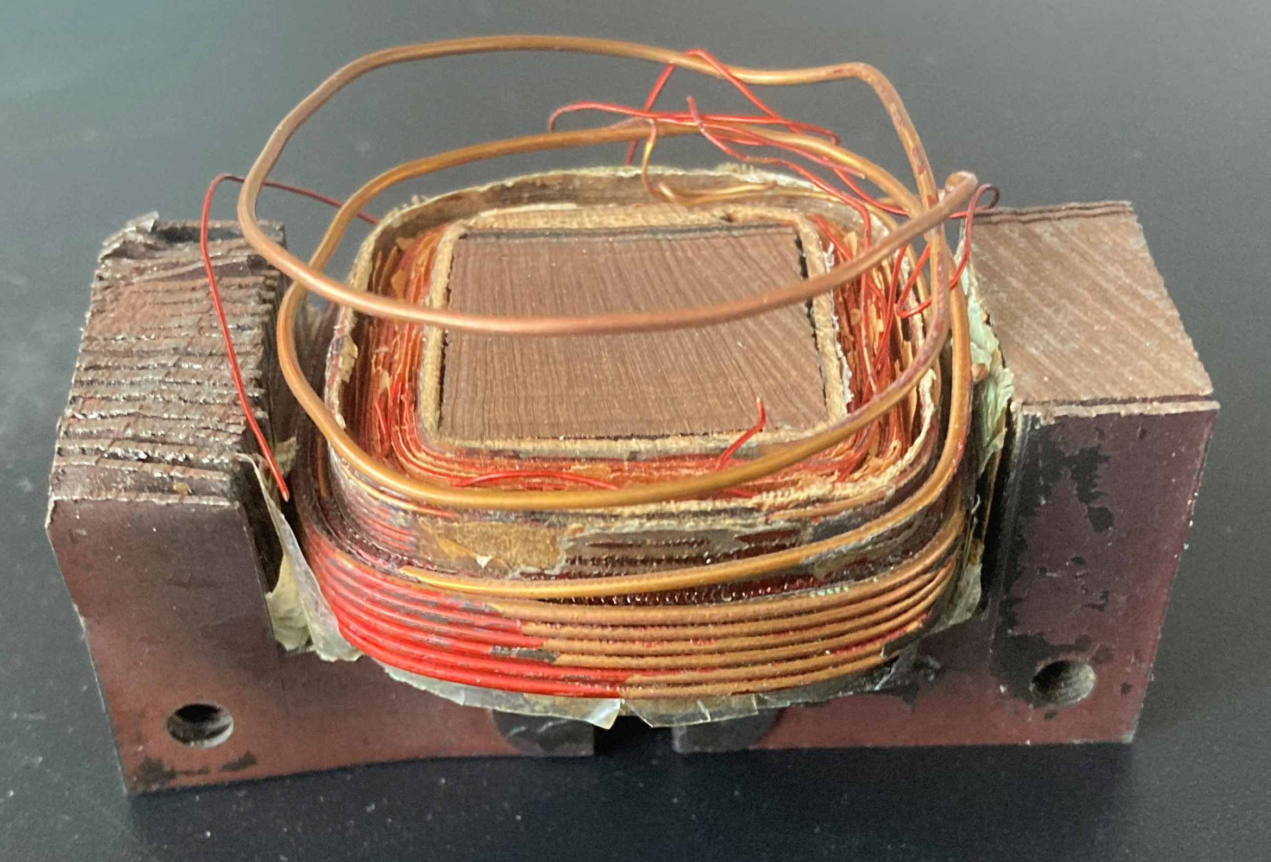
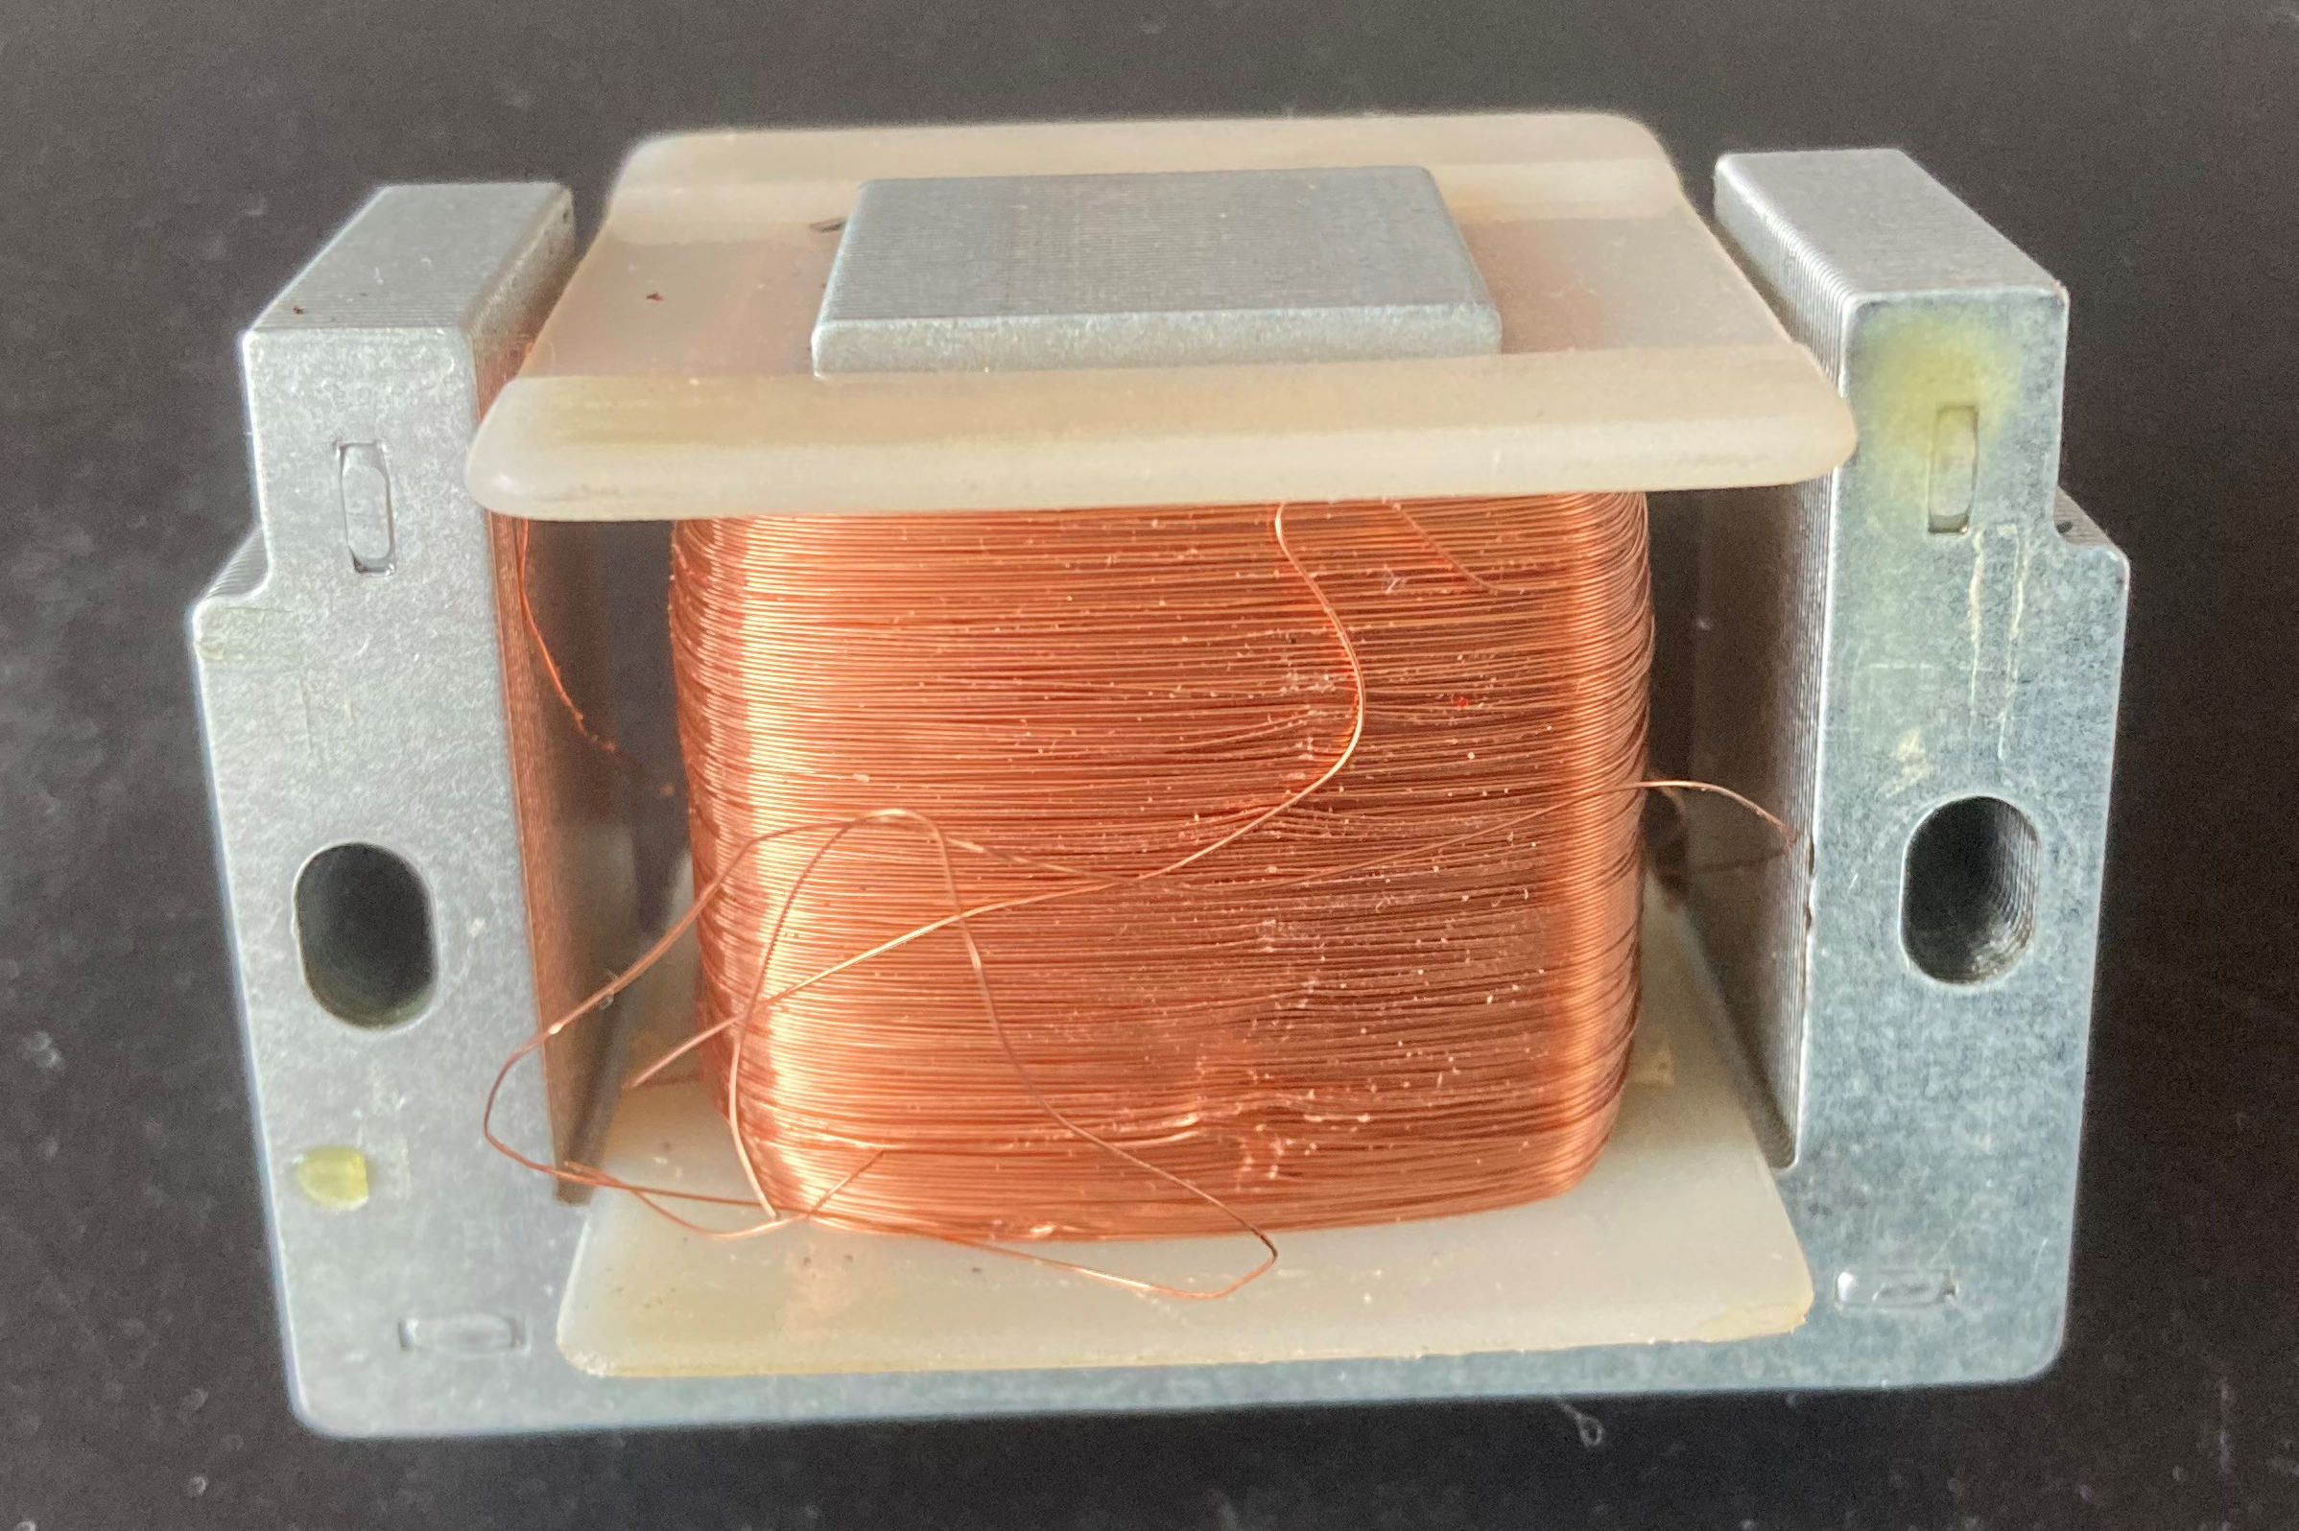
MENTAL MODEL
A transformer is controlled magnetic coupling
Energy transfers through a changing magnetic field.
NO CHANGING FLUX -> NO IDEAL TRANSFORMER ACTION
LECTURE 06 | TRANSFORMERS + ISOLATION
02

Slide 4
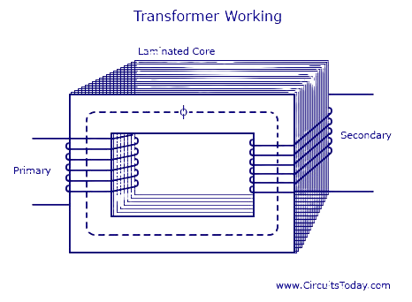
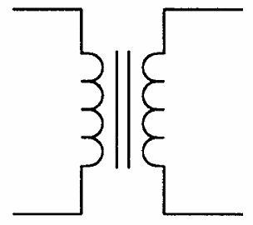
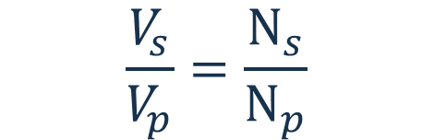

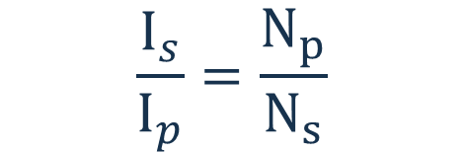
CORE RELATIONSHIP
Turns ratio sets ideal voltage ratio
$$\frac{I_{s}}{I_{p}}=\frac{N_{p}}{N_{s}}$$
$P_{in}=$ $P_{out}$
$$\frac{V_{s}}{V_{p}}=\frac{N_{s}}{N_{p}}$$
Current ratio is inverse for an ideal transformer.
Real output is lower because of loss.
Voltage follows the turns ratio.
STEP-UP VOLTAGE MEANS STEP-DOWN CURRENT CAPABILITY
LECTURE 06 | TRANSFORMERS + ISOLATION
03

Slide 5
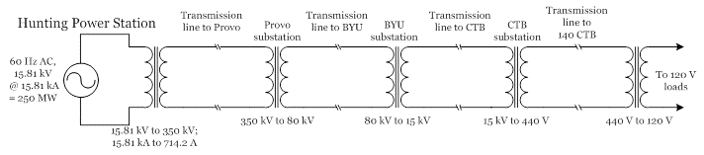


MENTAL MODEL
Why transformers?
REMEMBER
Step voltage up (and current down)
Step voltage down (and current up)
Provide DC isolation (block DC)
Provide impedance matching
$P_{in}=$ $P_{out}$
$P_{loss}=$ $I^{2}R$
AC IS EFFICIENT BECAUSE OF TRANSFORMERS
LECTURE 06 | TRANSFORMERS + ISOLATION
02

Slide 6

MATCHING INTUITION
Impedance can be reflected across a transformer
$$\sqrt{\frac{Z_{s}}{Z_{p}}}=\frac{N_{s}}{N_{p}}$$
Amplifier
Transformer
6Ω
Speaker
Impedance Matching
Making source and load work well together
The amplifier works best if it sees 600 Ω. What should be the output transformer?
2:1 TURNS = 4:1 IMPEDANCE
LECTURE 06 | TRANSFORMERS + ISOLATION
09

Slide 7
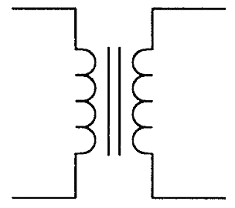








PREDICT BEFORE MEASURING
Ratio example
$$V_{p}=20 V_{RMS}$$
$$V_{s}= ?$$
$$N_{p}=100 turns$$
$$I_{p}= ?$$
$$N_{s}=50 turns$$
$$I_{s}=100 mA$$
$$P_{in}= ?$$
$$P_{out}= ?$$
LECTURE 06 | TRANSFORMERS + ISOLATION
04

Slide 8
NON-IDEAL BEHAVIOR
Real inductors and transformers have limits
Loss
Frequency limits
Ratings
Winding resistance and core loss turn some stored or transferred energy into heat.
Parasitic capacitance, self-resonance, and core saturation limit ideal reactance and transfer.
Current, voltage, frequency, insulation, and temperature limits must all be respected.
Blocks
Passes
May still couple
Direct DC continuity and many ground-loop currents.
Changing signals and power within the transformer's bandwidth.
Capacitance, leakage flux, common-mode energy, or unsafe insulation failure.
LECTURE 06 | TRANSFORMERS + ISOLATION
05
Notes:
Connect back to Lecture 5: X_L = 2 pi f L is an ideal model

Slide 9
WHERE IS THE CURRENT TRYING TO GO?
Useful current vs. unwanted current paths
Mode | Where measured | Typical concern
Differential | Between two signal conductors | Desired information or line imbalance
Common mode | Both conductors relative to a shared reference | Leakage, ground current, emissions
Ground loop | Multiple return paths at different potential | Hum, error, unsafe current
Isolation barrier | No intended conductive return | Barrier rating and parasitic coupling
Coupling can bypass intended wiring
Magnetic coupling: changing current in one loop produces a changing magnetic field that reaches another loop
Capacitive coupling: changing voltage transfers energy through the small unintended capacitance between conductors.
Conducted coupling: signals travel through a shared ground, supply, or return path.
LECTURE 06 | TRANSFORMERS + ISOLATION
07

Slide 10
BEFORE FRIDAY
Exit check
A transformer has twice as many secondary turns as primary turns. What happens to ideal voltage?
NEXT: EMI + CONTAINMENT
LECTURE 06 | TRANSFORMERS + ISOLATION
12
Notes:
Expected voltage doubles; ideal current capability halves.

