Slide 1
CYBER 327 / LECTURE 07
EMI, Near-Field Leakage, and Signal Containment
Find where unwanted energy starts, how it travels, and whether the fix works.
SEP 18, 2026
LECTURE 07 | EMI + CONTAINMENT
01
Notes:
Use plain language first, then name the technical term. Keep the lesson tied to measurements students can make in Lab 3.

Slide 2
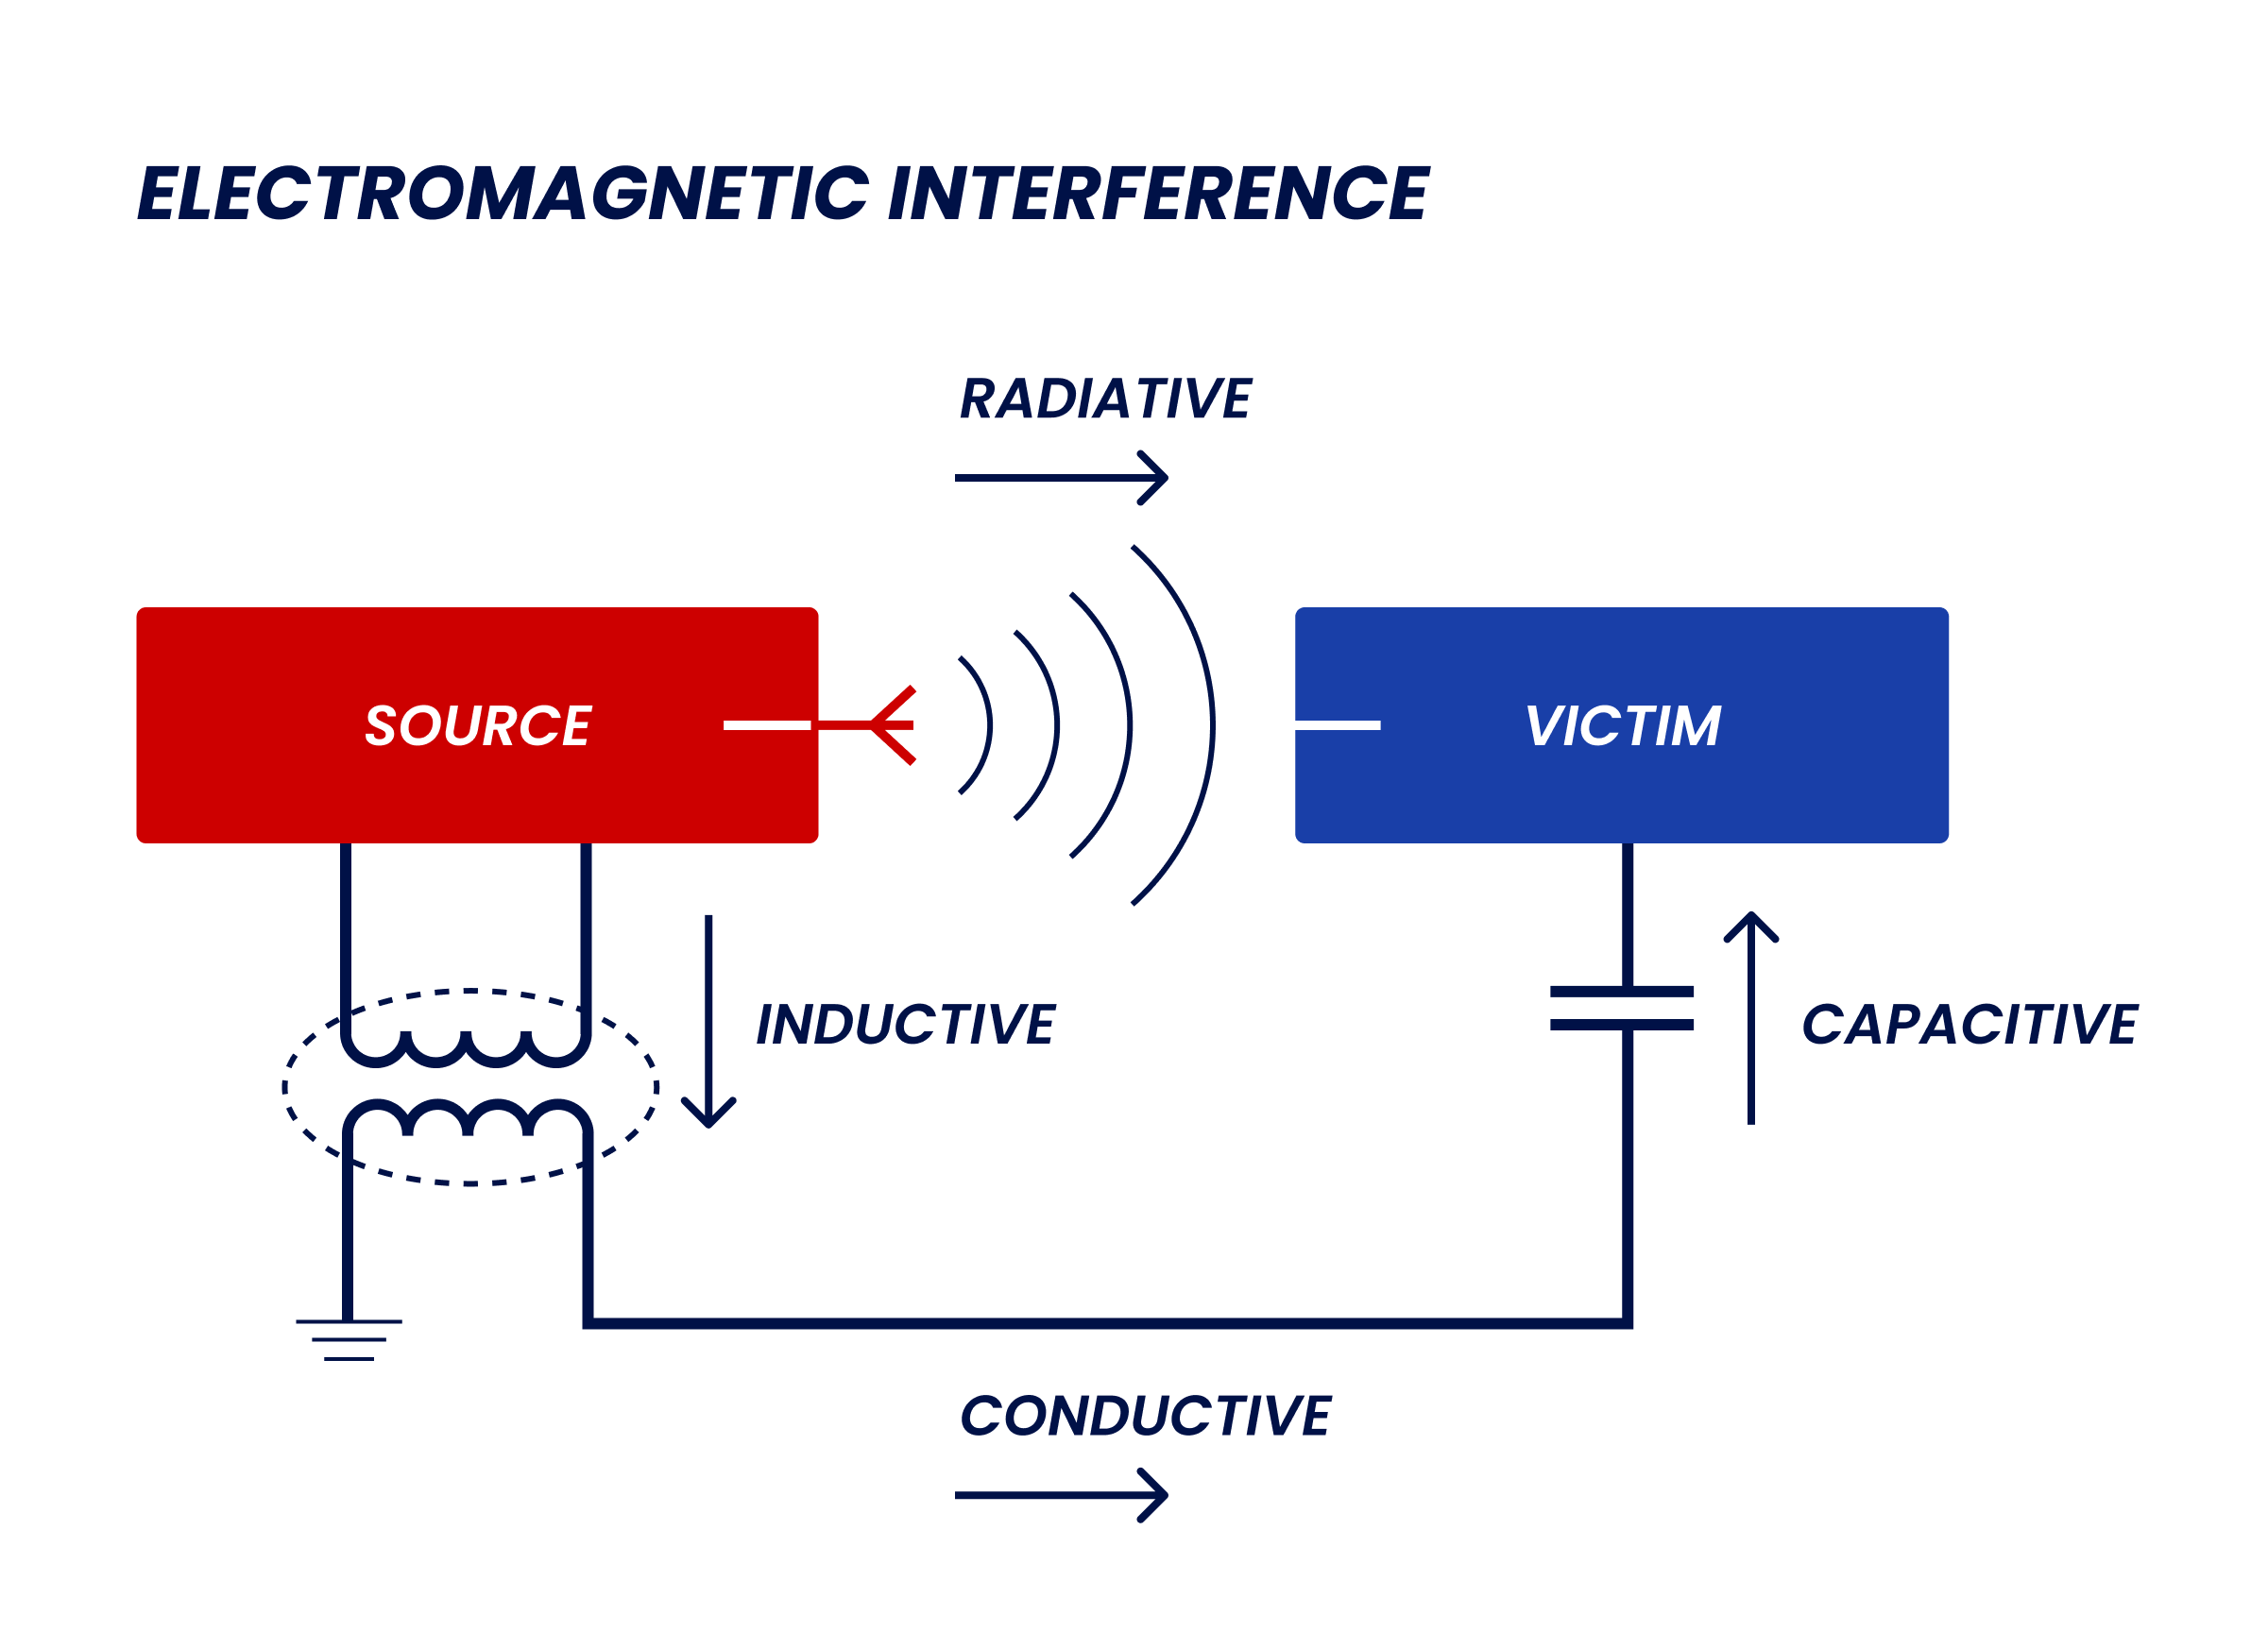
A SIMPLE MODEL
Electromagnetic Interference (EMI)
SOURCE
PATH
AFFECTED CIRCUIT
The source creates unwanted electrical energy.
The path carries that energy into another circuit.
CIA Triad
Confidentiality - Leaks
Integrity - Corruption
Availability - Disruption
LECTURE 07 | EMI + CONTAINMENT
02
Notes:
Image: https://www.solomotorcontrollers.com/blog/electromagnetic-interference-emi/

Slide 3
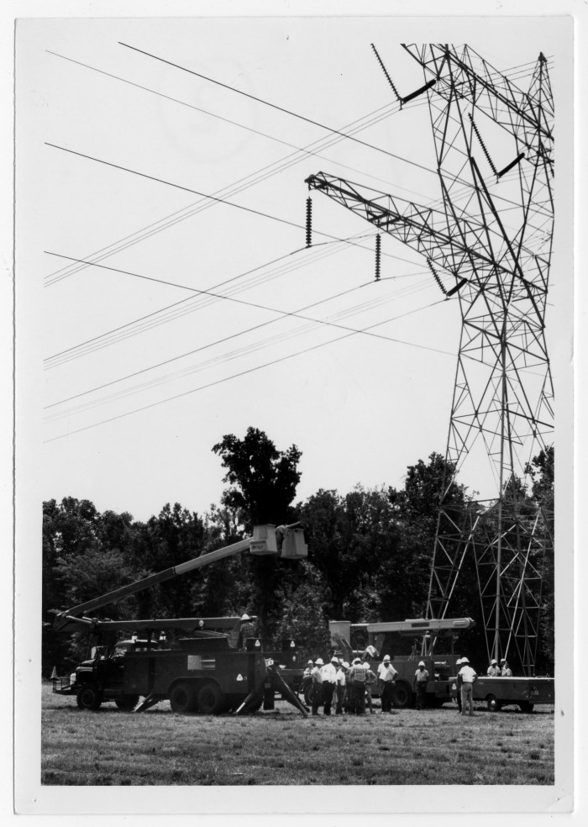

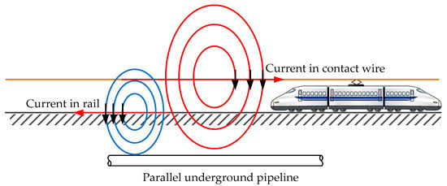
COUPLING PATHS
Unwanted energy can travel in four main ways
USS FORRESTAL FIRE (1967)
Through wires
Across an electric field
Across a magnetic field
Conducted coupling uses shared wires, grounds, or power supplies.
Capacitive coupling occurs when a changing voltage affects a nearby conductor.
Inductive coupling occurs when a changing current produces voltage in a nearby loop.
LECTURE 07 | EMI + CONTAINMENT
03
Notes:
Images:
https://www.history.navy.mil/content/history/nhhc/our-collections/photography/numerical-list-of-images/nhhc-series/nh-series/USN-1126000/USN-1126644.html
https://texashistory.unt.edu/ark:/67531/metapth769466/m1/1/
https://www.mdpi.com/1996-1073/11/9/2255

Slide 4
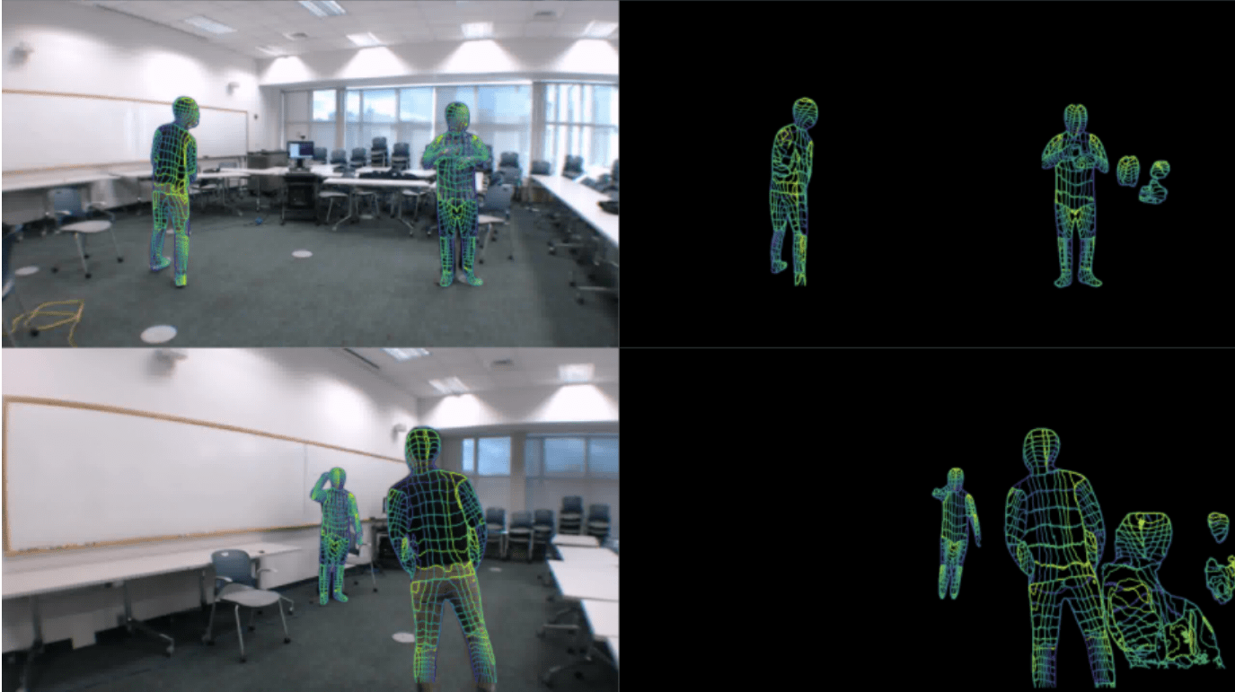
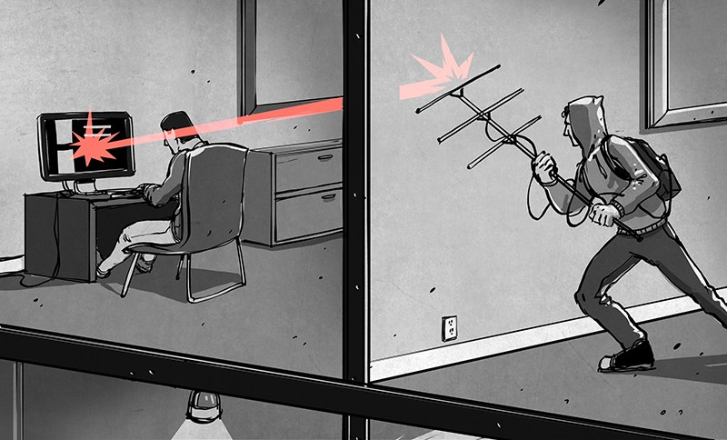
CYBERSECURITY CONNECTION
Coupling can interfere with signals or reveal activity
Unwanted energy entering a signal path can distort the signal and make receiver errors more likely.
Energy leaking out can reveal that a device is active, when it operates, and the frequency or pattern it uses.
Through EM radiation
Radiated coupling is when energy propagates away from a circuit and is received by an antenna. .
LECTURE 07 | EMI + CONTAINMENT
11
Notes:
Images:
https://www.spatialintelligence.ai/p/your-wifi-can-see-you-heres-how

Slide 5
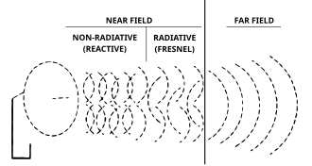
NEAR FIELD AND FAR FIELD
Distance changes how we describe the field
Region | Model | What we may observe
Very close: reactive near field | Electric or magnetic effects may dominate | Rotation and small distance changes matter greatly
Nearby: radiating near field | The electromagnetic wave is still taking shape | Object size and geometry both matter
Far away: far field | The signal behaves more like a traveling radio wave | Antennas, polarization, and path loss matter
LECTURE 07 | EMI + CONTAINMENT
04
Notes:
Near field: adjusting TV antenna, coming near a radio
Far Field: Jamming
Image
https://en.wikipedia.org/wiki/Near_and_far_field

Slide 6
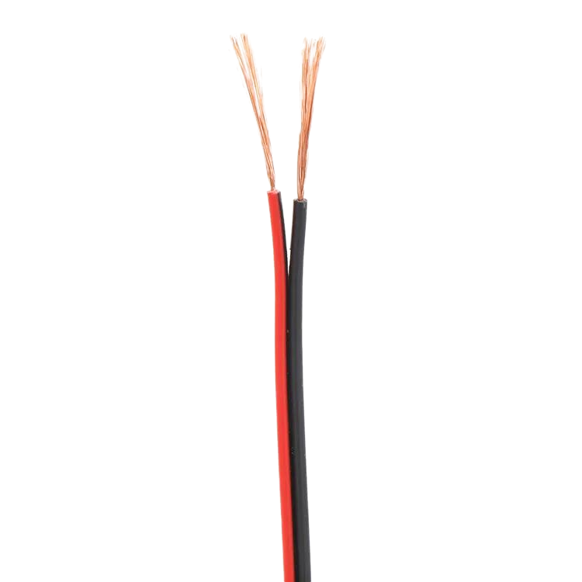
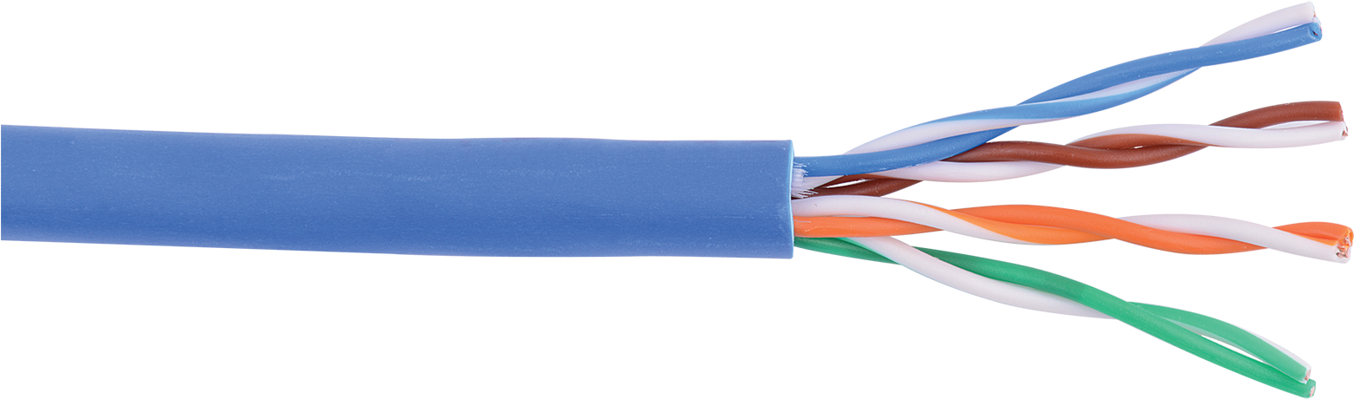
INDUCTIVE COUPLING
What affects coupling
Use a larger loop
Turn the loop
Move it away
More magnetic field passes through the loop, so the measured pickup often increases.
A 90-degree rotation can reduce how much magnetic field passes through it.
Increasing distance usually reduces nearby magnetic pickup.
Twisted Pair
Each twist reverses the small loop direction, so nearby magnetic effects partly cancel.
LECTURE 07 | EMI + CONTAINMENT
05
Notes:
Images
https://www.wirecablemakingmachine.com/news/shielded-vs-unshielded-network-cable-which-should-you-use.html

Slide 7
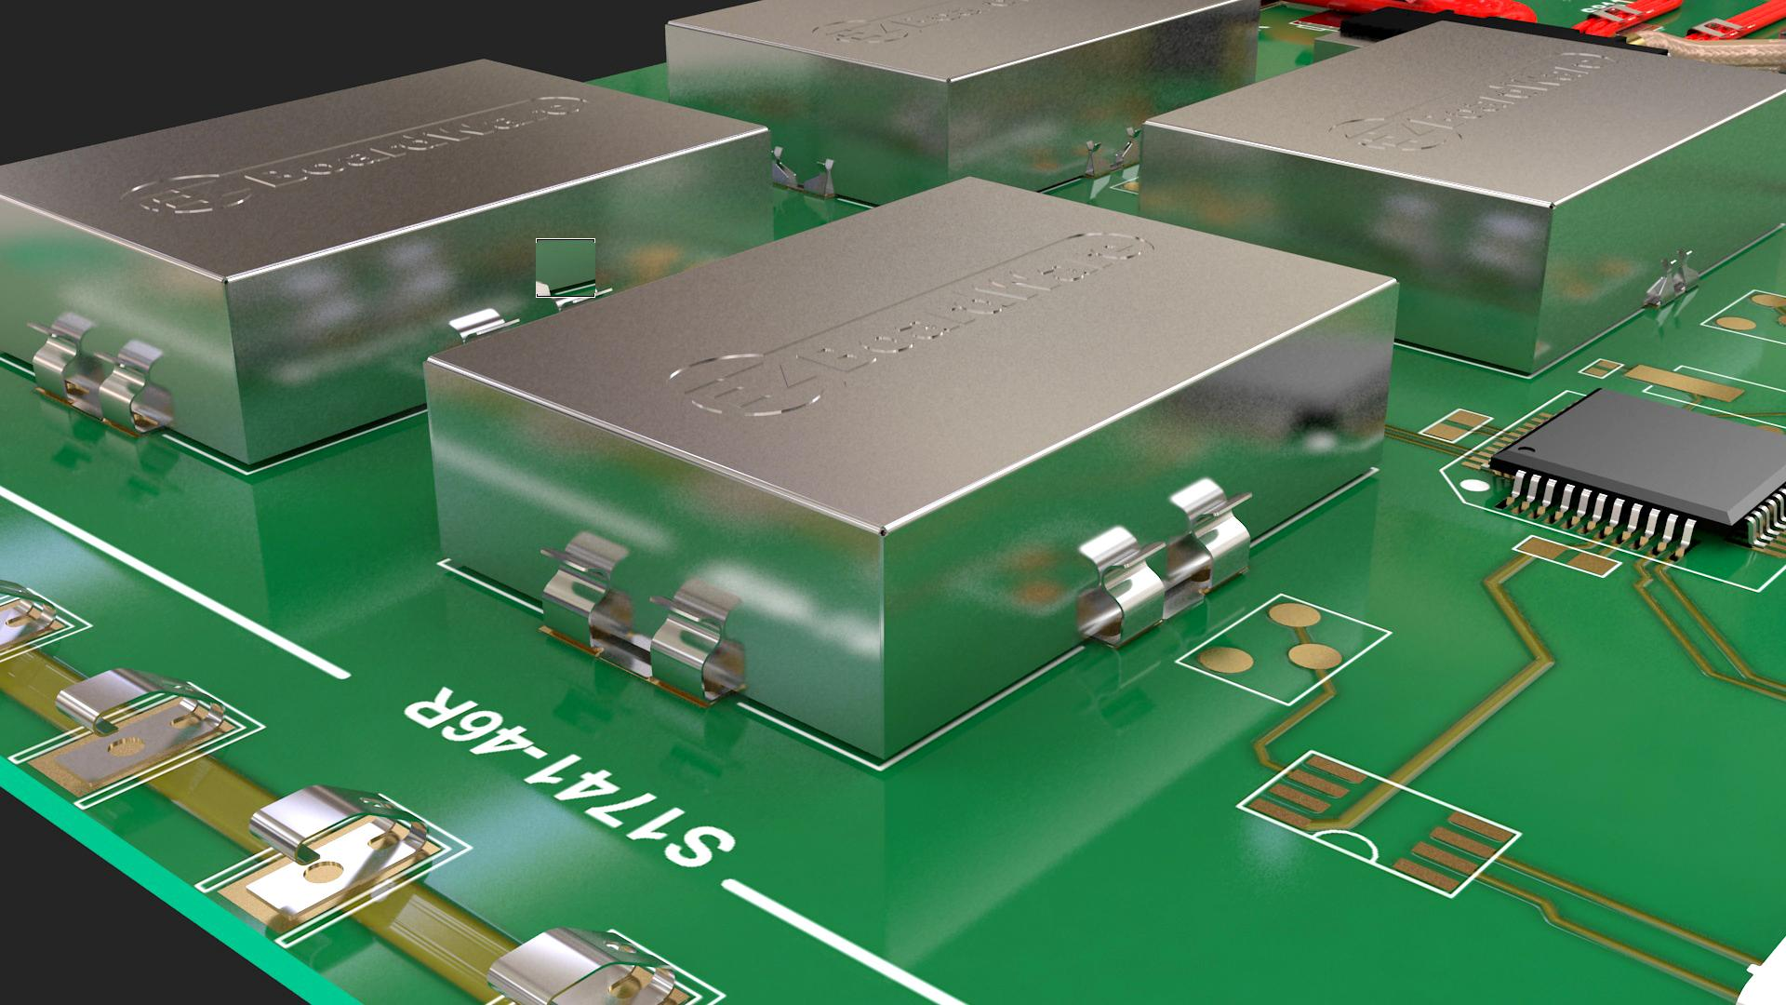
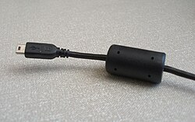
CHOOSING A FIX
Reduce EMI at the source, path, or receiving circuit
Shield
Where to act | Example changes
Source | Reduce current or edge speed; add filtering
Path | Add distance, twist wires, improve routing or shielding
Receiving circuit | Add filtering or use a differential receiver
Whole system | Improve layout, enclosure, and grounding
Provides a controlled path for unwanted electric-field energy when connected correctly.
Ferrite
Makes some high-frequency currents harder to sustain on a wire or cable.
LECTURE 07 | EMI + CONTAINMENT
09
Notes:
Images
https://en.wikipedia.org/wiki/Ferrite_bead
https://www.harwin.com/blog/emc-emi-shielding-explained

Slide 8
WEEK 3 SYNTHESIS
Exit check
Two nearby wires are not electrically connected, yet a changing voltage on one produces a signal on the other.
NEXT: CAPACITANCE + IMPEDANCE
LECTURE 07 | EMI + CONTAINMENT
14
Notes:
Supported: the 90-degree placement reduced measured crosstalk in this setup. Control source, resistance, and scope settings; repeat across frequency, spacing, or wire length before generalizing.

