Slide 1
CYBER 327 / LECTURE 08
Capacitance, Impedance, and RLC Behavior
Opposing reactances make one circuit behave differently across frequency.
SEP 21, 2026
LECTURE 08 | CAPACITANCE + RLC
01

Slide 2
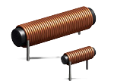
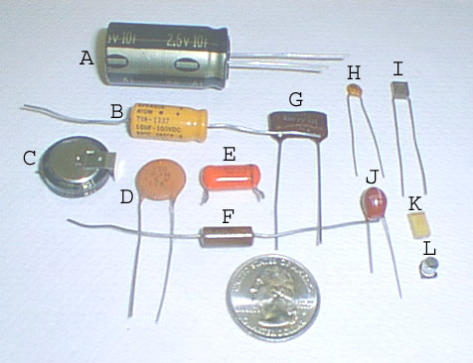
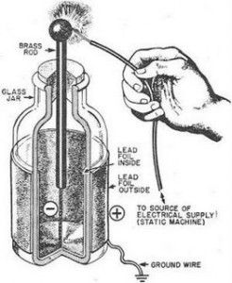
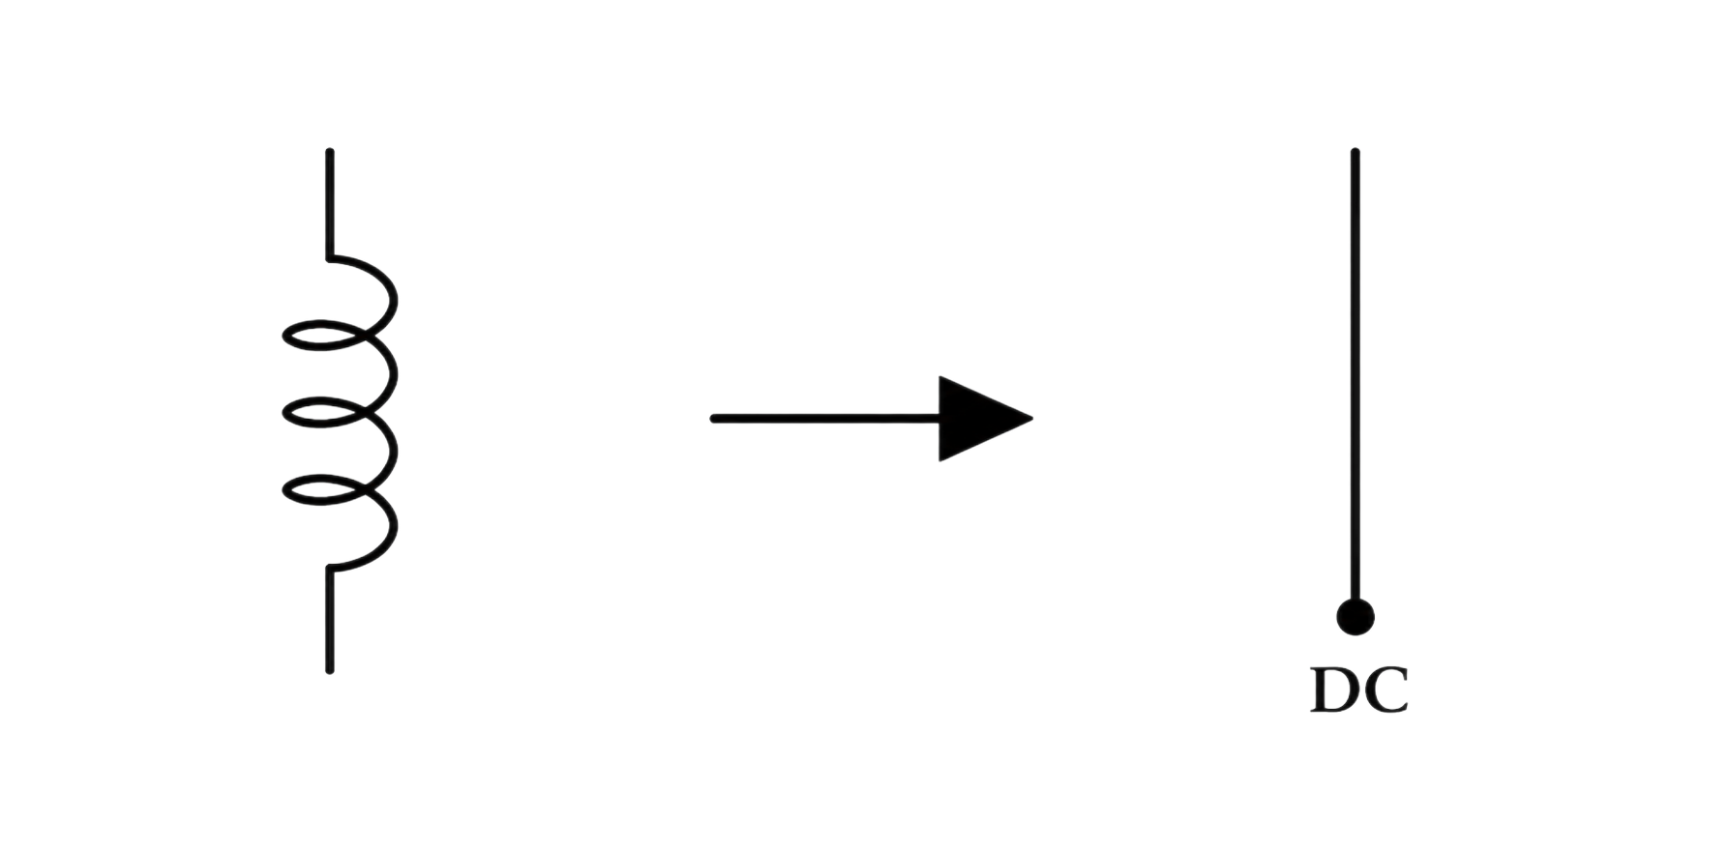
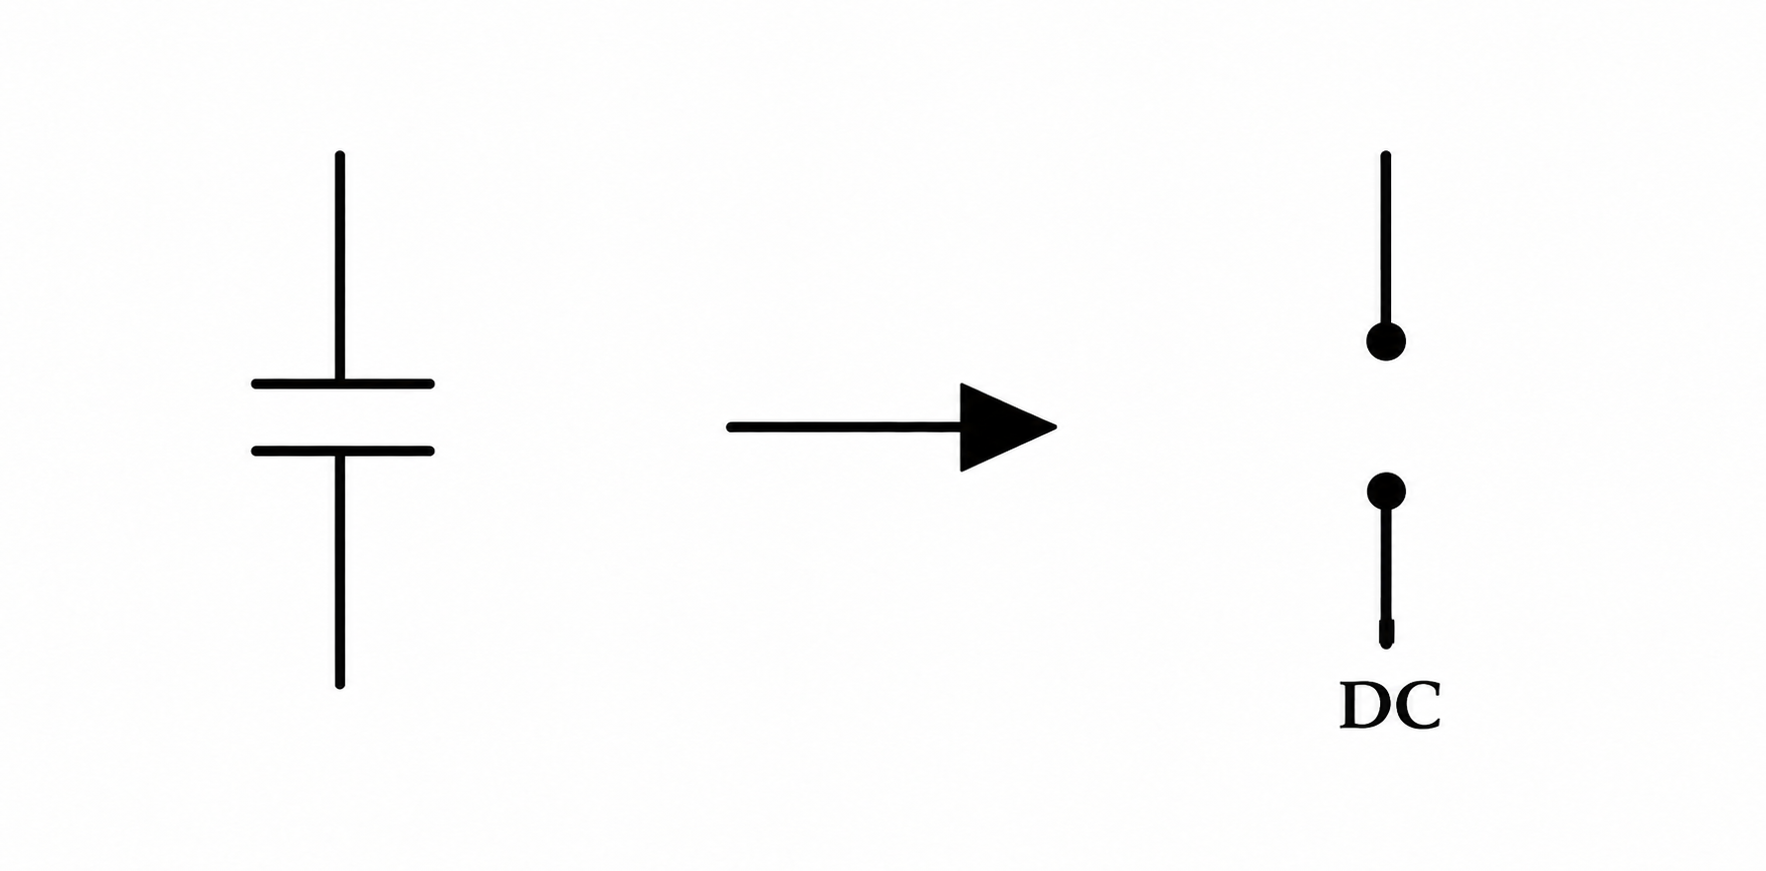
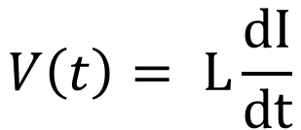
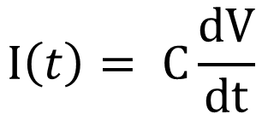
RECALL
Inductors and capacitors respond in opposite ways
$$V\left(t\right)= L\frac{dI}{dt}$$
$$I\left(t\right)= C\frac{dV}{dt}$$
Henry (H)
Farad (F)
Inductor
Capacitor
Current cannot change instantly. Ideal reactance rises with frequency.
Voltage cannot change instantly. Ideal reactance falls with frequency.
LECTURE 08 | CAPACITANCE + RLC
02

Slide 3
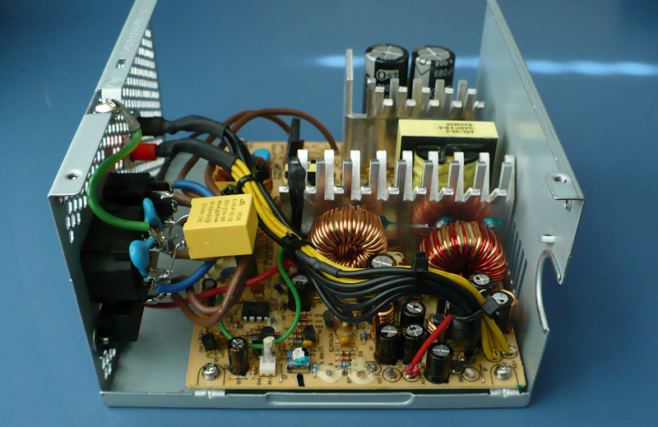
RECALL
Inductors and capacitors respond in opposite ways
$$V\left(t\right)= L\frac{dI}{dt}$$
$$I\left(t\right)= C\frac{dV}{dt}$$
Inductor
Capacitor
Oppose rapid changes in current
Oppose rapid changes in voltage
LECTURE 08 | CAPACITANCE + RLC
02

Slide 4
RETRIEVAL
Inductors and capacitors respond in opposite ways
 | Capacitor | Inductor
Stores energy in
Equation
Responds to change in
If that quantity changes rapidly
If that quantity stops changing
AC relationship
Equivalent
ELI THE ICE MAN
LECTURE 08 | CAPACITANCE + RLC
02

Slide 5
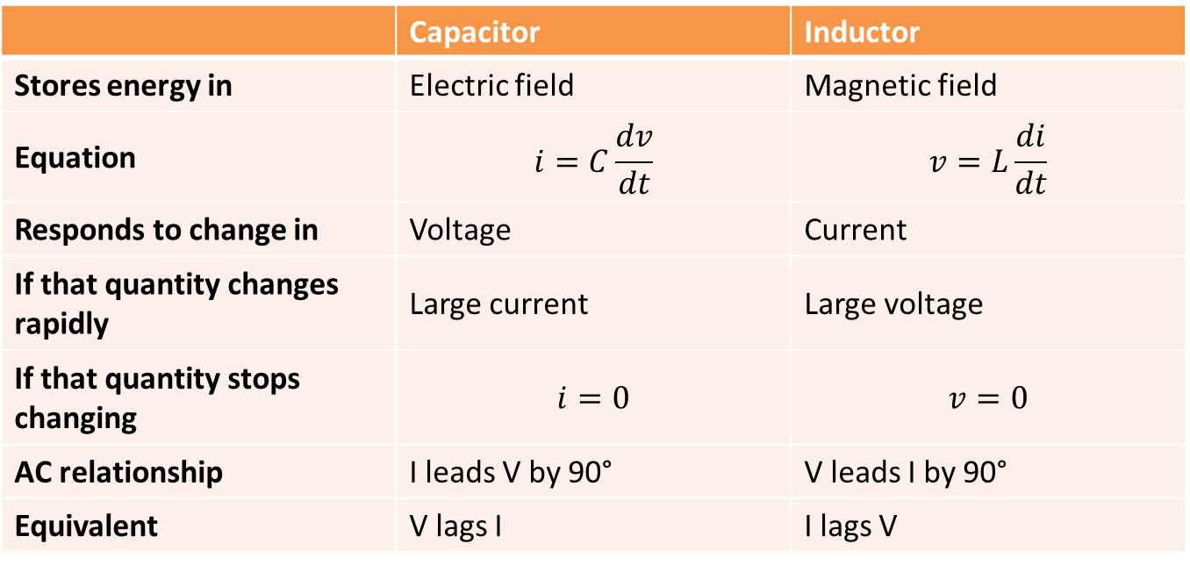
RETRIEVAL
Inductors and capacitors respond in opposite ways
 | Capacitor | Inductor
Stores energy in | Electric field | Magnetic field
Equation | $$i=C\frac{dv}{dt}$$ | $$v=L\frac{di}{dt}$$
Responds to change in | Voltage | Current
If that quantity changes rapidly | Large current | Large voltage
If that quantity stops changing | $$i=0$$ | $$v=0$$
AC relationship | I leads V by 90° | V leads I by 90°
Equivalent | V lags I | I lags V
ELI THE ICE MAN
LECTURE 08 | CAPACITANCE + RLC
02

Slide 6
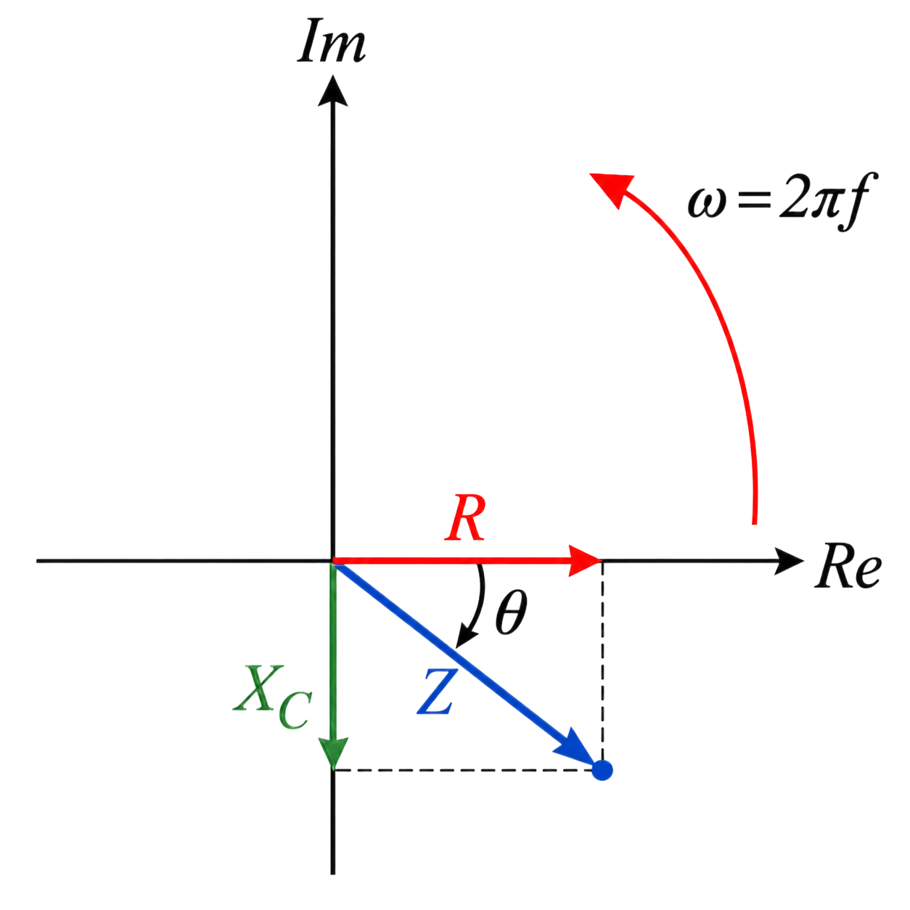





FREQUENCY DEPENDENCE
Capacitive reactance
INDUCTIVE REACTANCE
$$X_{C}=\frac{1}{ωC}$$
$$X_{L}=ωL$$
WHERE
$$ω=2πf$$
$$X_{C}∝\frac{1}{fC}$$
Capacitive reactance magnitude in ohms.
$$X_{L}∝fL$$
LOW f: LARGE $X_{C}$ | HIGH f: SMALL $X_{C}$
LECTURE 08 | CAPACITANCE + RLC
05

Slide 7
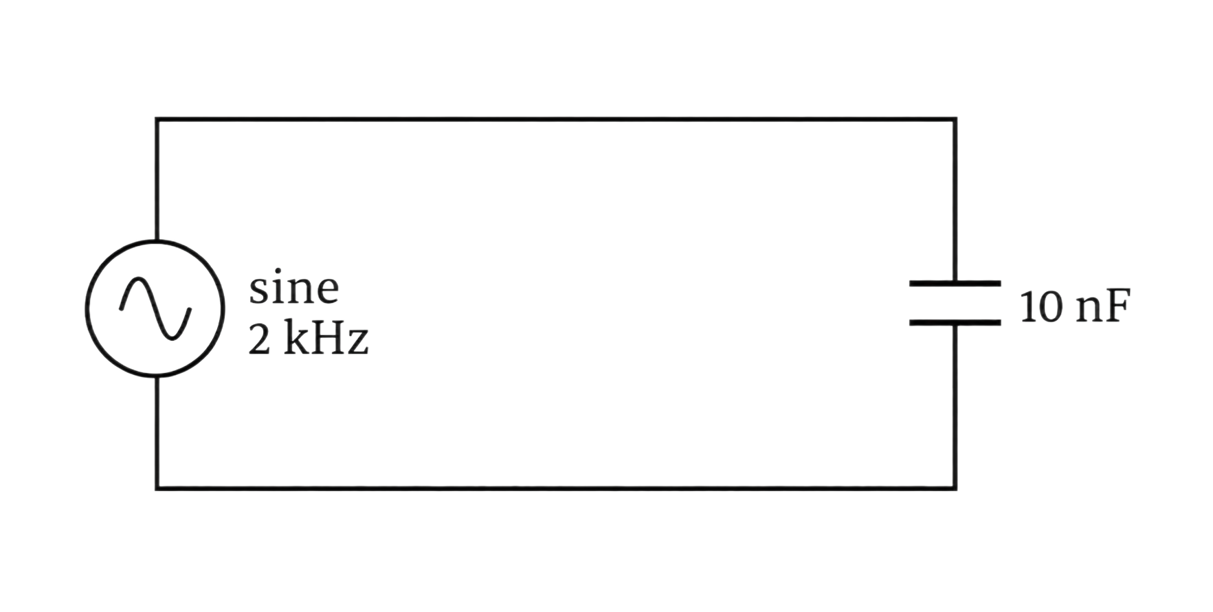





REACTANCE AND CURRENT
Example
$$C= 10 nF$$
$$f= 2 kHz$$
$$V_{RMS}= 1V$$
$$X_{C}= ?$$
$$I_{C}= ?$$
LECTURE 05 | INDUCTANCE + REACTANCE
11
Notes:
XC = 7.96 kΩ and IC = 125.7 uArms

Slide 8
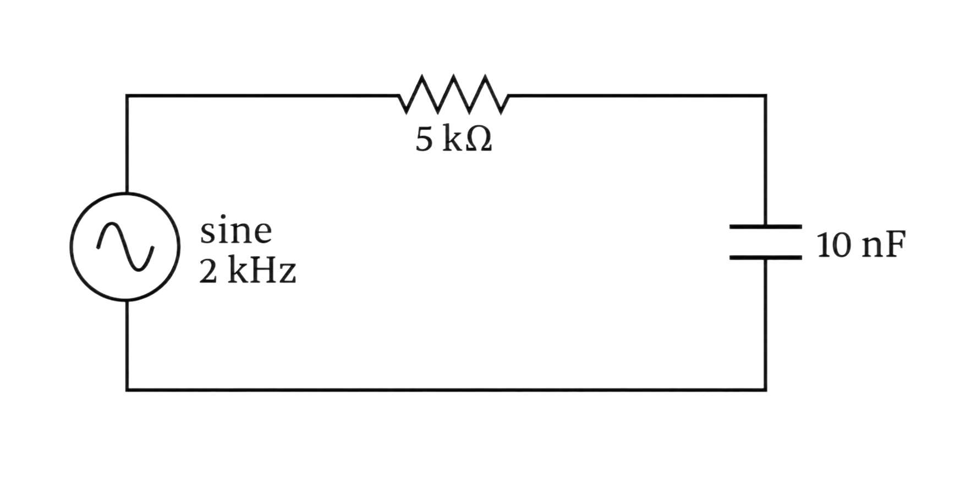






REACTANCE AND CURRENT
The RC Circuit
$$R= 5 kΩ$$
$$C= 10 nF$$
$$f= 2 kHz$$
$$V= 1V∠0°$$
$$X_{C}= ?$$
$$Z= ?$$
$$I_{C}= ?$$
LECTURE 05 | INDUCTANCE + REACTANCE
11
Notes:
XC = 9.4kΩ <-57.9 and IC = 106.4 uArms <57.9

Slide 9
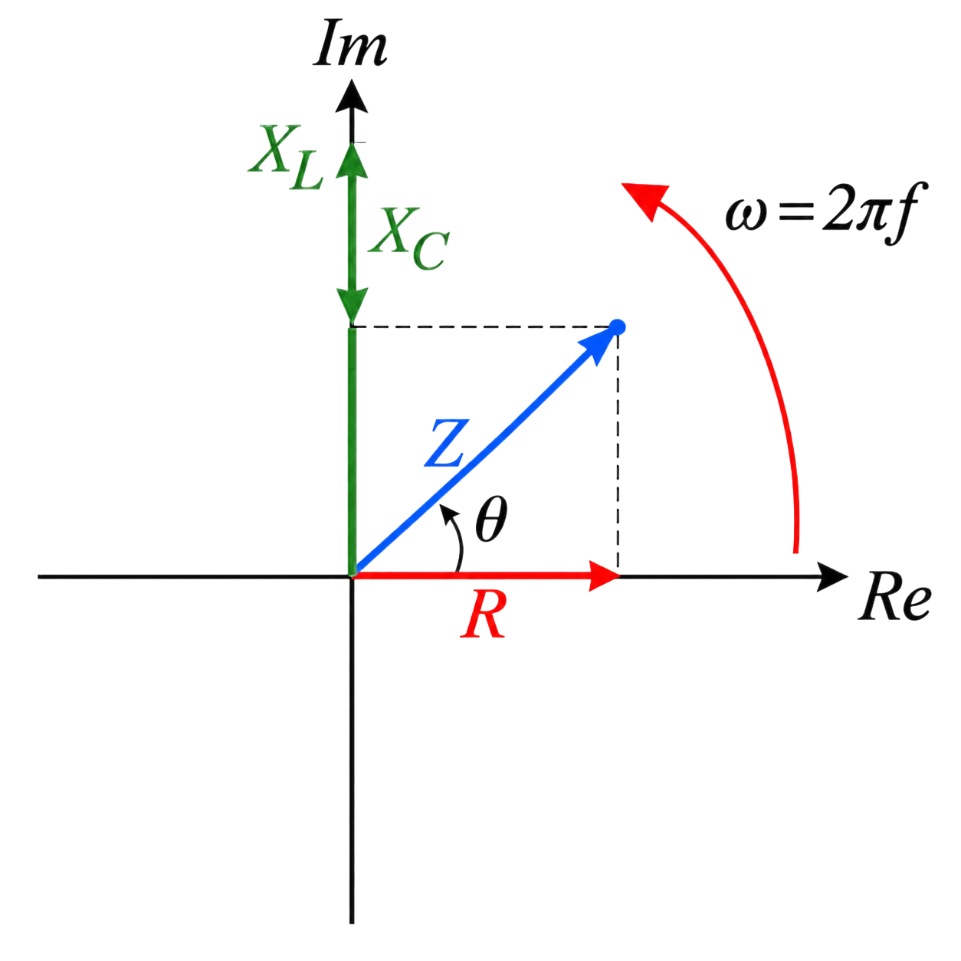




SERIES RLC MODEL
Impedance combines resistance and net reactance
$$X=X_{L}−X_{C}$$
$$\left|Z\right|=\sqrt{R^{2}+X^{2}}$$
$$θ=\tan^{-1}\left(\frac{X}{R}\right)$$
$$V=IZ$$
REACTANCES OPPOSE EACH OTHER; RESISTANCE DOES NOT CANCEL
LECTURE 08 | CAPACITANCE + RLC
07
Notes:
Make clear that R, XL, and XC cannot normally be added as unsigned scalars. The magnitude equation follows from the right-triangle phasor model.

Slide 10
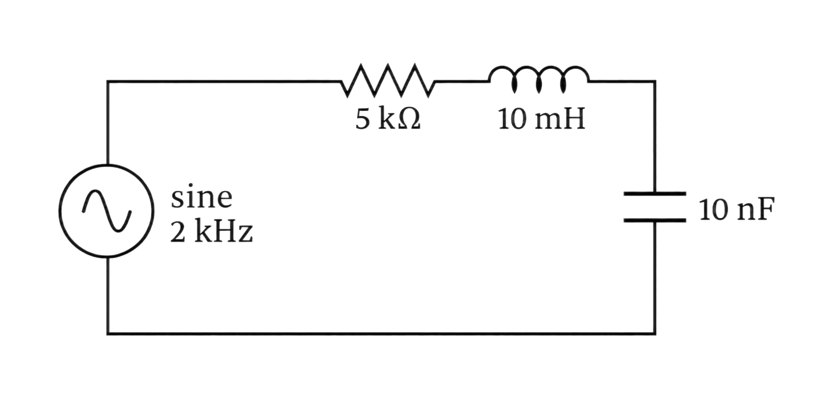







INDUCTANCE AND CURRENT
Example
$$R= 5 kΩ$$
$$L= 10 mH$$
$$C= 10 nF$$
$$f= 2 kHz$$
$$V= 1V∠0°$$
$$X= ?$$
$$Z= ?$$
$$I_{total}= ?$$
LECTURE 05 | INDUCTANCE + REACTANCE
11
Notes:
XC = 7.96kΩ XL = 127.7Ω X = -7.832kΩ Z = 9.294kΩ <-57.4 I = 107.6uA <57.4

Slide 11
WORKED MODEL
Frequency changes the same RLC circuit
Frequency | X_L | X_C | Net behavior | |Z|
2.00 kHz | 127 Ω | 7.96 kΩ | Capacitive | 9.294 kΩ
15.9 kHz | 999 Ω | 1.00 kΩ | Near balance | 5k Ω
50.0 kHz | 3.142 kΩ | 318 Ω | Inductive | 5.742 kΩ
LECTURE 08 | CAPACITANCE + RLC
08

Slide 12

MODEL BEFORE FORMULA
Exit check
As frequency rises, $X_{L}$ rises and $X_{C}$ falls. What must happen somewhere between?
Predict what happens to series current and resistor voltage when the reactances balance.
NEXT: RESONANCE + FILTERING
LECTURE 08 | CAPACITANCE + RLC
13
Notes:
Expected: XL and XC can become equal, net reactance approaches zero, impedance is minimized, current peaks, and resistor voltage peaks.

