Slide 1
CYBER 327 / LECTURE 09
Resonance, Selectivity, and Filtering
Measure which frequencies a channel favors, attenuates, and cannot separate.
SEP 23, 2026
LECTURE 09 | RESONANCE + FILTERING
01
Notes:
Turn the RLC model into measurable channel selectivity. Keep dB out of this lecture; use amplitude ratios and the 0.707 half-power criterion.

Slide 2
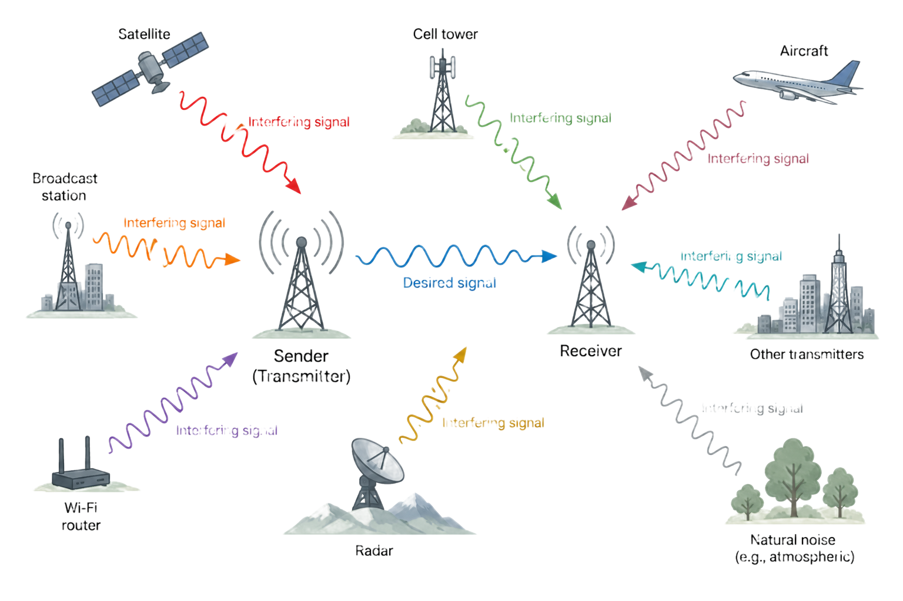
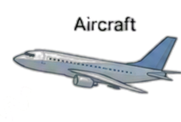
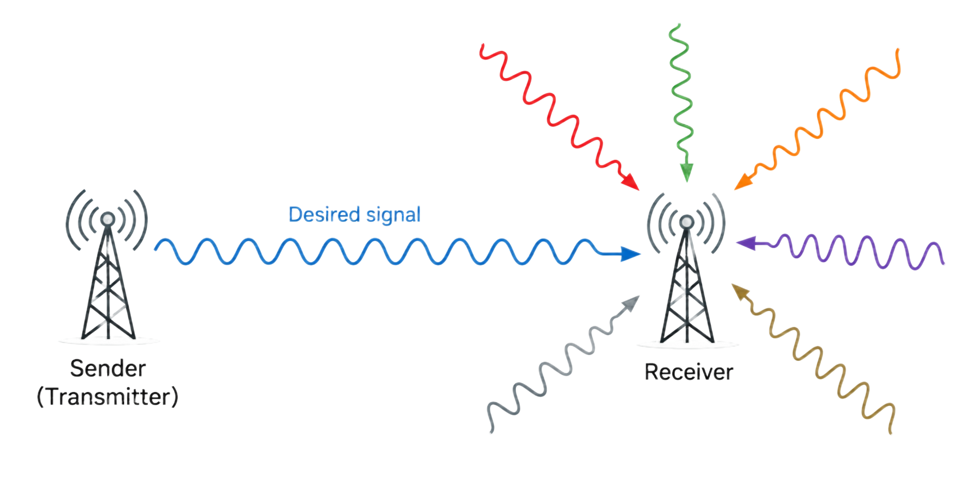

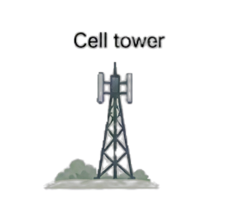
OPENING PROBLEM
A receiver should not treat every frequency equally
Desired
A known channel occupies a limited frequency region.
Undesirable
Noise and interference may exist above, below, or inside that region.
LECTURE 09 | RESONANCE + FILTERING
02
Notes:
Ask whether a filter can distinguish two sources at exactly the same frequency. No: frequency selectivity alone cannot separate coincident signals.

Slide 3
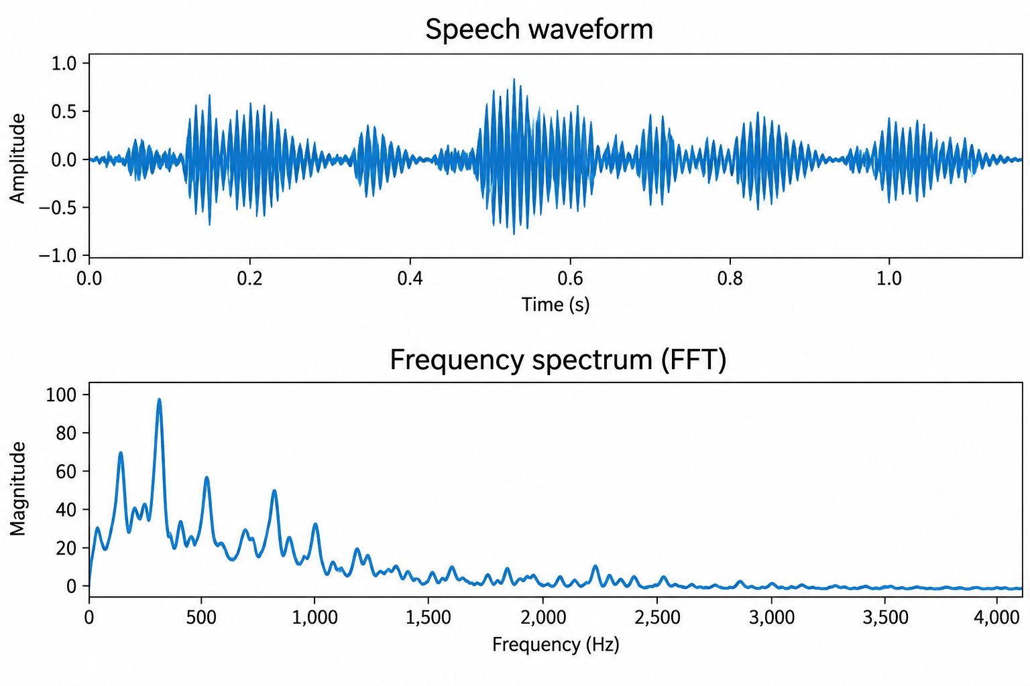
OPENING PROBLEM
A receiver should not treat every frequency equally
Desired
A known channel occupies a limited frequency region.
Undesirable
Noise and interference may exist above, below, or inside that region.
LECTURE 09 | RESONANCE + FILTERING
02
Notes:
Ask whether a filter can distinguish two sources at exactly the same frequency. No: frequency selectivity alone cannot separate coincident signals.

Slide 4
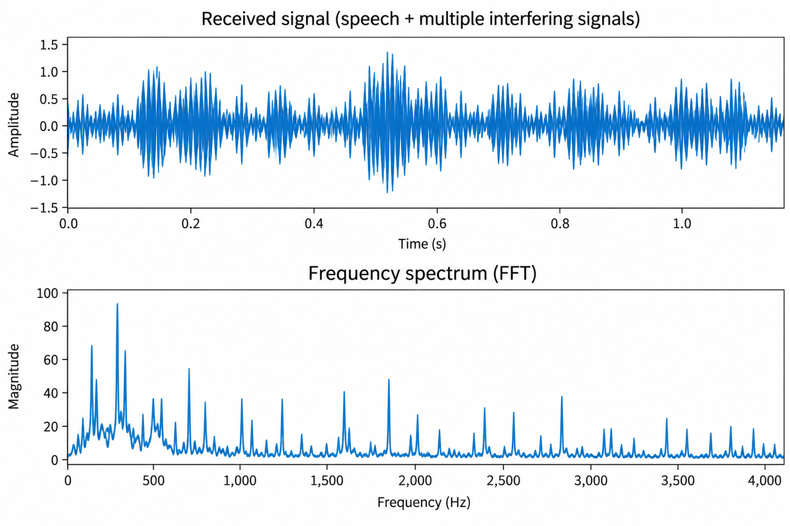
OPENING PROBLEM
A receiver should not treat every frequency equally
Desired
A known channel occupies a limited frequency region.
Undesirable
Noise and interference may exist above, below, or inside that region.
LECTURE 09 | RESONANCE + FILTERING
02
Notes:
Ask whether a filter can distinguish two sources at exactly the same frequency. No: frequency selectivity alone cannot separate coincident signals.

Slide 5
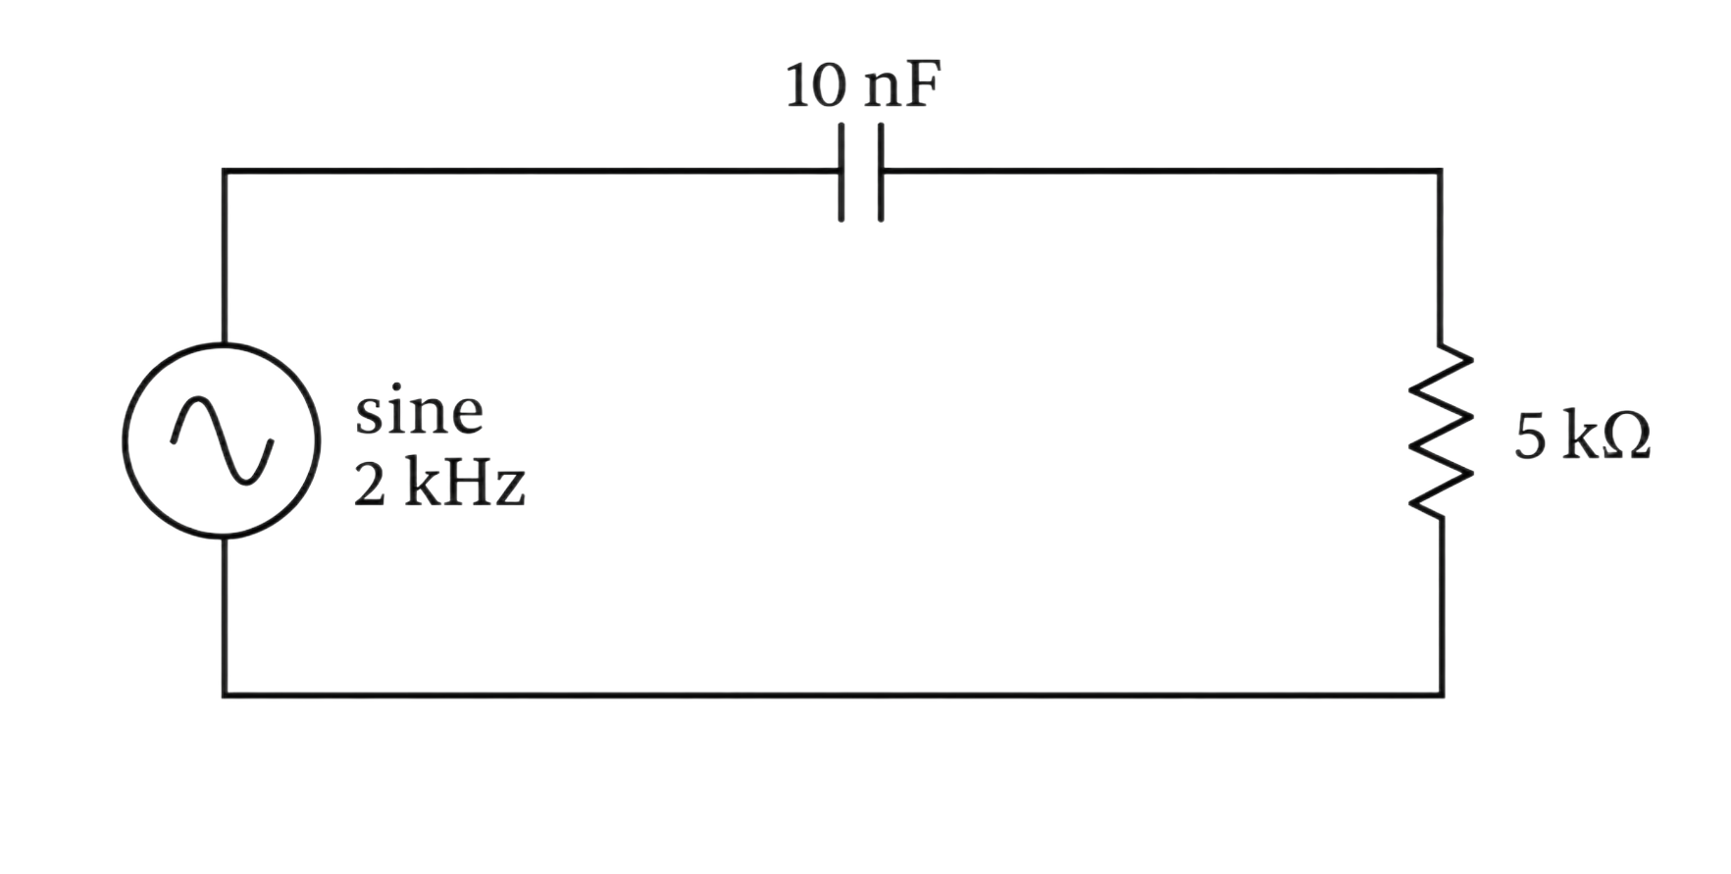
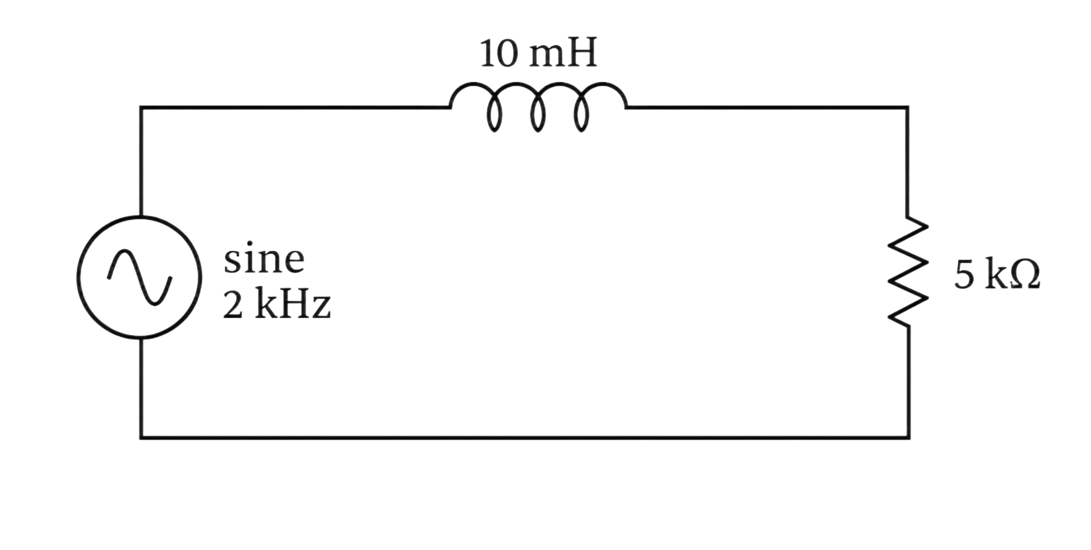


RECALL
Filters
RC Circuit
RL Circuit
$$X_{C}∝\frac{1}{fC}$$
$$X_{L}∝fL$$
HIGHER F = HIGHER I
HIGHER F = LOWER I
LECTURE 09 | RESONANCE + FILTERING
02
Notes:
Ask whether a filter can distinguish two sources at exactly the same frequency. No: frequency selectivity alone cannot separate coincident signals.

Slide 6
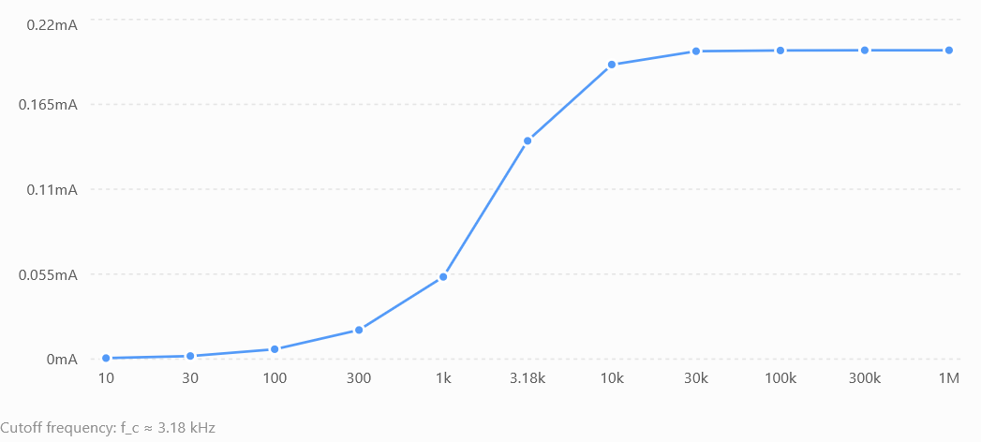
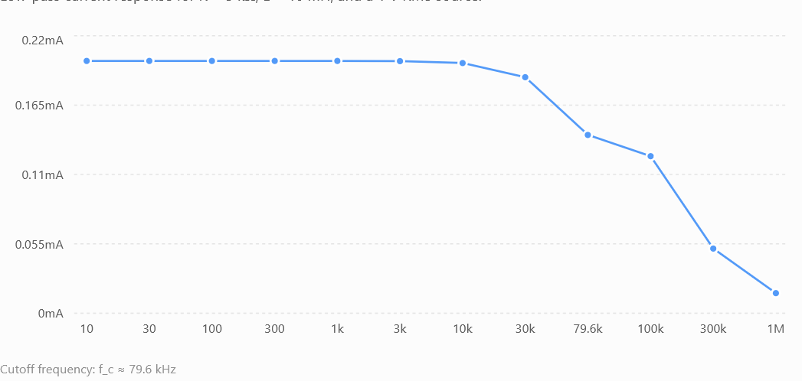
RECALL
Filters
RC Circuit
RL Circuit
HIGH PASS FILTER
LOW PASS FILTER
Accepts higher frequencies
Accepts lower frequencies
LECTURE 09 | RESONANCE + FILTERING
02
Notes:
Ask whether a filter can distinguish two sources at exactly the same frequency. No: frequency selectivity alone cannot separate coincident signals.

Slide 7
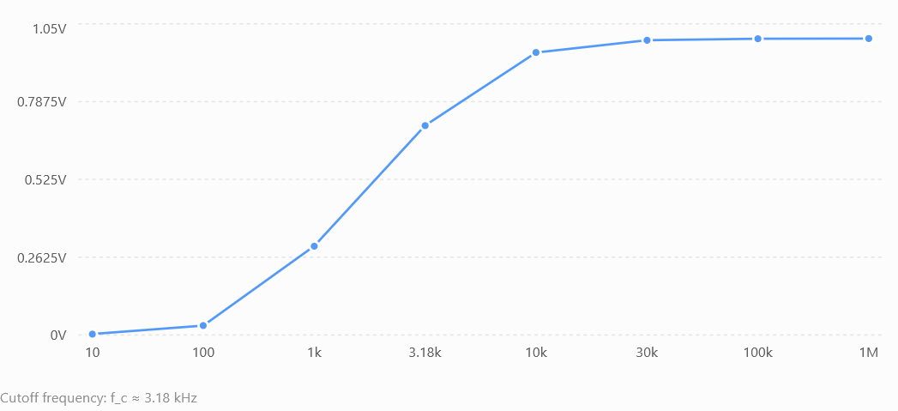
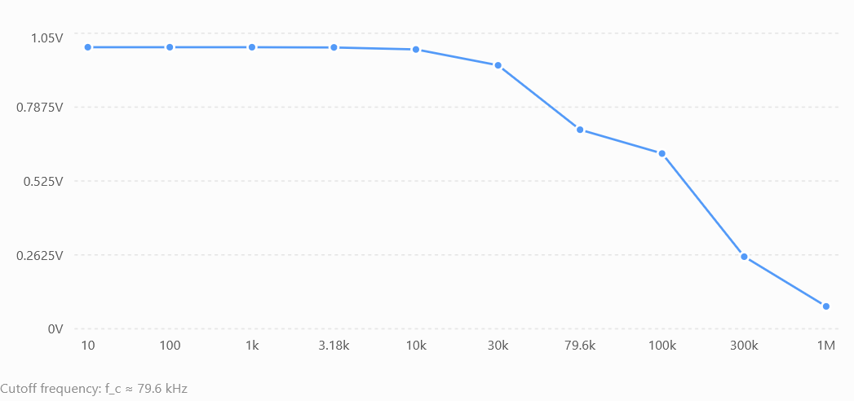
BUT
Filters depend on where you look
+
V
-
+
V
-
RC Circuit
Look at V across R
RL Circuit
HIGH PASS FILTER
LOW PASS FILTER
LECTURE 09 | RESONANCE + FILTERING
02
Notes:
Ask whether a filter can distinguish two sources at exactly the same frequency. No: frequency selectivity alone cannot separate coincident signals.

Slide 8
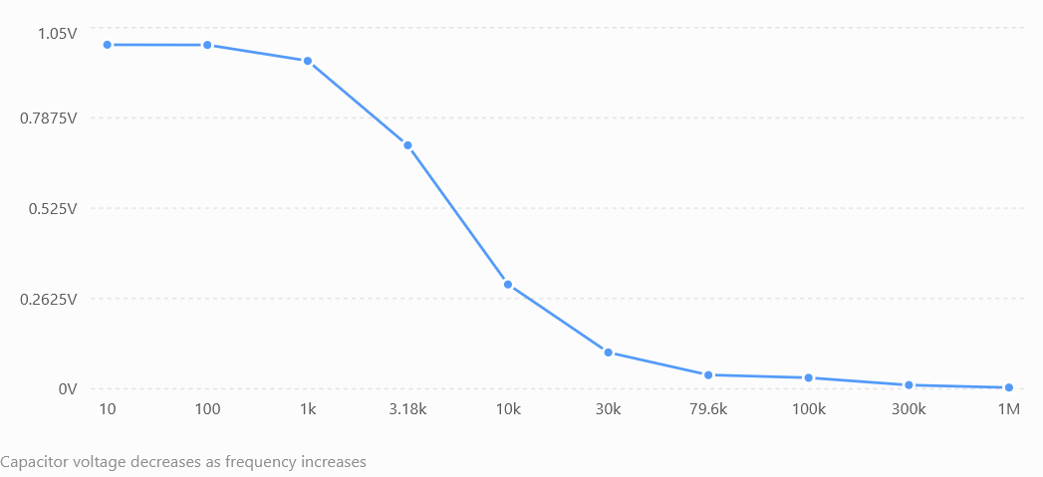
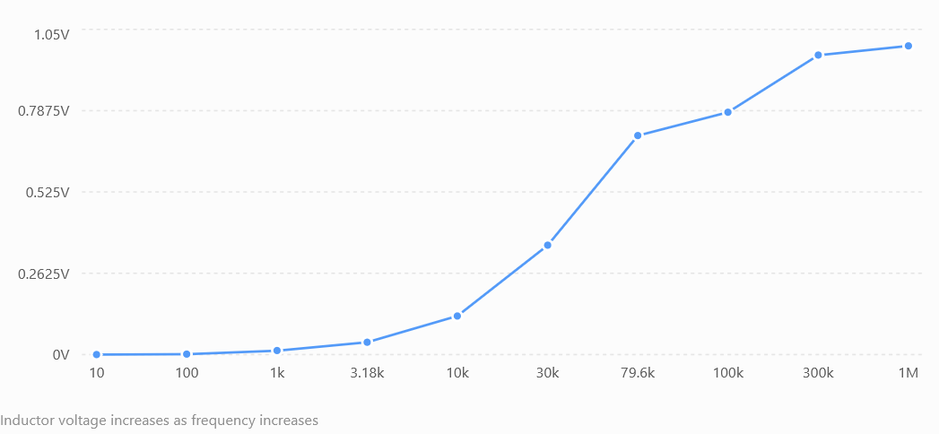
BUT
Filters depend on where you look
+ V -
+ V -
RC Circuit
Look at V across L/C
RL Circuit
LOW PASS FILTER
HIGH PASS FILTER
LECTURE 09 | RESONANCE + FILTERING
02
Notes:
Ask whether a filter can distinguish two sources at exactly the same frequency. No: frequency selectivity alone cannot separate coincident signals.

Slide 9


BUT
Filters depend on where you look
+ V -
+ V -
RC Circuit
RL Circuit
$$f_{C}=\frac{1}{2πRC}$$
$$f_{C}=\frac{R}{2πL}$$
CUTOFF FREQUENCY
Frequency where it breaks even
LECTURE 09 | RESONANCE + FILTERING
02
Notes:
Ask whether a filter can distinguish two sources at exactly the same frequency. No: frequency selectivity alone cannot separate coincident signals.

Slide 10
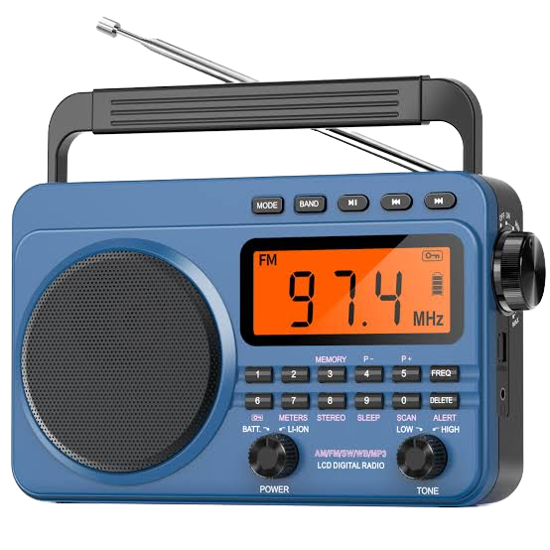
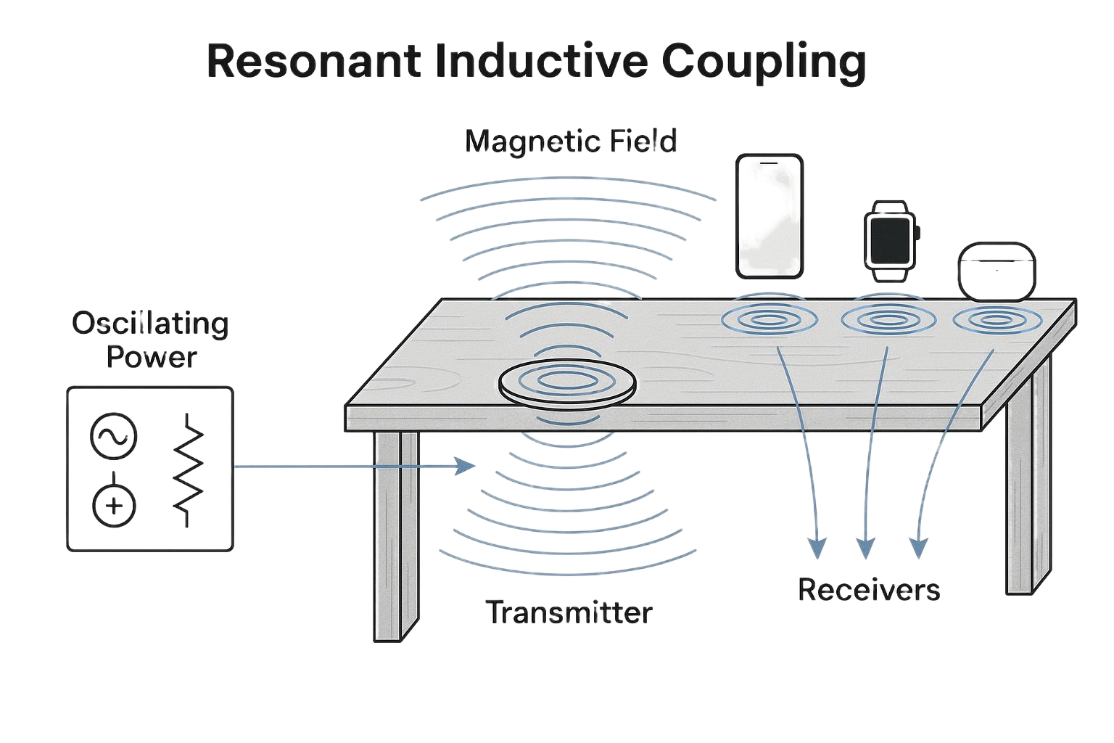


RESONANT FREQUENCY
Series resonance occurs when reactances balance
$$X_{L}=X_{C}$$
Resonant Frequency
Z at f0 is about R
$$f_{0}=\frac{1}{2π\sqrt{LC}}$$
Inductive and capacitive reactance magnitudes match.
Series current reaches its maximum.
AT RESONANCE: NET REACTANCE = 0
LECTURE 09 | RESONANCE + FILTERING
03
Notes:
Images:
https://www.ebay.com/itm/406656200825
https://www.voltraware.com/magnetic-resonance-technology-wireless-charging/

Slide 11
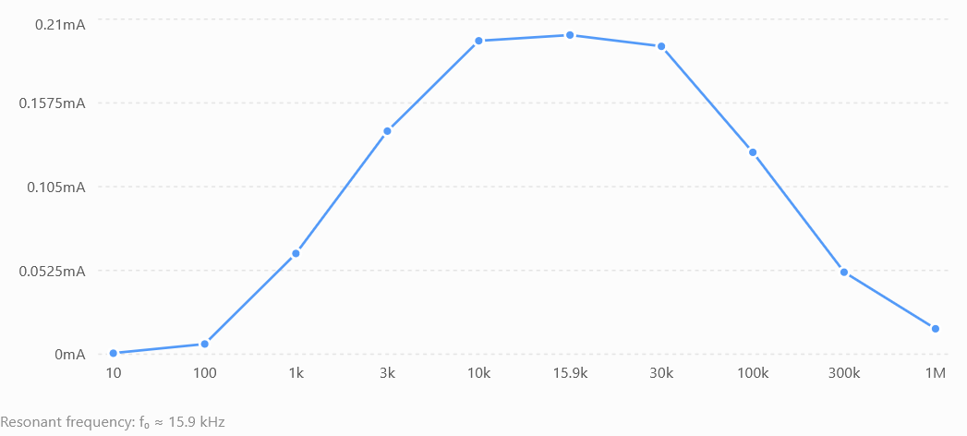
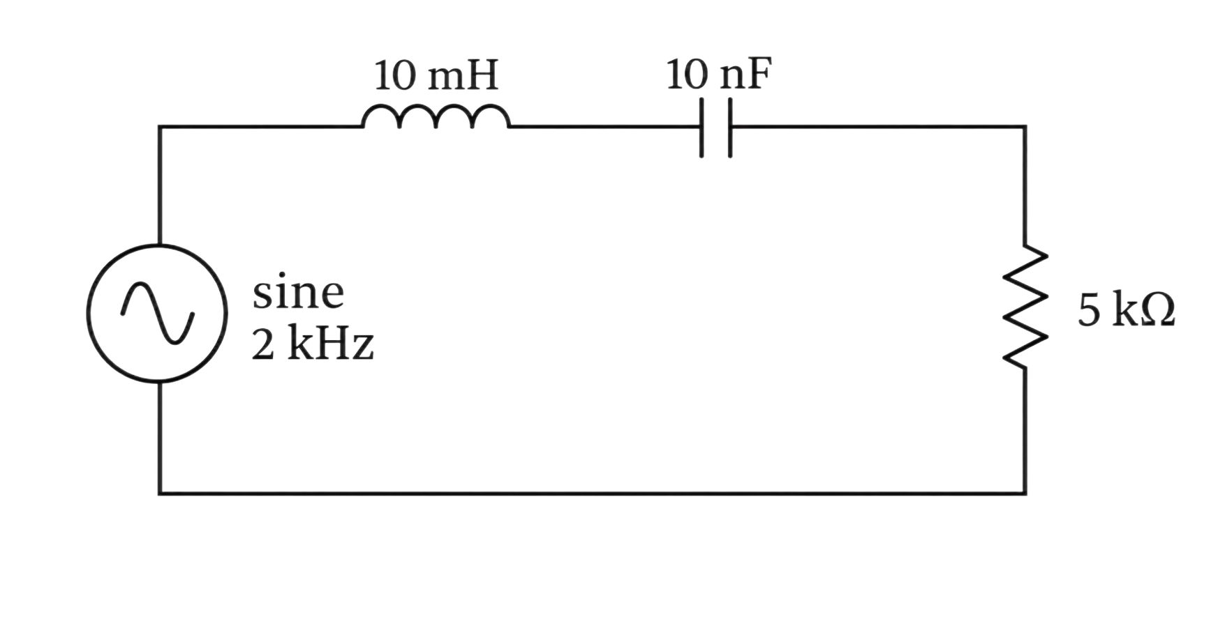

RLC IN RESONANCE
The band-pass filter
CURRENT IS MAXIMUM AT RESONANCE
$$f_{0}=\frac{1}{2π\sqrt{LC}}$$
LECTURE 09 | RESONANCE + FILTERING
04

Slide 12
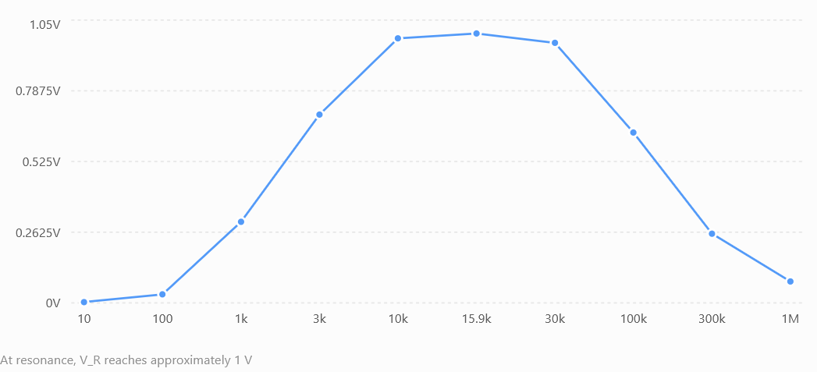
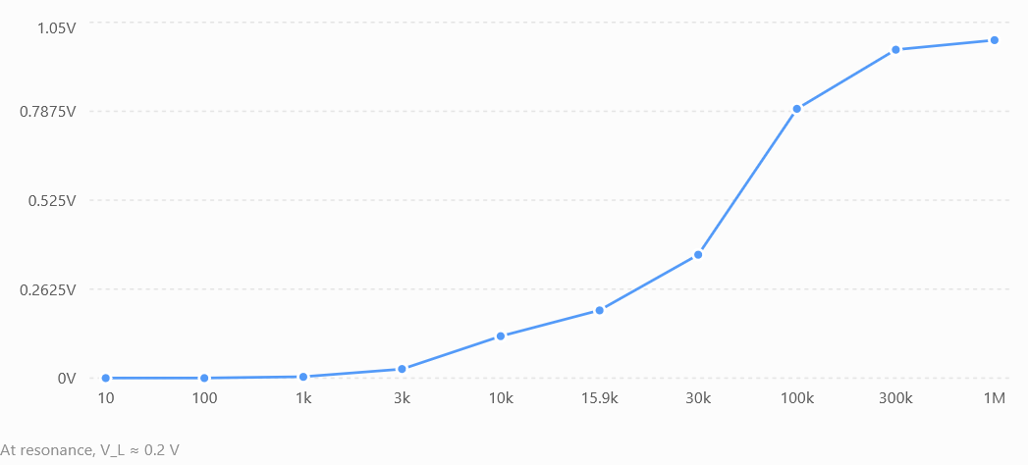
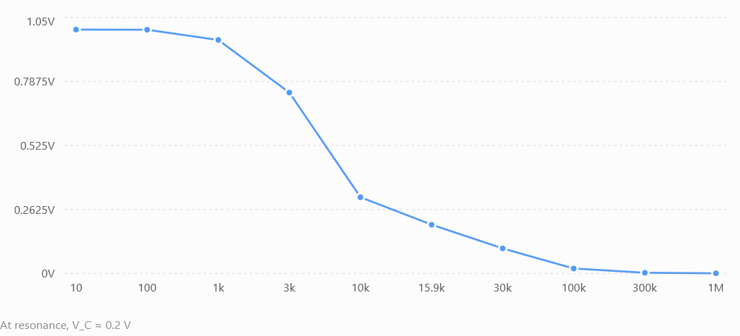
RLC IN RESONANCE
The band-pass filter
V ACROSS R
V ACROSS L
V ACROSS C
LECTURE 09 | RESONANCE + FILTERING
04

Slide 13
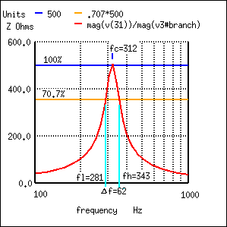


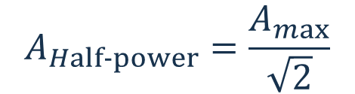
HALF-POWER CRITERION
Bandwidth needs a stated boundary
$$BW=f_{H}−f_{L}$$
$$A_{Half-power}=\frac{A_{max}}{\sqrt{2}}$$
Width between the two crossing frequencies.
Amplitude at half power for equal impedance. (-3dB point)
$$Q=\frac{f_{0}}{BW}$$
Quality Factor. Sharpness of the measured response.
LECTURE 09 | RESONANCE + FILTERING
06
Notes:
https://www.allaboutcircuits.com/textbook/alternating-current/chpt-6/q-and-bandwidth-resonant-circuit/

Slide 14
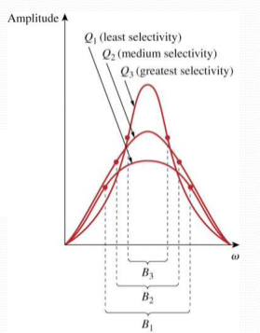
TRADEOFF
Q describes selectivity, not quality in general
Higher Q
Narrower bandwidth and stronger discrimination near f0.
Lower Q
System tradeoff
Broader response and less sensitivity to tuning error.
A very narrow filter may reject a drifting or wideband desired signal.
LECTURE 09 | RESONANCE + FILTERING
07

Slide 15
RESPONSE CATEGORIES
Four basic filters answer different needs
Filter | Primarily passes | Primarily attenuates | Example
Low-pass | Below cutoff | Above cutoff | Remove high-frequency noise
High-pass | Above cutoff | Below cutoff | Block DC or slow drift
Band-pass | Selected band | Outside the band | Select one channel
Band-stop/Band-reject | Outside a rejected band | Selected band | Suppress a narrow interferer
LECTURE 09 | RESONANCE + FILTERING
08
Notes:
How do you get a band reject filter?

Slide 16
SELECTIVITY CLAIM
Exit check
End of prologue
Welcome to Communication Systems
NEXT: MESSAGES, SIGNALS, CARRIERS AND CHANNELS
LECTURE 09 | RESONANCE + FILTERING
14

