Slide 1
CYBER 327 / LECTURE 13
Investigating an Unknown Signal
Classify observable features
FRIDAY, OCTOBER 2, 2026
LECTURE 13 | SIGNAL IDENTIFICATION AND SP
01

Slide 2
FROM CONCEPT TO EVIDENCE
So far this week
WHAT FREQUENCIES MAKE UP A WAVEFORM?
HOW DO SIGNAL STRENGTH AND NOISE AFFECT COMMUNICATION?
HOW DO WE USE THOSE IDEAS TO INVESTIGATE AN UNFAMILIAR SIGNAL?
LECTURE 13 | SIGNAL IDENTIFICATION AND SP
02

Slide 3
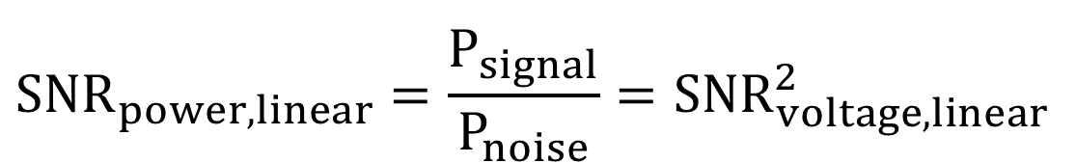
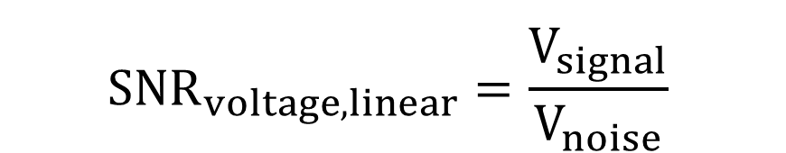



QUANTITATIVE MODEL
Important Equations
$$dB=10\log_{10}\left(\frac{P_{2}}{P_{1}}\right)$$
$$C=B\log_{2}(1+{SNR}_{power,linear})$$
$${SNR}_{power,linear}=\frac{P_{signal}}{P_{noise}}={SNR}_{voltage,linear}^{2}$$
$$dB=20\log_{10}\left(\frac{V_{2}}{V_{1}}\right)$$
$${SNR}_{voltage,linear}=\frac{V_{signal}}{V_{noise}}$$
$${SNR}_{db}={Signal}_{dB}-{Noise}_{dB}$$
$${SNR}_{power,linear}={10}^{{{SNR}_{dB}}/{10}}$$
LECTURE 13 | SIGNAL IDENTIFICATION AND SP
05
Notes:
Work one numerical or proportional example. Emphasize what changes, what remains fixed, and where the model stops being reliable.

Slide 4
TIME TO EXERCISE
dB Practice
Perfect wire
(R = 0Ω; L = 0H; C = 0F)
P₁ = 1W; P₂ = 1W.
Find dB.
AM Radio Example:
If Tx power = 50,000W; path loss ≈100 dB. What is received power?
Reference Example:
Given signal at -20dBm; find wattage.
Satellite communication
path loss ≈ -180 dB
If Tx power = 1000W, what is received power?
Amplifier Example:
Signal in = 10mW;
Signal out = 100 W. Find gain of amplifier.
Reference Example:
Given signal at 15dBm; find wattage.
LECTURE 13 | SIGNAL IDENTIFICATION AND SP
07
Notes:
-20/10 = -2
-2 = 1/10² * 1mW = 10 µW
1 fW
5 µW
40 dB
-20/10 = -2
-2 = 1/10² * 1mW = 10 µW
15/10 = 1.5
1.5 = 10^{1.5} * 1mW =
31.6 * 1mW = 31.6 mW

Slide 5
TIME TO EXERCISE
dB Practice
Reference Example:
Given signal at 40dBW; find wattage.
Reference Example:
Given signal at -60dBmV; find voltage.
Reference Example:
Given signal at -20dBm; find wattage.
Reference Example:
Given signal at 40dBV;
find voltage.
Amplifier Example:
Signal in = 10mW; Signal out = 100 W. Find gain of amplifier.
Reference Example:
Given signal at 15dBm; find wattage.
LECTURE 13 | SIGNAL IDENTIFICATION AND SP
07
Notes:
-20/10 = -2
-2 = 1/10² * 1mW = 10 µW
1 fW
5 µW
40 dB
-20/10 = -2
-2 = 1/10² * 1mW = 10 µW
15/10 = 1.5
1.5 = 10^{1.5} * 1mW =
31.6 * 1mW = 31.6 mW

Slide 6
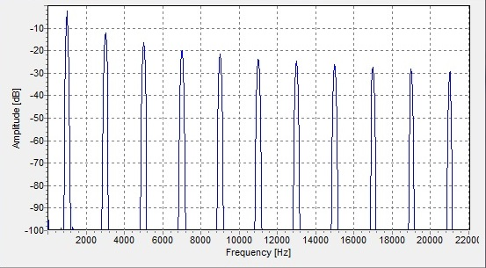
TIME TO EXERCISE
Spectra Practice
What shape is this waveform?
What is the fundamental frequency?
How many harmonics can you see?
This is only a partial spectrum; how many harmonics does this square
wave actually consist of?
LECTURE 13 | SIGNAL IDENTIFICATION AND SP
07
Notes:
Square wave
1 kHz
10
∞

Slide 7
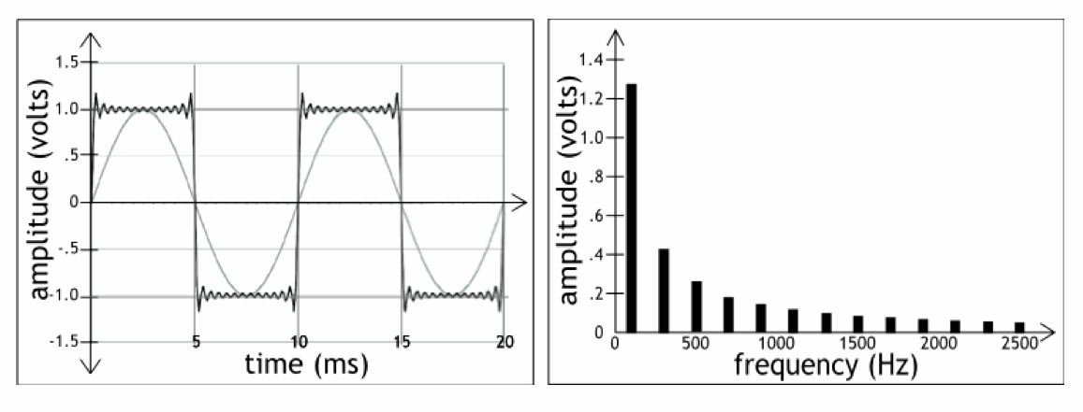
TIME TO EXERCISE
Spectra Practice
What is the fundamental frequency?
What is the frequency of the 7th harmonic?
LECTURE 13 | SIGNAL IDENTIFICATION AND SP
07
Notes:
Period = 10ms
f = 1/10ms = 100 Hz
1st harmonic = fundamental
3rd harmonic = 300 Hz
5th harmonic = 500 Hz
7th harmonic = 700 Hz

Slide 8
BRIDGE FORWARD
Exit check
How can we use a signal to send another signal?
NEXT: AMPLITUDE MODULATION AND SIDEBANDS
LECTURE 13 | SIGNAL IDENTIFICATION AND SP
10

