Slide 1
CYBER 327 / LECTURE 30
From Pulses to Messages: UART and Device Interfaces
What can its internal pins reveal?
WEDNESDAY, NOVEMBER 11, 2026
LECTURE 30 | FROM PULSES TO MESSAGES UART
01

Slide 2
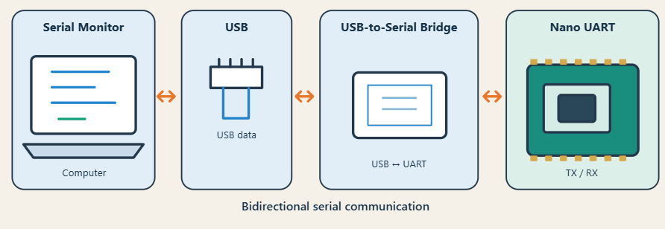
USE A FAMILIAR CONNECTION
What is behind Serial Monitor?
UART = universal asynchronous receiver/transmitter
Serial= data is sent serially (one after another, not parallel)
LECTURE 30 | FROM PULSES TO MESSAGES UART
03

Slide 3
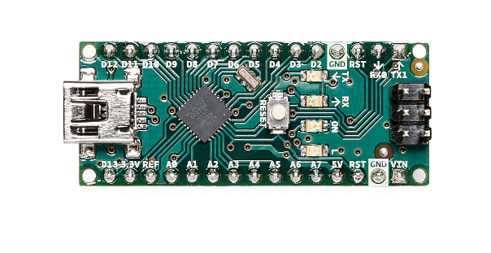
UART TRANSPORTS A DATA FIELD
Characters to numbers to pulses
Character
K
→
ASCII value
0x4B
→
Decimal
75
→
8-bit field
01001011
LECTURE 30 | FROM PULSES TO MESSAGES UART
04
Notes:
\

Slide 4
TX, RX AND A COMMON ELECTRICAL REFERENCE
A serial link
“8-N-1
115200 baud
0 – 3.3V/5V”
“8-N-1
115200 baud
0 – 3.3V/5V”
Device A
Device B
TX → RX
TX: transmit output
RX: receive input
RX: receive input
TX: transmit output
RX ← TX
Common reference; no clock wire
Asynchronous
UART: NRZ (non-return-to-zero), LOW=0 / HIGH=1
Carrier?
LECTURE 30 | FROM PULSES TO MESSAGES UART
05
Notes:
The devices agree beforehand what is the baud and configuration
UART assumes 1 bit/symbol so baud=bit rate
Therefore they can get the bit interval
There is no carrier!

Slide 5
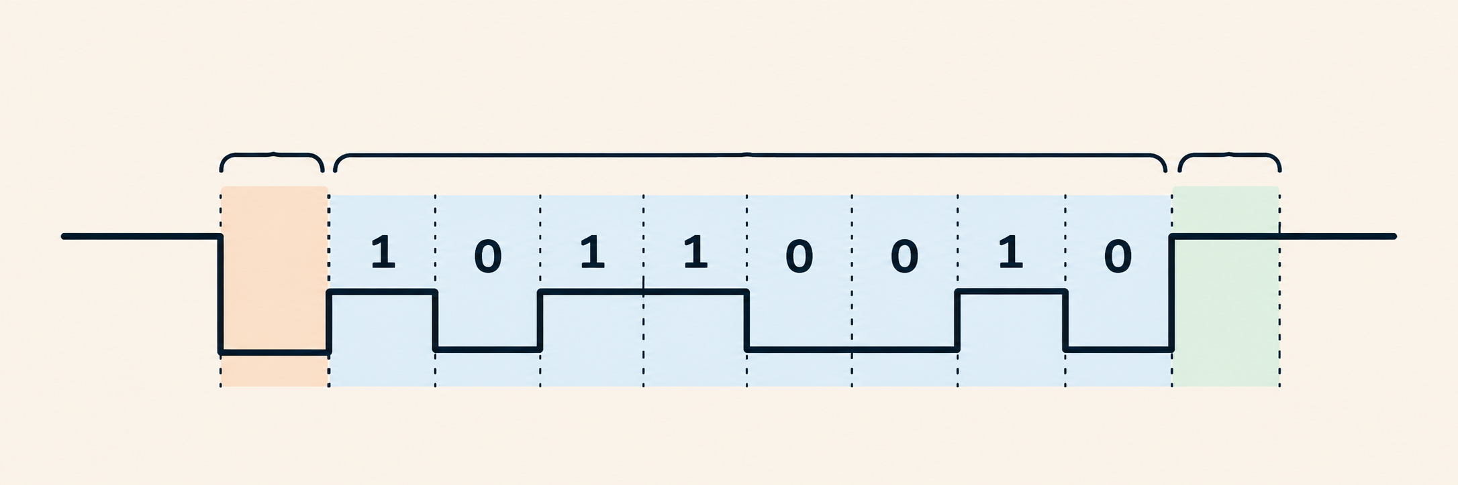
A START AND STOP SURROUND THE DATA
An 8N1 frame
(Parity)
Start
Data
Stop
8N1 = eight data bits, no parity, one stop bit
LECTURE 30 | FROM PULSES TO MESSAGES UART
06
Notes:
Decode the configuration label 8N1: eight data bits, N means no parity, one stop bit. A start bit precedes those fields, so the complete frame has ten bit intervals. Idle is a line state, not an additional fixed-count frame field. The stop interval supplies the required idle level even when frames are back-to-back; there need not be a separate idle gap. A stop bit is not an error-detection checksum. Other formats exist, but the quantitative examples use 8N1.

Slide 6
A START AND STOP SURROUND THE DATA
More configurations
Format | Data bits | Parity | Stop bits | Bits/frame
8N1 | 8 | None | 1 | 10
8E1 | 8 | Even | 1 | 11
8O1 | 8 | Odd | 1 | 11
7E1 | 7 | Even | 1 | 10
8N2 | 8 | None | 2 | 11
LECTURE 30 | FROM PULSES TO MESSAGES UART
06
Notes:
Decode the configuration label 8N1: eight data bits, N means no parity, one stop bit. A start bit precedes those fields, so the complete frame has ten bit intervals. Idle is a line state, not an additional fixed-count frame field. The stop interval supplies the required idle level even when frames are back-to-back; there need not be a separate idle gap. A stop bit is not an error-detection checksum. Other formats exist, but the quantitative examples use 8N1.

Slide 7
ANNOTATED WORKED BYTE
How a frame is transmitted
K: 0x4B = 01001011 in conventional MSB-first notation
Start
D0
D1
D2
D3
D4
D5
D6
D7
Stop
0
1
1
0
1
0
0
1
0
1
Time → data travels least-significant bit (LSB) first
LECTURE 30 | FROM PULSES TO MESSAGES UART
08
Notes:
01001011 is written most significant bit first.
UART sends the data field least significant bit first: 1 1 0 1 0 0 1 0.
Add start LOW and stop HIGH to obtain 0 | 11010010 | 1 in time order.

Slide 8
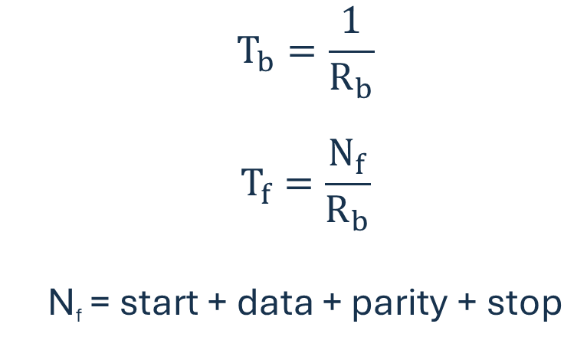
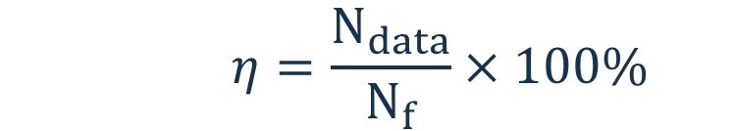

USE THE BIT RATE OF THIS BINARY UART AND COUNT EVERY FRAMING INTERVAL
Calculate bit duration and complete frame duration
Binary UART timing
Character (frame) rate
$$T_{b}=\frac{1}{R_{b}}$$
$$T_{f}=\frac{N_{f}}{R_{b}}$$
N_{f} = start + data + parity + stop
$$R_{chars}=\frac{\text{R}\text{b}}{N_{f}}$$
Bit interval
Bit rate
Data-field efficiency
# Bits per frame
Frame interval
What proportion of transmitted bits is useful data?
Bit rate
$$η=\frac{N_{data}}{N_{f}}×100\%$$
# Bits per frame
19,200 baud, 8N1?
LECTURE 30 | FROM PULSES TO MESSAGES UART
10
Notes:
R_b in bits/s equals its numerical baud value.
At 19200 baud, T_b=1/19200 s=52.0833 microseconds.
With ten intervals per 8N1 frame, T_f=10/19200 s=520.8333 microseconds.
19,200 / 10
1,920 characters/s

Slide 9
INFER A BIT RATE
Turn measured timing into readable bytes
Standard Baud rate
1,200
2,400
4,800
9,600
19,200
38,400
57,600
115,200
230,400
460,800
921,600
Measure identified bit intervals
3 intervals = 156 μs
What is the baud rate?
LECTURE 30 | FROM PULSES TO MESSAGES UART
12
Notes:
52 μs / bit → near 19,200 baud

Slide 10

A REAL DEVICE\
DVR (digital video recorder)
stores security-camera feeds.
The expected route
Another connection
Network viewer
→ login check
→ recordings
Internal header
→ compatible listener
→ startup messages
LECTURE 30 | FROM PULSES TO MESSAGES UART
02
Notes:
\

Slide 11
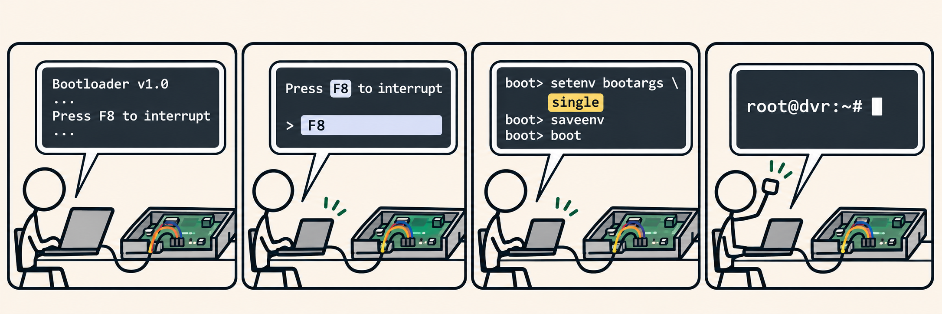
THE DOCUMENTED TAKEOVER
Pen Test Partners (10 February 2016)
Read startup
output
Interrupt
bootloader
Change boot
settings
Root
shell
→
→
→
Bootloader: loads the operating system.
Root shell: a command interface with highest privileges.
LECTURE 30 | FROM PULSES TO MESSAGES UART
13
Notes:
the researcher physically opened the DVR and identified header J18 as a 115200 serial port.
Normal operation exposed output without an interactive shell.
Rebooting revealed U-Boot, software that loads the operating system.
Interrupting startup exposed its command console;
changing boot arguments led to single-user startup and a root shell
Disable unnecessary interactive UART consoles in prod
Restrict bootloader access
Protect boot settings
Require authentication for recovery access
Use secure/verified boot

Slide 12
CALCULATE BEFORE THE INSTRUCTOR REVEALS THE NOTES SOLUTION
Practice
A binary UART uses 38,400 baud and 8O1
Calculate
Then determine
1. Bit duration
2. Complete frame duration
3. Ideal character rate
4. Data-field efficiency
State the number of intervals in the frame before substituting into the equations.
LECTURE 30 | FROM PULSES TO MESSAGES UART
16
Notes:
1. Bit duration (1/38400) 26.04 µs
2. Complete frame duration (11/38400) 286.46 µs
3. Ideal character rate(38,400/11) 3,490.91 characters/s
4. Data-field efficiency (8/11 x100%) 72.73%

Slide 13
EXIT CHECK AND FRIDAY’S INVESTIGATION
Exit Check
Read the eight DATA intervals, then find the character.
Start
D0
D1
D2
D3
D4
D5
D6
D7
Stop
NEXT: NETWORK TOPOLOGIES AND ETHERNET
LECTURE 30 | FROM PULSES TO MESSAGES UART
18
Notes:
1 1 1 0 0 0 1 0. Reconstruct conventional binary 01000111, hexadecimal 47, ASCII G

