Slide 1
CYBER 327 / LECTURE 26
Video and Compression
How many bits does a stream demand?
MONDAY, NOVEMBER 2, 2026
LECTURE 26 | MEDIA TRANSMISSION CASE STUD
01

Slide 2
RETRIEVE LAST WEEK’S TOOLS
Before the camera: rate and errors
1 · Mapped rate
QPSK carries two bits per symbol.
At 50 ksymbol/s, what is its mapped bit rate?
2 · Measured BER
A test compares 600,000 known bits and finds 12 wrong bits.
What is the BER?
LECTURE 26 | MEDIA TRANSMISSION CASE STUD
02

Slide 3
CONNECT THE APPLICATION TO THE COMMUNICATION CHAIN
From a captured image to a useful picture
Decrypt +
playback buffer
Camera
image bits
→
Compress
then encrypt
→
Link + channel
recover bits
→
→
Decode video
and display
Inside the link: coding → modulation → physical channel → receiver decisions
LECTURE 26 | MEDIA TRANSMISSION CASE STUD
03

Slide 4
DEFINE THE QUANTITIES BEFORE MULTIPLYING
What does one video frame contain?
One enlarged frame
Pixel
One picture sample.
Frame
One complete image.
Pixel depth
8-bit grayscale: 256 brightness values.
Frame rate
Illustrative grid, not to scale.
Example image: 800 × 600 pixels.
25 frames represented each second.
LECTURE 26 | MEDIA TRANSMISSION CASE STUD
04
Notes:
Our example uses eight-bit grayscale, allowing 256 brightness values
What if it is eight-bit RGB color?

Slide 5
RAW RATE = WIDTH × HEIGHT × BITS PER PIXEL × FRAMES/S
How many bits does the raw camera produce?
Pixels per frame
800 × 600 = 480,000
Bits per frame
480,000 × 8 = 3,840,000
Raw data rate
3,840,000 × 25 = 96 Mbit/s
Available application throughput: 6 Mbit/s.
The uncompressed feed does not fit.
LECTURE 26 | MEDIA TRANSMISSION CASE STUD
05
Notes:
800 × 600 = 480,000 pixels in one frame.
At eight bits each, that is 3,840,000 bits per frame.
At 25 frames/s, raw video demands 96,000,000 bit/s = 96 Mbit/s.
We need compression!

Slide 6
COMPRESSION REDUCES REPRESENTATION SIZE
Compression makes a different tradeoff
Choice | What the receiver recovers
Lossless | Exactly the original input data
Lossy | An approximation of the original
Video codec | Encoder compresses; decoder reconstructs
Codec | Also called | Typical uses
H.264 | AVC | Widely compatible streaming, recordings, and video calls
H.265 | HEVC | Efficient high-resolution video, including 4K
AV1 | — | Modern internet streaming
VP9 | — | Web video, notably YouTube
MPEG-2 Video | H.262 | DVDs and older digital television
ProRes | — | Video production and editing
LECTURE 26 | MEDIA TRANSMISSION CASE STUD
06

Slide 7
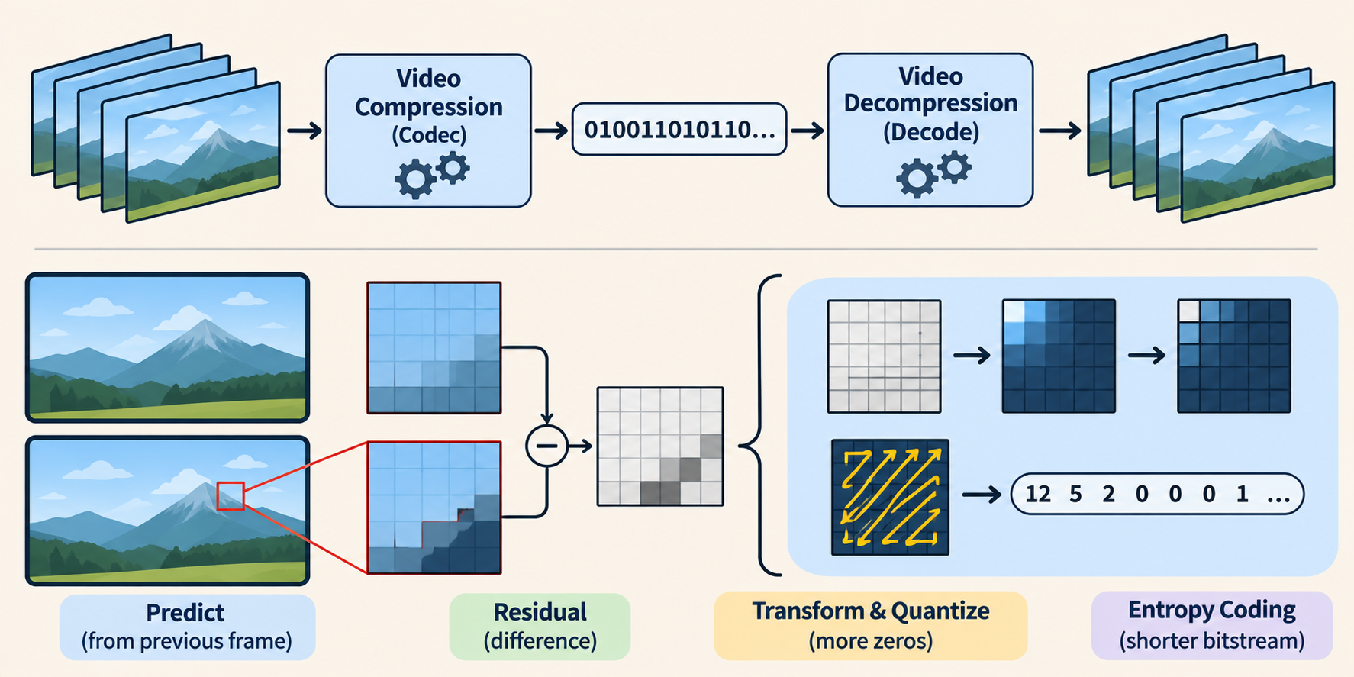
FOLLOW THE SAME CAMERA THROUGH A 24:1 TEACHING EXAMPLE
Does the compressed camera fit the link?
Link is 6 Mbit/s max
If average video rate is 96 Mbit/s,
will it fit with 24:1 compression?
LECTURE 26 | MEDIA TRANSMISSION CASE STUD
07
Notes:
If the constructed ratio is 24:1, so compressed rate of 4 Mbit/s.
That average is below the available 6 Mbit/s application throughput, leaving 2 Mbit/s of rate headroom in this simplified model. It does not guarantee every frame arrives on time: instantaneous content demand, delivery variation, encoder delay, loss and other traffic may matter. We have excluded audio and additional application overhead. Ratio and rates refer to the same duration; do not reverse the ratio or call a 24:1 ratio a 24 percent reduction.

Slide 8
A SEGMENT IS A CHUNK OF VIDEO; PACKETS CARRY PIECES OF ITS DATA
Delivery must meet demand
Mbit delivered in successive one-second intervals
6
6
Playback: 4 Mbit each second
6
4
2
2
2
0
0–1 s
1–2 s
2–3 s
3–4 s
16 Mbit in 4 s. The average is 4 Mbit/s; the delivery is uneven.
LECTURE 26 | MEDIA TRANSMISSION CASE STUD
08

Slide 9
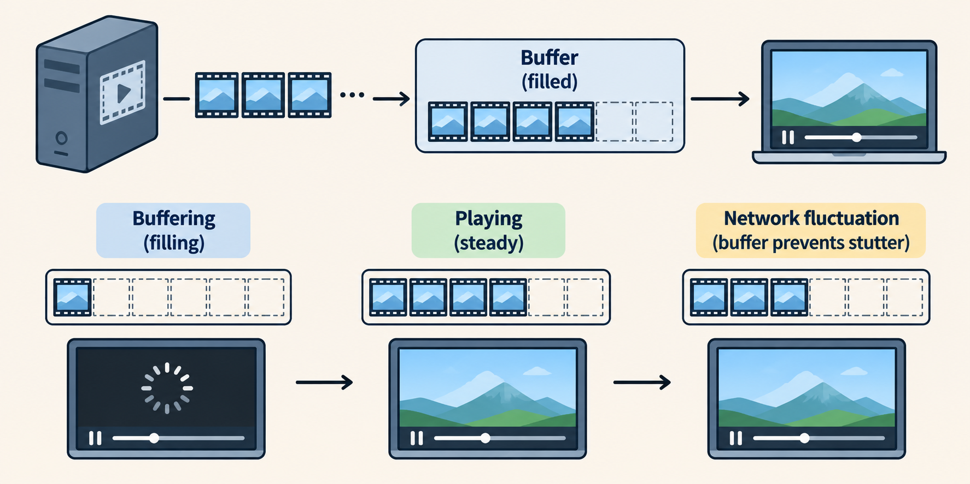

STATE THE INITIAL CONDITION AND WHAT HAPPENS TO NEW ARRIVALS
How much playback can the buffer preserve?
Playback buffer
Stores data for later display
→
$$reserve=\frac{stored data}{playback rate}$$
If I have a 1MB (8Mbit) buffer and playback costs 4Mbit/s,
How long can the video last before it ends?
LECTURE 26 | MEDIA TRANSMISSION CASE STUD
09

Slide 10
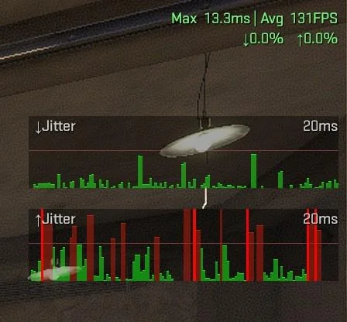
BUFFER CAPACITY, PLAYBACK RESERVE AND END-TO-END DELAY ARE DIFFERENT QUANTITIES
Video Terms
Term | Meaning
Latency (ping) | Time from captured event to display
Jitter | How much the delay varies
LECTURE 26 | MEDIA TRANSMISSION CASE STUD
10

Slide 11
SEPARATE RESEARCH EXAMPLE · USENIX SECURITY 2017
Can encrypted video still reveal what is playing?
An observer sees bursts of traffic while someone watches an encrypted video.
Video server
→
Encrypted traffic
→
Viewer
Traffic bursts →
Compression and streaming segments create patterns in data size and timing.
Traffic analysis: drawing inferences from communication patterns.
Research case: Beauty and the Burst, USENIX Security 2017
LECTURE 26 | MEDIA TRANSMISSION CASE STUD
12
Notes:
Add dummy data or smooth traffic bursts to hide patterns. Both can cost bandwidth or add delay.

Slide 12
CHECK UNDERSTANDING
Exit check
A grayscale camera sends 400 × 300 pixels,
8 bits/pixel and 20 frames/s.
1. Calculate the raw video rate.
2. With 12:1 compression, calculate the average video rate.
3. A full buffer holds 400 kB. How long will playback last if arrivals stop?
NEXT: CHOOSING A WIRELESS SYSTEM
LECTURE 26 | MEDIA TRANSMISSION CASE STUD
16
Notes:
Raw rate: 400 × 300 × 8 × 20 = 19,200,000 bit/s = 19.2 Mbit/s.
With 12:1 compression the average is 1.6 Mbit/s.
The full 400 kB buffer holds 3.2 Mbit, so fixed 1.6 Mbit/s playback lasts 2 seconds if arrivals stop.

