Slide 1
CYBER 327 / LECTURE 27
Wireless Systems Survey: Wi-Fi, RFID, Bluetooth, IoT, and Cellular
How do radios share spectrum, and how can attackers exploit the exchange?
WEDNESDAY, NOVEMBER 4, 2026
LECTURE 27 | WIRELESS SYSTEMS SURVEY WI F
01

Slide 2
FOLLOW THE COMMUNICATION CHAIN INTO A SHARED PHYSICAL MEDIUM
What happens when you transmit wirelessly?
Bits
Modulation
Antenna
→
→
A message to send
Bits shape a waveform
Energy enters the field
Propagation: nearby receivers encounter a mixture of wanted and unwanted signals.
Select
Recover
Check
Filter a frequency region
Demodulate the signal
Who sent it? Should I obey?
Encountering energy, decoding bits and trusting a message are different steps.
LECTURE 27 | WIRELESS SYSTEMS SURVEY WI F
02

Slide 3
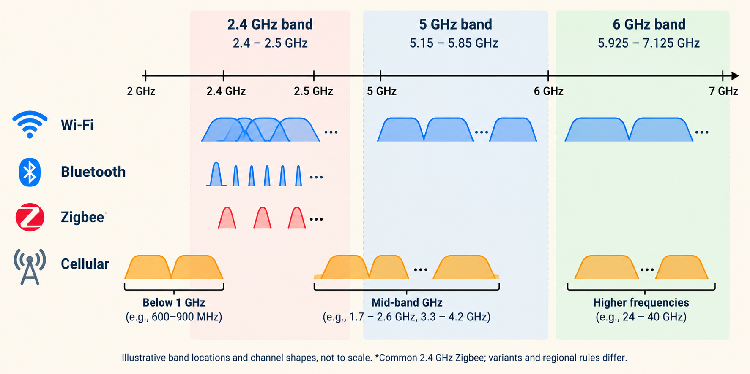
FIRST LOCATE THE SIGNAL; A BAND IS A RANGE OF FREQUENCIES
Different radios can meet in the same band
LECTURE 27 | WIRELESS SYSTEMS SURVEY WI F
03

Slide 4
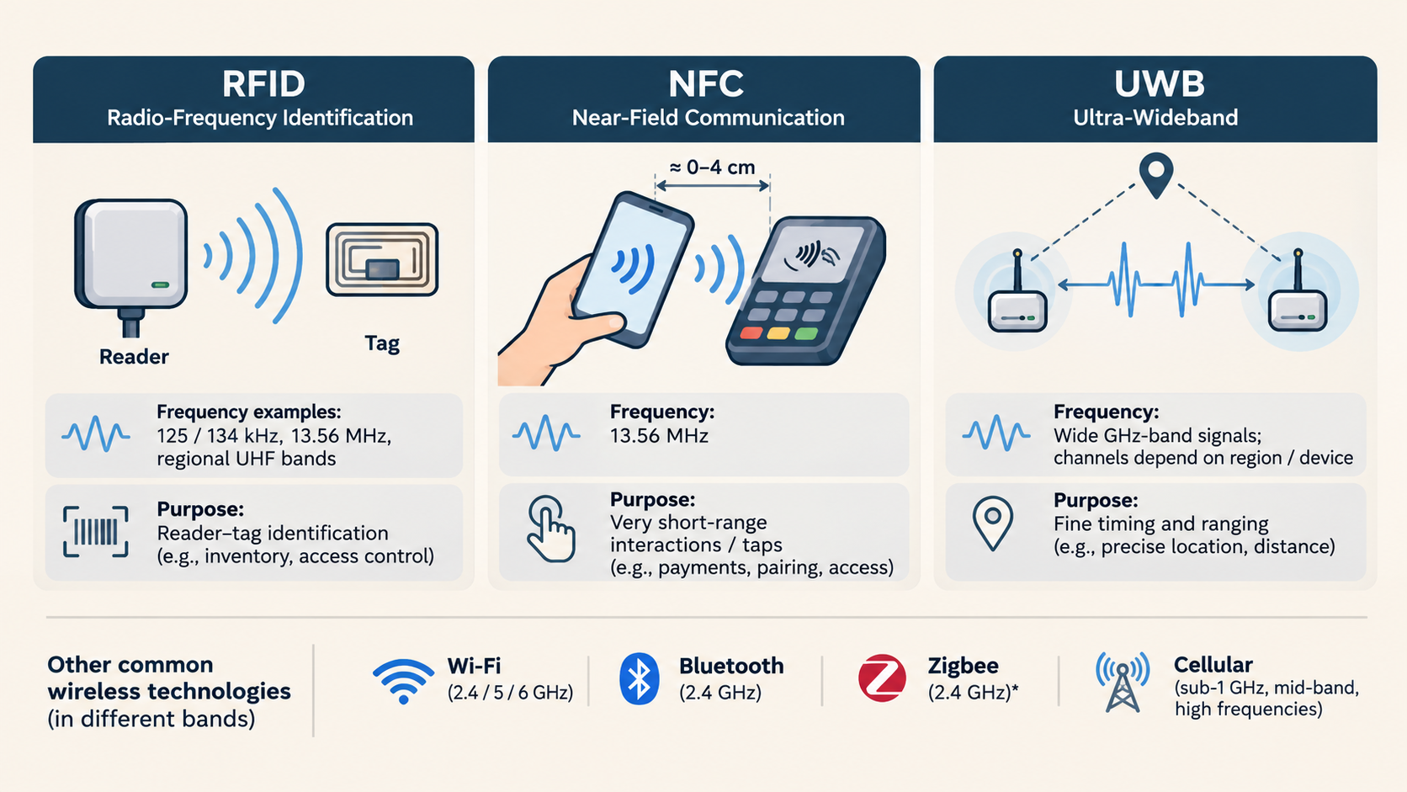
ILLUSTRATIVE EXAMPLES, NOT AN EXHAUSTIVE BAND PLAN
Other wireless technologies occupy other parts of spectrum
LECTURE 27 | WIRELESS SYSTEMS SURVEY WI F
04
Notes:
RFID examples include 125/134 kHz LF tags, 13.56 MHz HF tags and region-dependent UHF allocations
Not all RFID is NFC,
UWB means ultra-wideband: signals occupy a broad frequency span, with GHz-band implementations used for fine timing and ranging.

Slide 5
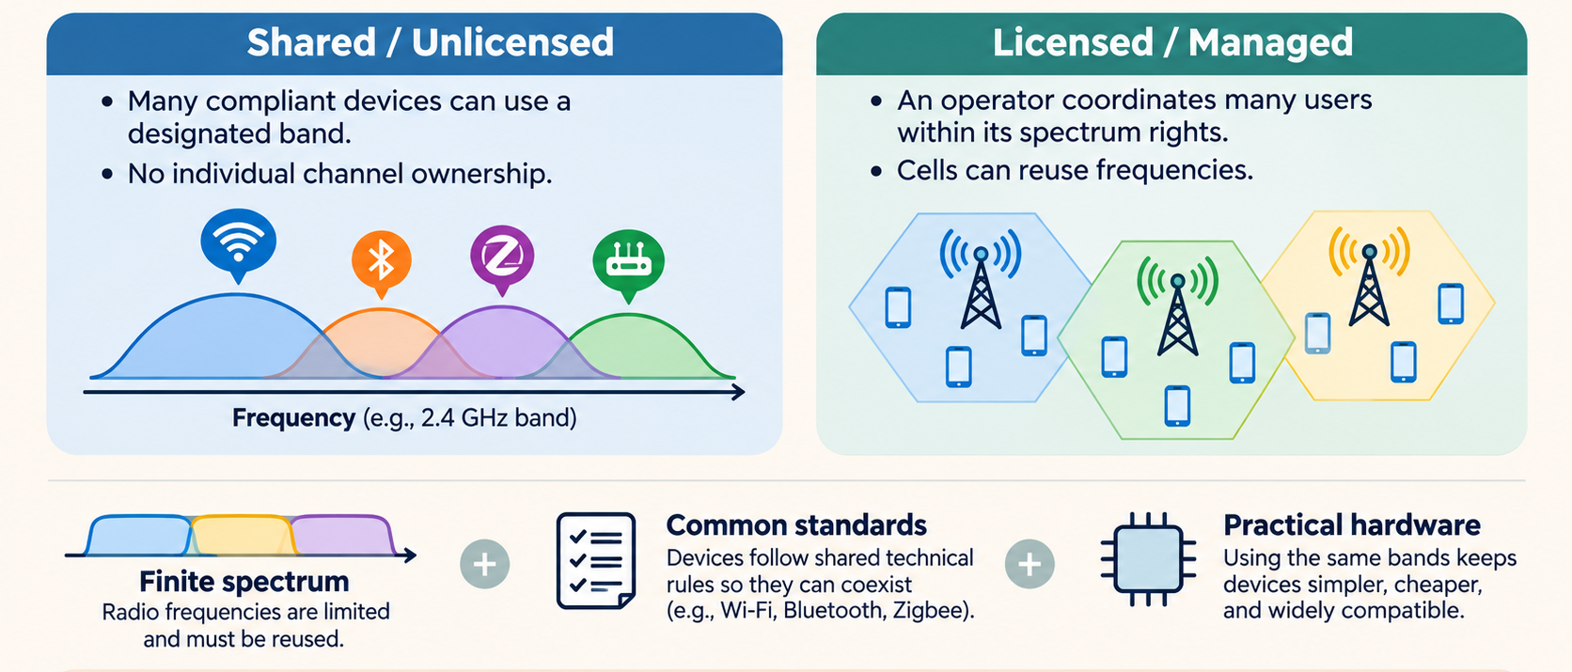
A SHARED BAND IS PRACTICAL; A PRIVATE FREQUENCY FOR EVERY DEVICE IS NOT
Why do wireless technologies share spectrum?
Shared use still has rules. Licensed and unlicensed systems can also share a band under conditions.
LECTURE 27 | WIRELESS SYSTEMS SURVEY WI F
05
Notes:
Why not give each device a private frequency?
Spectrum is finite, and allocating exclusive frequencies to every nearby consumer device would be impractical.
Unlicensed spectrum can also coexist with licensed incumbents, as in the FCC 6 GHz

Slide 6
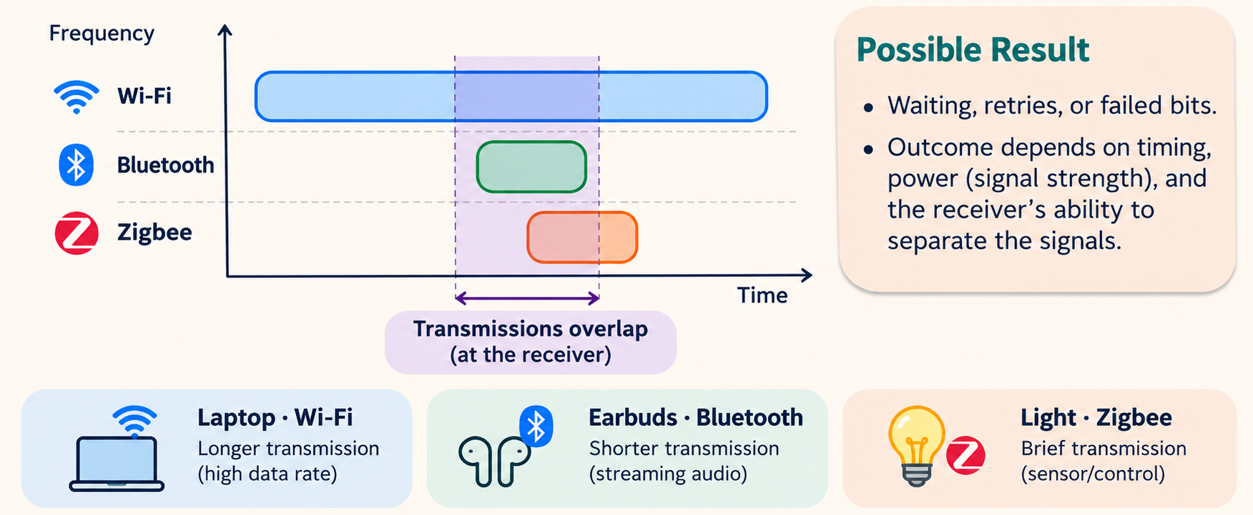
OVERLAP IN FREQUENCY AND TIME CAN CHANGE WHAT THE RECEIVER DECIDES
Sharing can disturb the intended receiver
LECTURE 27 | WIRELESS SYSTEMS SURVEY WI F
06
Notes:
All three may use 2.4 GHz, but:
Wi-Fi typically uses relatively wide channels.
Bluetooth uses narrow channels and changes frequencies rapidly.
Zigbee commonly uses narrow channels and DSSS.

Slide 7
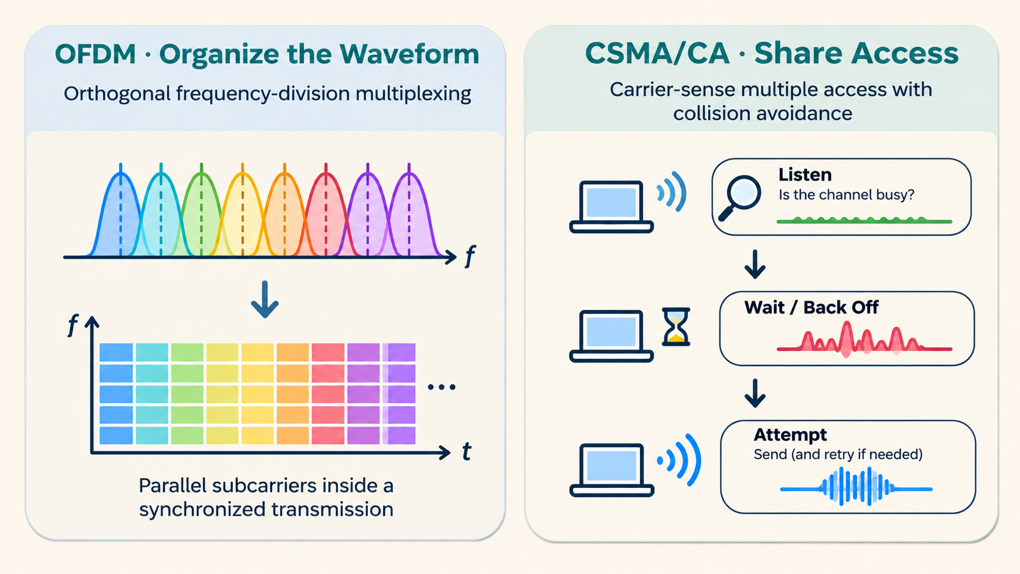
CONNECT LECTURE 24’S OFDM TO A REAL WIRELESS SYSTEM
Wi-Fi organizes the signal and shares access
Common Wi-Fi modes: OFDM + channel planning + access rules.
LECTURE 27 | WIRELESS SYSTEMS SURVEY WI F
07
Notes:
CSMA/CA means carrier-sense multiple access with collision avoidance:
check whether the channel is busy,
wait/back off according to the protocol, then attempt transmission.

Slide 8
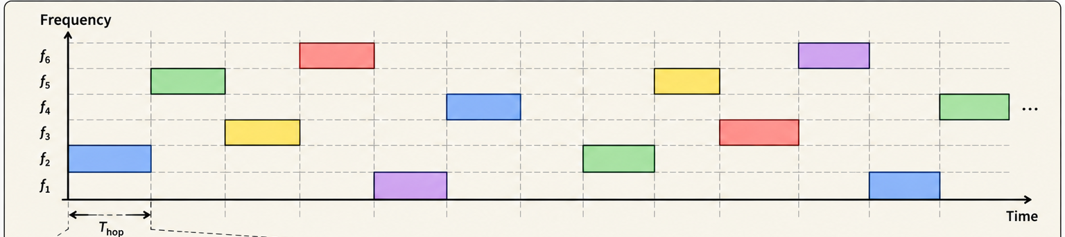
CONNECT LECTURE 24’S FHSS TO ADAPTIVE FREQUENCY HOPPING
Bluetooth changes channels together
FHSS: frequency-hopping spread spectrum
AFH: adapt the channel choices when some work poorly
Laptop · Wi-Fi
Earbuds · Bluetooth
Light · Zigbee
Illustrative connected-data hopping. A public hopping sequence is not encryption; broad interference can still disrupt.
LECTURE 27 | WIRELESS SYSTEMS SURVEY WI F
08
Notes:
Retrieve FHSS: frequency-hopping spread spectrum. A connected Bluetooth pair follows agreed channel selection and timing so it meets on successive channels. AFH means adaptive frequency hopping: the devices update a shared channel map to avoid channels found unsuitable.

Slide 9
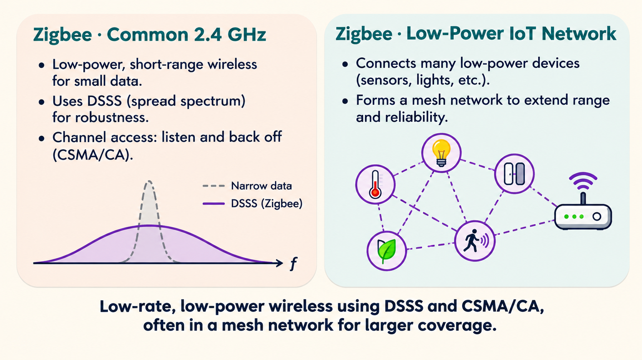
SPREADING IS A WAVEFORM METHOD; MANAGED SCHEDULING IS AN ACCESS METHOD
Zigbee and cellular combine different tools
LECTURE 27 | WIRELESS SYSTEMS SURVEY WI F
09
Notes:
Common 2.4 GHz Zigbee uses an IEEE 802.15.4 physical layer with DSSS, direct-sequence spread spectrum

Slide 10
COEXISTENCE MEANS DIFFERENT RADIOS OPERATING IN THE SAME ENVIRONMENT
Each method solves part of the shared-radio problem
Different channels
Separate some traffic in frequency.
Waiting / scheduling
Arrange access in time.
Hopping / spreading
Change frequency use or spread and recover the data.
OFDM
Organize synchronized parallel subcarriers.
MIMO: multiple-input multiple-output. Multiple antennas and processing
can use spatial paths for reliability or throughput.
LECTURE 27 | WIRELESS SYSTEMS SURVEY WI F
10
Notes:
Coexistence: different wireless devices or networks can operate in the same area while keeping interference manageable.

Slide 11
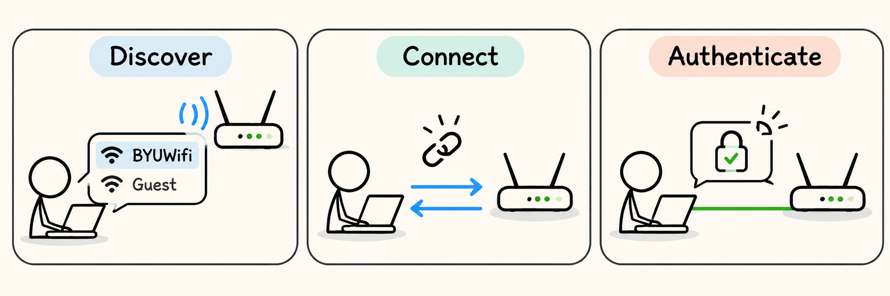
NETWORK TERMS
How a device connects to a wireless network
AP: access point.
Beacon: discovery announcement.
SSID: advertised network name
WiFi sends both:
Data frames: your internet traffic
Management frames: manage the connection
LECTURE 27 | WIRELESS SYSTEMS SURVEY WI F
11
Notes:
Define AP as access point, a device offering a wireless connection into a network.
A beacon is a periodic discovery announcement.
SSID, service set identifier, is the advertised network name.
Association establishes a connection under the system's rules
authentication checks identity through the configured method
Wi-Fi sends both:
Data frames: carry your internet traffic.
Management frames: manage the connection, including a deauthentication message that effectively says, “This connection is ended.”

Slide 12
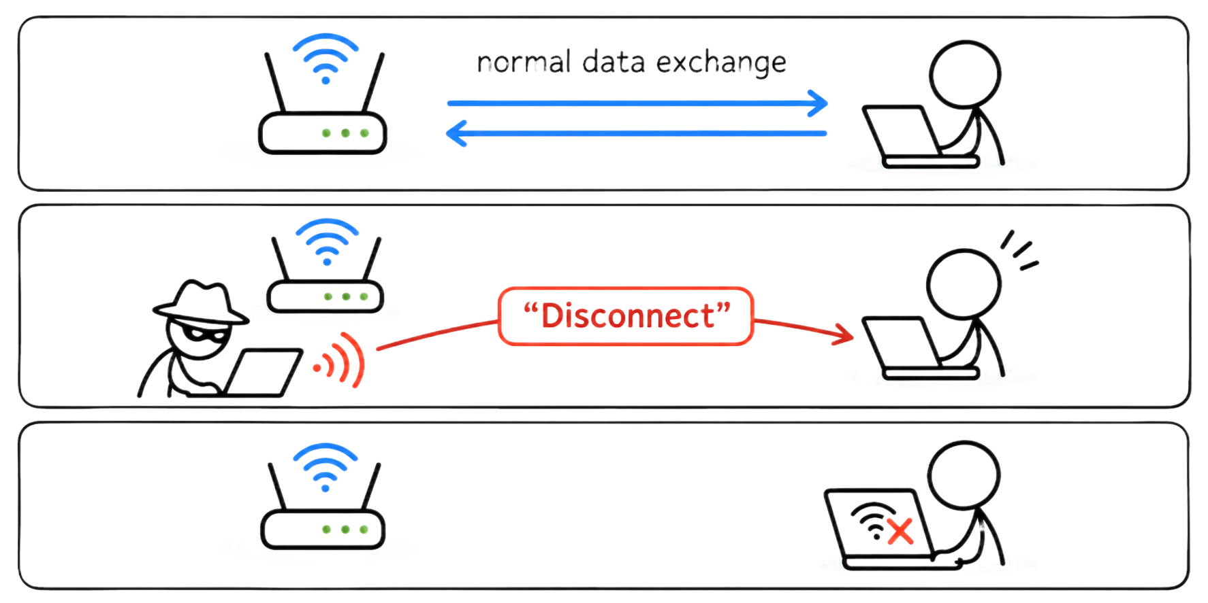
ATTACKER SENDS A BELIEVABLE MANAGEMENT MESSAGE; A SUSCEPTIBLE RECEIVER OBEYS
Deauthentication: a forged message ends the connection
PMF = protected management frames.
LECTURE 27 | WIRELESS SYSTEMS SURVEY WI F
12
Notes:
If PMF (Protected Management Frames) is not active, vulnerable
https://doi.org/10.6028/NIST.IR.8235 and https://www.cisco.com/c/en/us/td/docs/wireless/controller/8-10/config-guide/b_cg810/wlan_security.html .

Slide 13
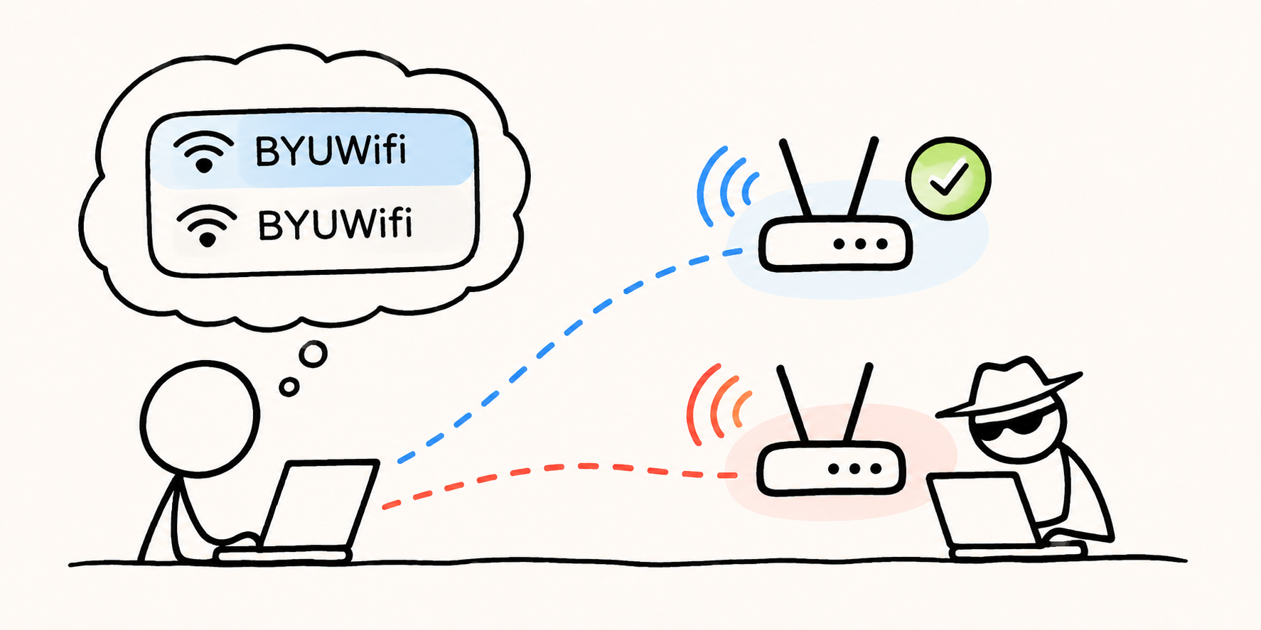
THE ATTACKER USES A REAL RADIO LINK TO CLAIM A FALSE IDENTITY
Evil twin: an imitation network offers a connection
LECTURE 27 | WIRELESS SYSTEMS SURVEY WI F
13
Notes:
Source: https://attack.mitre.org/techniques/T1557/004/ .

Slide 14
TRACE THE DECISION POINTS INSTEAD OF ASSUMING AUTOMATIC SUCCESS
One possible sequence: disconnect, then impersonate
1 · Disconnect
2 · Reconnect?
3 · Impersonate
A forged message is accepted
only on a susceptible connection.
The device may seek a link.
Its settings still constrain the choice.
An imitation AP offers a link.
Identity checks can reject it.
→
→
Deauthentication can occur without an evil twin. An evil twin can operate without deauthentication.
LECTURE 27 | WIRELESS SYSTEMS SURVEY WI F
14
Notes:
Source: NIST IR 8235 Appendix C and MITRE ATT&CK T1557.004. The diagrams are explanatory, not a live attack demonstration.

Slide 15
DELIVERING BITS, AUTHENTICATING A NETWORK AND PROTECTING AN APPLICATION ARE DIFFERENT JOBS
Match the protection to the problem
Problem | Relevant protection
Interference / contention | Channel planning, adaptive hopping or scheduling
Forged disconnect message | PMF: protected management frames
Imitation access point | Approved profile + expected authentication
LECTURE 27 | WIRELESS SYSTEMS SURVEY WI F
15

Slide 16
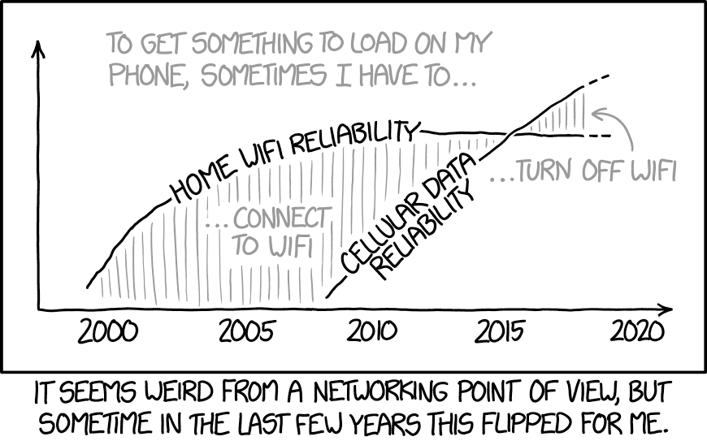
CHECK UNDERSTANDING
Exit check
NEXT: CELLULAR & SDR
LECTURE 26 | MEDIA TRANSMISSION CASE STUD
16
Notes:
Raw rate: 400 × 300 × 8 × 20 = 19,200,000 bit/s = 19.2 Mbit/s.
With 12:1 compression the average is 1.6 Mbit/s.
The full 400 kB buffer holds 3.2 Mbit, so fixed 1.6 Mbit/s playback lasts 2 seconds if arrivals stop.

