Slide 1
CYBER 327 / LECTURE 02
Electrical Foundations II
Ohm’s Law and Series Circuits
SEP 04, 2026
50-MINUTE SESSION
LECTURE 02 | FOUNDATIONS II
01
Notes:
Connect directly to Wednesday and the lab that follows. Keep arithmetic purposeful and measurement-centered.

Slide 2
FROM LAST LECTURE
Recap
Why does a circuit need a complete loop?
Can’t it be just one line?
LECTURE 02 | FOUNDATIONS II
15

Slide 3
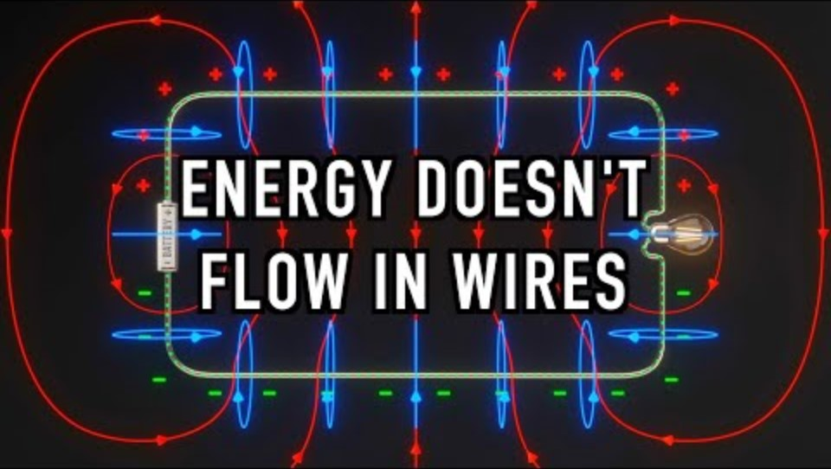
FROM LAST LECTURE
A Thought Experiment
LECTURE 02 | FOUNDATIONS II
15

Slide 4
FOUNDATION RECAP
Electronic Terms
Term | Units | Unit Abbrev | Symbol
Voltage | Volts | V | E/V
Current | Amperes | A | I
Resistance | Ohms | Ω | R
Power | Watts | W | P
Frequency | Hertz | Hz | f
LECTURE 02 | FOUNDATIONS II
03

Slide 5
UNITS AND PREFIXES
[1-999] [prefix] [unit]
6.7 k Ω
ENGINEERING NOTATION
Prefix | Symbol | Multiplier | Prefix | Symbol | Multiplier
milli | m | 10⁻³ | kilo | k | 10³
micro | µ | 10⁻⁶ | Mega | M(illion) | 10⁶
nano | n(ine) | 10⁻⁹ | Giga | G | 10⁹
pico | p | 10⁻¹² | Tera | T(welve) | 10¹²
Convert:
0.00900 V
0.00001383 A
2 430 000 000 W
LECTURE 02 | FOUNDATIONS II
04

Slide 6



CORE RELATIONSHIPS
Ohm’s Law
$$I=\frac{V}{R}$$
$$R=\frac{V}{I}$$
$$V=I R$$
Voltage across a resistance equals current through it times resistance.
For a fixed voltage, more total resistance means ___ current.
For a fixed resistance, more voltage means ___ current.
LECTURE 02 | FOUNDATIONS II
05

Slide 7
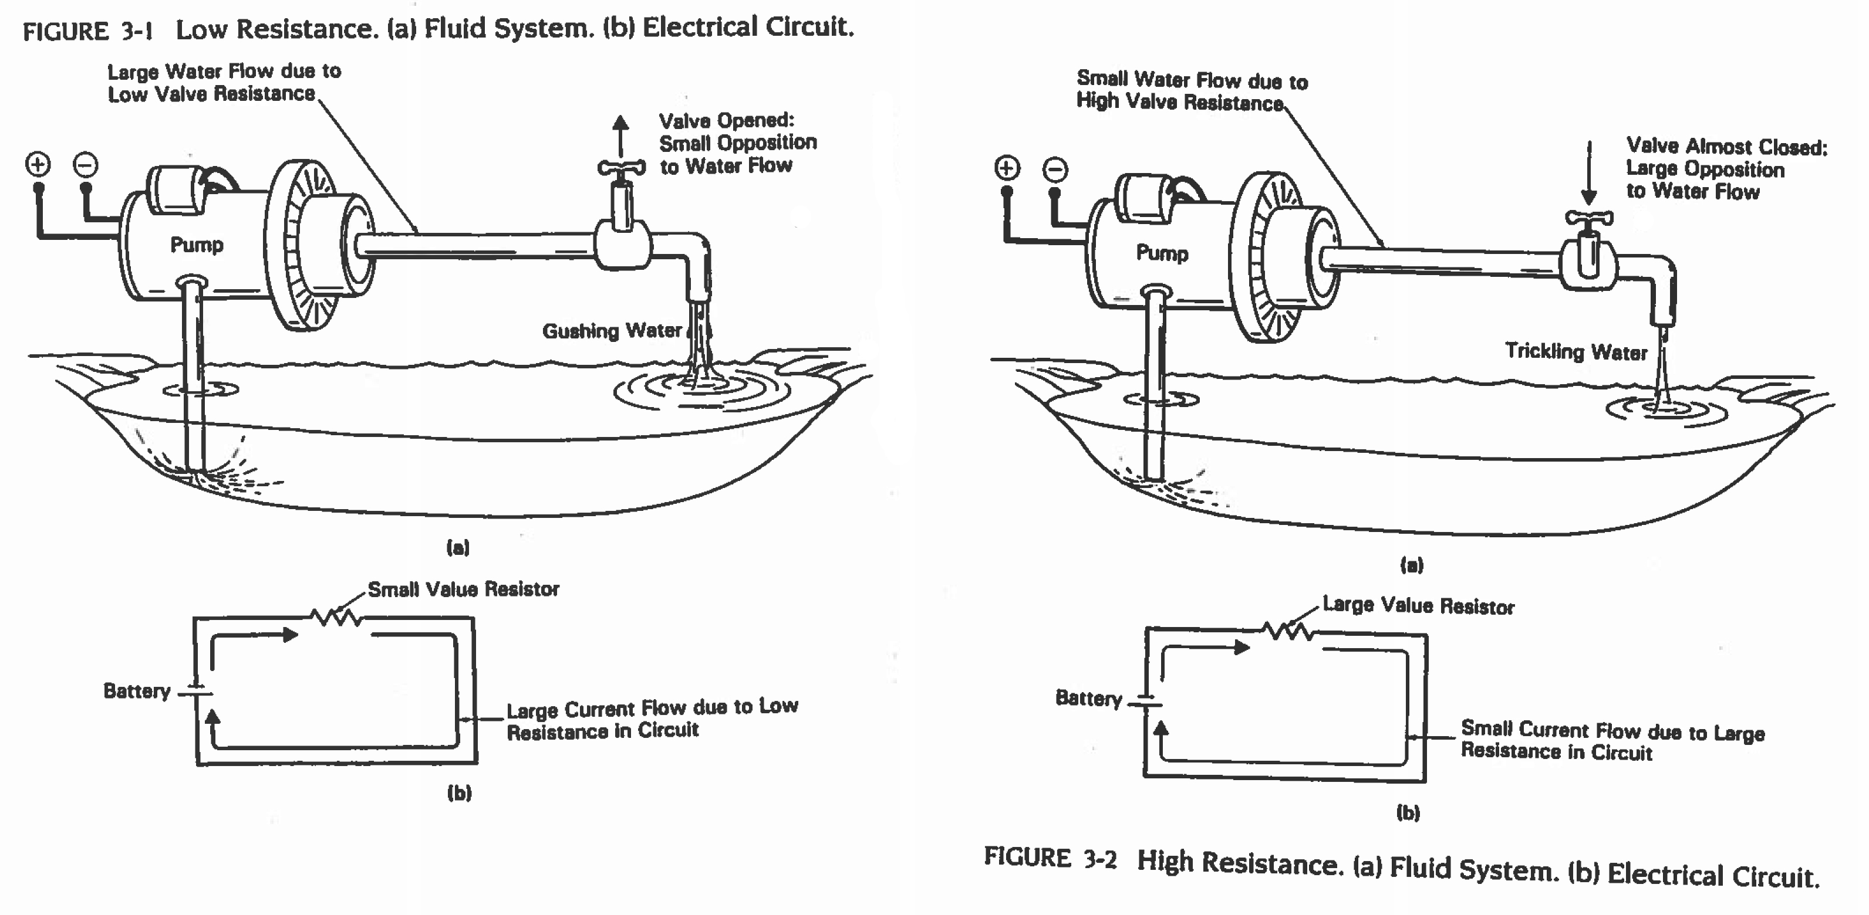
CORE RELATIONSHIPS
Ohm’s Law
LECTURE 02 | FOUNDATIONS II
05

Slide 8



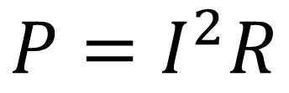



CORE RELATIONSHIPS
Power Formula
$$P=I V$$
$$P=\frac{V^{2}}{R}$$
Remember:
$$V=I R$$
$$I=\frac{V}{P}$$
$$V=\frac{I}{P}$$
$$I=\frac{V}{R}$$
$$P=I^{2}R$$
LECTURE 02 | FOUNDATIONS II
05

Slide 9
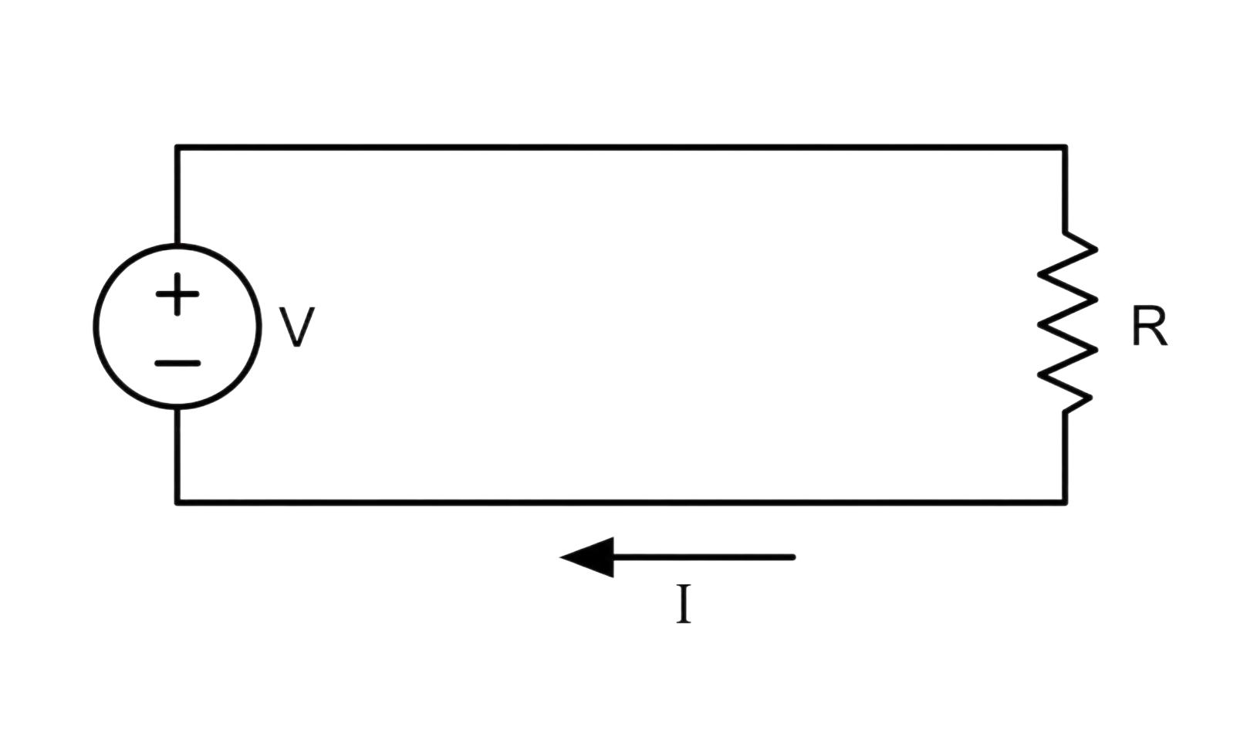




Remember:
THE FIRST TOPOLOGY
$$V=I R$$
$$P=I V$$
THE CIRCUIT
SOURCE
LOAD
Let:
$$V=10 V$$
$$R=50 Ω$$
What is the current passing through R, IR?
What is the voltage drop across R, VR?
What is the power dissipated by R?
KIRCHOFF’S VOLTAGE LAW
The total voltage around any closed loop or path in a circuit must add up to zero.
The voltage across the source should be equal to the voltage across all the loads
LECTURE 02 | FOUNDATIONS II
06
Notes:
Have students trace the path aloud. Use conventional current direction only; avoid electron-flow digression.

Slide 10
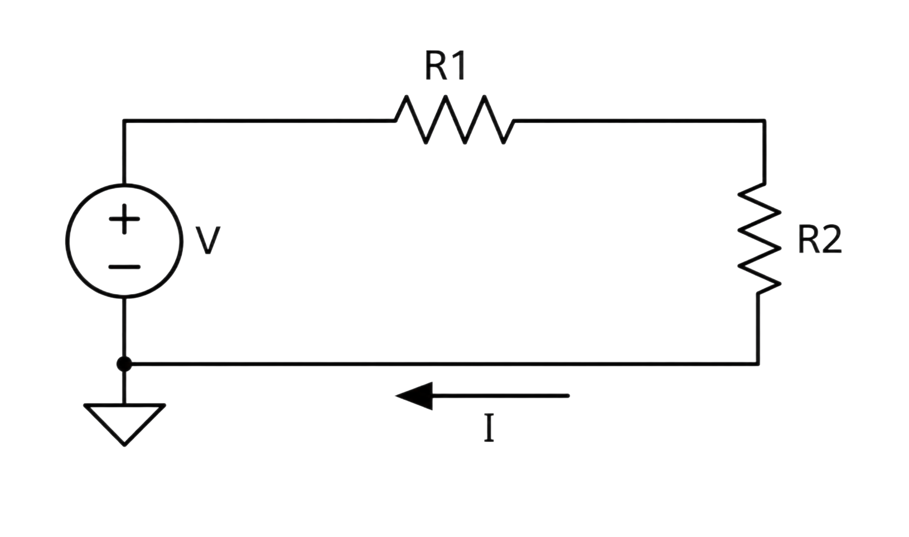



Remember:
THE FIRST TOPOLOGY
$$V=I R$$
$$P=I V$$
THE SERIES CIRCUIT
NODE A
NODE B
Let:
$$R1=50 Ω$$
$$V=300 V$$
$$R2=50 Ω$$
What is the total resistance?
What is the current passing through RTOTAL, IR?
What is the voltage drop across R1, VR1?
What is the voltage drop across R2, VR2?
NODE C
GROUND
LECTURE 02 | FOUNDATIONS II
06

Slide 11
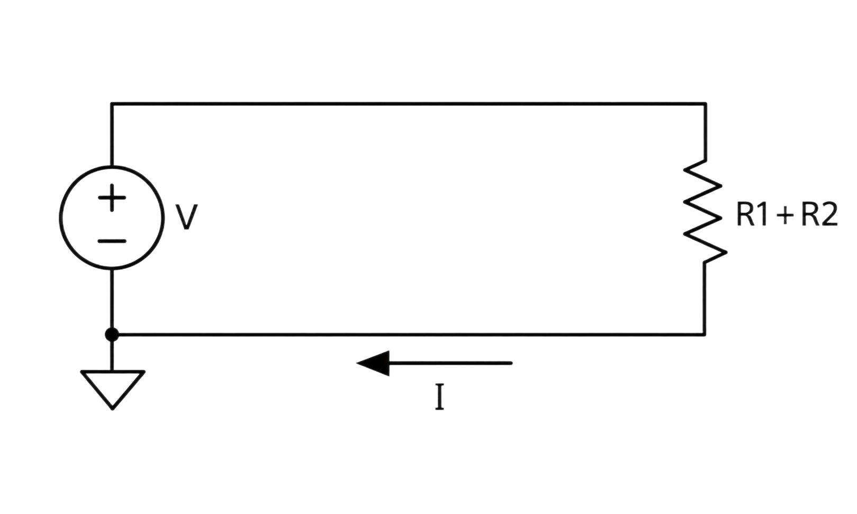
Remember:
THE FIRST TOPOLOGY
$$V=I R$$
$$P=I V$$
THE SERIES CIRCUIT
NODE A
NODE B
Let:
$$R1=50 Ω$$
$$V=300 V$$
$$R2=50 Ω$$
What is the total resistance?
What is the current passing through RTOTAL, IR?
What is the voltage drop across R1, VR1?
What is the voltage drop across R2, VR2?
NODE C
GROUND
KIRCHOFF’S CURRENT LAW
The total current entering a node must equal the total current leaving that same node.
The current across series components are equal
LECTURE 02 | FOUNDATIONS II
06

Slide 12

Remember:
THE FIRST TOPOLOGY
$$V=I R$$
$$P=I V$$
THE SERIES CIRCUIT
NODE A
NODE B
Let:
$$R1=50 Ω$$
$$V=300 V$$
$$R2=50 Ω$$
What is the total resistance?
What is the current passing through RTOTAL, IR?
What is the voltage drop across R1, VR1?
What is the voltage drop across R2, VR2?
NODE C
GROUND
$$I=I_{R1}=I_{R2}$$
LECTURE 02 | FOUNDATIONS II
06

Slide 13
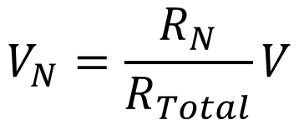
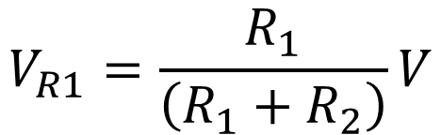

THE FIRST TOPOLOGY
THE VOLTAGE DIVIDER
NODE A
NODE B
Let:
$$R1=50 Ω$$
$$V=300 V$$
$$R2=100 Ω$$
What is the total resistance?
What is the current passing through RTOTAL, IR?
What is the voltage drop across R1, VR1?
What is the voltage drop across R2, VR2?
NODE C
GROUND
$$V_{R1}=\frac{R_{1}}{\left(R_{1}+R_{2}\right)}V$$
$$V_{N}=\frac{R_{N}}{R_{Total}}V$$
LECTURE 02 | FOUNDATIONS II
06

Slide 14
THE FIRST TOPOLOGY
THE VOLTAGE DIVIDER
NODE A
NODE B
Let:
$$R1=50 Ω$$
$$V=300 V$$
$$R2=100 Ω$$
What is the voltage of Node A, VA?
What is the voltage of Node B, VB?
What is the voltage of Node C, VC?
NODE C
GROUND
$$V_{R1}=\frac{R_{1}}{\left(R_{1}+R_{2}\right)}V$$
$$V_{N}=\frac{R_{N}}{R_{Total}}V$$
LECTURE 02 | FOUNDATIONS II
06

Slide 15
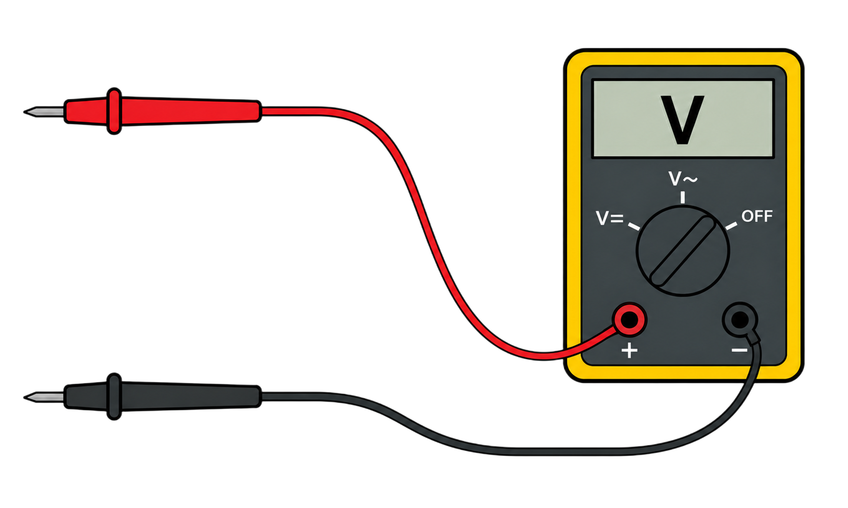
MEASUREMENT SAFETY
HOW DOES ONE GET THE MEASUREMENT?
Mode | Connection
Voltage | Across two points (parallel)
Resistance | Across isolated component/path
Current | Open path; insert meter in series
What if my measurements are off?
LECTURE 02 | FOUNDATIONS II
09

Slide 16

MEASUREMENT SAFETY
HOW DOES ONE GET THE MEASUREMENT?
Mode | Connection
Voltage | Across two points (parallel)
Resistance | Across isolated component/path
Current | Open path; insert meter in series
What if my measurements are off?
LECTURE 02 | FOUNDATIONS II
09

Slide 17
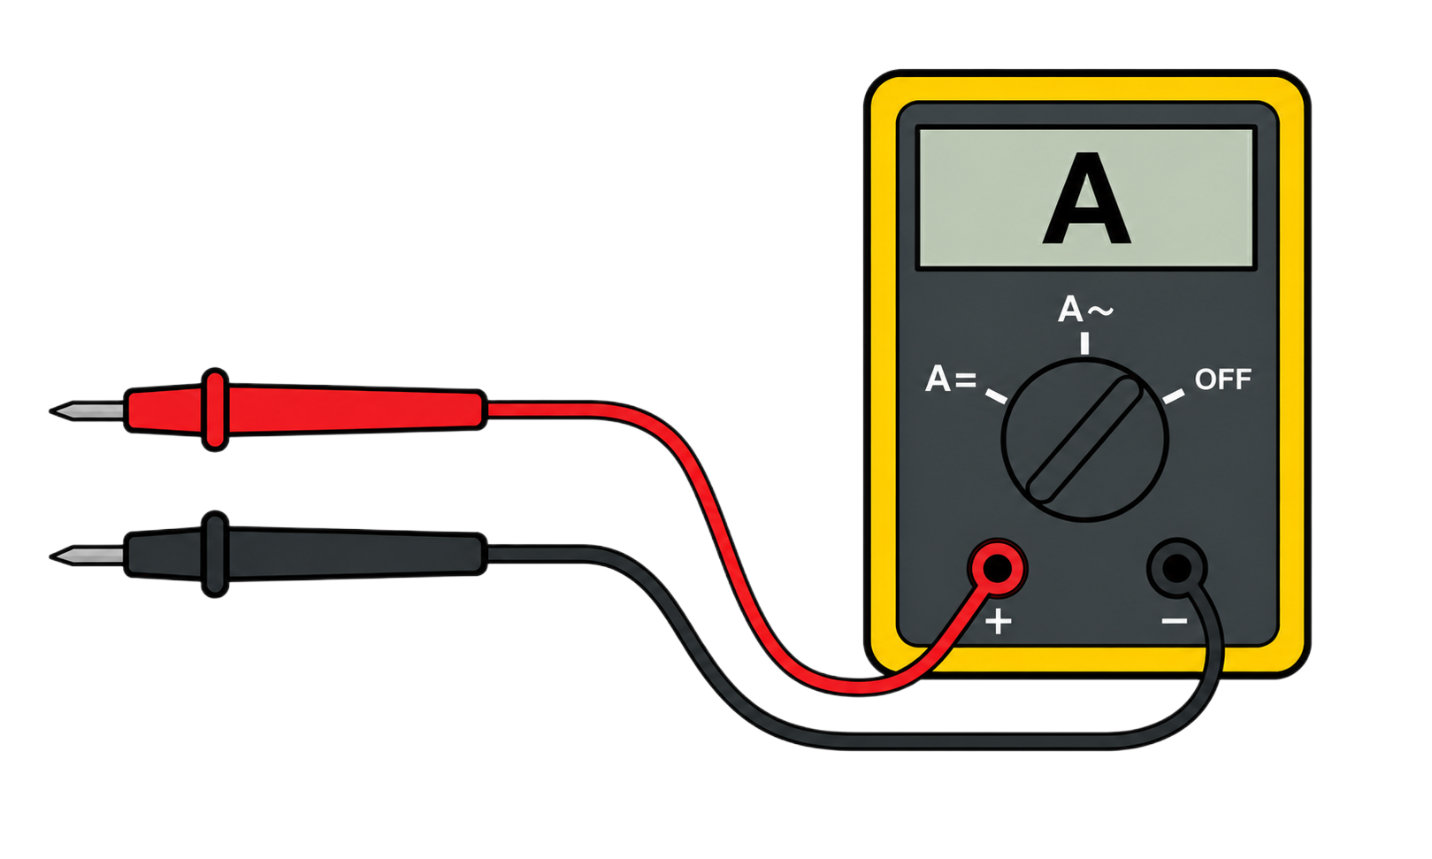
MEASUREMENT SAFETY
HOW DOES ONE GET THE MEASUREMENT?
Mode | Connection
Voltage | Across two points (parallel)
Resistance | Across isolated component/path
Current | Open path; insert meter in series
What if my measurements are off?
LECTURE 02 | FOUNDATIONS II
09

Slide 18
TOLERANCE AND UNCERTAINTY
What if my measurements are off?
Component tolerance
Instrument limits
Meaningful deviation
A 5% resistor may legitimately differ from its printed nominal value.
Resolution, accuracy, lead resistance, and reference choice affect measured values.
A fault claim needs a stable pattern larger than plausible variation and consistent with circuit behavior.
COMPARE AGAINST A MEASURED BASELINE
LECTURE 02 | FOUNDATIONS II
10

Slide 19

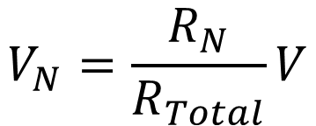





THE FIRST TOPOLOGY
CHANGES TO THE CIRCUIT
NODE A
NODE B
Your friend says:
$$R1=50 Ω$$
$$V=300 V$$
$$R2=100 Ω$$
You measure:
NODE C
$$V_{A}=300 V$$
GROUND
$$V_{B}=50 V$$
$$V_{C}=0 V$$
$$V_{N}=\frac{R_{N}}{R_{Total}}V$$
Does this check out?
LECTURE 02 | FOUNDATIONS II
06

Slide 20
READY FOR THE LAB?
Exit check
A 5.00 V source drives 5.00 kohm total. What current should flow?
How should you connect the ammeter to measure the current?
NEXT: PARALLEL CIRCUITS & POWER
LECTURE 02 | FOUNDATIONS II
15

