Slide 1
CYBER 327 / LECTURE 03
Parallel Circuits and Loading
A new branch changes a lot
SEP 09, 2026
LECTURE 03 | PARALLEL + POWER
01

Slide 2
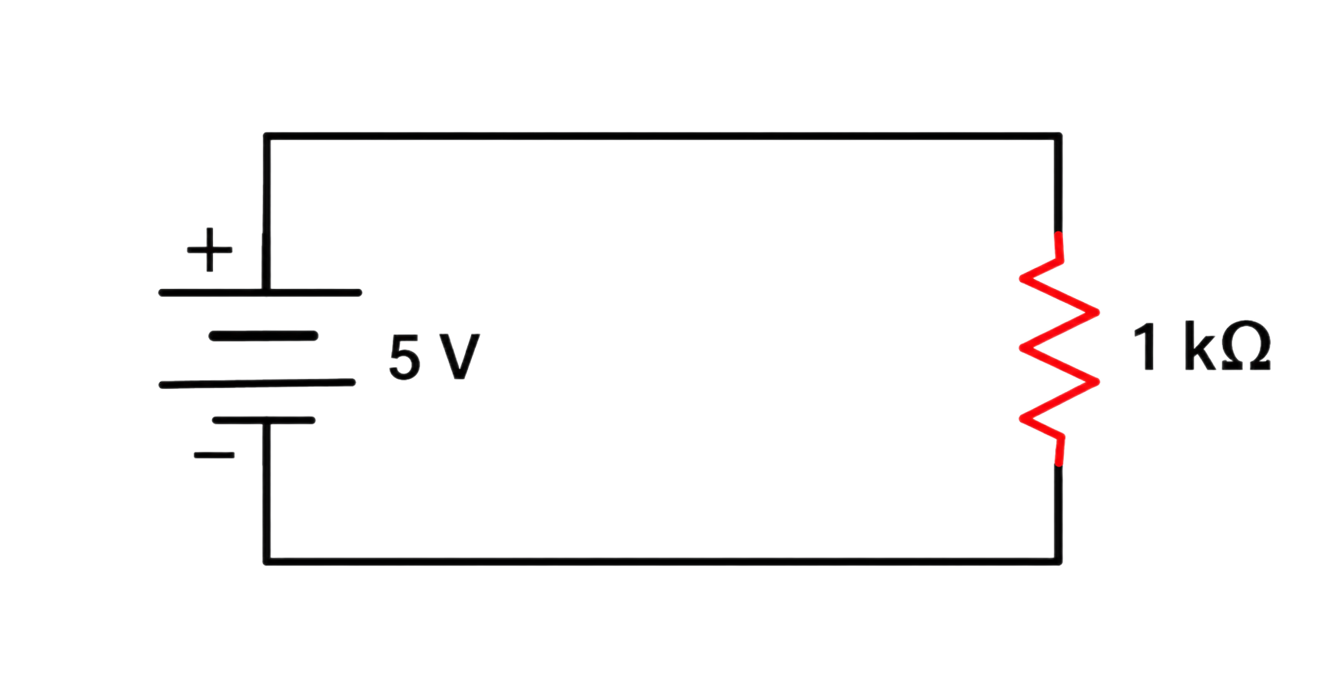
OPENING CASE
What happens when you add a parallel load?
Before:
I = 5mA
LECTURE 03 | PARALLEL + POWER
02

Slide 3
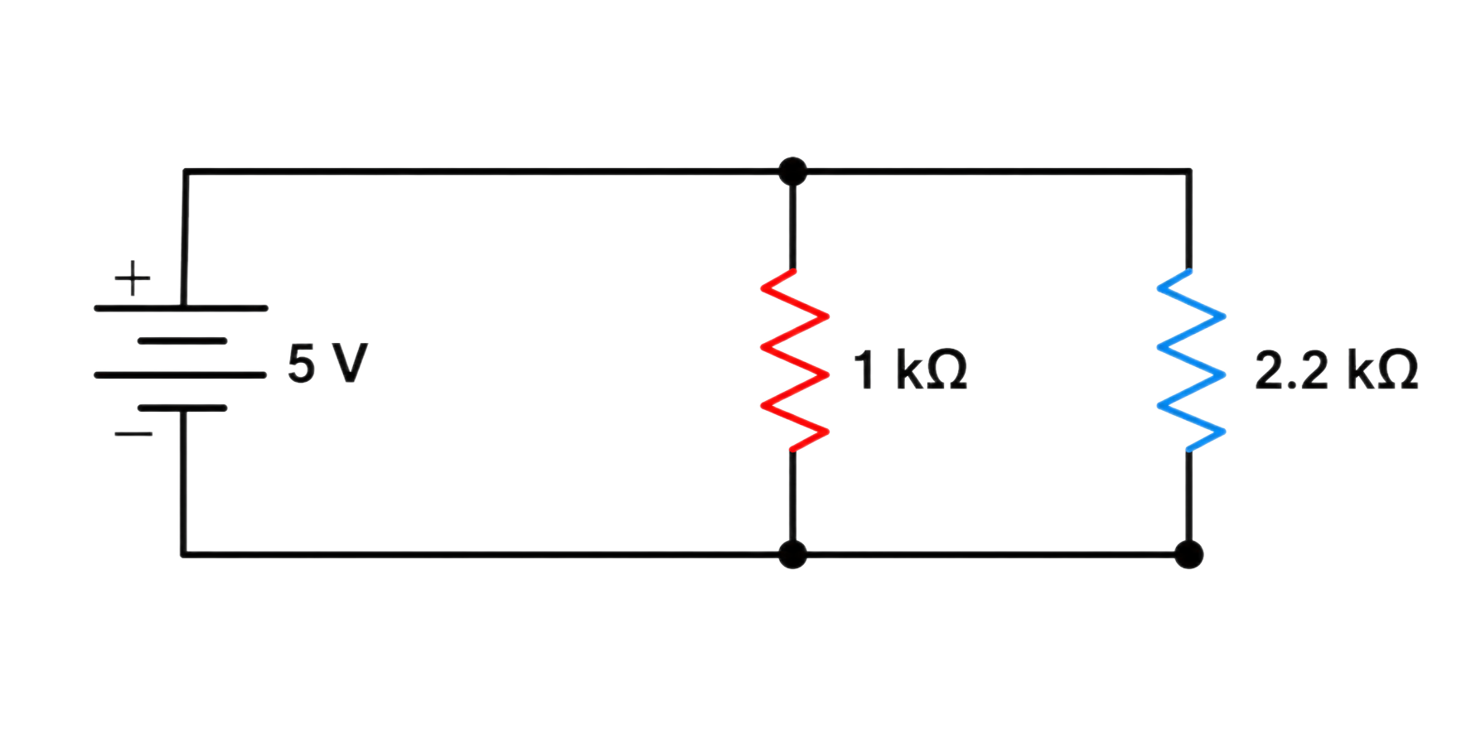
OPENING CASE
What happens when you add a parallel load?
Element | Voltage | Current | Power
R1
R2
Source
Question
The load determines the requested current through Ohm’s law.
If the source reaches its current limit, its output voltage may fall.
Wiring and connection resistance can also produce voltage droop under load.
What must the source now provide, and what happens if it cannot?
LECTURE 03 | PARALLEL + POWER
03

Slide 4
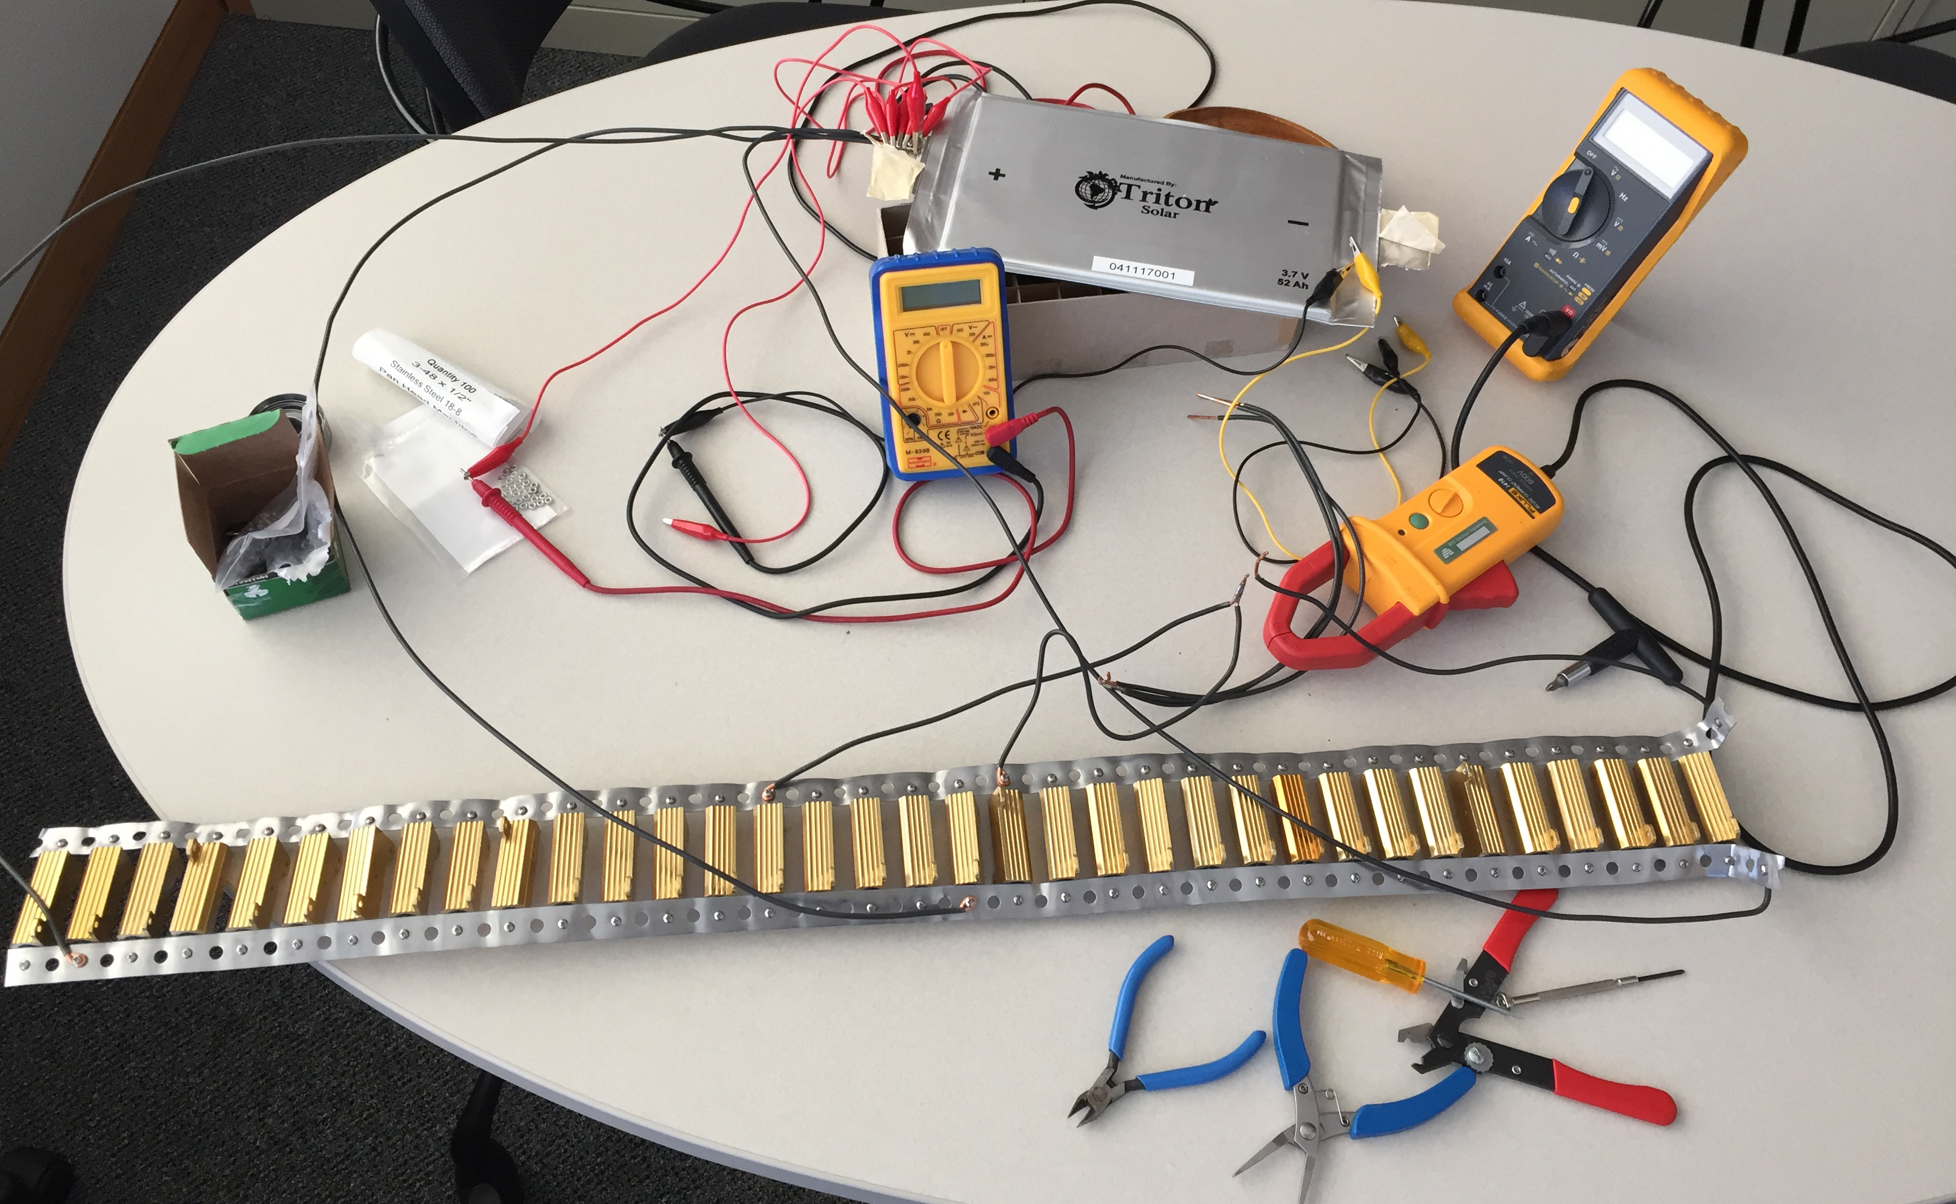
OPENING CASE
Battery Load Testing
LECTURE 03 | PARALLEL + POWER
02

Slide 5


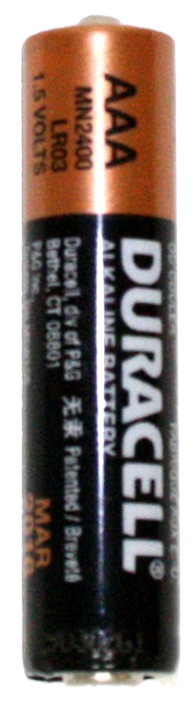
OPENING CASE
Ampacity
The maximum safe current for a component under certain conditions.
700 A
3 A
0.75 A
Battery Capacity
stored charge, normally measured in Ah or mAh.
LECTURE 03 | PARALLEL + POWER
02

Slide 6
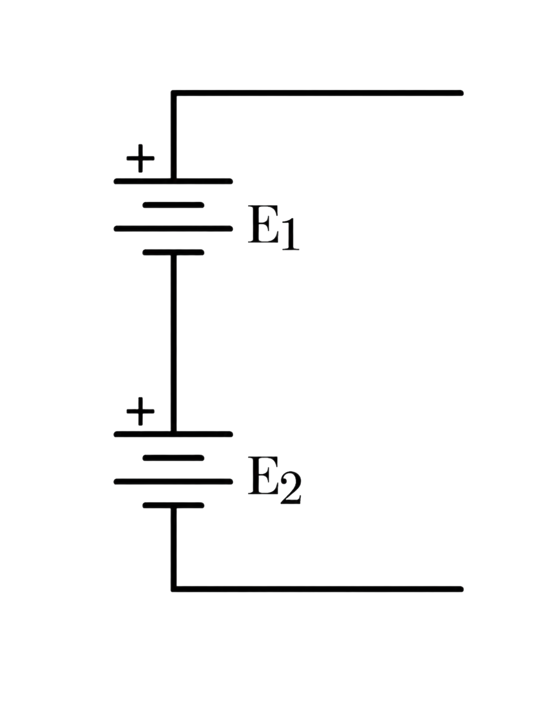
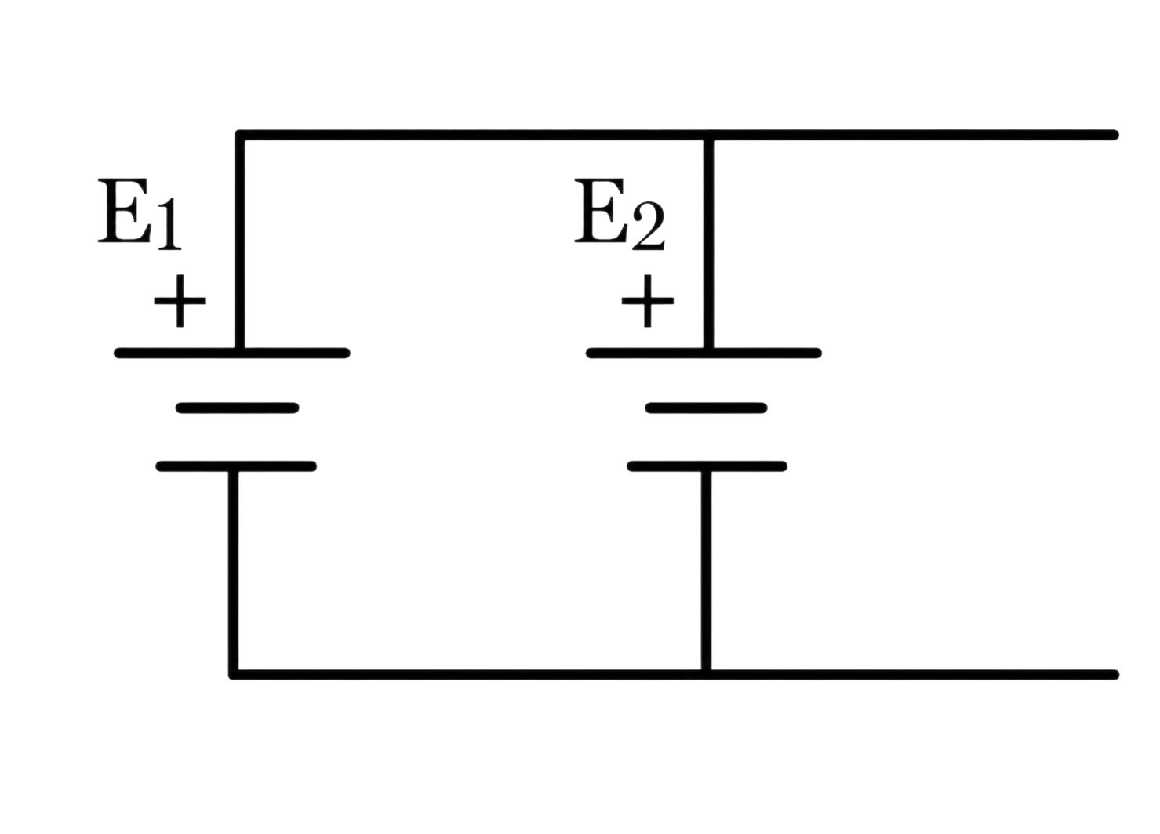
OPENING CASE
What happens when you add sources?
PARALLEL
SERIES
Same voltage, more current
Voltages add
Current is limited by weakest source
NEVER PARALLEL DIFFERENT SOURCES
LECTURE 03 | PARALLEL + POWER
02

Slide 7



PARALLEL RESISTANCE
Equivalent resistance
A shortcut
$$R_{eq}=\frac{R_{1}R_{2}}{R_{1}+R_{2}}$$
$$R_{eq}=\sum{\frac{1}{Rn}}$$
$$R_{eq} <R_{min}$$
Every added parallel path lowers equivalent resistance.
LECTURE 03 | PARALLEL + POWER
04

Slide 8

PARALLEL RESISTANCE
Conductance
The reciprocal of resistance
$G=\frac{1}{R}$
Units: Siemens (S)
1 Ω = 1 S
1 kΩ = 1 mS
1 MΩ = 1 µS
G_{T} = G₁ + G₂
LECTURE 03 | PARALLEL + POWER
04

Slide 9
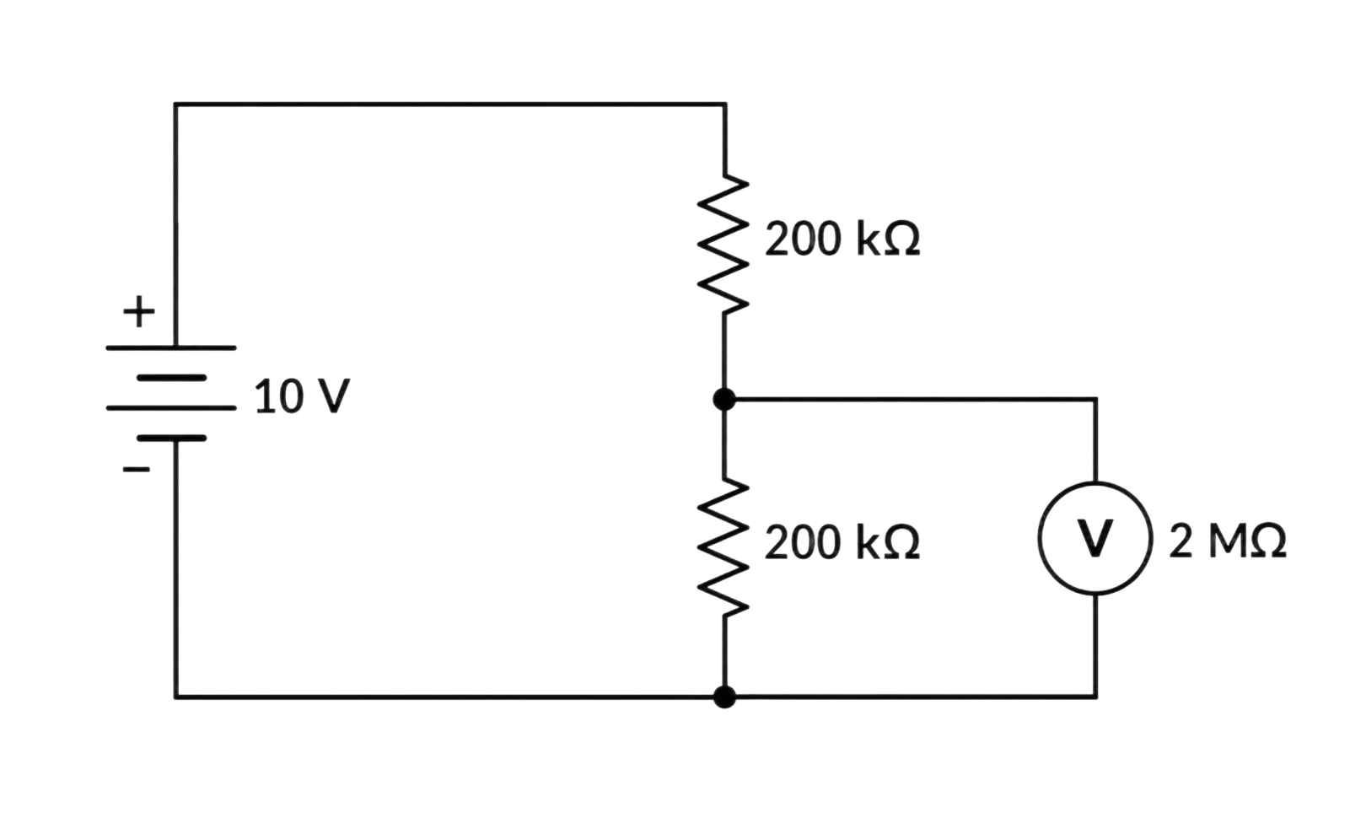


WORKED MEASUREMENT
Loading Effects
Before adding voltmeter:
$$R_{eq}= ?$$
$$V_{out}= ?$$
After adding voltmeter:
$$R_{eq}= ?$$
$$V_{out}= ?$$
THE INSTRUMENT BECOMES PART OF THE CIRCUIT
LECTURE 03 | PARALLEL + POWER
08

Slide 10
EVIDENCE DISCIPLINE
Observation is not inference
Observation
Inference
Not Yet Known
A directly measured, repeatable fact. Example: the rail is 5.0 V with Load A alone and 4.6 V when Load B is enabled.
A limited conclusion supported by that evidence. Example: the source or shared path cannot maintain 5.0 V at the combined load.
The exact failed component, cause, or intent. Choose another controlled measurement before claiming more.
LECTURE 03 | PARALLEL + POWER
11

Slide 11
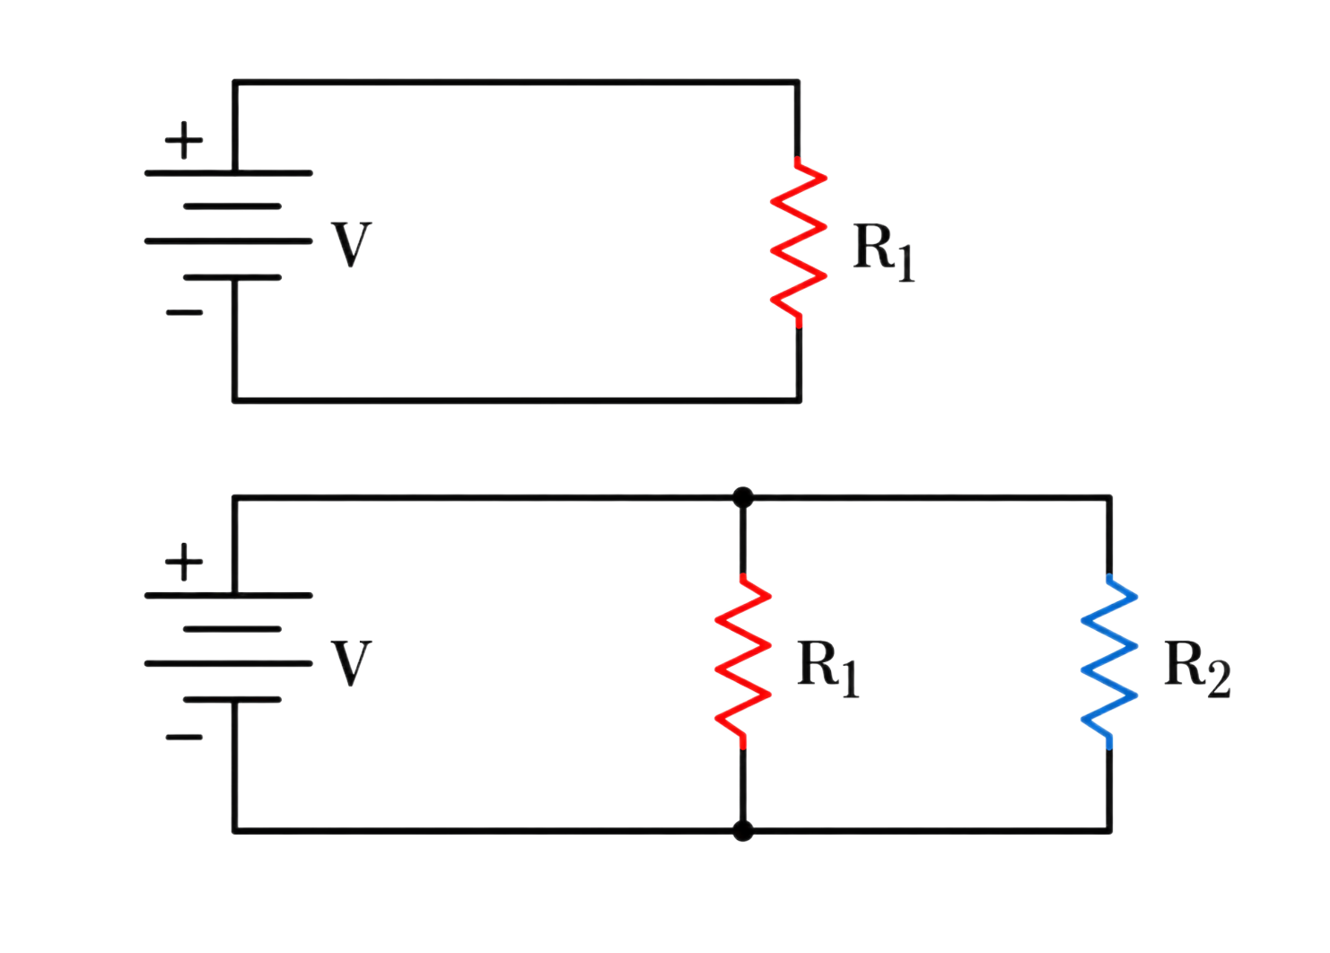
CLAIM - EVIDENCE - NEXT TEST
Case: a shared rail drops from 5.0 V to 4.6 V
Next test
Measure each branch current and source voltage at the terminals under controlled states.
Observed
Supported
Voltage is correct with Load A alone and falls when Load B is enabled.
The source or shared path cannot maintain 5.0 V at the combined load.
LECTURE 03 | PARALLEL + POWER
12
Notes:
Alternatives include current limit, weak supply, wiring resistance, incorrect Load B, or short. Do not jump directly to malicious load.

Slide 12
TAKEAWAYS
Circuits Summary
Property | Series | Parallel
All elements have the same
Largest R has | Largest/Smallest V Largest/Smallest P | Largest/Smallest I Largest/Smallest P
Rtotal is: | Greater/Less than Rmax | Greater/Less than Rmin
When there is a broken element:
LECTURE 03 | PARALLEL + POWER
12

Slide 13
CLAIM - EVIDENCE - NEXT TEST
Circuits Summary
Property | Series | Parallel
All elements have the same | I | V
Largest R has | Largest/Smallest V Largest/Smallest P | Largest/Smallest I Largest/Smallest P
Rtotal is: | Greater/Less than Rmax | Greater/Less than Rmin
When there is a broken element: | Open circuit | No effect
LECTURE 03 | PARALLEL + POWER
12

Slide 14
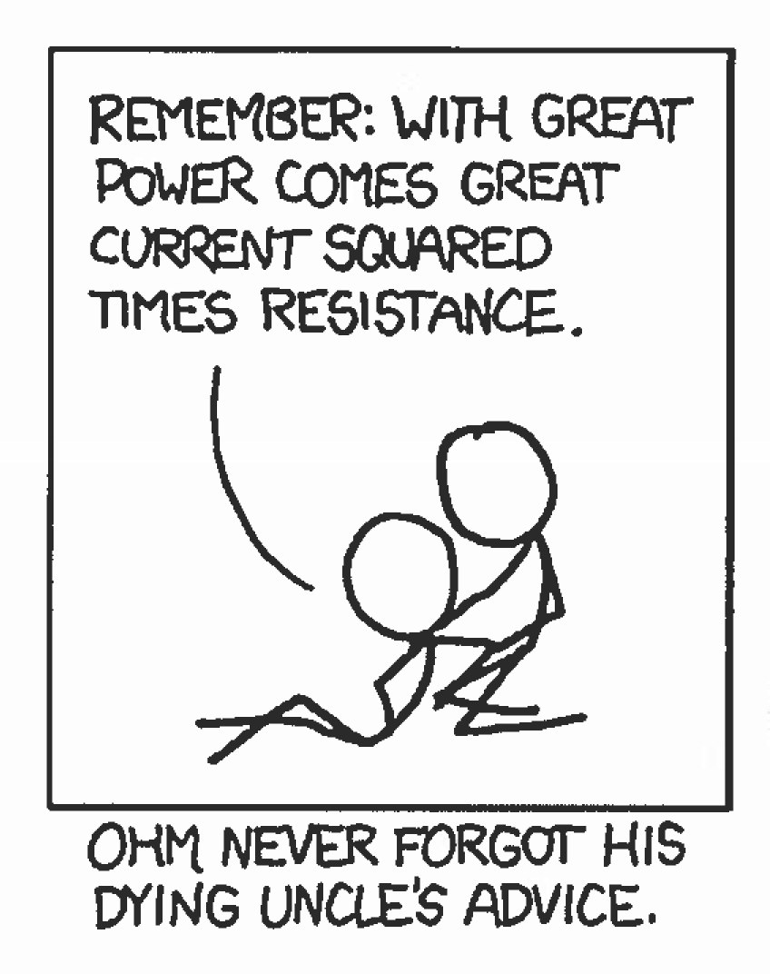
BEFORE FRIDAY
Exit check
NEXT: INSTRUMENTS + AC WAVEFORMS
LECTURE 03 | PARALLEL + POWER
13

