Slide 1
CYBER 327 / LECTURE 11
Time Domain, Frequency Domain, Fourier, and Harmonics
The same waveform tells different stories in time and frequency.
MONDAY, SEPTEMBER 28, 2026
\
LECTURE 11 | TIME DOMAIN FREQUENCY DOMAIN
01
Notes:
\

Slide 2
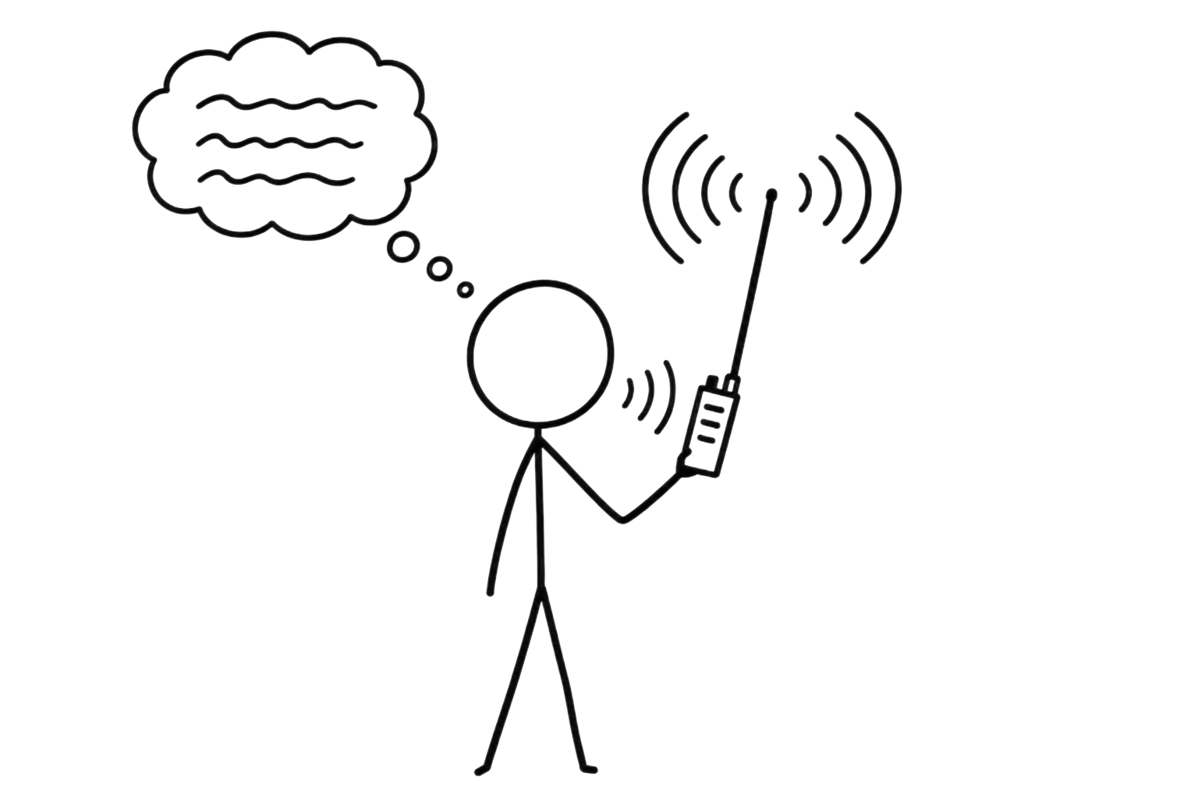
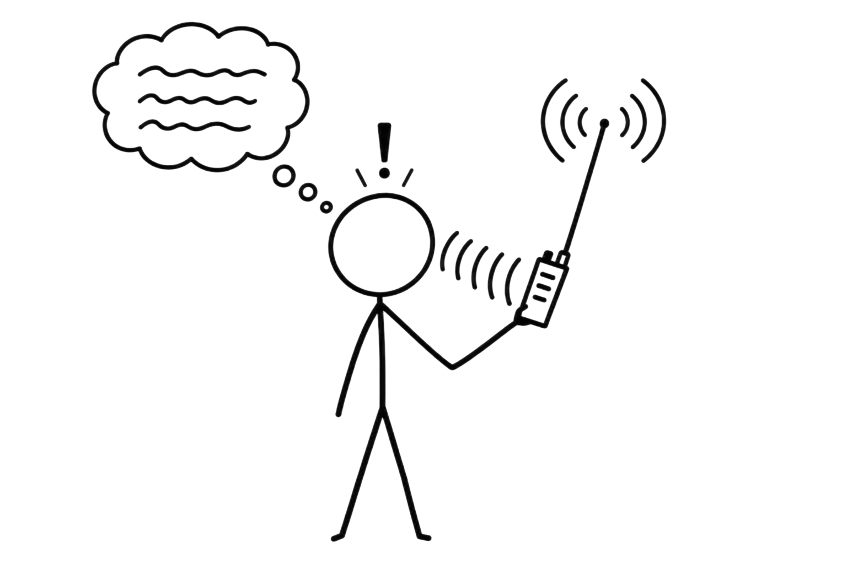
RECALL
The Communication System
Interference
Noise
Message
Transmitter
Receiver
Recovered message
Medium
Wire (copper)
Wireless
Optical Fiber
Signal
Encoding Method
LECTURE 10 | SYSTEMS + THREATS
02

Slide 3
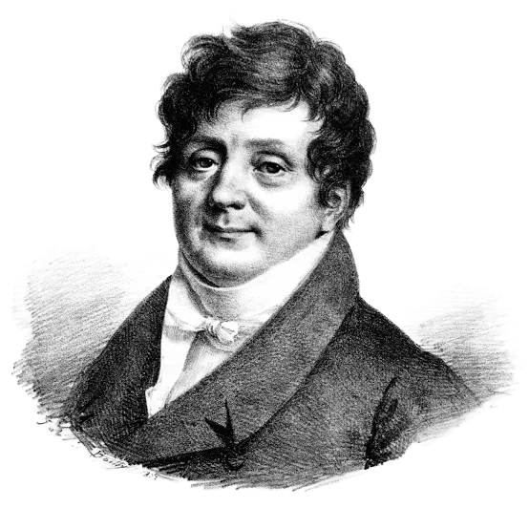
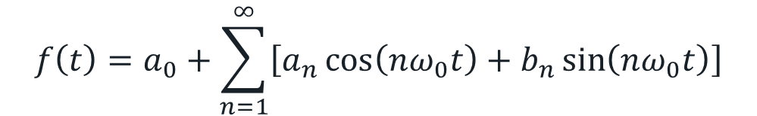
STARTING CONCEPTS
From Time to Frequency Domain
What if signals can be expressed as a sum of fundamental sinusoids?
James Fourier
$$f\left(t\right)=a_{0}+\sum_{n=1}^{∞}{\left[a_{n}\cos\left(nω_{0}t\right)+b_{n}\sin\left(nω_{0}t\right)\right]}$$
LECTURE 11 | TIME DOMAIN FREQUENCY DOMAIN
02
Notes:
First question: how does heat spread through an object?
Fourier Series
Fourier Transform

Slide 4
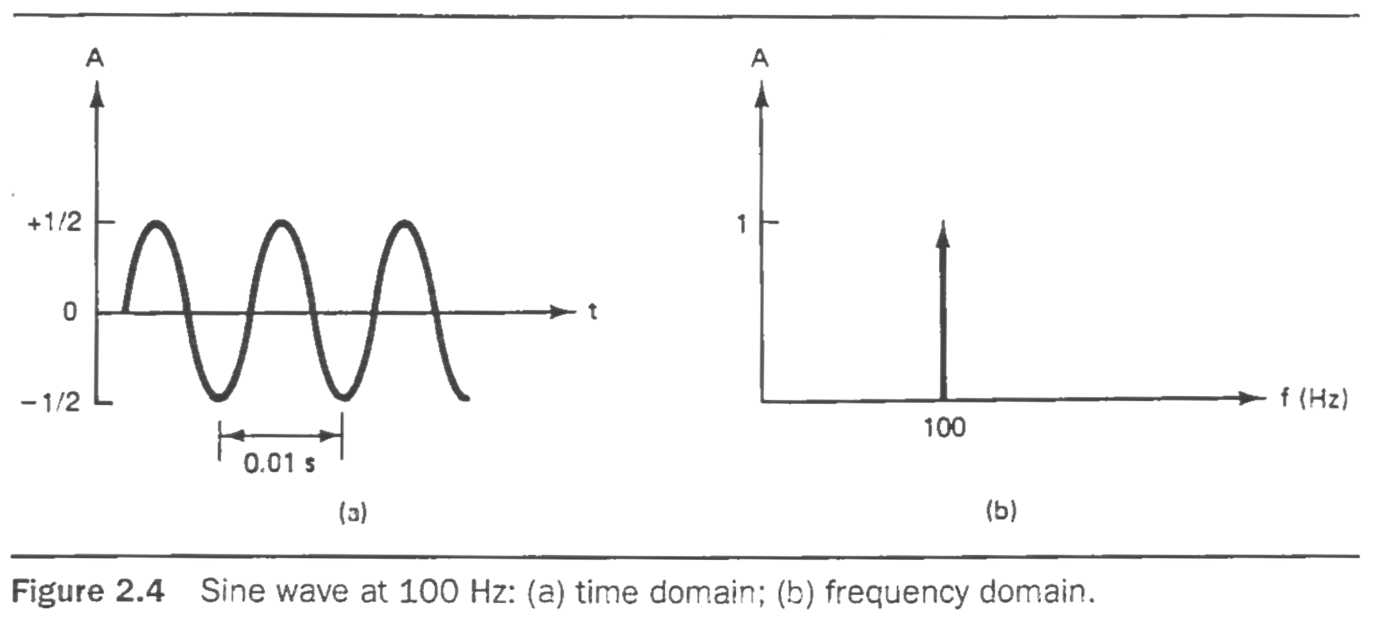

STARTING CONCEPTS
The Fourier Transform
What is the signal doing over time?
Time Domain
What frequencies make up the signal?
Frequency Domain
$$F\left(ω\right)=\int_{−∞}^{∞}{f}\left(t\right)e^{−iωt} dt$$
Demo
LECTURE 11 | TIME DOMAIN FREQUENCY DOMAIN
02
Notes:
First question: how does heat spread through an object?
Fourier Series
Fourier Transform

Slide 5
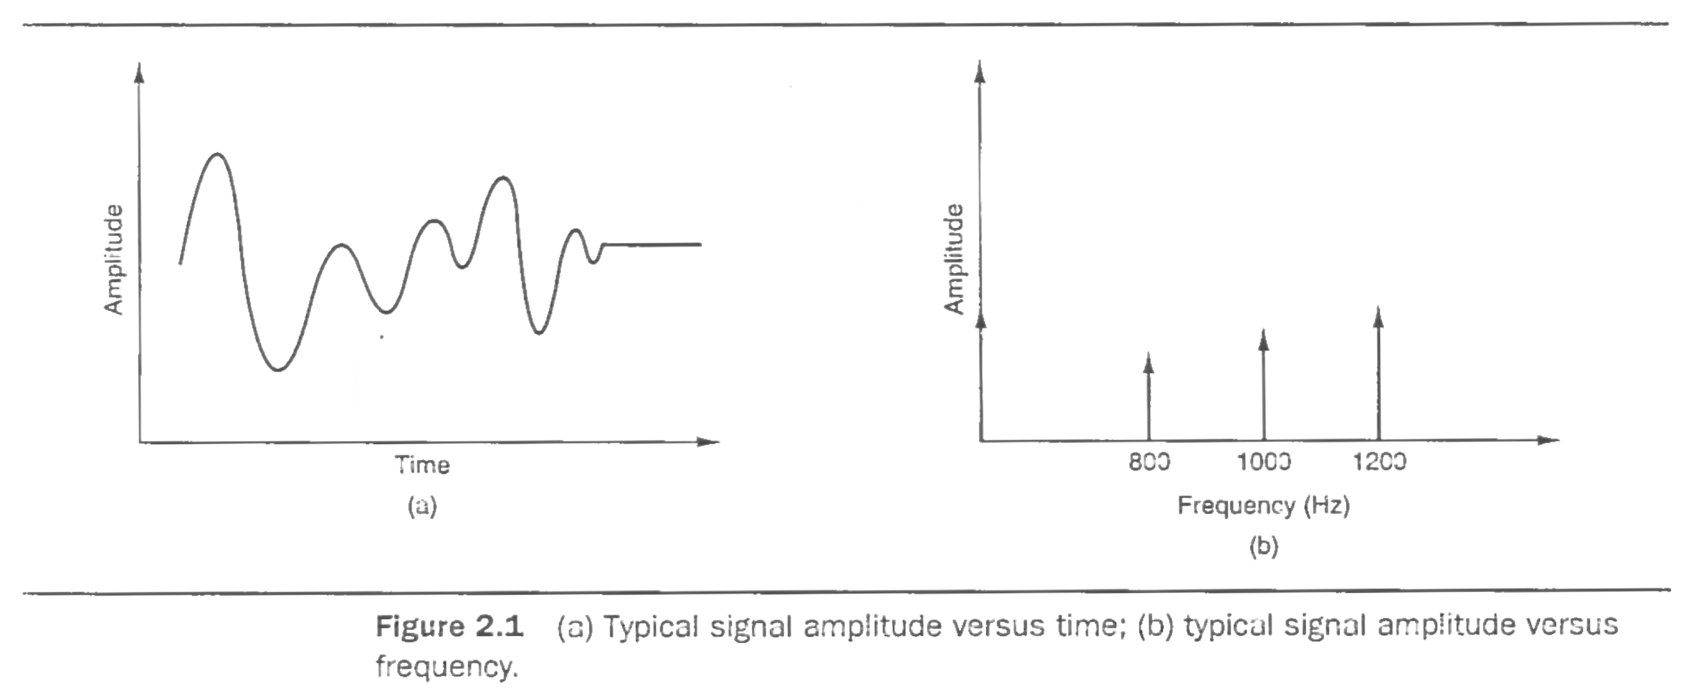
STARTING CONCEPTS
The Fourier Transform
What is the signal doing over time?
Time Domain
What frequencies make up the signal?
Frequency Domain
$$F\left(ω\right)=\int_{−∞}^{∞}{f}\left(t\right)e^{−iωt} dt$$
Demo
LECTURE 11 | TIME DOMAIN FREQUENCY DOMAIN
02
Notes:
First question: how does heat spread through an object?
Fourier Series
Fourier Transform

Slide 6
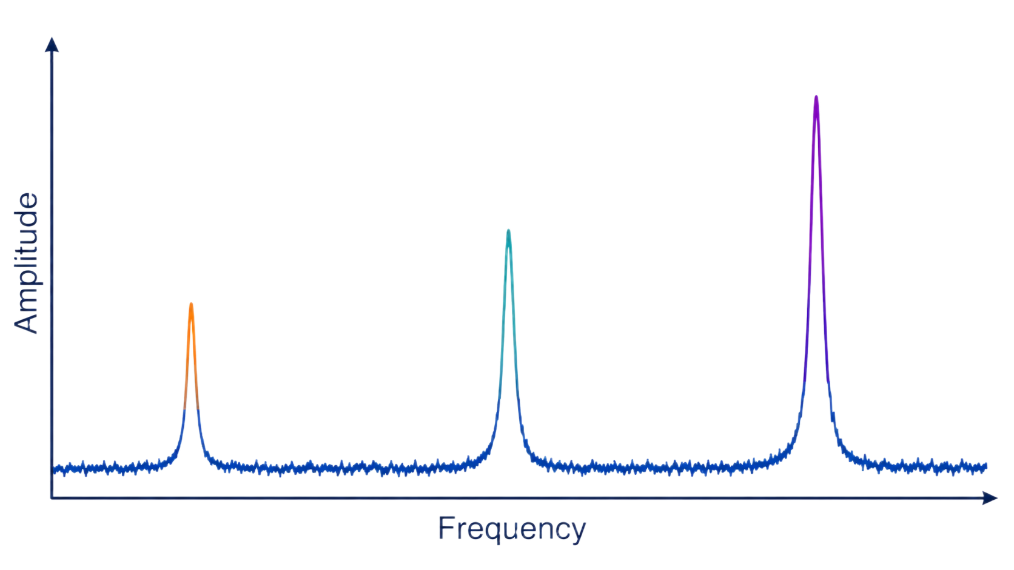
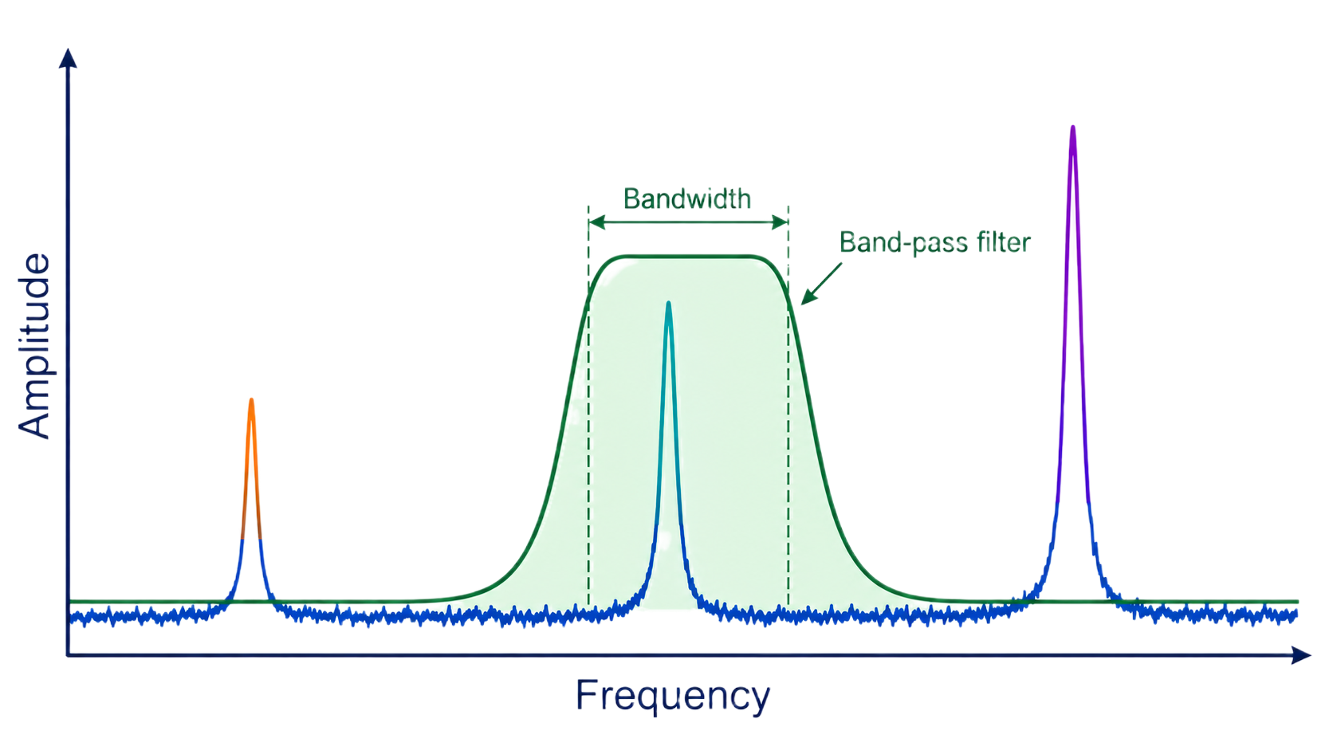
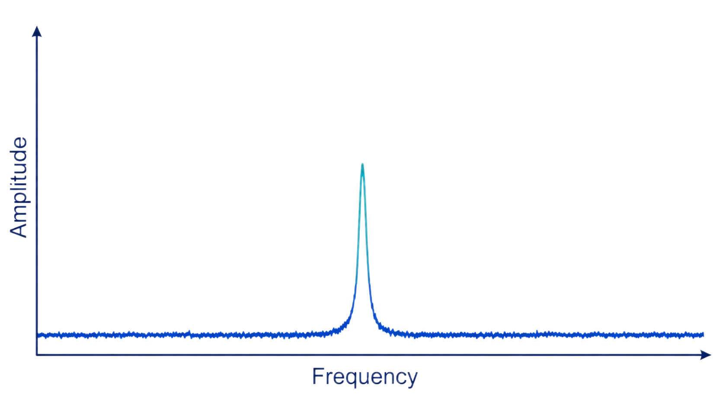

Recall: Filters
QUANTITATIVE MODEL
Core ideas
Term | Meaning
time domain | View of signal amplitude as a function of time.
frequency domain | View of how signal energy or amplitude is distributed across frequency.
$$T=\frac{1}{f}$$
Period and frequency
LECTURE 11 | TIME DOMAIN FREQUENCY DOMAIN
04

Slide 7
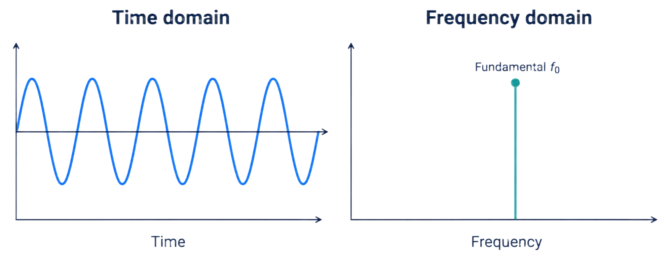
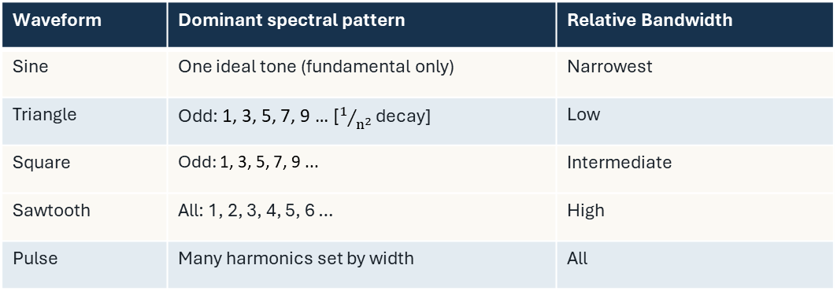

COMPARE BEFORE MEMORIZING
Harmonics
Waveform | Dominant spectral pattern | Relative Bandwidth
Sine | One ideal tone (fundamental only) | Narrowest
Triangle | Odd: 1, 3, 5, 7, 9 … [$1/{n^{2}}$ decay] | Low
Square | Odd: 1, 3, 5, 7, 9 ... | Intermediate
Sawtooth | All: 1, 2, 3, 4, 5, 6 … | High
Pulse | Many harmonics set by width | All
$$f_{n}=nf_{0}$$
Harmonic locations
fundamental
The lowest-frequency periodic component associated with a repeating waveform.
harmonic
the extra sine waves that combine to give a waveform its shape.
LECTURE 11 | TIME DOMAIN FREQUENCY DOMAIN
06

Slide 8
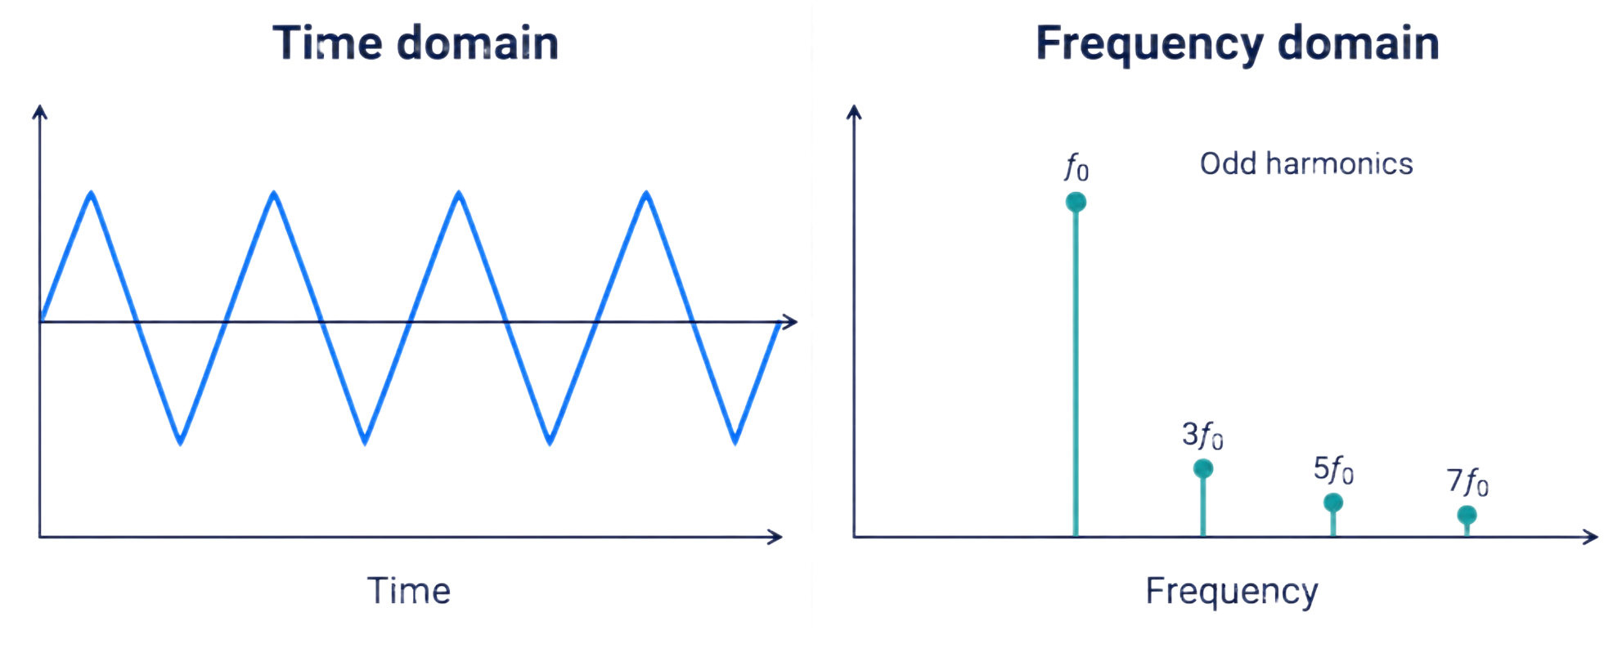
COMPARE BEFORE MEMORIZING
Harmonics
Waveform | Dominant spectral pattern | Relative Bandwidth
Sine | One ideal tone (fundamental only) | Narrowest
Triangle | Odd: 1, 3, 5, 7, 9 … [$1/{n^{2}}$ decay] | Low
Square | Odd: 1, 3, 5, 7, 9 ... | Intermediate
Sawtooth | All: 1, 2, 3, 4, 5, 6 … | High
Pulse | Many harmonics set by width | All
$$f_{n}=nf_{0}$$
Harmonic locations
fundamental
The lowest-frequency periodic component associated with a repeating waveform.
harmonic
A frequency that is a whole-number multiple of the fundamental frequency
LECTURE 11 | TIME DOMAIN FREQUENCY DOMAIN
06

Slide 9
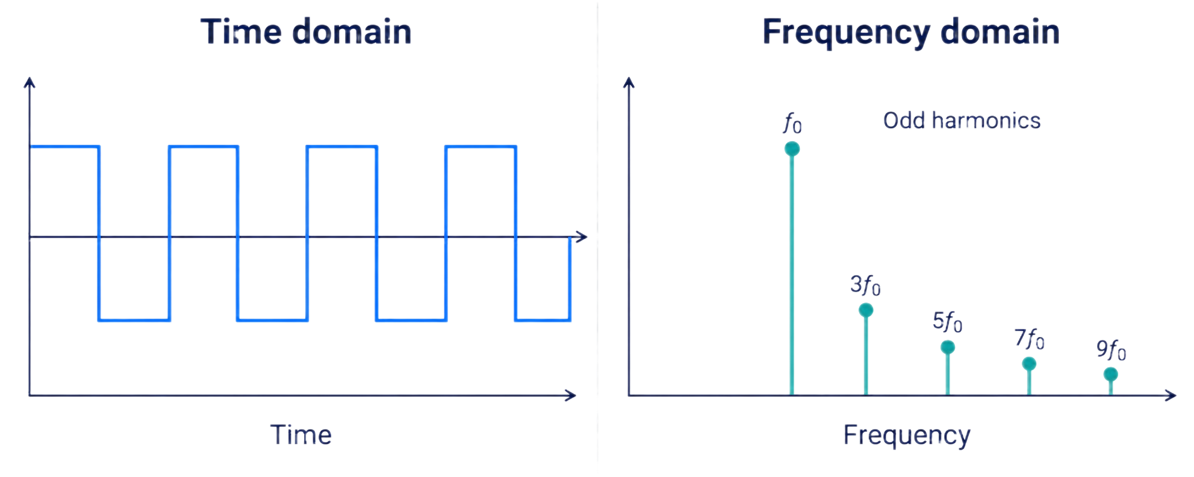
COMPARE BEFORE MEMORIZING
Harmonics
Waveform | Dominant spectral pattern | Relative Bandwidth
Sine | One ideal tone (fundamental only) | Narrowest
Triangle | Odd: 1, 3, 5, 7, 9 … [$1/{n^{2}}$ decay] | Low
Square | Odd: 1, 3, 5, 7, 9 ... | Intermediate
Sawtooth | All: 1, 2, 3, 4, 5, 6 … | High
Pulse | Many harmonics set by width | All
$$f_{n}=nf_{0}$$
Harmonic locations
fundamental
The lowest-frequency periodic component associated with a repeating waveform.
Rapid changes in time require more high-frequency content.
Demo
LECTURE 11 | TIME DOMAIN FREQUENCY DOMAIN
06

Slide 10
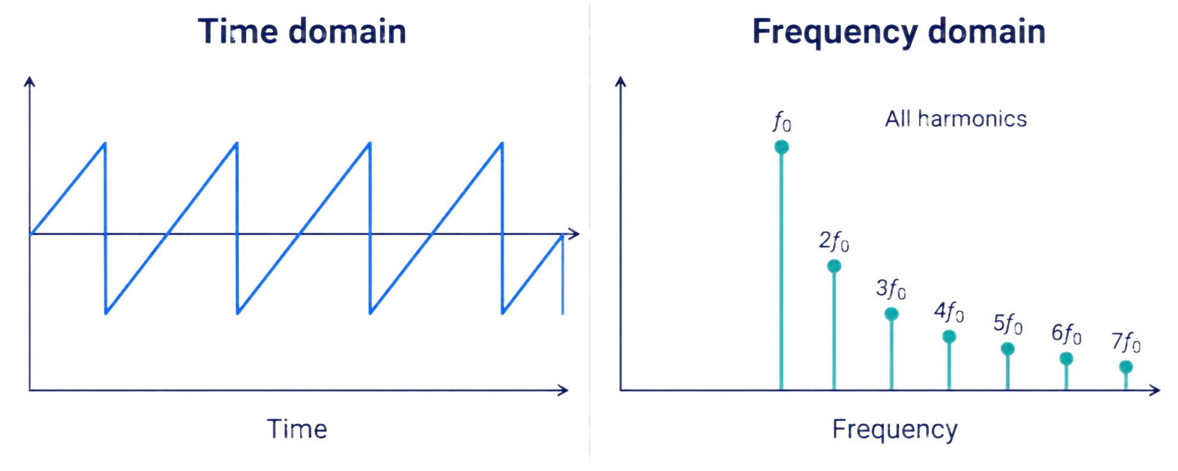
COMPARE BEFORE MEMORIZING
Harmonics
Waveform | Dominant spectral pattern | Relative Bandwidth
Sine | One ideal tone (fundamental only) | Narrowest
Triangle | Odd: 1, 3, 5, 7, 9 … [$1/{n^{2}}$ decay] | Low
Square | Odd: 1, 3, 5, 7, 9 ... | Intermediate
Sawtooth | All: 1, 2, 3, 4, 5, 6 … | High
Pulse | Many harmonics set by width | All
$$f_{n}=nf_{0}$$
Harmonic locations
fundamental
The lowest-frequency periodic component associated with a repeating waveform.
Rapid changes in time require more high-frequency content.
Demo
LECTURE 11 | TIME DOMAIN FREQUENCY DOMAIN
06

Slide 11
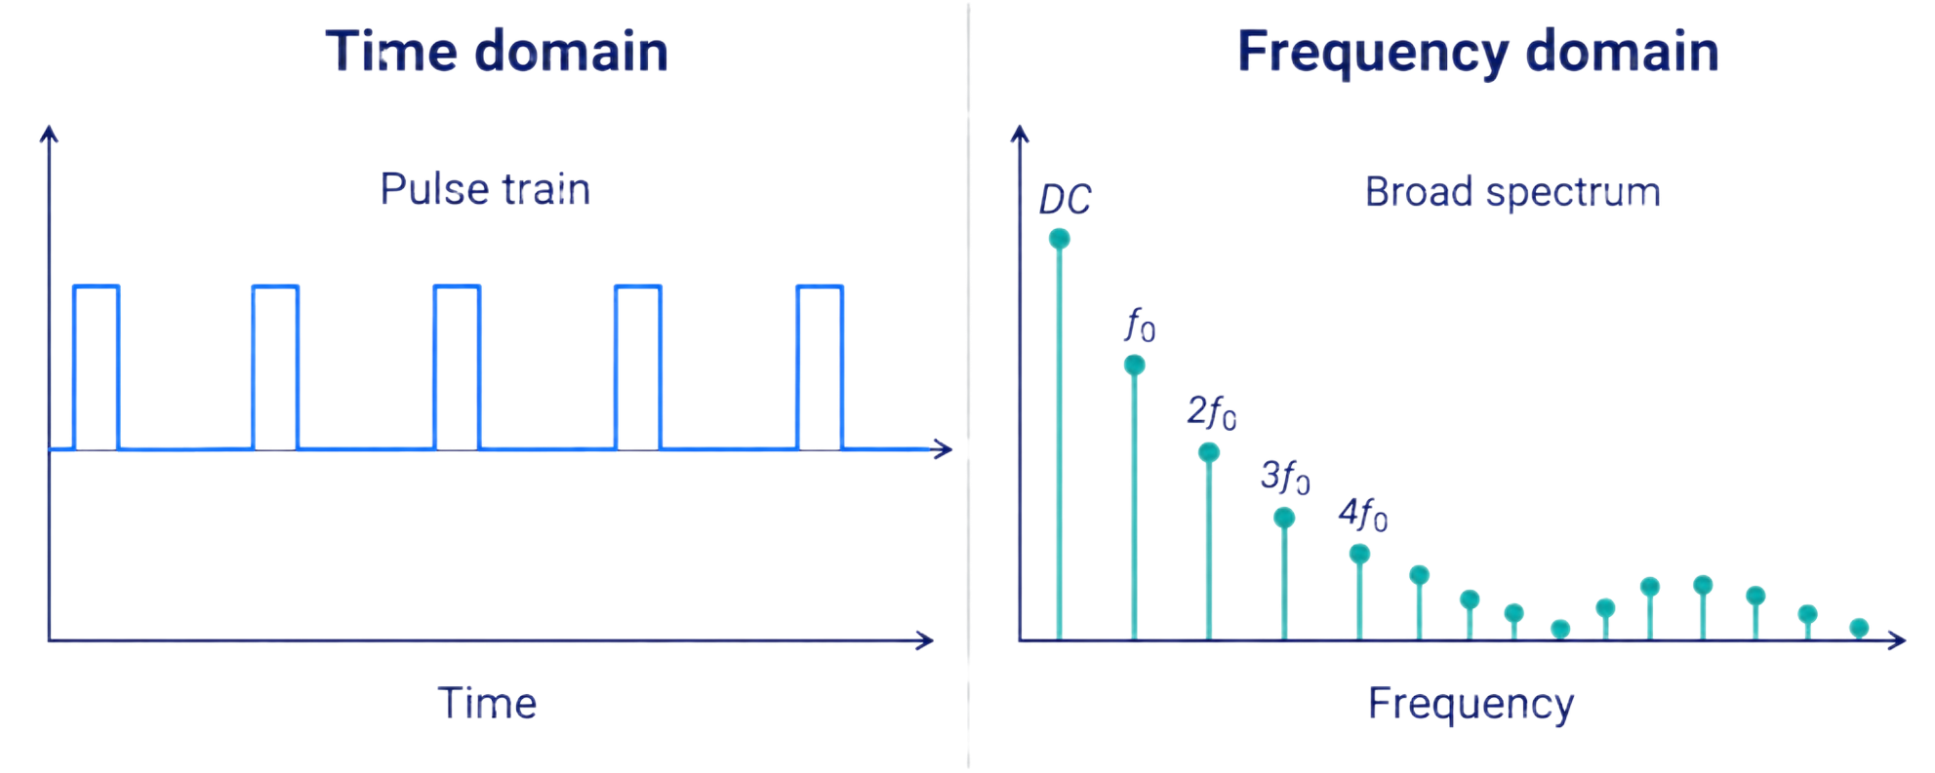
COMPARE BEFORE MEMORIZING
Harmonics
Waveform | Dominant spectral pattern | Relative Bandwidth
Sine | One ideal tone (fundamental only) | Narrowest
Triangle | Odd: 1, 3, 5, 7, 9 … [$1/{n^{2}}$ decay] | Low
Square | Odd: 1, 3, 5, 7, 9 ... | Intermediate
Sawtooth | All: 1, 2, 3, 4, 5, 6 … | High
Pulse | Many harmonics set by width | All
$$f_{n}=nf_{0}$$
Harmonic locations
fundamental
The lowest-frequency periodic component associated with a repeating waveform.
Rapid changes in time require more high-frequency content.
Demo
LECTURE 11 | TIME DOMAIN FREQUENCY DOMAIN
06

Slide 12
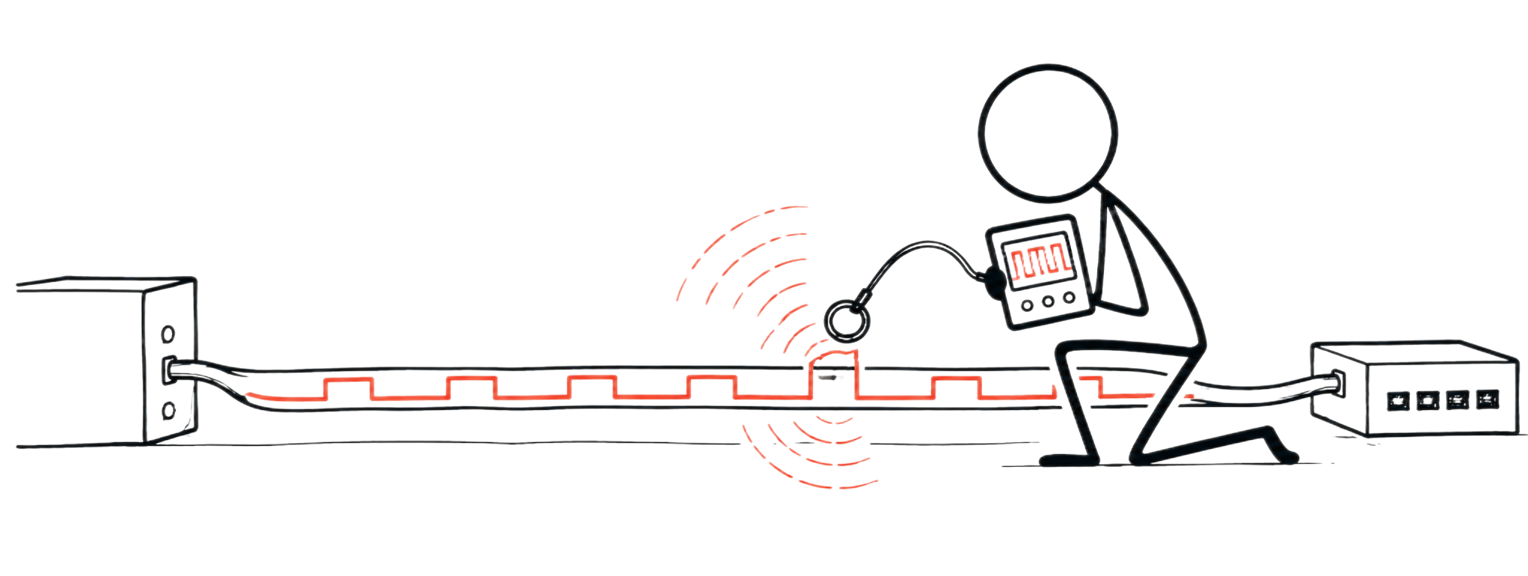
APPLICATION, NOT REPLACEMENT
Cybersecurity follows the physical behavior
Review
Spectral fingerprints for signal identification
Detectability from amplitude, bandwidth, harmonics, and duty cycle
What does the time-domain representation of a periodic waveform tell you about its BW requirements?
Why do instruments and waveforms all sound different if they are at the same frequency?
What single periodic waveform has a single frequency component?
What periodic waveform do we always use as the carrier in electronic communication?
What is a harmonic?
What happens to a sine wave’s spectrum when we change its amplitude over time to carry information?
LECTURE 11 | TIME DOMAIN FREQUENCY DOMAIN
08
Notes:
The sharper and faster the waveform changes, the more high-frequency harmonics it needs → more bandwidth. A smooth sine wave needs very little BW; sharp pulses need much more.
They can have the same fundamental frequency (pitch) but different harmonics. Different harmonic content gives them different timbre or sound quality.
A sine wave. An ideal sine wave contains only one frequency.
A sinusoidal carrier (sine/cosine). A pure sinusoid provides a single, well-defined carrier frequency.
A frequency that is a whole-number multiple of the fundamental frequency. For a 1 kHz fundamental, 2 kHz is the 2nd harmonic, 3 kHz the 3rd, etc.
If we start changing the sine wave to carry information, additional frequency components appear around the original frequency.

Slide 13
BRIDGE FORWARD
Exit check
What features distinguish a square wave from a sine wave in the spectrum?
NEXT: DECIBELS, NOISE, SNR, AND SHANNON CAPACITY
LECTURE 11 | TIME DOMAIN FREQUENCY DOMAIN
10

