Slide 1
CYBER 327 / LECTURE 28
More Wireless, Cellular and SDR
FRIDAY, NOVEMBER 6, 2026
LECTURE 28 | 5G CELLULAR AWARENESS SDR AN
01
Notes:
Open with the shared room from revised Lecture 27: Wi-Fi, Bluetooth and other radios occupy the same space. A wireless application is now missing messages. As the person investigating, what evidence would you ask for before naming a cause? The professional skill is an availability investigation: observe reception, judge quality, compare with delivery, test alternative explanations and choose a response. This fifty-minute Friday meeting has no quiz. Use constructed illustrations and supplied data rather than requiring a live receiver or attack demonstration. The route is receiver evidence first, then quality, cellular as an example, and an interference/jamming investigation. Remove the former application analogy. Transition: where do the measurements actually come from?

Slide 2
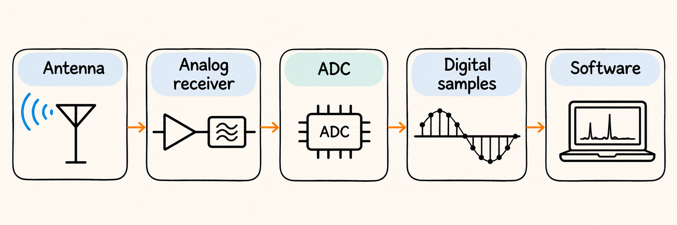
CONTINUE LECTURE 27’S SHARED ROOM: WHAT CAN WE OBSERVE?
Where does receiver evidence come from?
Software can show spectrum / waterfall
LECTURE 28 | 5G CELLULAR AWARENESS SDR AN
02
Notes:
Follow antenna, analog receiver, ADC, samples and software.

Slide 3
FREQUENCY AND DISPLAYED LEVEL
Fast Fourier Transform
dBFS
-20
-40
-60
-80
995
997
999
1000
1001
1003
1005
Frequency (kHz)
LECTURE 28 | 5G CELLULAR AWARENESS SDR AN
03
Notes:
FFT means fast Fourier transform

Slide 4
WATERFAL DIAGRAM
A waterfall shows when activity changes
Filter width
What you choose to receive
Level ↑
Time
↓
995
1000
1003
1005
Frequency (kHz)
SDR = software-defined radio
http://websdr.org/
LECTURE 28 | 5G CELLULAR AWARENESS SDR AN
04
Notes:
SDR means software-defined radio: software performs important processing but does not replace physical receiving hardware.

Slide 5

STRONG WANTED POWER CAN COEXIST WITH POOR QUALITY
Calculate the wanted-to-unwanted power ratio
Wanted power S
Calculate SINR:
S = 100 pW
I = 8 pW
N = 2 pW
The signal you are trying to recover.
Strong reception alone is not enough.
Interference I + noise N
Other received energy competes with the wanted signal.
What if I+N doubles?
Condition | S | I + N | Linear SINR | SINR in dB
Initial | 100 pW | 10 pW | 10 | 10 dB
I+N doubles | 100 pW | 20 pW | 5 | About 7 dB
$$\boxed{{SINR}_{linear}=\frac{P_{S}}{P_{I}+P_{N}}}$$
LECTURE 28 | 5G CELLULAR AWARENESS SDR AN
08
Notes:
Use the existing numerical example: S = 100 pW, I = 8 pW and N = 2 pW, measured compatibly. Add the linear powers I + N = 10 pW, then form SINR = 100/10 = 10, a dimensionless ratio. Apply the already taught conversion 10 log10(10) = 10 dB only after forming the ratio. Do not add dBm numbers or use 20 log10 for this power ratio. The common pW unit cancels. A computed SINR is not a measured BER, guaranteed throughput or authentication result. This is a constructed teaching power budget, not a reading inferred from the previous dBFS picture. Transition: what happens if the wanted power remains unchanged but the room gets noisier?

Slide 6
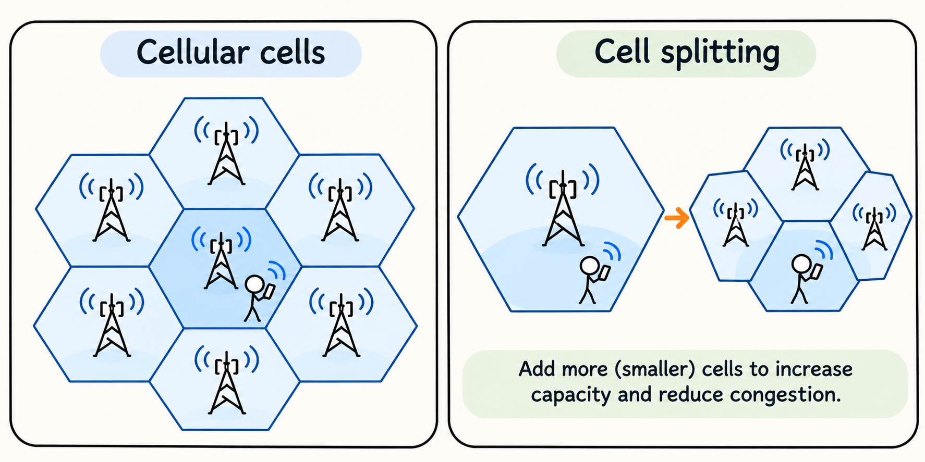
ANOTHER EXAMPLE OF RECEIVER EVIDENCE
Cellular Networks
LECTURE 28 | 5G CELLULAR AWARENESS SDR AN
10

Slide 7
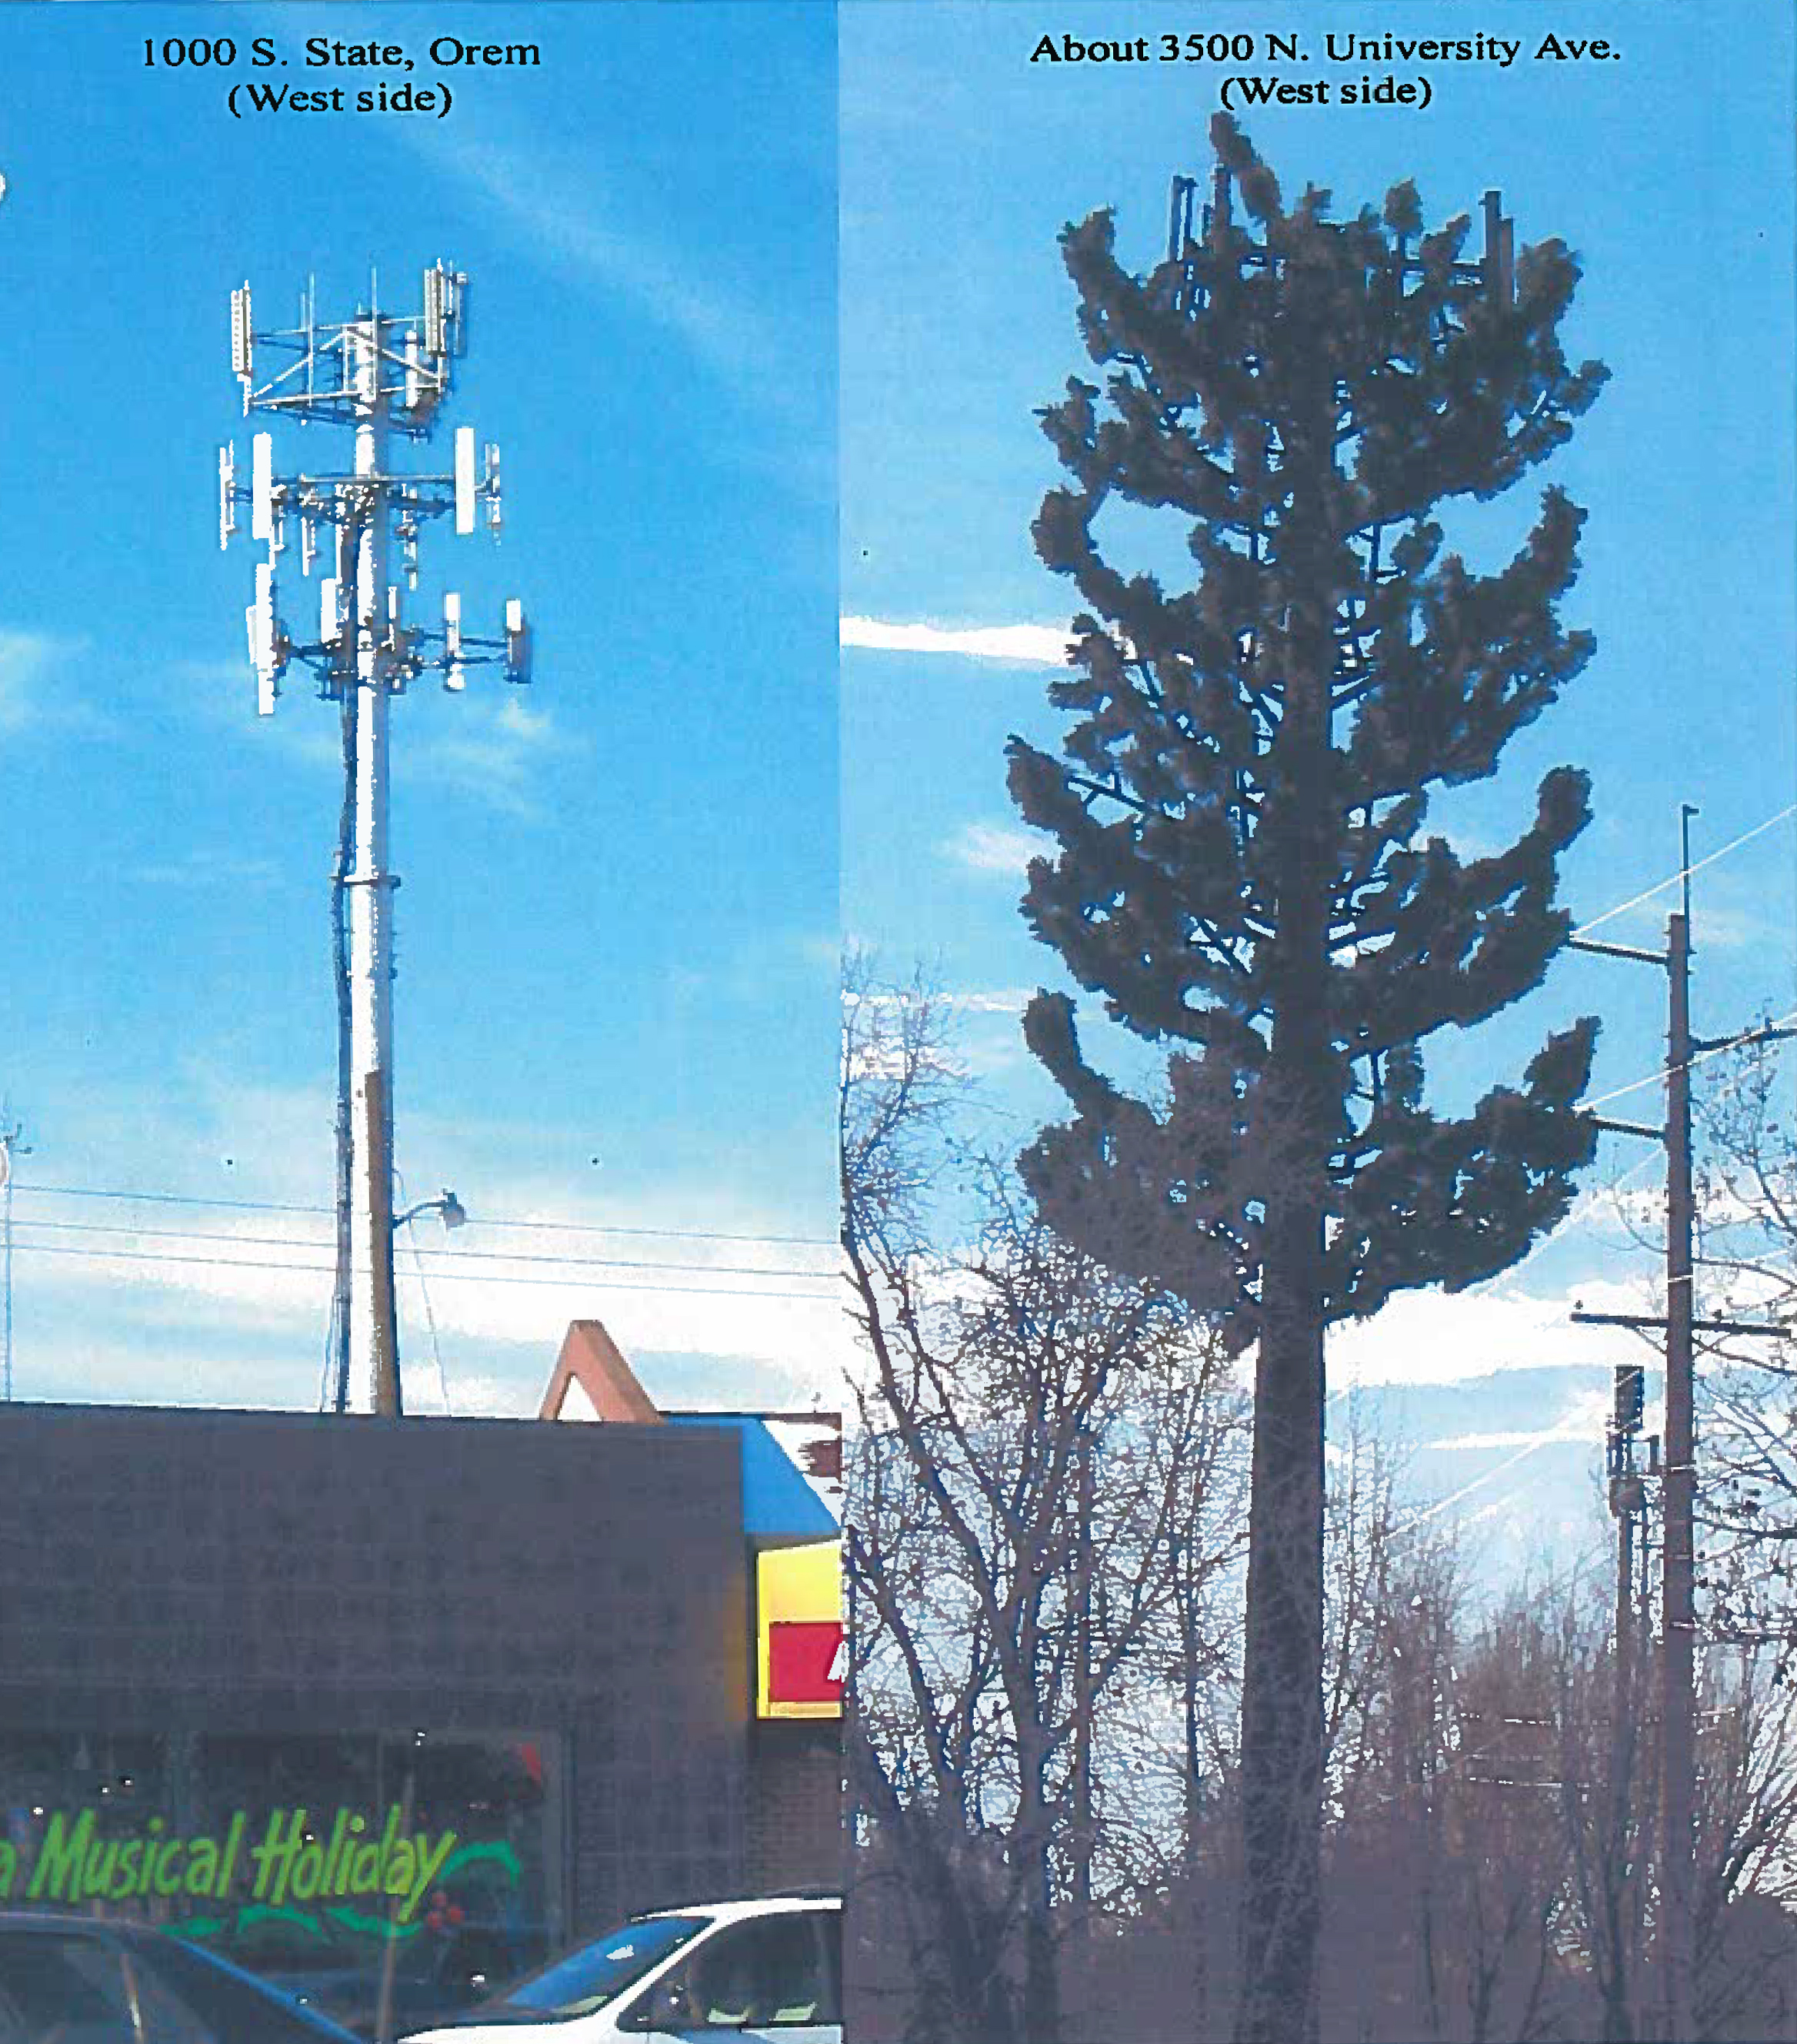
DBM USES ONE MILLIWATT AS ITS REFERENCE; DB EXPRESSES A RATIO
Which measurement answers which question?
Metric | Expanded name | What it describes
RSRP (dBm) | Reference signal received power | Power on defined reference-signal resources
RSRQ (dB) | Reference signal received quality | Reference power relative to total reception and specified bandwidth
SINR (ratio or dB) | Signal-to-interference-plus-noise ratio | Wanted power relative to interference plus noise
LECTURE 28 | 5G CELLULAR AWARENESS SDR AN
11
Notes:
A cell tower can have multiple providers!
RSRP is reference signal received power: power on defined reference resources, commonly reported in dBm.
RSRQ is reference signal received quality: a ratio involving reference power, total reception and specified measurement bandwidth; it is not simply another name for SINR.
SINR compares wanted power with interference plus noise under its measurement definition and may be expressed as a linear ratio or dB.
RSRQ’s total-power measurement includes useful transmissions from your own cell, as well as interference and noise.
SINR’s denominator contains interference and noise, excluding the desired signal.

Slide 8
COMPARE CELLULAR POWER / QUALITY,
Which location is best?
Location | RSRP | RSRQ | SINR
X | -74 dBm | -15 dB | 4 dB
Y | -75 dBm | -25 dB | 20 dB
Z | -86 dBm | -8 dB | 17 dB
LECTURE 28 | 5G CELLULAR AWARENESS SDR AN
12
Notes:
X has strongest RSRP (-74 dBm)
Z has best RSRQ (-8 dB) and SINR (17 dB).
Z is the leading quality candidate

Slide 9
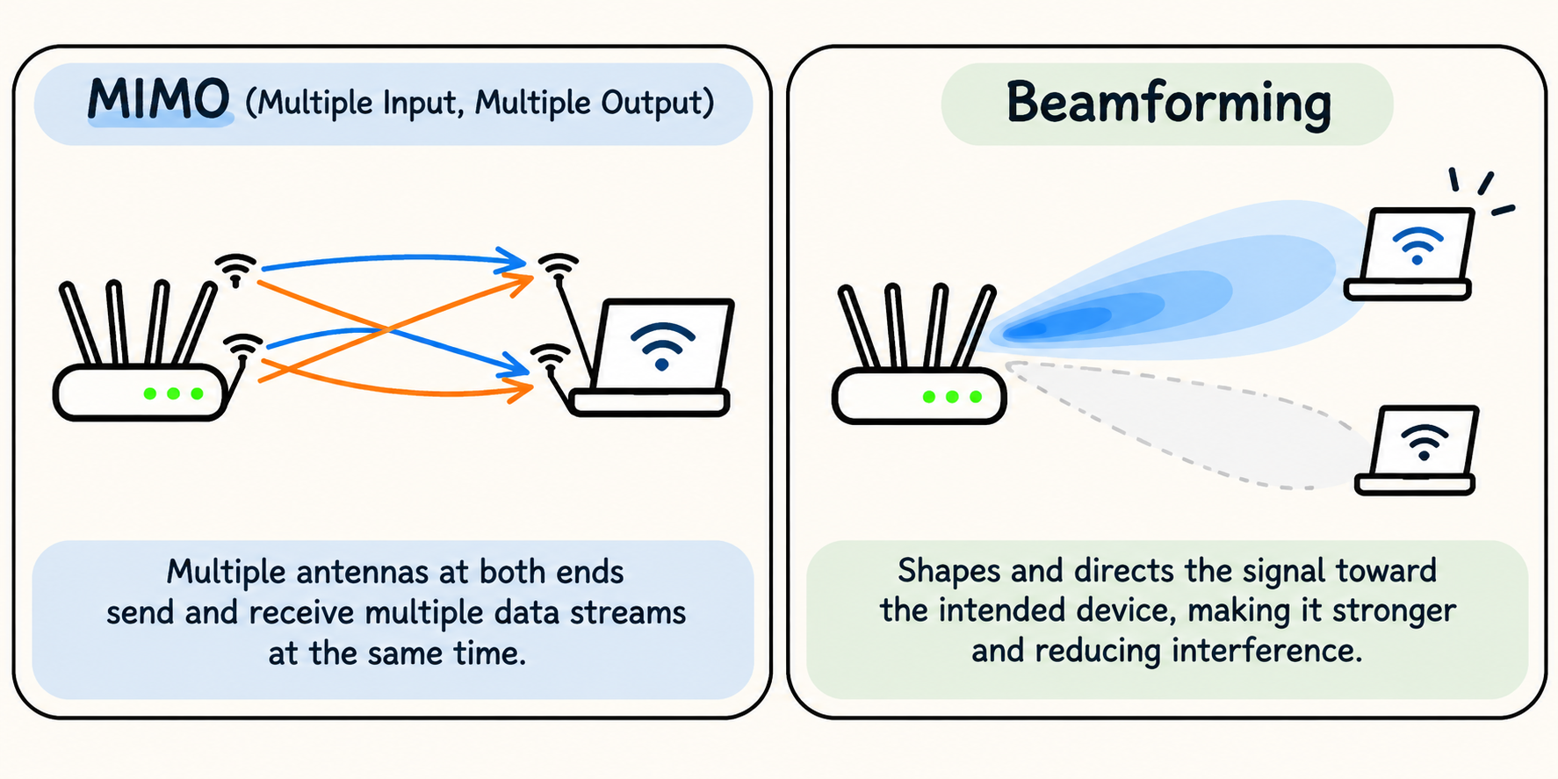
WIRELESS TECHNIQUES
MIMO and Beamforming
LECTURE 28 | 5G CELLULAR AWARENESS SDR AN
13

Slide 10
WORK INDEPENDENTLY BEFORE REVEALING THE NOTES ANSWER
Practice: calculate quality and choose the next evidence
Try the calculation
Wanted power = 90 pW; interference = 20 pW; noise = 10 pW.
Calculate linear SINR, then express it in dB.
Review: 10 log10(linear power ratio). Keep powers linear until the final conversion.
LECTURE 28 | 5G CELLULAR AWARENESS SDR AN
17
Notes:
Give time to calculate before revealing the notes solution. SINR = 90/(20+10) = 3, or 10 log10(3) = 4.77 dB.

Slide 11
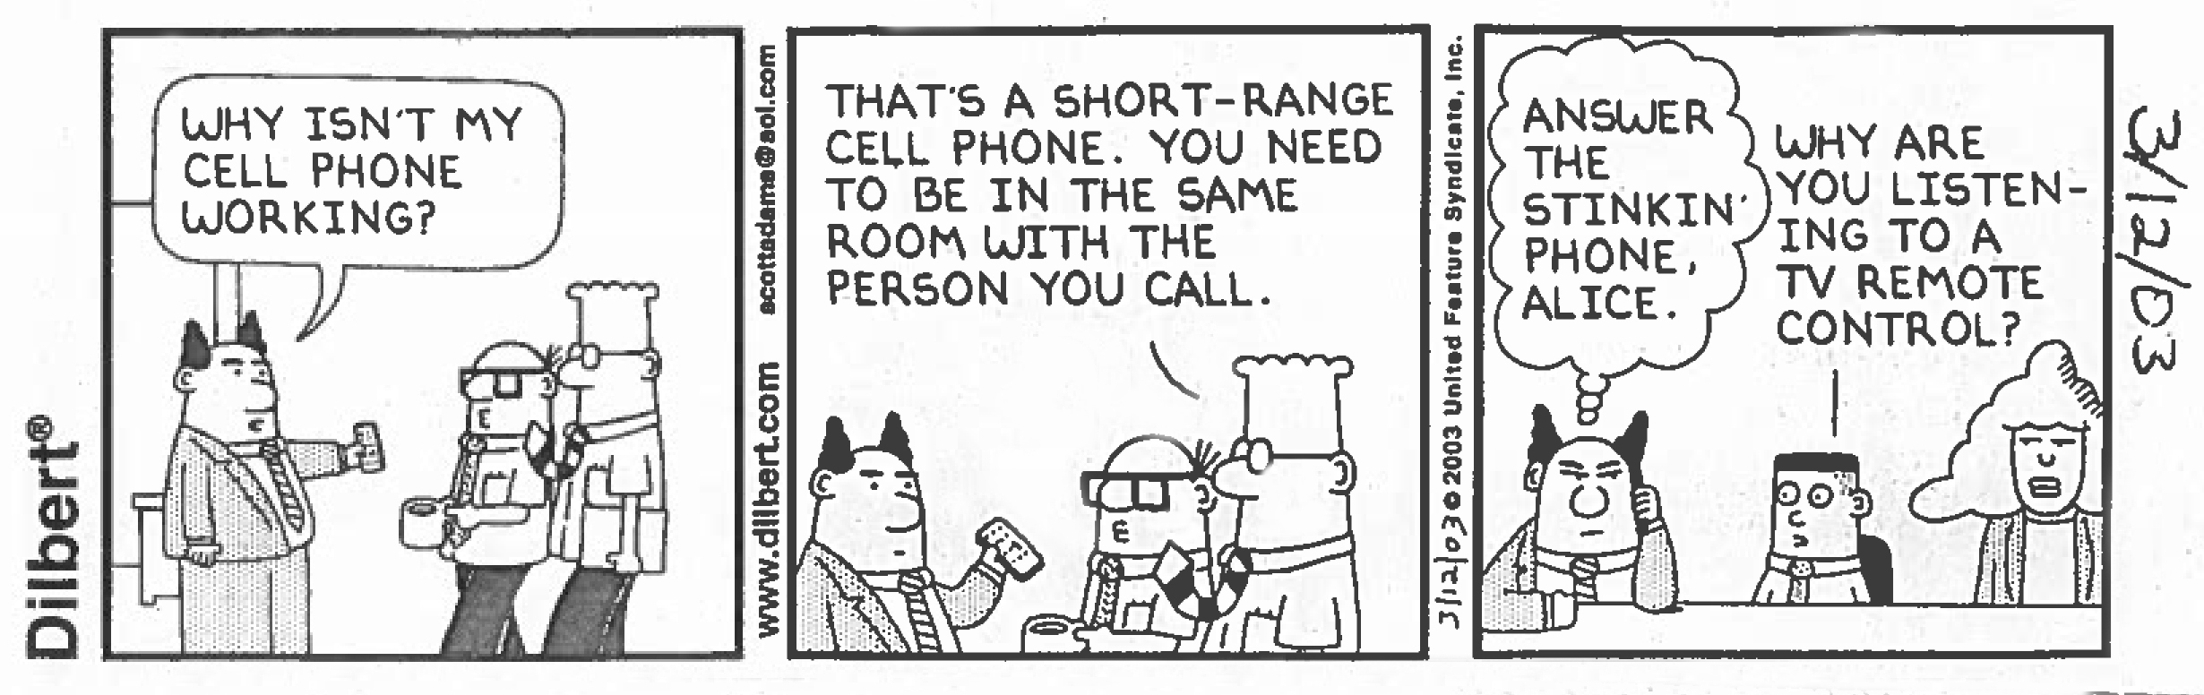
CHECK UNDERSTANDING
Exit check
NEXT: CELLULAR & SDR
LECTURE 26 | MEDIA TRANSMISSION CASE STUD
16

