Slide 1
CYBER 327 / LECTURE 04
AC Waveforms and Measurements
The connection, setting, and instrument are part of every result.
SEP 11, 2026
LECTURE 04 | INSTRUMENTS + AC
01

Slide 2
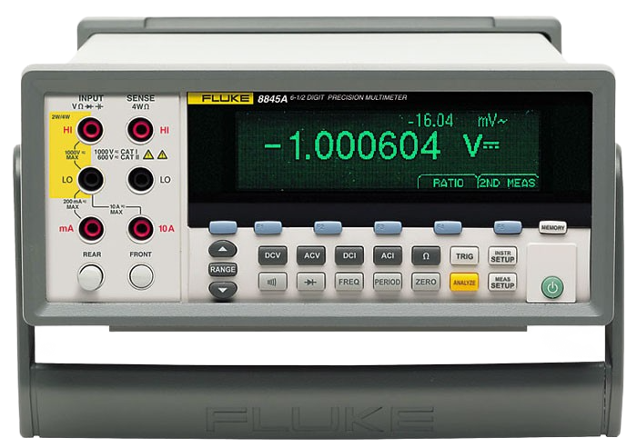
INSTRUMENT QUALITY
Accuracy, precision, and resolution
Accuracy
Precision
Resolution
Closeness to the true value within stated conditions.
Repeatability or spread across repeated measurements.
Smallest displayed or distinguishable increment.
LECTURE 04 | INSTRUMENTS + AC
12
Notes:
A stable five-digit result can still be inaccurate.

Slide 3
BENCH ROLES
Four instruments, four jobs
DC supply
Function generator
Provides controlled voltage with a current limit.
Creates known waveforms, frequency, amplitude, and offset.
Oscilloscope
DMM
Shows voltage versus time and derived measurements.
Measures DC/AC voltage, resistance, and current within its bandwidth and mode limits.
LECTURE 04 | INSTRUMENTS + AC
02
Notes:
Ask which instrument creates the test signal and which observes it. Emphasize that every instrument has limits.

Slide 4
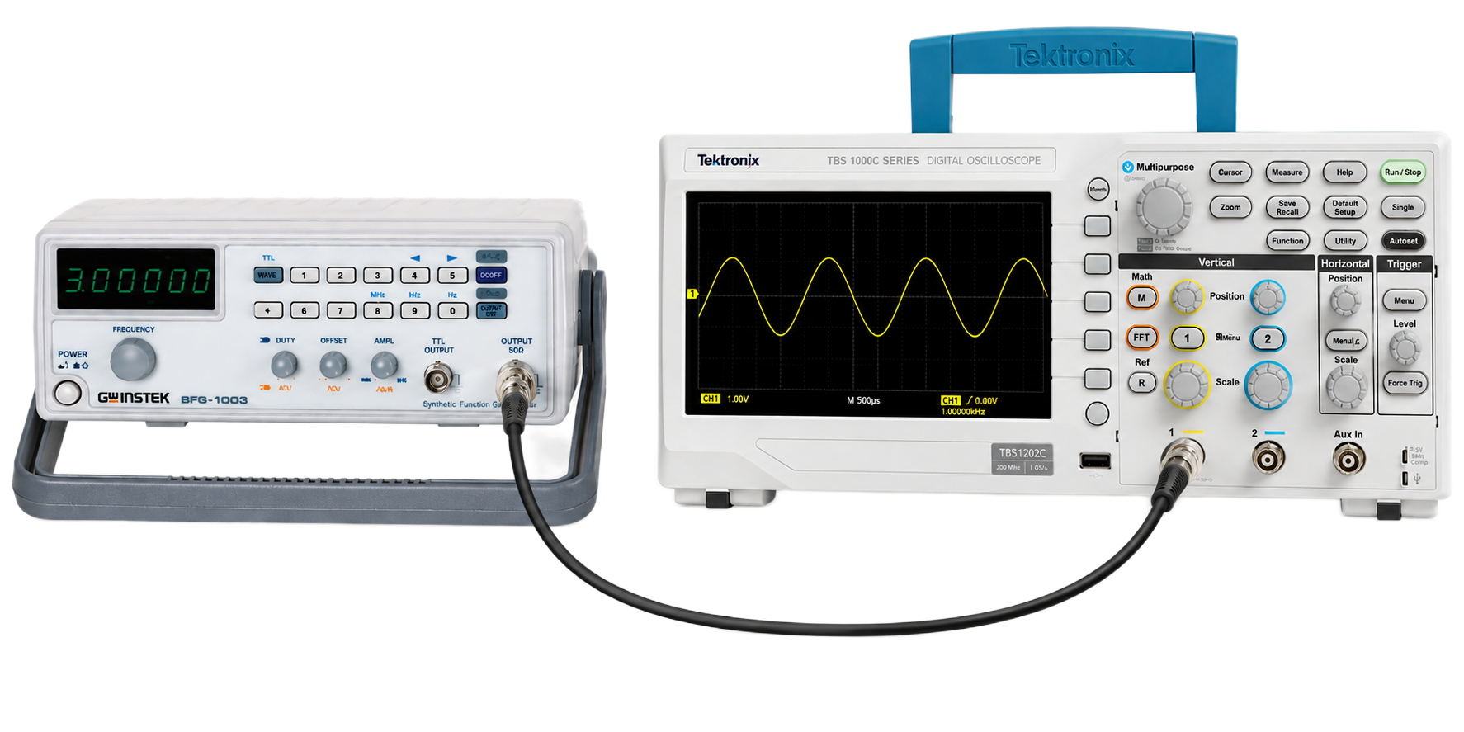
TRUST BOUNDARY
The measurement chain can change the result
SOURCE
CABLE
PROBE
INSTRUMENT
SETTING
DISPLAY
CLAIM
An error or limitation at any block can propagate into the conclusion.
LECTURE 04 | INSTRUMENTS + AC
03
Notes:
Walk through a 1x/10x probe mismatch as an example of a valid display representing the wrong scale.

Slide 5
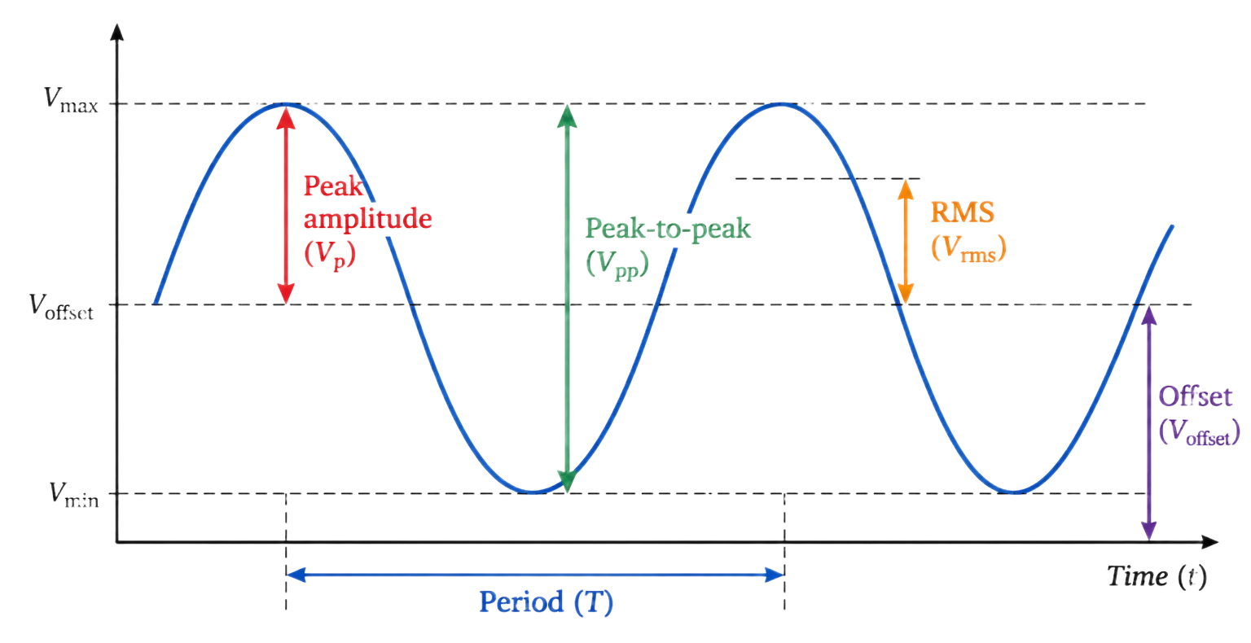
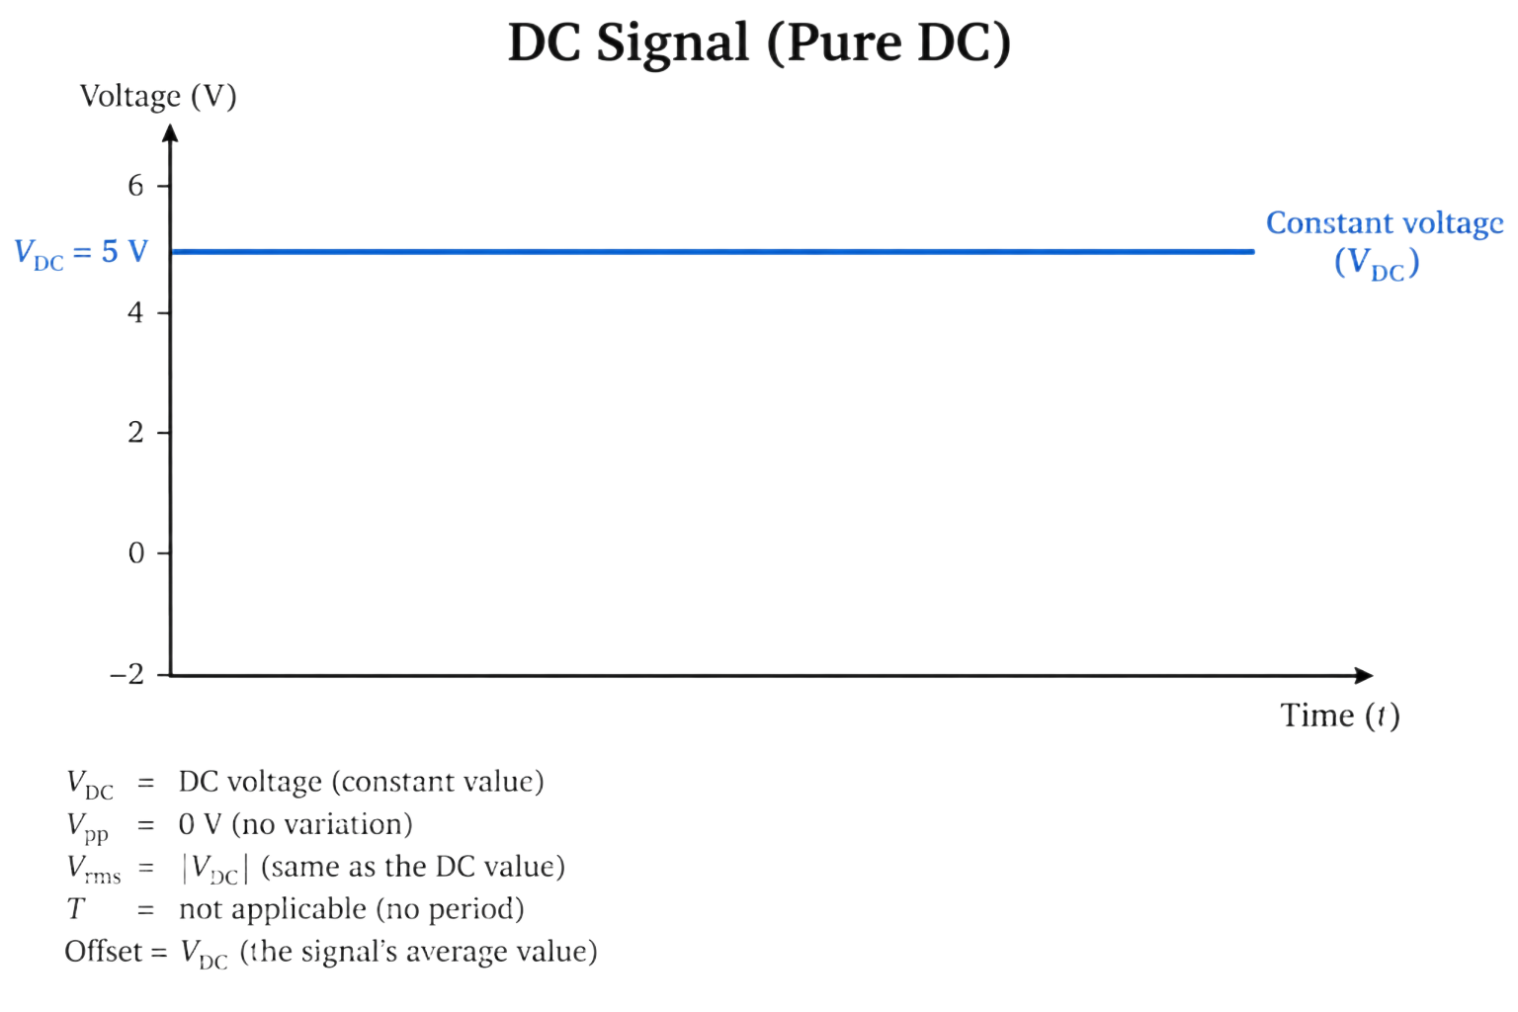
AC VOCABULARY
A periodic waveform has measurable structure
Term | Definition | Measurement
Peak | Maximum value relative to reference | V_peak
Peak-to-peak | Maximum minus minimum | V_pp
Period | Time for one cycle | T in seconds
Frequency | Cycles per second | f = 1/T
Offset | Average or center value | V_offset
Quantity | Sine-wave relationship | Use
V_peak | V_pp / 2 when centered | Maximum excursion
V_rms | V_peak / sqrt(2) for a sine | Equivalent heating/power
V_offset | Center relative to reference | Bias and allowable input range
V_max / V_min | Offset +/- peak | Clipping and threshold checks
LECTURE 04 | INSTRUMENTS + AC
05

Slide 6
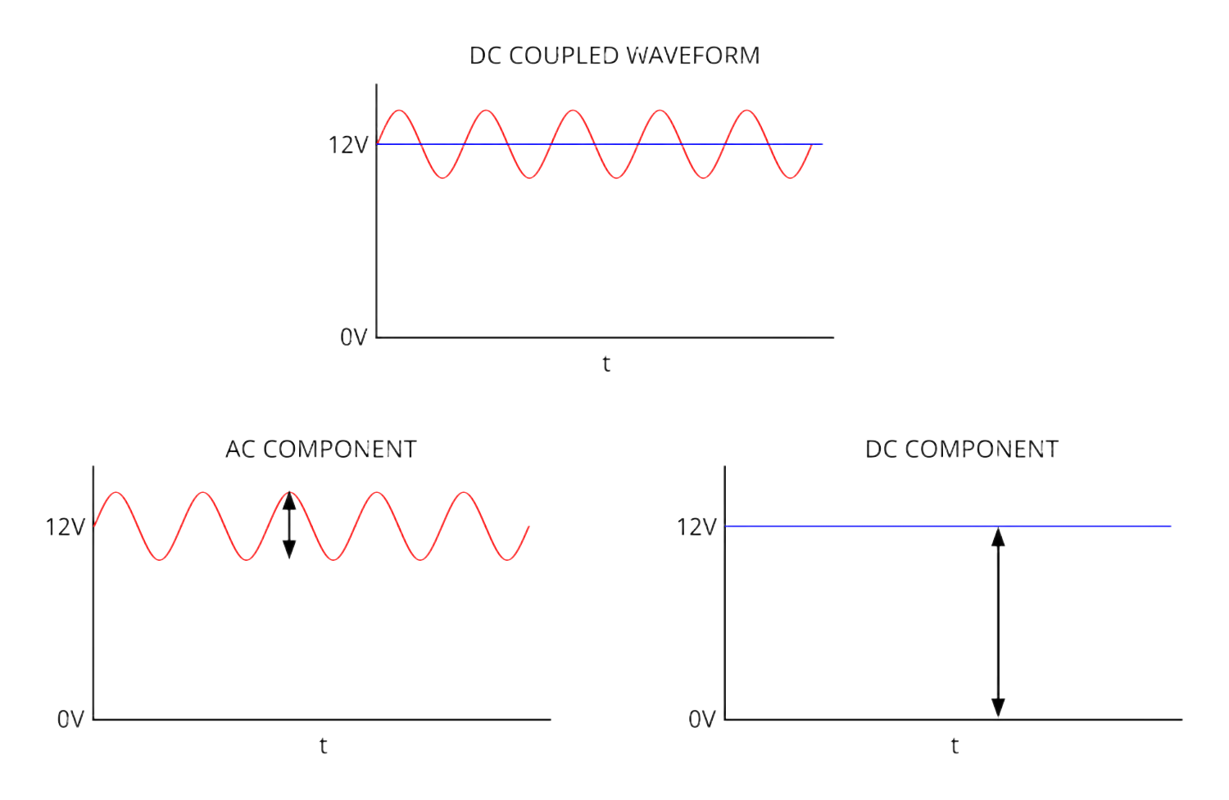
DC VERSUS AC
Coupling changes what the display includes
Channel mode | What the scope shows | Main caution
DC coupling | AC variation plus DC offset | Use this to preserve the full waveform
AC coupling | AC variation with DC blocked | The offset disappears from view
LECTURE 04 | INSTRUMENTS + AC
08

Slide 7
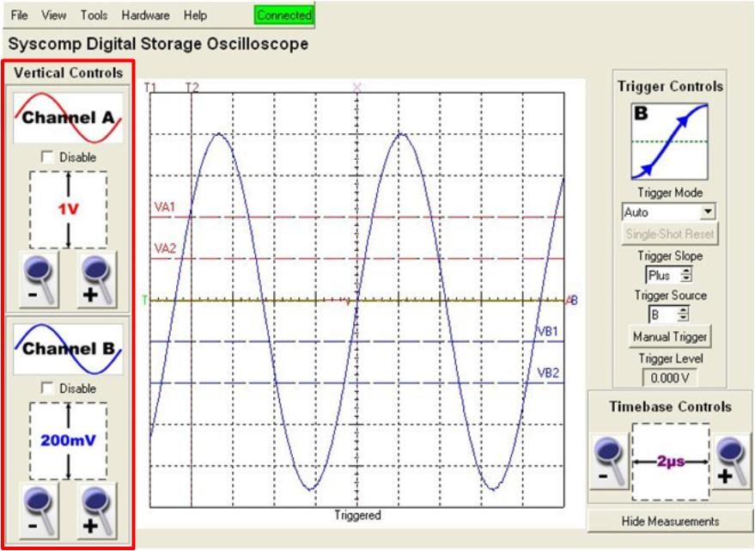
CONTROLS THAT MATTER
Oscilloscope setup
Vertical
Horizontal
Trigger
Volts/div, channel coupling, offset, probe factor, input limit.
Seconds/div, sample rate, record length, acquisition mode.
Source, level, slope, mode, and holdoff stabilize repeated events.
LECTURE 04 | INSTRUMENTS + AC
09

Slide 8
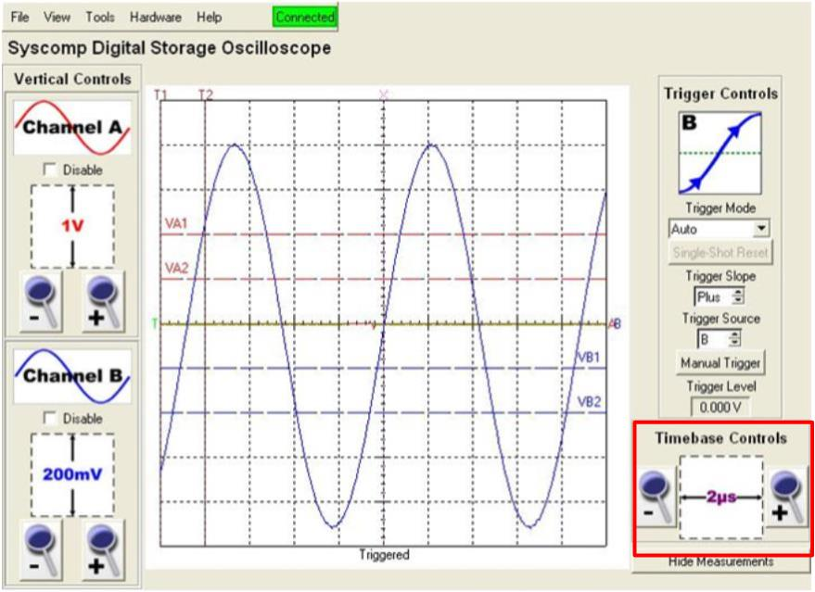
CONTROLS THAT MATTER
Oscilloscope setup
Vertical
Horizontal
Trigger
Volts/div, channel coupling, offset, probe factor, input limit.
Seconds/div, sample rate, record length, acquisition mode.
Source, level, slope, mode, and holdoff stabilize repeated events.
LECTURE 04 | INSTRUMENTS + AC
09

Slide 9
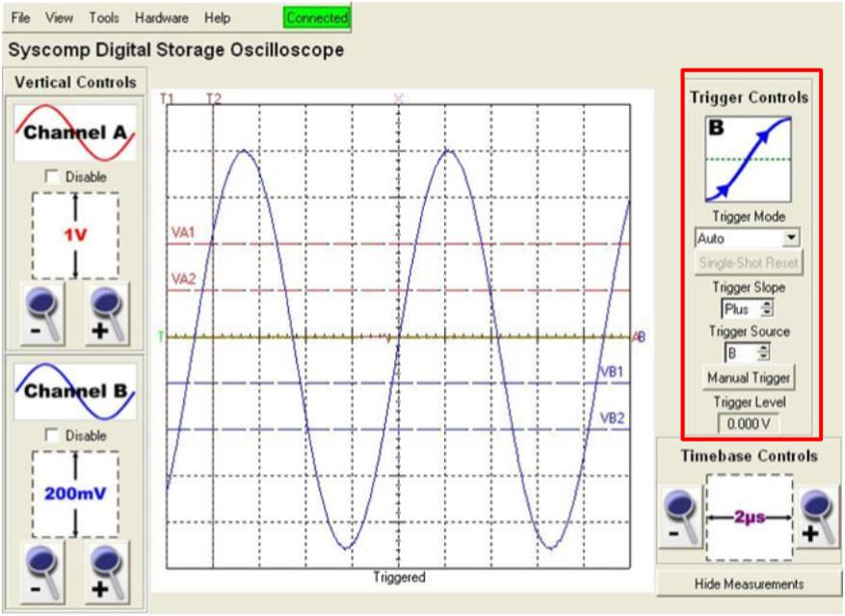
CONTROLS THAT MATTER
Oscilloscope setup
Vertical
Horizontal
Trigger
Volts/div, channel coupling, offset, probe factor, input limit.
Seconds/div, sample rate, record length, acquisition mode.
Source, level, slope, mode, and holdoff stabilize repeated events.
LECTURE 04 | INSTRUMENTS + AC
09

Slide 10
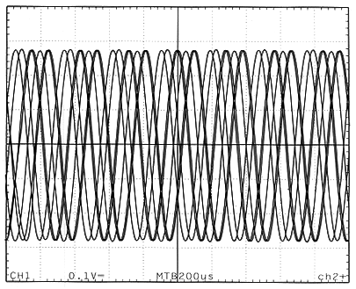
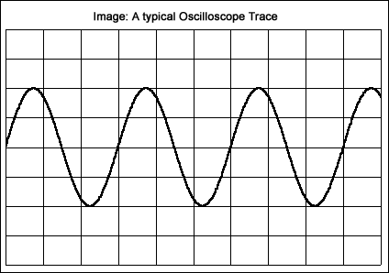
CONTROLS THAT MATTER
Oscilloscope setup
Vertical
Horizontal
Trigger
Volts/div, channel coupling, offset, probe factor, input limit.
Seconds/div, sample rate, record length, acquisition mode.
Source, level, slope, mode, and holdoff stabilize repeated events.
LECTURE 04 | INSTRUMENTS + AC
09

Slide 11
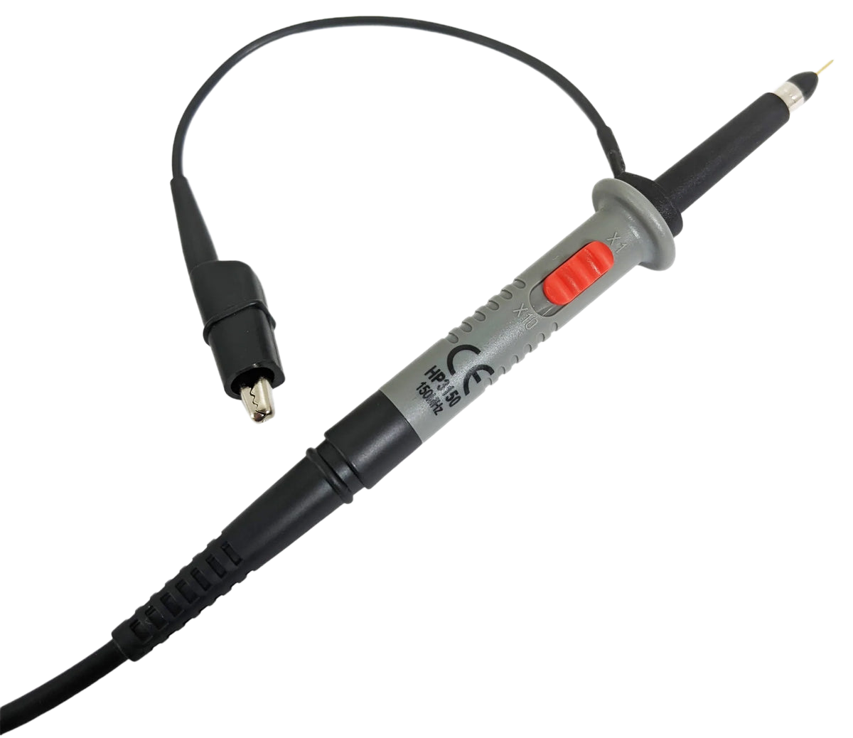
PROBE CHOICE
1x and 10x probes trade sensitivity for loading
Property | 1x probe | 10x probe
Signal at scope | Full amplitude | One tenth amplitude; scope compensates
Typical resistance | Lower | Higher
Typical capacitance | Higher | Lower
Bandwidth | Usually lower | Usually higher
Common failure | Loads high-impedance node | Probe-factor mismatch gives 10x error
LECTURE 04 | INSTRUMENTS + AC
10

Slide 12
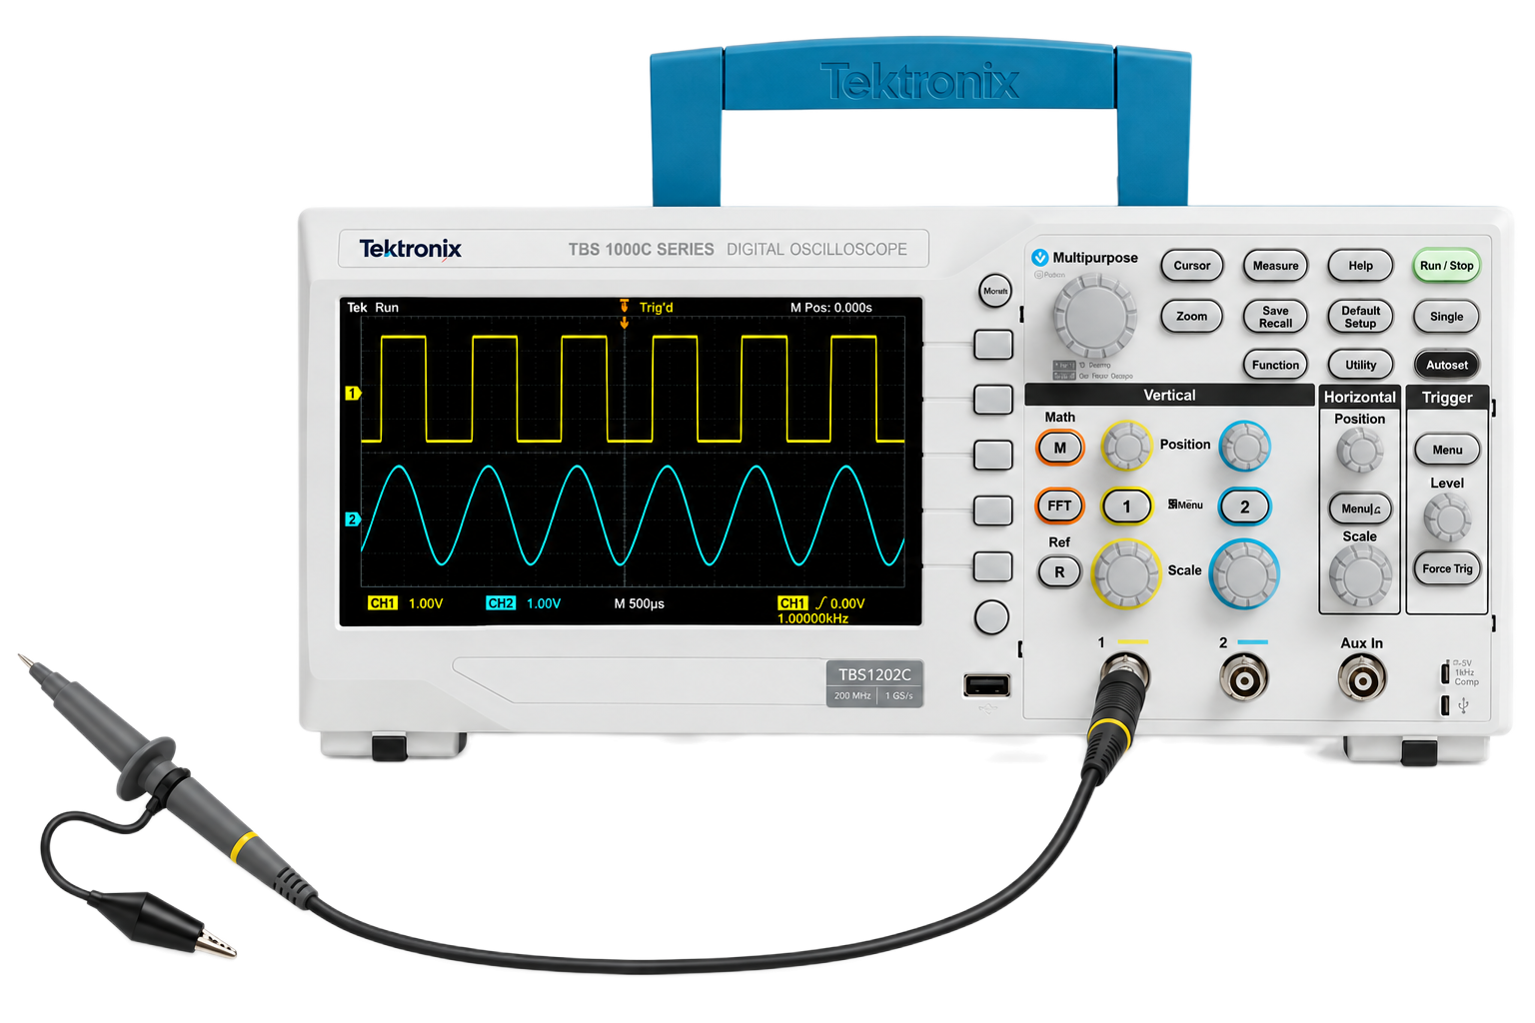
DIAGNOSE THE CHAIN
The size of the error points to the setting
“I will multiply by 1x/10x”
“I will reduce by 1x/10x”
10x pattern
2x pattern
Probe switch and scope-channel probe factor do not match.
Generator amplitude assumes a 50-ohm load while the actual load is High-Z, or vice versa.
LECTURE 04 | INSTRUMENTS + AC
14
Notes:
A probe-factor mismatch commonly creates a factor-of-ten error. A generator 50-ohm versus High-Z convention commonly creates a factor-of-two error. Verify the actual instrument behavior before relying on either diagnostic pattern.

Slide 13
MEASUREMENT INTEGRITY
Lab 2
Measure two parallel-load states and compare source current.
Compare DMM, 1x-probe, and 10x-probe loading on a high-value divider.
Create a 1 kHz, 2.00 Vpp sine wave with +1.00 V offset.
Diagnose a probe-factor mismatch and an AC-coupling display change.
Record the connection, settings, measurements, and evidence.
LECTURE 04 | INSTRUMENTS + AC
15

Slide 14
READY FOR THE BENCH?
Exit check
What happens to a DC offset when the channel changes from DC to AC coupling?
NEXT: PHASE + INDUCTANCE
LECTURE 04 | INSTRUMENTS + AC
16

