Slide 1
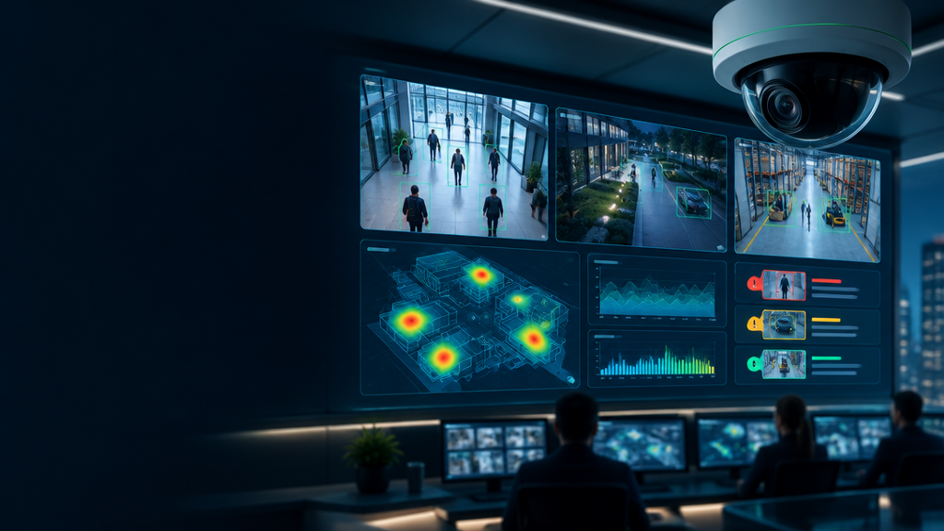
Smart CCTV
Manager
AI-powered video monitoring for activity analysis and operational insights
October 22, 2026

Slide 2
The problem with traditional CCTV
BEFORE
AFTER
Footage → backlog
Signals → decisions
Raw footage overload
Real-time activity detection
Delayed incident awareness
Reviewable alerts
Manual video review
Operational insights

Slide 3
From video to structured operational signals
CAMERA
INPUT
PEOPLE +
TRACKS
ZONES +
EVENTS
TIMELINES +
ALERTS
DASHBOARD
INSIGHT
Human validates sensitive alerts
The platform prioritises reviewable evidence and actionable context—not autonomous judgement.

Slide 4
How it works — a modular system pipeline
Video
input
Object
tracking
Activity
analysis
Dashboard +
notifications
Person
detection
Zone + event
logic
Event
manager
Pose estimation and fall detection sit inside activity analysis. Incident records retain clip, camera, timestamp, confidence and review outcome.

Slide 5
Capability maturity — clearly separated
IMPLEMENTED / REPOSITORY-DESCRIBED
Person detection · Object tracking · Pose estimation · Activity analysis · Fall detection · Incident recording · Dashboard monitoring
PROTOTYPE OR UNDER TESTING
Activity-specific models · Event confirmation flows
PLANNED — NOT YET TESTED
Restaurant table states · Sweeping/mopping detection · Parking availability · Industry-specific reports

Slide 6
Build where impact meets readiness
HIGH
IMPACT
People + zone occupancy
Queue monitoring
Restricted-zone + fall alerts
Advanced event models
Table occupancy
Parking occupancy
Industry modules
LOW READINESS
HIGH READINESS

Slide 7

Hotel + restaurant — an illustrative service loop
1:25 PM Table appears vacant
1:27 PM Possible cleaning detected
1:31 PM Staff confirms table ready
1:42 PM Table occupied again
ILLUSTRATIVE EXAMPLES · queue length · fall signal · restricted entry · sweeping/mopping alert (unconfirmed)

Slide 8
50 use cases, organised into seven practical clusters
Hospitality + food
tables · queues
Facilities + agriculture
cleaning · perimeter
Retail + venues
footfall · zones
SMART CCTV
MANAGER
USE-CASE MAP
Transport + parking
spaces · flow
Industrial + logistics
safety · loading
Education + government
occupancy · access
Healthcare + senior care
falls · wandering

Slide 9
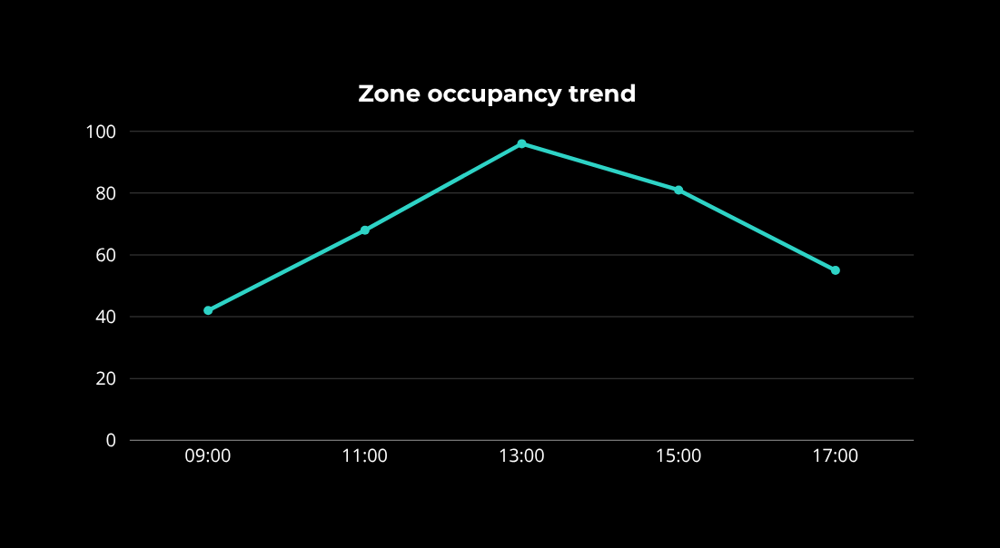
Operational insight, with review built in
PEOPLE
128
ZONE OCCUPANCY
72%
QUEUE EST.
6 min
Fall signal · CAM-04 · 13:18
Awaiting human review
Restricted zone · CAM-11 · 13:24
Reviewed · dismissed
Queue threshold · CAM-02 · 13:31
Awaiting human review

Slide 10
Evaluate the system people will actually operate
REAL-WORLD CONSTRAINTS
MEASURES THAT MATTER
Camera angle, occlusion and lighting change detection quality. Sweeping, mopping and serving need dedicated models and labelled data. Parking needs stable views and marked boundaries. Presence does not imply intent.
Missed-event rate
False alarms per camera-hour
Processing delay
Quality of human review
Frame-level accuracy alone is not an operational acceptance test.

Slide 11
Responsible deployment is a product capability
Valid purpose + public notice
Role-based access + event logs
TRUST
BY DESIGN
No cameras in private areas
Correction workflows + human review
Data minimisation + retention limits
Biometrics only when lawful and necessary
Protected credentials + secure endpoints
No AI-only medical or safety decisions

Slide 12
A modular path from signals to operational intelligence
01 · INITIAL
02 · VALIDATE
03 · EXTEND
People counting
Zone + table occupancy
Queue monitoring
Incident alerts
Pilot deployments
Real-world footage
User feedback
Iterative improvements
One industry module at a time
Reports + dashboard depth
Responsible scale
Transform passive recording into actionable, privacy-conscious operational intelligence.

