Slide 1
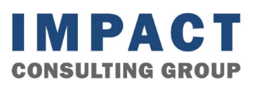
Impact Consulting Group
Rotman MBA-Led Consulting Since 1972
50 + Years of Legacy
400 + Completed Projects
5 + Sectors Serviced
Rotman School of Management | University of Toronto
impact@rotman.utoronto.ca
Notes:
60s arjun
Good morning everyone, and thank you so much for taking the time to meet with us today.
I’m arjun, and this is mengyi and aarti.
We are Impact Consulting. Today we are representing a team of five Rotman MBA graduates, but before we stepped onto campus, we were professionals managing complex sales cycles, driving strategy, and working with enterprise clients. As a group we’re incredibly hungry, customer-obsessed, and want to bring a fresh, execution-focused perspective to the Canadian business landscape. Our goal is simple: we wish to be the preferred partner for top-tier, consulting services to commercial businesses and organizations that need serious strategic support but want a leaner, more agile partner without breaking your budgets.
5min
Market sizing /Market entry feasibility
Customer segmentation
Competitor benchmarking
Go-to-market recommendation
What are some of the most common problems you witness CEO’s / companies that you work with face commonly?
Max 3/4

Slide 2
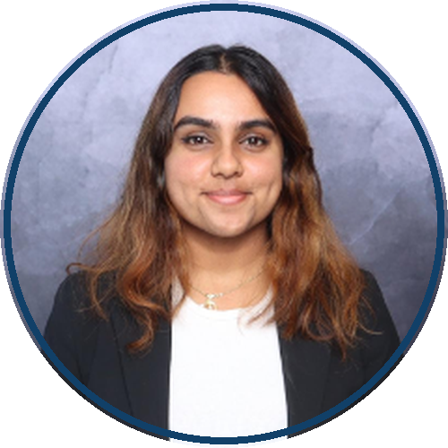
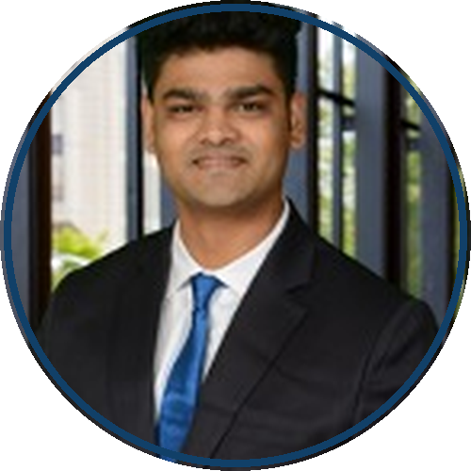

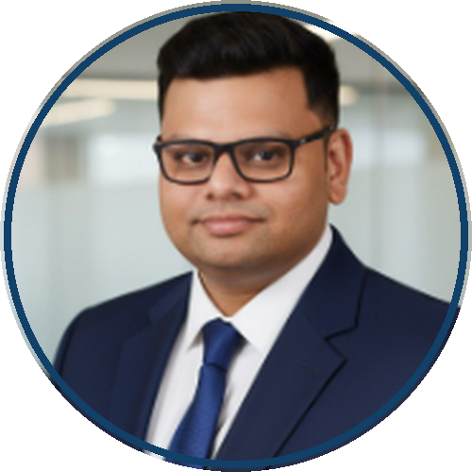
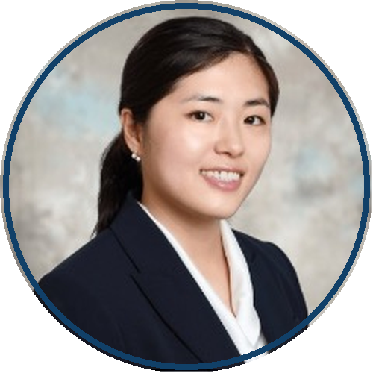
What is Impact Consulting?
1
2
3
4
5
Hungry
Customer Obsessed
Agile
Impact Driven
Lean
Impact Consulting Group | Rotman School of Management
02

Slide 3
Why Impact Consulting ?
1
2
3
4
Fresh Outlook
Low Investments
Upfront- Time Saving Quick Turnarounds
Unbiased perspective
Impact Consulting Group | Rotman School of Management
02

Slide 4
Market & Growth Questions We Can Structure
Where we can help?
2
Customer segmentation
3
Competitor benchmarking
4
Go-to-market recommendation
1
Market sizing & entry feasibility
“Your Challenges. Our Favourite Kind of Homework.”
Impact Consulting Group | Rotman School of Management
02

Slide 5

Sassafraz
Iconic Yorkville restaurant & hospitality brand · Toronto, ON
01 · CLIENT OVERVIEW
02 · CHALLENGE
Diversify revenue by expanding into the wellness hospitality space.
The leadership team needed to determine:
Expansion feasibility check,
Strategic alignment to current business
Brand perception and customer sentiment.
Competitive positioning
03 · WHAT IMPACT DID
04 · EXPECTED OUTCOMES
Conducted secondary research: competitor analysis, brand perception, and consumer sentiment on the proof of concept.
Identified a need for a Gap Analysis and built required feature specs. Conducted interviews within companies ICP
Proceeded to a location analysis phase.
The gap analysis and location study provided a clear roadmap to next-stage investment decisions. Not a generic feasibility report.
Impact Consulting Group | Rotman School of Management
03
Notes:
90s arjun
Possible script:
Let's start with a simple question.
Think of a brand you know well — maybe a restaurant, a retailer, or a local business. If that brand suddenly expanded into a completely new category, what would make you believe that expansion makes sense?
Is it customer demand? Brand fit? Competitive positioning? Or the ability to execute?
That was the question behind Sassafraz, an iconic Yorkville restaurant and hospitality brand. Sassafraz already had strong brand equity, a loyal customer base, and a successful café business. But the leadership team was exploring whether the brand could move into the wellness hospitality space.
The idea was promising, but also uncertain. Would customers accept Sassafraz in this new category? Was the opportunity strategically aligned with the brand? What gaps existed compared with competitors already in the space?
Impact helped structure that decision. The team conducted competitor analysis, explored consumer sentiment and brand perception, recruited interview participants, and identified gaps that needed further validation.
The outcome was not just a feasibility report. It gave the client a clear roadmap for whether, when, and how to move forward before committing major resources.
And this reflects where Impact creates value: helping organizations turn early-stage growth questions into evidence-based next-step decisions.
Let's start with a simple question.
If a brand you love suddenly expanded into a completely new category — what would make you believe that move makes sense? Customer demand? Brand fit? Competitive positioning?
That was the question behind Sassafraz. An iconic Yorkville restaurant with strong brand equity, a loyal customer base, and a thriving café — but the leadership team was exploring whether they could move into wellness hospitality.
The idea was promising, but came with a lot of questions like. Would customers accept Sassafraz in this new category? Was there a real gap in the market? How did they stack up against competitors that are already in this space? Here’s where impact came in:
The team helped structure that decision. We ran competitor analysis, assessed brand perception, recruited a diverse of interviewees consisting of— business owners, industry contacts, Rotman alumni — and built a gap analysis identifying exactly what the expansion would need to succeed. That also fed directly into a location analysis.
The outcome wasn't just a feasibility report. But rather gave leadership a clear roadmap.— before committing major resources.
This is exactly how Impact creates value: turning early-stage growth questions into evidence-based decisions.

Slide 6


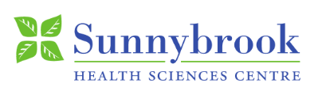




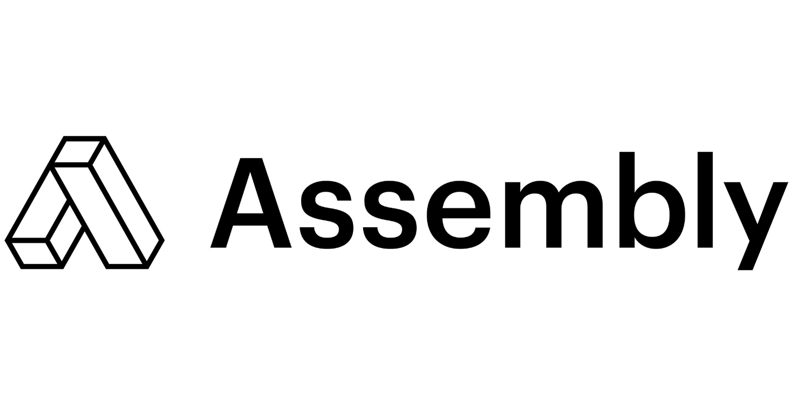

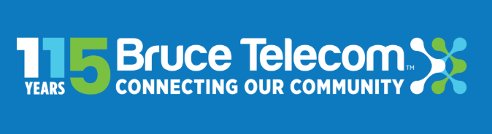


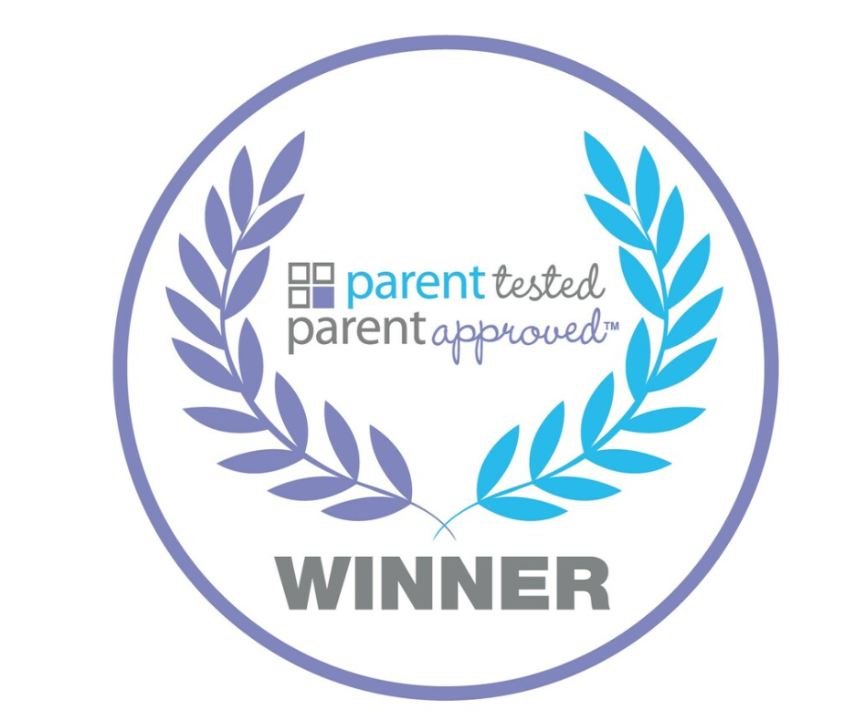

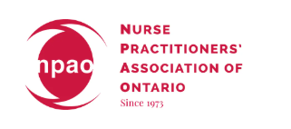

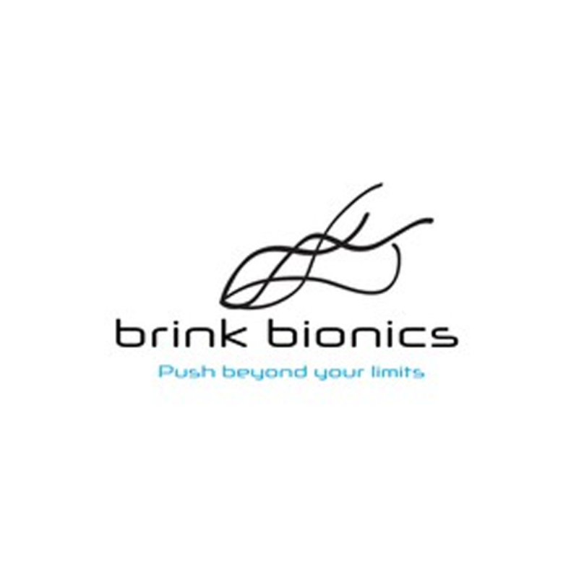



Where We’ve Stepped In So Far
Impact Consulting Group | Rotman School of Management
05
Notes:
30s arjun
Possible script:
Here’s a small list of clients we have supported over the years and look forward to any help that you might be able to offer us in your networks or within your own organisations. Thank you healthcare, education, community, nonprofit, and growth-stage organizations, because Impact has been useful across very different organizational contexts. The key point is not the sector itself — it is whether there is a focused question where fresh thinking and structured analysis can create practical value.
Q1. Are these all recent clients or current projects? A: These are representative organizations Impact has supported across different years and sectors. We included them to show the range of organizations Impact has worked with, not to suggest that they are all current or recent clients. Q2. What kind of work did Impact do for these organizations? A: The specific scope varies by project, but Impact projects generally involve focused research, analysis, stakeholder insight, market or operational questions, and practical recommendations. This page is mainly meant to show the breadth of sectors and project contexts where Impact has worked. Q3. Is Impact mainly focused on healthcare and nonprofit organizations? A: Healthcare and nonprofit organizations are well represented here, but Impact is not limited to those sectors. We also work with business, growth-stage, community-facing, and education-related organizations. The common thread is not the sector, but whether there is a focused question where structured MBA analysis can help. Q4. Why did we choose this mix of logos instead of only large corporate names? A: We chose this mix intentionally. Some organizations are more established, while others are smaller, growth-stage, or community-facing. That reflects where Impact can often be useful: focused questions where fresh MBA thinking and structured analysis can create value. Q5. Are these logos meant to be formal endorsements? A: No. We use this as a representative list of organizations Impact has supported in the past, not as formal endorsements. The purpose is to show the diversity of sectors and project contexts. Q6. Some of these organizations are not traditional companies. Why include them? A: That is actually part of Impact’s model. We are often useful for organizations that have real strategic, market, or operational questions but may not have the internal capacity or budget for a large consulting engagement. That can include nonprofits, community organizations, associations, education-related organizations, and growth-stage businesses. Q7. What should the audience take away from this page? A: The main takeaway is that Impact has worked across a range of organizations and sectors. We are not trying to position ourselves as a traditional consulting firm for large-scale mandates. We are showing that Impact can be useful when an organization has a focused question that would benefit from fresh thinking, structured analysis, and practical next steps.

Slide 7
WHY IMPACT
A Win-Win Value Exchange
Impact creates value when organizations need a solution to real business questions, and experienced MBA students secure meaningful consulting opportunities to apply and grow their skills.
What organizations need
THE CHEMISTRY
Rotman MBA perspective
Support to explore strategic or tactical questions that are real, but early, small, or unclear
Faster, more accessible analysis than a full consulting engagement
Fresh Rotman thinking on growth, Go To Market approaches, marketing, operations, digital, or AI questions
context
Focused scope + mutual commitment
talent
Real client problems to apply prior professional experience
A way to enhance consulting judgment, client management, and problem-solving skills
Opportunities to explore or pivot into consulting through hands-on experience
turns exploratory business questions into practical learning and decision support
Organizations receive
MBA students gain
Insight, fresh perspective, and practical next steps
Skill development, a strong bridge into future careers
Impact Consulting Group | Rotman School of Management
04
Notes:
60s mengyi
Possible script:
The way we think about Impact is as a win-win exchange.
For organizations, the value is an approach to business challenges that are real, but may be unclear for a full consulting engagement. Our clients obtain MBA thinking, structured analysis, and practical next steps.
On the flip side We are not looking for a classroom exercise. We seek real client problems where we can apply our prior experience, build consulting judgment, and grow through hands-on work.
The key is focused scope and mutual commitment. The organization brings the business context; the students bring talent and analysis. When the scope is well-defined, both sides can create meaningful value.
2. What projects fit Impact? Focused questions around market, customer, GTM, growth, operations, or strategic options.
3. What projects do not fit? Urgent execution, legal/technical/regulatory advice, highly confidential or very broad mandates.
4. What is your ask? Remember Impact and refer suitable small/exploratory/focused questions when there is a fit.

Slide 8
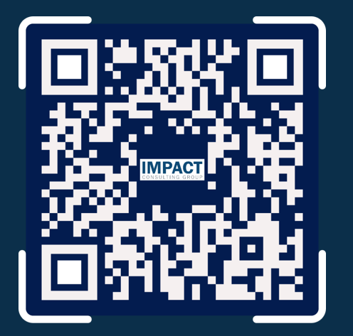
We’d Love to Hear From You!
Get in Touch
Impact Consulting Group Rotman School of Management impact@rotman.utoronto.ca
Notes:
10min arjun+mengyi
Where do you think Impact could create the most value?
What questions are too small or early for traditional consulting, but still worth structured analysis?
What would make you comfortable referring a project or contact to Impact?
Where should we be careful not to overreach?
Would you guys have the expertise to deliver complex projects?
Ans- Support of the board + prof., There is an organisational history to deliver complex projects, the impact of the alumni network that we can tap into

Slide 9
Appendix
Optional detail for scoping conversations and follow-up materials.
Impact Consulting Group | Rotman School of Management

Slide 10

OUR TEAM
Principal Team
Rotman MBA principals with cross-functional professional experience across strategy, analytics, healthcare, people, and business development.
Aarti Mohinani | Principal
• B.Sc. Psychology and Industrial Relations, University of Toronto
• 3+ years of experience in people strategy, DEI, and AI-driven change at KPMG Canada
• Expertise in workforce analytics, change management, and digital transformation
Rahul Raj | Principal
• B.Com. (H), NMIMS University, India​
• 7+ years of consulting experience with Fortune 500 clients, governments, development organizations, and nonprofits​
• Expertise in strategy execution, sustainability advisory, stakeholder management, and impact-driven growth initiatives
Arjun Anish | Principal
• B.Tech., Mechanical Engineering, Vellore Institute of Technology, India
• 5+ years of experience in SaaS sales, business development, and Key Account Management
• Expertise in B2B sales, client relationship management, territory planning, and growth strategy
Shiron Lee | Principal
• M.Sc., Pharmaceutical Sciences, University of Toronto; B.Sc., Chemistry, University of Calgary
• 6+ years of experience in biotech and healthcare
• Expertise in business development, equity analysis, and biotech entrepreneurship
Mengyi Liu | Principal
• B.Eng., Southeast University, China
• 8+ years of experience in cross-border trade, capital markets, and client relationship management
• Expertise in market research, stakeholder communication, and cross-border market analysis
Impact Consulting Group | Rotman School of Management
Notes:
backgrounds
This is our principal team.
The main point here is that we are a cross-functional MBA team. Everyone brings a different professional lens: people strategy, SaaS sales, consulting, healthcare, capital markets, business development, and market research.
So for clients, the value is not just extra capacity. It is that we can bring structured thinking, industry experience, and different perspectives to help them think through growth, market entry, customer segmentation, pricing, GTM, or scaling questions.
We are also supported by Rotman faculty, alumni, and the Impact board, so the team is not working in isolation.

Slide 11
ENGAGEMENT PROCESS
How We Work
Our process is designed to keep engagements focused, collaborative, and practical.
1
2
3
4
5
Discovery
Scoping Alignment
Research & Analysis
Recommendations
Decision Support
Understand the client context, objectives, constraints, and decision-making needs.
Translate the client need into a focused project scope with clear deliverables, timeline, and responsibilities.
Conduct the research, interviews, benchmarking, modelling, or process work required.
Synthesize findings into clear options, implications, and prioritized recommendations.
Deliver final materials designed to support decision-making, alignment, and practical next steps.
Each phase includes client input and alignment so the final recommendation reflects the organization’s real context, constraints, and priorities.
Impact Consulting Group | Rotman School of Management
Notes:
consulting process
This is how we keep projects focused and useful.
We start with discovery to understand the client’s context, constraints, and decision needs. Then we spend time on scoping alignment, because for Impact, a good project has to be focused enough to deliver real value within a realistic timeline.
Once the scope is clear, the team moves into research and analysis, then turns the findings into practical recommendations. The final step is decision support — making sure the output helps the client align and decide what to do next.
The most important point is that this is collaborative. We check in with the client throughout the process, so the final recommendation is not just theoretically correct, but actually useful in the client’s real context.

Slide 12
6–10 WEEK PROJECT FLOW
Sample Engagement Timeline
A typical Impact engagement can be structured across 6–10 weeks, depending on scope, client needs, and data availability.
Week 1
Discovery & Scope Alignment
Confirm objectives, key questions, data needs, stakeholders, timeline, and workplan.
Weeks 2–3
Research & Current-State Assessment
Conduct secondary research, interviews or surveys, document review, and process mapping.
Weeks 4–6
Analysis & Insight Development
Complete analysis, test hypotheses, conduct midpoint check-in, and develop findings.
Weeks 7–8
Recommendations & Roadmap
Build recommendations, prioritize options, develop roadmap, and incorporate feedback.
Final Week
Final Presentation & Next Steps
Present findings, discuss implications, align on next steps, and provide final materials.
Impact Consulting Group | Rotman School of Management
Notes:
typical consulting timeline
This is what a typical engagement timeline can look like. Most projects run for about 6 to 10 weeks, depending on the scope and data availability.
The first week is focused on discovery and scope alignment, so we are clear on the client’s objectives, key questions, timeline, and deliverables. The next few weeks are spent on research and current-state assessment, followed by analysis and insight development.
In the later stages, the team turns the findings into recommendations and a practical roadmap. The final week is used to present the findings, discuss implications, and align on next steps.
The main point is that Impact engagements are structured enough to create accountability, but flexible enough to stay practical for focused, exploratory questions.

Slide 13
POSITIONING
Why Impact Is Different
Impact combines the structure of a consulting engagement with the accessibility and flexibility of a student-led model.
High
Why clients choose Impact
Focused engagement zone
Structured MBA-led support
Clear scope, defined deliverables, and regular client check-ins.
Informal project support
Flexibility & accessibility
Flexible, but often less structured
Impact Consulting Group
Practical recommendations
Structured, research-backed, and practical
Recommendations grounded in the client’s context, constraints, and priorities.
Accessible consulting model
Useful for focused questions that benefit from structured analysis but may not require a full-scale consulting firm.
Full-scale consulting firm
Highly structured, typically suited for larger mandates
Business-school resources
Low
Rotman talent, research access, faculty perspective, advisors, and alumni network where relevant.
Low
Engagement structure & accountability
High
Impact is designed for focused business questions that benefit from structured analysis, practical recommendations, and a clear next step.
Impact Consulting Group | Rotman School of Management
Notes:
This is how we think about Impact’s positioning.
Informal support can be flexible, but it may not be structured enough to support a real business decision. Full-scale consulting firms are highly structured, but they are usually better suited for larger and more clearly defined mandates.
Impact sits in the middle. We offer a focused, MBA-led consulting model that is structured enough to create accountability, but still accessible and flexible enough for early, exploratory, or smaller business questions.
So clients choose Impact when they need clear scope, practical recommendations, and fresh Rotman MBA thinking, without committing to a full consulting engagement. The key is that the question needs to be focused enough for us to create a useful next step.

Slide 14
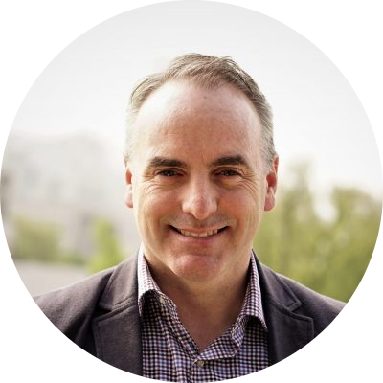
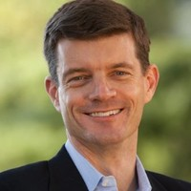
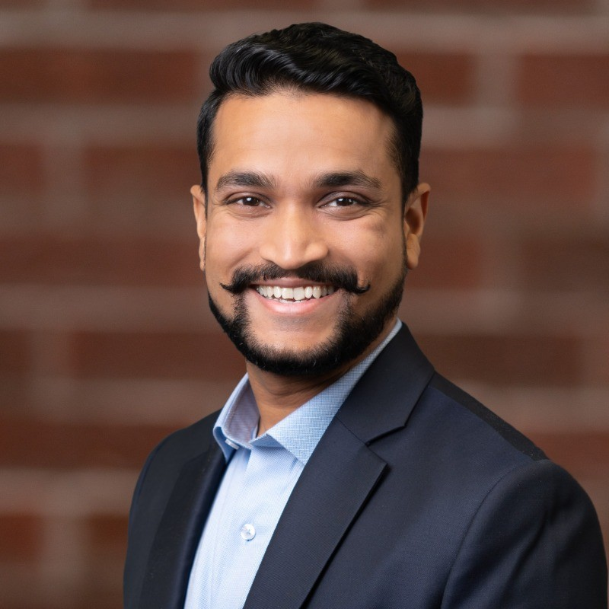
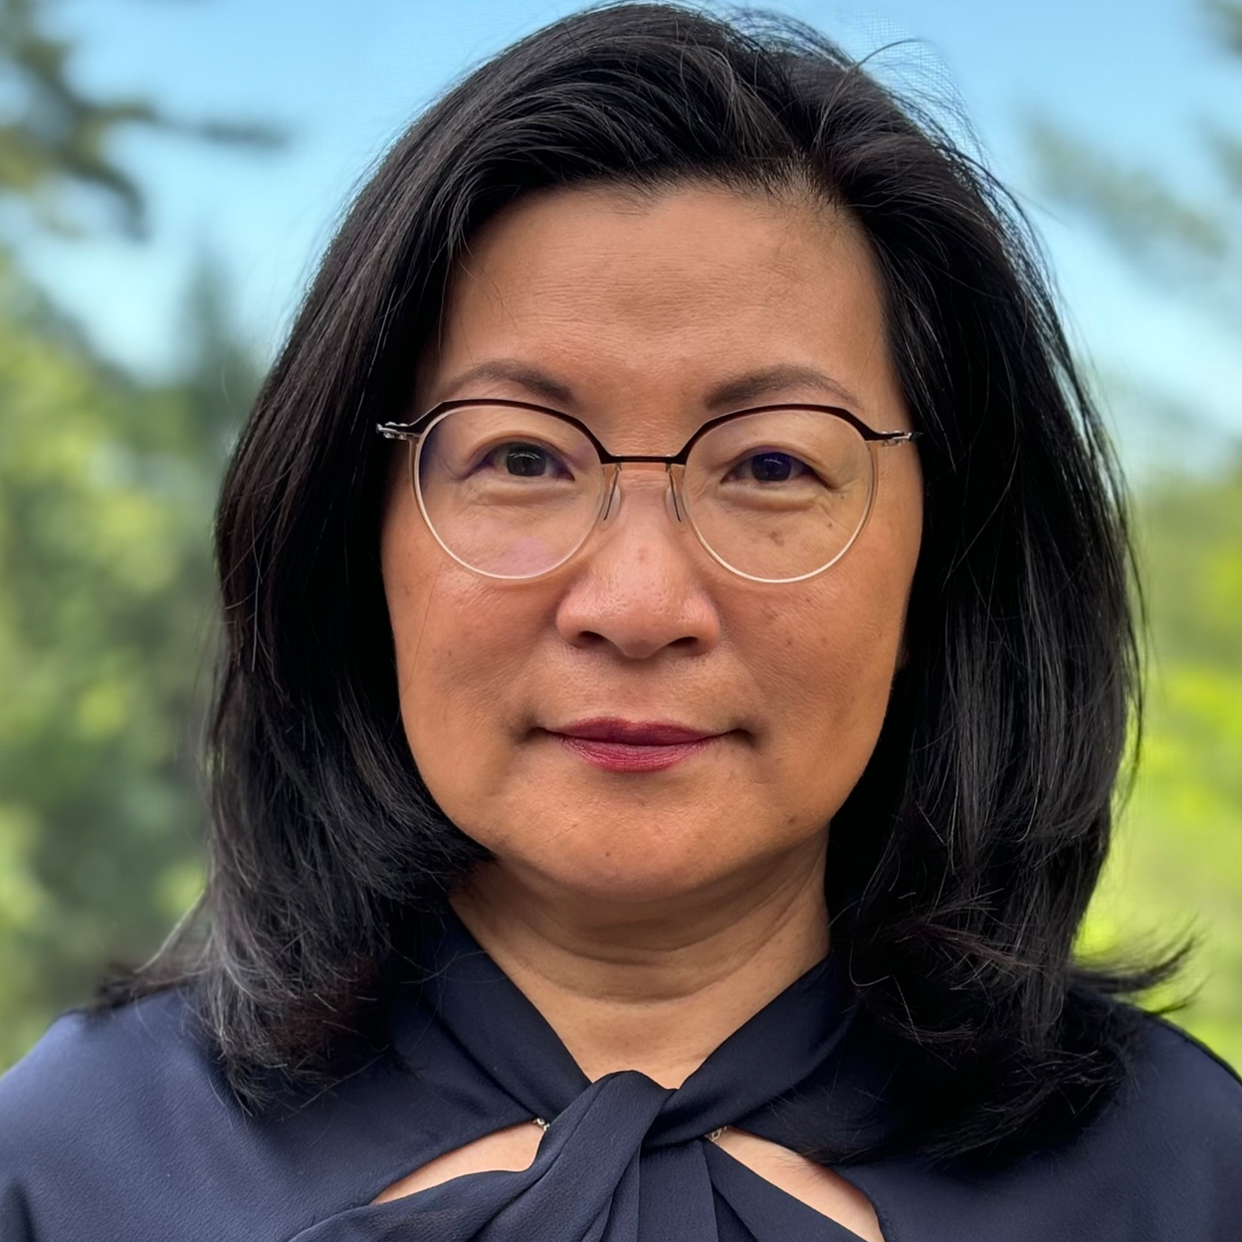
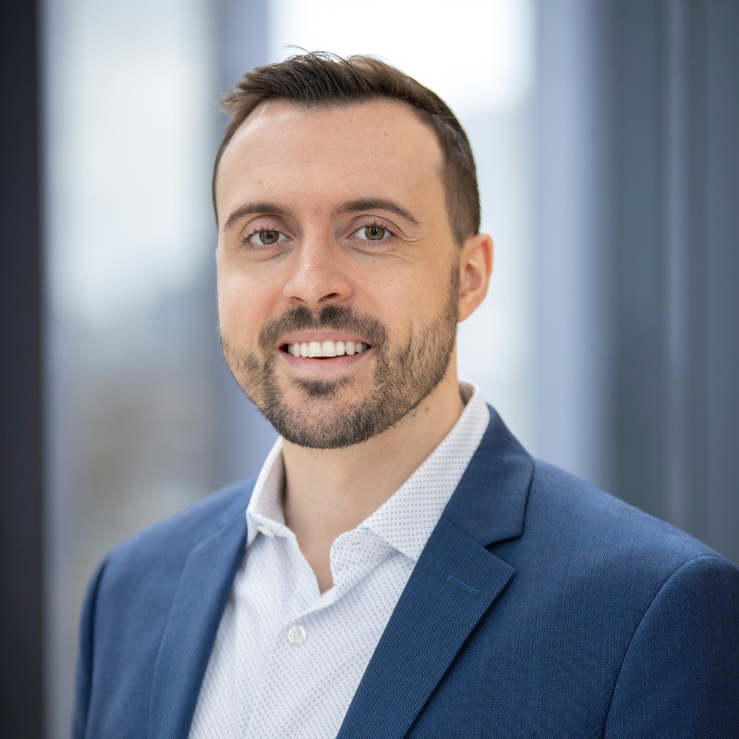
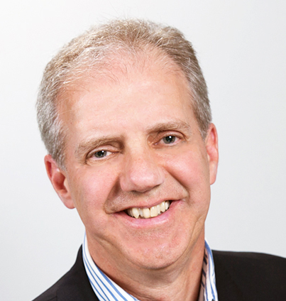
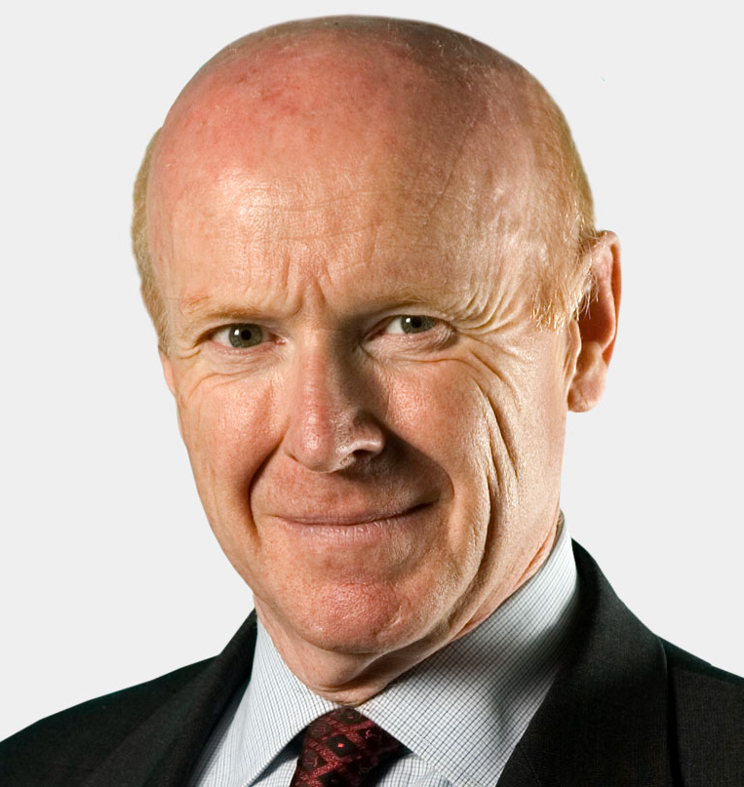
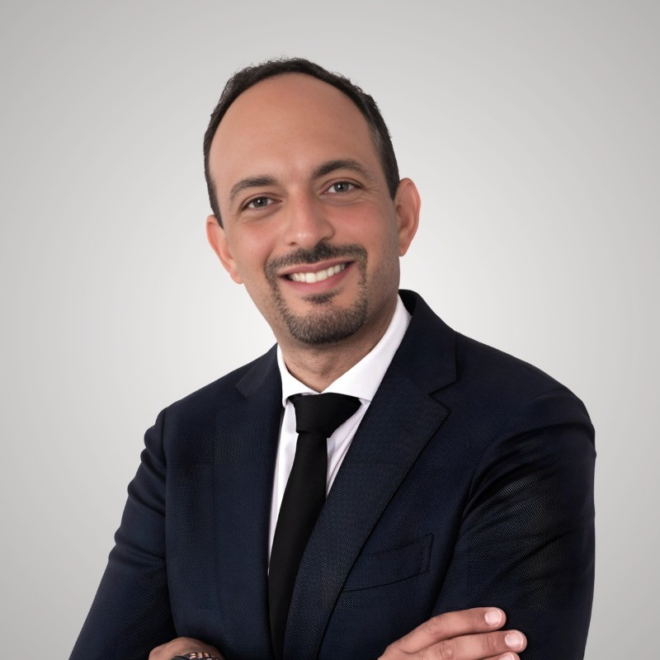
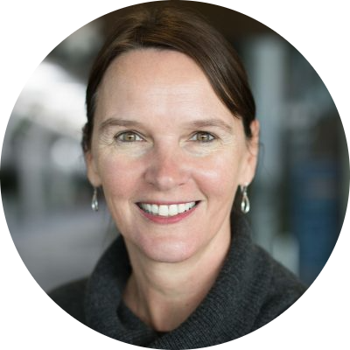
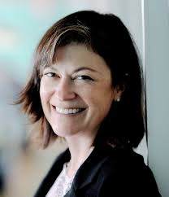
APPENDIX C
Board Members
We are supported by academic and industry experts
Rick Morris
Impact Advisory Board Chair and Intact VP, specializing in broker finance and M&A
Ned Welch
Rotman Professor and ex-McKinsey consultant
Chandan Sejekan
Recent Impact Principal and current Senior Consultant (PMP Strategy)
Irene Yeung
Rotman Executive in Residence and retired Principal Consultant at MNP Digital
Cole McClean
Recent Impact Principal and incoming EY consultant
Rob Rutledge
Executive Coach to C-suite leaders and ex-BCG consultant
Dan Richards
Rotman Professor and successful startup Founder
Roger Thompson
FirstService executive, and leadership coach helping senior leaders
Beatrix Dart
Rotman Professor and ex-McKinsey consultant
Katherine Magee
Rotman Commerce lecturer, expertise in strategy, marketing, facilitation
Impact Consulting Group | Rotman School of Management
Notes:
Board member quick reference:​
​
Dan Richards​
Marketing / finance / entrepreneurship / nonprofit leadership​
Dan brings 30 years of hands-on management experience in Canada’s financial industry. He built and sold two startups, led a public-company turnaround, and is a longtime Rotman marketing faculty member.​
​
Ned Welch​
Behavioral economics / consumer psychology / innovation / customer strategy​
Ned is an Adjunct Professor and Executive in Residence at Rotman. He previously held senior roles at McKinsey in marketing and design, working on product development, innovation, pricing, and customer strategy.​
​
Chandan Sejekan​
Consulting / leadership / people development​
Chandan is part of Impact’s advisory board and brings consulting rigor, leadership experience, and a focus on developing student consultants.​
​
Irene Yeung​
Technology consulting / AI & machine learning / digital transformation / data strategy​
Irene has 30+ years of experience in technology consulting. She co-founded a technology consulting firm that was later acquired, and has worked across business intelligence, AI/ML, digital transformation, data strategy, and executive stakeholder alignment.​
​
Rick Morris​
Insurance / acquisitions / corporate strategy / finance​
Rick is a Director of Acquisitions for Canada BrokerLink, part of Intact Financial Corporation. His background includes acquisition and integration of insurance brokerages, business development, distribution, underwriting management, and prior corporate strategy and finance work at BMO.​
​
Roger Thompson​
Operations / leadership / facilitation / organizational effectiveness​
Roger brings experience in consulting, executive leadership, meeting design, facilitation, and helping teams improve how they align, prioritize, and execute.​
​
Beatrix Dart​
Strategy / management consulting / social impact / corporate strategy​
Beatrix is a Professor of Strategy at Rotman and previously worked at McKinsey. She teaches management consulting, social impact, and corporate strategy, with a focus on growth strategies and experiential learning.​
​
Katherine Magee​
Marketing / strategy planning / facilitation / training / sustainability​
Katherine is principal of The Magee Resource Group, focused on strategy planning, training, and facilitation. She was previously VP Marketing at Franklin Templeton and has also worked on sustainability-related initiatives.​

Slide 15
EXAMPLES OF FOCUSED ENGAGEMENTS
Service Lines
Market & Growth Strategy
Operations & Process Improvement
Organization & Change Management
Customer & Stakeholder Insights
Impact & Nonprofit Advisory
Market sizing
Competitor benchmarking
Customer segmentation
Go-to-market recommendation
Growth strategy roadmap
Business model review
Revenue model assessment
Process mapping
Workflow assessment
KPI framework
Process gap analysis
Process improvement roadmap
Digital / AI readiness assessment
Organizational design
Workforce planning
Role clarity & decision rights
Training and onboarding plan
Talent Needs Assessment
Strategic priorities assessment
Board presentation support
Customer survey design
Stakeholder interviews
Focus group synthesis
Voice-of-customer research
User needs assessment
Customer journey mapping
CRM Process & Requirements Design
Impact assessment
Impact Measurement Framework
Fundraising strategy
Partnership strategy
Advisory board strategy
Impact Consulting Group | Rotman School of Management

