Slide 1

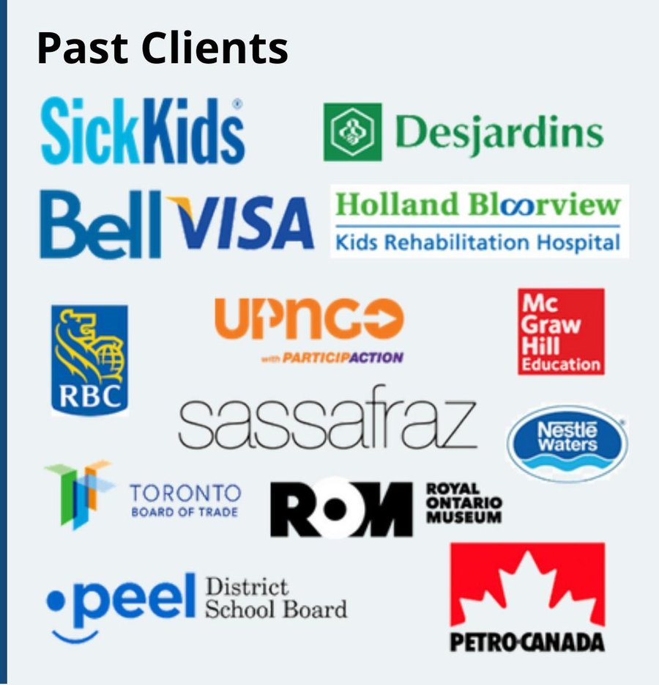











About Us
Founded in 1972, Impact Consulting Group is one of Canada's longest-running MBA student-led consulting firms, based at the Rotman School of Management, University of Toronto.
50 + Years of Legacy
400 + Completed Projects
5 + Sectors Serviced
Our Offering
The Impact Advantage
✓ Rotman MBA talent & diverse cross-sector expertise
✓ Research-backed analysis grounded in your unique context and considerations
✓ Structured engagements at competitive rates without compromising on quality
✓ Backed by Rotman faculty, industry advisors, and a strong alumni network
✓ Fresh perspectives with current academic thinking applied to real business problems
•Strategic Planning
•Scenario Modelling & Analysis
•ESG Strategies
•Growth Roadmap
•Business Model Review
Strategy
•Process Mapping & Controls
•Workflow Assessment
•KPI Framework
•Implementation Roadmap
•Budgeting
" The Impact team at Rotman, informed by state-of-the-art research and the enduring fundamentals of management thinking, delivers innovative, pragmatic and actionable solutions. I am a regular customer myself. The professionalism, the value added, and the can-do-attitude keep me coming back“ – Tiff Macklem, Former Rotman Dean
Operations
•Market Sizing
•Competitor Analysis
•Customer Segmentation
•Go-to-Market Recommendation
•Voice-of-Customer Research
Marketing
“I engaged them on two separate projects, for which I needed pricing model and financial projections expertise. Both engagements had their complexities and challenges, and the team was patient, gracious, thoughtful in their approach and communicative throughout. They adapted quickly, jumping in on client calls when I needed them to and collaborating well with the other team.” – Gina Leslie, LEAP
What We Stand For
•Digital Strategy & Planning
•AI Governance Readiness
•Digital Readiness Assessment
•AI Tool Adoption
•CRM Design & Implementation
Helping
Accessibility
Digital
Trust
Fresh Perspectives
Contact Us
•Change Management
•Recruitment
•Training and Development
•Workforce Planning
•Organizational Design
📞
🌐
www.ImpactConsultingGroup.ca
Human Capital
+1 437-8293707
Agility
Client-First
✉
📍
105 St. George Street, Suite 3092
Toronto, Ontario M5S 3E6
impact@rotman.utoronto.ca

