Slide 1
AI Agent Orchestration
Designing Intelligent, Scalable, and Collaborative
Multi-Agent Systems

Slide 2


01 · DEFINITION
Orchestration turns LLM calls into governed systems
Coordinates agents, tools, memory, and policy
Essential once work spans steps, roles, and systems
Enterprise uses: support triage, research, data operations, approvals

Slide 3






02 · AGENT ANATOMY
An agent is an LLM that reasons, plans, remembers, and acts
Reasoning
Planning
Memory and context
LLM core interprets intent.
Task decomposition into steps.
State carried across turns.
Tool usage
Autonomous
Human-supervised
Calls APIs, data, and files.
Runs within set guardrails.
Approval gates on risk.

Slide 4
03 · COMPARISON
Why agent orchestration?
Dimension | Single-prompt LLM app | Single agent | Multi-agent orchestration
Scalability | Limited by one context window | Bounded by one loop | Scales by adding workers
Specialization | None | Generalist with tools | Role-specific agents
Reliability | No validation step | Self-checks only | Validation and retry stages
Coordination challenge | None |  |  |  |  | Tool sprawl | Routing, state, conflicts

Slide 5
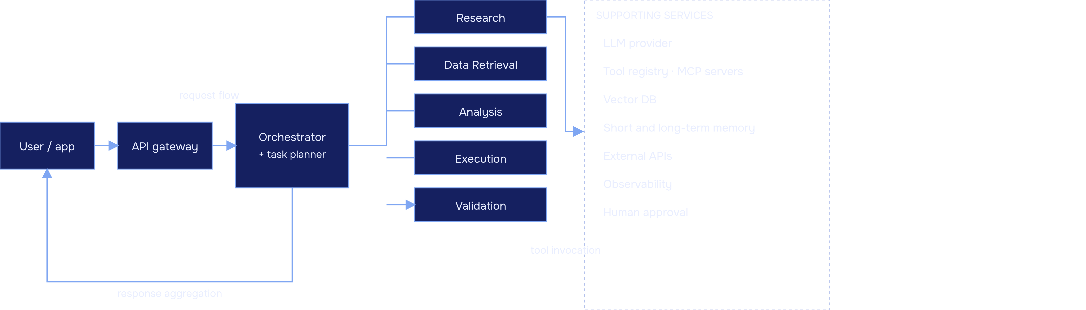
04 · ARCHITECTURE
Core architecture of an orchestration system

Slide 6
05 · PATTERNS
Seven orchestration patterns and when to use them
Sequential
Parallel
Supervisor-worker
Hierarchical
A → B → C. Use: ordered dependencies. Limit: slowest step gates all.
Fan-out, then merge. Use: independent subtasks. Limit: merge complexity.
One lead delegates. Use: clear routing. Limit: supervisor bottleneck.
Layered managers. Use: large task trees. Limit: added latency per layer.
Peer-to-peer
Event-driven
Human-in-the-loop
Agents negotiate directly. Use: exploratory work. Limit: hard to govern.
Agents react to events. Use: async triggers. Limit: harder to trace.
Approval checkpoints. Use: high-risk actions. Limit: human latency.

Slide 7
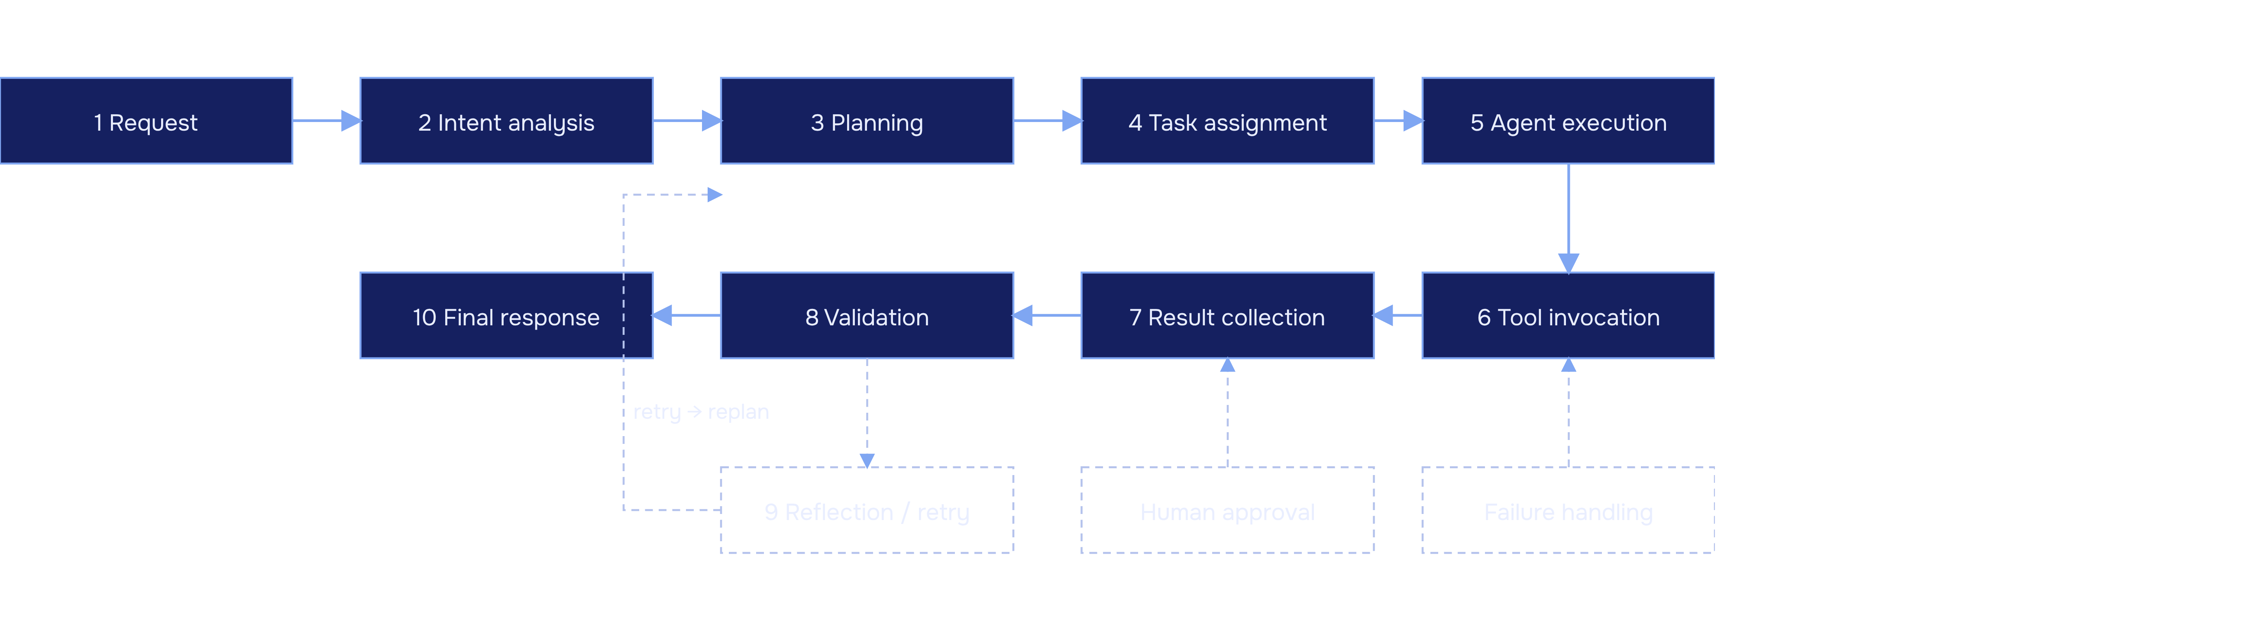
06 · LIFECYCLE
End-to-end execution lifecycle

Slide 8
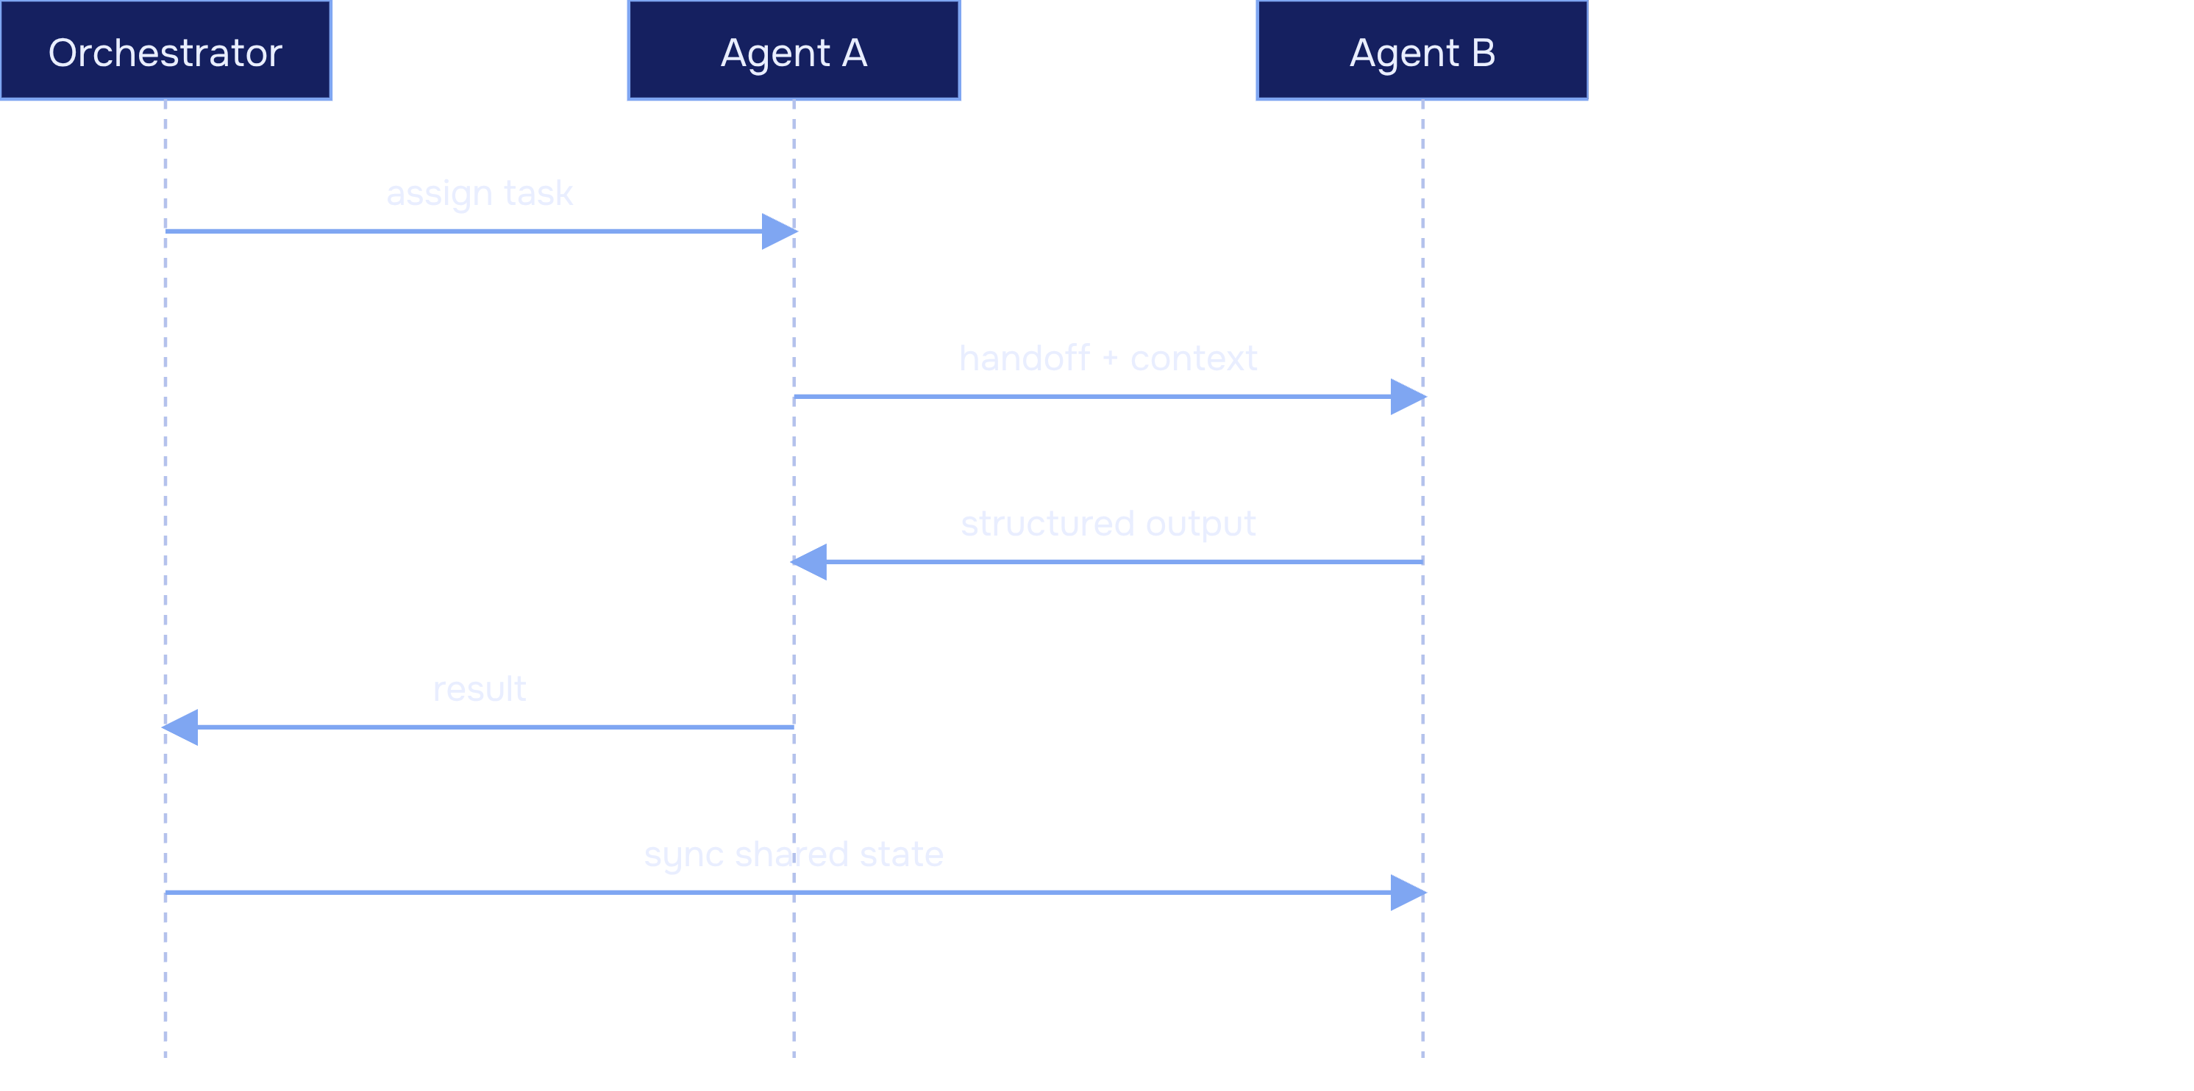
07 · COMMUNICATION
Multi-agent communication
Agent-to-agent messaging
Shared context and state
Message passing
Task handoff
Structured outputs
Context synchronization
Conflict resolution

Slide 9
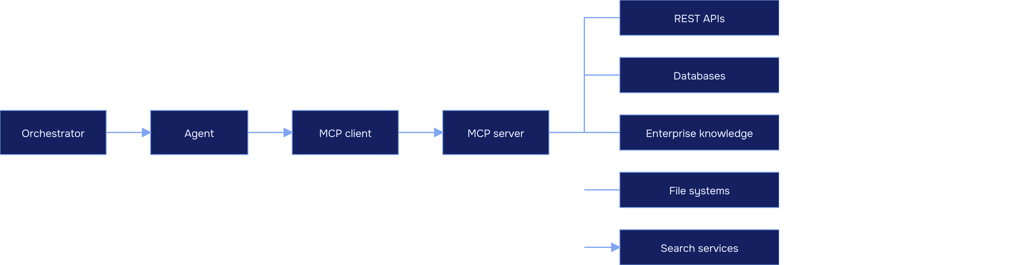
08 · TOOLS
Tools and Model Context Protocol

Slide 10
09 · STATE
Memory and state management
01
02
03
04
Working memory
Conversation memory
Persistent memory
Vector databases
Scratchpad for the current step.
Durable facts across sessions.
Semantic retrieval of knowledge.
Turn history per session.
05
06
07
Shared state
Context window management
Checkpointing and recovery
Common store agents read and write.
Resume a run after failure.
Summarize, trim, and select.

